Slide 1
Determining Cancer Hormone Receptor Status from H&E Stained Tissue Using Deep Learning
Dean Kelley
Committee Members
Dr. Anderson Nascimento Professor, Tacoma School of Engineering and Technology, Chair
Dr. Martine De Cock Professor, Tacoma School of Engineering and Technology
Dr. Juhua Hu Professor, Tacoma School of Engineering and Technology

Slide 2
Background
Every year
Millions of women are diagnosed with breast cancer
Hundreds of thousand die
A large majority of invasive breast cancers are hormone receptor-positive (HR+)
Tumor cells grow in the presence of estrogen (ER) and/or progesterone (PR)
Hormone receptor status (HRS) is a key molecular marker used for prognosis and treatment decisions
HRS is determined by pathologists by: Immunohistochemistry (IHC) stained biopsied tissue for the targeted receptor
This highlights the presence of cellular surface antigens

Slide 3
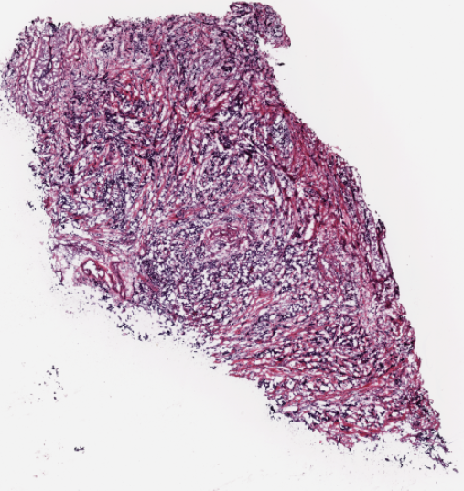
So, what’s the problem?
Traditional HRS determination is:
Expensive
Time consuming
Inconsistent due to IHC preparation and pathologist subjectivity
Is there an alternative?
Hematoxylin and eosin (H&E) staining
Highlights cellular morphology
Quick
Less expensive
Less variable in preparation.
This gives us H&E-stained whole slide images (WSIs)

Slide 4
Solution
Use machine learning to determine receptor status (RS) from H&E WSIs
Morphology of the tumor, captured in the H&E stain, contains predictive signal for the molecular marker status of the tumor
A machine-learning (ML) model can directly determine RS
Model is trained with clinical RS that are available from patient records and requires no additional pixel-level annotations
Train models using H&E WSIs as input data, and IHC annotations as input data labels
Use model for future WSI RS inference

Slide 5
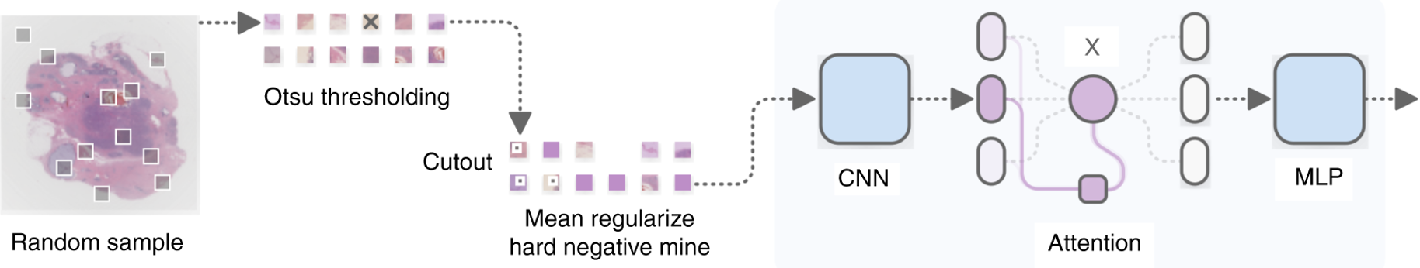

How
Design an attention-based deep neural network that uses multiple instance learning (MIL), which we are calling ReceptorNeXt
ReceptorNeXt is trained to predict RS from a bag of tiles randomly selected from a WSI
The WSI is divided into 256 × 256 pixel-size nonoverlapping tiles.
Thresholding
Source: Naik et al
Notes:
We are calling the model receptornext to pay homage to the paper that inspired this work. Where their model was named receptornet.

Slide 6
What is Multiple Instance Learning (MIL)?
Bag-level supervised machine learning that uses sets of labeled bags to learn a classifier
A bag contains a set of data, such as images, and is assigned a binary label
Label is based on the presence or absence of data with a particular property.
A bag is labeled 'positive' if it contains at least one positive instance
‘Negative' if otherwise

Slide 7
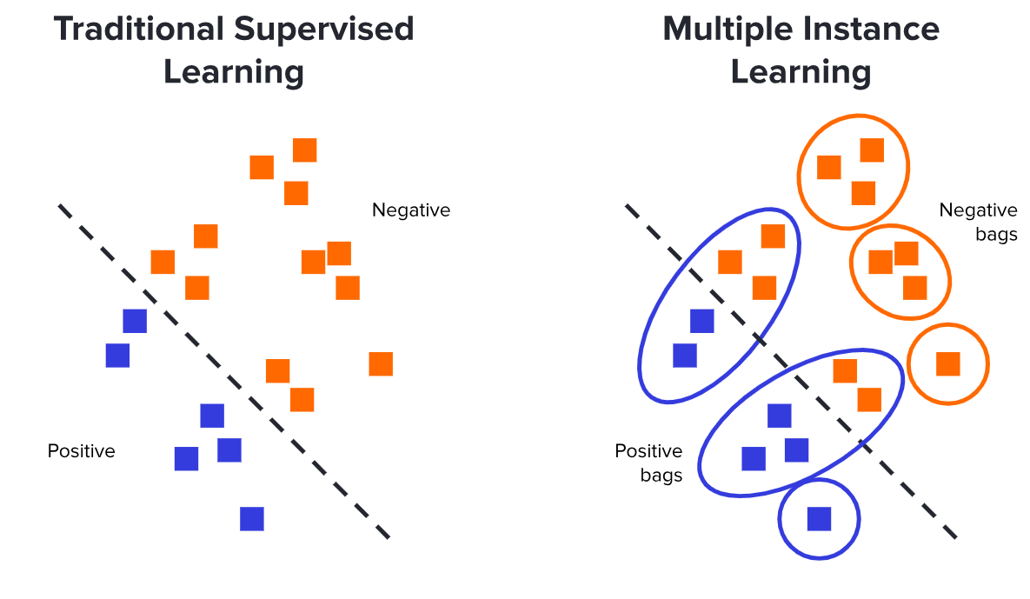
MIL Continued - MIL Compared to Traditional ML
Traditional ML
Each example is represented by a single feature vector and has a corresponding label
Features are extracted from the individual instances.
Try to find the details that separate positive and negative cases
https://nilg.ai/202105/an-introduction-to-multiple-instance-learning/

Slide 8
MIL Continued - MIL Compared to Traditional ML
MIL ML
We may not know whether a specific instance is positive or negative
We do know that at least one instance must be if a bag is labeled positive
Examining the instances in each bag can allow us to find the patterns that signify a positive instance
https://nilg.ai/202105/an-introduction-to-multiple-instance-learning/

Slide 9


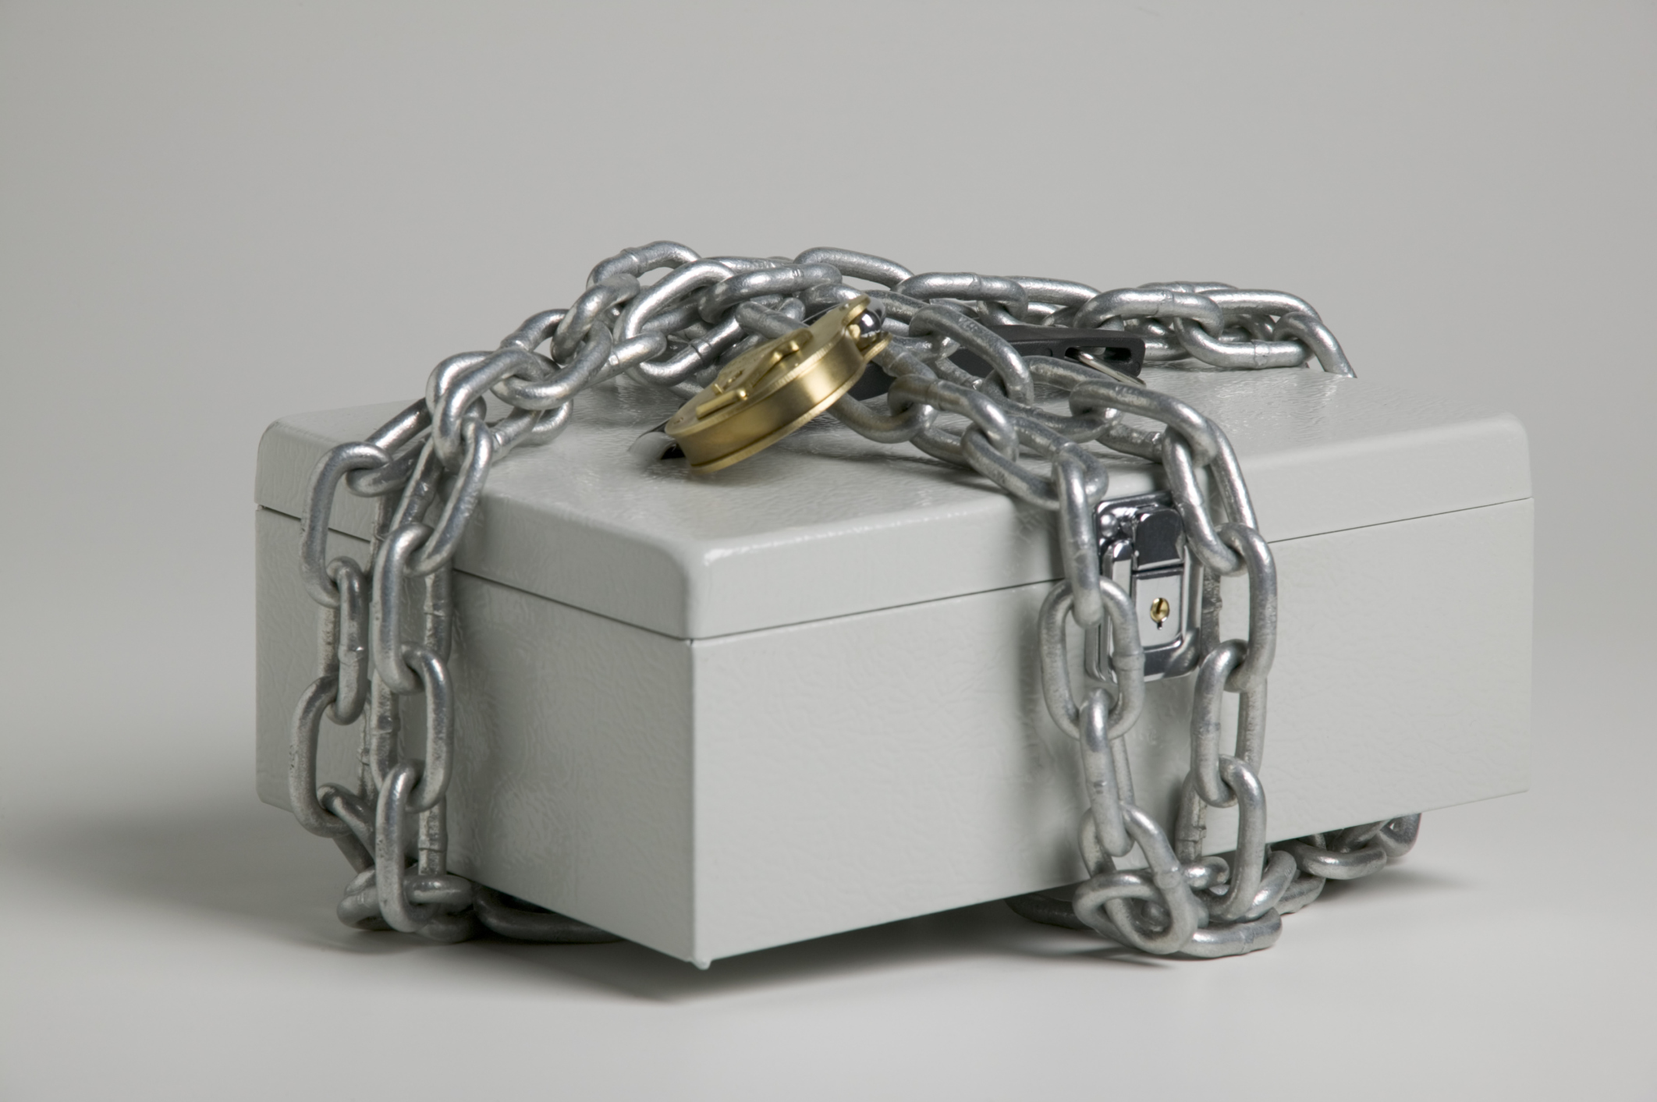


MIL Continued - MIL Example
Which key opens the box?
You will be the model and I will feed you the data

Slide 10
MIL Continued - MIL Example
Positive
Negative
Positive

Slide 11
MIL Continued - MIL Example

Slide 12
Data
3111 images from 1098 patients from The Cancer Genome Atlas (TCGA) dataset
Each WSI has three receptor classifiers:
Estrogen (ER)
Progesterone (PR)
Human Epidermal Growth Factor Receptor 2 (HER2)
Each of these have the following possible statuses:
Positive
Negative
Equivocal (ambiguous)
Null

Slide 13
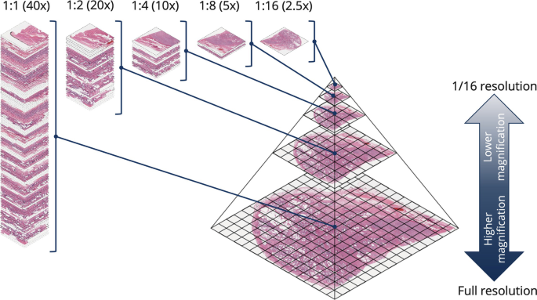
Data
Images range in dimensions of 30k-200k pixels high and/or wide and range in size 300MB-3GB
Some images are captured in 20x and 40x zoom
Images are saved in the form of multiple levels of resolution

Slide 14
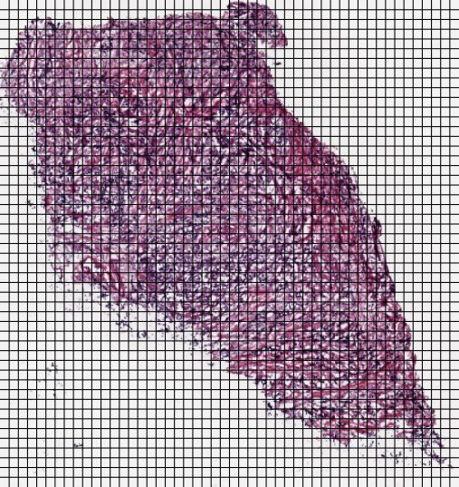


Data Processing
Used OpenSlide package in Python to acquire images at 20x zoom and break into 256x256 pixel tiles
Utilized multiprocessing to parallelize the tile saving process
Removed tiles containing:
Predominantly white space
Out of focus/blurry tissue
Annotations or empty data that gets past the above
Removed WSI containing fewer than 100 tiles

Slide 15
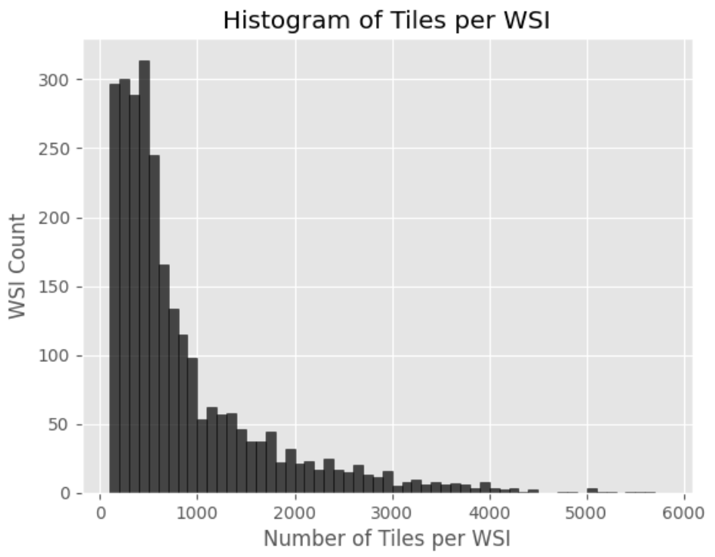
Processed Data
For each respective HR, WSIs containing equivocal and null entries are removed
A fourth classification was produced from the data – Triple Negative (NNN)
NNN is positive if all ER, PR and HER2 are negative
Else, negative
HR | Count | Percentage
 |  | Positive | Negative
ER | 2516 | 76.6 | 23.4
PR | 2509 | 65.8 | 34.2
HER2 | 1762 | 22.5 | 77.5
NNN | 1747 | 16.1 | 83.9

Slide 16
The Model
ReceptorNeXt, consists of three interconnected neural networks which are trained together
A feature extractor which converts each 256 × 256 pixel-size tile in a bag into a 512-dimensional feature vector
An attention module that creates a 512-dimensional aggregate of feature vectors from all the tiles in the bag, attention-weighted based on discriminative power, and
A decision layer that computes the probability of this bag being positive from the aggregate feature vector.

Slide 17
Method
Perform 10-fold cross-validation on ERS
Run experiments with:
Various feature extractors
ResNet50, ResNet101
ResNext50, ResNeXt101
Implementing Squeeze and Excitation blocks
Automatic Mixed Precision (AMP)
Ensemble Methods
Utilizing best model configuration, run inferences
PRS
HER2S
NNNS

Slide 18

Method
- Cross-Validation of Model:
300 epoch per fold
Early stopping
AUROC as performance metric
Data is very unbalanced, but using to compare with reference paper
- Test model on test dataset
- Ensemble Evaluation:
Run $n$ evaluations utilizing bags of $x$ tiles
Save inference results to dataframe
Select the max value of each WSI inference and calculate AUROC
Test 5 times and report average
Compute difference from the baseline

Slide 19
Results
Automatic Mixed Precision
2x faster training
Over 3x faster evaluation with 500 tile bag size
Almost 1GB less memory used
Precision | Runtime (min) |  |  |  |  |  |  | Max Memory Allocated (MiB)
 | Train | Evaluation
 | 50 | 50 | 100 | 200 | 300 | 400 | 500
FP32 | 6:26 | 0:27 | 0:55 | 2:26 | 4:10 | 5:44 | 10:10 | 10477
AMP | 3:04 | 0:15 | 0:30 | 1:28 | 2:26 | 2:38 | 3:22 | 9114

Slide 20
Results
Feature Extractors
ResNext50 w/ SE performed best
Surprisingly, ResNeXt101 w/ SE performed poorly despite promise from ResNet101
Model | Fold AUROC |  |  | Run Time (min)*
 | Avg | Min | Max | Train | Validate
ResNet50 | 0.774 | 0.643 | 0.853 | 2:17 | 1:27
ResNeXt50 | 0.798 | 0.76 | 0.839 | 2:35 | 1:34
ResNeXt50 w/ SE | 0.818 | 0.786 | 0.866 | 3:04 | 1:46
ResNet101 | 0.806 | 0.775 | 0.85 | 3:15 | 2:03
ResNeXt101 w/ SE | 0.746 | 0.716 | 0.782 | 4:27 | 2:28
* Per epoch

Slide 21
Results
HR Inference *
Hormone Receptor | Cross-Val | Test
 | Avg. AUC | AUC
ER Baseline | 0.86 | N/A
ER | 0.789** | 0.781
PR | 0.734 | 0.76
HER2 | 0.65 | 0.612
NNN | 0.731 | 0.582
* 5-Fold Cross-Validation
** ER performed worse than baseline (Naik et al)

Slide 22
Results - Ensembles
ER PR
Bag Sizes | AUC Improv. | Time
 | MAX
50 x 10 | -1.65 | 5:00
100 x 5 | -1.05 | 4:46
250 x 2 | -0.2 | 4:10
500 x 1 | - | 3:31
Bag Sizes | AUC Improv. | Time
 | MAX
50 x 10 | -2.40 | 5:08
100 x 5 | 0.00 | 4:46
250 x 2 | 1.00 | 4:13
500 x 1 | - | 3:31

Slide 23
Results - Ensembles
HER2 NNN
Bag Sizes | AUC Improv. | Time
 | MAX
50 x 10 | 3.20 | 3:59
100 x 5 | 2.40 | 3:28
250 x 2 | 1.30 | 3:06
500 x 1 | - | 2:36
Bag Sizes | AUC Improv. | Time
 | MAX
50 x 10 | 5.10 | 5:46
100 x 5 | 4.70 | 5:04
250 x 2 | 4.40 | 4:44
500 x 1 | - | 3:58

Slide 24
Conclusions
Produced open source
Data processing pipeline
MIL model that can make inferences on HRSs
AMP makes the model significantly more efficient
The ensemble method improves AUC by several points for datasets with imbalanced dataset where positive cases are fewer

Slide 25
Items to Explore in the Future
Acquire more data from
The Australian Breast Cancer Tissue Bank (ABCTB)
NIC Brazil which is building an expanded set of data with classifications for rare cancer subtypes
Explore Nvidia DALI to improve data load times
Explore Dual-Path networks utilizing ResNeXt and DenseNet feature extractors to extract useful information
Utilize a multiple GPU cluster to parallelize the training process
Configure model to run in Docker container for quick and easy deployment

Slide 26
Access
Project Repository:
https://github.com/deanak1987/TCSS702_Capstone
Data:
https://portal.gdc.cancer.gov/repository
Report (in progress):
https://github.com/deanak1987/TCSS702_Capstone/blob/main/DeanTCSS702CapstoneProjectReport2024.pdf

Slide 27
References
Project Inspiration
https://www.nature.com/articles/s41467-020-19334-3#Ack1

