Slide 1
Study Group Recommender with Machine Learning
Developed: by class of DATA322 Presented: by Team Machines

Slide 2
Problem Overview
Many students struggle with understanding course material, staying accountable, and performing well on exams. While study groups can feel intimidating, research shows they significantly improve comprehension, retention, and exam scores. Now the big question is: How do we create effective study groups that maximize learning, accountability, and confidence while minimizing the fear of participation?

Slide 3
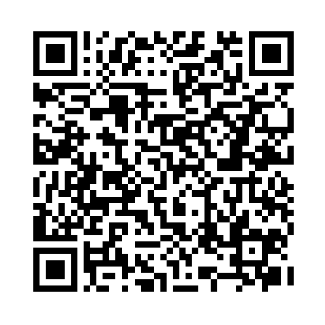
Data Collection - Fill Out This Form!
First, please fill out our short survey, which we’ll use to recommend everyone’s study groups! While you are all filling that out, we’ll begin talking about the methods used in our hierarchical clustering algorithm. You are all your own cluster to start, but will begin merging together one by one based on similarity and differences in responses!

Slide 4
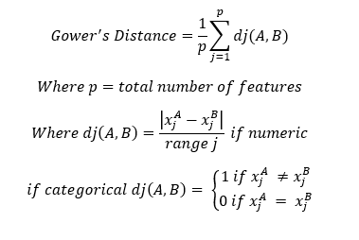
Gower’s for Distances Between Clusters
Gower’s Method

Slide 5
How does our distance work between students?
We calculate similarity between students based on:
(Numeric variables) (i.e., study hours per week, quiz/exam scores)
Measured by normalized numerical difference.
(Categorical variables) (i.e, major, preferred study style, availability, learning preference).
Measured by 0 if they match, 1 if they differ. Each variable contributes equally or weighted if needed to an overall similarity score.
(Final Distance Score) Distance ranges from 0 to 1.
0 = Very similar students
1 = Very different students
Students with (smaller distances) are grouped together in the recommender system to create balanced, compatible study groups.

Slide 6
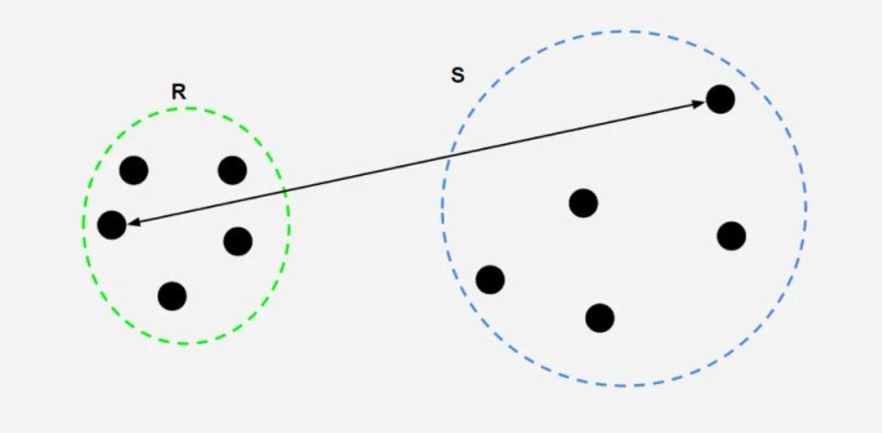
Complete Linkage for Merging Clusters
Complete linkage describes the metric we use to decide the merging of clusters. In particular, we merge the minimum distance created by the farthest points within two clusters, which is found by comparing the distances from every pair of points between the clusters.
Visualization of Complete Linkage

Slide 7
Tidy Data Collected

Slide 8
Let’s Look at the Code

Slide 9
Our Results Visualized as a Dendrogram

Slide 10
Group Recommendations and Student Assignment

Slide 11

Evaluation Form (from Presenting Team)
Feedback from the evaluation form will be anonymous, however the results will help us all improve future iterations of our model generalized to all students. ** Ask Rosanna if she wants to share the results to them later on **

Slide 12
Credits
Presented by Team Machines:
  Anthony Wolfe - Project Coordinator
  Dean Callahan - Technical Lead
  Jonathan Juarez - Data Scientist
  Devon Walker - Data Scientist
Data and Question Design By: Team SARA
Distance and Clustering By: Team Errors

