Slide 1
Redwood Analytics Project 3: Predicting Tree Biomass
By Evan Blem, Dean Callahan, Zach Griffiths, and Jaiden Roe

Slide 2
Data Dictionary
SPCD (Species Code): A numeric code which unqiuely identifies each tree species as specifed by the FIA (Forest Inventory and Analysis) species coding system. Each FIA species code corresponds uniquely to a scientific and common name. (Official definition: FIA species code.)
DO_BH (Diameter at Breast Height [Outside Bark]): Diameter of the tree stem measured at breast height (4.5 feet or 1.37 meters above ground) including bark. This is the standard foresty measurement “DBH (outside bark)” and is the primary size variable used in nearly all allometric biomass models. This is measured in inches.

Slide 3
Data Dictionary Continued
HT_TOT (Total Tree Height): The total height of the tree measured from ground level to the top of the crown. Used as a second size metric in volume and biomass modeling.This is measured in feet.
TT_DW_CRM (Total Tree Dry Biomass): The total above-ground dry weight of the tree (includes stem wood, stem bark, branches, folliage). This value comes from destructive sampling: the tree was felled, seperated into componenets, oven-dried, and weighed. This variable serves as the response variable (“target”) from biomass prediction. This is measured in kilograms.

Slide 4
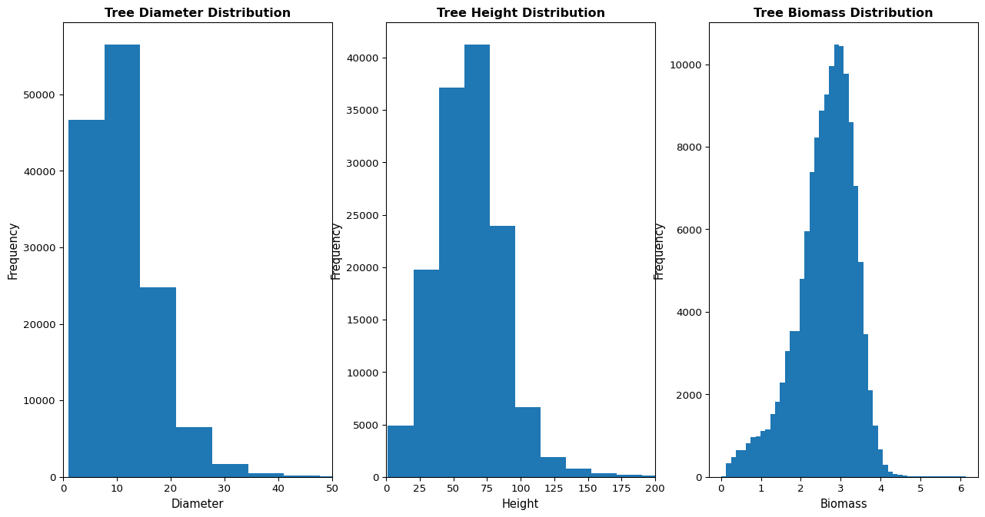
Univariate Visualizations

Slide 5
Data Summaries
 | SPCD | DO_BH | HT_TOT | TT_DW_CRM
count | 137079.000000 | 137079.000000 | 137079.000000 | 1.370790e+05
mean | 341.054465 | 11.104809 | 62.081565 | 1.530719e+03
std | 341.609599 | 8.046896 | 25.834963 | 1.698299e+04
min | 10.000000 | 1.000000 | 1.400000 | 1.020000e+00
25% | 121.000000 | 6.500000 | 45.000000 | 1.689850e+02
50% | 132.000000 | 9.900000 | 61.100000 | 5.276000e+02
75% | 611.000000 | 14.300000 | 76.700000 | 1.352070e+03
max | 8768.000000 | 334.900000 | 379.300000 | 1.385886e+06
COMMON_NAME loblolly pine 20140 slash pine 8006 Douglas-fir 7322 ponderosa pine 5609 shortleaf pine 5599 longleaf pine 4949 white oak 3955 sweetgum 3494 yellow-poplar 3372 red maple 3109 Name: count, dtype: int64

Slide 6
Data Summaries
 | HT_TOT | DO_BH | TT_DW_CRM
COMMON_NAME
Alaska yellow-cedar | 75.11 | 14.19 | 1873.10
American basswood | 70.87 | 11.84 | 821.54
American beech | 68.84 | 13.39 | 1867.46
American chestnut | 51.01 | 7.21 | 249.15
American elm | 54.26 | 9.15 | 515.40
American holly | 31.10 | 6.09 | 242.32
American hornbeam, musclewood | 31.87 | 2.82 | 40.72
American mountain-ash | 32.59 | 5.53 | 114.80
American sycamore | 77.29 | 13.40 | 1383.72
Atlantic white-cedar | 51.62 | 8.90 | 352.23

Slide 7
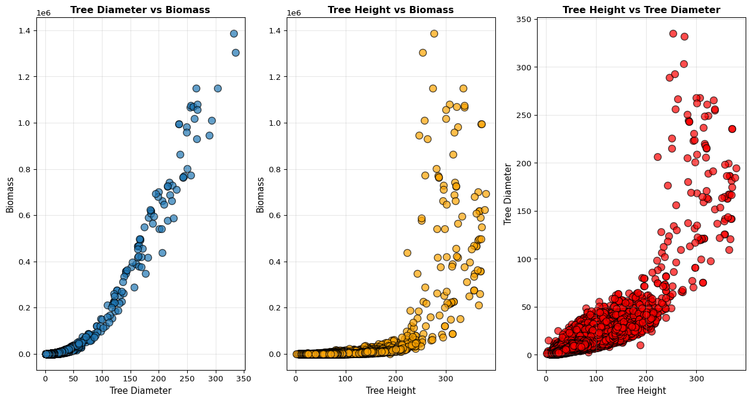
Bivariate Visualizations

Slide 8
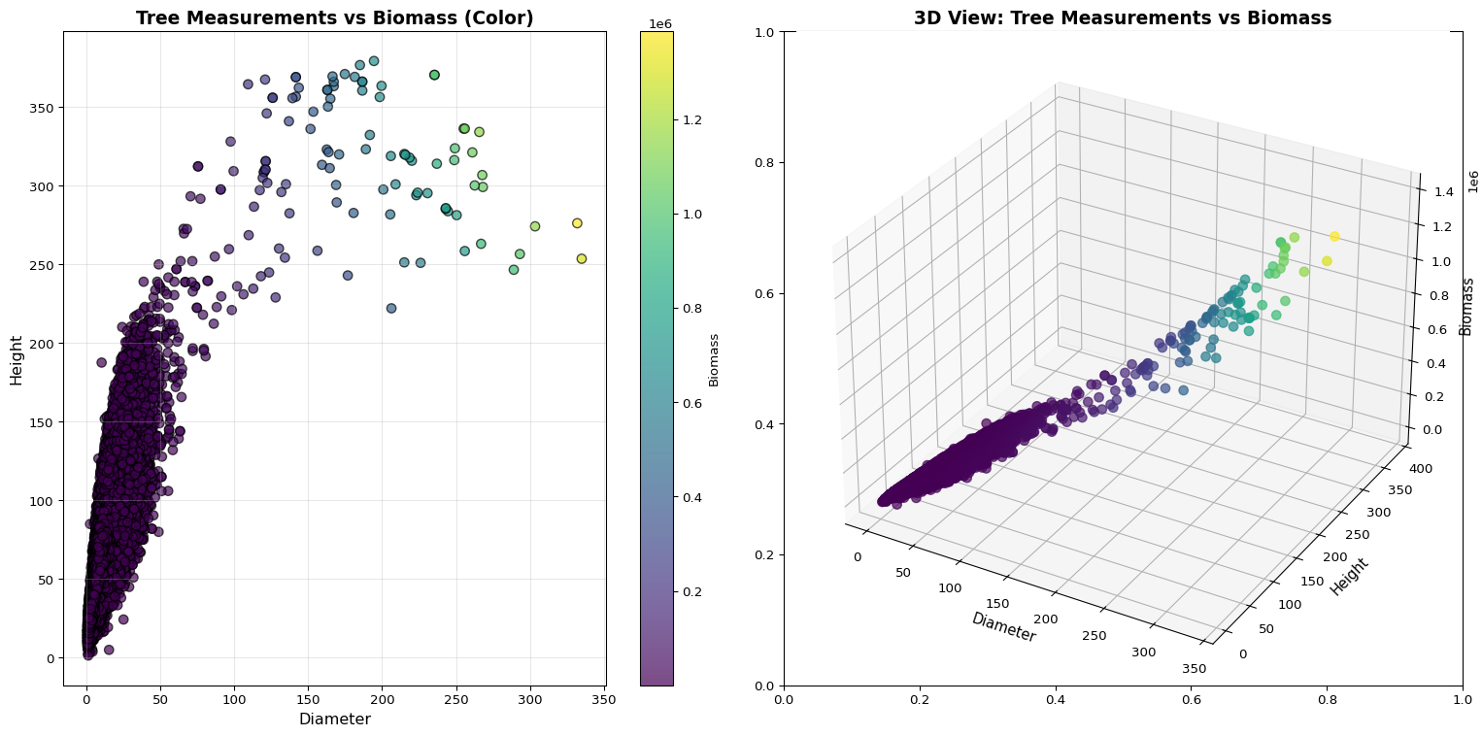
Additional Visualizations

Slide 9
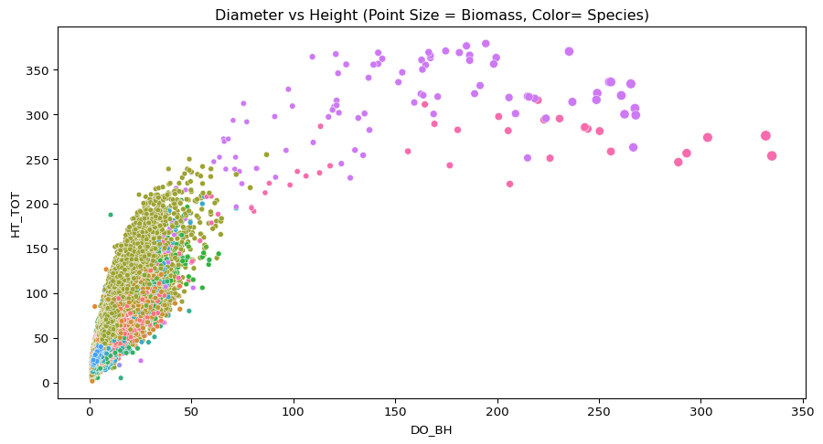
Visualization Containing all 4 Variables

Slide 10
Model Domain Information
Model Inputs & Domains:
SPCD: FIA species code (categorical). Only includes species in the full dataset with a count greater than 100.
DO_BH: Diameter, measured in inches. Valid Range: 1.0-255.9 inches (based on training data min and max)
HT_TOT: Height, measured in feet. Valid Range: 2.5-370.5 feet
Output:
TT_DW_CRM: Total above-ground dry biomass in kilograms

Slide 11
Model Limitations:
Species limitations: Model won’t work for less frequent species or species that don’t appear at all in the dataset
Effectiveness varies based on species: Some species it performs well on others it performs poorly on: RMSLE of 0.0234800 for loblolly pine vs RMSLE of 0.713023 for pecan
k=3: Lower k value may lead to overfitting of data due to potential outliers and noise

Slide 12
Performance Metric
The Performance metric we choose is Root Mean Square Logarithmic Error(RMSLE), because when we were looking at the dataset of the biomass of different kinds of tree species, we saw that some species have more data than other species so the assume that the data is skewed

Slide 13
Model
 | Species | k | MSE | RMSE | MAE | RMSLE
0 | balsam fir | 2 | 15832.533707 | 125.827396 | 34.820565 | 0.119617
1 | balsam fir | 3 | 16809.344173 | 129.650855 | 36.628377 | 0.123679
2 | balsam fir | 4 | 18117.114099 | 134.599829 | 38.884870 | 0.133858
3 | balsam fir | 5 | 21025.827183 | 145.002852 | 41.168470 | 0.144052
4 | balsam fir | 6 | 21741.268983 | 147.449208 | 40.728609 | 0.142813
... | ... | ... | ... | ... | ... | ...
895 | sugarberry | 6 | 1051.773141 | 32.431052 | 20.969306 | 0.565727
896 | sugarberry | 7 | 1393.100286 | 37.324259 | 25.037024 | 0.637629
897 | sugarberry | 8 | 1455.022421 | 38.144756 | 26.680208 | 0.665159
898 | sugarberry | 9 | 1358.161657 | 36.853245 | 21.021667 | 0.685162
899 | sugarberry | 10 | 1607.296767 | 40.091106 | 23.172083 | 0.677519

Slide 14
Technical Lead
 | SPCD | DO_BH | HT_TOT | TT_DW_CRM
0 | 12 | 7.5 | 45.2 | 178.86
1 | 12 | 9.3 | 62.7 | 323.46
2 | 12 | 9.7 | 56.7 | 342.47
3 | 12 | 11.4 | 66.1 | 499.35
4 | 12 | 6.4 | 51.8 | 113.92
Split and filtering methods
Feature engineering (what worked and what didn’t)
Tuning k for the best model
The final “best” model and error # Tree Measurement Data:

Slide 15
Tree Species Name Data:
 | SPCD | COMMON_NAME
0 | 10 | fir spp.
1 | 11 | Pacific silver fir
2 | 12 | balsam fir
3 | 14 | Santa Lucia or bristlecone fir
4 | 15 | white fir

Slide 16
Combined Dataset (species mapped onto bigger dataset):
 | SPCD | DO_BH | HT_TOT | TT_DW_CRM | COMMON_NAME
0 | 12 | 7.5 | 45.2 | 178.86 | balsam fir
1 | 12 | 9.3 | 62.7 | 323.46 | balsam fir
2 | 12 | 9.7 | 56.7 | 342.47 | balsam fir
3 | 12 | 11.4 | 66.1 | 499.35 | balsam fir
4 | 12 | 6.4 | 51.8 | 113.92 | balsam fir

Slide 17
Filtered data
 | SPCD | DO_BH | HT_TOT | TT_DW_CRM | COMMON_NAME
0 | 12 | 7.5 | 45.2 | 178.86 | balsam fir
1 | 12 | 9.3 | 62.7 | 323.46 | balsam fir
2 | 12 | 9.7 | 56.7 | 342.47 | balsam fir
3 | 12 | 11.4 | 66.1 | 499.35 | balsam fir
4 | 12 | 6.4 | 51.8 | 113.92 | balsam fir

Slide 18
Quality Assurance

