Slide 1
Redwood Analytics Project 3: Predicting Tree Biomass
By Evan Blem, Dean Callahan, Zach Griffiths, and Jaiden Roe

Slide 2
Data Dictionary
SPCD (FIA Species Code): A numeric code which unqiuely identifies each tree species and corresponds to a scientific and common name for the tree as specified by the FIA (Forest Inventory and Analysis) species coding system.
DO_BH (Diameter at Breast Height): Diameter of the tree stem measured at breast height (4.5 feet or 1.37 meters above ground) including bark. This is the standard forestry measurement “DBH (outside bark)” and is the primary size variable used in nearly all allometric biomass models. This is measured in inches.

Slide 3
Data Dictionary Continued
HT_TOT (Total Tree Height): The total height of the tree measured from ground level to the top of the crown. Used as a second size metric in volume and biomass modeling. This is measured in feet.
TT_DW_CRM (Total Tree Dry Biomass): The total above-ground dry weight of the tree (includes stem wood, stem bark, branches, folliage). The value comes from destructive sampling: the tree was felled, separated into componenets, oven-dried, and weighed. This variable serves as the target variable from biomass prediction. Measured in kilograms.

Slide 4
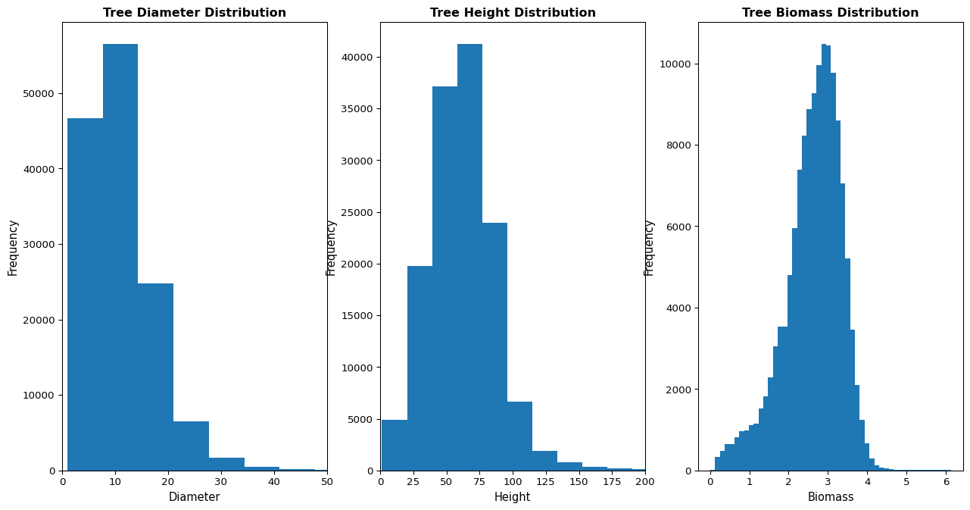
Univariate Visualizations

Slide 5
Data Summaries
 | SPCD | DO_BH | HT_TOT | TT_DW_CRM
count | 137079.000000 | 137079.000000 | 137079.000000 | 1.370790e+05
mean | 341.054465 | 11.104809 | 62.081565 | 1.530719e+03
std | 341.609599 | 8.046896 | 25.834963 | 1.698299e+04
min | 10.000000 | 1.000000 | 1.400000 | 1.020000e+00
25% | 121.000000 | 6.500000 | 45.000000 | 1.689850e+02
50% | 132.000000 | 9.900000 | 61.100000 | 5.276000e+02
75% | 611.000000 | 14.300000 | 76.700000 | 1.352070e+03
max | 8768.000000 | 334.900000 | 379.300000 | 1.385886e+06
COMMON_NAME loblolly pine 20140 slash pine 8006 Douglas-fir 7322 ponderosa pine 5609 shortleaf pine 5599 longleaf pine 4949 white oak 3955 sweetgum 3494 yellow-poplar 3372 red maple 3109 Name: count, dtype: int64

Slide 6
Data Summaries
 | HT_TOT | DO_BH | TT_DW_CRM
COMMON_NAME
Alaska yellow-cedar | 75.11 | 14.19 | 1873.10
American basswood | 70.87 | 11.84 | 821.54
American beech | 68.84 | 13.39 | 1867.46
American chestnut | 51.01 | 7.21 | 249.15
American elm | 54.26 | 9.15 | 515.40
American holly | 31.10 | 6.09 | 242.32
American hornbeam, musclewood | 31.87 | 2.82 | 40.72
American mountain-ash | 32.59 | 5.53 | 114.80
American sycamore | 77.29 | 13.40 | 1383.72
Atlantic white-cedar | 51.62 | 8.90 | 352.23

Slide 7
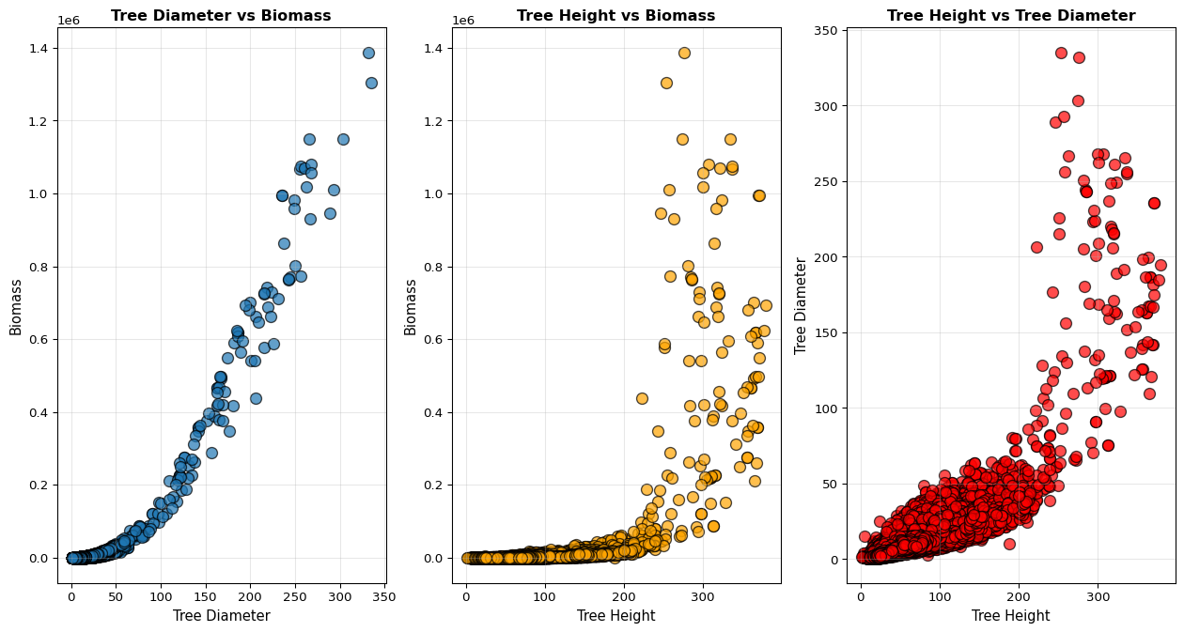
Bivariate Visualizations

Slide 8
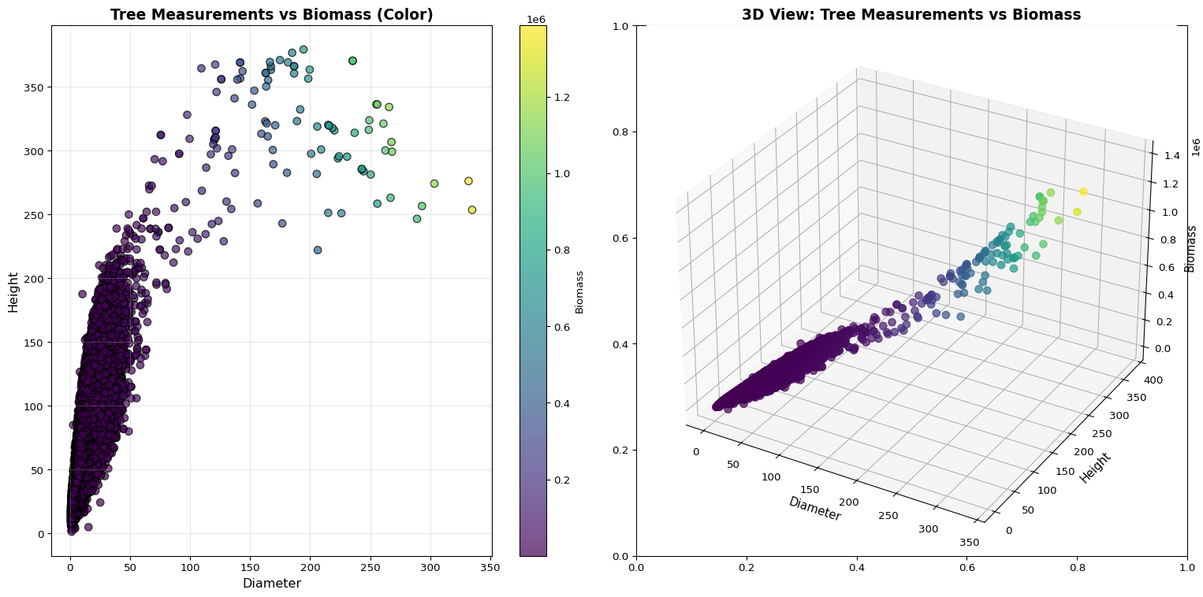
Additional Visualizations

Slide 9
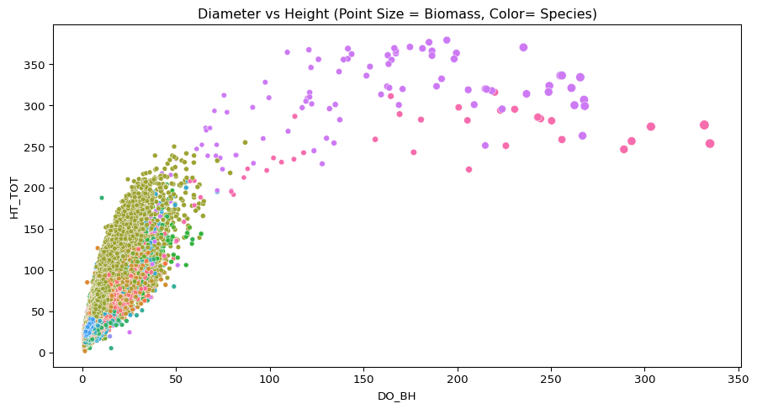
Visualization Containing all 4 Variables

Slide 10
Model Domain Information
Model Inputs & Domains:
SPCD: FIA species code (categorical). Only includes species in the full dataset with a count greater than 100.
DO_BH: Diameter, measured in inches. Valid Range: 1.0-255.9 inches (based on training data min and max)
HT_TOT: Height, measured in feet. Valid Range: 2.5-370.5 feet
Output:
TT_DW_CRM: Total above-ground dry biomass in kilograms

Slide 11
Model Limitations:
Species limitations: Model won’t work for less frequent species or species that don’t appear at all in the dataset
Effectiveness varies based on species: Some species it performs well on others it performs poorly on: RMSLE of 0.0234800 for loblolly pine vs RMSLE of 0.713023 for pecan
k=3: Lower k value may lead to overfitting of data due to potential outliers and noise

Slide 12
Consultation
We choose kNN regression over linear regression because when looking at the graphs Dean made, we saw that the tree diameter/height vs. biomass graphs all have exponential growth.
When relations between biomass and trees’ diameter and height are complex and nonlinear, data is abundant, and the model needs to be adaptive without making major changes in the model. kNN excels in capturing patterns and irregular patterns.

Slide 13
Performance Metric
When predicting tree biomass, we chose Root Mean Square Logarithmic Error for our performance metric since biomass data varies greatly, ranging from tiny saplings to enormous trees, and trees have exponential growth.
RMSLE over RMSE: focuses on percentage errors, making it fair to both small and large trees, unlike RMSE, which we believe penalizes errors on big trees. Fitting biomass estimations where scale matters more than absolute error. RMSLE provides a more balanced evaluation that considers the unique characteristics of tree biomass data.

Slide 14
Project Manager Model
 | Species | k | RMSE | MAE | RMSLE
0 | balsam fir | 2 | 125.825473 | 34.801913 | 0.119574
1 | balsam fir | 3 | 129.651479 | 36.646493 | 0.123724
2 | balsam fir | 4 | 134.599829 | 38.884870 | 0.133858
3 | balsam fir | 5 | 145.003601 | 41.209530 | 0.144063
4 | balsam fir | 6 | 147.451321 | 40.791681 | 0.142862
5 | balsam fir | 7 | 153.497849 | 42.310385 | 0.150128
6 | balsam fir | 8 | 156.757283 | 43.465652 | 0.154785
7 | balsam fir | 9 | 161.016352 | 44.758889 | 0.160937
8 | balsam fir | 10 | 157.999921 | 44.694861 | 0.160057

Slide 15
Average Root Mean Square Logarithmic Error
k Avg_RMSLE 0 2 0.152872 1 3 0.158059 2 4 0.162102 3 5 0.167931 4 6 0.174191 5 7 0.180289 6 8 0.185042 7 9 0.190129 8 10 0.196823

Slide 16
Technical Lead
Overview of data manipulation
Split and filtering methods
Tuning k for the best model
Feature engineering (what worked and what didn’t)
The final “best” model and error

Slide 17
Tree Measurement Data:
 | SPCD | DO_BH | HT_TOT | TT_DW_CRM
0 | 12 | 7.5 | 45.2 | 178.86
1 | 12 | 9.3 | 62.7 | 323.46
2 | 12 | 9.7 | 56.7 | 342.47
3 | 12 | 11.4 | 66.1 | 499.35
4 | 12 | 6.4 | 51.8 | 113.92
... | ... | ... | ... | ...
137074 | 922 | 2.5 | 24.8 | 15.98
137075 | 922 | 3.7 | 23.7 | 40.62
137076 | 922 | 2.9 | 30.9 | 22.74
137077 | 922 | 5.6 | 40.0 | 87.79
137078 | 922 | 1.9 | 25.1 | 8.33

Slide 18
Tree Species Name Data:
 | SPCD | COMMON_NAME
0 | 10 | fir spp.
1 | 11 | Pacific silver fir
2 | 12 | balsam fir
3 | 14 | Santa Lucia or bristlecone fir
4 | 15 | white fir
... | ... | ...
453 | 995 | tungoil tree
454 | 996 | smoketree
455 | 997 | Russian-olive
456 | 998 | Unknown dead hardwood
457 | 999 | Other or unknown live tree

Slide 19
Combined Dataset (species mapped onto bigger dataset):
 | SPCD | DO_BH | HT_TOT | TT_DW_CRM | COMMON_NAME
0 | 12 | 7.5 | 45.2 | 178.86 | balsam fir
1 | 12 | 9.3 | 62.7 | 323.46 | balsam fir
2 | 12 | 9.7 | 56.7 | 342.47 | balsam fir
3 | 12 | 11.4 | 66.1 | 499.35 | balsam fir
4 | 12 | 6.4 | 51.8 | 113.92 | balsam fir
... | ... | ... | ... | ... | ...
137074 | 922 | 2.5 | 24.8 | 15.98 | black willow
137075 | 922 | 3.7 | 23.7 | 40.62 | black willow
137076 | 922 | 2.9 | 30.9 | 22.74 | black willow
137077 | 922 | 5.6 | 40.0 | 87.79 | black willow
137078 | 922 | 1.9 | 25.1 | 8.33 | black willow

Slide 20
Filtered data (minimum 100 data points)
 | SPCD | DO_BH | HT_TOT | TT_DW_CRM | COMMON_NAME
0 | 12 | 7.5 | 45.2 | 178.86 | balsam fir
1 | 12 | 9.3 | 62.7 | 323.46 | balsam fir
2 | 12 | 9.7 | 56.7 | 342.47 | balsam fir
3 | 12 | 11.4 | 66.1 | 499.35 | balsam fir
4 | 12 | 6.4 | 51.8 | 113.92 | balsam fir
... | ... | ... | ... | ... | ...
137035 | 691 | 3.7 | 25.4 | 40.76 | water tupelo
137036 | 691 | 3.2 | 28.8 | 28.44 | water tupelo
137037 | 691 | 4.7 | 31.4 | 73.78 | water tupelo
137038 | 691 | 4.4 | 26.9 | 62.64 | water tupelo
137039 | 691 | 4.2 | 28.1 | 55.82 | water tupelo

Slide 21
Testing k values
Average (RMSLE) for k = 3: 0.15805917967387384 Average (RMSLE) for k = 4: 0.16210180527022203 Average (RMSLE) for k = 5: 0.16793082822322966 Average (RMSLE) for k = 6: 0.17419090936308976 Average (RMSLE) for k = 7: 0.18028949487962886

Slide 22
Adding features
 | SPCD | DO_BH | HT_TOT | TT_DW_CRM | COMMON_NAME | VOLUME | H_D_INT | H_SQUARED
0 | 12 | 7.5 | 45.2 | 178.86 | balsam fir | 1996.873144 | 339.00 | 2043.04
1 | 12 | 9.3 | 62.7 | 323.46 | balsam fir | 4259.150167 | 583.11 | 3931.29
2 | 12 | 9.7 | 56.7 | 342.47 | balsam fir | 4190.019479 | 549.99 | 3214.89
3 | 12 | 11.4 | 66.1 | 499.35 | balsam fir | 6746.844127 | 753.54 | 4369.21
4 | 12 | 6.4 | 51.8 | 113.92 | balsam fir | 1666.399867 | 331.52 | 2683.24
... | ... | ... | ... | ... | ... | ... | ... | ...
107641 | 461 | 17.5 | 87.4 | 2042.09 | sugarberry | 21022.145834 | 1529.50 | 7638.76
107642 | 461 | 10.0 | 66.5 | 565.80 | sugarberry | 5222.893375 | 665.00 | 4422.25
107643 | 461 | 6.2 | 54.2 | 191.04 | sugarberry | 1636.334851 | 336.04 | 2937.64
107644 | 461 | 16.0 | 82.5 | 1632.64 | sugarberry | 16587.595200 | 1320.00 | 6806.25
107645 | 461 | 16.7 | 76.5 | 1644.66 | sugarberry | 16756.522421 | 1277.55 | 5852.25

Slide 23
Testing and comparing models
Height squared average RMSLE: 0.1718436576886068 Height * diameter interacion average RMSLE: 0.15623129644085285 Volume feature average RMSLE: 0.15545015821636968

Slide 24
Quality Assurance
Testing uncertainty quantification methods for our prediction intervals
We did not use a linear model, so t-based prediction intervals couldn’t be made
Compared the other three methods
Conformal Prediction Intervals
Quantile Regression Prediction Intervals
Conformalized Quantile Regression (CQR) Prediction Intervals

Slide 25
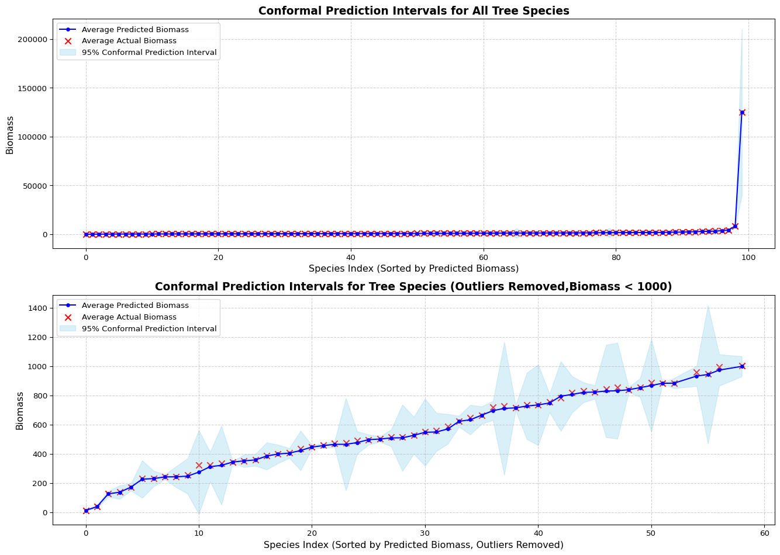
Conformal Prediction Intervals

Slide 26
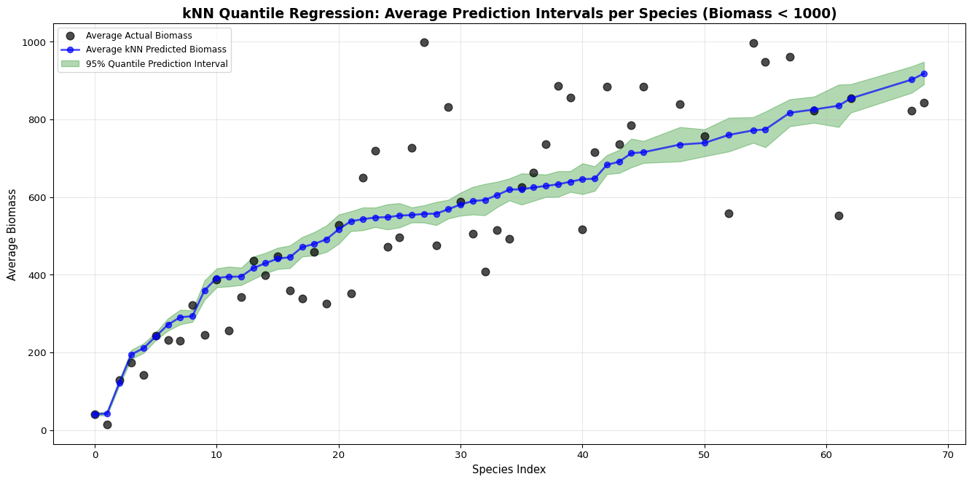
Quantile Regression Prediciton Intervals

Slide 27
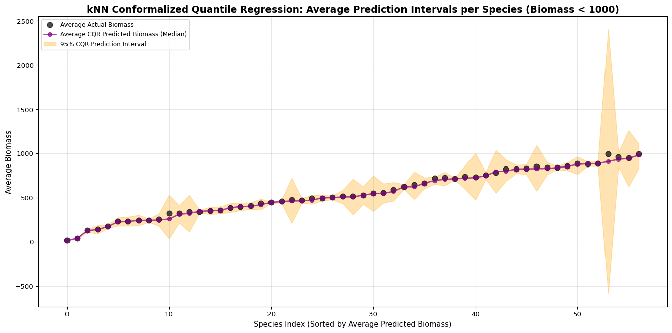
CQR Prediction Intervals

