Slide 1
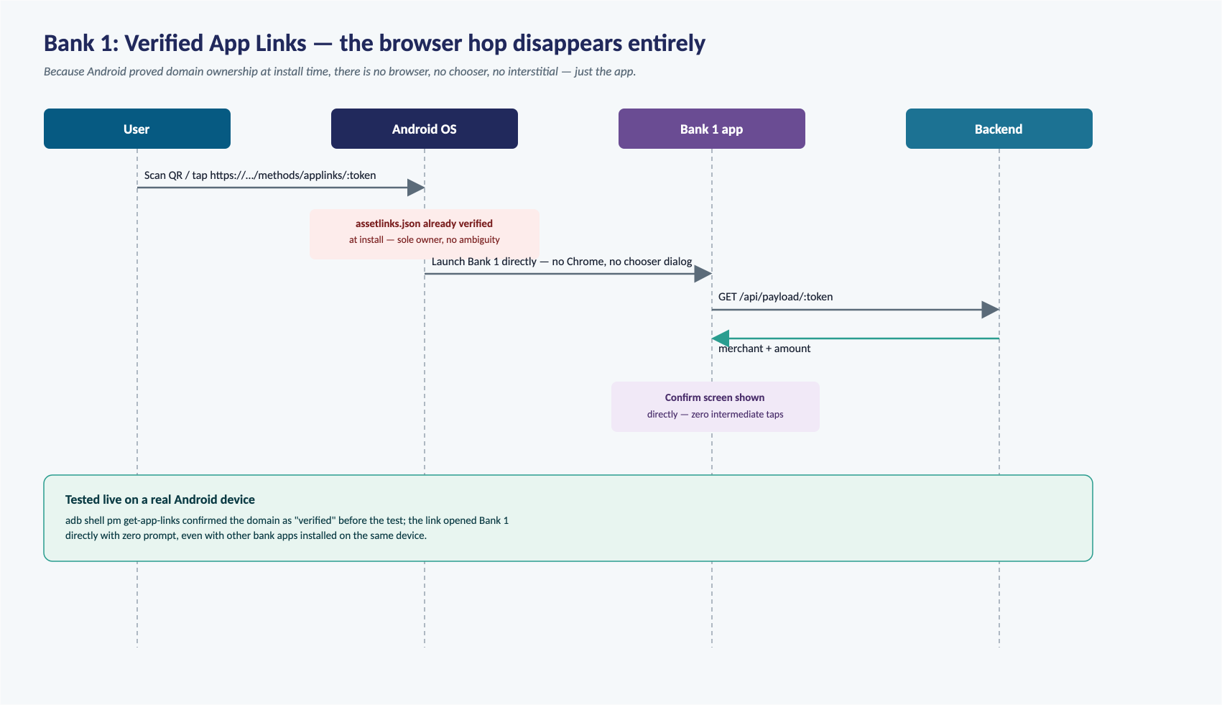

Slide 2
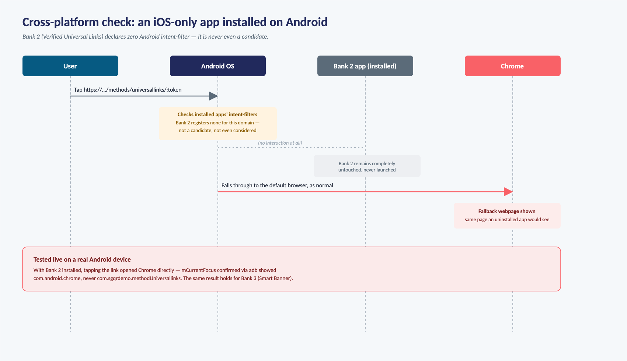

Slide 3
All 6 Methods, Sequence by Sequence
Five alternatives explored first, concluding with the core approach this project actually uses
App
Mechanism
Resolves via
Live result
Bank 1
Verified Android App Links
OS-verified ownership → direct launch
Opens directly, zero prompt
Bank 2
Verified iOS Universal Links
Entitlement + AASA → intended silent handoff
Safari + manual banner (free-account limit)
Bank 3
iOS Smart App Banner
Webpage <meta> tag → Safari-rendered banner
Banner can't render (needs App Store listing)
Bank 4
Android Explicit-Package Intent
Sender names the exact package → direct launch
Opens directly, zero prompt
Bank 5
Deferred Deep Linking
Clipboard carries the token across install
Correct token recovered, both platforms
Unregistered link
Core approach (Bank A/B/C)
No verification → chooser/picker is the point
Working end to end, both platforms
See the preceding two slides for the full step-by-step sequence behind Bank 1's direct launch and the Bank 2 cross-platform negative case.

Slide 4
Android: QR scan to native app chooser
The https link is deliberately unverified, so it opens in the browser first; the intent:// handoff triggers the real chooser.
User
Camera / QR tap
Android OS
Chrome
Backend
Bank X app
Scan with Camera — or tap the QR image on a webpage
Open https://…/pay/:token
Link unverified → default browser
GET /pay/:token + GET /api/payload/:token
Payment page: merchant, amount, [Continue to pay]
Tap “Continue to pay”
intent://pay?token=… (scheme=sgqrpay)
sgqrpay:// matches 3 installed apps → native chooser: Bank A · Bank B · Bank C
Pick one bank (A, B, or C)
Launch chosen bank with sgqrpay://pay?token=…
GET /api/payload/:token
merchant + amount → Confirm screen

Slide 5
iOS: QR scan to web picker to bank app
No apple-app-site-association is hosted, so the link always falls through to Safari; each bank button fires that app's custom URL scheme.
User
Camera / QR tap
iOS
Safari
Backend
Bank X app
Scan with Camera — or tap the QR image on a webpage
Open https://…/pay/:token
No Universal Link record → Safari
GET /pay/:token + /api/payload + /api/banks
Picker page: merchant, amount, grid of bank tiles
Tap one bank (A, B, or C)
Navigate bank<x>demo://pay?token=…
“Open in ‘Bank X’?” system prompt
Open
Launch chosen bank with the link
GET /api/payload/:token
merchant + amount → Confirm screen

Slide 6
Approval: the payment is single-use
Whichever bank app confirms first wins; the server atomically flips paid=true and rejects everyone after with 409.
User
Bank A app
Backend
Bank B app
Tap Approve
POST /api/payload/:token/pay {bank: “bankA”}
paid == false → set paid=true, paidBy=“bankA” (atomic check-then-flip)
200 OK
Deduct amount from balance · show Success screen
Tap Approve (same QR, moments later)
POST /api/payload/:token/pay {bank: “bankB”}
paid == true → reject
409 Conflict — payment already completed
“Already completed” message · balance unchanged

Slide 7
One user journey, two platforms
4 of 5 steps are identical on Android and iOS — only how you pick a bank differs
1
2
3
4
5
Android
Scan with Camera —
or tap the QR image
Page opens in the
default browser (Chrome)
Tap “Continue to pay”
→ native app chooser
Chosen bank app opens
to the Confirm screen
Tap Approve —
payment goes through
same
same
differs
same
same
iOS
Scan with Camera —
or tap the QR image
Page opens in
Safari
Tap a bank button
on the picker page
Chosen bank app opens
to the Confirm screen
Tap Approve —
payment goes through
From the user's side, it's one QR code and the same 5 beats every time — the only thing that changes is the mechanic behind step 3, driven entirely by how each OS treats an unregistered link.

