Slide 1
Examples of Automated Monthly Charts using Python

Slide 2
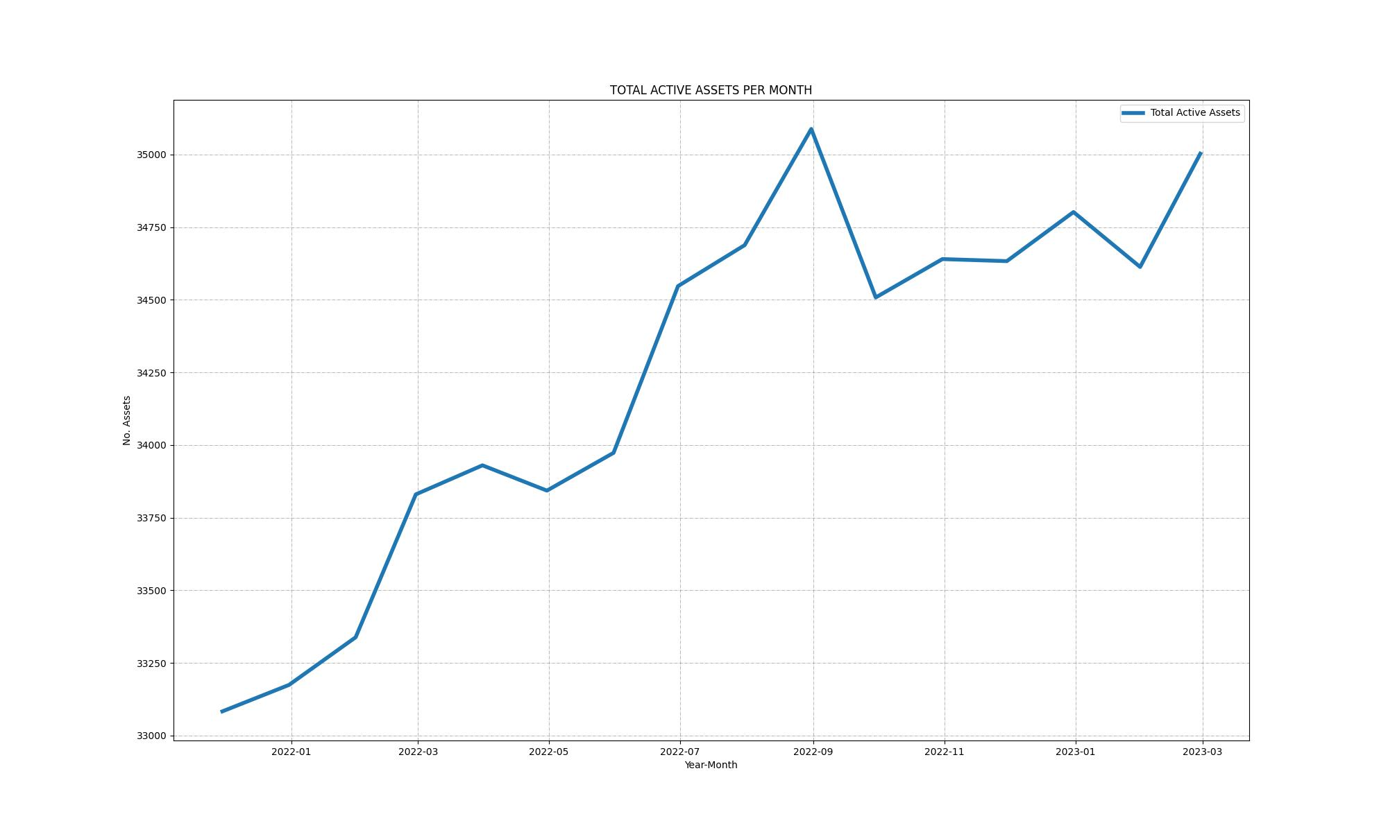
Trend of total assets

Slide 3
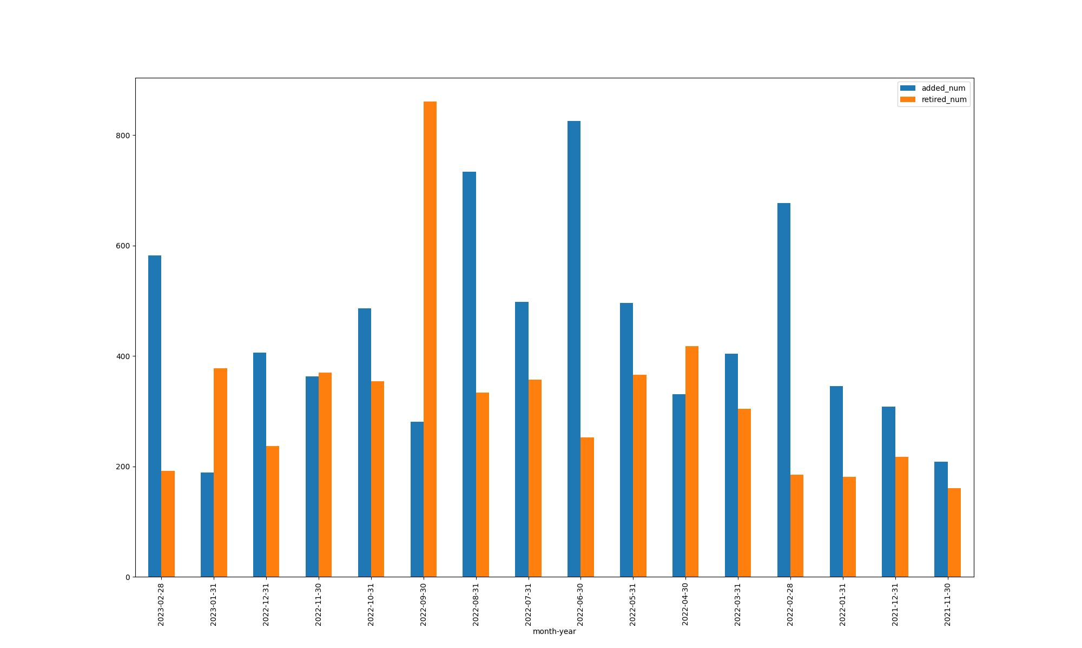
Added / Retired assets per month

Slide 4
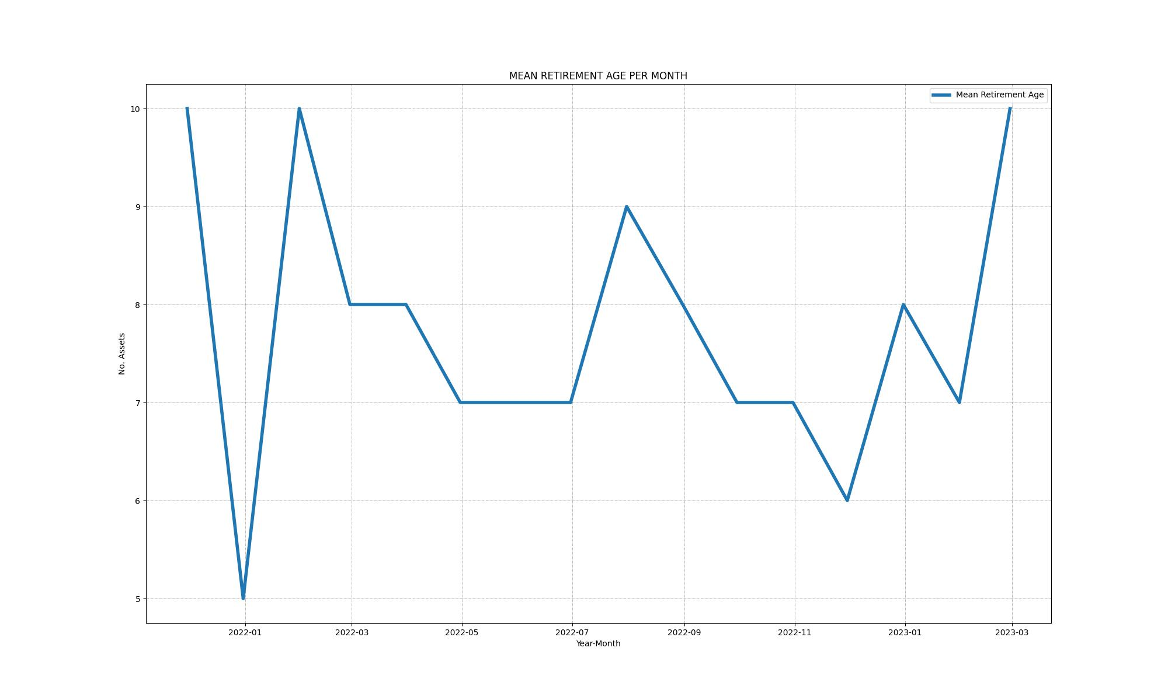
Mean retirement age of assets each month

Slide 5
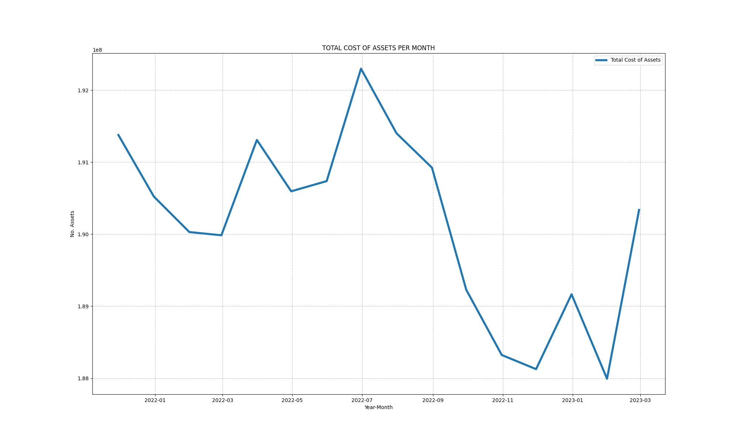
Cost of assets added each month

Slide 6
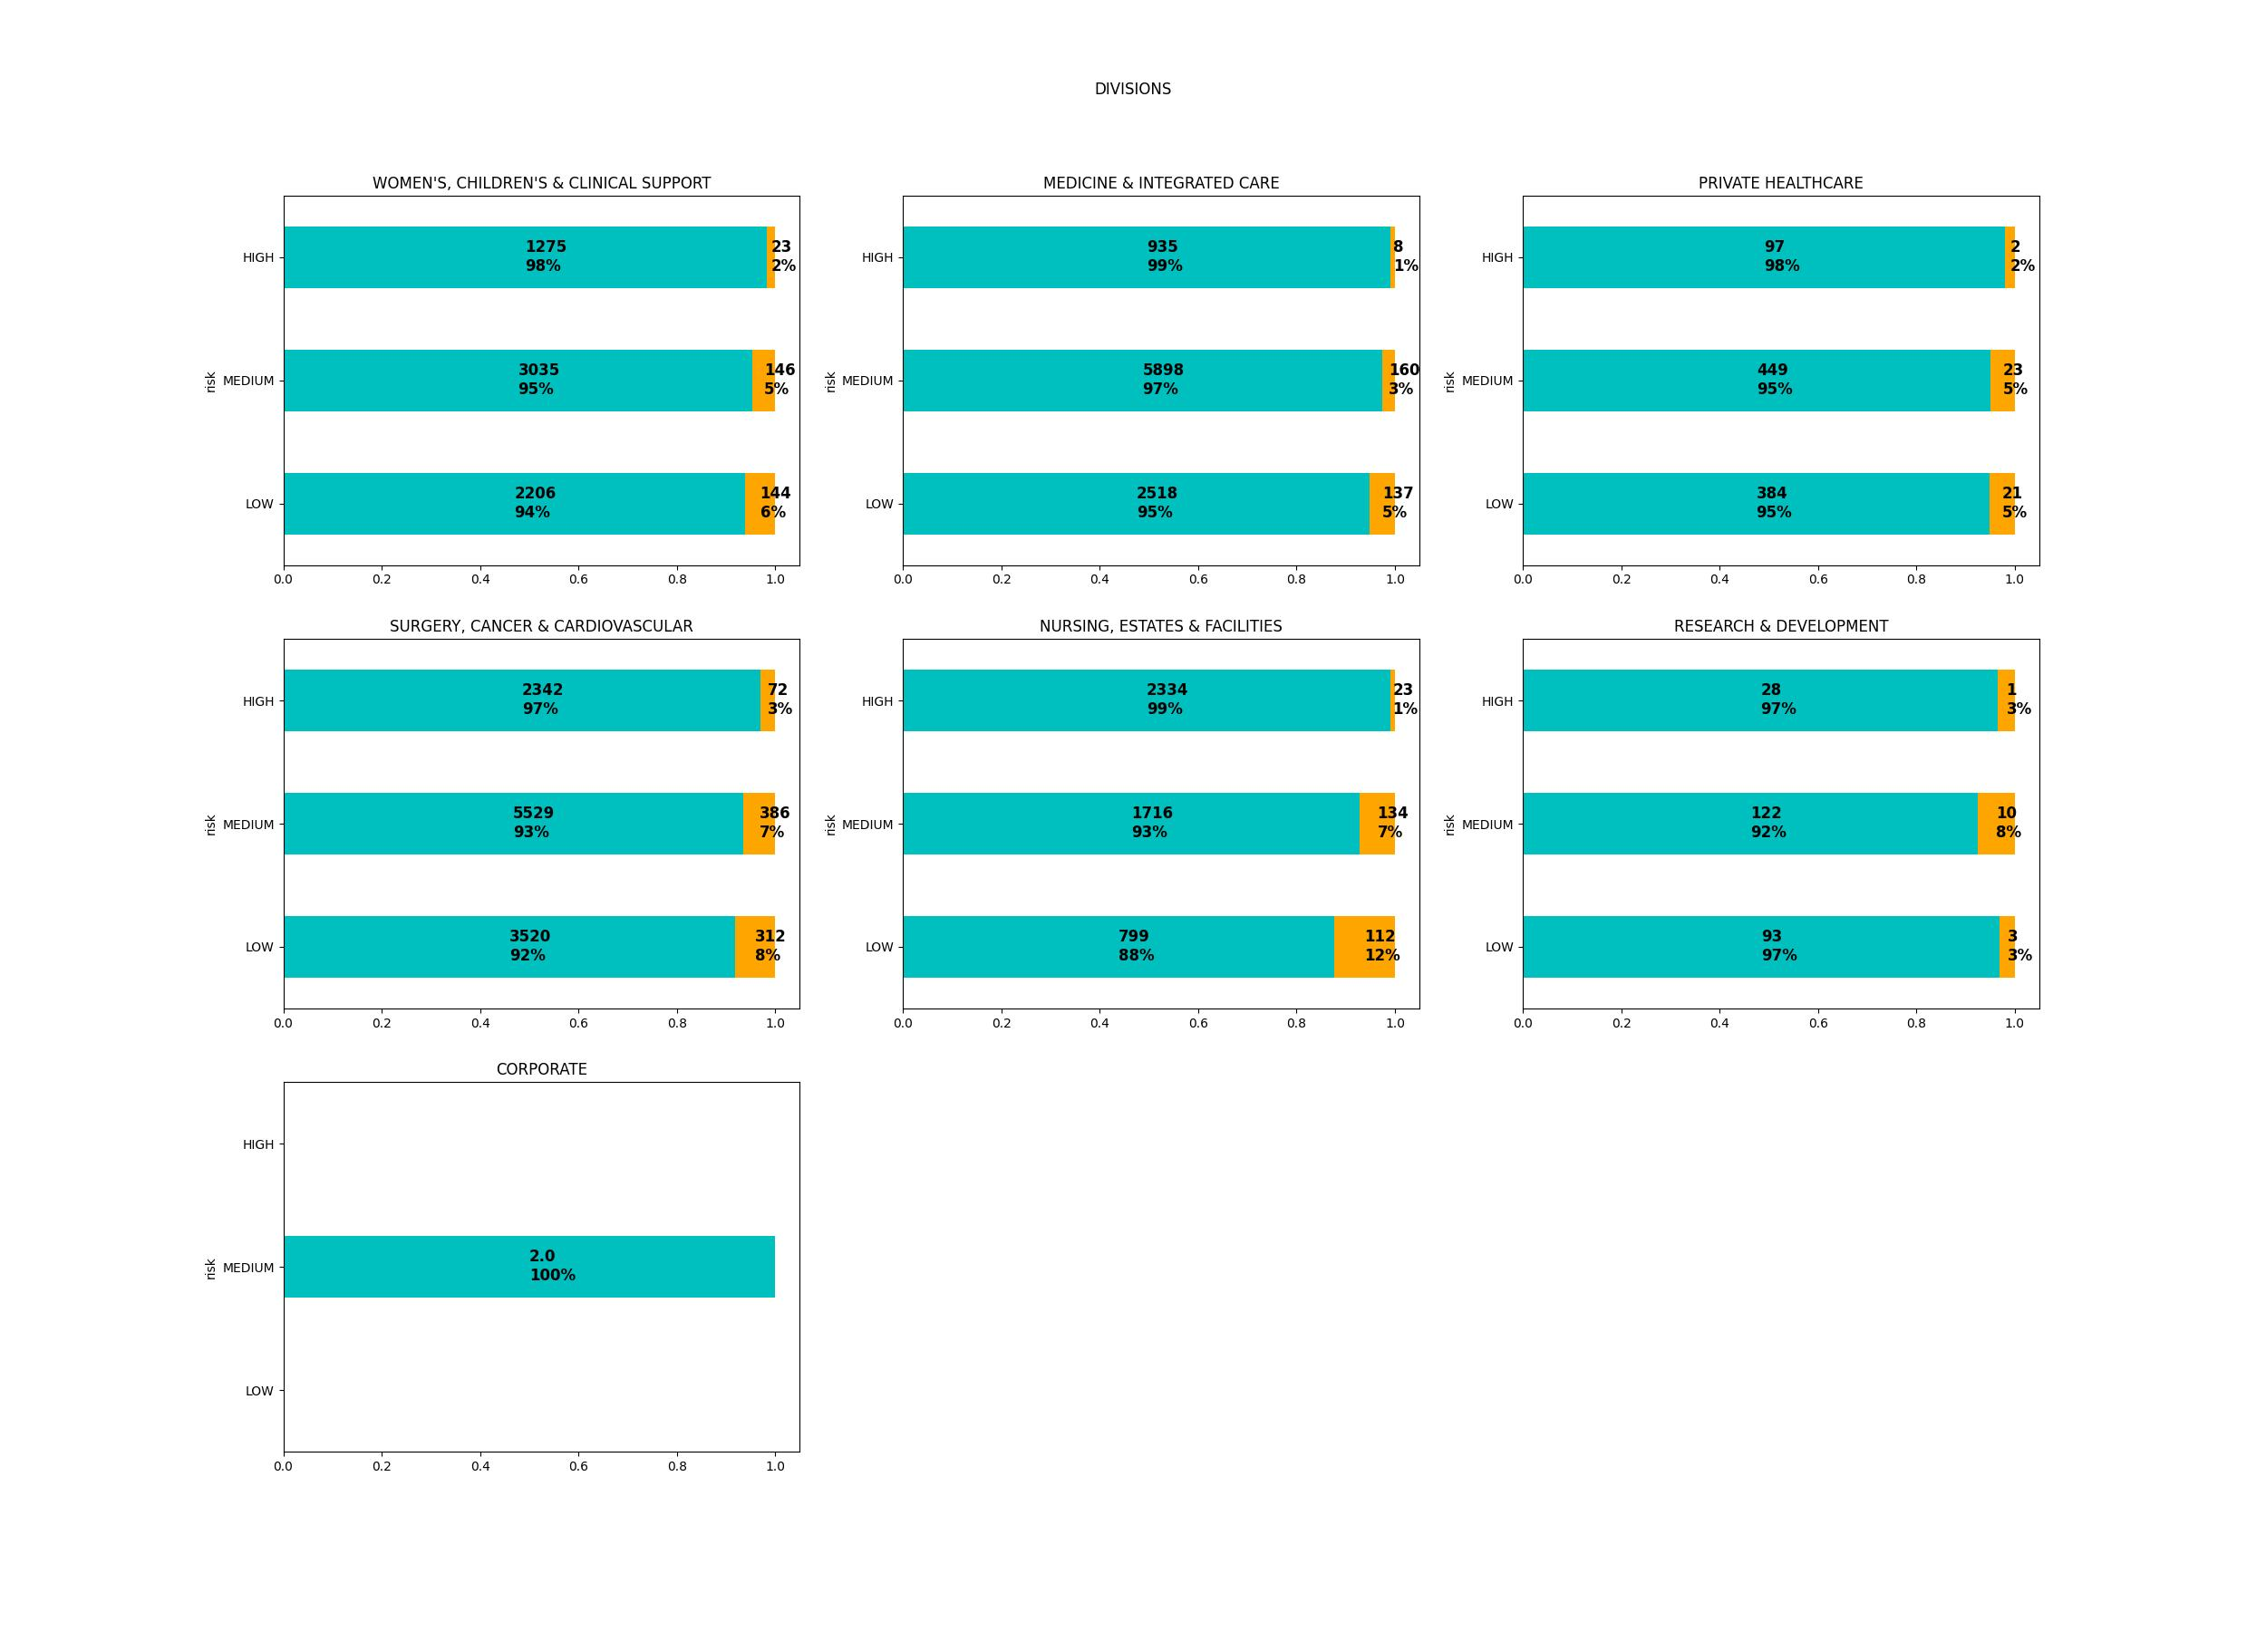
PM Monthly Compliance - Divisions

Slide 7
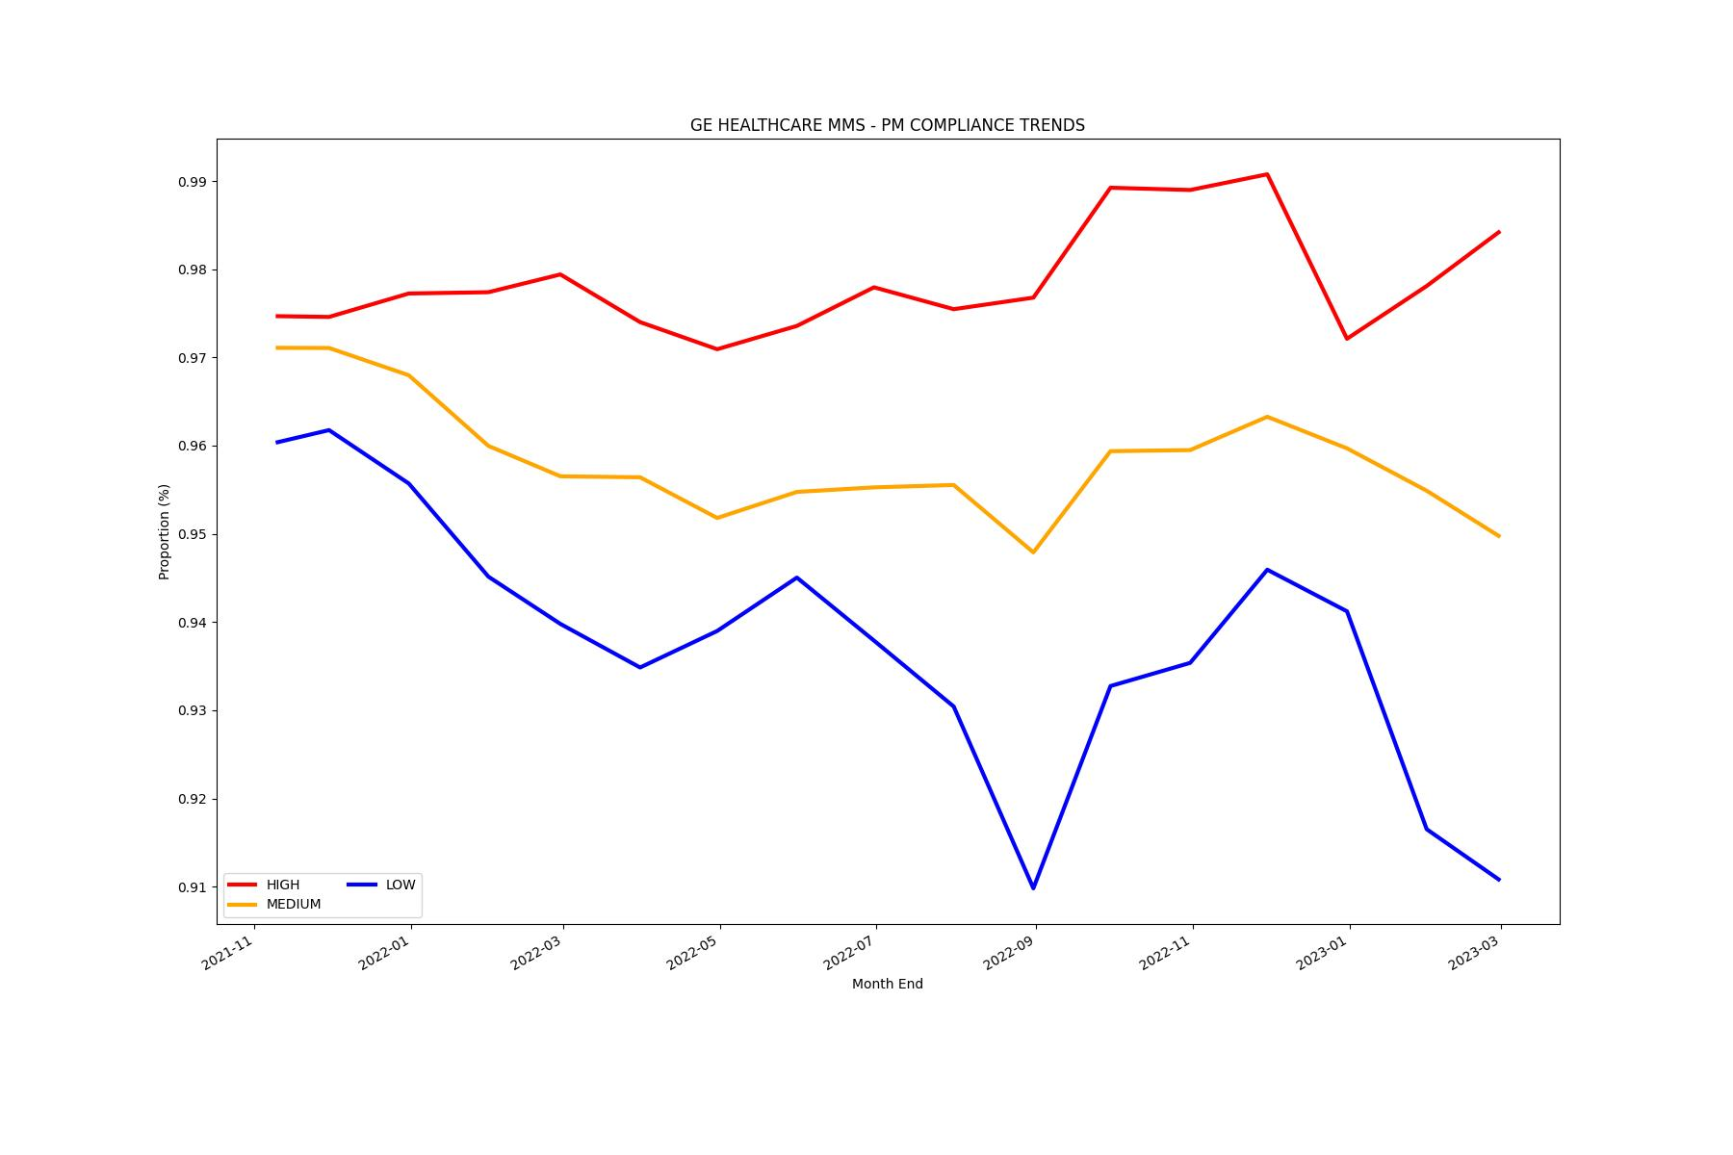
PM Monthly Compliance Trend

Slide 8
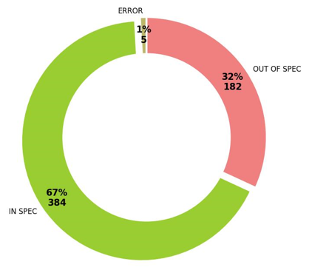
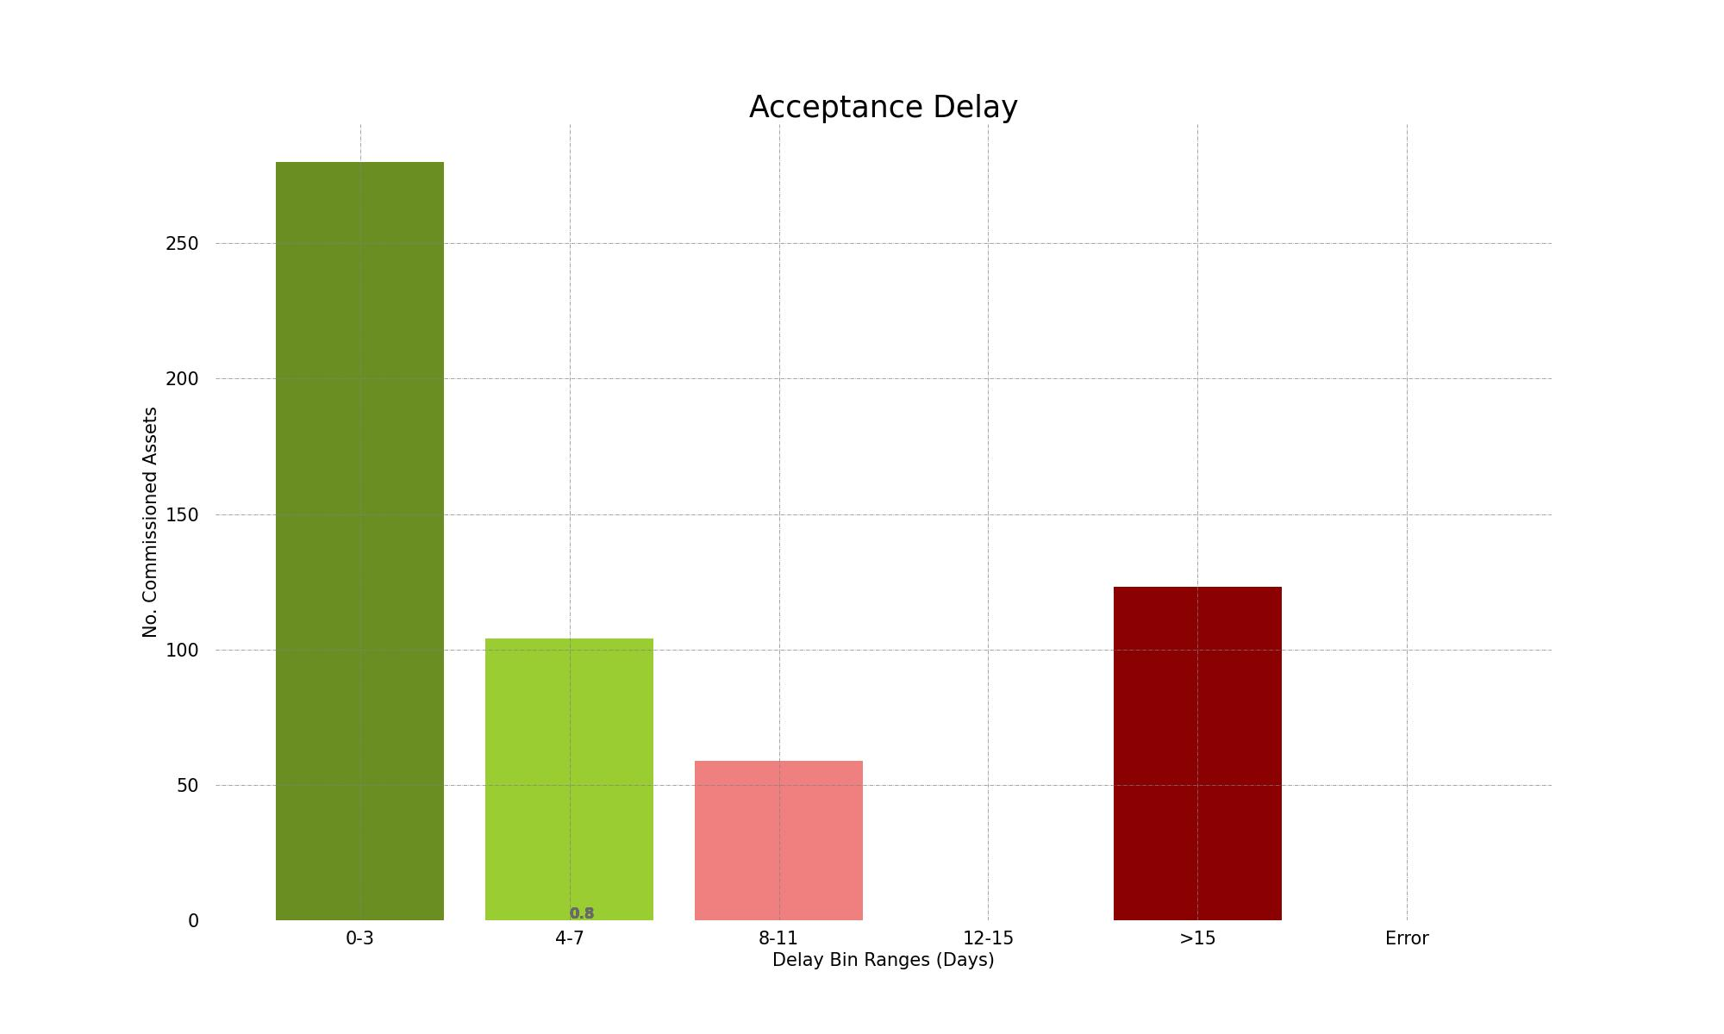
KPI Monthly Acceptance (requirement to be in use within <7 days of receipt)

Slide 9
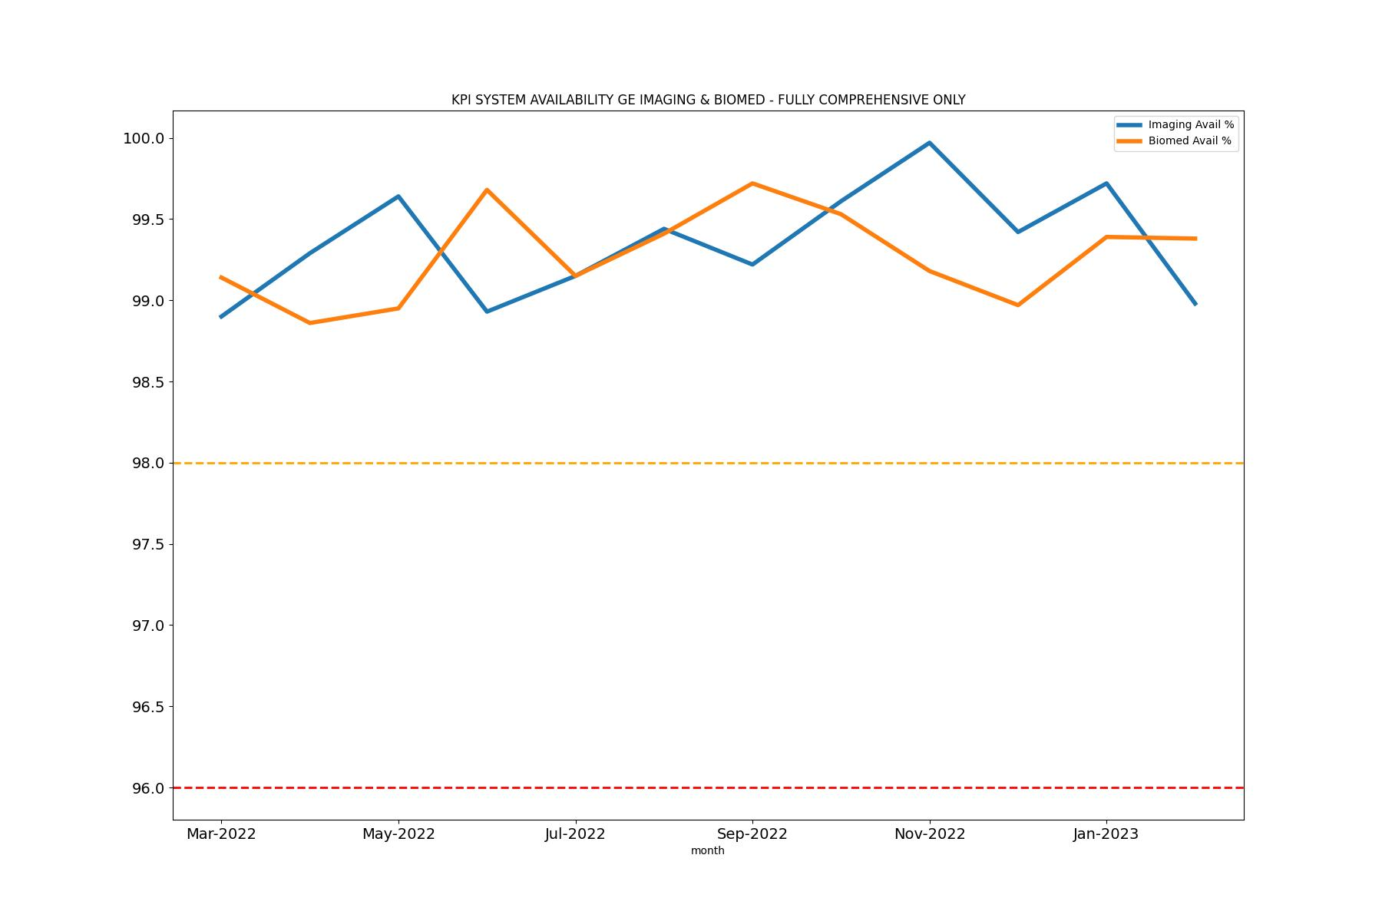
System Availability

Slide 10
End
Further questions please contact dean.evans@ge.com

