Slide 1
Miami bangor data

Slide 2
Data & vectorization #1
sampled 2799 utterances from the whole corpus (which contains 42910), that are candidates for code-switching, by filtering those with at least 2 languages (es, en, shared other, shared eng, shared es)
Using k=5 sliding window to create a single vector / instance, from a single utterance of the corpus.
2799 utterances were converted to 28059 vectors (using k=5): 4159 with cs – label 1, and 23900 w/o – label 0
Features: pos tag, ipa length, token length, is cognate (binary), ner tag, bow (word)

Slide 3
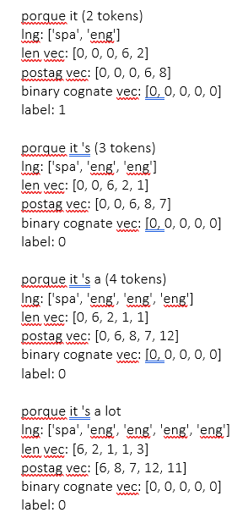
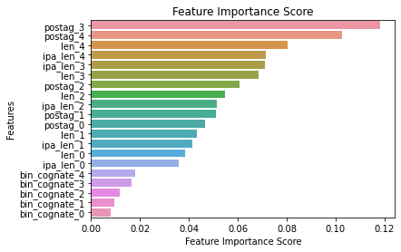
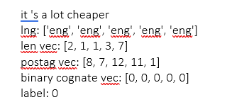
Data & vectorization #1
Vectorization #1:
Shorter vectors, i.e.: the beginning of each utterance are padded
example: The utterance is: “porque it 's a lot cheaper”
The vectors created ->
Classification: feature importance
Notes:
Pos tags

Slide 4
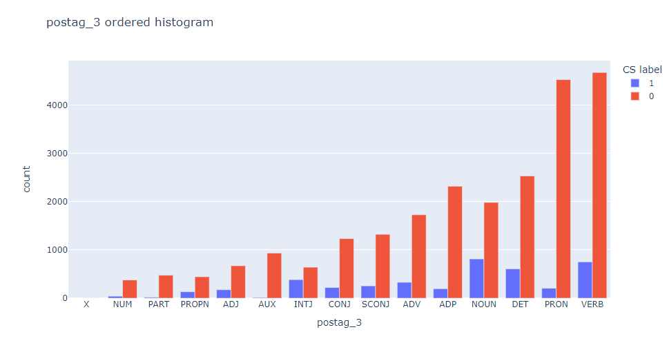
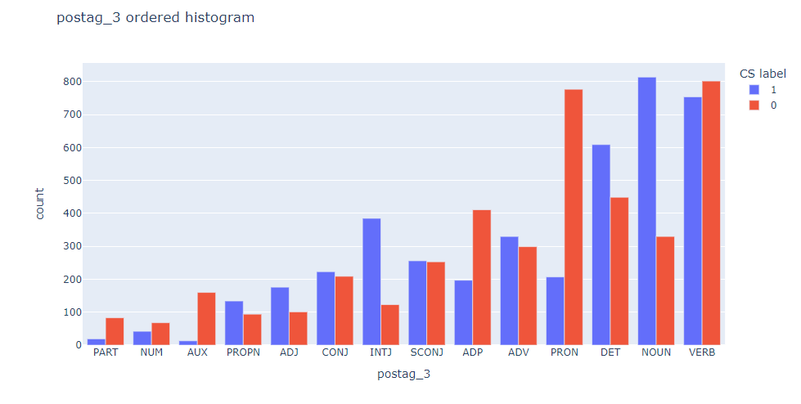
Data visualization – pos tags – 1 feature
Unbalanced case:
balanced case:

Slide 5
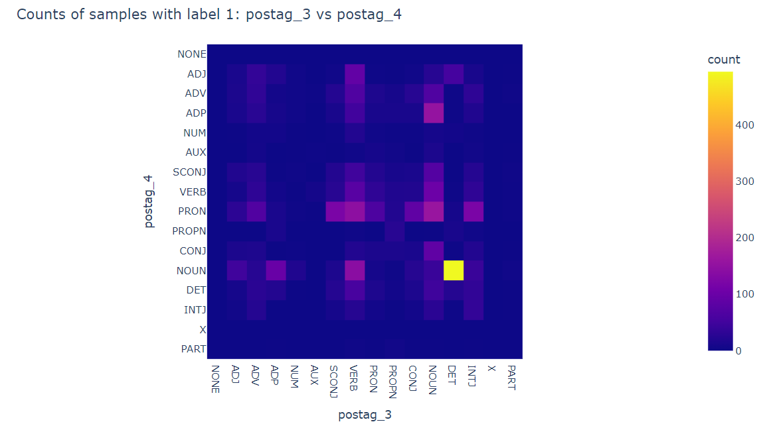
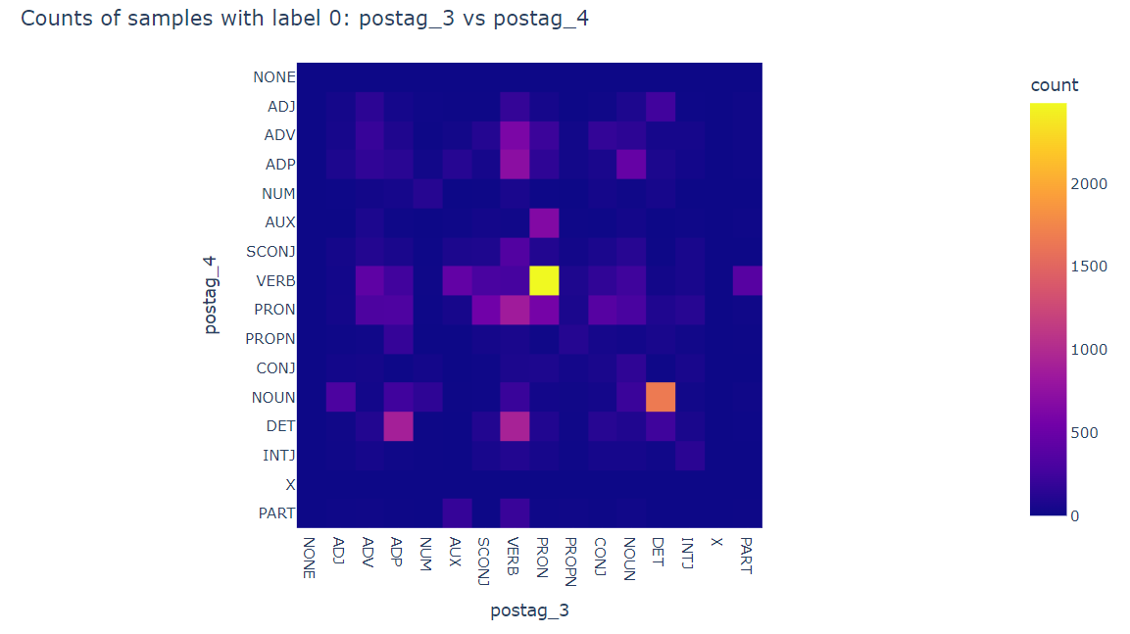
Data visualization – pos tags – 2 features
The figures below will show the distribution of samples (vectors) based on their pos tag 3 and 4, which are the most important features for the classification we performed.
Only unbalanced case
Notes:
Plots are for the unbalanced data – more 0’s

Slide 6
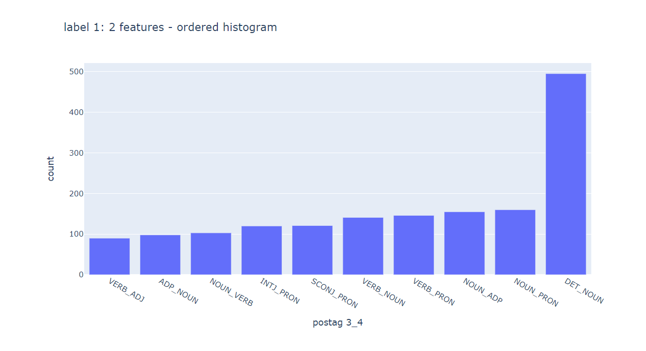
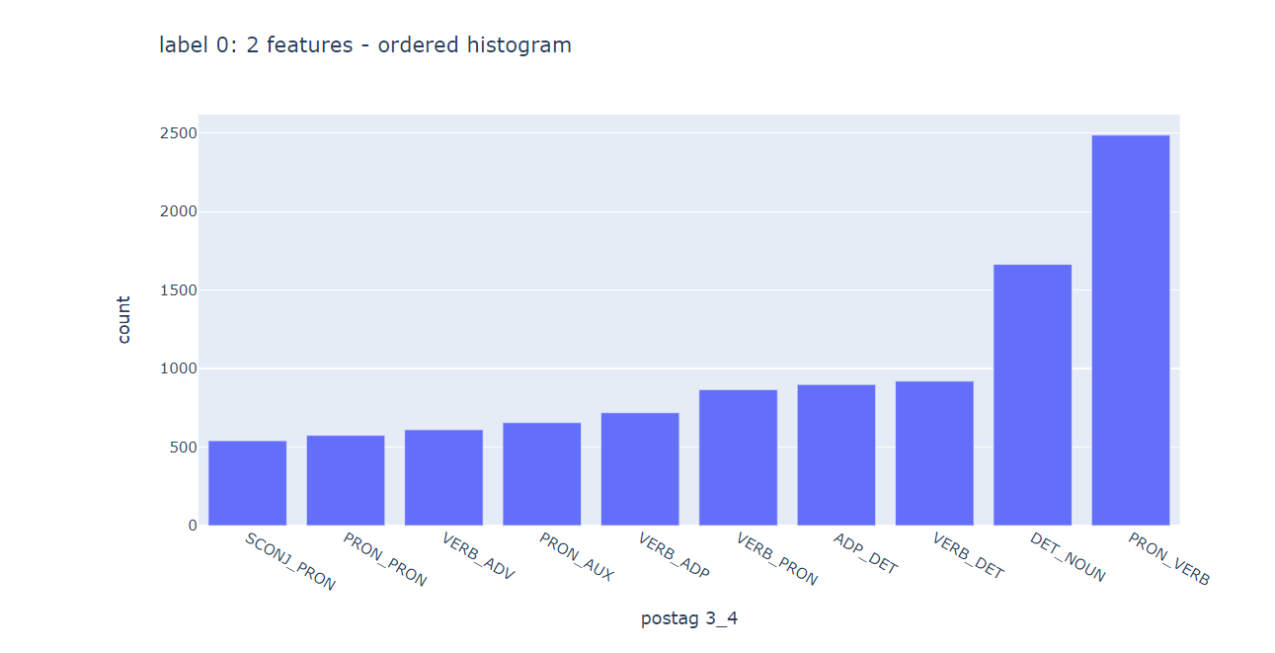
Data visualization – pos tags
Notes:
Still un balanced case

Slide 7
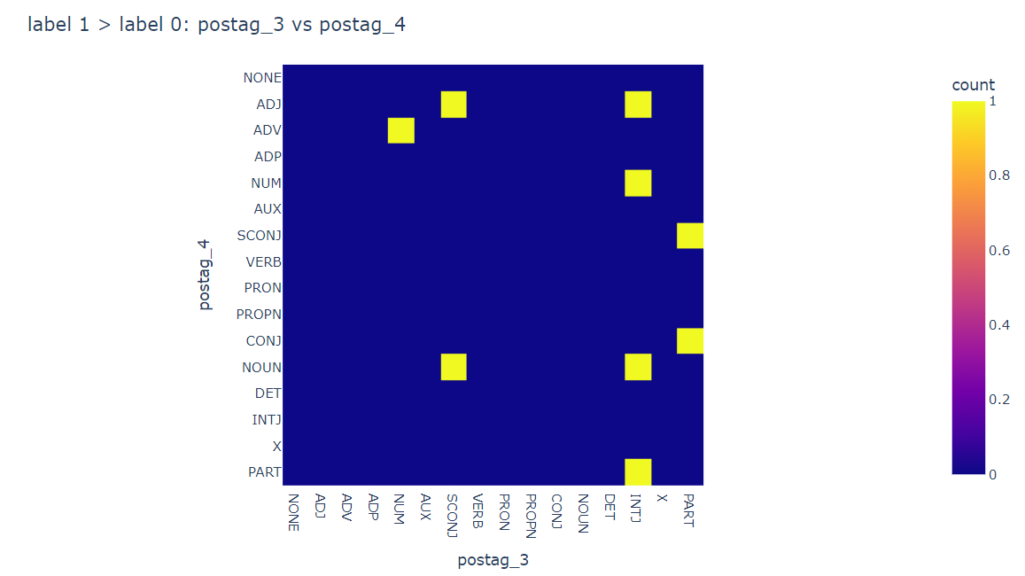
Data visualization – pos tags
even though there are only 14% 1’s, there are places where there are more “1”s:
Yellow means that there are more samples labeled with 1:
Specific cells are:
Pos3 – SCONJ and pos4 – Noun (15 1’s vs 10 0’s)
pos3 – INTJ and pos4 – Noun ( 42 1’s vs 23 0’s)
Examples of sentences per cell can be extracted

Slide 8
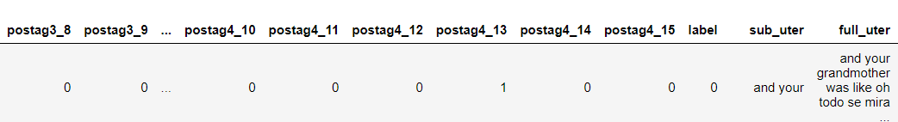
Data & vectorization #2
Vectorization #2:
This time, we look only on the pos tag 3 and 4 and we want to see which tags are important more to classification. We will use 1 hot encoding technique:
Still using K=5 as a sliding window size
There are 14 Tags:
{0: 'NONE', 1: 'X', 2: 'ADV', 3: 'ADJ', 4: 'NUM', 5: 'PRON', 6: 'AUX', 7: 'CONJ', 8: 'INTJ', 9: 'NOUN', 10: 'PART', 11: 'SCONJ', 12: 'ADP', 13: 'DET', 14: 'VERB', 15: 'PROPN'}
example: The utterance is:: “and your”:
The vectors created:
('and', 'eng', 'CONJ’), ('your', 'eng', 'DET’), postag vec: [0, 0, 0, 7, 13]
Notes:
The ‘NONE’ tag is just the padding we add to vectors smaller than k.
Example: so, for pos tag 4, only 13 (DET) is on, and for pos tag 3, only 7 (CONJ) is on.

Slide 9
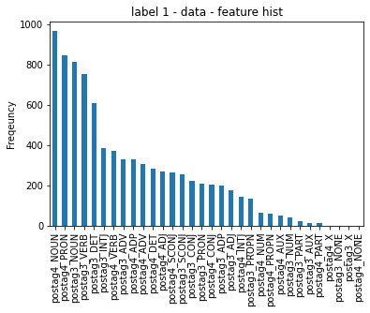
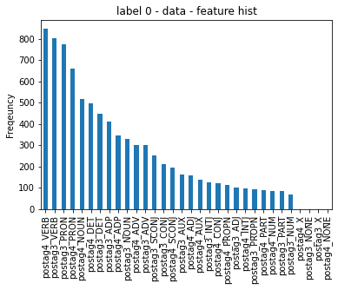
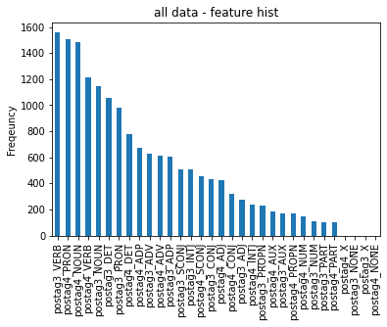
Data visualization – pos tags #2
Balanced data:

Slide 10
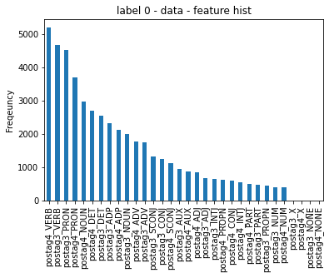
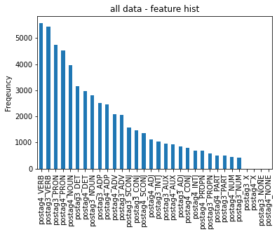
Data visualization – pos tags #2
UN - Balanced data:

Slide 11
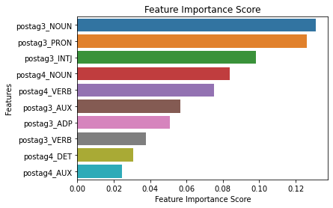
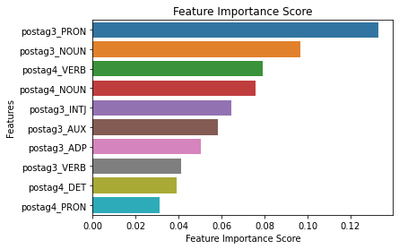
Data & vectorization #2
classification #2:
Top: unbalanced case
Bottom: balanced case

