Slide 1
Computer Vision-Driven Two-Stage Instance Segmentation of Post-Harvest Surface Defects in Apple and Tomato Using YOLO26
CIPHER | Artificial Intelligence 2 | AM3 | Mapúa University
Ralph Kevin G. Morales Alexander Jann P. Espia Deangelo James P. Largueza Niel Francis M. Arligue
Adviser: Dr. Lysa V. Comia | Final defense, October 2026

Slide 2
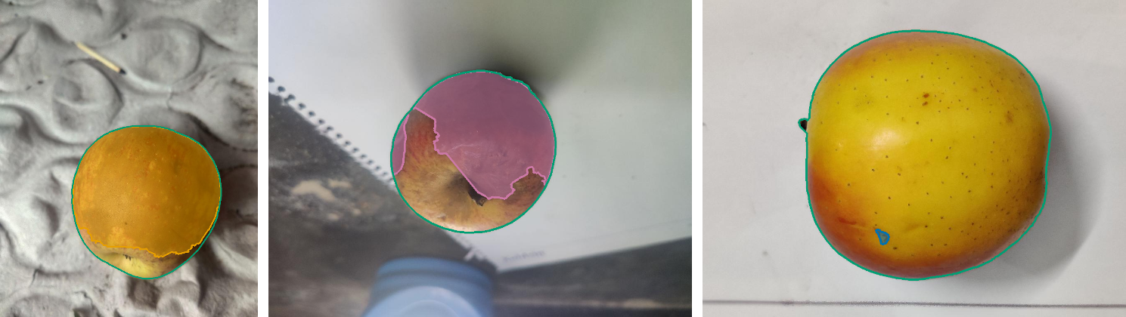
The problem
• Post-harvest sorting depends on visible skin defects
• Public grading sets such as AFruitDB label the whole image with a grade
• A grade does not say where the defect is or how big it is
• Goal: outline every visible defect at pixel level and name its type
• Scope: apple and tomato photos in RGB
Team masks: orange bruise or discoloration, pink rot mold or decay, blue surface damage, green whole fruit
CIPHER | AI2 AM3 | Fruit Defect Segmentation
2

Slide 3
Why instance segmentation
Classification
Detection
Instance segmentation
One label per image
Says grade 3 but not where
One box per object
Box around a bruise still covers healthy skin
One mask per object
Exact defect pixels so area can be measured
The professor's requirement: pixel-level precision. Our output is one mask per defect region.
CIPHER | AI2 AM3 | Fruit Defect Segmentation
3

Slide 4
Dataset sources
Source | Train files | License or owner
AFruitDB grading photos [1] | 986 | Mendeley Data, cited
Lab2Wild apple rot set [9] | 843 | Kaggle CC BY-NC-SA 4.0
Photos taken by the team | 281 | CIPHER
Total apple training files | 2,110 | 726 capture groups
AFruitDB tomato photos [1] | 1,313 | Mendeley Data, cited
• Original AFruitDB grades are image labels only
• All pixel masks were drawn by the team
• Roboflow export adds up to 3 variants per photo
• So 2,110 files are not 2,110 distinct photos
• Tomato: 1,313 files from 459 capture groups, same process
CIPHER | AI2 AM3 | Fruit Defect Segmentation
4

Slide 5
Defect classes and annotation
Class | Looks like | Train imgs | Train masks
bruise_discoloration | Smooth dark or discolored patch | 607 | 709
rot_mold_decay | Soft collapsed or moldy tissue | 620 | 697
surface_damage | Cut crack scar or dry spot | 547 | 873
• Polygons drawn by the team in Roboflow
• Every proposal reviewed and corrected by a member
• Pilots began with five classes then merged rare ones into three
• Excluded: shadows, glare, stems, speckles, normal ripening color
• Every class has more than 300 training images
CIPHER | AI2 AM3 | Fruit Defect Segmentation
5

Slide 6
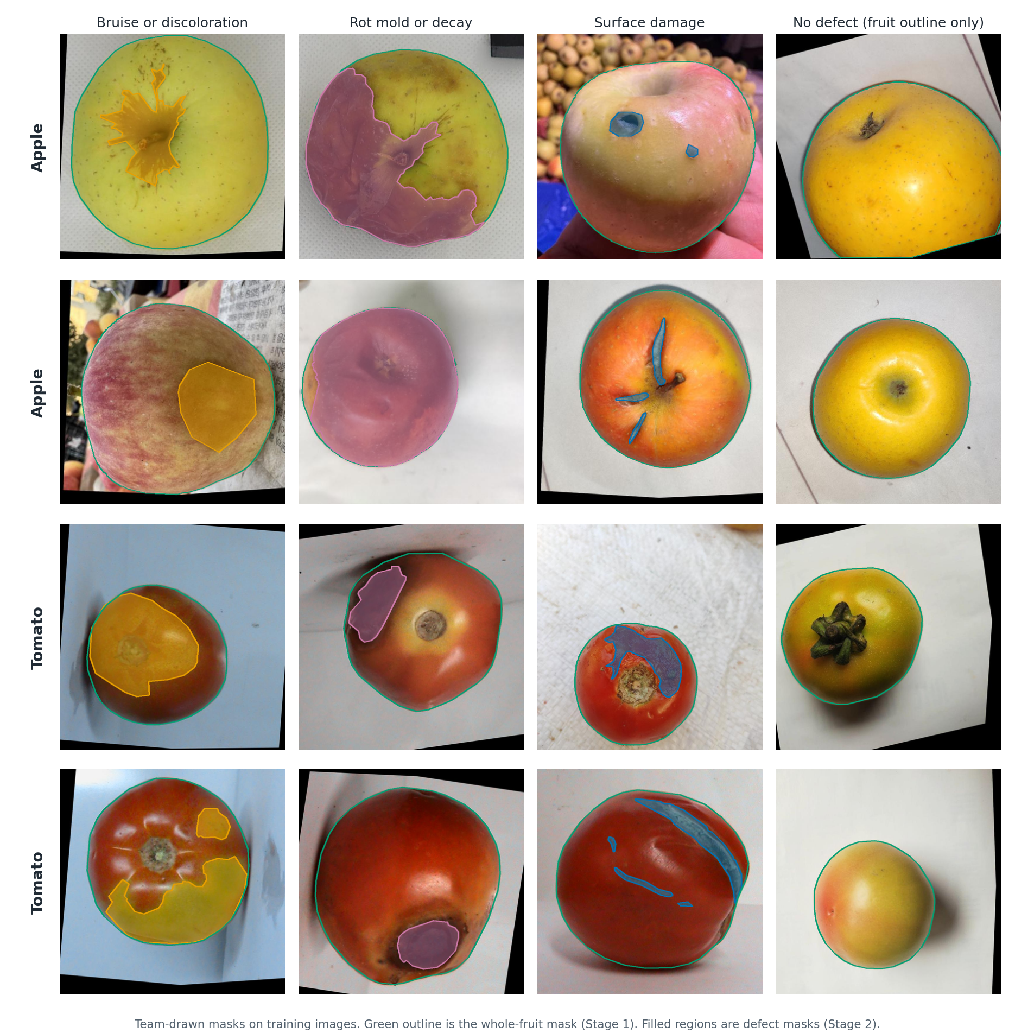
Gallery of labeled defects
CIPHER | AI2 AM3 | Fruit Defect Segmentation
6

Slide 7
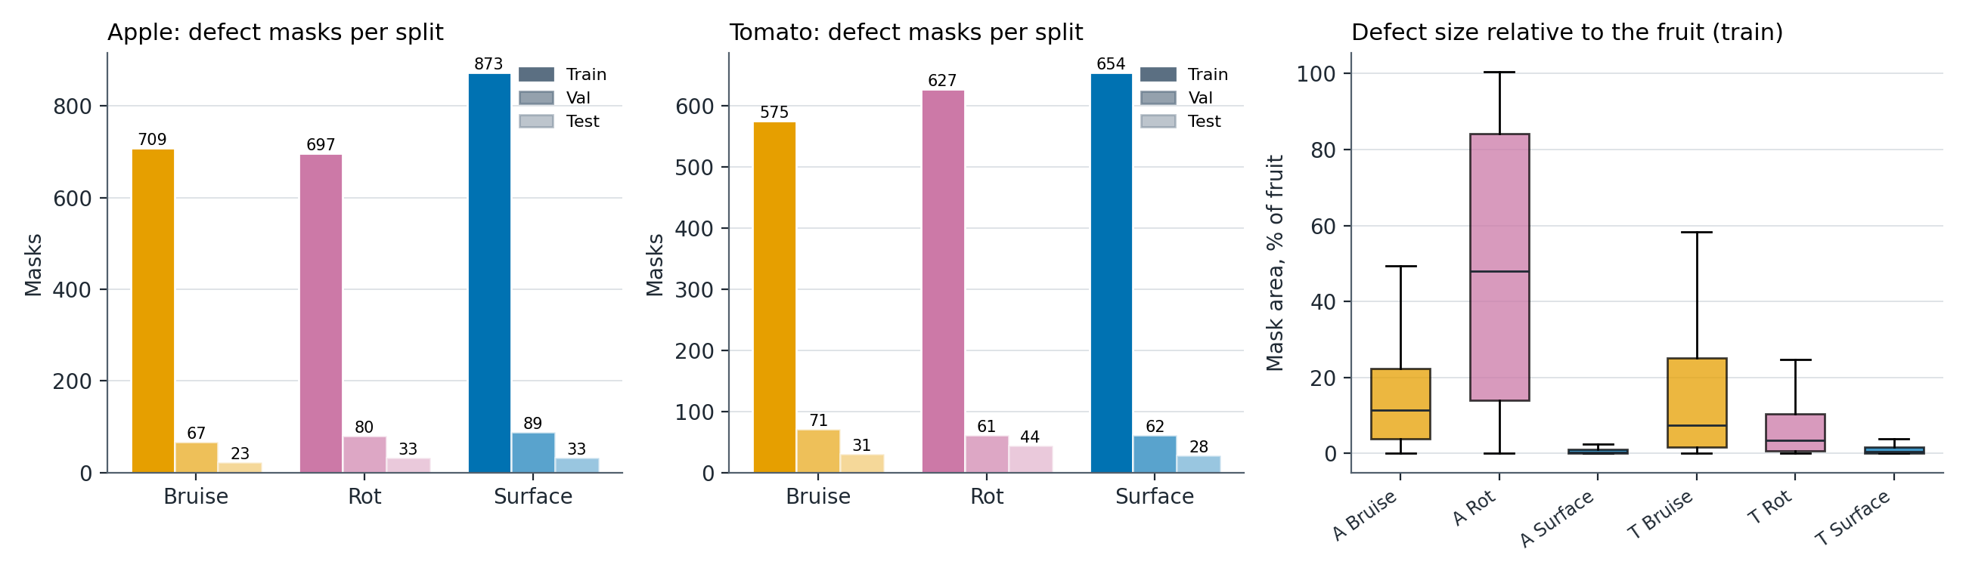
Class balance and defect size
• Every defect class has more than 570 training masks on each fruit
• Median defect size: apple rot 48% of the fruit, tomato rot 3.5%, surface damage under 0.5% on both
• Small masks are harder to segment, which matches the weaker tomato and surface damage scores
CIPHER | AI2 AM3 | Fruit Defect Segmentation
7

Slide 8
Splits and leakage control
Split | Images | Capture groups | Use
Train | 2,110 | 726 | Learning
Validation | 215 | 210 | Checkpoint choice
Test | 79 | 75 | Final check once
Reserve | 63 | 61 | Never used
• Split by capture group so variants of one photo stay together
• Exact pixel hashes checked across splits: no exact copies
• 545 training images have no defect and act as negatives
• Augmentation only on training images
• Test scores were never used to pick settings
CIPHER | AI2 AM3 | Fruit Defect Segmentation
8

Slide 9
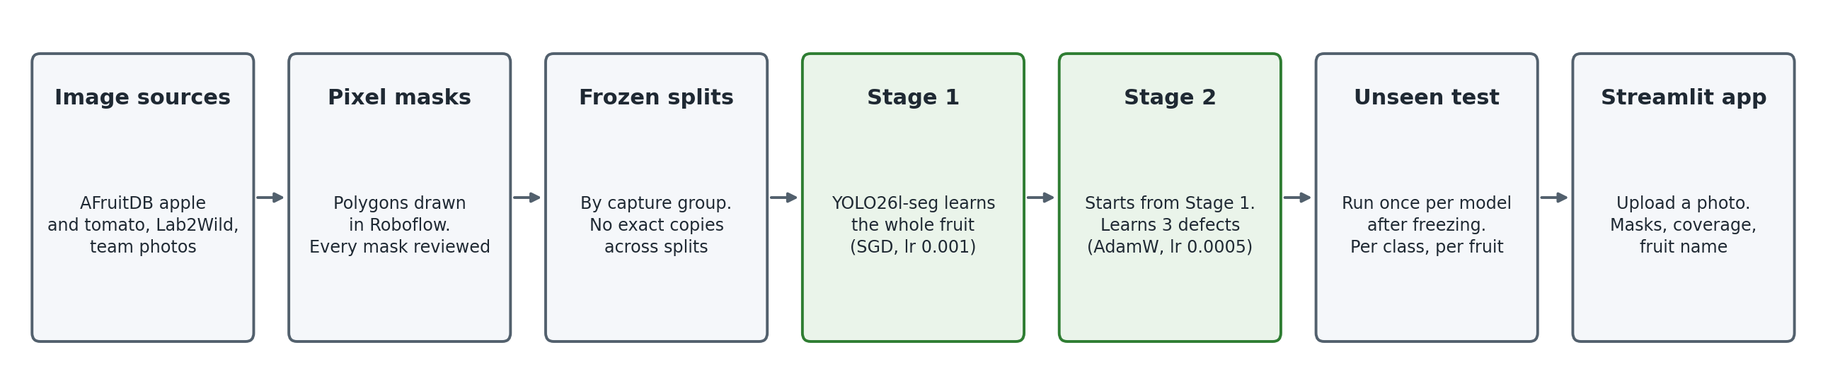
Project pipeline
CIPHER | AI2 AM3 | Fruit Defect Segmentation
9

Slide 10
Two-stage method
Pretrained
YOLO26l-seg
Stage 1
whole fruit mask
Stage 1
best.pt
Stage 2
3 defect classes
App
fruit + defects
• Stage 1 learns what an apple looks like on every training image, damaged or not
• Stage 2 starts from Stage 1 weights, rebuilds the output head for 3 defects, new AdamW optimizer
• Shared backbone and neck weights carry over so Stage 2 does not start from scratch
• In the app Stage 1 also gives the fruit area for defect coverage
CIPHER | AI2 AM3 | Fruit Defect Segmentation
10

Slide 11
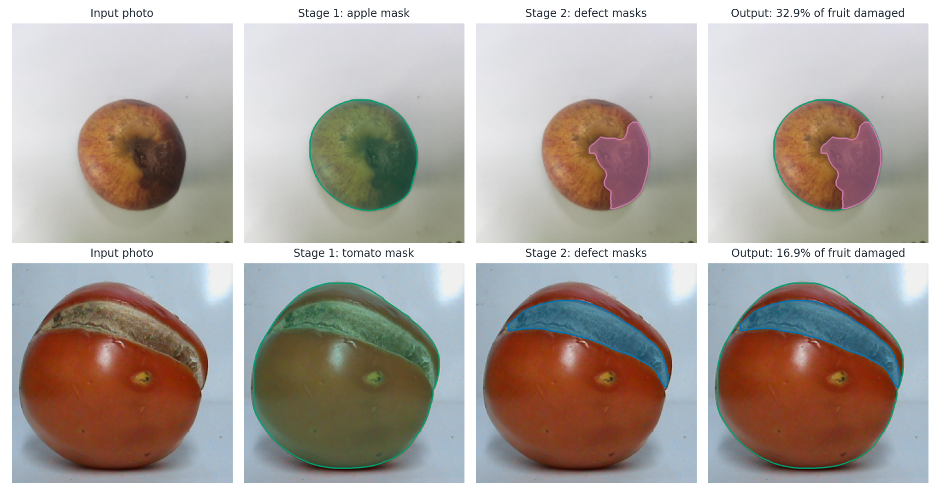
Two stages in action
CIPHER | AI2 AM3 | Fruit Defect Segmentation
11

Slide 12
Training settings
Setting | Stage 1 (Run 21) | Stage 2 (Run 22)
Start weights | yolo26l-seg.pt | Run 21 best.pt
Classes | apple | 3 defects
Optimizer / lr0 | SGD / 0.001 | AdamW / 0.0005
Max epochs / patience | 100 / 10 | 300 / 30
Image size / batch | 864 / 56 | 864 / 56
Schedule | cosine, 3 warmup | cosine, 3 warmup
Epochs run | 34 | 124
• Augment: flips, 10 degree rotation, small shift, scale and color
• No Mosaic, MixUp or Copy-Paste to keep defect texture real
• Ultralytics 8.4.126, AMP, seed 0
• NVIDIA A100 80 GB on Colab
CIPHER | AI2 AM3 | Fruit Defect Segmentation
12

Slide 13
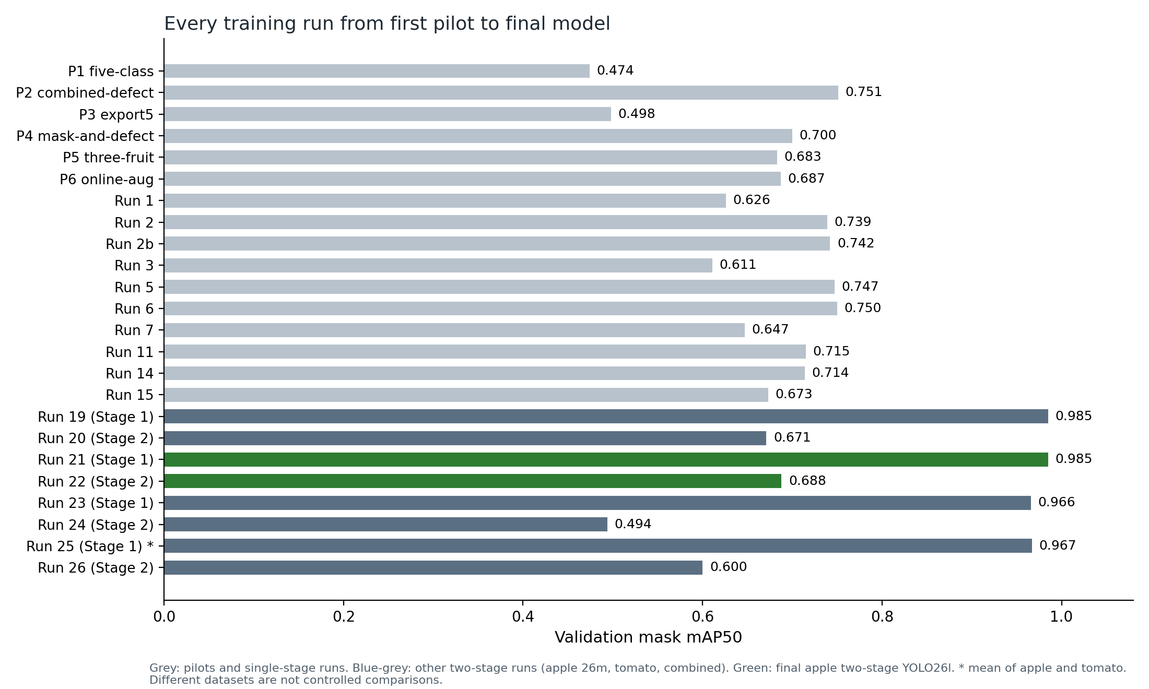
Run history: 24 runs
CIPHER | AI2 AM3 | Fruit Defect Segmentation
13

Slide 14
What changed between runs
Run | Data | Model | Change | mAP50 | mAP50-95
P1 | Apple 5 classes, 252 train | 26n | First pilot | 0.474 | 0.310
P2 | Apple + 1 merged defect | 26n | Merged defects | 0.751 | 0.523
P5 | Apple mango tomato | 26s | Three fruits | 0.683 | 0.526
Run 5 | Apple tomato + members | 26s | Member photos | 0.747 | 0.622
Run 11 | Apple tomato 3,423 train | 26m | Bigger set and model | 0.715 | 0.598
Run 14 | Apple 4 classes | 26m | Apple only, single stage | 0.714 | 0.558
Run 20 | Apple defects | 26m | Two-stage | 0.671 | 0.450
Run 22 | Apple defects | 26l | Two-stage, large | 0.688 | 0.457
Run 24 | Tomato defects | 26l | Two-stage, tomato | 0.494 | 0.295
Run 26 | Apple + tomato defects | 26l | One model, both fruits | 0.600 | 0.374
Joint runs average in the easy whole-fruit classes. Runs 20 and 22 report the three defect classes only so their lower number does not mean a worse model.
CIPHER | AI2 AM3 | Fruit Defect Segmentation
14

Slide 15
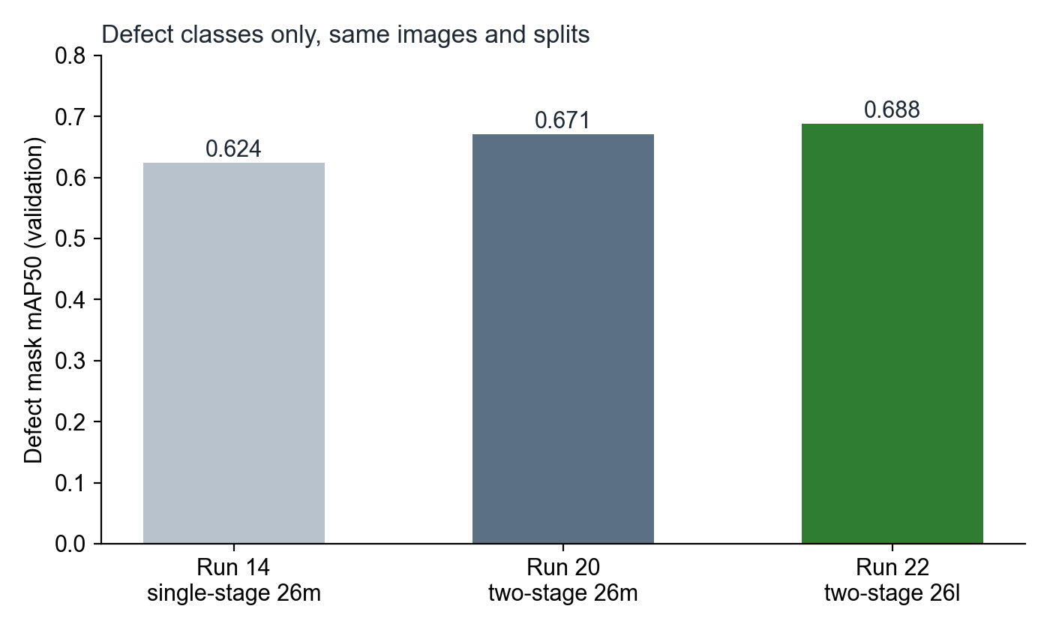
Same data, defects only
• Runs 14, 20, 22 use the same images and splits
• Average defect mAP50 rose from 0.624 to 0.688
• These runs also differ in size, optimizer and image size
• So the gain is not proof that two stages alone helped
CIPHER | AI2 AM3 | Fruit Defect Segmentation
15

Slide 16
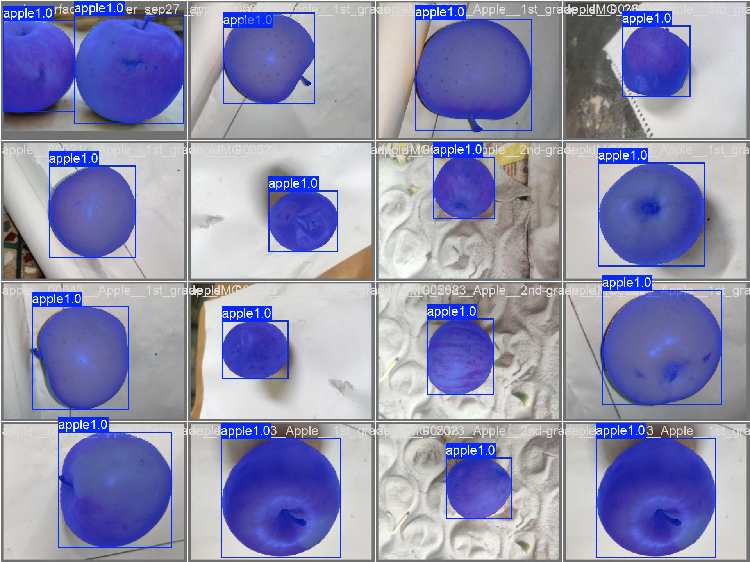
Stage 1 result: whole apple
Validation (215 images) | Value
Mask precision | 100.0%
Mask recall | 98.6%
Mask mAP50 | 98.5%
Mask mAP50-95 | 98.5%
CIPHER | AI2 AM3 | Fruit Defect Segmentation
16

Slide 17
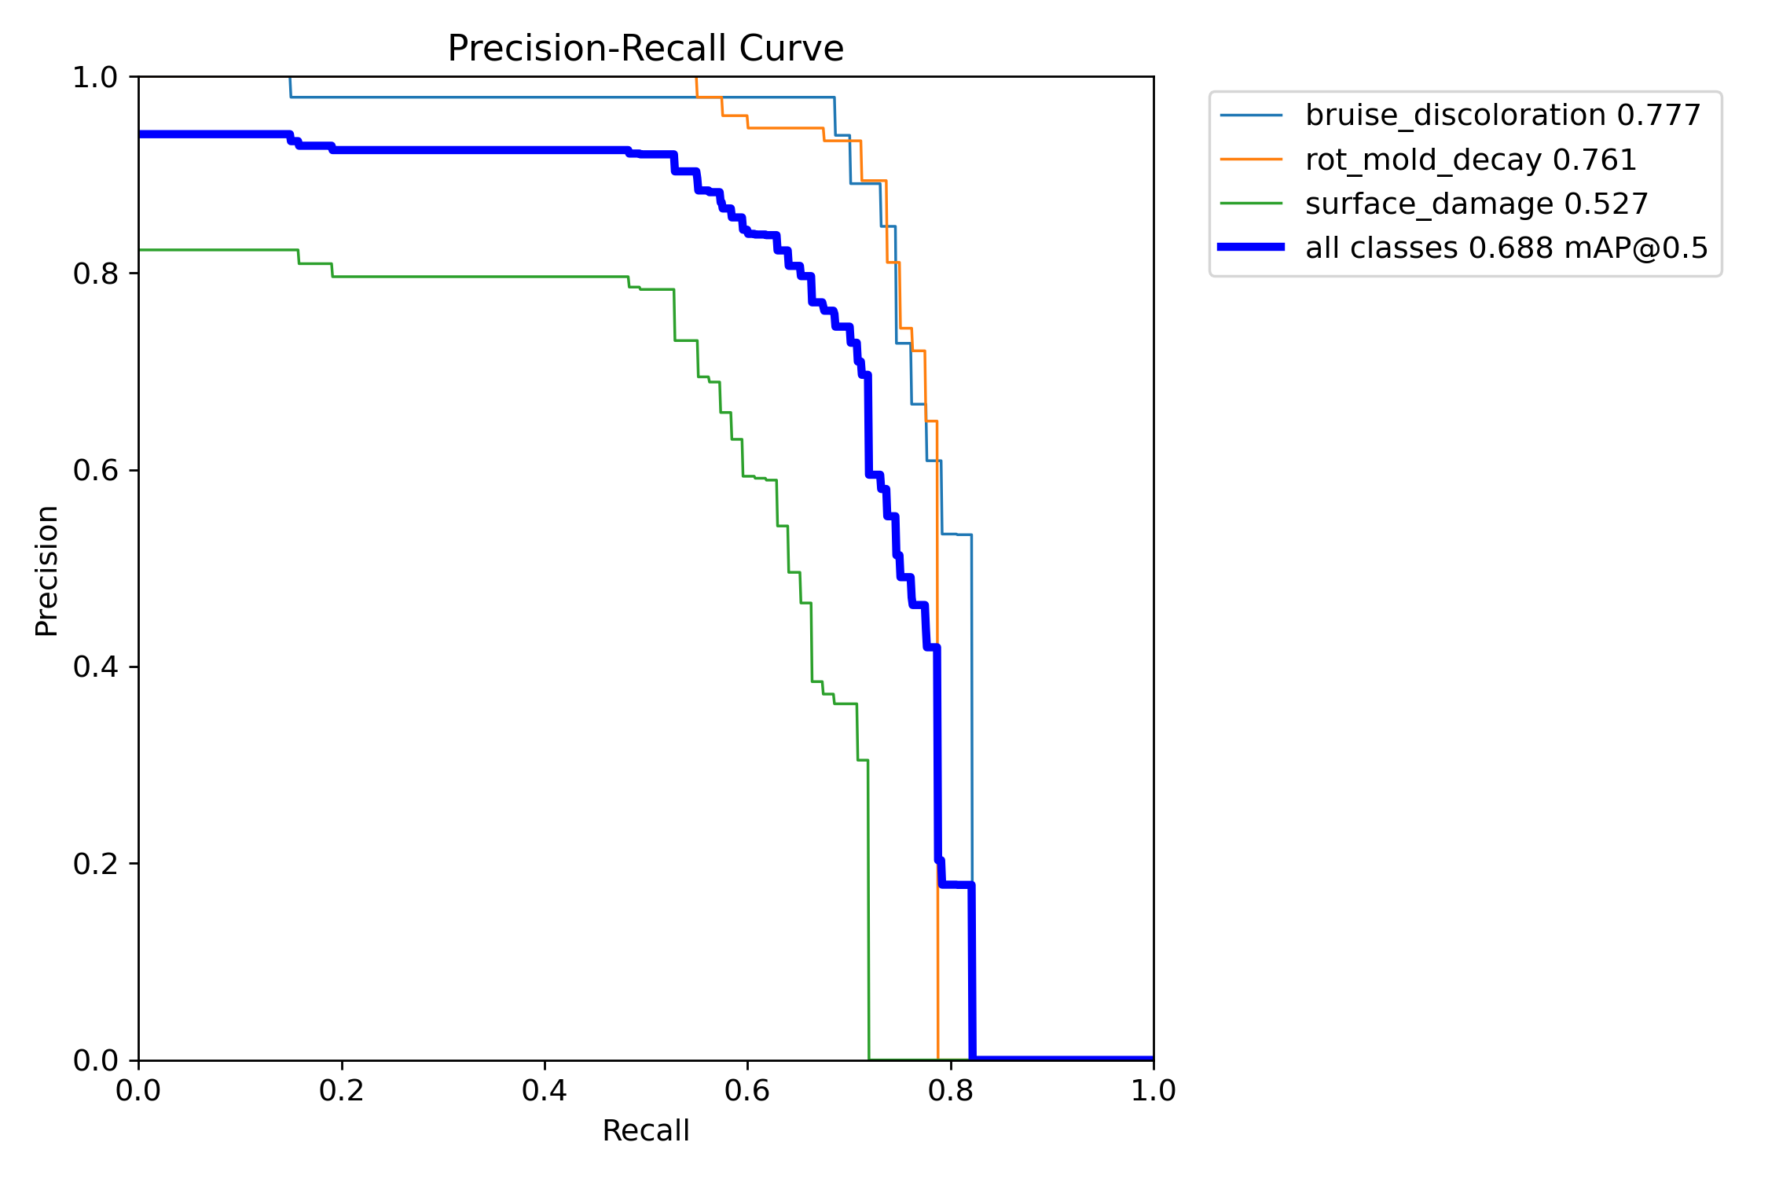
Stage 2 result: defects on validation
Class | Precision | Recall | mAP50 | mAP50-95
Bruise | 0.847 | 0.744 | 0.777 | 0.526
Rot | 0.931 | 0.713 | 0.761 | 0.591
Surface | 0.648 | 0.584 | 0.527 | 0.253
All | 0.809 | 0.680 | 0.688 | 0.457
CIPHER | AI2 AM3 | Fruit Defect Segmentation
17

Slide 18
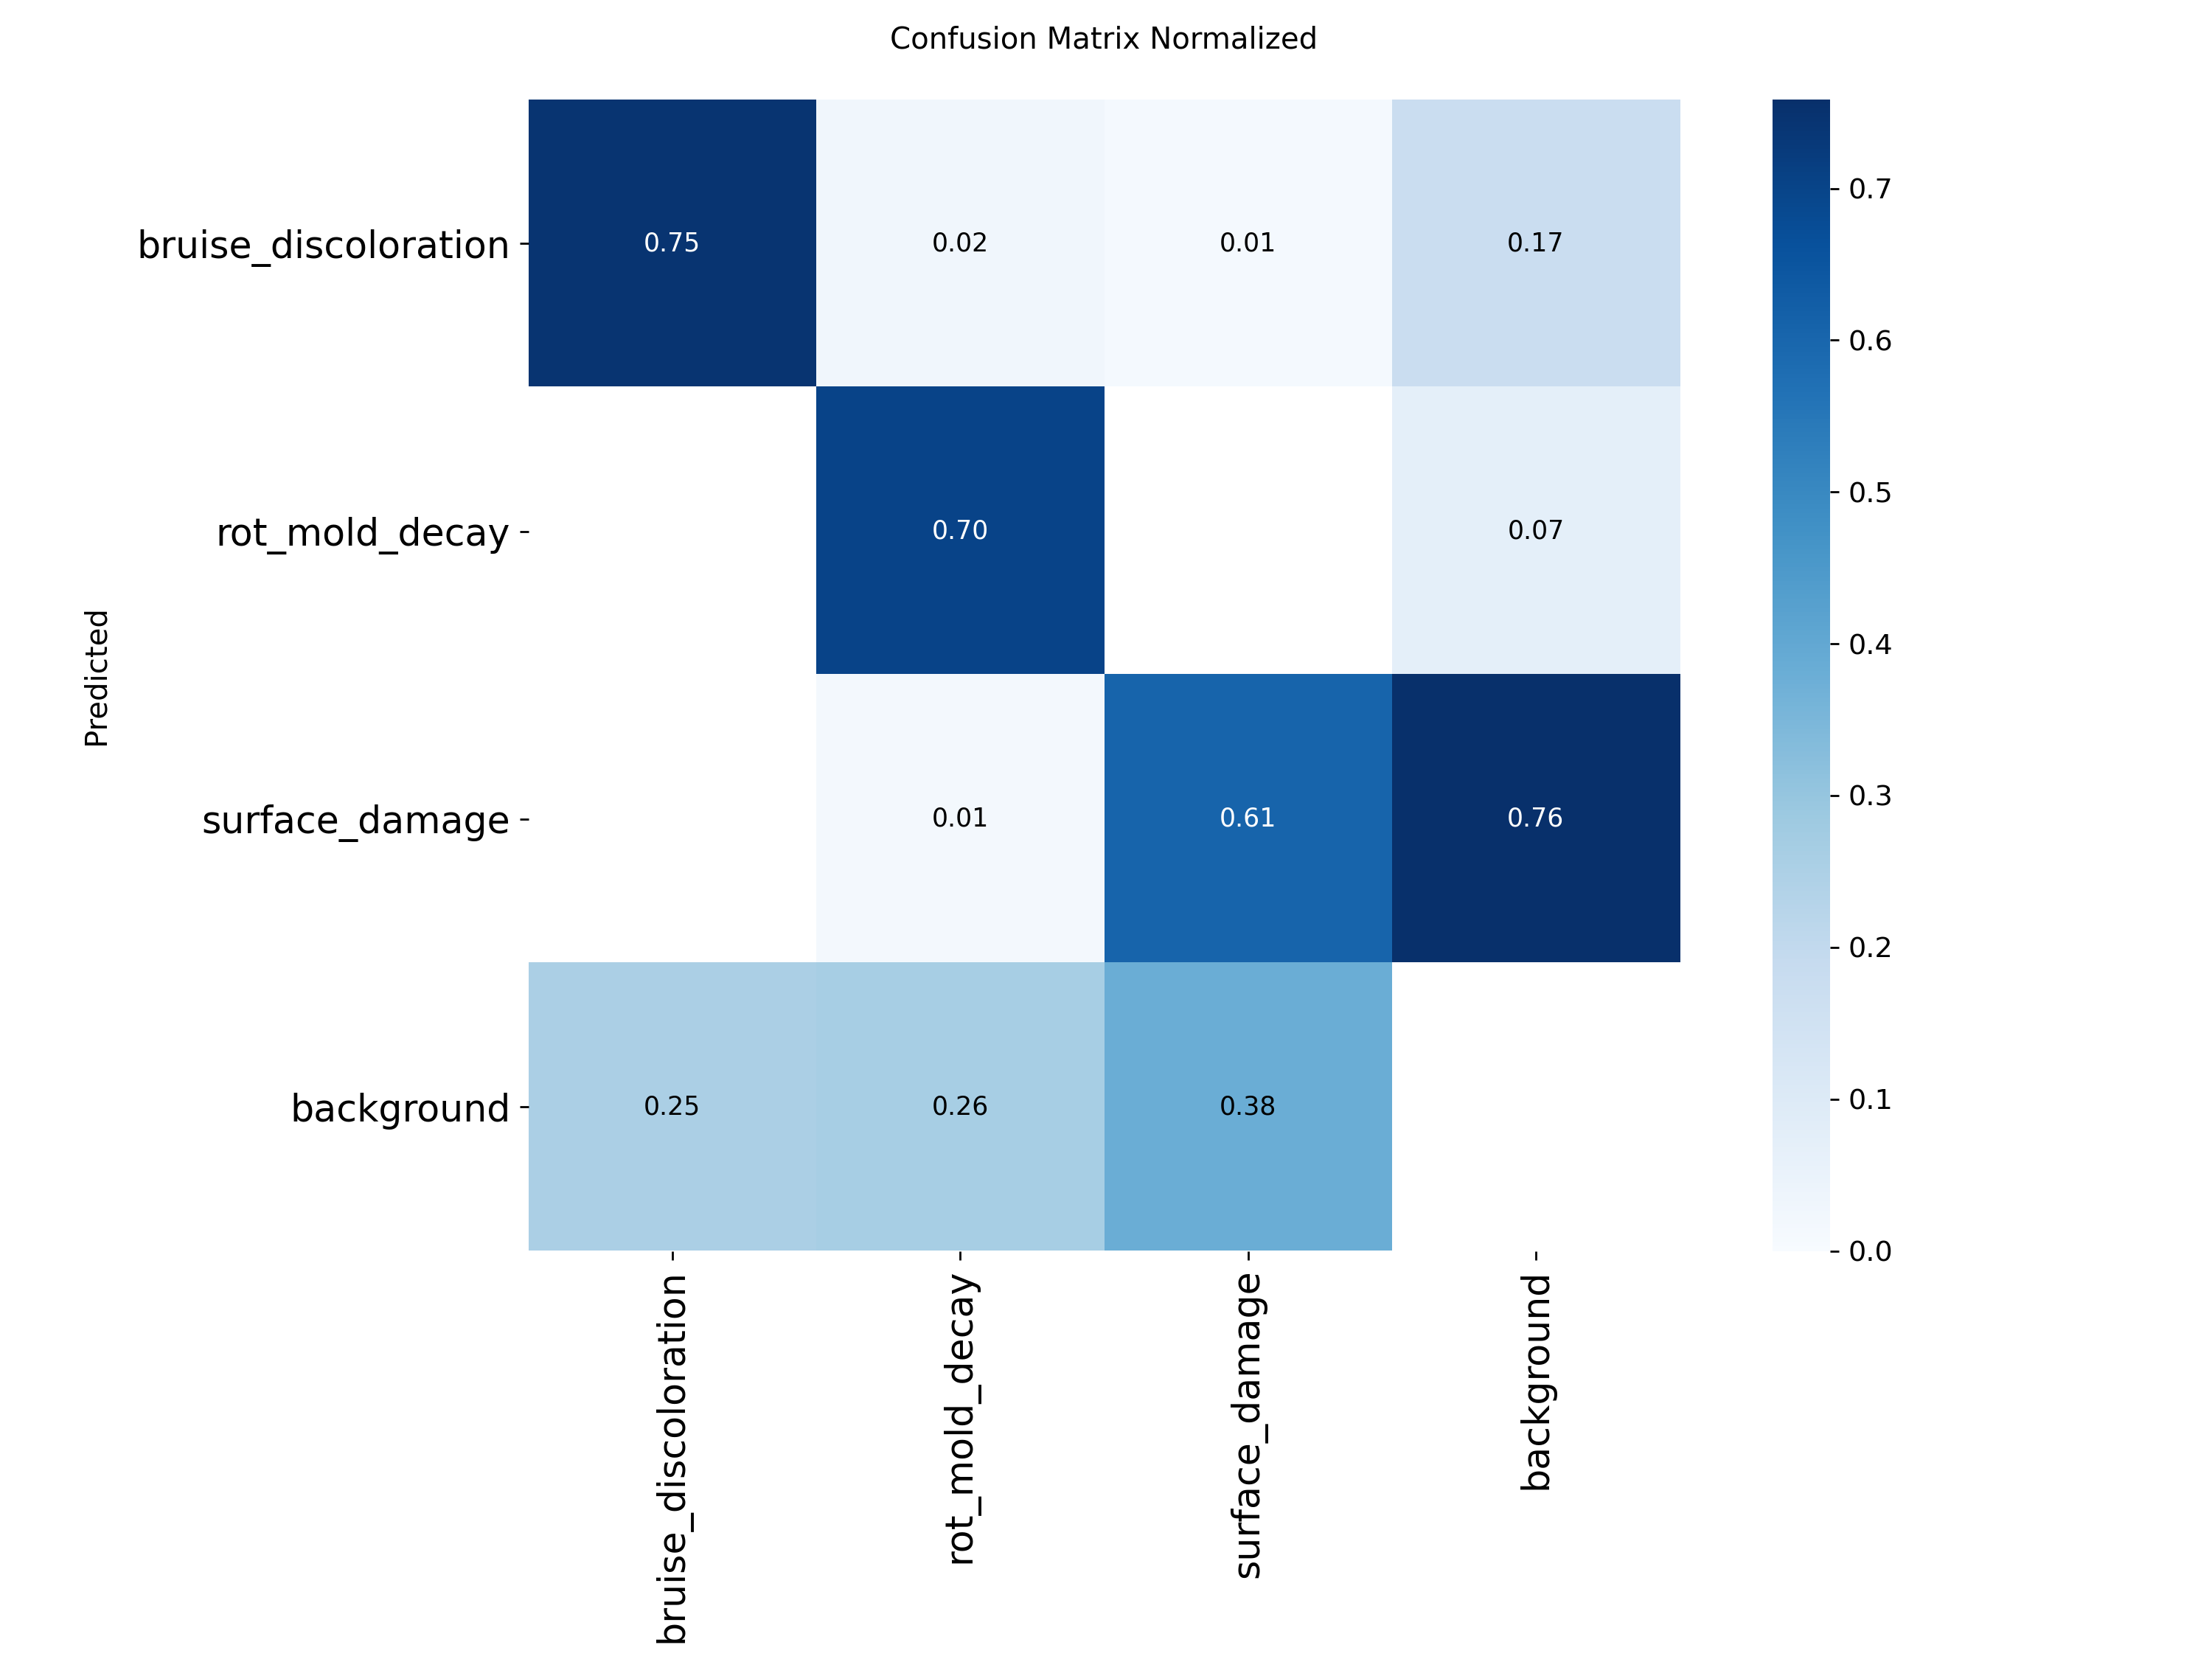
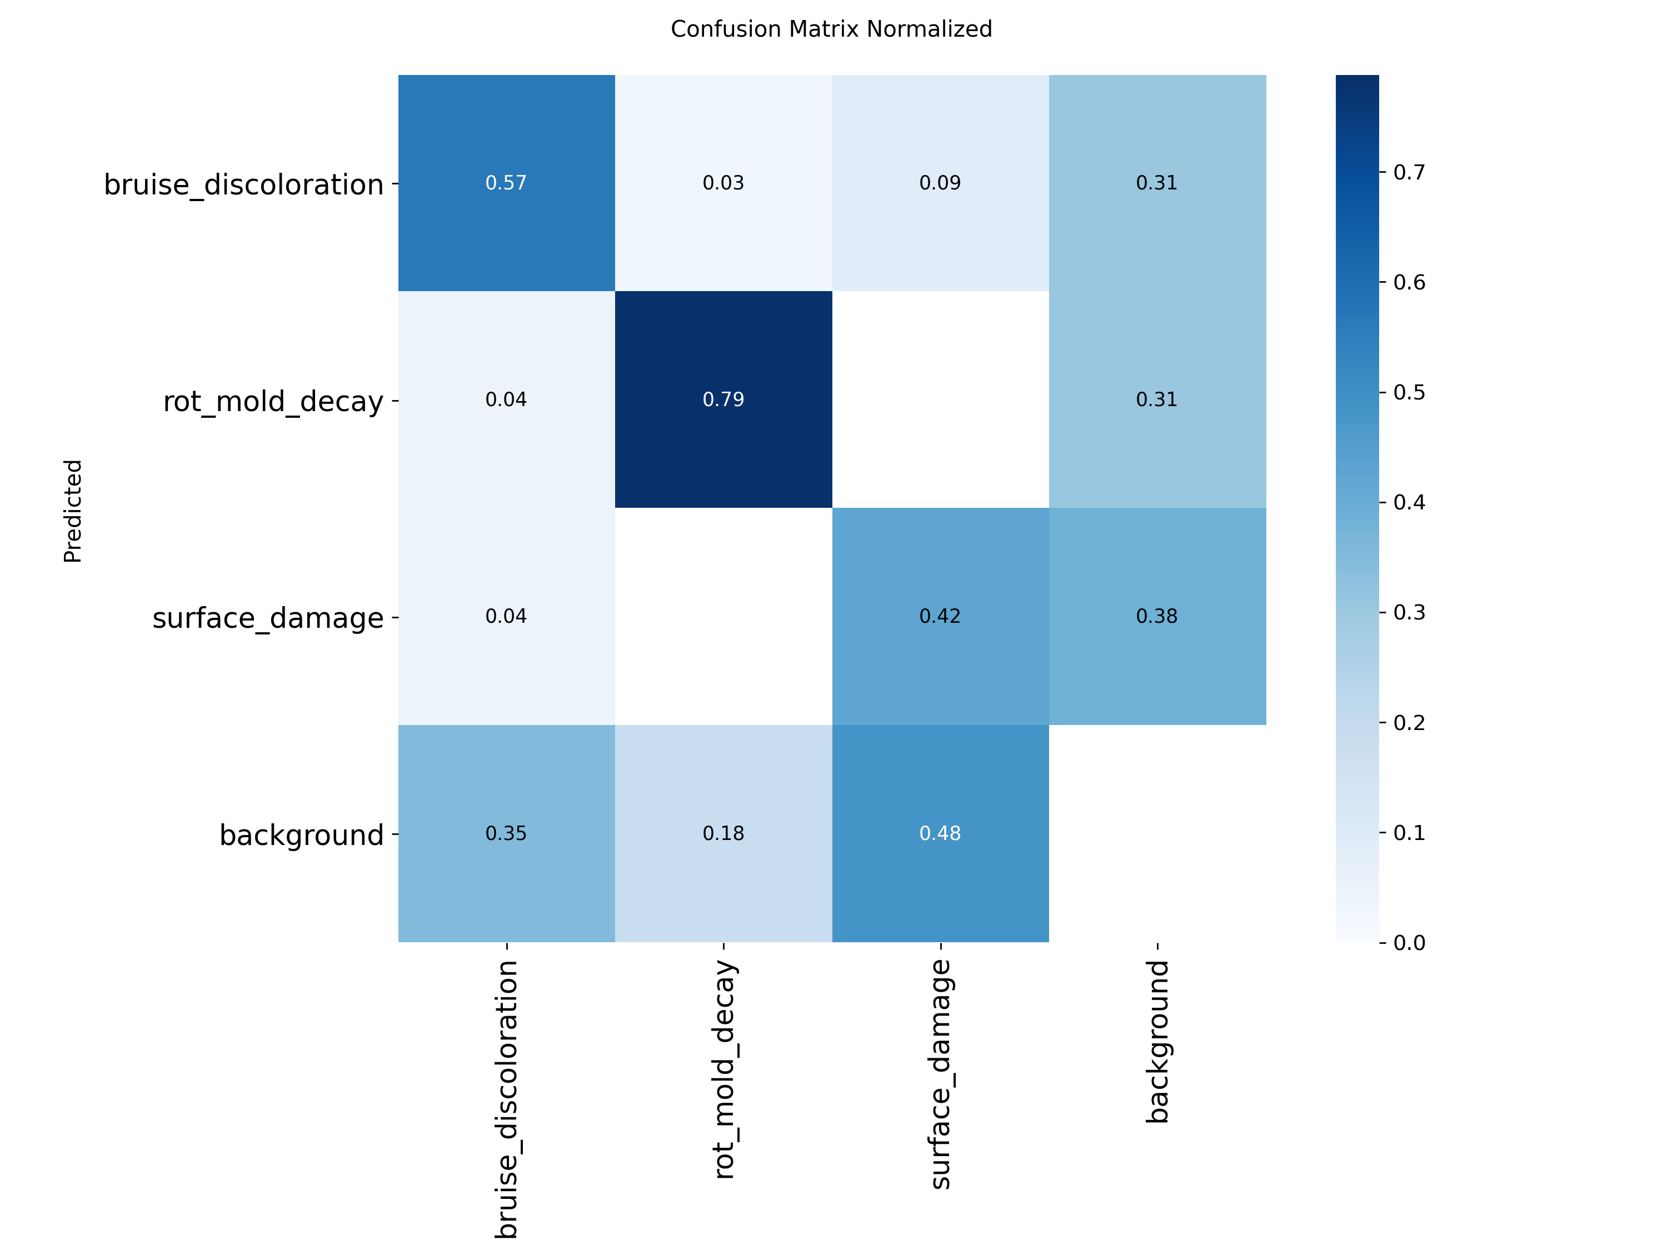
Confusion matrices
Validation (215 images)
Unseen test (79 images)
Columns are true classes. Main error: defects missed as background. Bruise and rot rarely confused (4% or less). Validation false alarms are mostly surface damage.
CIPHER | AI2 AM3 | Fruit Defect Segmentation
18

Slide 19
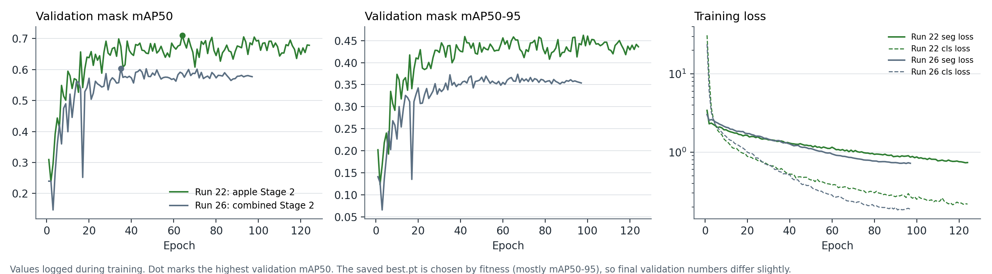
Learning curves
• Training loss falls smoothly. Validation mAP levels off after about 30 epochs
• Early stopping ended the runs before a long decline
• Tomato (Run 24) overfits: validation seg loss is lowest near epoch 26 then rises
• Ultralytics results.png for every run is in runs/
CIPHER | AI2 AM3 | Fruit Defect Segmentation
19

Slide 20
Unseen test set
Metric | Validation | Test (79 images)
Mask precision | 0.809 | 0.718
Mask recall | 0.680 | 0.597
Mask mAP50 | 0.688 | 0.613
Mask mAP50-95 | 0.457 | 0.411
• Test frozen before training and used once
• Drop vs validation is expected: checkpoint was picked on validation
• Almost all of the drop is bruise
• Rot and surface damage hold steady
• Small test set: one bruise miss moves recall about 4 points
Class | Val mAP50 | Test mAP50
Bruise | 0.777 | 0.594
Rot | 0.761 | 0.732
Surface | 0.527 | 0.511
CIPHER | AI2 AM3 | Fruit Defect Segmentation
20

Slide 21
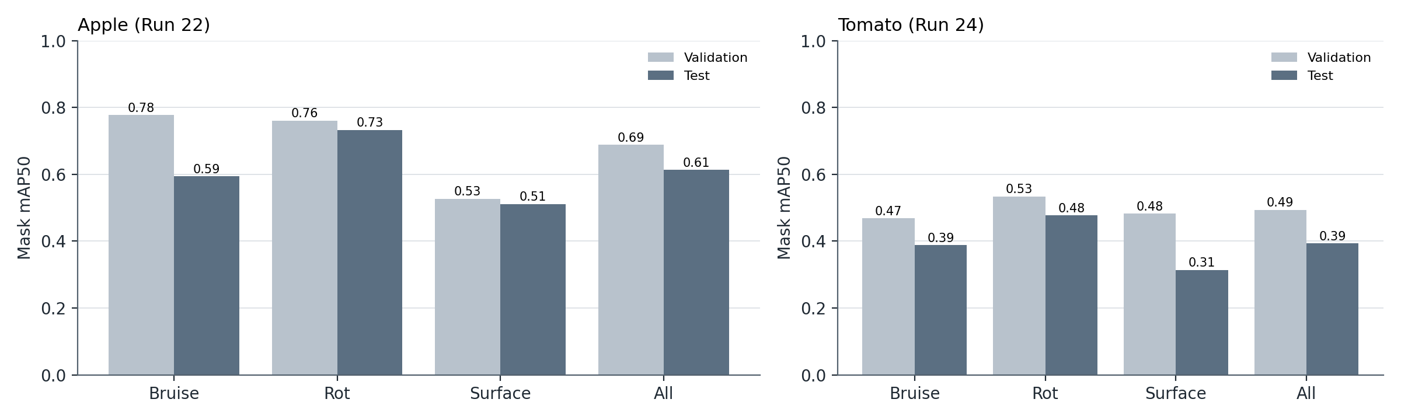
Validation vs test per class
• Apple rot and surface damage hold on unseen images
• Apple bruise drops the most: 0.777 on validation, 0.594 on test
• Tomato drops on every class, mostly from low recall
CIPHER | AI2 AM3 | Fruit Defect Segmentation
21

Slide 22
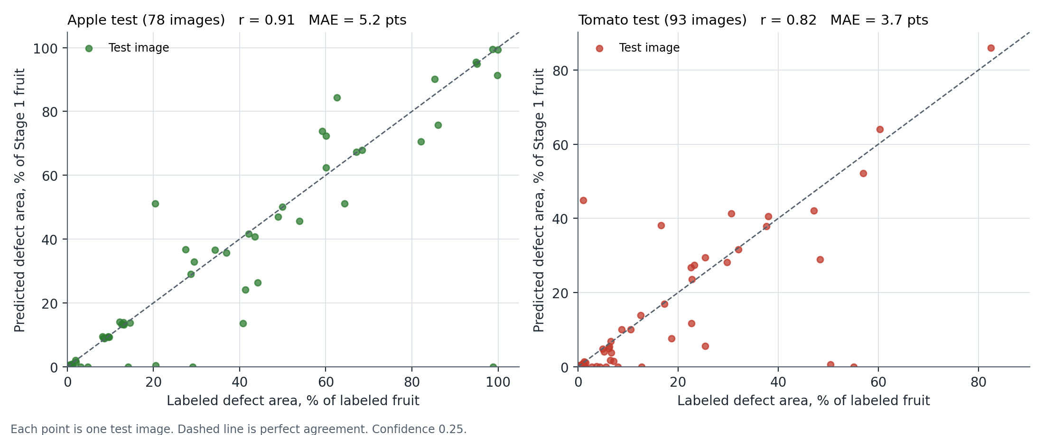
Does the damaged share match?
• Apple: r = 0.91, error 5.2 points
• Tomato: r = 0.82, error 3.7 points
• Most big errors are defects missed entirely
• Mean pixel IoU: apple 0.58, tomato 0.41
CIPHER | AI2 AM3 | Fruit Defect Segmentation
22

Slide 23
Tomato: two-stage result
Tomato | Validation | Test (95 images)
Stage 1 whole tomato mAP50 | 0.966 | -
Stage 2 precision | 0.709 | 0.732
Stage 2 recall | 0.473 | 0.375
Stage 2 mAP50 | 0.494 | 0.393
Stage 2 mAP50-95 | 0.295 | 0.194
• Whole tomato is easy for Stage 1
• When it marks a defect it is usually right
• But it finds only about 38% of tomato defects
• 1,313 train files from 459 groups vs 2,110 from 726 for apple
Class | Test P | Test R | Test mAP50
Bruise | 0.794 | 0.387 | 0.388
Rot | 0.848 | 0.382 | 0.477
Surface | 0.555 | 0.357 | 0.314
CIPHER | AI2 AM3 | Fruit Defect Segmentation
23

Slide 24
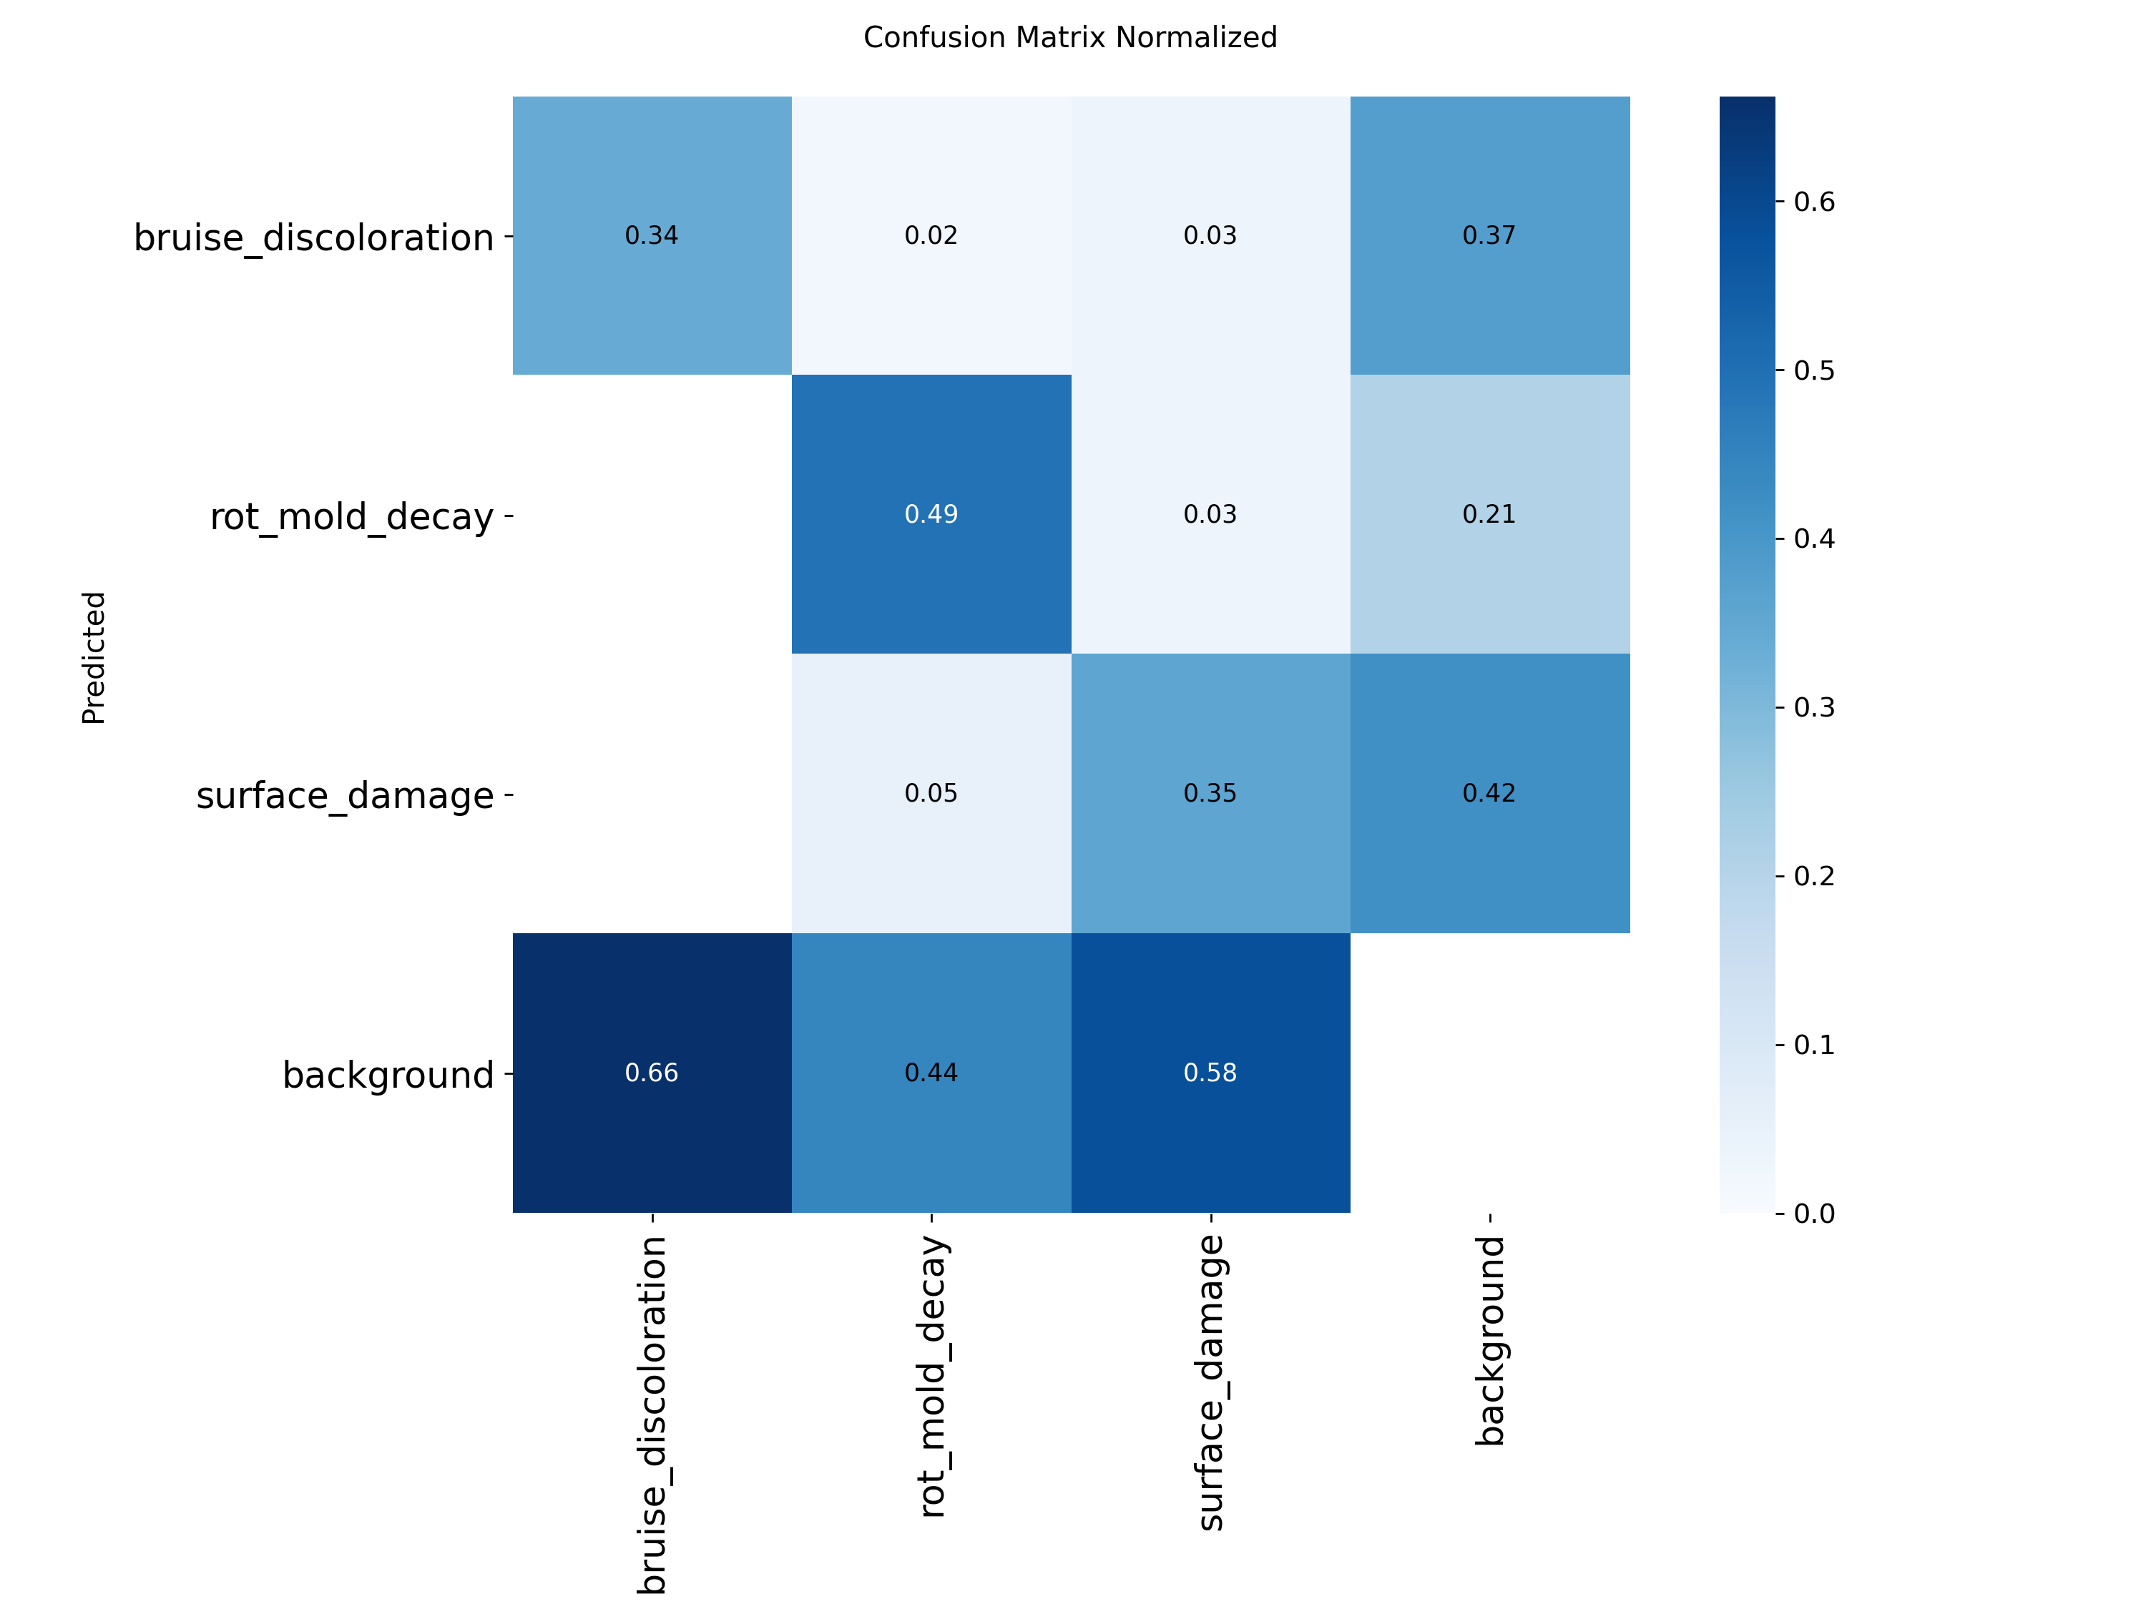
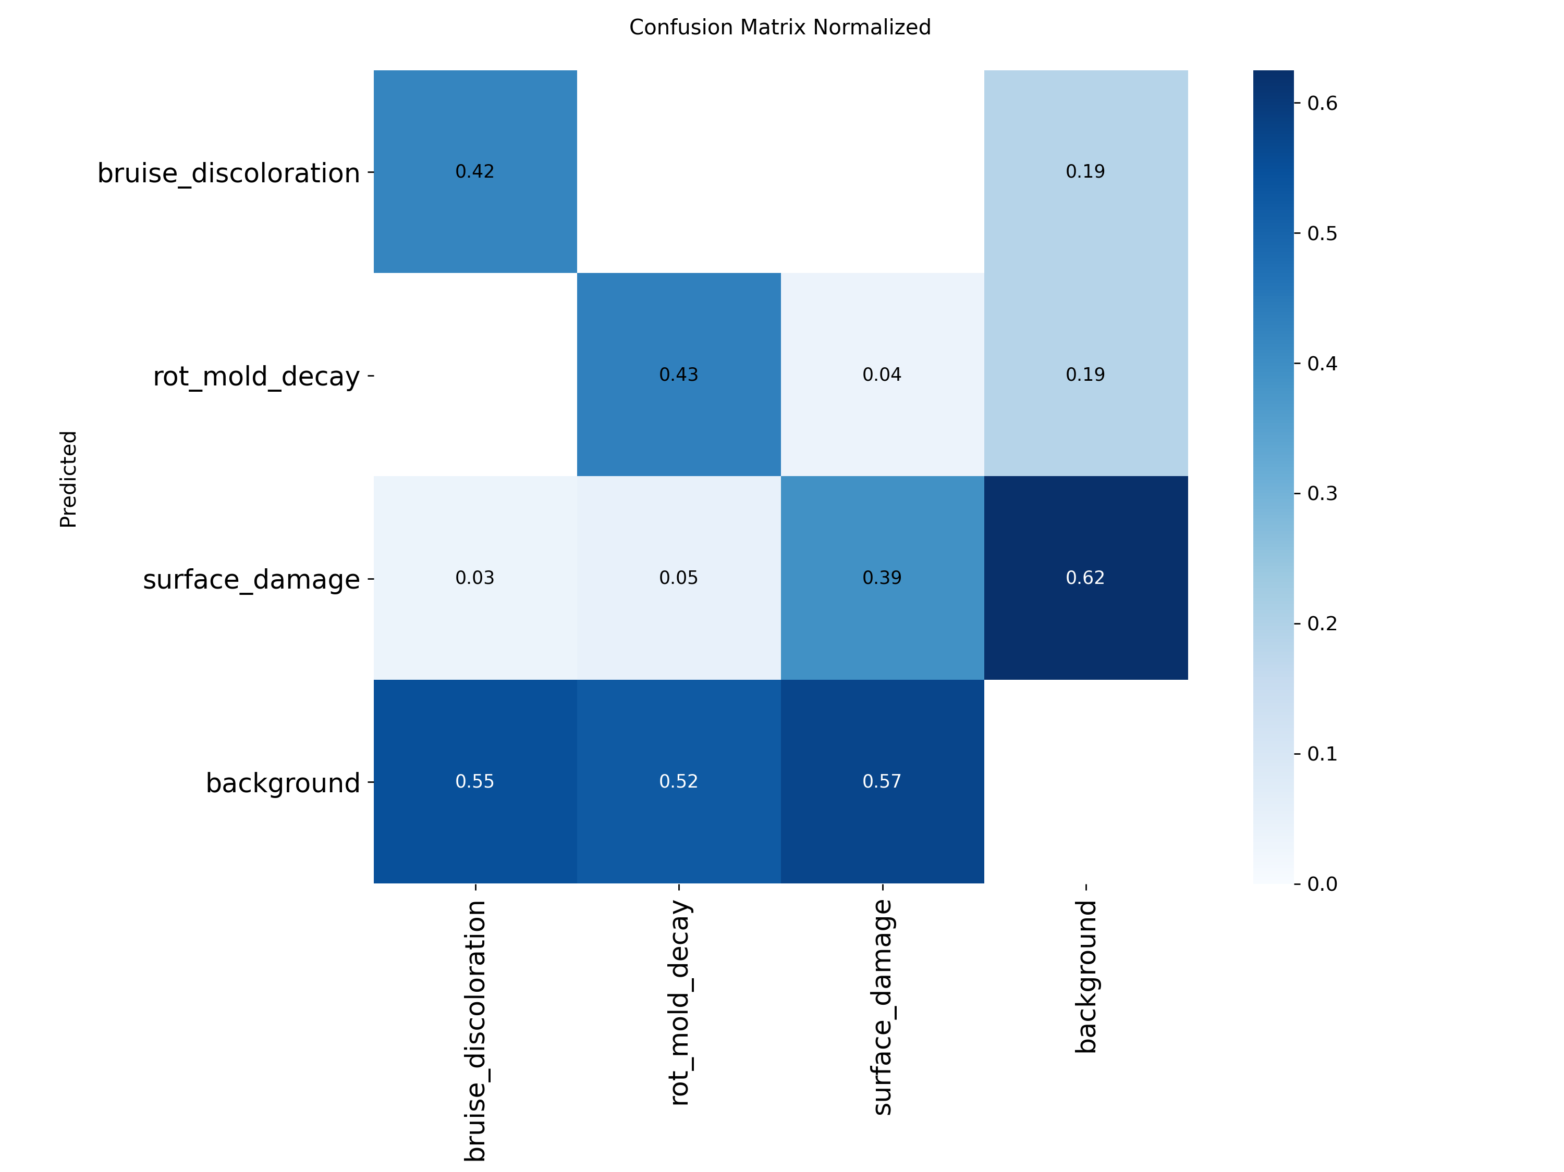
Tomato confusion matrices
Validation (132 images)
Unseen test (95 images)
On test 52% to 57% of each defect class is missed as background. Defect classes are rarely confused (5% or less). Most false alarms are surface damage.
CIPHER | AI2 AM3 | Fruit Defect Segmentation
24

Slide 25
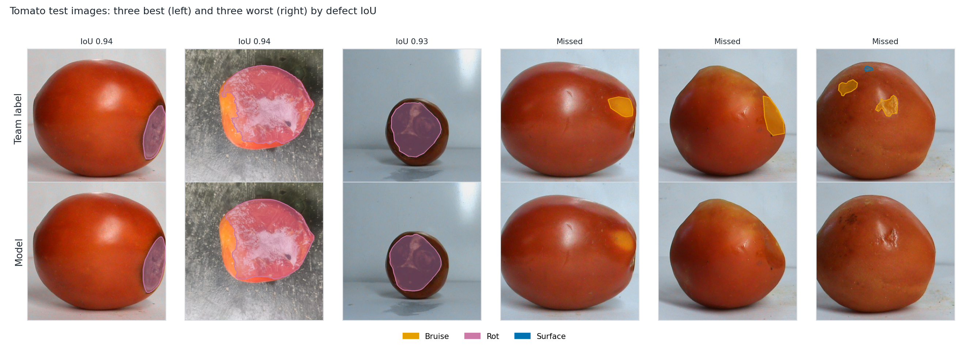
Tomato: best and worst test images
Large rot regions are found with IoU above 0.9. Faint bruises that are only a slight color change are missed.
CIPHER | AI2 AM3 | Fruit Defect Segmentation
25

Slide 26
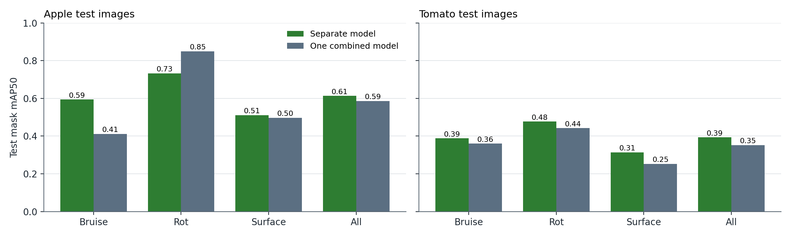
One model for both fruits
Test mask mAP50 | Apple sep | Apple comb | Tomato sep | Tomato comb
Bruise | 0.594 | 0.411 | 0.388 | 0.360
Rot | 0.732 | 0.849 | 0.477 | 0.442
Surface | 0.511 | 0.497 | 0.314 | 0.253
All | 0.613 | 0.586 | 0.393 | 0.352
• Level with separate models on validation
• Slightly lower on test for both fruits
• Apple rot up, apple bruise down
• Gaps are within noise of a small test set
• One model can serve both fruits at a small cost
sep = separate model per fruit (Runs 22, 24). comb = one combined model (Runs 25, 26)
CIPHER | AI2 AM3 | Fruit Defect Segmentation
26

Slide 27
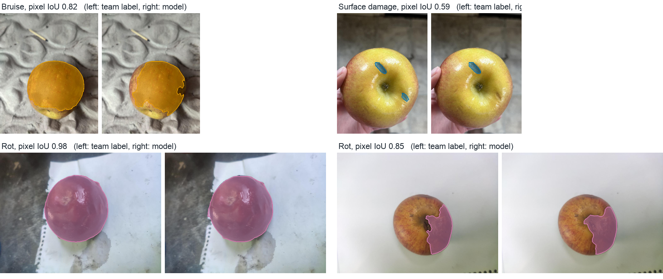
Good predictions on test images
Test images. Mean per-image pixel IoU over 62 test images with a defect: 0.583
CIPHER | AI2 AM3 | Fruit Defect Segmentation
27

Slide 28
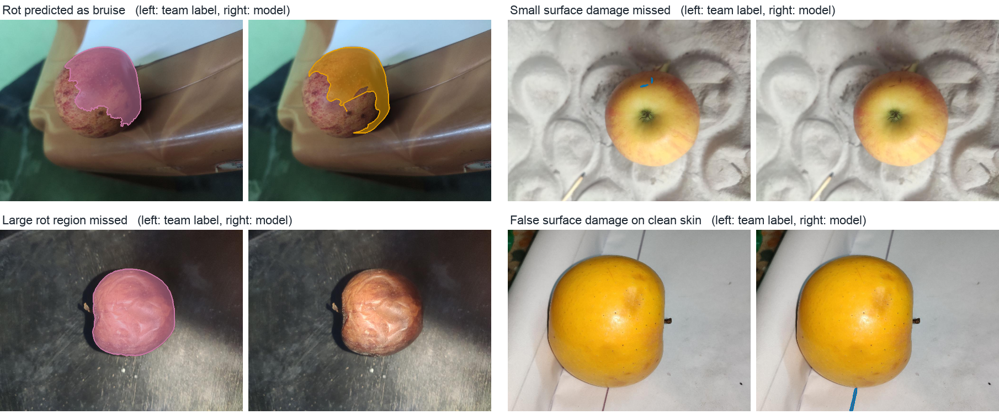
Failure cases
• Rot predicted as bruise on a discolored apple
• Whole-fruit rot label not found by the model
• Tiny surface damage missed
• Edge mark predicted as surface damage on clean skin
CIPHER | AI2 AM3 | Fruit Defect Segmentation
28

Slide 29
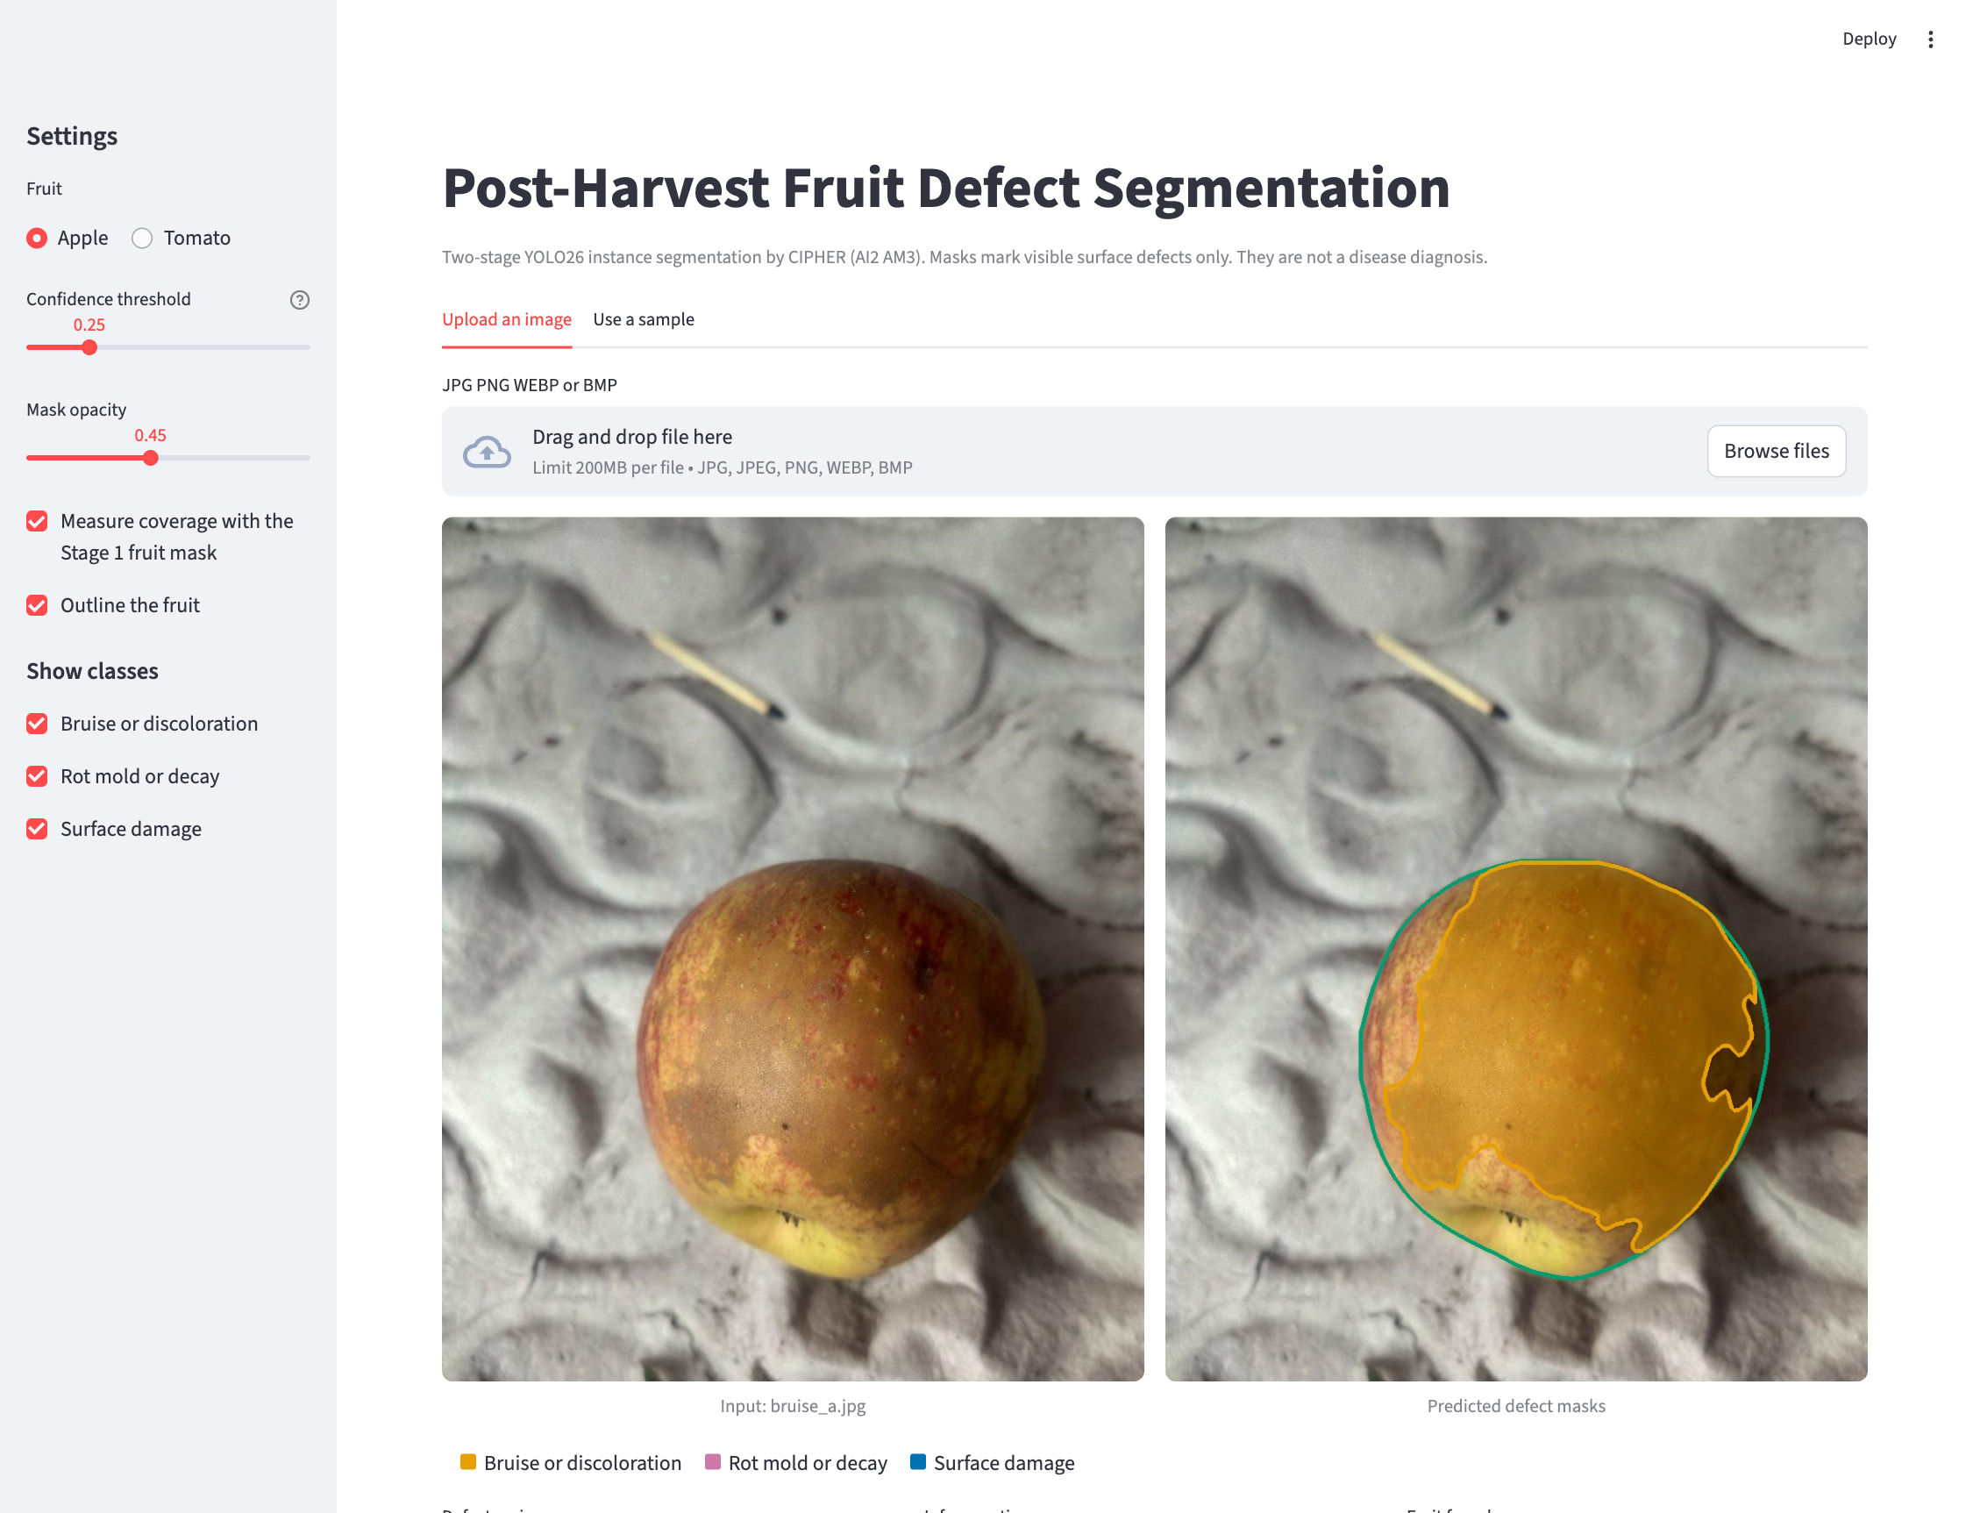
Web application (Streamlit)
• Pick apple, tomato or the combined model
• Upload a photo or use a sample
• Colored masks with a legend
• Defect share of the image and of the fruit
• Confidence slider and class toggles
• Download the result as PNG
• Clear messages for bad files or no defects
CIPHER | AI2 AM3 | Fruit Defect Segmentation
29

Slide 30
Limitations
• Labels describe appearance only. The model does not diagnose disease or internal damage
• Few image sources with mostly plain backgrounds
• Small surface damage remains hard and lowers recall
• Two-stage gain is not isolated from model size and settings
• One annotator per image with review. No formal agreement score yet
• Tomato recall is low: about half of its defects are missed
CIPHER | AI2 AM3 | Fruit Defect Segmentation
30

Slide 31
Conclusion and future work
Findings
Next steps
• Two-stage YOLO26l segments the whole apple almost perfectly
• Apple defects reach 0.613 test mask mAP50
• Rot is the most stable class and surface damage the hardest
• Tomato reaches 0.393 test mAP50 with low recall
• One combined model is close to two separate models
• Working upload app for apple and tomato
• More small-defect examples
• Controlled single-stage baseline with equal settings
• Test on new sources and lighting
• Measure agreement between annotators
CIPHER | AI2 AM3 | Fruit Defect Segmentation
31

Slide 32
References and AI disclosure
[1] Mojumdar et al., AFruitDB, Data in Brief 59, 2025
[5] Leiva, Rebeaud, Christen, apple scab with YOLO11, Plant Methods 22, 2026
[8] Nesteruk, Apple rotting segmentation problem in the wild, Kaggle, CC BY-NC-SA 4.0
[10] Ultralytics, YOLO26 documentation, 2026
Full IEEE reference list in the paper
AI tools used: Claude (Anthropic) and OpenAI Codex for planning, explanation and code scaffolding. All outputs were checked by the team. Full transcripts are included in the submission.
CIPHER | AI2 AM3 | Fruit Defect Segmentation
32

