Slide 1
UNIT A
The Nervous and Endocrine System

Slide 2
Chapter 11
The Nervous System

Slide 3
INDEX
Topic 1: Nerves & Action Potential
Topic 2: Central & Peripheral Nervous System
Topic 3: Sensory Reception

Slide 4
11.1 Nerves & Action Potential
Describe the general structure and function of a neuron and myelin sheath
Explain the formation and transmission of an action potential
Explain the intensity of a signal in terms of the all-or-none response
Explain the transmission of a signal across a synapse, as well as the main neurotransmitters involved
Describe the organization of neurons into nerves and the function of reflex arcs
* Textbook pages 364-384

Slide 5
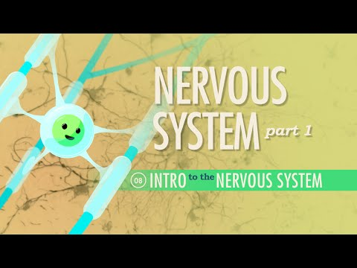
Introduction
Watch the following video for a general overview of what you will be learning about.
Feel free to come back to this video later on to review as well.

Slide 6
Overview
The nervous system works in conjunction with the endocrine system to respond to both internal and external environmental change, thereby maintaining homeostasis within the body.
The nervous system responds via electrochemical messages relayed from the brain.
The endocrine system responds via chemical messengers relayed through the bloodstream (hormones).

Slide 7
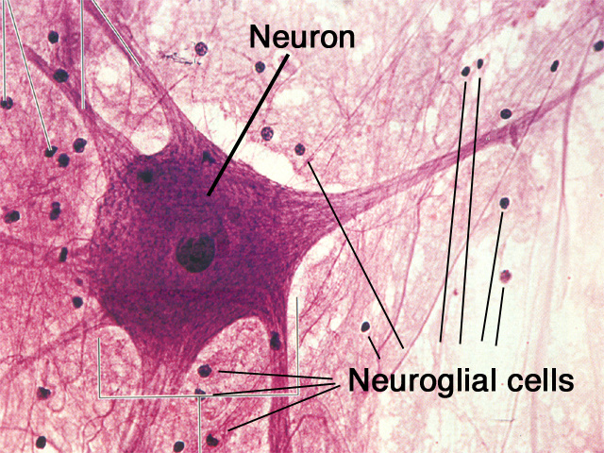
Nerves
Two main types of nerve cells found in the nervous system:
Glial Cells
do not conduct electrical signals
used for structural and nutritional support
2. Neurons (nerve cells)
conduct nerve impulses throughout the body
supported by glial cells

Slide 8
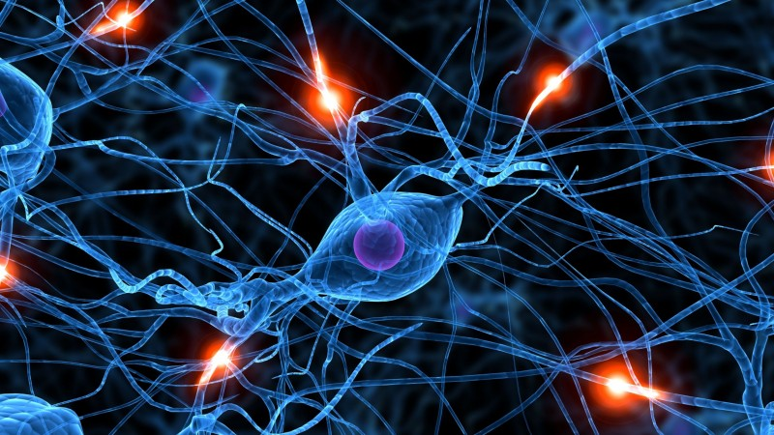
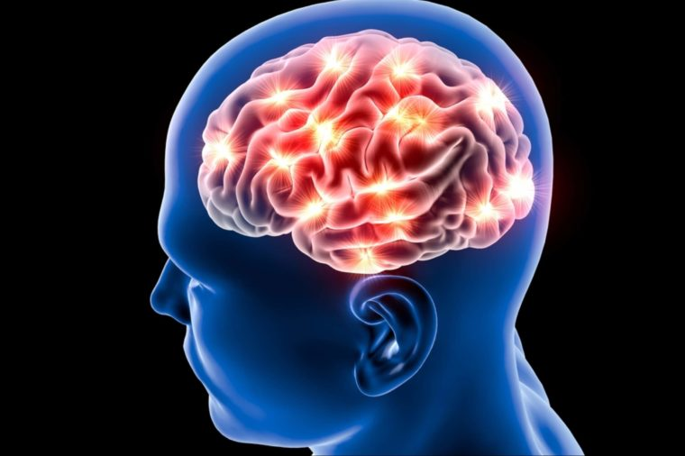
Neurons
Neurons are the basic unit of the nervous system...

Slide 9
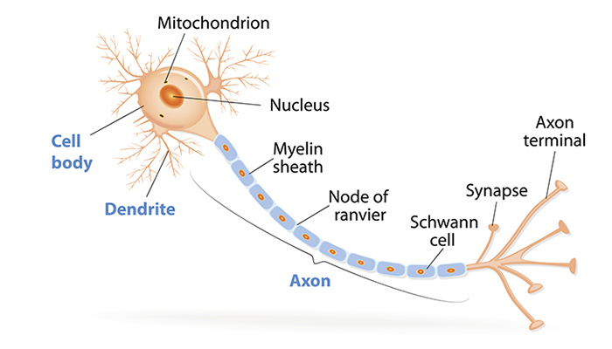
Neuron Structure
Dendrites are short thread-like branches which act to accept nerve impulses from other neurons and carry them towards the cell body, which is the main part of the cell, containing the nucleus and other organelles
Axons are longer branches which carry nerve impulses away from the cell body
A myelin sheath surrounds many axons, insulating the neuron and speeding up the rate of impulse transmission.

Slide 10
Schwann Cells, a type of glial cell, are responsible for producing the myelin that surrounds each axon.
In myelinated axons, gaps between Schwann cells are referred to as the nodes of Ranvier. Electrical impulses “jump” from node to node, which is referred to as saltatory conduction. This speeds up transmission, avoiding having to travel down the entire length of the axon.
Once the electrical signal reaches the axon terminal, it is then passed on to the dendrites of an adjoining neuron.
  Synapse: the space/junction between two adjoining neurons

Slide 11
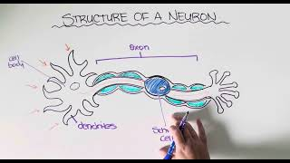
Re-cap: The Structure of a Neuron

Slide 12
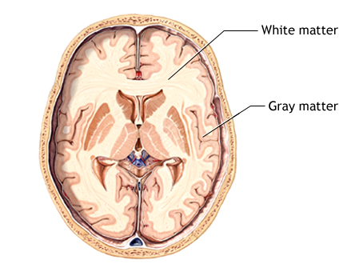
Myelination
The myelination of neurons is vital for proper signal transduction within the nervous systems.
Myelinated Neurons | Unmyelinated Neurons
Increased rate of nerve impulse conduction (saltatory conduction) | Slower nerve impulse conduction (impulse has to travel the entire length of the axon)
make up the white matter of your brain, which is responsible for conducting nerve impulses. | make up the grey matter of your brain, which is responsible for processing information and generating nerve impulses.
capable of regenerating after injury | not capable of regenerating after injury

Slide 13
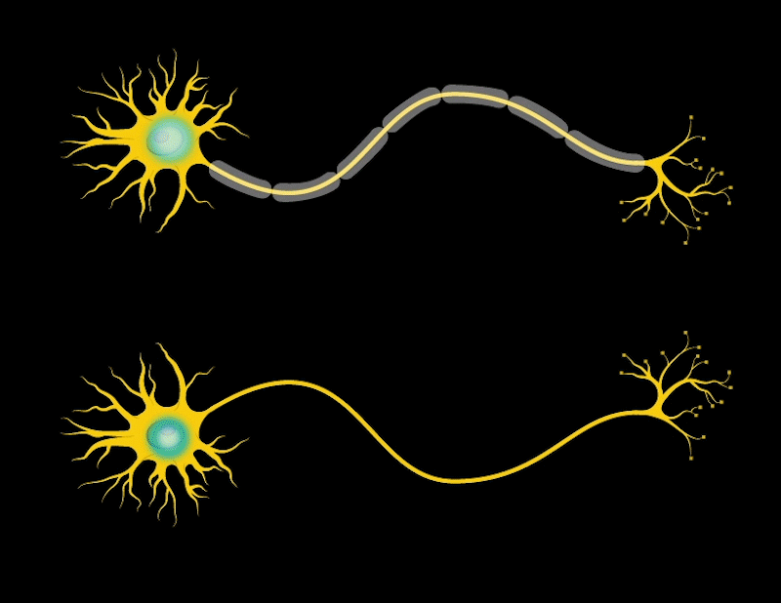
Myelination
Observe how the speed of the impulse is greater in the myelinated neuron.

Slide 14
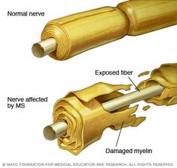
Multiple Sclerosis
MS is a genetic disorder which involves damage to the myelin sheath
Symptoms include numbness and tingling of the limbs, muscle spasms, and a loss of balance and coordination.
The more scar tissue that builds up along the nerve, the worse the symptoms become. As a result, MS gradually worsens with age.

Slide 15
Types of Neurons
Three main types of neurons work together to signal effectors (e.g. muscle cells) to respond appropriately to different stimuli:
Sensory Neurons (afferent)
Gather information from sensory receptors (i.e. touch/sight/sound/taste receptors) and transmit these impulses to the brain & spinal cord
Interneurons
Found in the Central Nervous System (brain and spinal cord)
Process and integrate incoming sensory info from sensory neurons and relay outgoing information to motor neurons
Motor Neurons (efferent)
Transmit information to effectors, such as muscles and glands

Slide 16
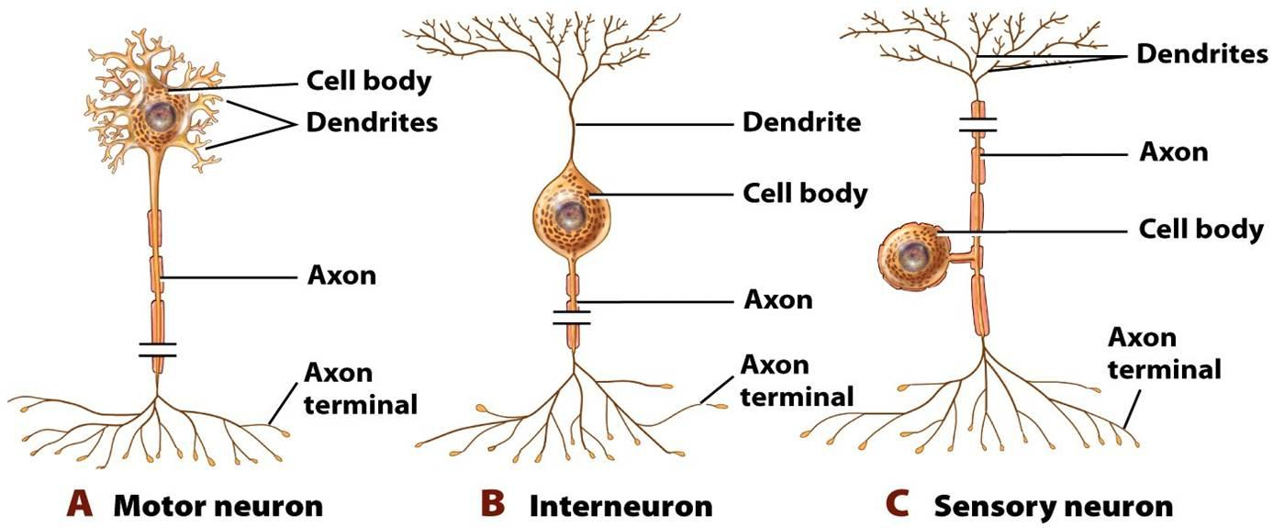
Motor, inter, and sensory neurons can be further classified based on the number of branches formed from the cell body.
Multipolar
Bipolar
Unipolar

Slide 17
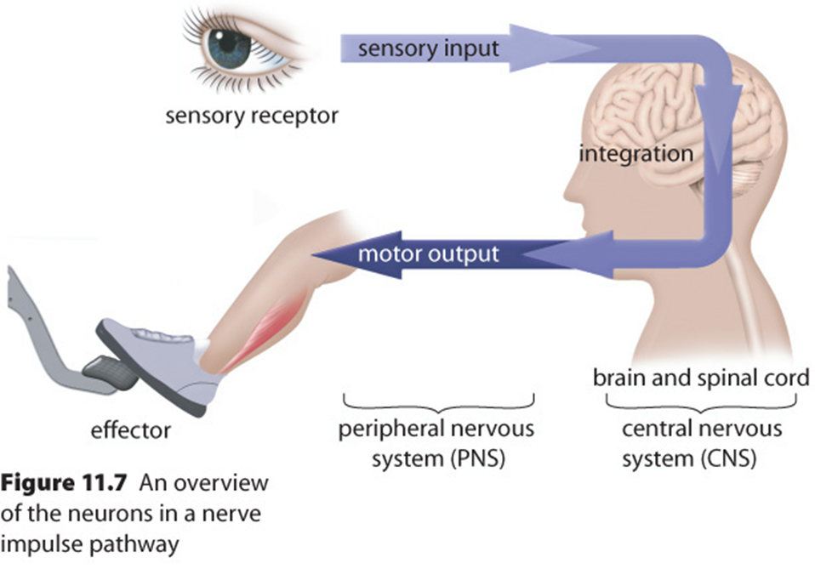
Typical Nerve Impulse Pathway

Slide 18
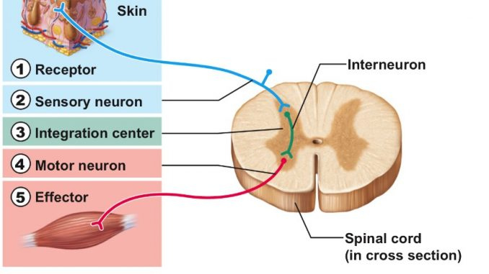
Neural Circuits and Reflex Arcs
Reflex arcs allow us to understand simple neural circuits typically composed of the five components below:
In some reflex arcs, the interneuron is not required, but there must be a minimum of a sensory and a motor neuron.
Interneuron

Slide 19
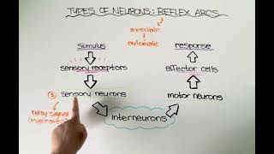
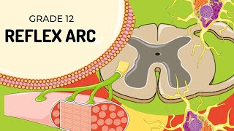
Reflex Arcs

Slide 20
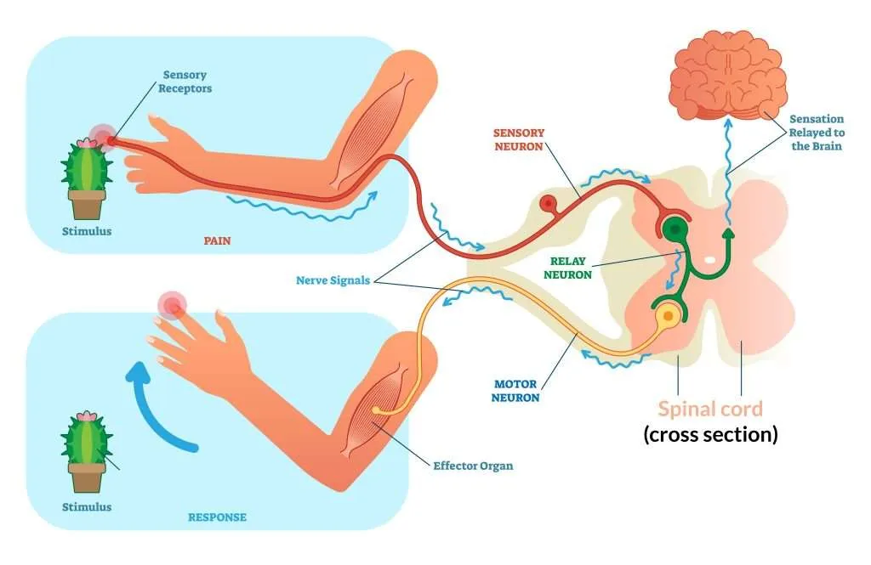
Reminder!
During a reflex arc, the information will still travel to the brain for further processing, however it first bypasses the brain and goes directly through the spinal cord to generate a quicker response

Slide 21
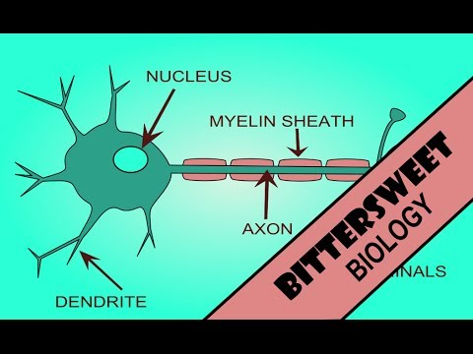
Conduction of Nerve Impulses (Electrical Event)
A nerve impulse or action potential has both a chemical and electrical component (hence the term electrochemical impulse)
Four stages of a nerve impulse:
Polarized/resting state
Depolarization
Repolarization
Refractory Period

Slide 22
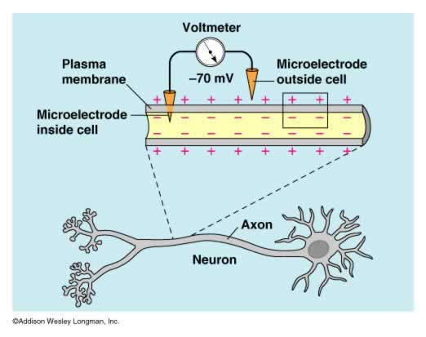
1) Resting State
The difference in charge across the membrane of a resting neuron is called resting membrane potential.
The inside of a neuron has a slight negative charge at rest, whereas the outside has a slight positive charge.
This results in a resting potential of -70 mV in most neurons
  Note: we often use specific numbers for voltages in our examples, but these can change from one neuron to another

Slide 23
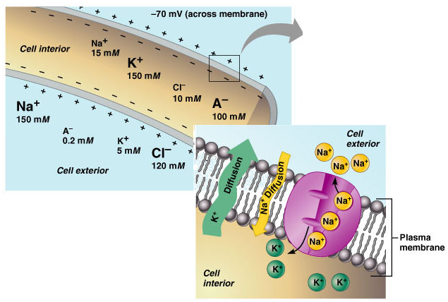
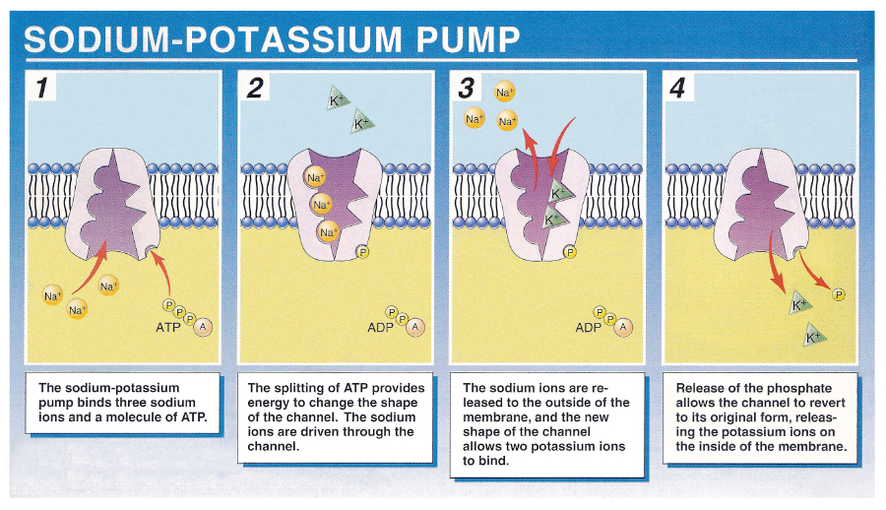
Resting State & the Sodium-Potassium Pump
Inside the resting cell, there exists a higher concentration of potassium (K+) than sodium (Na+); outside the cell, the opposite is true.
Potassium ions are able to passively diffuse out of the cell more easily than sodium ions can diffuse into the (K+ = “leaky” ion channels)
In an attempt to balance this difference, the sodium-potassium pump along the membrane surface will pump two K⁺ back into the cell in exchange for three Na⁺
As a result, as excess of positive charge accumulates outside of the cell membrane, causing the inside of the cell to become negatively charged relative to the outside. A constant membrane potential of -70 mV is maintained.

Slide 24
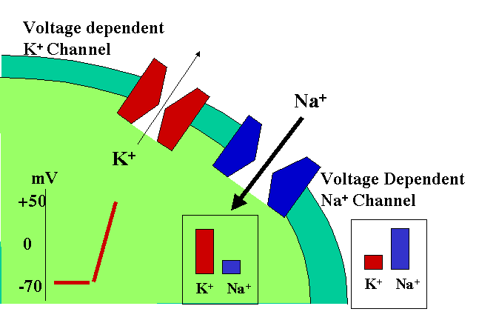
2) Depolarization
Action potential occurs when a neuron is stimulated by an electrical impulse.
If a strong enough impulse is received and the threshold potential is reached (approx. -55 mV), sodium gates will open, thus allowing Na+ to diffuse freely across the membrane.
Na+ rushes into the cell (down their concentration gradient → facilitated diffusion), leading to a slight positive charge on the inside relative to the outside.
This reverses the membrane potential from -70 mV to +40 mV; the membrane is now said to be depolarized.
Once Na+ reaches equilibrium, the membrane once again becomes impermeable to them, and the gates close.

Slide 25
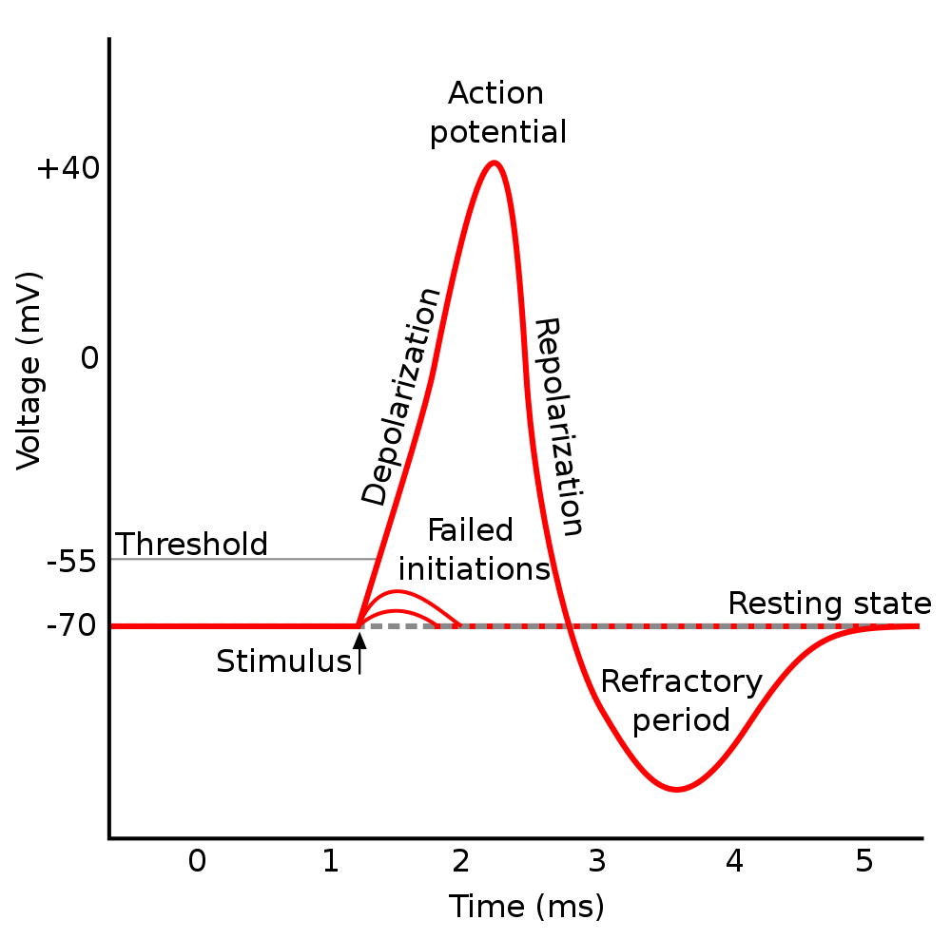
Depolarization & Threshold Potential
An action potential is considered to be an “all-or-none” event because any stimulus that fails to achieve the threshold membrane potential of at least -55 mV will have no effect
Note that increasing the stimulus strength does not increase the impulse strength; a neuron will either fire or not fire
The intensity of a stimulus is instead experienced as an increased frequency of nerve impulses (i.e. a more intense stimulus will simply cause more neurons to depolarize)

Slide 26
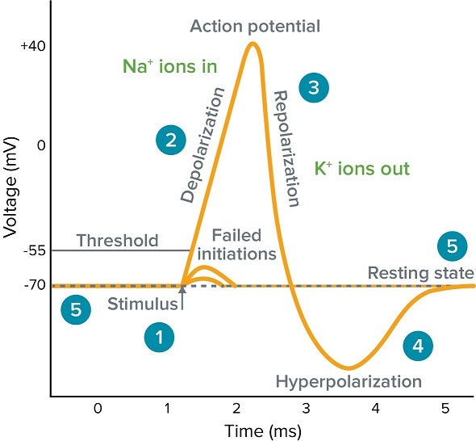
3) Repolarization
Once the action potential has peaked, Na+ gates close, and K+ gates open.
This restores the positive charge on the outside of the membrane; however, Na+ and K+ concentrations are briefly reversed compared to at the resting state (Na+ is higher inside the membrane)
The K+ channels are slow to close, which results in the hyperpolarization of the neuron. This means that the inside becomes slightly more negative than the resting potential.

Slide 27
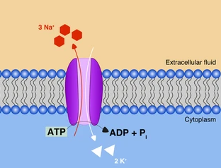
Na+/K+ exchange pump helps reset the correct distribution of ions
Even though during repolarization the inside becomes more negative again compared to the outside, we do not have the correct distribution of Na+ and K+ across the membrane. The sodium-potassium exchange pump helps reset the original distribution by pumping 3 Na+ out for every 2 K+ it pumps in.

Slide 28
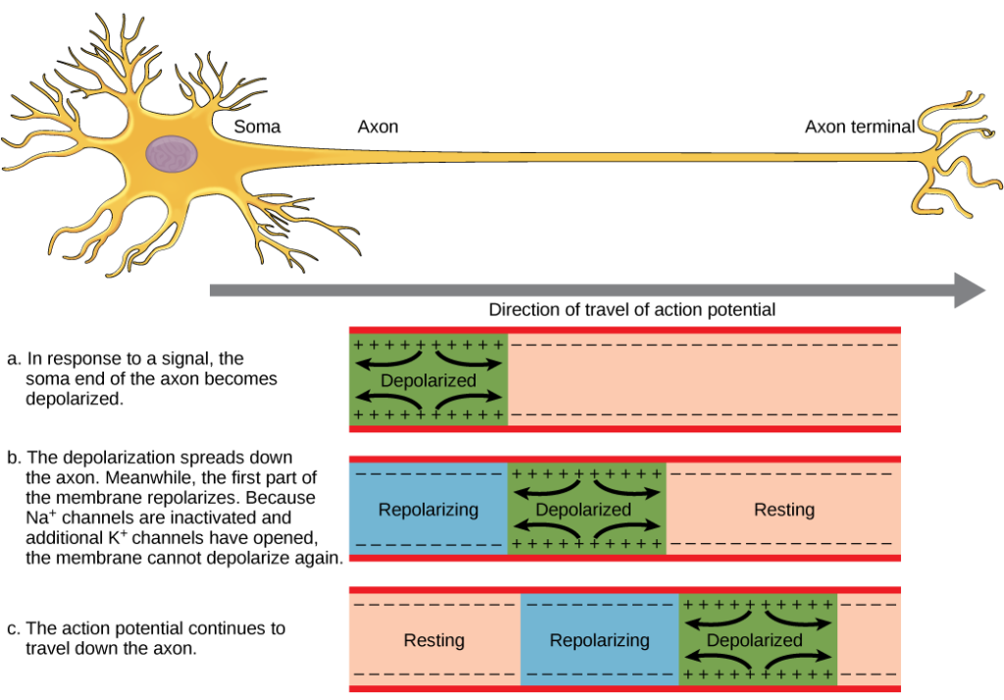
Nerve transmission occurs in a wave-like pattern down the length of the axon.

Slide 29
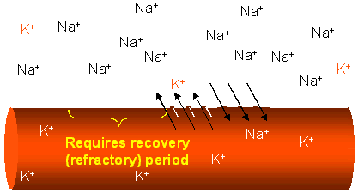
4) Refractory Period
Until the resting potential of the neuron has been properly restored, a second action potential cannot be conducted along the axon; this is referred to as the refractory period.
During this time, the membrane cannot be made permeable to Na+, so a second wave of depolarization cannot occur.

Slide 30
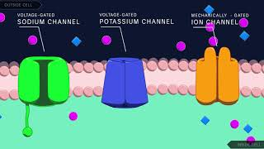
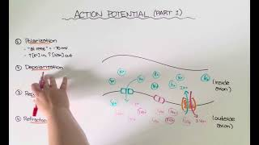
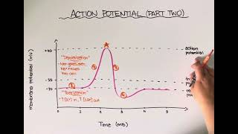
Re-cap: Action Potential
This is a tough topic… I would watch all three videos to make sure you really understand each step.

Slide 31
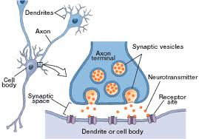
Signal Transduction across a Synapse (Chemical Event)
Once the impulse has traveled down the length of the axon, it reaches the axon terminal.
The axon terminal is in close contact with the dendrites of another neuron.
For the signal to move to the next neuron, it must cross the space between the axon terminal and the dendrites of the subsequent cell; this space is referred to as the synapse.

Slide 32
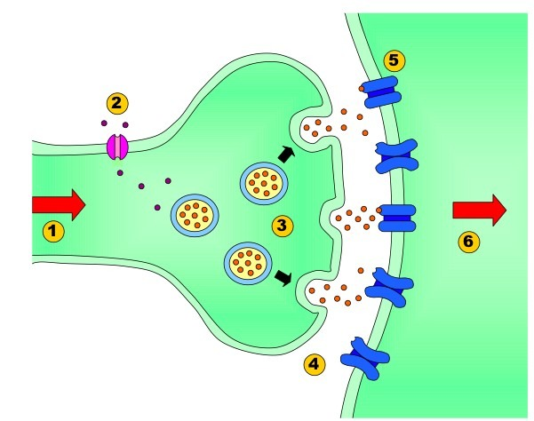
Neurotransmitter Release
Neurotransmitters are required to help transmit the electrical impulse from one neuron to another. These are stored in vesicles in the axon bulb.
An action potential reaches the axon terminal
Calcium channel “gates” within the axon terminal open, causing calcium ions to flow into the cell
Calcium ions trigger the movement and fusing of the vesicles with the presynaptic membrane (exocytosis). In turn, neurotransmitters are released into the synapse.
Neurotransmitters diffuse across the synaptic cleft to the post-synaptic membrane

Slide 33
Neurotransmitter Binding
Once neurotransmitters have reached the post-synaptic membrane, they bind with receptors embedded in the membrane
If the neurotransmitter is excitatory, binding induces an action potential in the postsynaptic neuron
Neurotransmitters are then released by the receptors and either return to the presynaptic neuron or are broken down by enzymes such as cholinesterase on the post-synaptic membrane

Slide 34

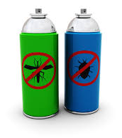
Neurotransmitter Types
There are two main types of neurotransmitters:
Excitatory (e.g. glutamate, acetylcholine, epinephrine)
cause the sodium channels of the post-synaptic membrane to open and sodium to flow in, resulting in slight depolarization of the membrane and lowering the threshold potential of the post-synaptic neuron
    e.g. acetylcholine is a neurotransmitter found in muscle cells; it excites the muscle membrane, causing depolarization and contraction of the muscle fibre
    Cholinesterase (an enzyme) is required to break down acetylcholine after the action potential has occurred
Often when more than one neuron fires at the same time, a sufficient amount of neurotransmitter is released to cause depolarization of the postsynaptic membrane. The production of an action potential as a result is referred to as summation
…insecticides and sarin nerve gas work by blocking the release of cholinesterase, causing muscles to remain in a state of constant contraction

Slide 35
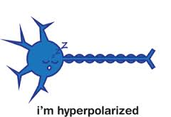
Neurotransmitter Types Cont’d
Inhibitory (e.g. GABA)
Trigger potassium channels to open, causing potassium ions to flow out and thus lowering the membrane potential.
This leads to hyperpolarization, making it more difficult to generate an action potential (because the threshold level has been increased)
Problems with GABA are often associated with epilepsy and Huntington’s disease

Slide 36
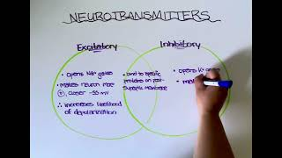
Excitatory vs. Inhibitory Neurotransmitters
Excitatory | Inhibitory
depolarize membranes by increasing permeability to Na+ | hyperpolarize membranes by increasing permeability to K+ or Cl-
move membrane potential towards threshold (causes it to become more positive) | move membrane potential away from threshold (causes it to become more negative)

Slide 37
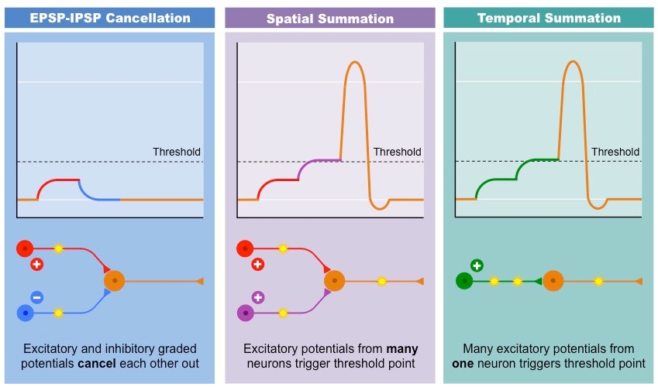
Summation
Summation is the process that determines whether or not an action potential will be generated by the combined effects of excitatory and inhibitory signals (threshold potential may or may not be reached).
  Spatial summation: from multiple simultaneous inputs
  Temporal summation: repeated inputs

Slide 38
Some Common Neurotransmitters:
*Memorize
Neurotransmitter | Action | Secretion Sites | Major Effects
acetylcholine* | Excitatory | Neuromuscular regions, CNS, PNS | Skeletal muscle contraction/parasympathetic
norepinephrine* | Excitatory | CNS, PNS | Wakefulness/sympathetic
dopamine | Generally excitatory | CNS, PNS | Voluntary movement and emotion
serotonin | Generally inhibitory | CNS | Sleep
GABA* | Inhibitory | CNS | Motor behaviour

Slide 39
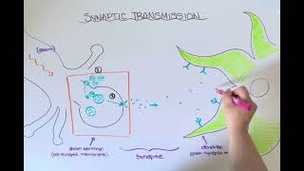
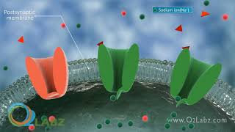
Re-cap: Synaptic Transmission

Slide 40
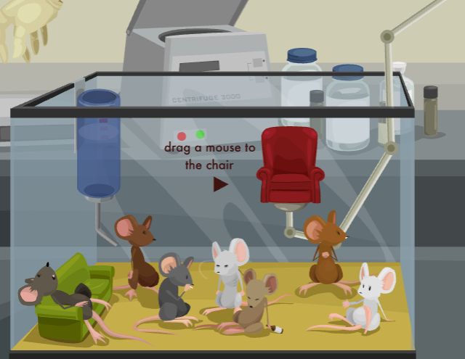
Drugs and the Nervous System
You do not need to memorize information in these next two slides. However, make sure you understand how drugs are able to alter synaptic transmission using these mechanisms.
DO, however, play around with the following simulation. The best way to understand many biological systems is to observe what happens when they are not functioning normally. https://learn.genetics.utah.edu/content/addiction/mouse/

Slide 41
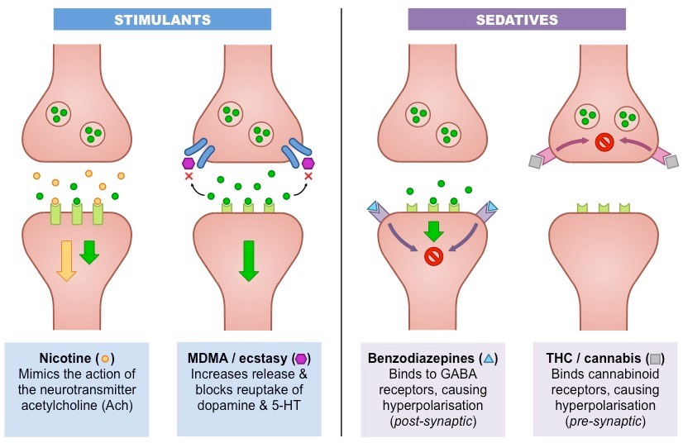
Action of Drugs at the Synapse
Mechanisms of stimulants
Drug mimics the neurotransmitter & stimulates the receptor.
Drug decreases the rate of neurotransmitter breakdown or re-uptake, leading to continued stimulation of the receptor.
Drug increases the rate of neurotransmitter release from the presynaptic neuron.

Slide 42
Action of Drugs at the Synapse
Mechanisms of depressants:
Drug blocks the receptor site so that the neurotransmitter cannot interact with the receptor.
Drug decreases synthesis & storage of a neurotransmitter at the presynaptic neuron.
Drug increases rate of breakdown of a neurotransmitter in the synapse.

Slide 43
11.2 & 11.3 Central & Peripheral Nervous System
Identify the principal structures & functions of the central and peripheral nervous systems (e.g. cerebral hemispheres and lobes, cerebellum, pons, medulla oblongata, hypothalamus, spinal cord, sympathetic and parasympathetic systems, sensory-somatic system)
Explain the functions of the central and peripheral nervous systems in regulating the voluntary (somatic) and involuntary (autonomic) systems
* Textbook pages 385-401

Slide 44
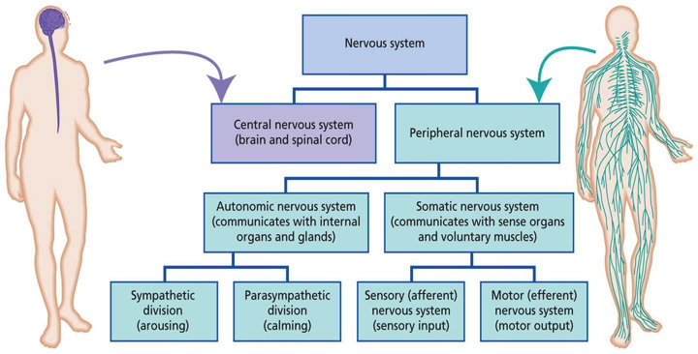
Nervous System Organization
Fight-or-flight
Rest and digest

Slide 45
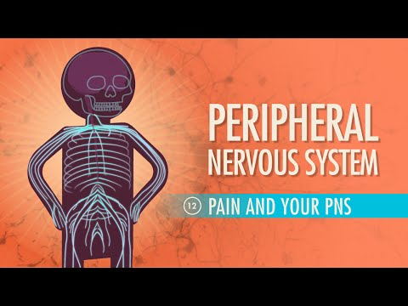
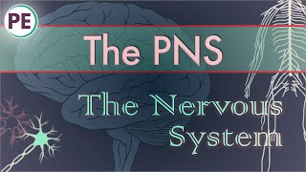
Peripheral Nervous System

Slide 46
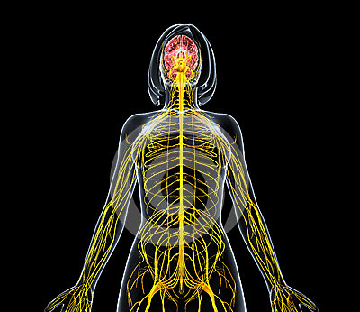
Peripheral Nervous System
The PNS consists of nerves which link the brain and spinal cord to the rest of the body, including sensory organs, muscles, glands, and internal organs.
Two main divisions:
The somatic system
voluntary control
carries info from sensory receptors to skeletal muscles using sensory and motor neurons
The autonomic system
involuntary control
maintains homeostasis (breathing, heart rate)

Slide 47

Subdivisions of the autonomic system:
many of the physiological changes in response to stress are detectable by polygraphs; heart rate, blood pressure, and breathing rate all tend to increase when someone is telling a lie
Sympathetic response (stress response)
“fight or flight” response
activated during stressful situations
the neurotransmitters acetylcholine & norepinephrine are released to excite muscles
Pupils dilate, blood pressure increases & heart beats faster to prepare your body
digestion slows and the bladder is constricted
Parasympathetic response
“rest and digest” response
activated when the body is calm and at rest
associated with the neurotransmitter acetylcholine
Pupils constrict, slows heart rate, reduces blood pressure, promotes digestion

Slide 48
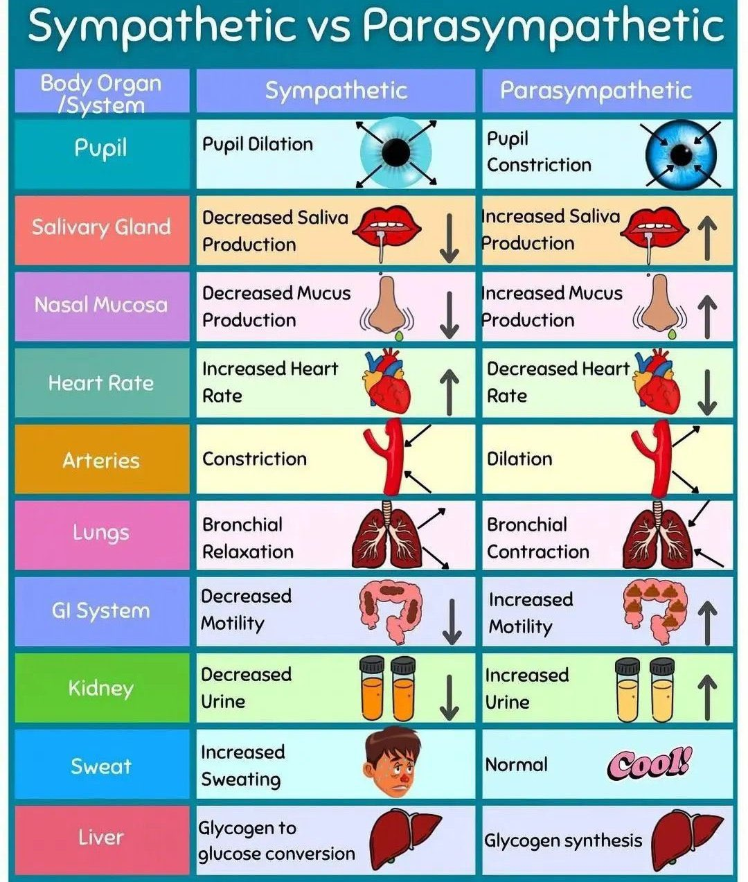
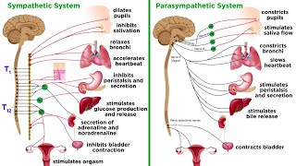

Slide 49
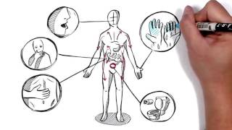

Extra: The Stress Response and Anxiety
The stress response, which triggers when our bodies perceive a threat, served an important evolutionary purpose in helping our ancestors survive dangerous situations. However, in modern times, stressors often aren't physical threats but rather psychological ones like exams, social pressures, or work deadlines. While the stress response can still help us cope with these challenges, if it's triggered too frequently or intensely, it can lead to chronic stress and anxiety. This is because our bodies aren't designed to handle prolonged periods of stress, and the constant activation of the stress response can have negative effects on both our physical and mental health, contributing to conditions like anxiety disorders.
Some strategies to help reduce anxiety based on our understanding of the autonomic nervous system.

Slide 50
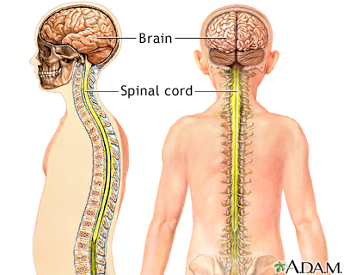
Central Nervous System
Composed of the brain and spinal cord, the central nervous system is the site of neural integration and processing.
Damage to the CNS can affect everything from temperament and motor control to the maintenance of homeostasis depending on which region is harmed.
The CNS consists of two types of nervous tissue: grey matter (unmyelinated neurons) & white matter (myelinated neurons)

Slide 51
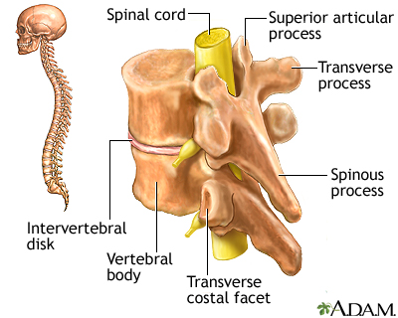
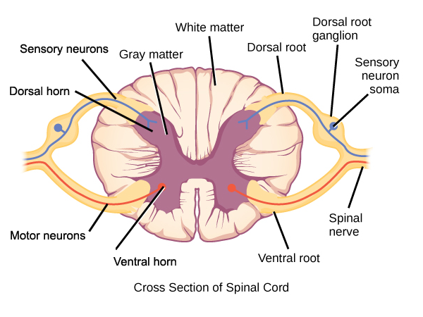
The Spinal Cord
The spinal cord provides a vital link for communication between the brain and peripheral nervous system…

Slide 52
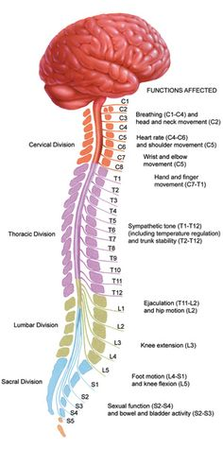
Each segment of the spinal cord is responsible for specific functions.
(Note: you don’t need to memorize the specific regions or what they affect)
The delicate tissues of the spinal cord are protected by cerebrospinal fluid and a series of vertebrae.
Injury to areas of the spinal column closer to the brain results in the loss of more functions compared to injury of areas closer to the abdomen.

Slide 53
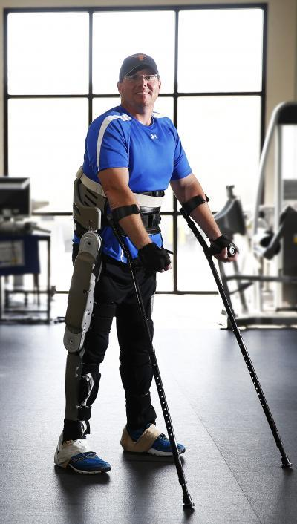
Extra: Levels of Paralysis
A spinal cord injury usually results in the area of the body below the injury site being partially or completely unable to communicate with the brain.
Paraplegia: If the injury occurs below the first thoracic vertebrae in the upper back region, the paralysis is likely to be confined to the legs. A paraplegic patient will retain full use of their arms and hands.
Quadriplegia: If the injury occurs above the first thoracic vertebrae in the cervical vertebrae or neck region of the body, the paralysis generally results in loss of movement in all limbs. Abdominal and chest muscles may also be affected, resulting in weakened breathing and the inability to properly cough to clear the chest.
Paraplegic patients are not necessarily confined to a wheelchair; modern prosthetics and stem cell treatment can provide an increased level of mobility

Slide 54

The Brain
The brain is the center for intelligence, consciousness, and emotion. It also regulates bodily functions without conscious thought (e.g. breathing).
Enclosed within the skull, the brain is surrounded by a tough three-layer membrane known as the meninges.
Cerebrospinal fluid circulates between the meninges and the spinal cord, acting as a shock absorber and a transport medium, carrying nutrients & waste to and from brain cells.
Brain intro:

Slide 55

General Organization
of the Brain
 | FOREBRAIN | MIDBRAIN | HINDBRAIN
Main Structures | cerebrum basal ganglia hippocampus amygdala thalamus hypothalamus | tectum tegmentum | pons cerebellum medulla
General Roles | Learning & memory, conscious thought, problem solving, coordination & voluntary actions | Transmits signals between the forebrain & hindbrain; associated with vision, hearing, temp. Regulation & alertness | The “primitive” brain; controls breathing, heart rate, blood pressure, sleep/wake cycles, and balance.

Slide 56


The Forebrain: Cerebrum
The forebrain or cerebrum is the largest part of the brain. It is divided into left and right hemispheres, and can be further categorized into four main lobes, each of which is responsible for a series of specific functions.
The surface of the cerebrum is referred to as the cerebral cortex. Composed of grey matter, the cortex has many folds which act to increase surface area.

Slide 57
The Forebrain: Cerebrum
Four Lobes of the Cerebrum
Frontal Lobe
conscious thought; decision making
intelligence, memory & personality
controls voluntary muscle movements
Parietal Lobe
somatosensory functions (touch)
processes information about body position
Temporal Lobe
auditory reception (hearing)
Occipital Lobe
processes visual information

Slide 58


The Forebrain: Cerebrum
Left & right hemispheres
Structures found in the left and right hemispheres are responsible for different functions
The left-hemisphere tends to be more analytical & concrete, while the right-hemisphere tends to be more creative & abstract
  However, there is a great degree of overlap and interaction between the
Communication between the two hemispheres occurs via the corpus callosum and is essential for integrating these functions

Slide 59

The Forebrain: Cerebrum
Extra: Broca’s vs. Wernicke’s Aphasia
Damage to the brain can lead to impairments in language, or aphasia.
Depending on which area is damaged, patients may experience difficulties with language production (Broca’s Aphasia) or language comprehension (Wernicke’s Aphasia).
In Broca’s Aphasia, patients are unable to produce fluent speech despite understanding what others are saying.
In Wernicke’s Aphasia, patients are able to produce fluent speech, but do not actually understand what they are saying/what is being said to them, so their words often do not make sense.
Patients with Broca’s Aphasia can learn to speak through song, as the area of the brain responsible for singing is different than the area responsible for speech.

Slide 60

Other key structures of the brain & their functions:
*
*
*
*
Oblongata
*will not be tested

Slide 61


Re-cap: Structures of the Brain

Slide 62

An in-depth understanding of the brain has helped inform a number of misunderstood issues…
(the next three slides are EXTRAs)

Slide 63

Example: Association between chronic depression/anxiety and early childhood trauma…
https://www.blueknot.org.au/Resources/General-Information/Impact-on-brain

Slide 64

Early childhood trauma actually changes the way the brain develops:

Slide 65

Another example: Addiction as a disease? Or a form of learning…

Slide 66

Re-cap: Nervous System Quick Summary
*10 minute review of everything up to this point

