Slide 1
BIOLOGY 30
UNIT C
Chapter 17
Mendelian Genetics

Slide 2
TOPIC 1:
Inheritance
Genes vs. alleles
Genotype vs. phenotype
Autosomal dominant vs. autosomal recessive modes of inheritance
Mendel's Law of Segregation
Single Trait Crosses including Monohybrid crosses
Punnett squares
Test crosses
Textbook pgs. 584-591

Slide 3
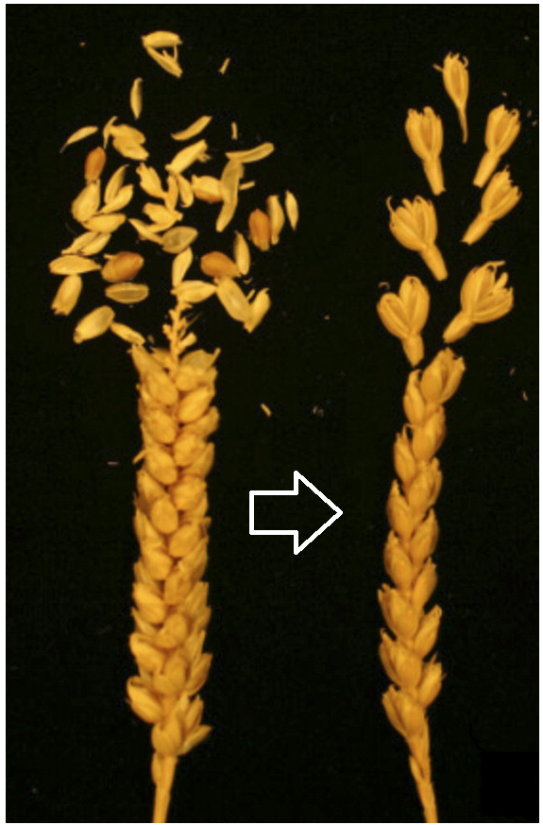
Selective Breeding
Selective breeding (i.e. artificial selection) is the process by which humans use animal breeding and plant breeding to selectively develop desired traits
We’ve been doing it for longer than most people realize…
“Accidental” selective breeding of wheat began as early as 9000 BC in the Middle East
Farmers were able to collect and plant the seeds of one variety of wheat more easily than the other, thus “selecting for” this former strain without realizing it

Slide 4
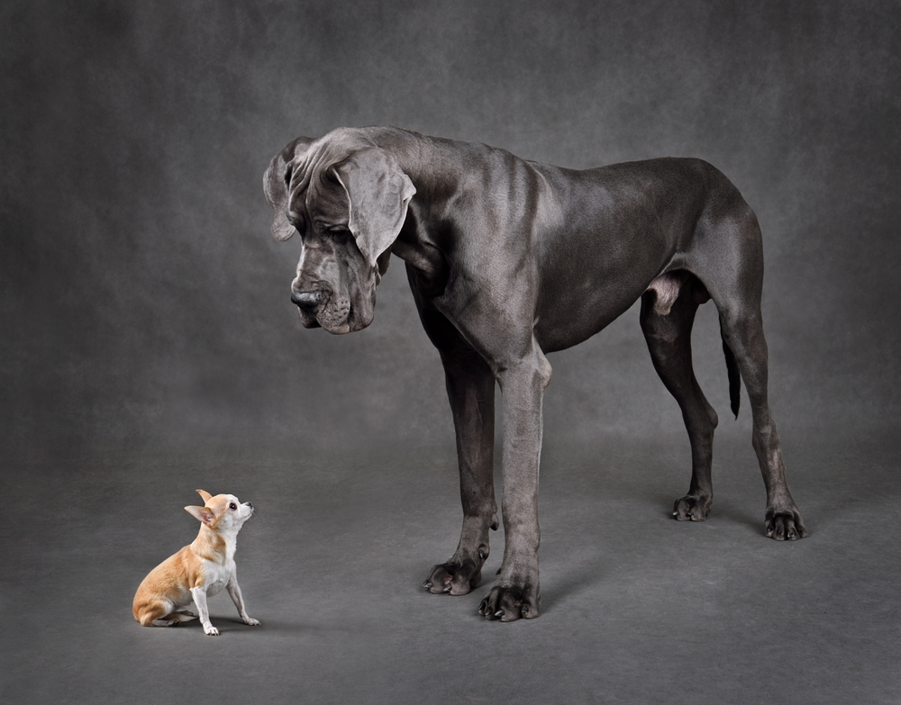
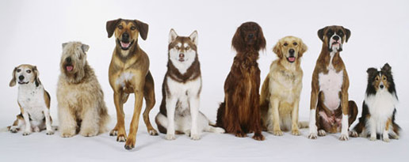
Through an understanding of genetics, we have been able to take advantage of selective breeding, leading to the development of new varieties of organisms with desirable traits and behaviours.

Slide 5
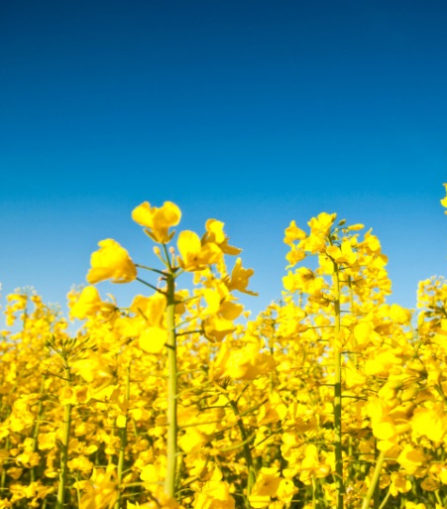
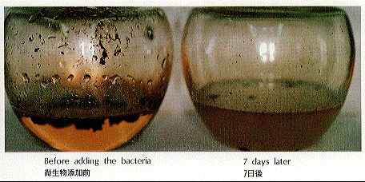
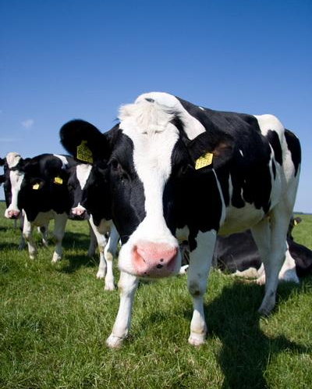
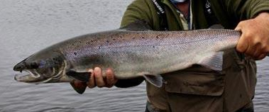
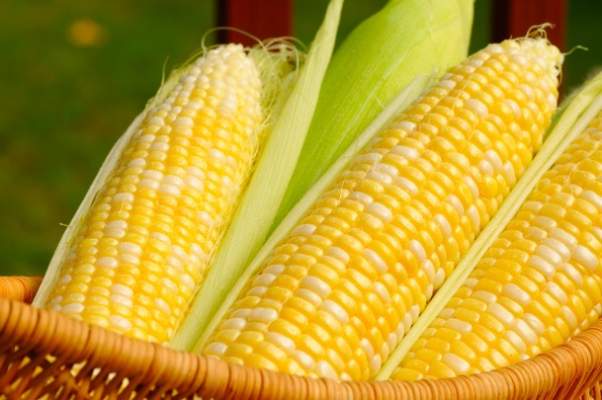
Other species that are the product of selective breeding:

Slide 6
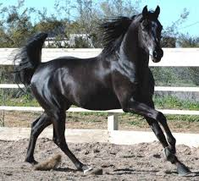
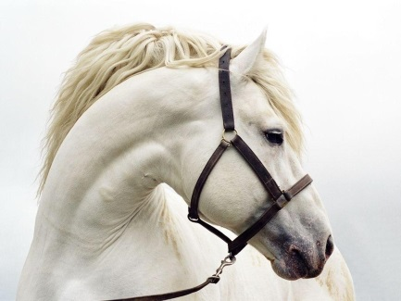
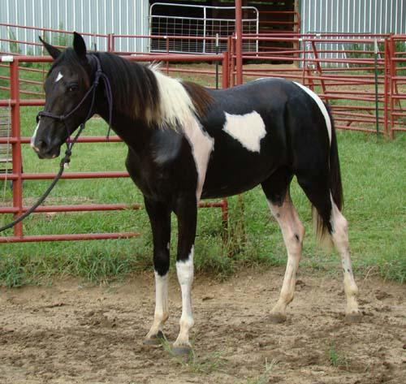
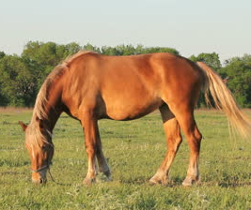
But how does it work???
?
?

Slide 7
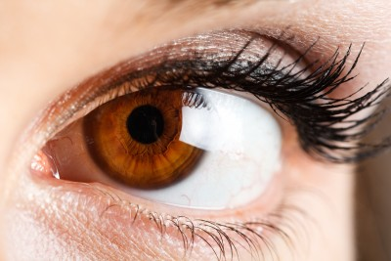
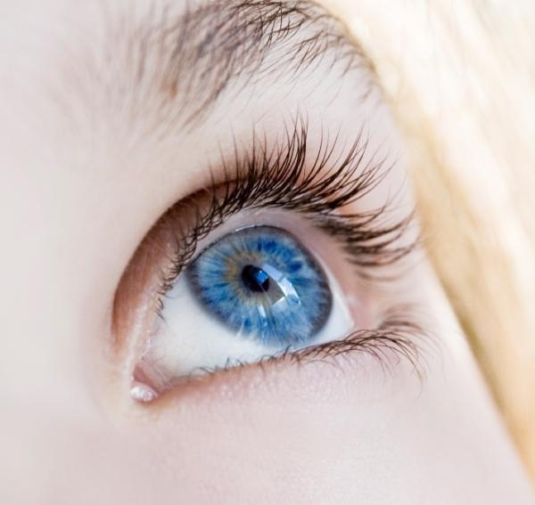
GENES, ALLELES AND TRAITS
Traits are determined by specific genes, or segments of DNA. Different variations of genes are known as alleles. In most cases, one allele is dominant over the other, influencing the way such genes are expressed…
The dominant allele (represented by capital letter) is always expressed when present
A recessive allele (represented by lowercase letter) is only expressed in the absence of the dominant allele.
The allele that encodes brown eyes (B), for example, is dominant over the recessive allele that encodes blue eyes (b).

Slide 8
PHENOTYPE VS. GENOTYPE
This means that although we receive genes from both parents, our characteristics are NOT determined by the “blending” of our parents traits. It is determined by the dominant vs. recessive interaction of the alleles we receive.
Phenotype refers to the outward expression of traits. For example, having brown eyes or having blue eyes.
Genotype on the other hand refers to the combination of alleles an individual has for a given trait.
For example, your teacher’s genotype for eye color is ‘bb’. Since she only has recessive alleles, this means that her phenotype is ‘having blue eyes’
Note: A phenotype isn’t always a visible trait like color. It could be a behaviour or a physiological trait, such as ‘able to digest lactose’ or ‘not able to digest lactose.

Slide 9
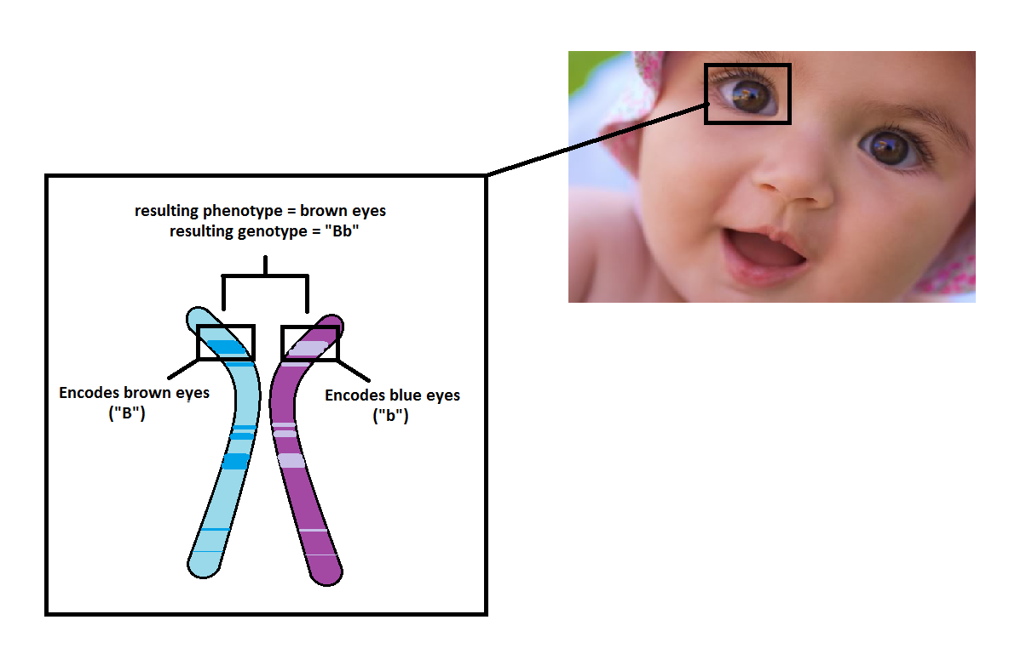
Another Example:
This child’s dad donated an allele encoding brown eyes (B). Her mom donated an allele encoding blue eyes (b). Because the “brown eye” allele or “B” is dominant to the “blue eye” allele or “b”, her eyes appear brown rather than blue.

Slide 10
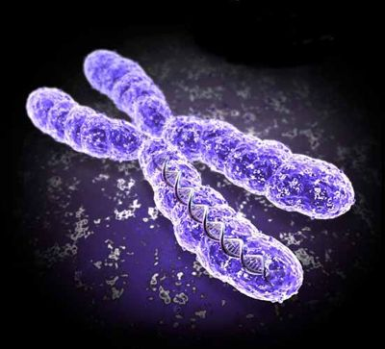
ALLELE COMBINATIONS
Homozygous - having two of the same alleles
Heterozygous - having two different alleles
If traits are influenced by the interaction of two alleles (one from the mom, one from the dad), and one allele is always dominant over the other, how many potential allele combinations are there for each trait?

Slide 11
Zygosity:
Homozygous means having two of the same alleles
Heterozygous means having two different alleles
For simple dominant-recessive traits there are three possible allele combinations:
BB (homozygous dominant)
Both parents gave a dominant allele
Results in dominant phenotype
Bb (heterozygous)
One parent gives a dominant allele, the other parent gives a recessive allele
Results in dominant phenotype
bb (homozygous recessive)
Both parents give a recessive allele
Results in recessive phenotype

Slide 12
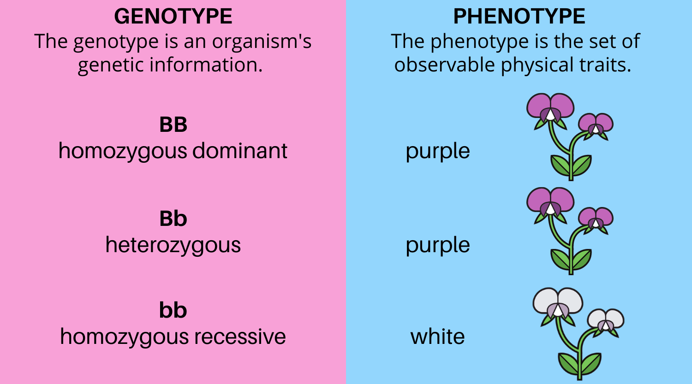
Genotype, Phenotype and Zygosity

Slide 13
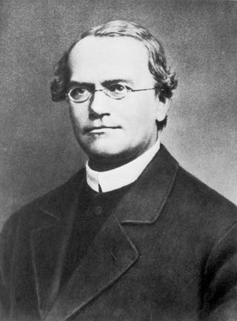
Mendelian Genetics
The idea of dominant and recessive alleles was first described by Gregor Mendel…
He conducted test crosses with peas of different phenotypes and realized that for each trait, offspring displayed either the maternal or paternal phenotype rather than a blending of the two.
E.g. a true-breeding (i.e. homozygous) plant with purple flowers crossed with a true-breeding (i.e. homozygous) plant with white flowers always produced offspring with purple flowers, not light purple as previously suggested by the blending theory of inheritance
Thus, he concluded that purple flowers were dominant to white

Slide 14
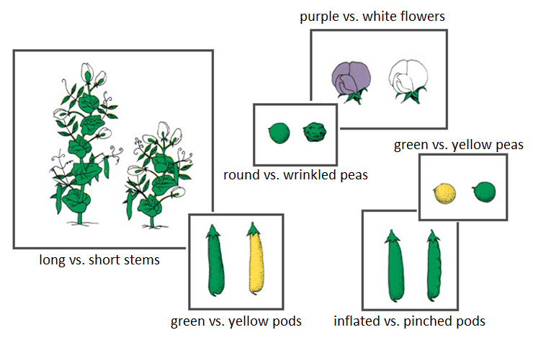
Some traits studied by Mendel:
Each trait is controlled by a single gene or set of alleles that, fortunately for Mendel, had a simple dominant-recessive relationship
(as we will see later, this is not always the case which would have really messed things up for him)

Slide 15
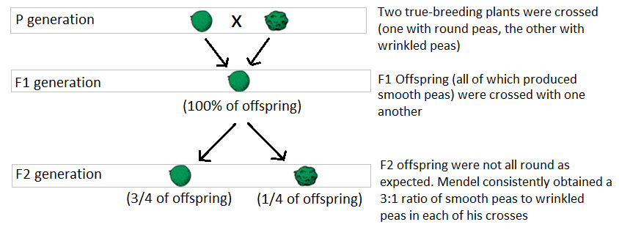
Mendel’s crosses yielded some very interesting patterns…
(P = Parental)
(F1 = First filial)
(F2 = Second filial)

Slide 16
How could traits that were not present in the F1 generation re-appear in the F2 generation? And why in such a predictable ratio?

Slide 17
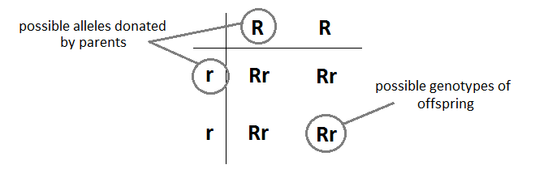
MENDEL’S TEST CROSSES:
Because all of the offspring from the initial cross (F1 gen.) are round, we know that round is dominant to wrinkled.
Parents are “purebred”; thus, the genotype of round parental plants is RR, and that of wrinkled parental plants is rr
Cross: RR x rr

Slide 18
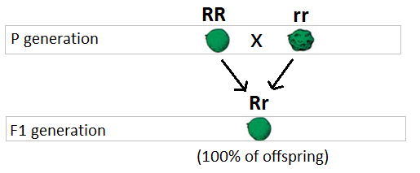
MENDEL’S TEST CROSSES CONT’D
Parents are RR (round) and rr (wrinkled), and F1 offspring are all Rr (round):
Now that we know the genotype of F1 individuals, we can use the same process to determine the genotype of F2 individuals…

Slide 19
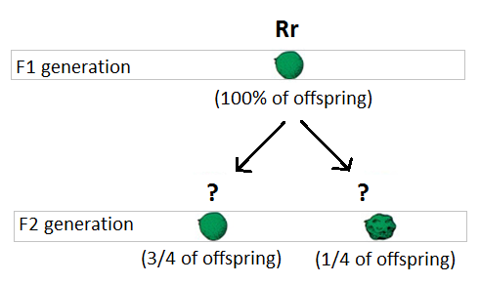
MENDEL’S TEST CROSSES CONT’D
Recall that the F2 generation are the offspring of a cross between individuals of the F1 generation:

Slide 20
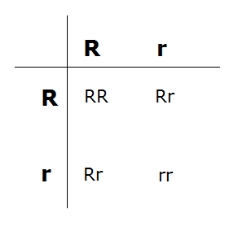
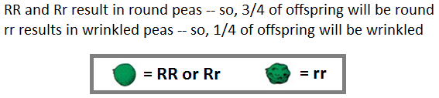
MENDEL’S TEST CROSSES CONT’D
Cross: Rr x Rr

Slide 21
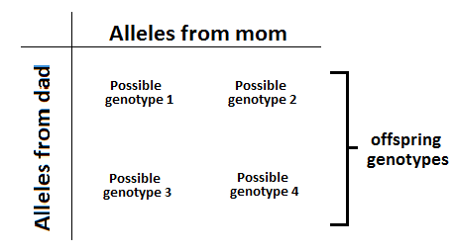
So, as long as we know the genotype of individuals being crossed, we can determine the ratio and potential genotypes of their offspring.
This is done through the use of a
Punnett Square:

Slide 22
Because of the particular way in which chromosomes align during metaphase I of meiosis, each of the four allele combinations is as likely as the other.

Slide 23
Collectively, these ideas are referred to as
The Law of Segregation:
All individuals have two copies of each gene. These copies segregate randomly during gamete formation, and each gamete receives one copy of every gene.
The Law of Segregation forms the basis of modern theories of inheritance.

Slide 24
Furthermore, Mendel observed that …
…when true-breeding parents with contrasting traits are crossed together, only one form of the trait appears in the next generation.
This is called the Law of Dominance.

Slide 25
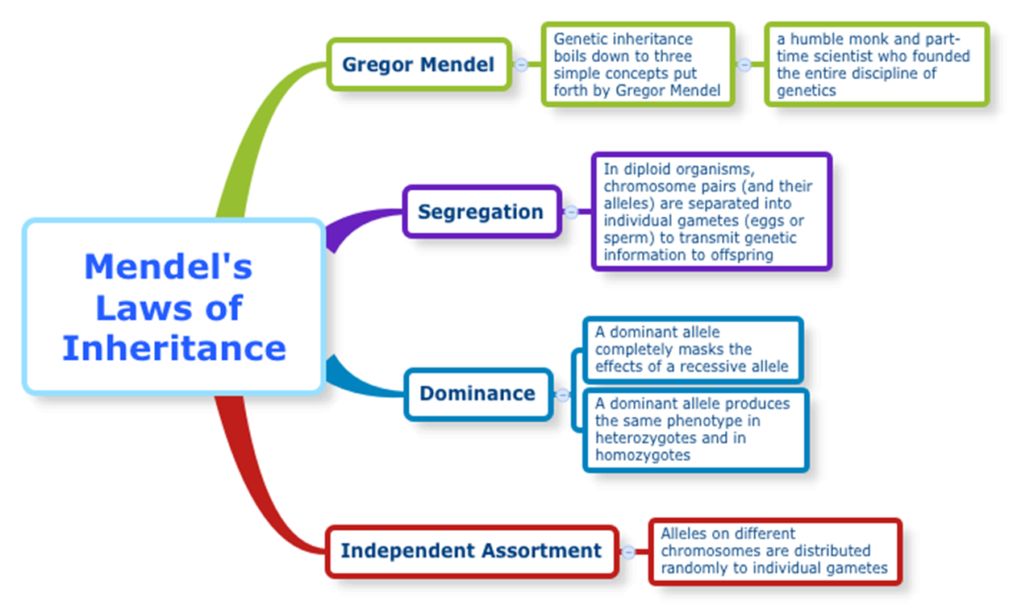
Altogether, Mendel’s experiments on pea plants allowed him to develop the following three laws. We have addresses the first two so far. The Law of Independent Assortment will be looked at in the next topic.

Slide 26
MODE OF INHERITANCE
Because of the Law of Segregation, as long as the mode of inheritance of a particular trait and the genotypes of two parents are known, we can use a Punnett Square to determine the possible genotypes of offspring.
Autosomal dominant mode of inheritance = trait is dominant & inherited on an autosome (as opposed to the sex chromosomes)
Autosomal recessive mode of inheritance = trait is recessive & inherited on an autosome (as opposed to the sex chromosomes)

Slide 27
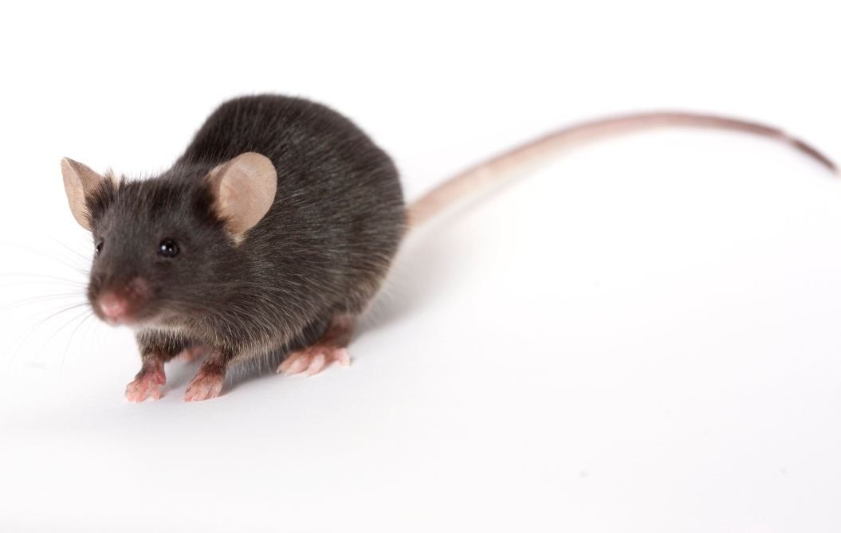
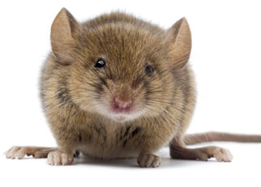
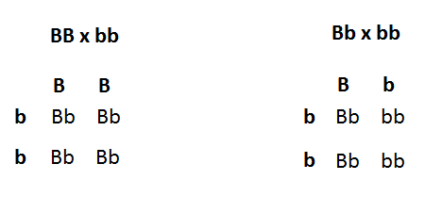
Single Trait Crosses
Example:
In mice, black fur is inherited in an autosomal dominant manner (black fur is dominant to brown fur)...
List the genotypes of a black mouse and a brown mouse.
If a heterozygous black mouse is crossed with a brown mouse, what is the probability that their offspring will have black fur? Brown fur?
Possible genotypes for a black mouse: BB or Bb
Possible genotype of a brown mouse: bb
?
The probability of having black fur is 2/4 = 1/2 or 0.50.
The probability of having brown fur is also 2/4 = 1/2 or 0.50.

Slide 28
If two heterozygous black mice are crossed, what will be the genotypic and phenotypic ratio of their offspring?
?
Bb x Bb
B b
B BB Bb
b Bb bb
Note:
A 1:2:1 genotypic ratio and/or a 3:1 phenotypic ratio is highly indicative that we are dealing with a monohybrid cross, which is a cross between two organisms that are both heterozygous for a single trait.
Genotypic ratio:
1 : 2 : 1
BB : Bb : bb
Phenotypic ratio:
3 : 1
Black : brown

Slide 29
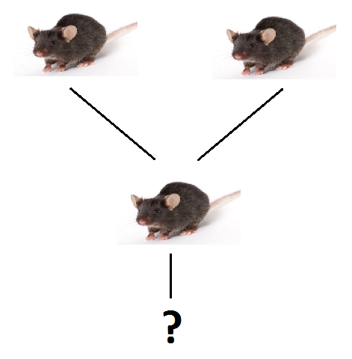
Is it possible for a homozygous black mouse and a heterozygous black mouse to have ‘children’ that are brown? How about “grandchildren” that are brown?
BB x Bb
B B
B BB BB
b Bb Bb
Bb x Bb
B b
B BB Bb
b Bb bb
No children will be brown, because each possible combination has at least one dominant black allele.
If two of the heterozygous children from the F1 generation reproduce, they will have a ¼ chance of having brown offspring. So yes!

Slide 30
Is it possible for a homozygous black mouse and a heterozygous black mouse to have ‘children’ that are brown? How about “grandchildren” that are brown?
Bb x Bb
B b
B BB Bb
b Bb bb
We just observed how recessive phenotypes can ‘skip’ generations. This is because they are being masked by the dominant allele, but they are still present and will show up if paired with another recessive allele.
If two of the heterozygous children from the F1 generation reproduce, they will have a ¼ chance of having brown offspring. So yes!

Slide 31
Test Crosses
An individual with the dominant phenotype could be either homozygous (BB) or heterozygous (Bb). By performing a test cross, we can determine the true genotype of such individuals.
Cross the unknown individual (B?) with an individual who displays the recessive phenotype (bb) (because their genotype is known):
There are two possible outcomes:
If the unknown was homozygous, all offspring will show dominant phenotype
If heterozygous, some (typically half) offspring will show recessive phenotype

Slide 32
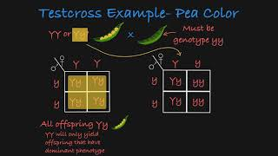
Test Crosses
There are two possible outcomes:
If the unknown was homozygous, all offspring will show dominant phenotype
If heterozygous, some (typically half) offspring will show recessive phenotype
Note: This will typically require sufficient number of offspring so we can feel confident about which outcome we are observing. If the recessive phenotype is present, this is sufficient to conclude that the unknown must have been heterozygous. But we need a good number of offspring showing only the dominant phenotype to feel confident declaring the unknown homozygous, to rule out it occurring due to random chance.

Slide 33
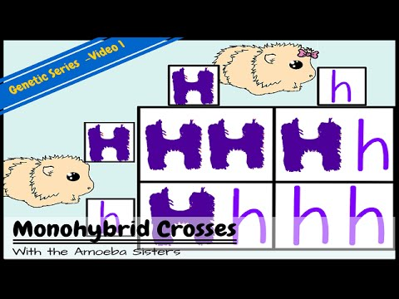
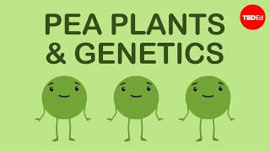
Inheritance and Punnett Squares Recap

Slide 34
TOPIC 2: TWO TRAIT CROSSES
Two trait crosses including dihybrid crosses
Independent assortment
Textbook pgs. 591-593

Slide 35
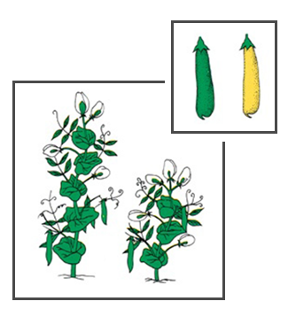
Dihybrid Crosses
Mendel also conducted experiments to determine whether the pattern of segregation of alleles for one gene had any influence on that of another gene…
E.g. Plant size and pod colour:
Are plants with the “tall” allele just as likely to have the allele that encodes green pods as the allele that encodes yellow pods?

Slide 36
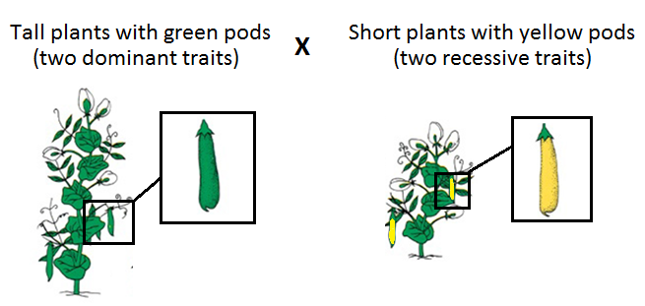

Two true-breeding plants for two different traits are crossed…
ttgg

Slide 37
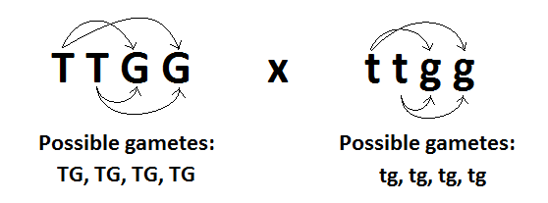
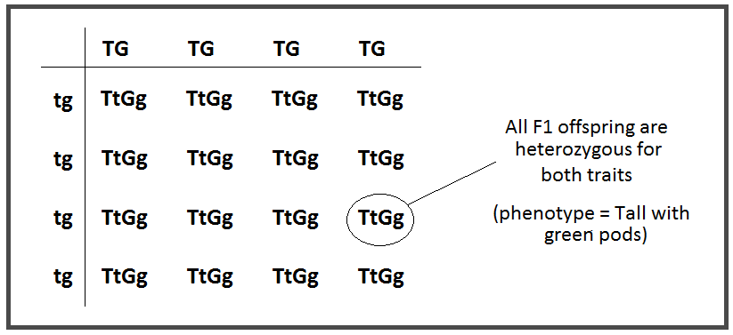
F1 Generation:

Slide 38
Like in the F2 generation of Mendel’s monohybrid crosses, crossing of
F1 individuals produces a predictable phenotypic ratio in the F2 generation of dihybrid crosses as well…

Slide 39
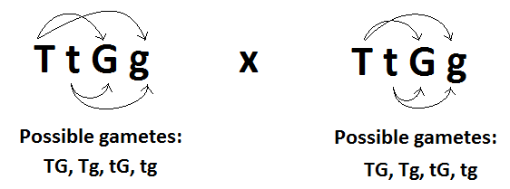
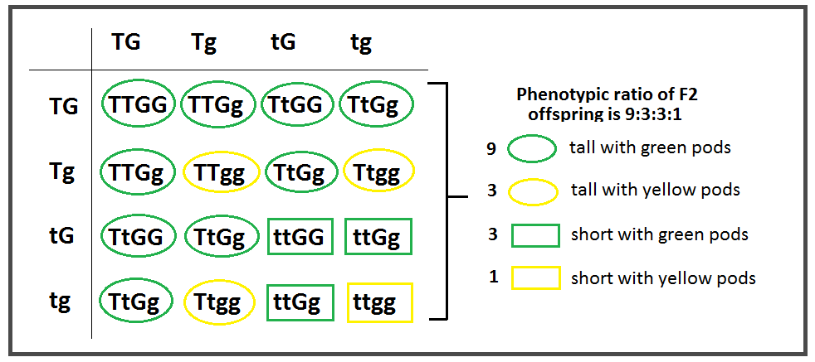
F2 Generation:

Slide 40
Because such crosses consistently yielded this 9:3:3:1 ratio, Mendel concluded that the segregation of alleles for one gene had no influence on the segregation of alleles for another gene…
This is known as Mendel’s Second Law, or the Law of Independent Assortment:
The two alleles for one gene segregate independently of alleles for other genes during gamete formation.

Slide 41
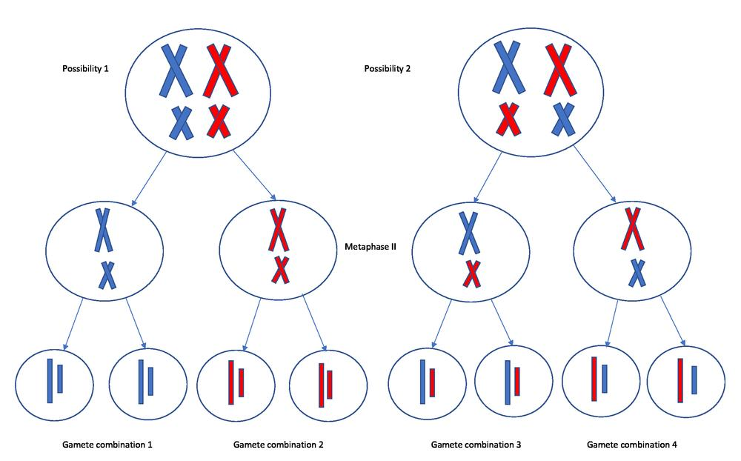
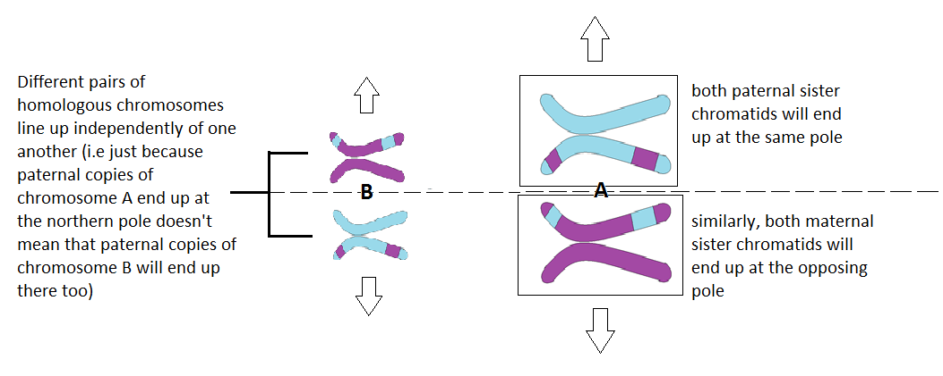
Law of Independent Assortment
The two alleles for one gene segregate independently of alleles for other genes during gamete formation.
Recall these diagrams from your notes on meiosis II where we discussed how chromosomes line up independently of one another during metaphase I. Take a moment to reflect on how this connects to the Law of Independent Assortment.

Slide 42
Now we have addressed all three laws of Mendel:

Slide 43
TWO TRAIT CROSSES
Example 1:
In tomatoes, red fruit is dominant to yellow fruit, and tall plants are dominant to short plants. A plant that is heterozygous for both traits is crossed with a plant that is heterozygous for the gene encoding height, and homozygous recessive for the gene encoding fruit colour.
What are the phenotypes & genotypes of the plants being crossed?
‘Red fruit is dominant to yellow’ so let’s use ‘R’ to represent red and ‘r’ to represent the yellow allele.
Similarly, if ‘tall is dominant to short’ let’s use ‘T’ to represent the tall allele and ‘t’ to represent the short allele.
So the parents phenotypes and genotypes are:
 | genotype | phenotype
Plant that is heterozygous for both traits | RrTt | Red and tall
Plant that is heterozygous for height and homozygous recessive for color | rrTt | Yellow and tall

Slide 44
TWO TRAIT CROSSES
Example 1:
In tomatoes, red fruit is dominant to yellow fruit, and tall plants are dominant to short plants. A plant that is heterozygous for both traits is crossed with a plant that is heterozygous for the gene encoding height, and homozygous recessive for the gene encoding fruit colour.
b. What proportion of offspring will be…
  tall with red fruit?
  tall with yellow fruit?
  short with red fruit?
  short with yellow fruit?
Step 1 with a cross is to identify the genotypes of the parents. This we have already done in part a:
RrTt x rrTt
Step 2 is to identify the possible gametes and set up the Punnett Square. Not all two trait crosses will require a large 4x4 Punnett Square. Just identify the possible gametes and construct accordingly.
Rr Tt x rrTt
So parent 1 can make the RT, Rt, rT, and rt gametes, while parent 2 can only make rT and rt gametes.
There is no need to consider the other four combinations because they will be repeat and will not impact the ratio.

Slide 45

TWO TRAIT CROSSES
Example 1:
In tomatoes, red fruit is dominant to yellow fruit, and tall plants are dominant to short plants. A plant that is heterozygous for both traits is crossed with a plant that is heterozygous for the gene encoding height, and homozygous recessive for the gene encoding fruit colour.
Step 3 Use the gametes to set up and fill out a Punnett Square
Tip: use lots of space for your Punnett square so you can color code or fill out phenotypes directly in the boxes.
 | rT | rt
RT | RrTT Red and tall | RrTt Red and tall
Rt | RrTt Red and tall | Rrtt Red and short
rT | rrTT Yellow and tall | rrTt Yellow and tall
rt | rrTt Yellow and tall | rrtt Yellow and short
Step 4 Use information to answer question.
b. What proportion of offspring will be…
  tall with red fruit? 3/8
  tall with yellow fruit? 3/8
  short with red fruit? 1/8
  short with yellow fruit? 1/8

Slide 46
TWO TRAIT CROSSES
Example 2:
In summer squash, white fruit color (W) is dominant over yellow fruit color (w) and disk-shaped fruit (D) is dominant over sphere-shaped fruit (d). A plant that produces yellow, disk-shaped fruit is crossed with a plant that produces white, sphere-shaped fruit.
What are the potential genotypes of the plants being crossed?
We know that the parents display some of the dominant phenotypes, but we don’t know just yet whether they are homozygous dominant or heterozygous for those traits, since both cases would display the dominant phenotype. We can represent this unknown allele by the line:
wwD_ x W_dd
b) Some of the offspring have yellow, sphere-shaped fruit. What does this tell us about the genotypes of the parents?
The genotype of these offspring with yellow, sphere-shaped fruit must be homozygous recessive for both traits, so wwdd. This is only possible, if BOTH parents had a copy of both w and d alleles.
So the parent cross must be:
wwDd x Wwdd

Slide 47
TWO TRAIT CROSSES
Example 2:
In summer squash, white fruit color (W) is dominant over yellow fruit color (w) and disk-shaped fruit (D) is dominant over sphere-shaped fruit (d). A plant that produces yellow, disk-shaped fruit is crossed with a plant that produces white, sphere-shaped fruit.
c) If this parental cross produces 80 seeds, how many of those seeds would give rise to
wwDd x Wwdd
White flowering squash?
Squash with yellow and sphere-shaped flowers?
Portion of seeds that will give rise to white flowering squash is 2/4 or ½ or 0.5. To calculate the actual number of squash, we simply multiple the total number by this decimal value:
80 x 0.50 = 40 squash
 | Wd | wd
wD | WwDd White and disk | wwDd Yellow and disk
wd | Wwdd White and sphere | wwdd Yellow and sphere
¼ = 0.25
0.25 x 80 = 20 squash

Slide 48
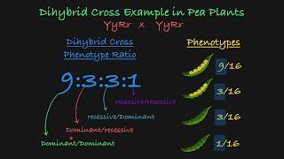
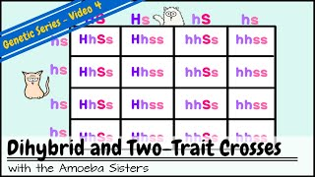
Two Trait Crosses Recap
This was a short lesson, but ensure that you do all of the assigned practice before moving on, as more complexity is coming. You want to feel comfortable working with one trait and two trait crosses for these ‘simple’ dominant/recessive allele relationships
Note: You don’t actually need to do a 4x4 punnett square for the example in the second video. If you notice, each column will look the same!

Slide 49
TOPIC 3:
OTHER MODES OF INHERITANCE
Incomplete dominance
Codominance
Sex-linked traits
Multiple alleles
Blood types
Textbook pgs. 594-598 and 601-609

Slide 50
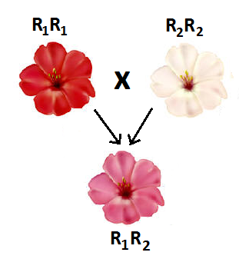
Other Modes of Inheritance
INCOMPLETE DOMINANCE
Occurs when neither allele on a particular gene can mask the presence of the other (i.e. there is no true “dominant” allele)
Two alleles of the same variety are required to fully express their phenotype; heterozygotes thus display partial expression of each → we see an intermediate phenotype
Upper and lowercase letters not used when representing incomplete dominance, rather two capitals letters.

Slide 51
Example:
In some varieties of flowering plants, petal colour is determined by two alleles which demonstrate incomplete dominance. One version of the allele, R₁, encodes red flowers, while another version of the allele, R₂, encodes white flowers.
Determine the genotype of each of the following plants:
A plant with red flowers
A plant with pink flowers
A plant with white flowers
A plant with red flowers is crossed with a plant with pink flowers. What proportion of offspring will also have pink flowers?
R₁R₁
R₁R₂
R₂R₂
R₁R₁ x R₁R₂
R₁ R₂ ½ = 0.50 will have pink flowers
R₁ R₁R₁ R₁R₂

Slide 52
Example:
In some varieties of flowering plants, petal colour is determined by two alleles which demonstrate incomplete dominance. One version of the allele, R₁, encodes red flowers, while another version of the allele, R₂, encodes white flowers.
c. Is it possible for the cross described in part b to produce offspring with white flowers? Explain.
No, it is not. The only way an offspring is white is if it is R₂R₂, which means both parents would have to have a copy of the R₂ allele.

Slide 53
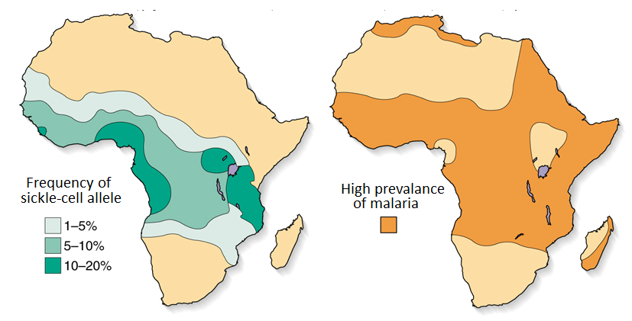
Another example:
Sickle-cell anemia is one form of incomplete dominance where heterozygotes actually have increased evolutionary fitness under certain circumstances…

Slide 54
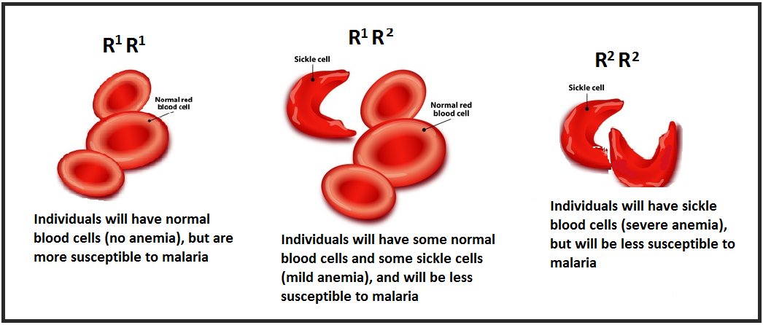
Sickle-cell anemia (incomplete dominance):
R₁R₁ x R₁R₂
R₁ R₂
R₁ R₁R₁ R₁R₂
If a homozygous man with normal blood cells has children with a heterozygous woman, what is the probability that their children will be born with severe anemia?
What percentage of their children will be more likely to survive if exposed to malaria?
0.00
½ → 50%

Slide 55
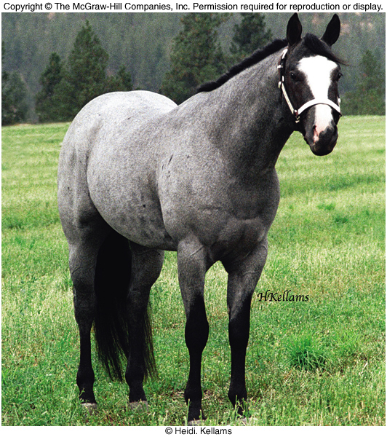
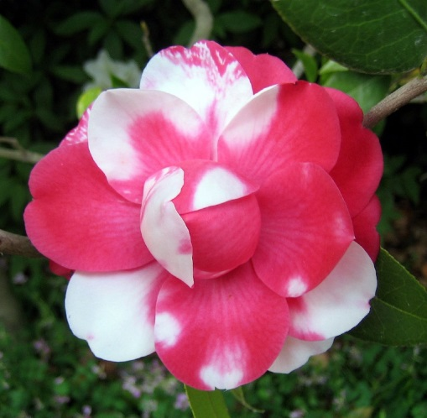
CODOMINANCE
Both alleles on a particular gene are fully expressed (i.e. two equally “dominant” alleles)
Both alleles require just one copy to fully express their phenotype; heterozygotes thus express one allele in certain cells and the opposing allele in others

Slide 56
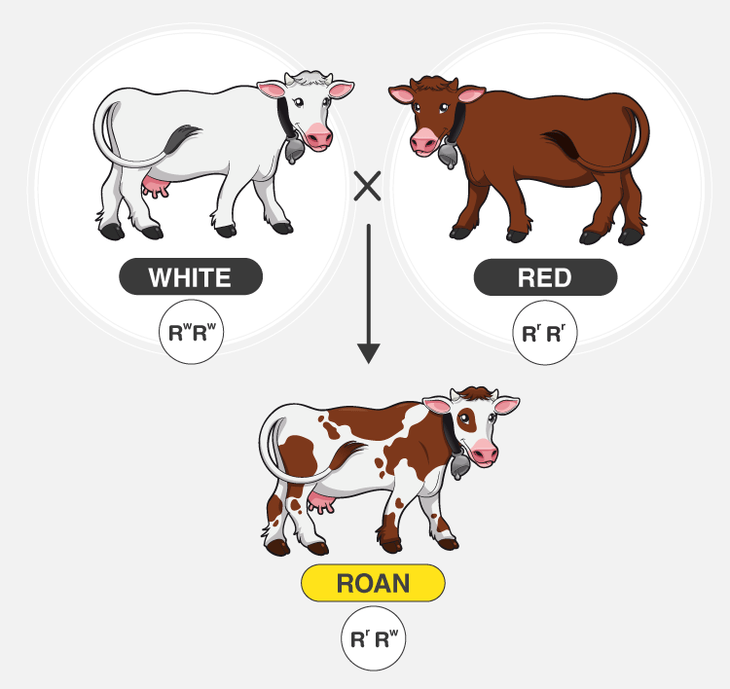
The ‘roan’ coloring in cattle is an example of codominance. The white allele and red allele both get expressed when present.

Slide 57
Example:
In other varieties of flowering plants, petal colour is determined by two alleles which demonstrate codominance. One version of the allele, R₁, encodes red flowers, while another version of the allele, R₂, encodes white flowers.
Determine the phenotype of each of the following plants:
R₁R₁
R₁R₂
R₂R₂
A plant with red flowers is crossed with a heterozygous plant. What proportion of offspring will also have red flowers?
Red
Red and white
White
R₁R₁ x R₁R₂
R₁ R₂ ½ = 0.50 will have red flowers
R₁ R₁R₁ R₁R₂

Slide 58
Example:
Roan coloring is an example of codominance between the white and red coloring alleles. Determine the genotypic and phenotypic ratios of the F1 generation when a roan cow is crossed with a roan bull.
Let R₁ represent the red allele and R₂ represent the white allele. So our cross is:
R₁R₂ x R₁R₂
R₁ R₂
R₁ R₁R₁ R₁R₂
R₂ R₁R₂ R₂R₂
Genotypic ratio:
1 : 2 : 1
R₁R₁ : R₁R₂ : R₂R₂
Phenotypic ratio:
1 : 2 : 1
red : roan : white

Slide 59

SEX-LINKED TRAITS
Genes that are located on the X or Y chromosome display different inheritance patterns than genes located on autosomes (chromosomes 1-22)
This is because males do not receive an X-chromosome from their father, and females must inherit their father’s single X-chromosome
Colour blindness is a recessive trait carried on the x-chromosome

Slide 60

X-linked traits were discovered by Thomas Hunt Morgan through experiments with fruit flies (Drosophila melanogaster).
He observed that white-eyed mutations appeared only in male flies when a red-eyed female was crossed with a white-eyed male.
Morgan proposed that the gene for eye color was on the X chromosome. Males (XY) inherit this trait directly from their mother, while females (XX) can carry the mutation without expressing it if they have one normal copy. This was the first evidence linking genes to specific chromosomes, shaping our understanding of sex-linked inheritance.

Slide 61

Example: Colour Blindness
(Mode of inheritance: X-linked recessive)
To have regular vision, a dominant allele must be present. So,
  in females, two recessive alleles are required to be colour blind
  In males, there is no second X-chromosome to carry a possible dominant allele; thus, only one recessive allele is required be colour blind. This is why colour blindness is more common in males.

Slide 62
Alright..things are going to get a little confusing when working with sex-linked traits. First, we MUST use the chromosomes X and Y alongside the uppercase/lowercase letters to denote it is sex-linked and to calculate appropriate probability. Second, we must be careful with reading the question to know what it is looking for. Is it asking for a child, a son, an affected daughter, etc.?
carrier: an organism that is heterozygous and ‘carries’ the recessive allele. You can not be a carrier for a dominant gene. You either have the condition or not in that case.
Example 1:
A woman who is a carrier for color blindness and a man with normal vision have children.
What is the probability of their next…
child being color blind?
son being color blind?
daughter being color blind?
child being a son who is color blind?
Let X^{B} represent the normal vision allele and X^{b} represent the recessive color blind allele. So our cross is:
X^{B}X^{b} x X^{B}Y
X^{B} Y
X^{B} X^{B}X^{B} X^{B}Y
X^{b} X^{B}X^{b} X^{b}Y
1/4 = 0.25
1/2 = 0.5 (50% of sons color blind)
Normal vision
0/2 = 0 (none of the daughters will be colorblind)
Color blind
1/4 = 0.25

Slide 63
Alright..things are going to get a little confusing when working with sex-linked traits. First, we MUST use the chromosomes X and Y alongside the uppercase/lowercase letters to denote it is sex-linked and to calculate appropriate probability. Second, we must be careful with reading the question to know what it is looking for. Is it asking for a child, a son, an affected daughter, etc.?
Example 2:
A woman who is color blind and a man with normal vision have children.
What is the probability of their next…
child being color blind?
son being color blind?
daughter being color blind?
child being a son who is color blind?
Let X^{B} represent the normal vision allele and X^{b} represent the recessive color blind allele. So our cross is:
X^{b}X^{b} x X^{B}Y
X^{B} Y
X^{b} X^{B}X^{b} X^{b}Y
X^{b} X^{B}X^{b} X^{b}Y
2/4 = 0.5
2/2 = 1 (100% of sons color blind)
Normal vision
0/2 = 0 (none of the daughters will be colorblind)
Color blind
2/4 = 0.5

Slide 64
Let X^{B} represent the normal vision allele and X^{b} represent the recessive color blind allele. So our cross is:
X^{b}X^{b} x X^{B}Y
X^{B} Y
X^{b} X^{B}X^{b} X^{b}Y
X^{b} X^{B}X^{b} X^{b}Y
Normal vision
Color blind
In the previous example, we observed that when we are dealing with an X-linked recessive trait:
an affected mother will have all her sons affected
an unaffected father will ‘save’ all her daughters and none of them will be affected
This is why x-linked conditions are more common in men.

Slide 65


EXTRA BUT FUN AND RELEVANT!
BARR BODIES
Although females carry two X-chromosomes in each of their cells, only one of these chromosomes is active; the other one condensed into what is called a Barr Body.
The particular X chromosome that is inactivated in each cell is completely random. This mode of inheritance accounts for the colour patterns seen in tortoiseshell and calico cats. These are female cats that are heterozygous for the X-linked color traits. Each cell randomly inactivates an X chromosome and will express a random available color. Therefore only female cats can have this random coloring pattern!
To read more: https://www.bio.miami.edu/dana/dox/calico.html

Slide 66

Note: We focused on examples on the X-chromosome (i.e. X-linked traits) mainly. There are Y-linked traits as well, but because only males have/need the Y-chromosome, there are a lot less genes on this and these are typically only relevant to male development and functioning. This is also why the Y-chromosome is much smaller than the X-chromosome.
So we often use sex-linked and X-linked interchangeable, because most sex-linked traits are X-linked.

Slide 67
MULTIPLE ALLELES
Often, more than two alleles may exist for a particular trait (i.e. although an organism only inherits two alleles for each gene, many different alleles can exist within the population)
In humans, for example, a single gene determines blood type. However, three different alleles exist:
I^{A}, I^{B}, and i
Note: the gene is designated “I” or “i” depending on the presence of an antigen. I^{A} thus indicates the presence of an A antigen on red blood cells, and I^{B} indicates the presence of a B antigen. The absence of an antigen is marked by “i”

Slide 68

Alleles for blood type:
I^{A}, I^{B}, and i
Different combinations of these three alleles produce four different phenotypes, which are commonly referred to as A, B, AB, or O.
A = I^{A}I^{A} or I^{A}i
B = I^{B}I^{B} or I^{B}i
AB = I^{A}I^{B}
O = ii
Alleles I^{A} and I^{B} are codominant, but both are dominant over the recessive allele i.
Order of Dominance: I^{A} = I^{B} > i

Slide 69

Multiple Alleles
EXAMPLE 1:
A woman homozygous for blood type A has a child with a man heterozygous for blood type B. What is the probability that their child has the blood type AB?
½ of offspring will
have the AB blood type

Slide 70




Before we move on to the next example problem, let’s review some math around probability…
To calculate the probability of two independent events, we must multiply the probability of each event happening individually.
Example 1: The probability of toss a coin getting two heads in a row is:
Tossing a head
Tossing a head
Tossing two heads in a row
Example 2: The probability of tossing a head and rolling a 3.
Tossing a head
Rolling a 3
Tossing a head and rolling a three

Slide 71

EXAMPLE 2:
A woman with blood type B has a child with a man with blood type AB. The woman’s father had blood type O. What is the probability that their child is a son and has the blood type B?
Since the woman’s blood type is B, her genotype can be either I^{B}I^{B} or I^{B}i. However, since we are told that her father has blood type O, his genotype must be ii and therefore must have passed on a i allele to his daughter. So the woman’s genotype must be I^{B}i.
Therefore our cross is:
I^{B}i x I^{A}I^{B}
I^{A} I^{B}
I^{B} I^{A}I^{B} I^{B}I^{B}
i I^{A}i I^{B}i
Now we must remember that blood type and sex are independent events since they are not on the same chromosome. So we must multiply the individual probabilities:
Being a boy
Having blood type B
Being a boy and having blood type B
Simplified probability

Slide 72

POLYGENIC INHERITANCE
Many traits are controlled by more than one gene. As a result, phenotypes vary gradually from one extreme to another rather than displaying two discrete forms. These are referred to as continuous traits…
Skin colour and height are two examples of polygenic inheritance.

Slide 73


Recap of (almost) everything so far…

Slide 74
TOPIC 4: PEDIGREES
Pedigree symbols
Use of pedigrees to determine genotype
Use of pedigrees to determine mode of inheritance
Textbook pgs. 611-617

Slide 75


Pedigrees
A pedigree is a type of flowchart that uses symbols to show the expression of a particular trait through multiple generations of a single family.
From your data booklet:

Slide 76

PEDIGREES
Roman numerals are used to indicate generations. Numbers are used to indicate individuals within each generation.
PRACTICE:
How many offspring are produced by the individuals shown in generation 1?
Is individual 3 of generation II male or female?
List the offspring produced by individuals 2 & 3 of generation II.
How many individuals in total comprise generation IV?
3
M
III-2 and III-3
4

Slide 77

PEDIGREES: PREDICTING GENOTYPE
Pedigrees can be used to predict the genotype of a given individual…
What is the genotype of individual 3 in generation I?
What must be the genotypes of individuals 1 & 2 in generation I?
What are the possible genotypes of individual 6 in generation II?
Is it possible for individuals 7 & 8 of generation II to produce an affected child?
Mode of Inheritance:
Autosomal Dominant
dd
Dd and Dd → only way to produce the unaffected offspring II-7
DD or Dd are both possible
No, because they both must be dd → no way to pass on the dominant copy

Slide 78

PEDIGREES: PREDICTING GENOTYPE
What must be the genotypes of individuals 2 & 3 of generation II? How do you know?
What is the most likely genotype of individual 3 of generation III? How do you know?
Mode of Inheritance:
Autosomal Recessive
Rr and Rr → we know they must have at least a dominant copy as they are not affected. But they must also each have a recessive copy because they were able to produce affected offsprings.
It is most likely RR. Her partner, III-2 must be rr, and since none of their kids are affected this is likely because III-3 only has the dominant R allele. But technically, we can not be 100% certain since 4 kids is a relatively small sample size.

Slide 79

PEDIGREES: PREDICTING GENOTYPE
What must be the genotypes of individuals 1 & 2 of generation I?
What are the most likely genotypes of individuals 1 & 2 of generation II?
Mode of Inheritance:
X-linked Recessive
I-1: X^{R}X^{r} → X^{R} because not affected and X^{r} b/c she has an affected son, who must have received the X^{R} allele from mom.
I-2: X^{R}Y → not affected so must have X^{R} as well as a Y b/c male
II-1: X^{R}Y → not affected so must have X^{R} as well as a Y b/c male
II-2: most likely X^{R}X^{R} because none of her sons are affected.

Slide 80
PEDIGREES: PREDICTING GENOTYPE
If individual 4 of generation II has children with a woman who is heterozygous for the trait, what is the probability that
  they will produce an affected child?
  Their next son will be affected?
Mode of Inheritance:
X-linked Recessive
¼ = 0.25
½ = 0.50
X^{r}Y x X^{R}X^{r}
X^{R} X^{r}
X^{R} X^{R}X^{R} X^{R}X^{r}
Y X^{R}Y X^{r}Y

Slide 81

What are the genotypes of individuals 1 & 2 of generation I?
What is the probability that if individuals 6 & 7 of generation II have another girl, she will be affected?
Mode of Inheritance:
X-linked Dominant
I-1: X^{D}X^{d} → must have X^{D} b/c affected, and must have X^{d} b/c has unaffected son.
I-2: X^{d}Y → X^{d} b/c unaffected male
2/2 = 1 (100 % →dads affected with an X-linked dominant condition will pass it on to all their daughters)
X^{d}X^{d} x X^{D}Y
X^{D} Y
X^{d} X^{D}X^{d} X^{D}Y
X^{d} X^{D}X^{d} X^{d}Y

Slide 82

PEDIGREES: PREDICTING MODE OF INHERITANCE
Pedigrees can also be used to determine the mode of inheritance for a particular trait.
Example #1
CLUES:
both males and females are equally affected → not likely to be sex-linked
trait appears in all generations
affected children cannot be born to unaffected parents
affected parents can produce an unaffected child
Definitive clue that it is a dominant trait.

Slide 83

PEDIGREES
Predicting mode of inheritance
Example #1 = Autosomal Dominant

Slide 84


PEDIGREES
Predicting mode of inheritance
Example #2
CLUES:
both males and females are equally affected → not likely to be sex-linked
trait tends to skip generations
unaffected parents may produce affected offspring
Definitive clue that it is a recessive trait.

Slide 85


PEDIGREES
Predicting mode of inheritance
Example #2 = Autosomal Recessive

Slide 86

PEDIGREES
Predicting mode of inheritance
Example #3
CLUES:
only males affected → likely sex-linked
no transmission of trait from father to son → not Y-linked, so likely X-linked at this point
trait skips generations
Unaffected parents produce affected offspring → recessive

Slide 87

PEDIGREES
Predicting mode of inheritance
Example #3 = X-linked Recessive
All affected males must be X^{b}Y
All unaffected males must be X^{B}Y
Unaffected females can be either X^{B}X^{B} or X^{B}X^{b}
Affected females must be X^{b}X^{b}

Slide 88

PEDIGREES
Predicting mode of inheritance
Example #4
CLUES:
Females affected more than males
trait does not skip generations → likely dominant
affected sons have an affected mother
still no father to son transmission
All daughters born to an affected father are also affected → huge clue it is x-linked dominant

Slide 89

PEDIGREES
Predicting mode of inheritance
Example #4 = X-linked Dominant
All affected males must be X^{B}Y
All unaffected males must be X^{b}Y
Unaffected females must be X^{b}X^{b}
Affected females can be either X^{B}X^{b} or X^{B}X^{B}

Slide 90

As well as generally unequal distribution of males and females.
As well as generally unequal distribution of males and females.

Slide 91


Recap, and further explanation and examples of Pedigree problems

Slide 92

Extra: Genes and the Environment: Epigenetics
Recent findings have suggested that just because you possess a particular allele does not mean you will express it. This is due to epigenetics…
Genes can be turned “on” or
“off “ by methylation of the DNA
Environmental factors can trigger methylation
E.g. Breast cancer (people with the BRCA1 or BRCA2 allele are more likely to develop breast cancer, but only if something causes these genes to be turned “on”)
https://vimeo.com/248146854

Slide 93

Extra: Epigenetics

Slide 94
TOPIC 5: GENE LINKAGE & MAPPING
Evidence for gene linkage
Parental vs. recombinant gametes
Gene mapping
Textbook pgs. 599-601

Slide 95


GENE LINKAGE
Typically, the inheritance of a particular trait is thought to follow Mendel’s law of independent assortment, allowing us to accurately predict the phenotypic and genotypic ratios of offspring. Occasionally, however, genes may be observed as “breaking” this rule…
Genes that are located close together on the same chromosome are called linked genes.
Alleles for these genes tend to segregate together during meiosis unless they are separated by crossing over.
  Crossing over occurs when two homologous chromosomes exchange genetic material during meiosis I. The closer together two genes are on a chromosome, the less likely their alleles will be separated by crossing over

Slide 96

Unlinked genes found on different chromosomes will assort independently and yield all possible allele combination in a 1:1:1:1 ratio.
Ab:AB:ab:aB
1 : 1 : 1 : 1
Linked genes found on the same chromosomes will not assort independently and are only expected to yield the original/parental combinations:
Ab:AB:ab:aB
0 : 1 : 1 : 0
Linked genes found on the same chromosomes will not assort independently, however crossing over may occur between then, yielding some recombinants
Ab:AB:ab:aB
some : most : some : most
The farther apart the genes are, the greater the likelihood of crossing over and greater the number of recombinants.

Slide 97


Slide 98

Linkage Map for the Human X Chromosome. This linkage map shows the locations of several genes on the X chromosome. Some of the genes code for normal proteins. Others code for proteins that are associated with genetic disorders.
Which pair of genes would you expect to have a lower frequency of crossing over: the genes that code for hemophilia A and G6PD deficiency, or the genes that code for Protan and Xm?
Hemophilia A and G6PD would have a lower crossing over frequency because they are closer together. There’s a lower chance that the chiasma (break in the chromosome where crossing over occurs) will occur between these two genes.

Slide 99
However, because the genes for hair and eye colour are on the same chromosome, they will undergo crossing over less often, causing them to produce fewer recombinant gametes…
Non-linked genes = 50% parental gametes,
50% recombinants
Linked genes = less than 50% recombinants
The genes for hair and eye colour are therefore said to be linked.

Slide 100

Genes that are closer together on the same chromosome will cross over less frequently, thus producing fewer recombinant gametes. These genes are more closely linked than genes that are further apart on a chromosome…
For example, genes H and d will cross over less often than genes
B and H, thus producing fewer
recombinant gametes
Based on the number of recombinant gametes for each set of genes, then, we can determine their distance relative to one another on a chromosome (gene mapping)

Slide 101
In Summary...
Genes are more likely to be linked if they are found on the same chromosome
We know that two genes are linked if we see gametes with more parental genotypes than recombinant genotypes (because crossing over occurs less frequently when genes are on the same chromosome)
We also know that two genes are linked if we see a different ratio of parental & recombinant offspring than predicted

Slide 102
Gene Mapping
The relative distance between two genes on the same chromosome may be determined using a method known as gene mapping.
Recall that in non-linked (“normal”) genes, 50% of gametes will be parental, and 50% will be recombinant.
In linked genes, less than 50% of gametes will be recombinant due to reduced frequency of crossing over.
Genes that are closer together cross over less frequently. So, the lower the recombination frequency, the closer together they are.
For example, genes H and d will cross over less than genes B and H, producing fewer recombinant gametes.

Slide 103


Gene Mapping
Example:
In smurfs, white hair (H) is dominant to blonde hair (h), and large noses (N) are dominant to small noses (n).
A smurf heterozygous for both traits (HhNn) is crossed with a blonde haired, small nosed smurf (hhnn). If these two genes are NOT linked, what would we expect the phenotypic ratio of offspring to be?

Slide 104

Although this cross should yield a 1:1:1:1 phenotypic ratio, you observe the following…
6 offspring with white hair and large noses
2 offspring with white hair and small noses
2 offspring with blonde hair and large noses
6 offspring with blonde hair and small noses

Slide 105




6 offspring with white hair and large noses (HhNn)
2 offspring with white hair and small noses (Hhnn)
2 offspring with blonde hair and large noses (hhNn)
6 offspring with blonde hair and small noses (hhnn)
Recall that the original cross was
HhNn x hhnn…
Because there are more parental genotypes (HhNn and hhnn) than recombinants (Hhnn and hhNn) compared to the predicted ratio, we can conclude that the genes for hair colour and nose size are likely linked (i.e. they are on the same chromosome)
But how far apart are they?

Slide 106


With a recombination frequency of 25%, we may conclude that the genes for hair colour and nose size in smurfs is 25 map units apart:

Slide 107

Named in honour of Thomas Morgan
‘Map What’??
A map unit (mu), also known as a centiMorgan (cM), is a unit of measure for gene linkage. It describes how closely together are two gene loci (plural of locus) are located.
  A cM is about 1 million base pairs long, but we don’t want to think of it in terms of an actual physical distance, but rather as a measure of the recombination frequency and therefore how close together those two genes are, relatively speaking.
  For example, if hair colour and nose size are 25 map units apart, it means that 25% of the time they will cross over and create recombinants, as we have seen in this example

Slide 108
Now consider another trait on the same chromosome: eye colour (where brown eyes are dominant and blue eyes are recessive)
A smurf heterozygous for both eye colour and nose size (EeNn) is crossed with a smurf with blue eyes and a small nose (eenn), producing the following genotypic ratio:
7 EeNn (brown eyes, long nose)
1 Eenn (brown eyes, short nose)
1 eeNn (blue eyes, long nose)
7 eenn (blue eyes, short nose)
What is the position of the gene that encodes eye colour relative to the genes encoding nose size and hair colour?

Slide 109

The genes for eye colour and nose size are 12.5 map units apart, and we already know that the genes for nose size and hair colour are 25 map units apart. So…

Slide 110

* Note that a recombination frequency greater than 50% indicates that the genes are likely on different chromosomes (or are very far apart on the same chromosome) and therefore assort independently

Slide 111
PRACTICE:
Flies can be characterized by a number of traits, including…
Eye colour, where red eyes (E) are dominant to purple (e)
Body colour, where black (B) is dominant to grey (b)
Wing size, where large wings (L) are dominant to vestigial (l)
Use a Punnett Square to represent the cross between a purple-eyed fly with vestigial wings and a fly that is heterozygous for both eye colour and wing size. List the predicted phenotypic ratio of this cross IF the traits for eye colour and wing size are not linked.
eell x EeLl
 | EL | El | eL | el
el | EeLl | Eell | eeLl | eell
IF the traits are not linked, we can see in the Punnett square that the phenotypic ratio should be:
1 : 1 : 1 : 1
Red eyes red eyes purple eyes purple eyes
Large wings vestigial w. Large wings vestigial w.

Slide 112
Parental
Parental
Recombinant
Recombinant
A scientist performs the cross described above and obtains the following results:
40 EeLl
40 eell
10 Eell
10 eeLl
Label each genotype above as parental or recombinant.
Are the genes for eye colour and wing size linked? Explain how you know.
How far apart on the same chromosome are the genes for eye colour and wing size?
They are linked, because we did not observe the expected 1:1:1:1 ratio that we would expect if the genes would assort independently during meiosis.
Recombination frequency = 20/100 = 20%
The genes for eye color and wing size are 20 map units apart.

Slide 113
Two more crosses are conducted, and the following results are obtained:
Eye colour & body colour are found to have a recombination frequency of 14%
Body colour and wing size are found to have a recombination frequency of 6%
Given this information, construct a chromosome map for
the genes for eye colour, body colour, and wing size in flies.
Eye color
Bodycolor
Wing size

Slide 114


