Slide 1


Slide Deck 8: Fact vs Opinion and Journalism

Slide 2
What is a fact?
What is an opinion?

Slide 3
A fact is something that is known or proven to be true.
An opinion is a view or judgment formed about something, not necessarily based on fact or knowledge.

Slide 4
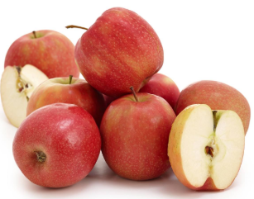
Fact vs. Opinion
Fact:
An apple is a fruit.
Opinion:
Apples are delicious.

Slide 5
What is journalism?

Slide 6

Journalism involves the gathering, evaluating and presenting of news and information to the public.

Slide 7
Fact-based journalism: Purpose is to inform.
Focuses on reporting on issues and events. While it may include analysis or assessment, it is based on facts, not opinion.
Opinion journalism: Purpose is to criticize, praise, interpret or persuade.
An opinion piece provides a viewpoint about an issue or event. It may not be neutral or balanced. Examples include editorials, columns and commentary.

Slide 8
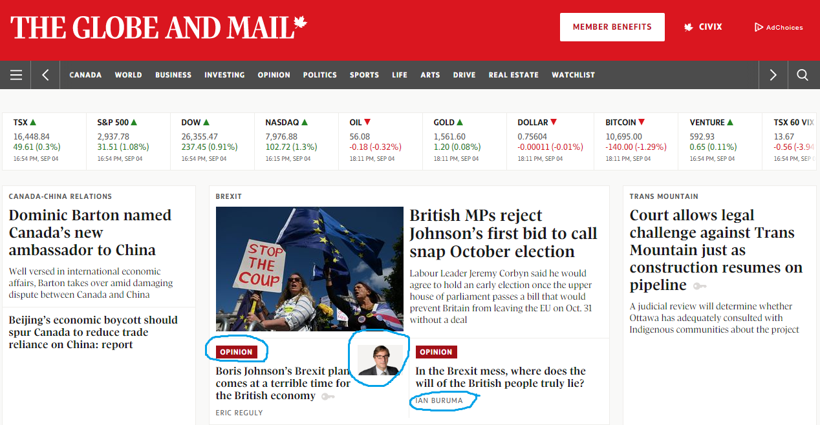
Look for signs that an article is an opinion-piece, such as labels, photos of journalists, or names of the authors up front.

Slide 9
Why is it important to distinguish between fact-based news reporting and commentary?

