Slide 1
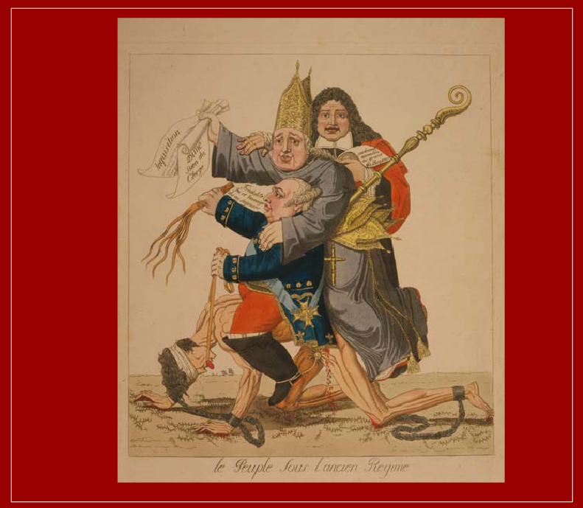

Slide 2
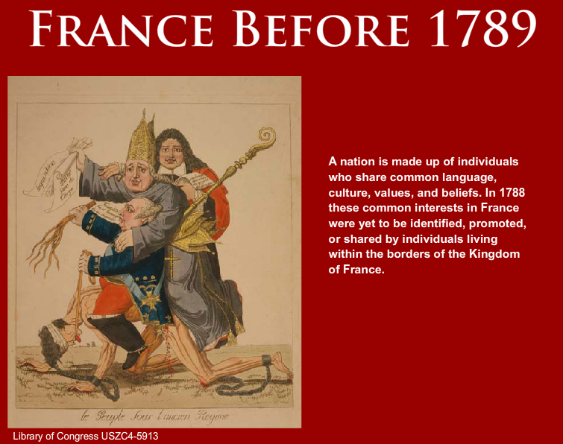

Slide 3
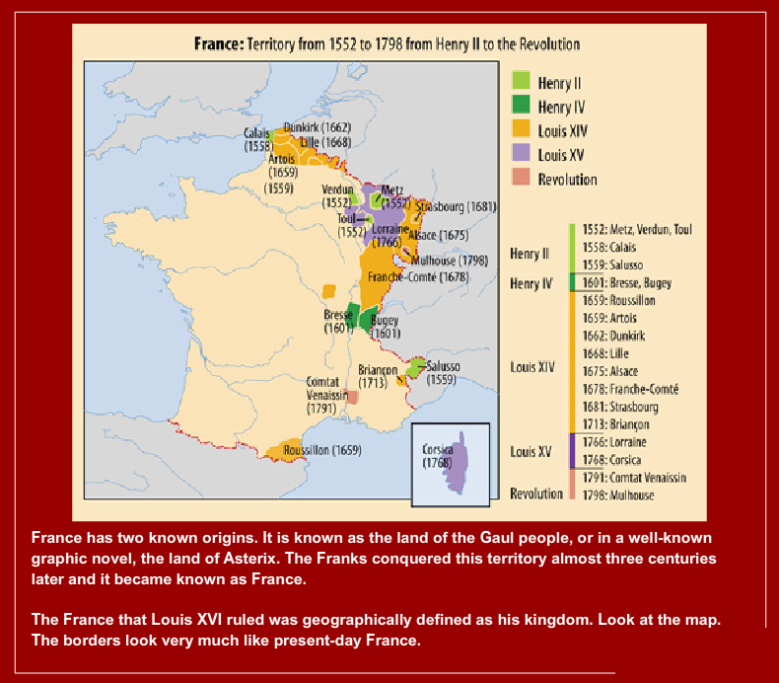

Slide 4
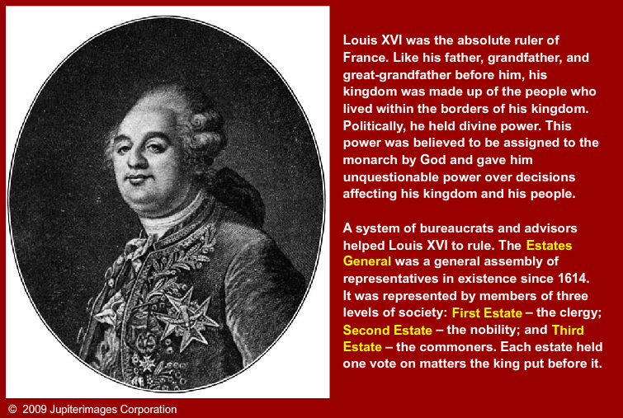

Slide 5
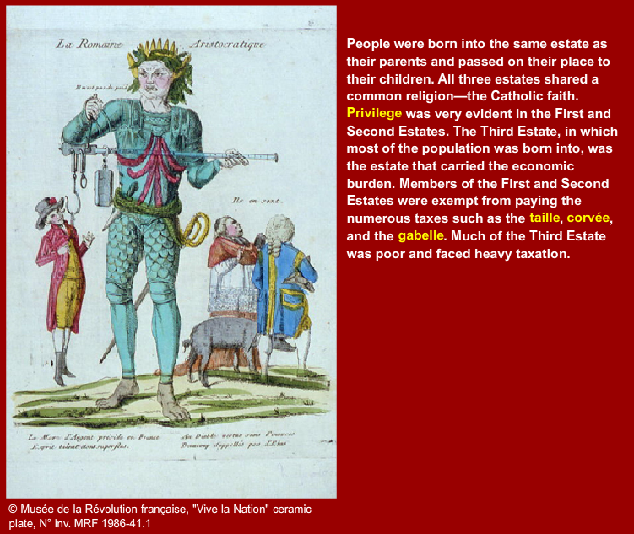

Slide 6
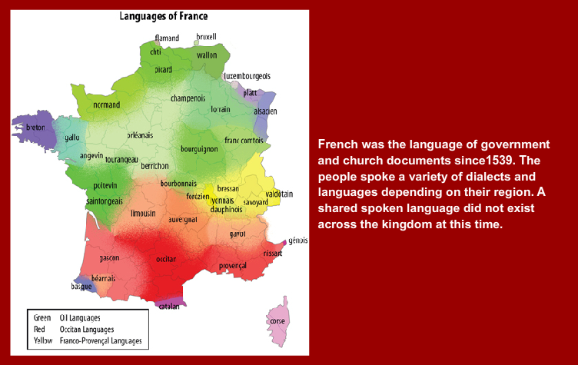

Slide 7
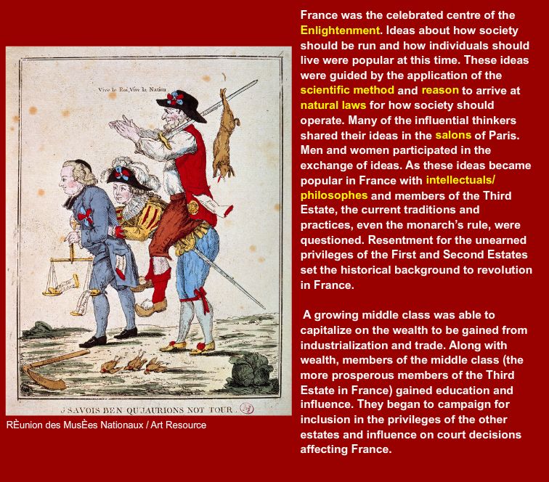

Slide 8
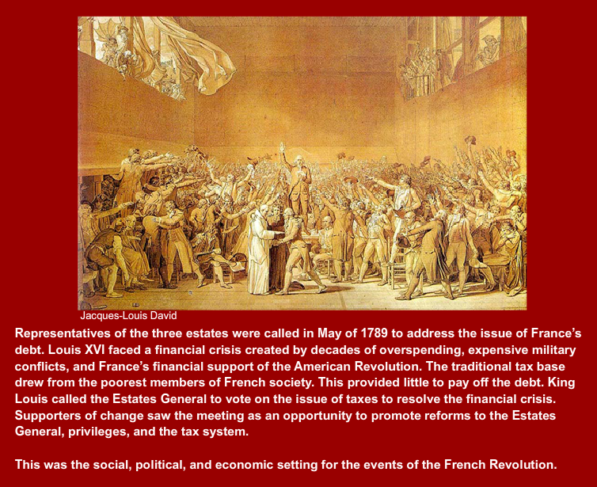

Slide 9
Terms encountered in the presentation
Estates General: a general assembly of representatives of the three estates that formed French society before the revolution in 1789.
privelege: exemptions or special rights assigned to the First and Second Estates (for example, exclusion from most taxation and the right to attend the Royal Court).
taille: a tax levied by the King, approximately 10% of earnings.
corvee: a wine tax.
gabelle: a salt tax.
scientific method: steps to investigate a problem - 1) identify the problem; 2) apply the experimental conditions; analyze the changes.
reason: a method of thinking that follows a scientific, logical approach.
natural laws: observable laws of interaction between people, animals, plants and the environment and that are applied to how individuals in society interact.
salon: a location where philisophes were invited to share their ideas in an audience of influential members of society (often the actual living rooms of influential women in society).
intellectuals/philisophes: writers and philosophers who expressed ideas about how society should operate.

