Slide 1
German Expansionism Between World War I and World War II (Interwar Period)

Slide 2
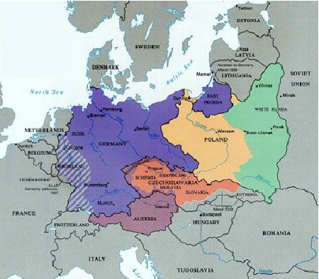
Germany in 1933

Slide 3
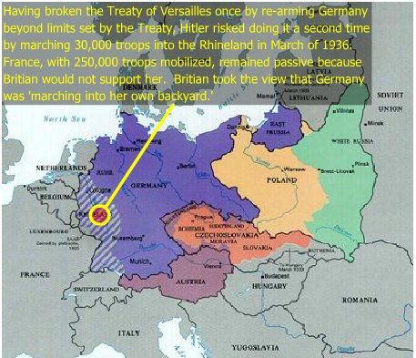
Remilitarized in 1936

Slide 4
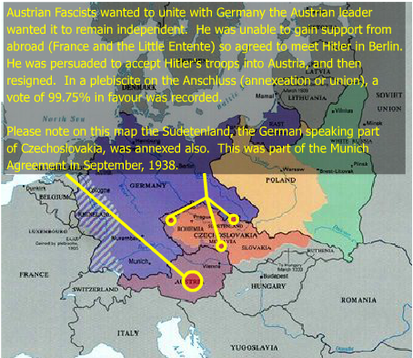
Annexations in 1938

Slide 5
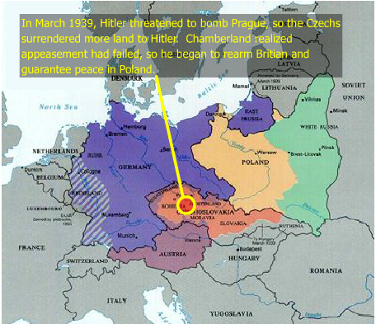
Satellite States March 1939

Slide 6
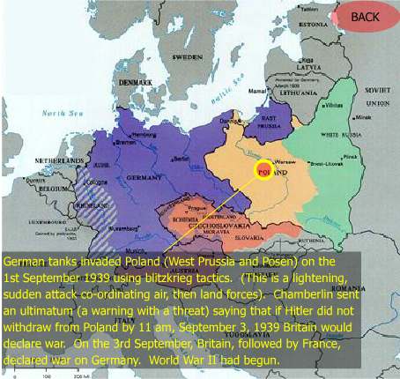
Conquered by Germany 1939

Slide 7
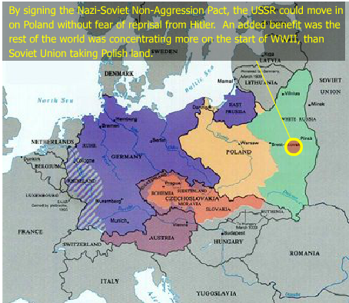
Annexed by the Soviet Union 1939

