Slide 1
Chapter 13
The Endocrine System

Slide 2
Chapter 13: Endocrine System
Roles of the endocrine vs. nervous system
Positive vs. negative feedback
Principal endocrine glands: hypothalamus/pituitary complex, thyroid, parathyroid, adrenal glands, & islet cells of the pancreas
* Textbook pages 434-465

Slide 3
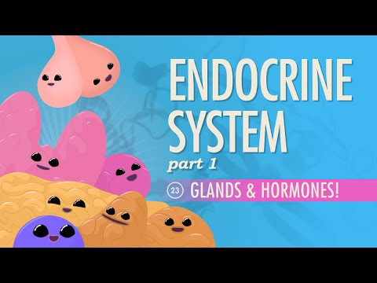
Intro/Overview

Slide 4
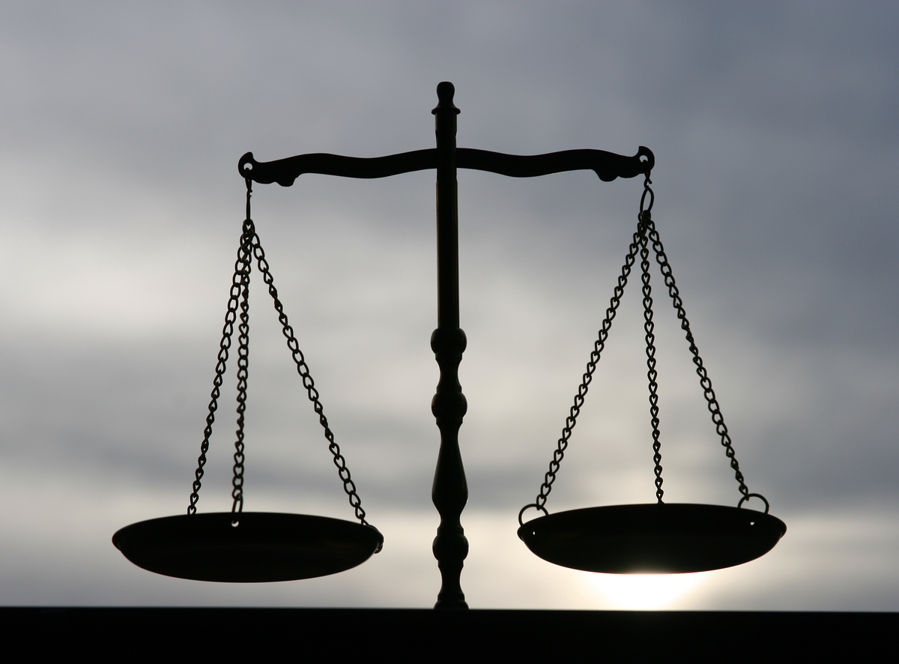
Homeostasis is…
A stable internal environment that the body aims to maintain for optimal functioning
A ‘state of internal equilibrium’

Slide 5
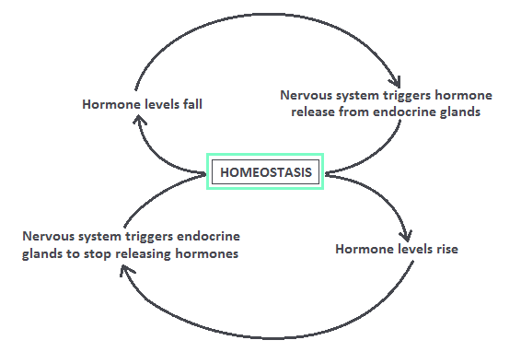
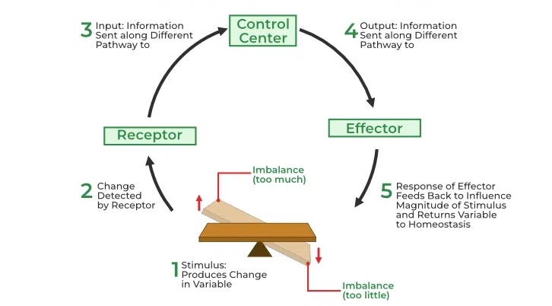
The endocrine system works in conjunction with the nervous system to maintain homeostasis within the body:

Slide 6
Although the two systems work together, there are some key differences between them and the way in which they act
NERVOUS SYSTEM | ENDOCRINE SYSTEM
Rapid response to change | Sustained response to change
Electrical/chemical signals | Hormonal signals
Signals relayed through neurons (hence rapid response) | Signals relayed through the bloodstream (hence slower response)
Affects specific locations | Affects whole-body functioning

Slide 7
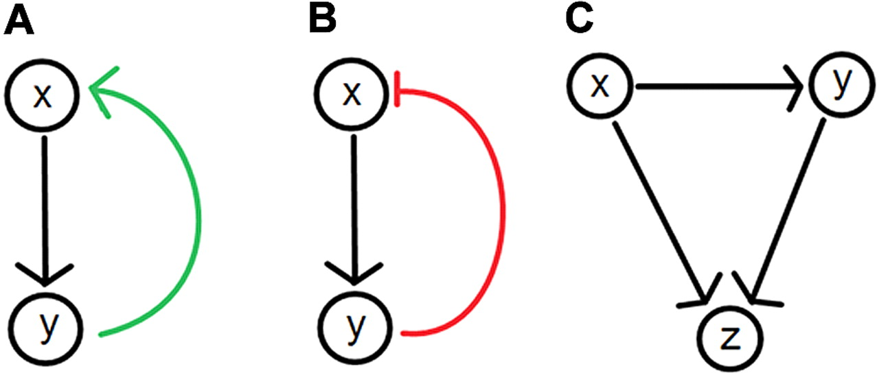
Feedback Loops
The endocrine system responds to changes in the internal environment through the use of positive or negative feedback.
Negative Feedback:
returns a system to homeostasis
inhibits or counteracts the stimulus that sets off the response
Positive Feedback:
takes the body further from homeostasis
exaggerates or increases the stimulus that sets off the response
Positive Negative

Slide 8
Feedback Loop Examples
Negative Feedback:
Blood sugar: After eating, blood sugar levels rise, triggering the release of insulin from the pancreas. Insulin stimulates cells to become permeable to sugar, causing blood sugar levels to fall, and insulin production to cease.)
Positive Feedback:
Childbirth: As the baby moves into position and presses on the cervix, it sends a signal to increase the rate of contractions, which further pushes the baby against the cervix which in turn increases contractions even further.

Slide 9
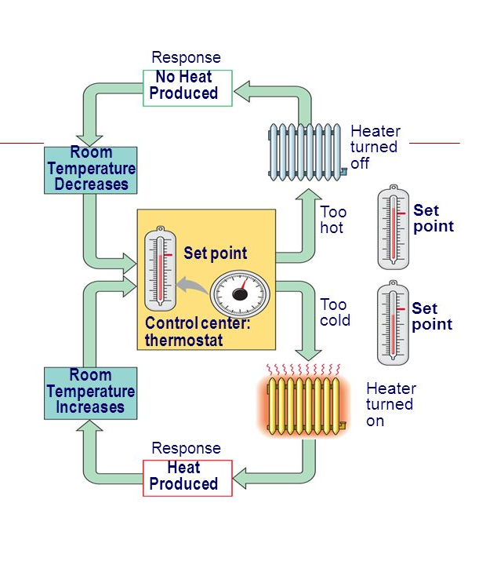
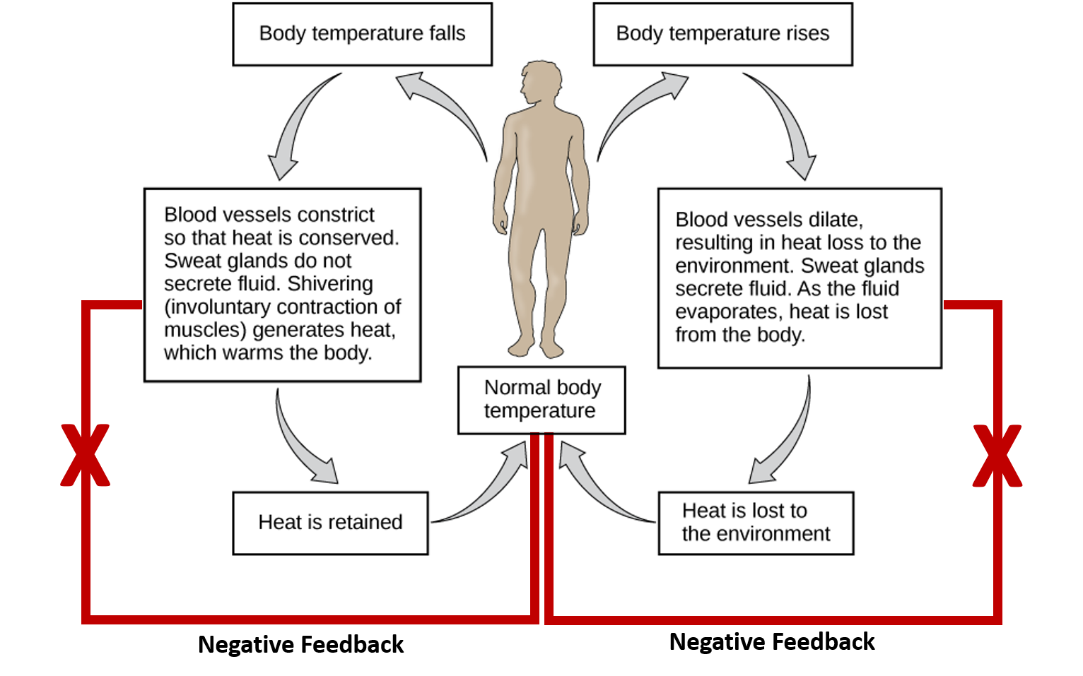
Most feedback loops in the human body are negative, and aim to reestablish homeostasis when a particular value is out of normal range.
An example is body temperature, that can be compared to how the thermostat works in your home:

Slide 10
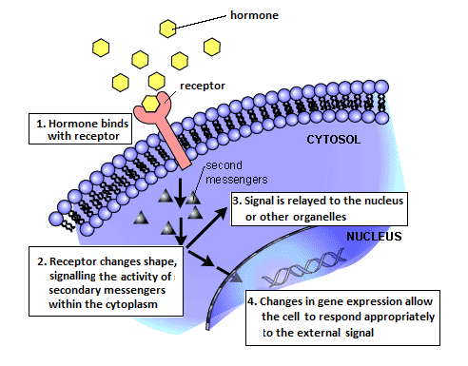
Hormones interact with receptor proteins specific to their target tissue, inducing a conformational shape change which leads to a cascade of events within each cell
Hormones

Slide 11
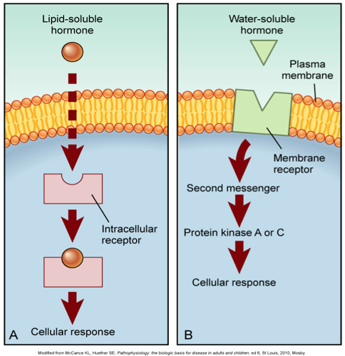
Two types of hormones, classified by the way they interact with target cells:
Water soluble hormones cannot cross the lipid membrane, and thus interact with cells by binding to external receptor sites (e.g. hGH, epinephrine)
Fat soluble hormones are able to diffuse across the lipid membrane, and thus interact with cells by binding to receptor sites within the cytoplasm (e.g. sex hormones)

Slide 12
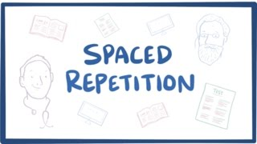
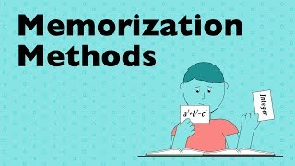
Over the next several slides, you will learn about each endocrine gland and its hormones. There is a LOT to remember for this chapter, which can include some memorization. BUT..memorization should not occur without meaning. I strongly encourage you to watch these two short videos that will help you use some strategies to better retain and recall information, not only in Bio but in your other courses as well.
You are responsible for knowing:
ALL of these hormones
The gland that releases them
Their target
Their effect

Slide 13
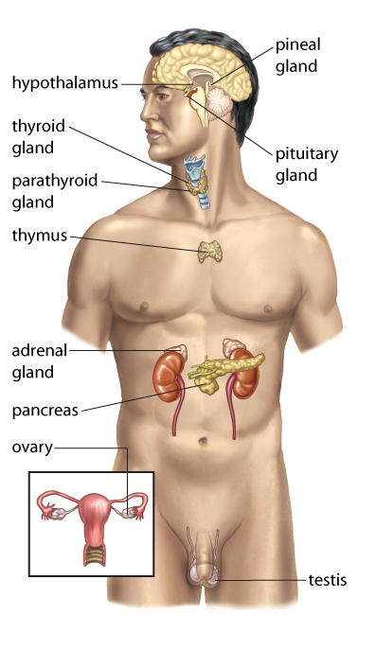
Key glands of the endocrine system
Each is responsible for secreting specific hormones which, in turn, target and affect the function of specific tissues/organs.
(see table 13.1 in your text)

Slide 14
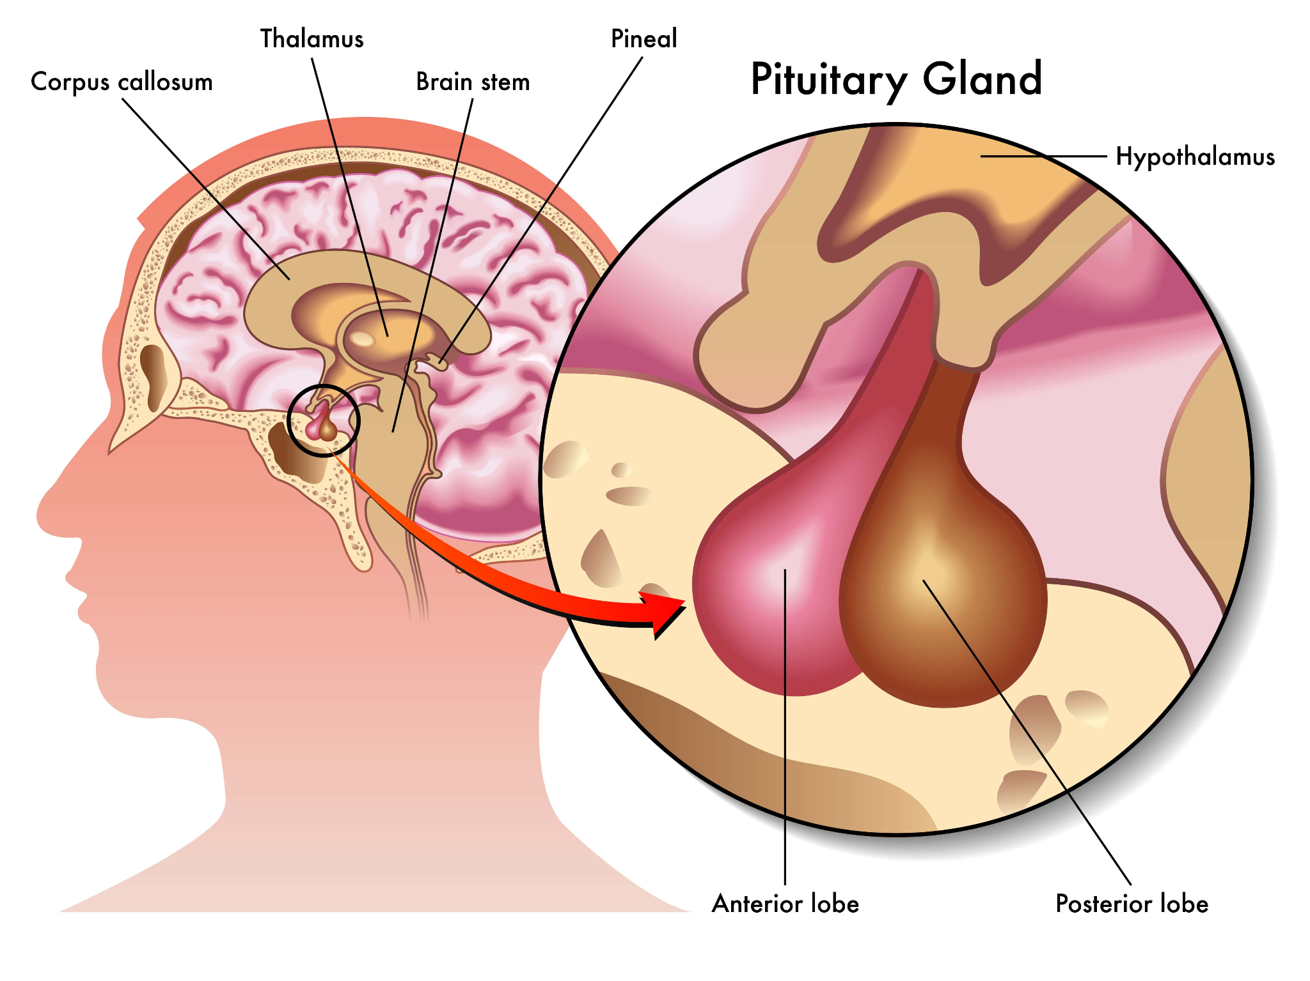
Hypothalamus & Pituitary
The hypothalamus uses its releasing hormones (RHs) to stimulate the pituitary gland, which in turn is responsible for releasing a number of different hormones involved in growth & metabolism, development, reproduction, and other critical functions.
For this reason, the pituitary is often called the “master gland”
Many hormones released from hypothalamus & pituitary are tropic hormones, meaning they stimulate other endocrine glands to release other hormones.

Slide 15
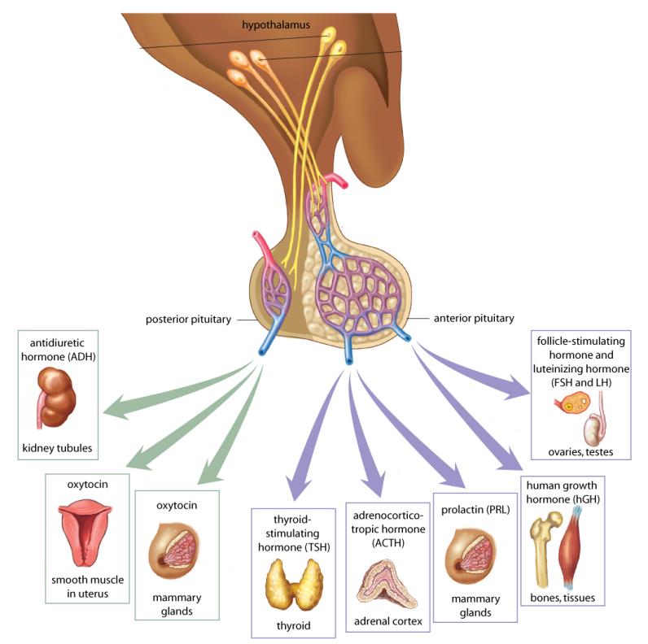
Hypothalamus & Pituitary
The anterior pituitary (front portion) synthesizes its own hormones to be released upon stimulation by hypothalamic releasing hormones
The posterior pituitary (back portion) stores hormones that were produced by the hypothalamus until release

Slide 16
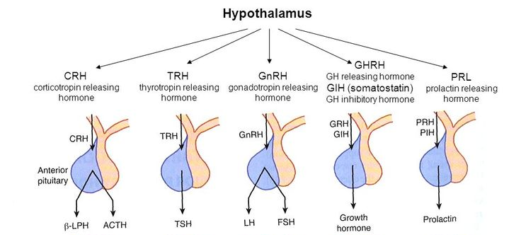
Each anterior pituitary hormone is released upon stimulation by a ‘releasing hormone’ from the hypothalamus. (You only need to remember/recognize the starred ones)

Slide 17
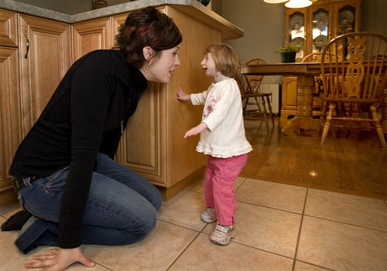

Anterior Pituitary Hormones
Human growth hormone (hGH)
  affects nearly all body tissues in some way by stimulating the production of growth factors from the liver
  increases protein synthesis, cell division and growth (of cartilage, bone, and muscle tissue in particular), and metabolic release of stored fats
  Especially important during childhood, leading to the elongation of bones
Pituitary Dwarfism
Gigantism

Slide 18
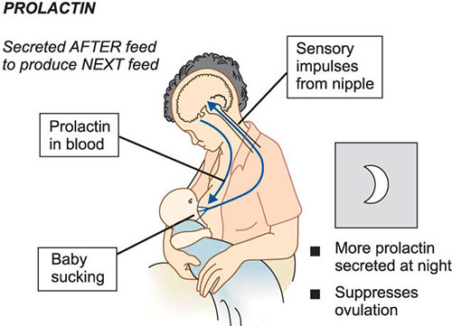
Anterior Pituitary Hormones
Prolactin (PRO)
  Prolactin stimulates the production of milk (lactation) in the mammary glands
Follicle Stimulating Hormone (FSH)
  Stimulates the production of sperm in the testes and egg in the ovaries (more on this in Unit B)
Luteinizing Hormone (LH)
  Stimulates sex hormone production in the ovaries and testes
  Stimulates ovulation (more on this in Unit B)

Slide 19
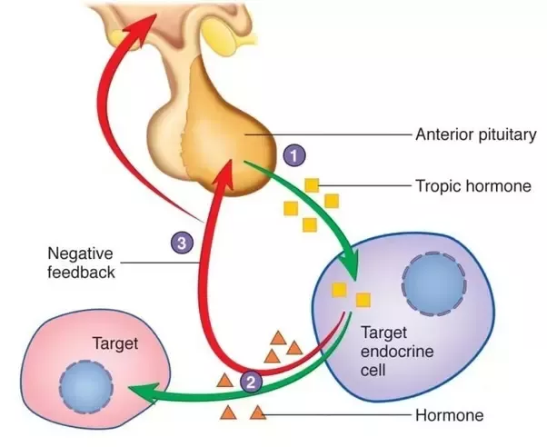
Anterior Pituitary Hormones
These last two anterior pituitary hormones are tropic hormones, which means they act on another endocrine gland. We will look at these in more detail as we look at their target glands.
Thyroid Stimulating Hormone (TSH)
  Stimulates the thyroid gland to release thyroxine when thyroxine levels are low
Adrenocorticotropic Hormone (ACTH)
  Stimulates the adrenal cortex to release cortisol and aldosterone

Slide 20
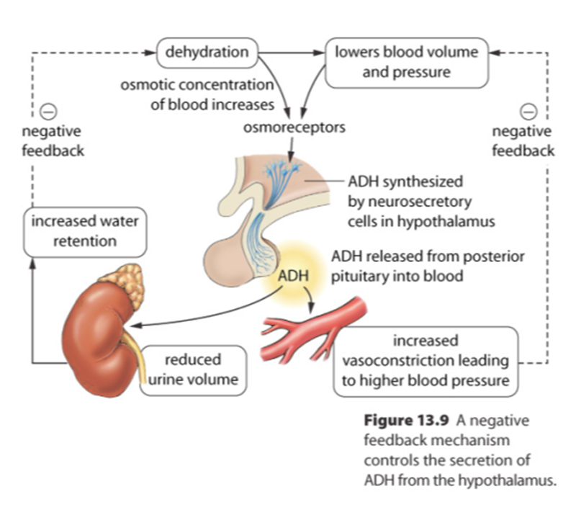
Posterior Pituitary Hormones
Antidiuretic hormone (ADH)
  also known as vasopressin
  Released when dehydrated and regulates water reabsorption by kidneys
  Making the collecting ducts of the nephrons more permeable to water and thus increases the reabsorption of water into the blood → this in turn makes less, more concentrated urine

Slide 21
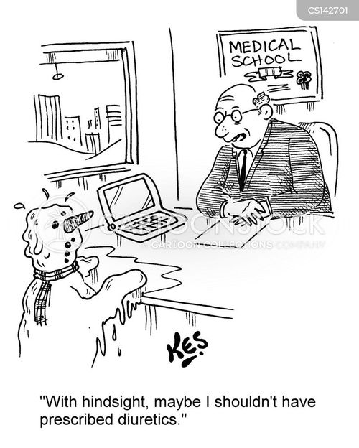
Diuretics, such as caffeine, inhibit the production of ADH, which in turn makes the kidneys less permeable water, leading to decreased water reabsorption.
This leads to the production of large volumes of dilute urine.

Slide 22
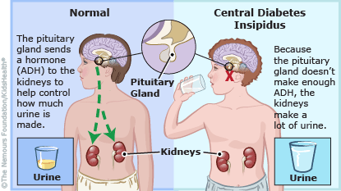
Diabetes Insipidus
…
The inability to produce, store, or properly respond to ADH
Affected individuals produce large volumes of urine, resulting in the loss of ions from the blood
Continuous risk of dehydration
Treated by administering ADH
*Note: Diabetes Insipidus has nothing to do with Diabetes Mellitus (more later). They simply share the name due to similarities in symptoms.

Slide 23
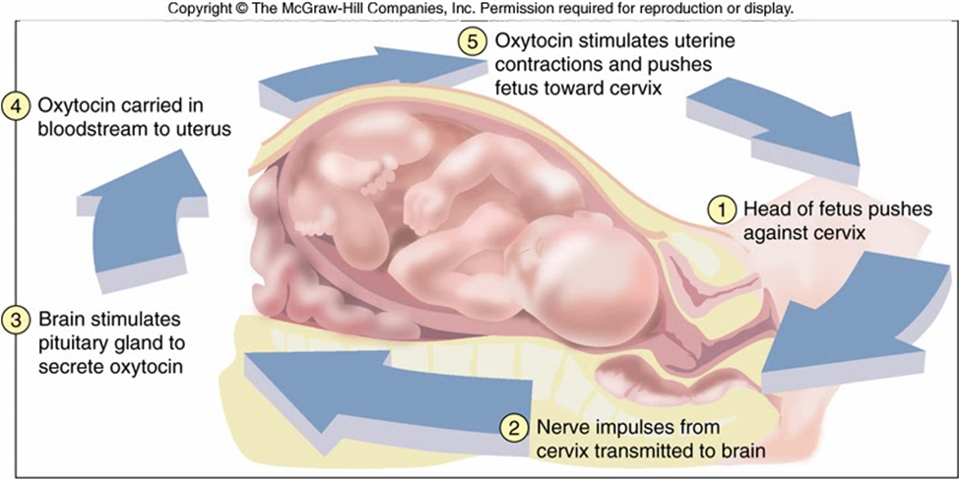
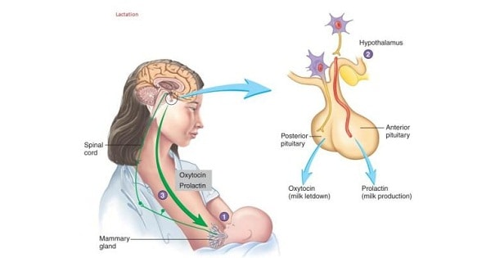
Posterior Pituitary Hormones
Oxytocin (OCT)
  Stimulates uterine contractions during childbirth in a positive feedback loop
  Releases milk from the mammary glands
    Note: Prolactin allows mammals to produce milk, but oxytocin is required to release to milk
  In other words, oxytocin is the hormone that helps ‘squeeze things out of the body’

Slide 24
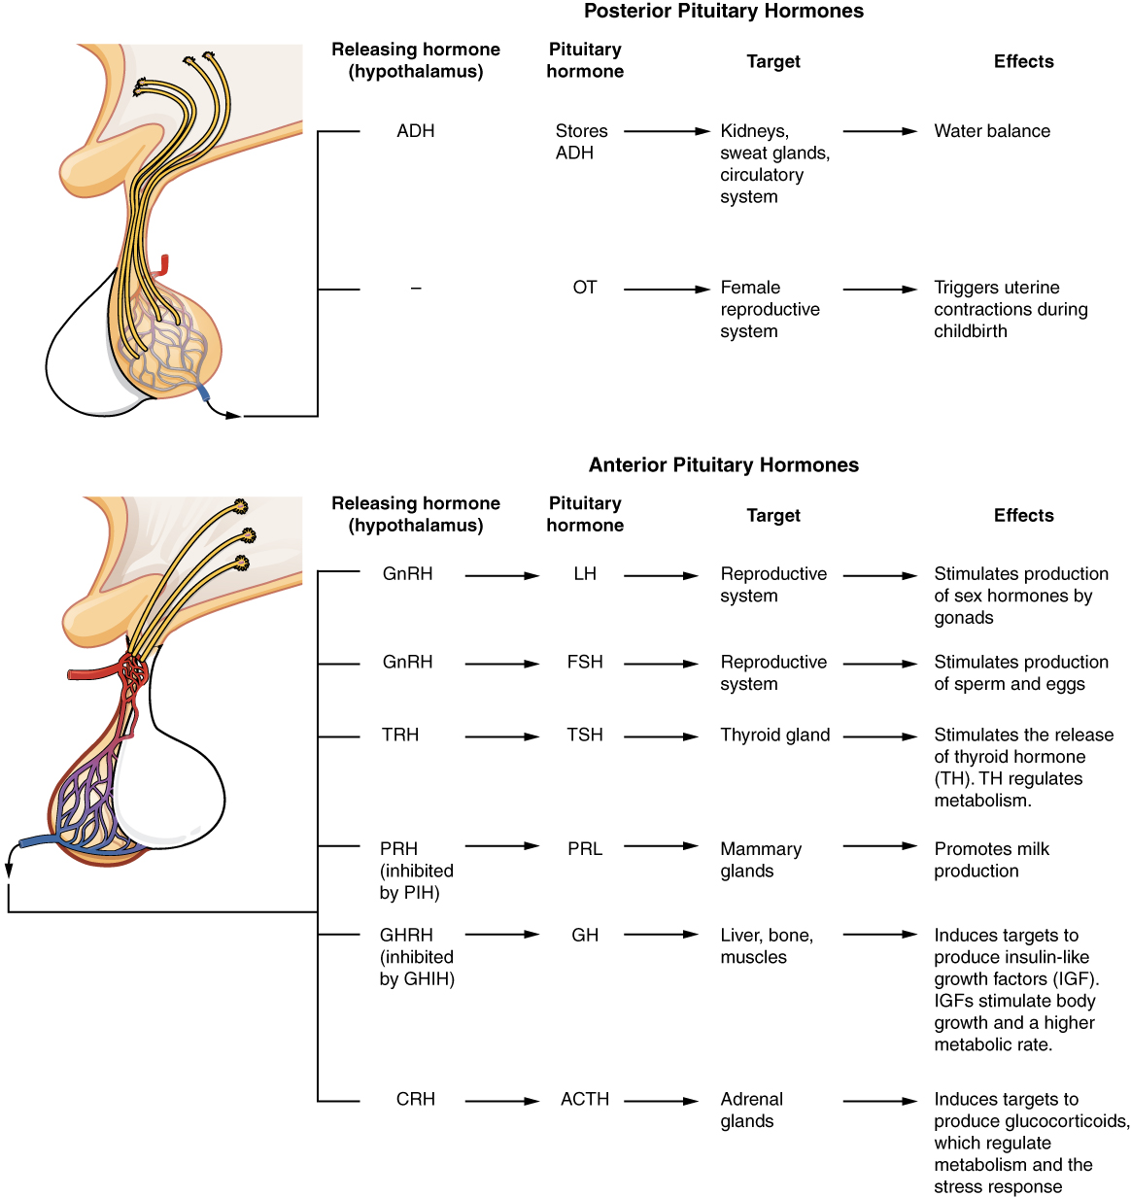
Summary of Hypothalamic and Pituitary Hormones

Slide 25
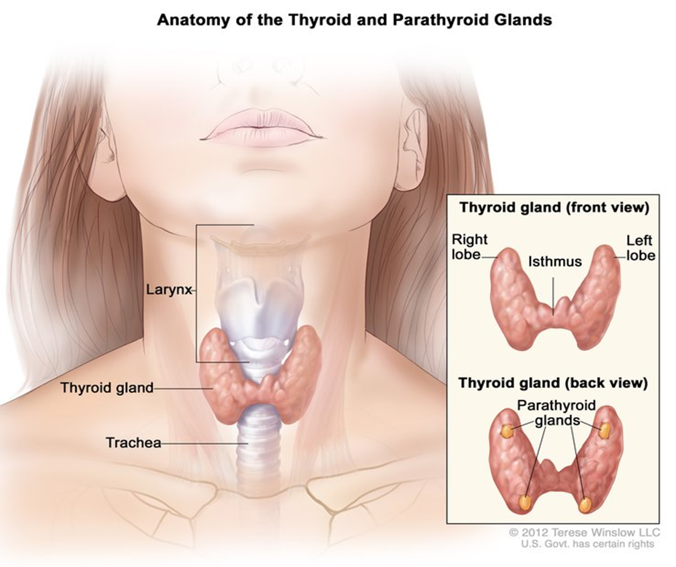
Hormones of the Thyroid and Parathyroid Glands
The thyroid gland is a butterfly shaped gland that sits anterior to the trachea and below the larynx. On the back side of the thyroid gland, there are four smaller glands called the parathyroid glands.

Slide 26
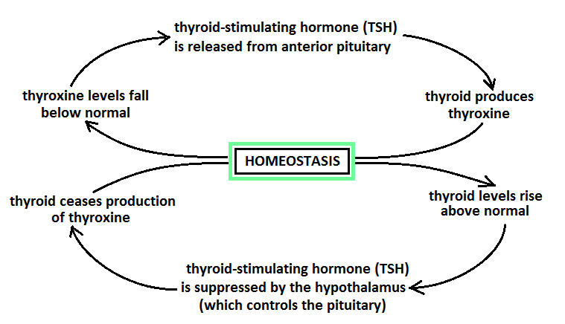
Hormones of the Thyroid and Parathyroid Glands
Thyroxine (T4)
  Released by the thyroid gland upon stimulation by TSH from the anterior pituitary
  Its role is to increase metabolism (using up blood sugar, burning fat, increasing temperature, etc.)
  Systemic effects (no single target)
Negative Feedback Control of Thyroxine Production

Slide 27
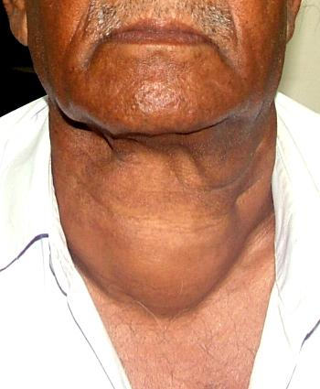
Thyroxine and Iodine
The thyroid requires iodine to produce hormones such as thyroxine
Insufficient iodine in the diet thus inhibits thyroxine production, meaning there will be no signal to stop the secretion of TSH
The constant stimulation of the thyroid gland by TSH that results leads to the development of a goitre

Slide 28
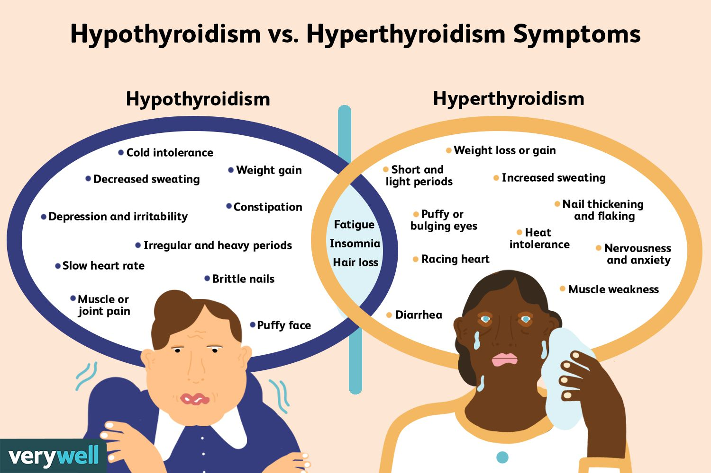
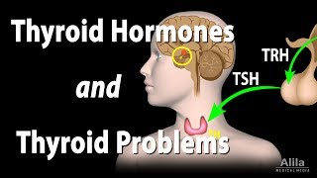
Problems with Thyroxine Production
Hypothyroidism is a condition where too little thyroxine is produced.
Hyperthyroidism is where too much thyroxine is produced.
This leads to opposite symptoms in affected individuals.

Slide 29
Problems with Thyroxine Production
This is a good place for us to pause and see how well we understand feedback loops…
Consider the following situations and make predictions:
A patient complains of persistent fatigue, feeling cold and weight gain. Their doctors confirms via blood test that they have hypothyroidism. What would their thyroxine and TSH levels be on a blood test?
Low thyroxine, but high TSH. Patient is not at homeostasis, and since their thyroxine levels are low, there is a constant release of TSH trying to stimulate the thyroid gland to produce more thyroxine.

Slide 30
Problems with Thyroxine Production
2. Let’s consider a different patient who had their thyroid gland removed due to cancer. What would you expect their TSH levels to be?
Their TSH levels would be high again. There is no thyroxine produced at all, but the hypothalamus/pituitary gland do not know that there is no thyroid gland, so they continue to try to stimulate it anyways.
3. A third patient has a pituitary tumor that is leading to an overproduction of TSH.. How would this impact their levels thyroxine and TRH? What symptoms would you expect?
Thyroxine would increase, and therefore we would observe symptoms of hyperthyroidism. TRH levels would be below normal.

Slide 31
Hormones of the Thyroid and Parathyroid Glands
Calcitonin
  Released by the thyroid gland as a response to high blood calcium (Ca²⁺) levels
  To reduce blood calcium levels, calcitonin
    stimulates uptake of Ca²⁺ into bones
    reduces reabsorption of Ca²⁺ in kidneys
Parathyroid Hormone (PTH)
  Released by the parathyroid gland as a response to low blood calcium (Ca²⁺) levels
  To increase blood Ca²⁺ levels, PTH
    stimulates release of Ca²⁺ from bones
    increases reabsorption of Ca²⁺ in kidneys
Notice anything?

Slide 32
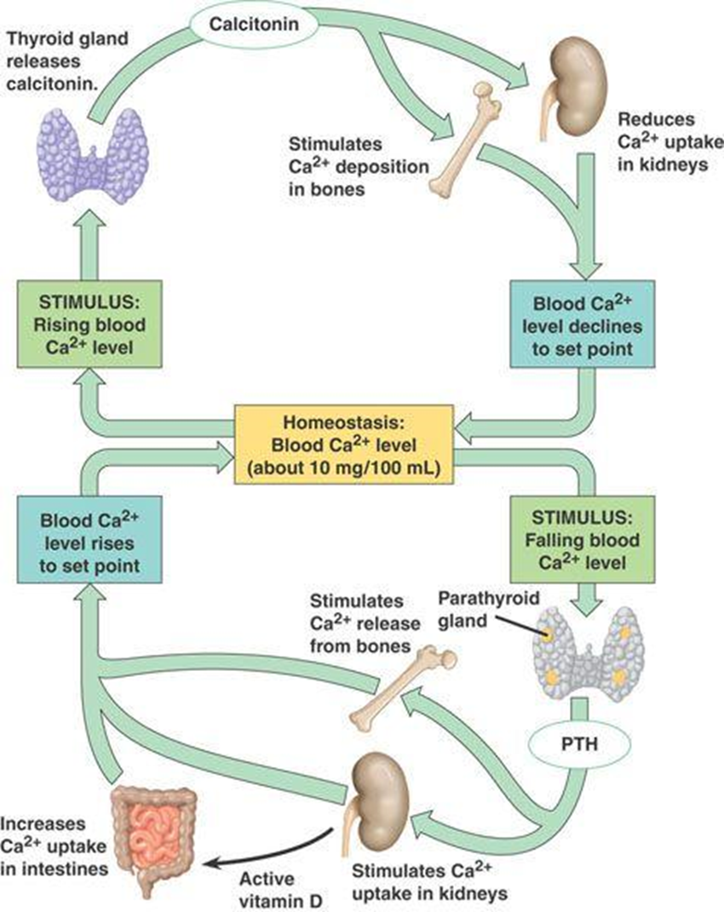
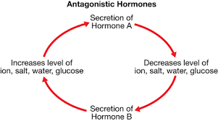
Calcitonin and PTH are an example of antagonistic hormones, which are a pair of hormones that have opposing effects.

Slide 33
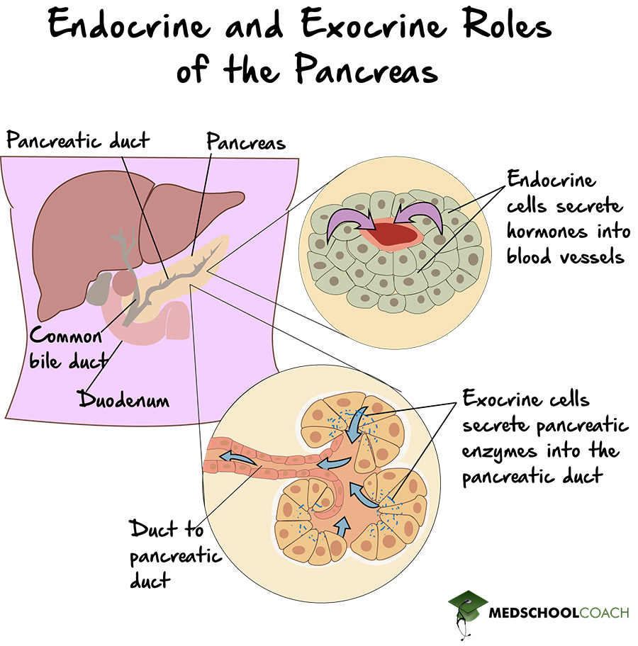
Hormones of the Pancreas
The pancreas is both an exocrine and an endocrine gland.
In Bio 20, you learned about the exocrine functions of the pancreas. In Bio 30, we will only be interested in its endocrine functions

Slide 34
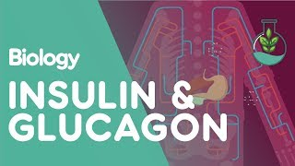
Hormones of the Pancreas
Insulin
  Released by the beta cells of the pancreas
  Released after a meal when blood sugar levels are high
  Makes cells more permeable to glucose, and therefore causes cells to take in glucose → this in turn reduces blood sugar levels to the normal range
  Promotes storage of glucose as glycogen in the liver
Glucagon
  Released by the alpha cells of the pancreas
  Released when blood sugar levels are low
  Promotes the breakdown of glycogen in the liver to re-release glucose into the bloodstream → this in turn increases blood sugar levels to the normal range
Another antagonistic hormone pair!

Slide 35
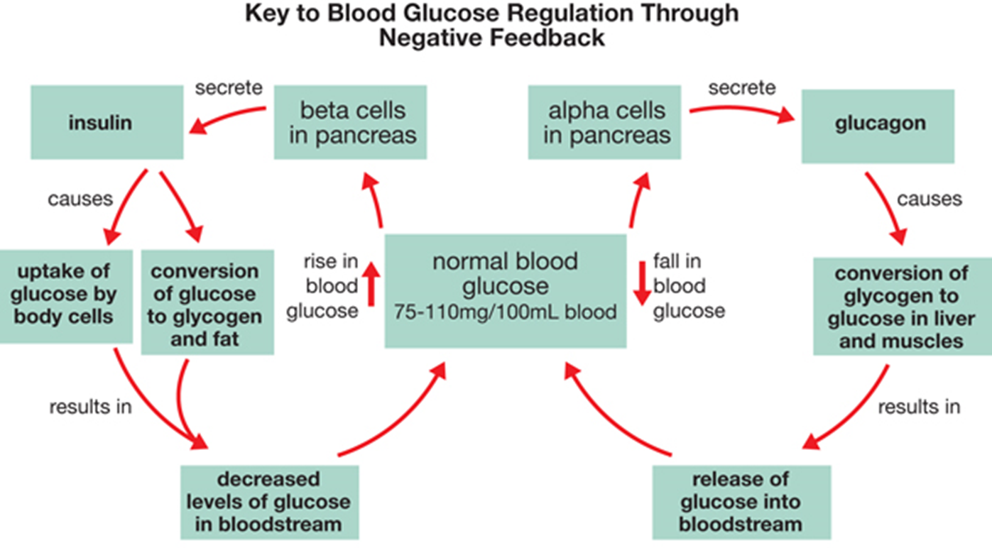

Slide 36
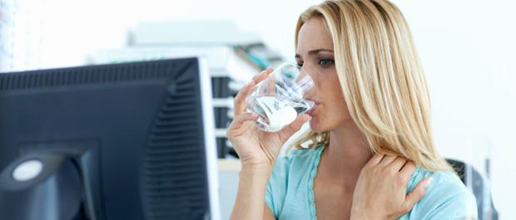

Diabetes Mellitus
…
The inability to produce enough insulin or respond appropriately to insulin
Causes blood glucose levels to rise sharply after meals (hyperglycemia)
Cells cannot properly obtain the glucose they require for metabolism; individuals become fatigued
Body compensates by metabolising fats and proteins instead of glucose. These are more difficult to break down, and release ketones, a toxic by-product.
Excess glucose in the bloodstream is excreted through urine; high amounts of urine are produced due to changes in osmotic gradient (can lead to frequent thirst)

Slide 37
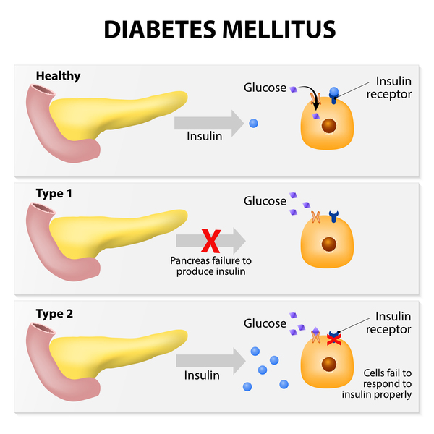
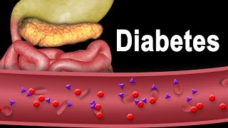
TYPE 1 DIABETES MELLITUS
Diagnosed in childhood
Immune system produces antibodies that attack and destroy the beta cells of the pancreas
Leads to decreased insulin production
Treated with daily insulin injections
TYPE 2 DIABETES MELLITUS
Develops over time
Cell receptors stop responding well to insulin
Poor diet and lack of exercise can be contributing factors
Treated with either insulin injections before meals OR diet, exercise and sulfonamides

Slide 38
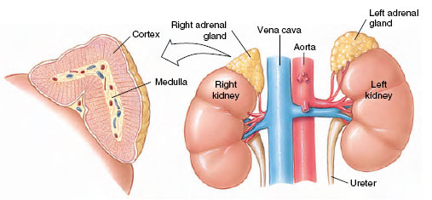
Adrenal Cortex & Adrenal Medulla
The adrenal gland is located on the top of the kidneys, and is divided into two regions: the outer cortex and the middle medulla.
Adrenal medulla produces epinephrine and norepinephrine, involved in the short-term stress response
Adrenal cortex produces glucocorticoids (e.g. cortisol) and mineralocorticoids (e.g. aldosterone), involved in the long-term stress response

Slide 39
 | Adrenal Cortex | Adrenal Medulla
Plays part in … | long term stress response | short term stress response
Releases hormones … | upon stimulation by ACTH (Adrenocorticotropic hormone) → slower response | upon direct stimulation by nervous system → fast response
Hormones… | Cortisol: reduces pain, increases inflammation, increases energy availability by decreasing glucose storage, and by breaking down proteins Aldosterone: Increases reabsorption of Na⁺ in the kidneys, which in turn increases water reabsorption leading to increased blood volume and pressure | Epinephrine and norepinephrine: initiate the fight-or-flight response (increase HR, increase breathing rate, etc.)

Slide 40
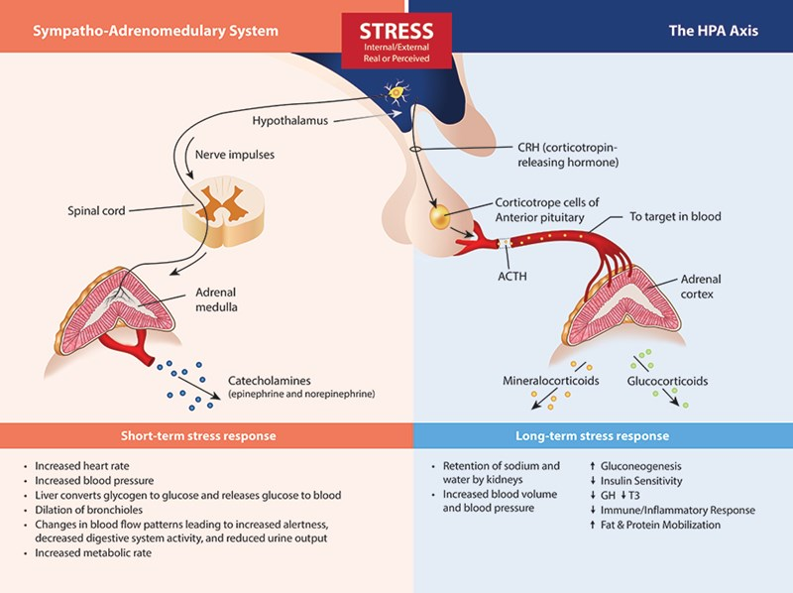
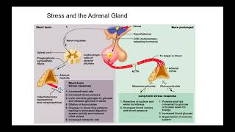
Epinephrine and norepinephrine
Aldosterone
Cortisol

Slide 41
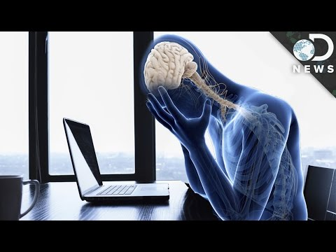
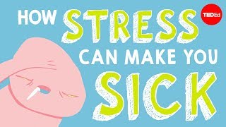
How does stress affect your body?

Slide 42
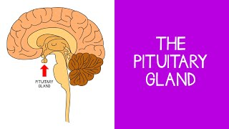
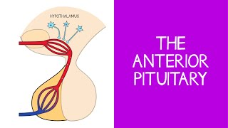
Putting it all together…

Slide 43
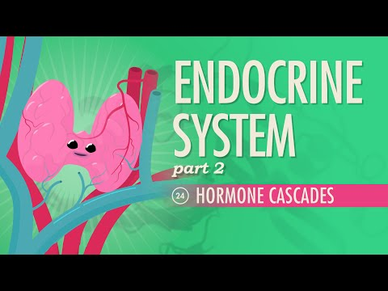
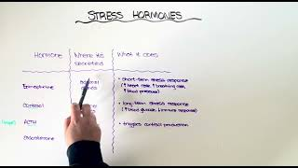
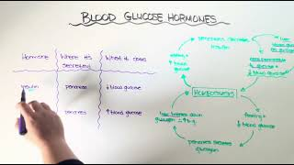
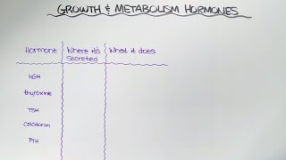
Chapter Review:
Stress Hormones
Blood Glucose Hormones
Growth & Metabolism Hormones

