Slide 1
UNIT 2:
Reproduction & Development
BIOLOGY 30

Slide 2
Chapter 15
Human Development

Slide 3
Chapter 15:
Human Development
Reproductive technologies
Fertilization
Cleavage, gastrulation & implantation
Neurulation & organ development
Supportive structures (placenta, amniotic cavity)
Stages of fetal development
Environmental factors & fetal development
Parturition & lactation (role of prolactin & oxytocin)
Textbook pgs. 506-543

Slide 4
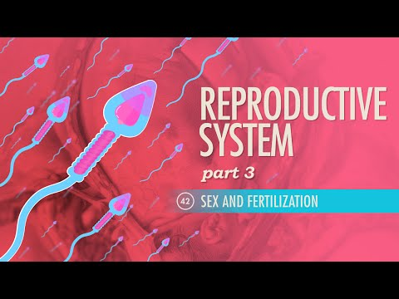
Fertilization

Slide 5
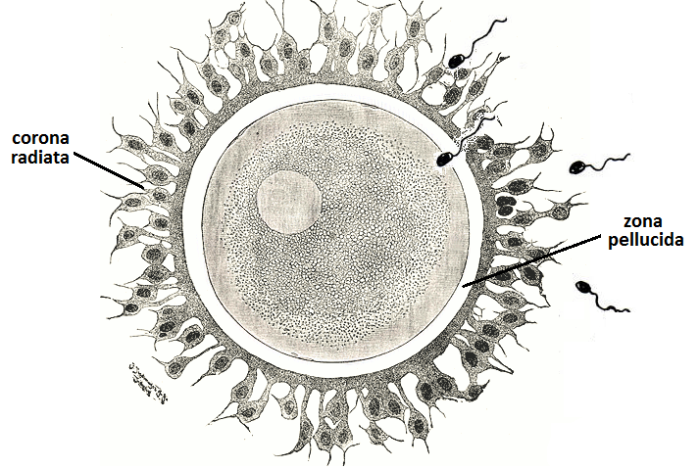
Fertilization
Fertilization if the joining of male and female gametes (sperm and egg) to form a zygote (a fertilized egg).
Each gamete is haploid, meaning they contain only 23 chromosomes or half the amount other cells have. As these two haploid cells fuse, they form a diploid zygote with 46 chromosomes. (More on ploidy and cell division in Unit C)
Occurs within the oviduct (fallopian tubes)
Unique coating layers of the egg (corona radiata and zona pellucida) ensure that only one sperm may successfully attach

Slide 6
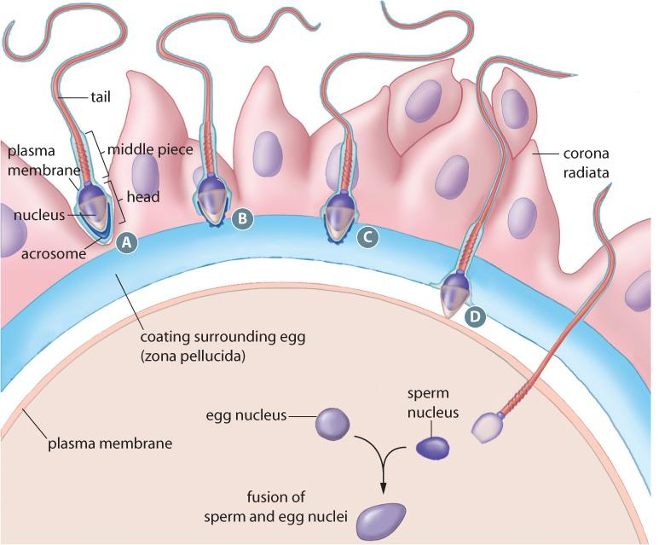
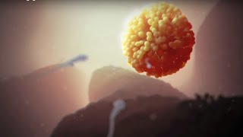
THE PROCESS:
Sperm cells release enzymes from their acrosome cap to digest the outer coating of the egg
Sperm cells move farther through the coating towards the plasma membrane
Once a sperm enters the egg, the egg’s plasma membrane depolarizes, preventing other sperm from entering
The nuclei of the sperm and egg fuse, resulting in a single cell with a complete set of 46 chromosomes (referred to as the zygote)

Slide 7
Stages of Development
Pregnancy can be divided into:
  2 stages
    Embryonic stage: weeks 1-8
    Fetal stage: weeks 9-12
OR
  3 trimesters
    First trimester: months 1-3
    Second trimester: months 4-6
    Third trimester: months 7-9
Important developmental milestones occur during these periods.

Slide 8
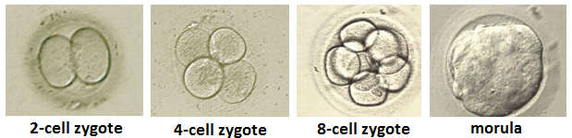
Cleavage and Implantation
Trimester 1/Embryonic Stage
After fertilization, the zygote continues moving through the oviduct towards the uterus. During this time, several cell divisions occur, leading to the formation of the morula.
Initial cell division occurs rapidly, leaving little time for cell growth.
This process of cell division without enlargement is called cleavage.
Over the 3-5 day period required to reach the uterus, cleavage
occurs several times to form a sphere of 16 cells. This is the morula.

Slide 9
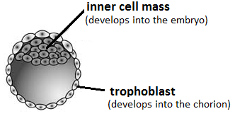
Upon entering the uterus, the morula further develops into the blastocyst, a fluid-filled structure consisting of two layers:
  the trophoblast which will release hCG and later turn into the chorion and placenta, and
  and the inner cell mass, which will later develop into the embryo
Between days 5-7, the blastocyst will begin attaching itself to the endometrium of the uterus; a process known as implantation.
Implantation is complete by days 10-14. If successful, the woman is now said to be pregnant.

Slide 10
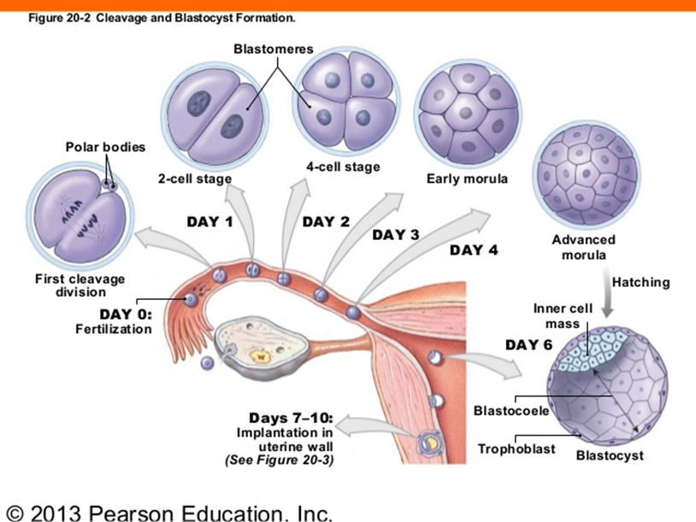

Slide 11
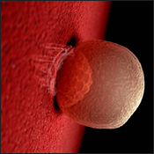
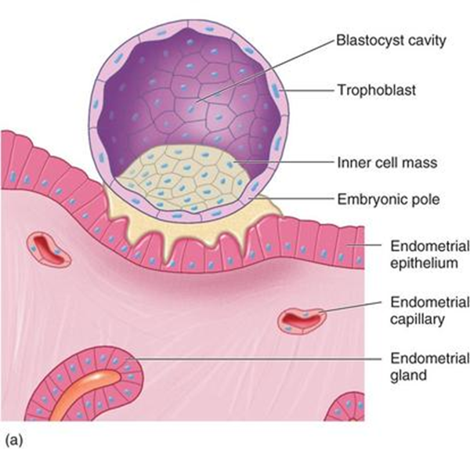
Human Chorionic Gonadotropin (hCG)
Remember… in the menstrual cycle, the role of the corpus luteum is to release progesterone (and some estrogen) to maintain the endometrial lining should implantation occur. If no fertilization and implantation occur, the corpus luteum degenerate after about 14 days. In turn, there is no progesterone and estrogen produced and thus the endometrium will shed → menstruation.
But what if fertilization and implantation do occur?
We do not want the endometrium lining to shed as that would lead to a miscarriage.

Slide 12
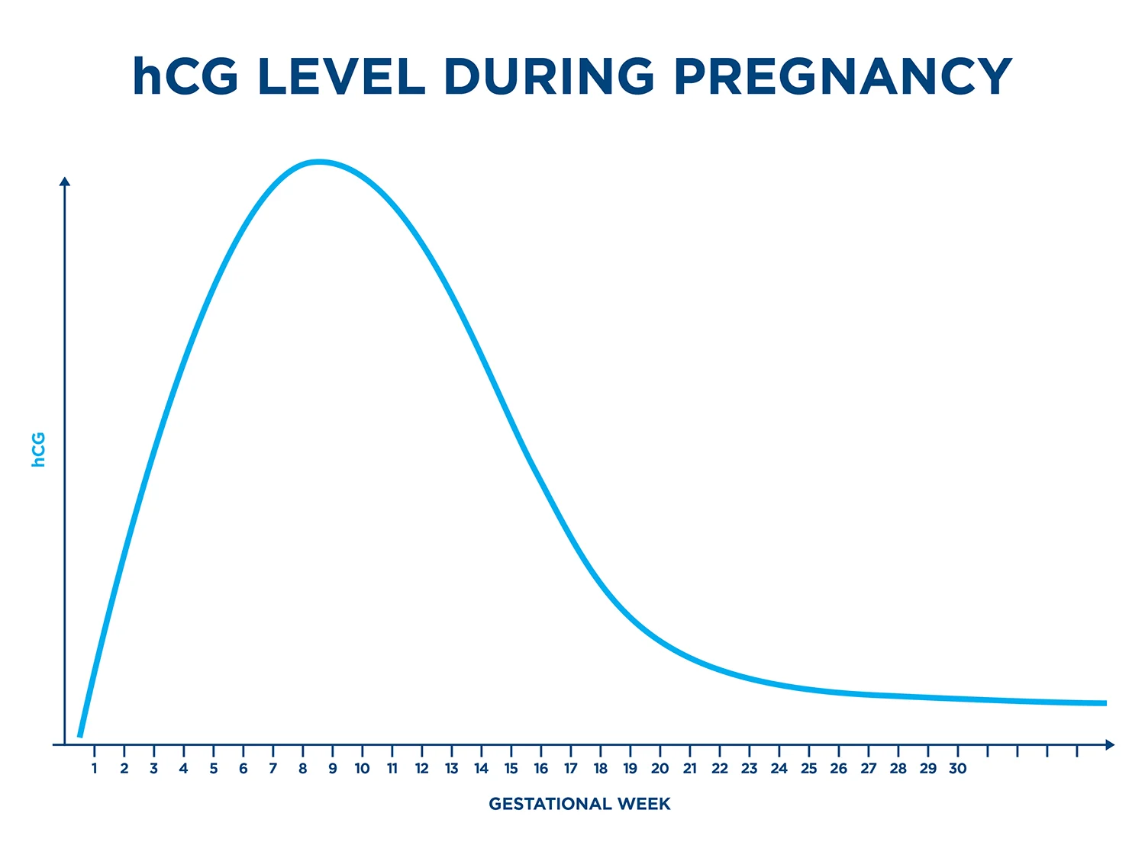
Human Chorionic Gonadotropin (hCG)
Once implantation occurs, the trophoblast begins secreting the hormone human chorionic gonadotropin (hCG)…
hCG maintains the corpus luteum so that it continues secreting estrogen and progesterone
This maintains the endometrium and prevents menstruation
hCG levels decline after the second month of pregnancy, when the placenta is able to secrete these hormones on its own

Slide 13
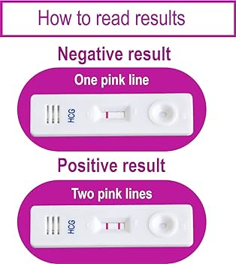
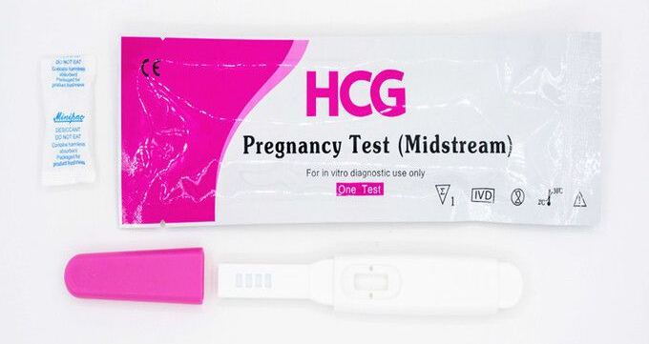
Urine pregnancy tests look for the presence of hCG. Since the trophoblast is the only possible source of hCG in the body, if hCG is present then pregnancy is confirmed.
Since the trophoblast begins to produce hCG within 1-2 weeks of fertilization, which occurs soon after ovulation, hCG can be often detected up to one week before an expected menstrual cycle. Most accurate results, however, would be expected after a missed cycle.
hCG Pregnancy Tests

Slide 14
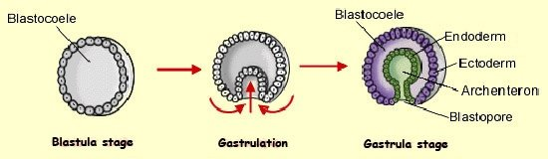
Gastrulation
During week 2, the blastocyst begins to change…
A space known as the amniotic cavity forms between the inner cell mass and the trophoblast.
  This cavity will contain amniotic fluid that will serve to cushion and protect the developing baby from physical trauma
The inner cell mass flattens and folds upon itself to create three distinct layers: the outer ectoderm, the inner endoderm, and the middle mesoderm.
This process is known as gastrulation, after which the blastocyst is referred to as the gastrula.

Slide 15
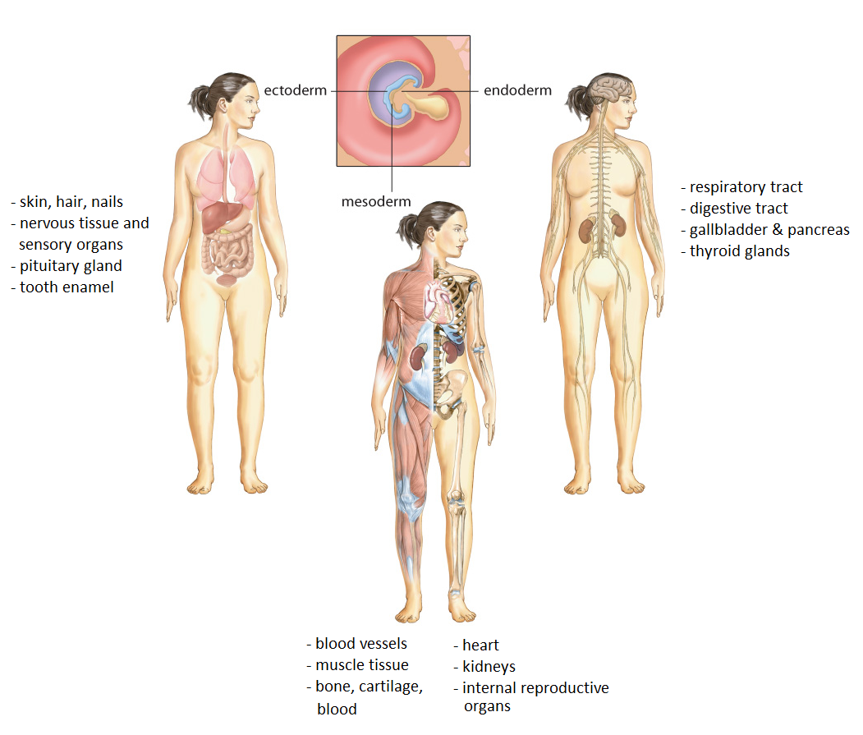
Each of the three layers (referred to as germ layers) differentiates into a specific set of tissues and organs:

Slide 16
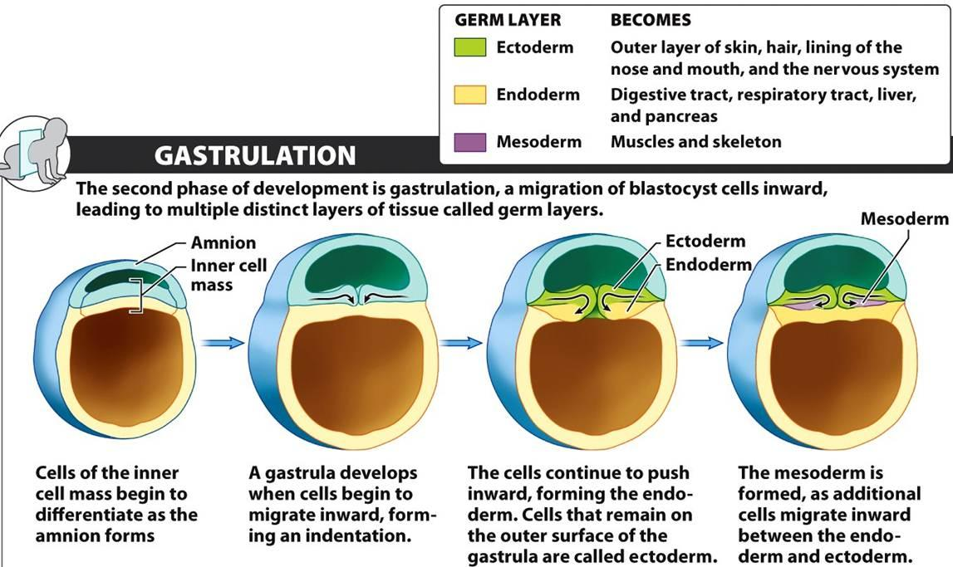

Slide 17
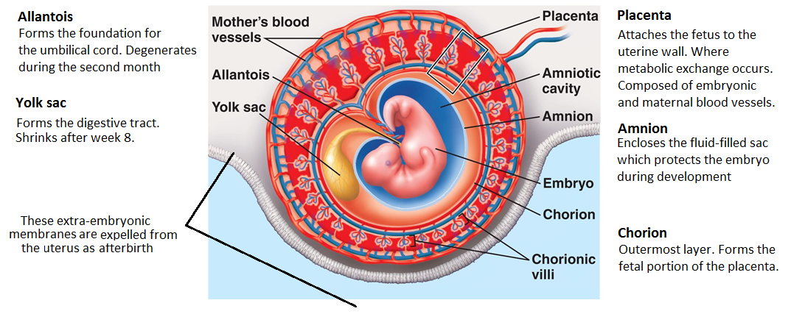
Structures that support the embryo
Starting in week 3 up to week 8, membranes external to embryo develop, called extraembryonic structures
Also produces the first red blood cells until the bone marrow is formed and takes over.

Slide 18
Occurs between weeks 3 & 8, when germ layers begin to fold and early organ systems take shape…
Organ Formation (Organogenesis)
Week 3 = neurulation (formation of neural tube which will later develop into the brain and spinal cord), primitive heart starts beating
Week 4 = Formation of blood cells. Lungs and kidneys take shape, and small buds (which will develop into arms and legs) appear. A distinct head is visible.
Week 5 = Eyes open, cells of the brain undergo rapid differentiation.
Week 6 = Continued development of the brain, lengthening of limbs.
Week 7 = Organs and skeleton almost completely formed, external genitalia begin to differentiate. Nervous system begins to coordinate body activity
Week 8 = Embryo is the size of a paperclip. 90% of organs are established.

Slide 19
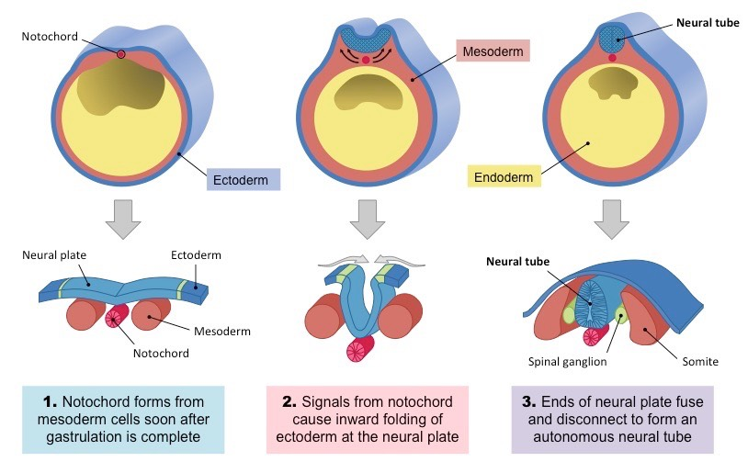
Neurulation

Slide 20
FUNCTIONS OF THE PLACENTA:
Nutritional functions | Transports nutrients from mother to fetus Stores nutrients
Excretory functions | Transports wastes from fetal blood to the mothers blood
Respiratory functions | Transports oxygen from the mother to the fetus and CO2 from the fetus to the mother
Endocrine functions | Secretes hormones Allows hormones from the fetus to diffuse into the mothers blood (and vice versa)
Immune functions | Transports antibodies from the mother to the fetus

Slide 21
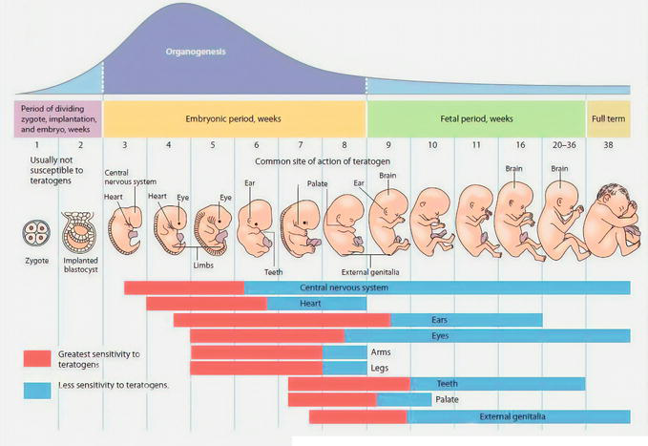

Slide 22
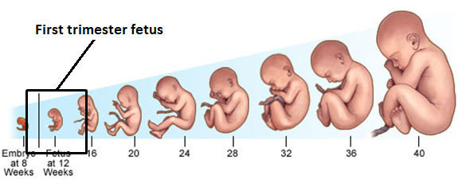
Fetal Development
FIRST TRIMESTER
(weeks 1-12)
embryonic period = weeks 1-8
  gastrulation and organ differentiation)
fetal period = weeks 9-12
  Body continues to grow, skeleton begins to harden
  External reproductive organs become distinguishable

Slide 23
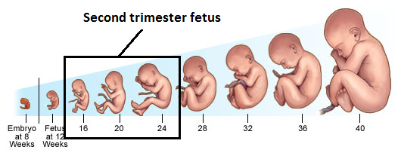
Fetal Development
SECOND TRIMESTER
(Weeks 13-24)
Heartbeat is strong enough to hear with a stethoscope
Rapid brain growth, nervous system begins to function
Mother begins to feel movement
Fetus would not likely survive if it was born at this stage

Slide 24
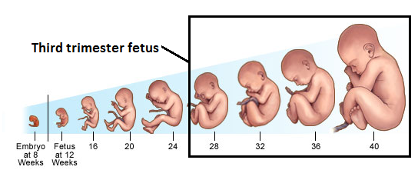
Fetal Development
THIRD TRIMESTER
(weeks 25-38)
Rapid brain development and organ maturation
Fetus nearly doubles in size
Month 7: fetus turns upside down and usually survives if born at this stage

Slide 25
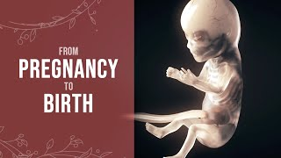
From Conception to Birth

Slide 26
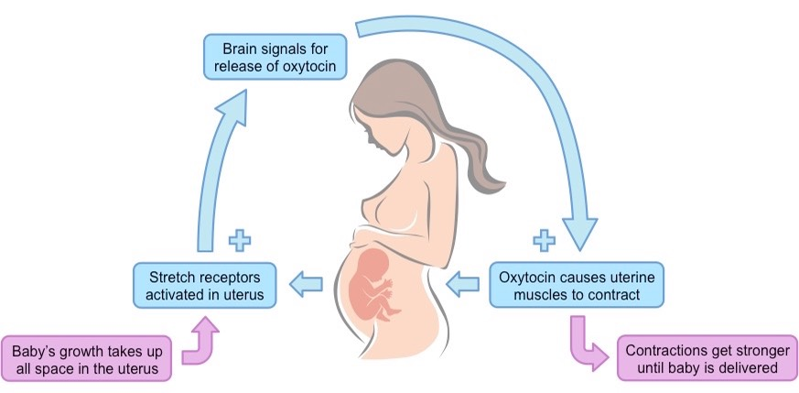
Parturition: Delivery of the Baby
The onset of labour, or uterine contractions, is regulated by positive feedback mechanisms…
The cycle continues until birth occurs
Contractions are also aided by the production of prostaglandins, a group of hormones which act on the same tissue they are produced by

Slide 27
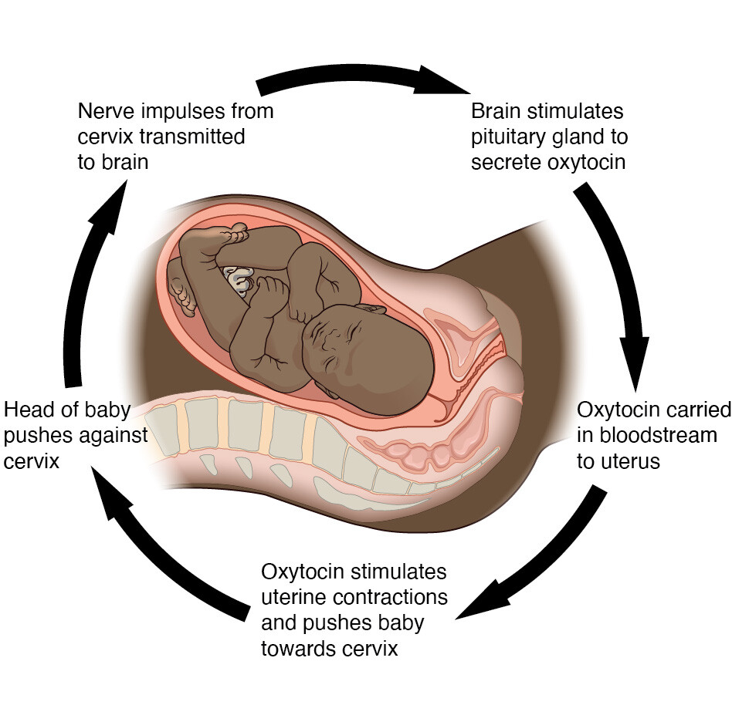
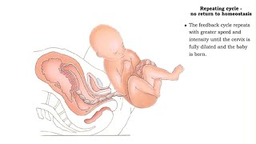
Parturition

Slide 28
Hormonal control of lactation:
During pregnancy, high levels of estrogen and progesterone suppress the production of milk
After birth, the pituitary begins to secrete prolactin, which then stimulates milk production
The actual release of milk from the breasts (lactation) is mediated by oxytocin, which causes contractions within the mammary lobules; suckling motions send signals through nerve endings to the hypothalamus, which then stimulates the pituitary to release oxytocin.
For some women, the sound of an infant crying can also stimulate the production of oxytocin.

Slide 29
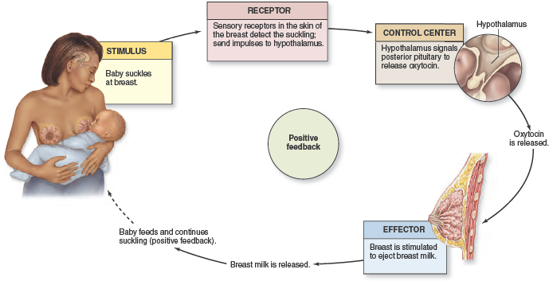
Lactation

Slide 30
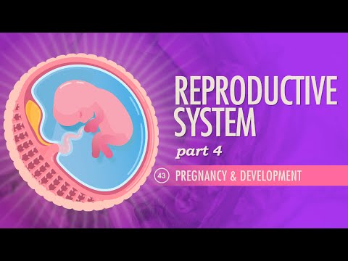
Fetal Development Review

Slide 31
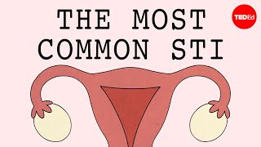
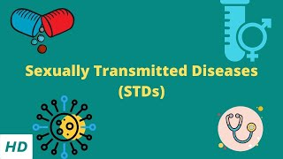
Sexually Transmitted Infections
*you do not need to memorize individual STIs and their effects. You should be able to list some examples, and understand their implications for fertility and general health of both parents and fetus/baby
Caused by viruses, bacteria, or parasites
Transmitted through sexual contact
Impact general health as well as the ability to reproduce
HIV/AIDS Hepatitis B Genital Herpes
Syphilis Chlamydia Gonorrhea
Human Papillomavirus* Pelvic Inflammatory Disease

Slide 32
Teratogens
The placenta does NOT filter out harmful substances…
You should be able to describe some examples teratogens and their impact on embryonic or fetal development.
!
Drugs, alcohol, etc. circulating in the mothers blood will pass through the placenta to the fetus’s blood
Can have severe consequences (such as FASD, or Fetal Alcohol Spectrum Disorder)
Such substances are referred to as teratogens
Teratogens are most harmful during the first trimester during when the neural tube and most organs develop
Why would the developing blastocyst not be very sensitive to teratogens during the first 10-14 days after fertilization?
  The cells in the blastocyst have not begun to differentiate yet so if one cell is damaged, a different one can easily take over

Slide 33
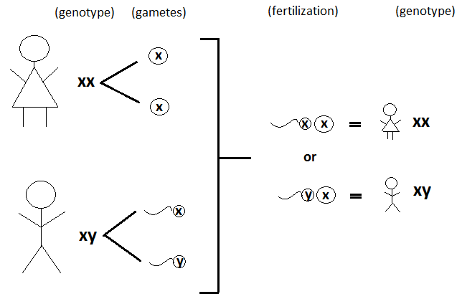
Sex Determination in Humans
Chromosomal (or genetic) sex is determined at fertilization
  XX → Female
  XY → Male

Slide 34
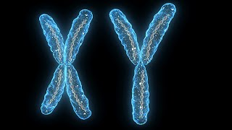
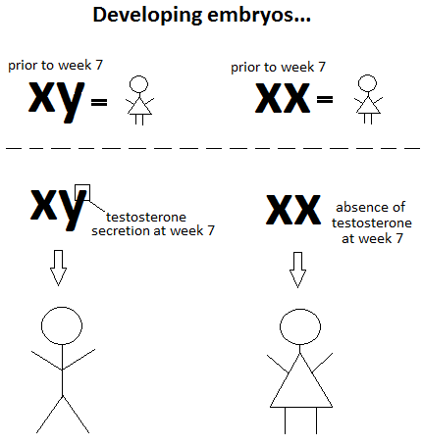
However, anatomic sex is not determined until about the seventh week of development:
At week seven, genes contained within the short arm of the Y chromosome encode the secretion of testosterone, which then causes the embryo to begin differentiating.
The absence of this gene means that no testosterone is produced. As a result, the embryo will continue developing as a female.

Slide 35
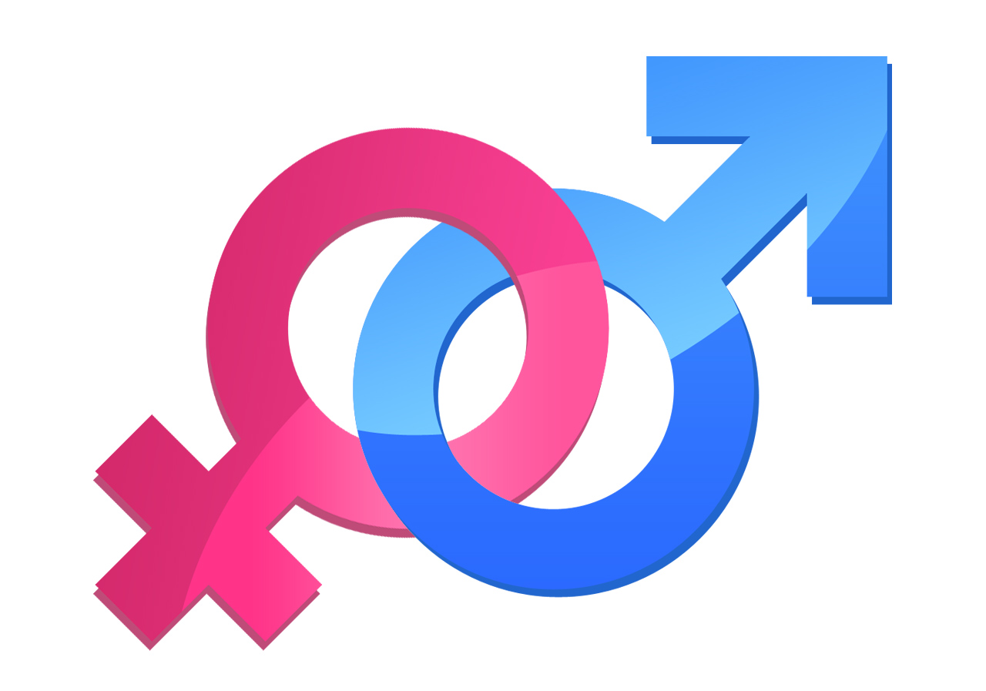
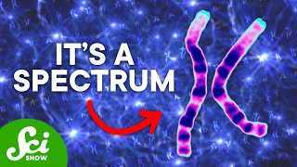
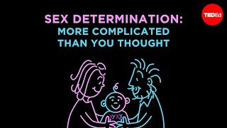
Is it possible for a person to be genetically male but anatomically female? Vice versa?

Slide 36
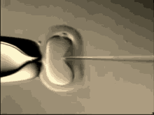
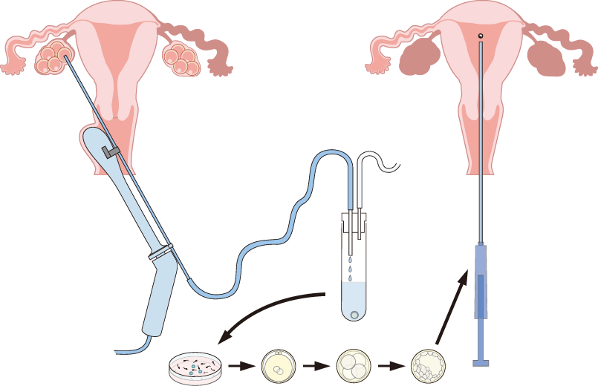
Reproductive Technologies
Technologies to support conception
In-vitro fertilization (IVF)
involves retrieving eggs from a woman's ovaries and fertilizing them with sperm in a laboratory setting. The resulting embryos are then transferred directly into the woman's uterus, aiming to achieve pregnancy.

Slide 37
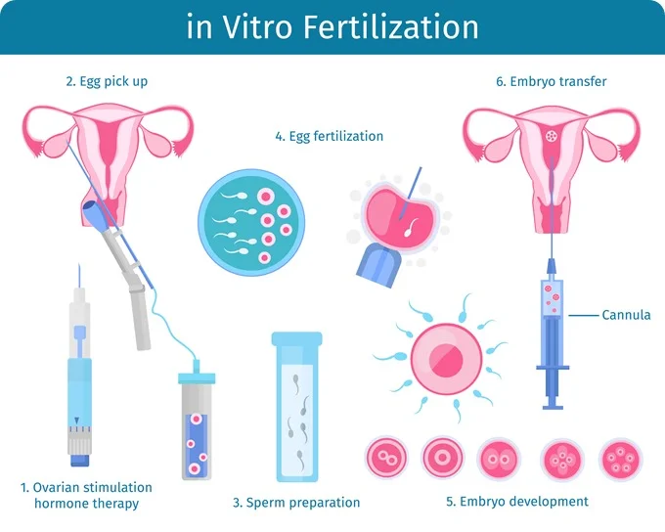

Slide 38
Reproductive Technologies
Technologies to support conception
Fertility Drugs
medications used to stimulate ovulation and enhance the chances of conception in individuals facing fertility issues. They work by regulating hormones to promote the development of multiple eggs, increasing the likelihood of successful fertilization and pregnancy
Typically a prerequisite step for successful IVF
E.g. Clomiphene citrate. Taken by mouth, this drug stimulates ovulation by causing the pituitary gland to release more follicle-stimulating hormone (FSH) and luteinizing hormone (LH), which stimulate the growth of an ovarian follicle containing an egg.

Slide 39
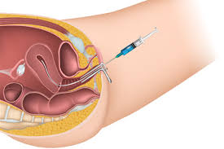
Reproductive Technologies
Technologies to support conception
Artificial Insemination
fertility treatment that involves directly inserting sperm into a woman's reproductive tract to facilitate conception without sexual intercourse.

Slide 40
Reproductive Technologies
Technologies to prevent conception
Physical barriers (i.e. male condoms and female diaphragms)
Prevent sperm from reaching eggs
Male condoms offer additional protection against Sexually Transmitted Infections (STIs)
Chemical barriers (e.g. spermicide)
Kill sperm and therefore prevent them from reaching and fertilizing an egg
Lower effectiveness, typically used in combination with other methods

Slide 41
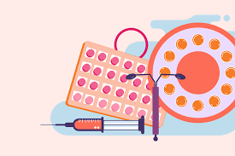
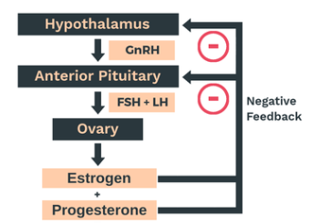
Negative Feedback and Hormonal contraceptives
Hormonal Contraceptives (e.g. Birth control pill, injections, Intrauterine Devices (IUDs), etc.)
Contraceptive technologies whereby artificial hormones mimic the effect of progesterone and therefore through negative feedback inhibit the release of FSH and LH from the anterior pituitary. This ultimately prevents ovulation.
Morning After Pill (i.e. Plan B)
More intensive hormone treatment taken for emergency use
Very high dose of synthetic hormones that can prevent or delay ovulation if taken within 48 hours of intercourse

Slide 42
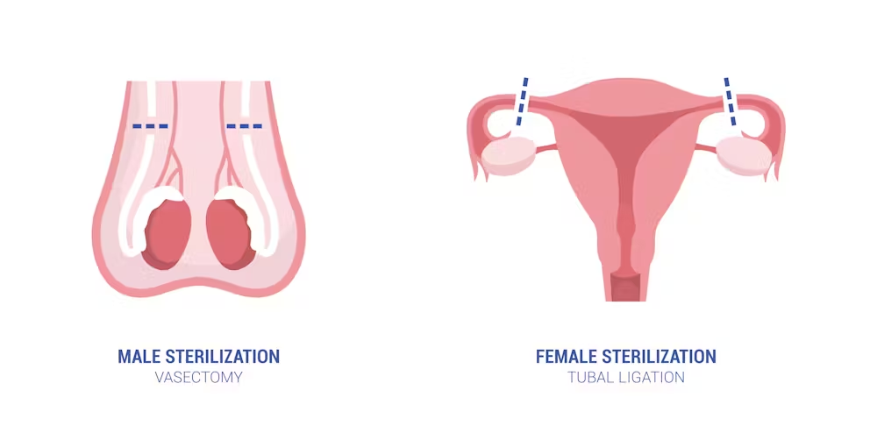
Reproductive Technologies
Technologies to prevent conception
Tubal Ligation
Surgery that involves cutting the oviducts and tying off the cut ends. Prevents ovum from reaching sperm and the uterus.
Vasectomy
Male equivalent to tubal ligation, whereby the vas deferens is cut and tied off. Sperm do not enter semen and leave the male body.

