Slide 1
BIOLOGY 30
UNIT C
Chapter 18
Molecular Genetics

Slide 2
TOPIC 1: DNA STRUCTURE & REPLICATION
Griffith’s transformation experiment
The Hershey-Chase experiment
DNA structure
Semiconservative replication
Steps & enzymes involved in DNA replication
The Meselson-Stahl experiment
Textbook pgs. 622-635

Slide 3
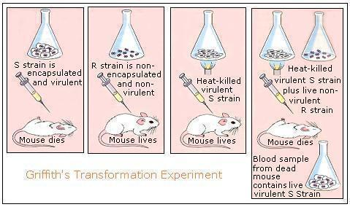
Note: We have to know some names of scientists and their contributions to our understanding of genetics and heredity. (i.e. testable)
The “Transforming Principle”
In 1928, an experiment was conducted by Frederick Griffith which demonstrated that bacteria can be re-programmed through a process called transformation…
Griffith’s experiment suggested that something inside the cell must be responsible for its programming, and that this molecule could be transferred from cell to cell.
The molecule that was responsible for the cell’s programming (aka the hereditary material) was still up for debate…

Slide 4
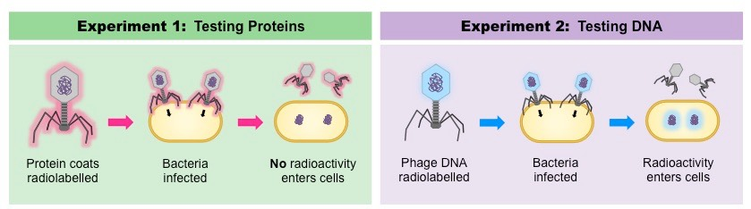
A Case for DNA as the “Transforming Principle”
In 1952, Alfred Hershey and Martha Chase conducted a series of experiments to prove that DNA, and not protein, was the hereditary material.
This involved radio-labelling the proteins and DNA associated with a particular virus and allowing it to infect a bacterium to see which factor would be “injected” to transform the bacterium.

Slide 5
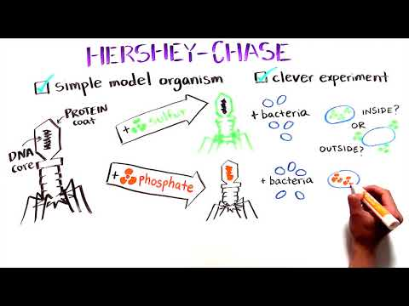
The Hershey-Chase Experiment:

Slide 6
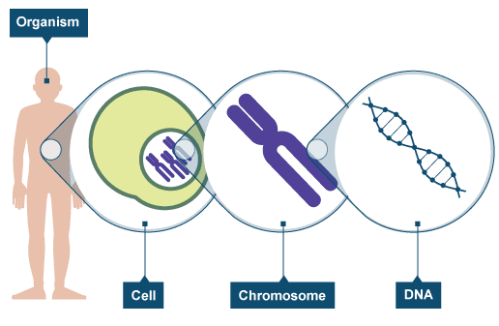
DNA: The Hereditary Material
DNA is the nucleic acid molecule that governs the processes of heredity in all plant and animal cells.
Every cell in your body (with the exception of your gametes) contains the same DNA within its nucleus
The way that DNA is expressed, however, differs from cell to cell
  I.e. not every gene is turned on in every cell

Slide 7
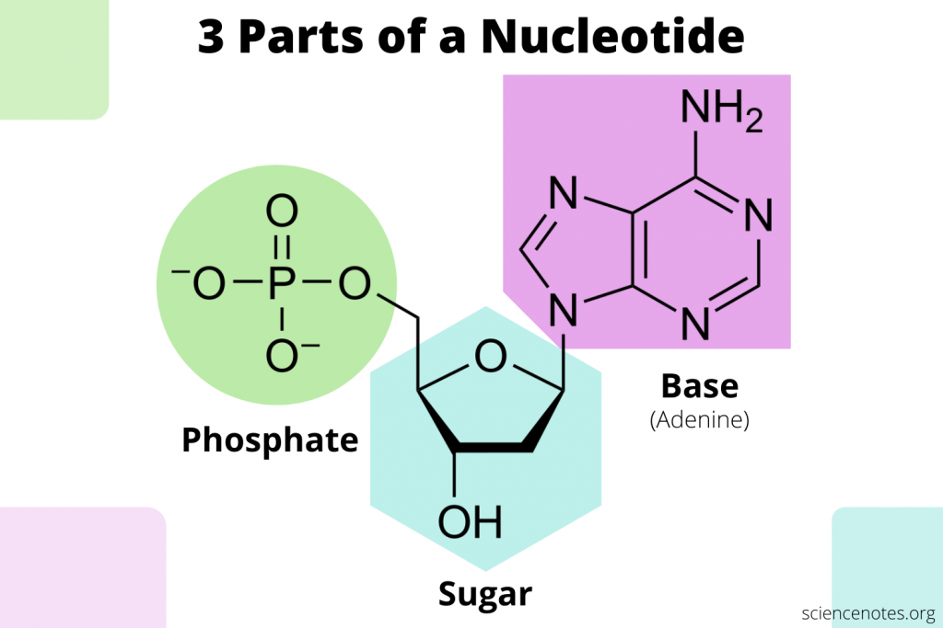
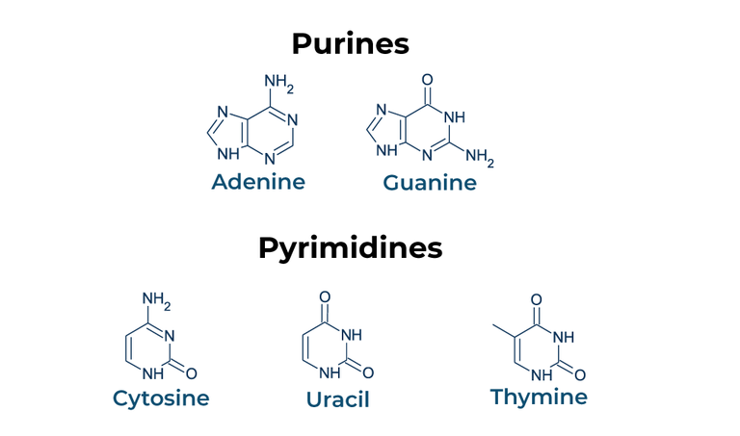
The DNA Nucleotide
Dna is made up of long chains of individual units (monomers) called nucleotides. Each nucleotide consists of:
  A five-carbon sugar
  A phosphate group
  One of four nitrogenous bases:
    Adenine (A)
    Guanine (G)
    Cytosine (C)
    Thymine (T)
Purines have a double ring (adenine and guanine), whereas pyrimidines have a single ring (thymine and cytosine)
More on uracil later

Slide 8
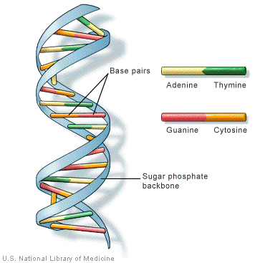
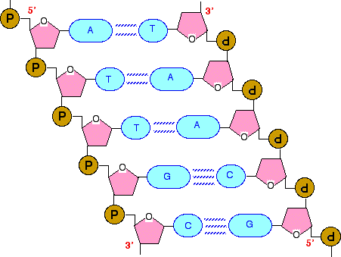
The Structure of DNA
DNA molecules form a double helix, with a sugar-phosphate backbone held together by complementary nitrogenous base pairs. The “rules” for each DNA molecule include…
Hydrogen bonds form between nitrogenous base pairs
Adenine (A) always pairs with Thymine (T)
Cytosine (C) always pairs with Guanine (G)
Each base is bonded to a sugar group.
Sugar groups are bonded to phosphates.
The grouping that exists between a phosphate molecule, a sugar molecule, and a single nitrogenous base is collectively referred to as a nucleotide
NUCLEOTIDE

Slide 9
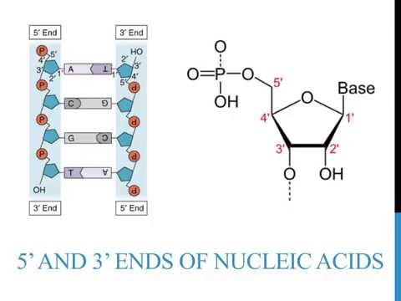
The Structure of DNA
DNA strands are also said to be antiparallel, meaning that they run in the opposite direction as one another:
The 5’ and 3’ ends run in opposite directions
  These numbers come from organic chemistry naming rules, and simply describe a particular carbon in the sugar, and thus the orientation of the nucleotide
This property has important implications for DNA replication & protein synthesis

Slide 10
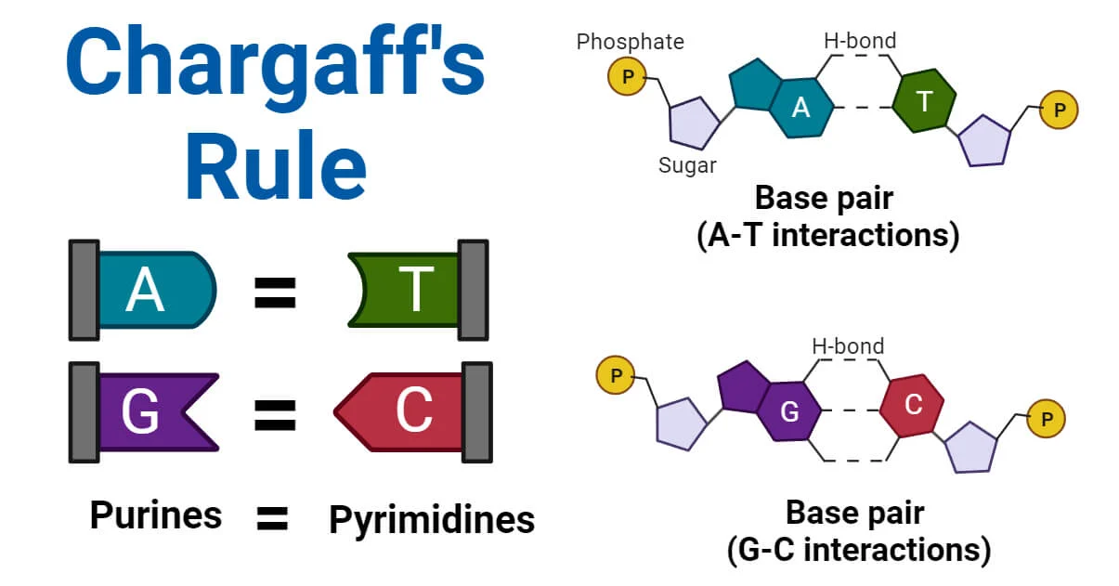
But how did we come to know so much about the structure of DNA?
In the 1940s, Erwin Chargaff figured out that the 4 different nitrogenous bases aren’t present in equal amounts. They are present in varied, yet characteristic proportions where A=T and C=G.
This became known as Chargaff’s Rule.
The AT:GC ratio is same for same species and different for different species
The amount of A = the amount of T
The amount of C = the amount of G
A+T does not necessarily equal G+C

Slide 11
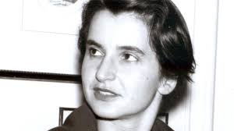
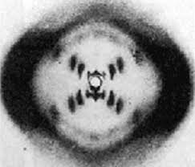
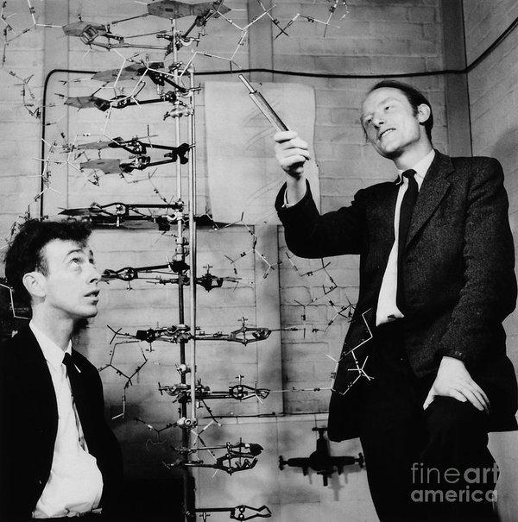
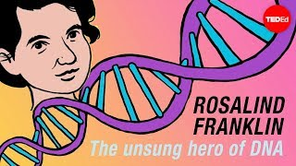
Discovering the Structure of DNA:
In the 1950s, British scientist Rosalind Franklin used X-ray photography to analyze the structure of DNA. Her observations provided crucial new information about the molecular structure of DNA.
In 1953, James Watson and Francis Crick were the first to produce the structural model of DNA that could account for all the evidence from Franklin’s experiments as well as Chargaff’s observations.
More reading if interested:
https://www.sciencehistory.org/historical-profile/james-watson-francis-crick-maurice-wilkins-and-rosalind-franklin

Slide 12
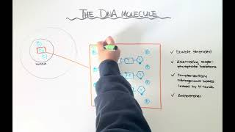
Re-cap: The DNA Molecule

Slide 13
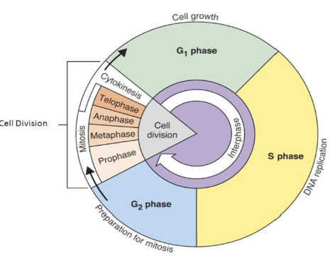
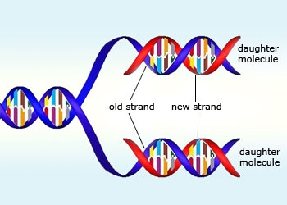
DNA Replication
During S phase of interphase, a cell replicates its entire genome in order to produce a new cell with an identical set of DNA.
Each strand of DNA serves as a template for the creation of its complementary strand
DNA replication is thus said to be semi-conservative; that is, each new molecule of DNA contains one strand of the original DNA molecule and one newly synthesized strand

Slide 14
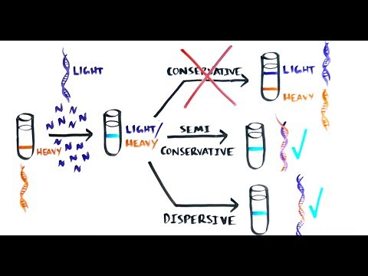
The Meselson-Stahl Experiment
The semiconservative nature of DNA replication was proven by the Meselson-Stahl Experiment.
The semiconservative model maintains that the original double helix serves as a template for, but does not contribute to, a new double helix.

Slide 15
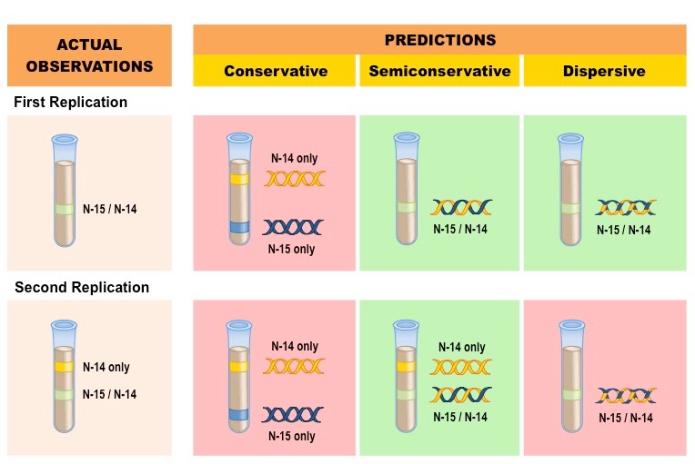
The Meselson-Stahl Experiment

Slide 16
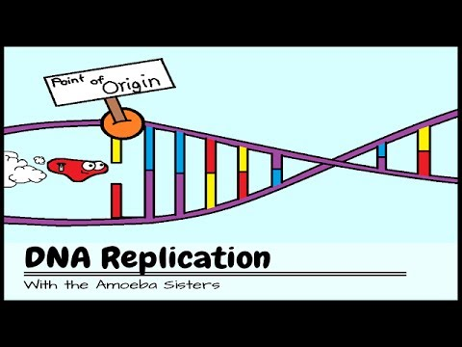
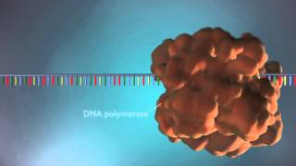
DNA Replication
Watch these videos first, then read the summary in the next slides. You may then come back and re-watch these videos, or find others to better understand the process as a whole.

Slide 17
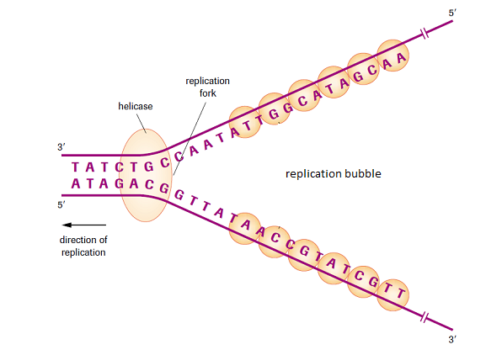
DNA Replication
STEP 1: INITIATION
A group of enzymes known as helicases bind to a specific sequence of DNA referred to as the replication origin
The helicases then “cut” and unravel the double helix. The y-shaped area that forms where the DNA is split is known as the replication fork, while the unwound region is known as the replication bubble.
The single unwound strands of DNA serve as templates for replication

Slide 18
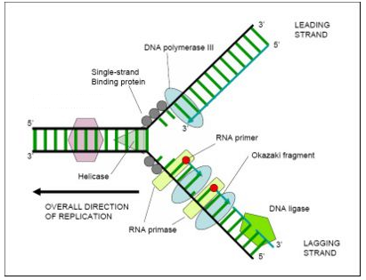
Tip: There’s often meaning in words in biology. Anything that ends in ‘ase’ is an enzyme, that ‘makes something happen’. A polymer, is a long chain of monomer subunits, such as nucleotides. DNA polymerase, therefore is an enzyme that creates DNA polymerase.
STEP 2: ELONGATION
A primer sequence synthesized by the RNA primase enzyme signals DNA polymerase where to begin.
DNA polymerase begins to add nucleotides within the replication bubble, creating two new strands of DNA that are complementary to each existing strand.
Once replication is complete, the primers are removed by DNA polymerase
Elongation always takes place in the 5’ to 3’ direction, meaning that one strand will always be “leading” (replicated continuously) and the other will always be “lagging” (replicated in short segments known as Okazaki fragments)
Okazaki fragments of the lagging strand are spliced (‘glued’) together by an enzyme known as DNA ligase

Slide 19
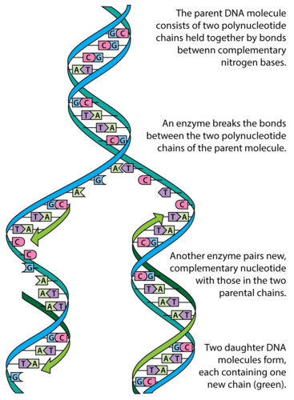
STEP 3: TERMINATION
As soon as the newly formed strands are complete, they rewind automatically into their chemically stable helix structure
Replication proceeds until the two new DNA molecules separate; the dismantling of the replication complex is known as termination

Slide 20
Key Enzymes to Know
ENZYME | FUNCTION
helicase | Cleaves (cuts) and unwinds DNA
RNA primase | Synthesizes primer to begin elongation process
DNA polymerase | adds new nucleotides from 5’ end to 3’ end of existing strand and removes primer sequences from DNA once replication is complete
DNA ligase | Splices together Okazaki fragments of lagging strand

Slide 21
Re-cap: DNA Replication
Note: Ignore any reference to DNA polymerase 3 vs 1 in the videos. These are only in prokaryotes, and we do not study them in this course. In eukaryotes we actually have more, but we will not distinguish between them and will refer to any as just DNA polymerase in this course.

Slide 22
TOPIC 2: TRANSCRIPTION & TRANSLATION
Properties of DNA vs. RNA
Transcription of DNA into mRNA
Translation of mRNA into an amino acid sequence
Role of tRNA in translation
Role of rRNA in translation
Codons vs. anticodons
Introns vs. exons
Textbook pgs. 636-642

Slide 23
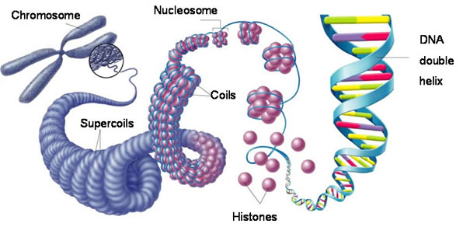
Gene Expression
Recall that DNA provides the “instructions” for each of our cells.
Each segment of DNA (gene) is responsible for encoding a specific protein, which carries out a specific function.
Not every gene is expressed in each cell. This is what allows cells to specialize and function differently.
Some genes do not appear to code for any proteins… “junk” DNA?

Slide 24
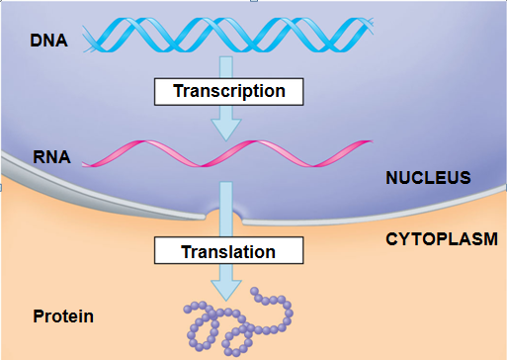
Central Dogma of Biology
In order for a segment of DNA to be expressed by a cell, it must first be transcribed into mRNA (messenger RNA) and then translated into a sequence of amino acids (a protein). This is referred to as the “central dogma” of gene expression.
Allows different cells to express different genes
So, although all cells contain the same DNA, not all cells behave the same

Slide 25
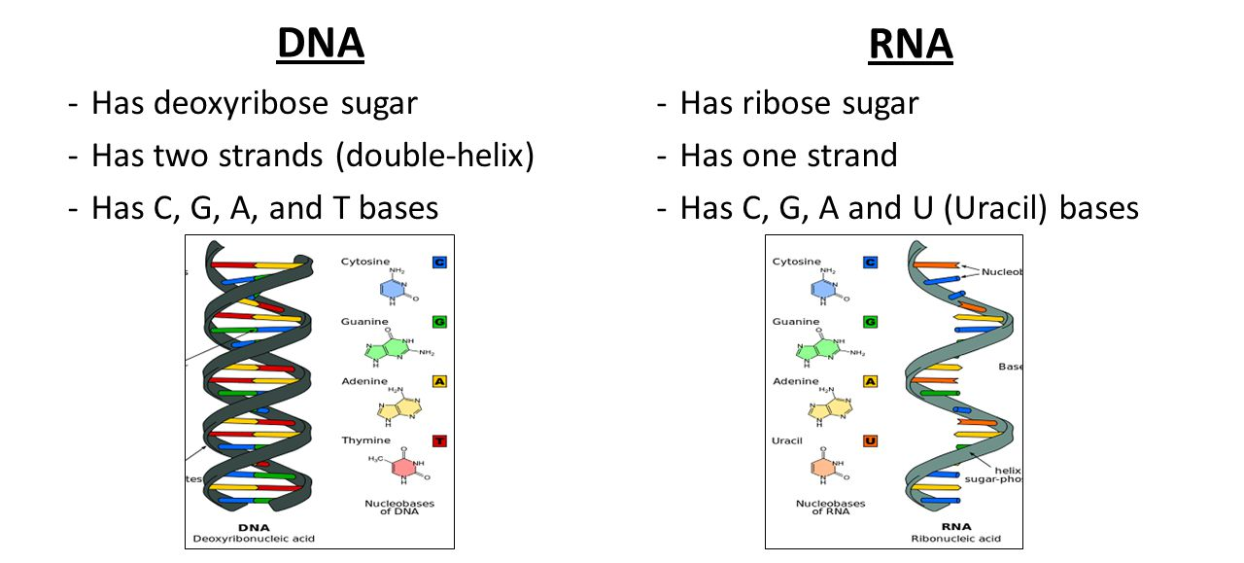
Okay, so what is RNA exactly?

Slide 26
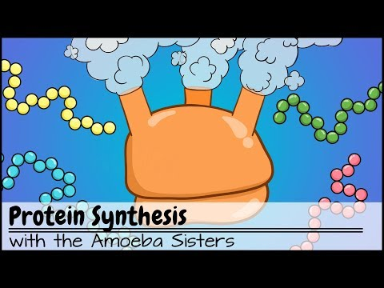
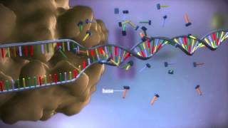
From DNA to Protein
Again, watch these videos first, then read the summary in the next slides. You may then come back and re-watch these videos, or find others to better understand the process as a whole.

Slide 27
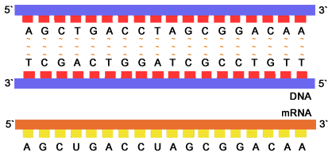
Transcription
During transcription, the information in a segment of double-stranded DNA is copied into a single strand of messenger RNA (mRNA)
Transcription takes place within the nucleus of a cell.
Only one strand of the DNA (the coding or “sense” strand) is transcribed into mRNA. SInce only one strand is transcribed, there is no need for Okazaki fragments here.
  The other strand is referred to as non-coding or antisense strand.
Transcription is initiated when RNA polymerase binds to the promoter region of the coding strand and begins to add complementary base pairs in the 5’ to 3’ direction.
Whenever a thymine should be inserted, it is replaced by uracil (U’s instead of T’s) because in RNA, there is no thymine.
Once RNA polymerase reaches a termination sequence, the mRNA strand is complete and can leave the nucleus to be translated into a protein.

Slide 28
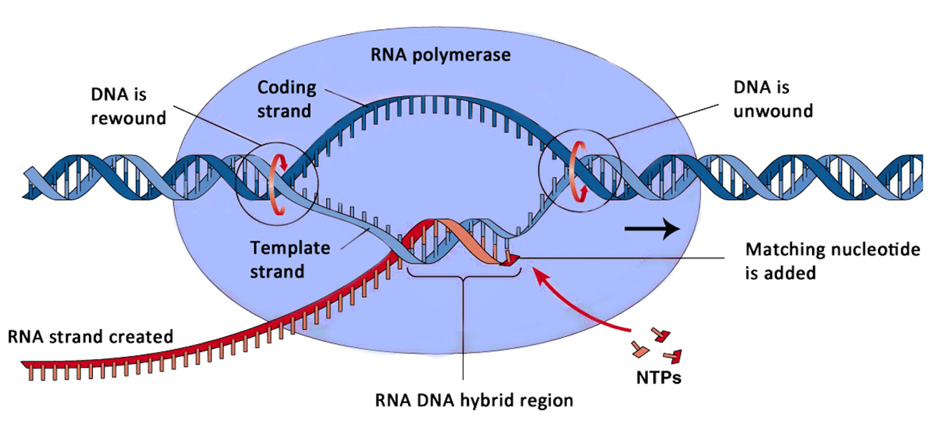
Transcription

Slide 29
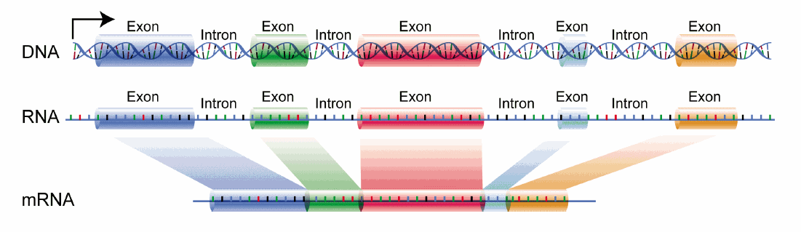
Extra: mRNA processing
Before translation takes place, the mRNA sequence is modified to remove sequences of mRNA called introns.
Introns are sequences of RNA that do not code for proteins.
The remaining RNA sequences are referred to as exons.
This modification process occurs only in eukaryotes.

Slide 30
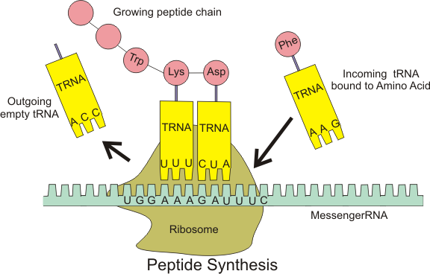
2) Translation
Once DNA is transcribed into mRNA, it then leaves the nucleus and moves into the cytoplasm of the cell to be translated into a protein.
The mRNA sequence is split into codons (groups of three base pairs), each of which links to a specific amino acid through the use of transfer RNA (tRNA).
Codons are linked to amino acids by tRNA anticodons.
Ribosomes (ribosomal RNA - rRNA) serve as the functional units of protein synthesis, working with tRNA to translate mRNA into amino acids

Slide 31
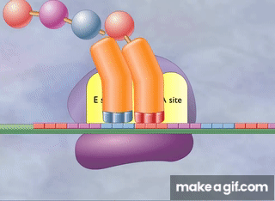
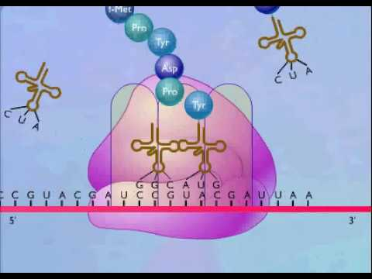
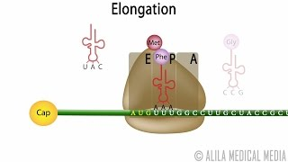
Ribosomes are typically free-floating within the cytoplasm; these ribosomes produce proteins for use within the cell.
Ribosomes consist of two subunits: a large subunit and a small subunit. The mRNA sequence is “sandwiched” between these two subunits when it is translated.
Each codon to be translated arrives at the “A” site of the ribosome with the help of tRNA. It then moves to the “P” site, where the correct amino acid is attached to the growing polypeptide chain. It then exits at the “E” site.
Bound ribosomes produce proteins for export.

Slide 32
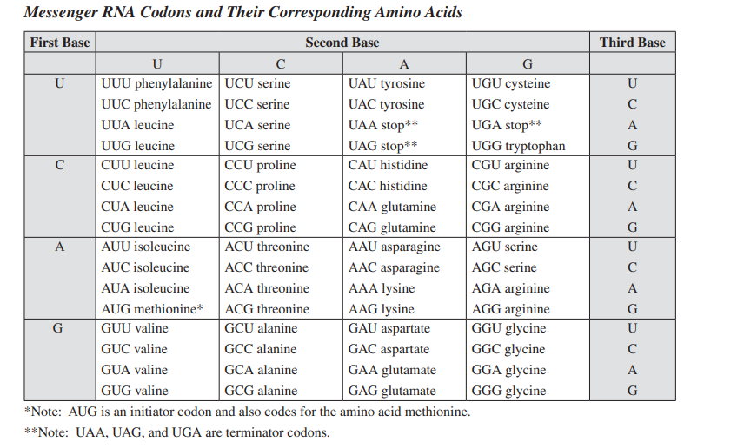
Codons to Amino Acids
Table of mRNA codons (in your data booklet) and corresponding amino acids
For example, if the mRNA sequence is AGC, the amino acid ‘serine’ will be inserted during translation
Remember!! You must be using mRNA to look up the amino acid in this table.
AUG - is an initiator or start codon. The ribosomes will ‘scan’ the mRNA sequence, and only begin translating at AUG. AUG therefore also set the reading frame for the mRNA.
UAA, UAG, and UGA - terminator or stop codons. The ribosome will stop translating here and the protein in finished.

Slide 33
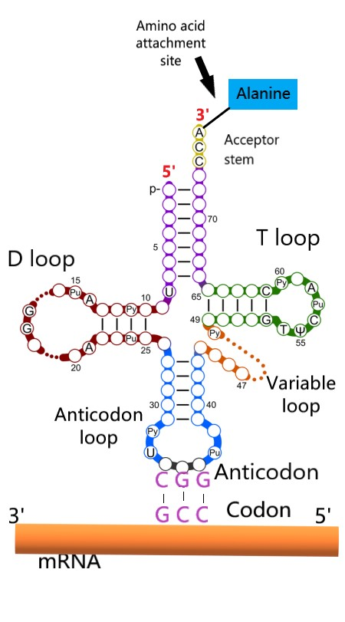
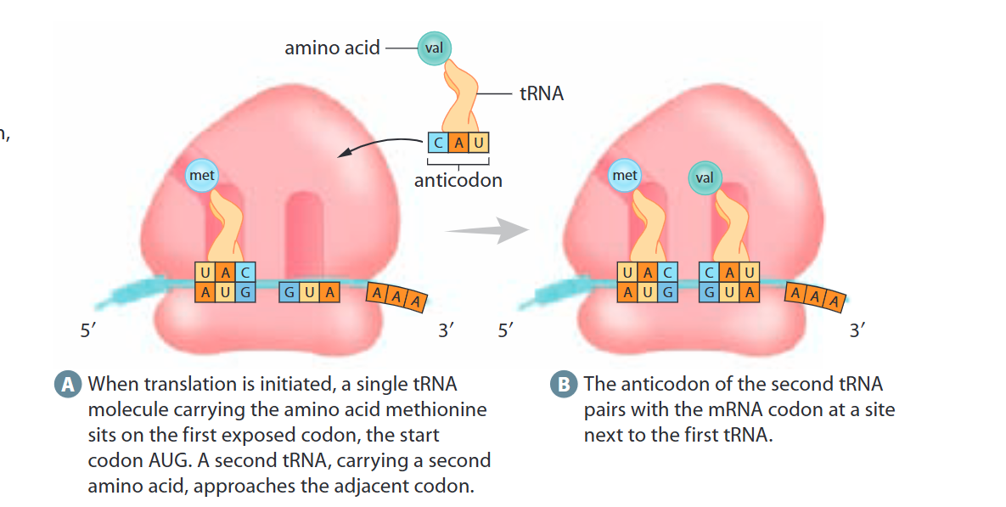
A closer look at tRNA
Although tRNA is still single stranded, like other RNA molecules, it also has a looped structure.
We don’t need to worry too much about the loops, but one of its loops contains the anticodon, through which the tRNA molecule binds to the complementary codon in the mRNA molecule.
E.g. a tRNA with an anticodon of CGG, will carry alanine, because the complementary mRNA codon is GCC. REMEMBER: You have to look up mRNA in your data booklet.

Slide 34
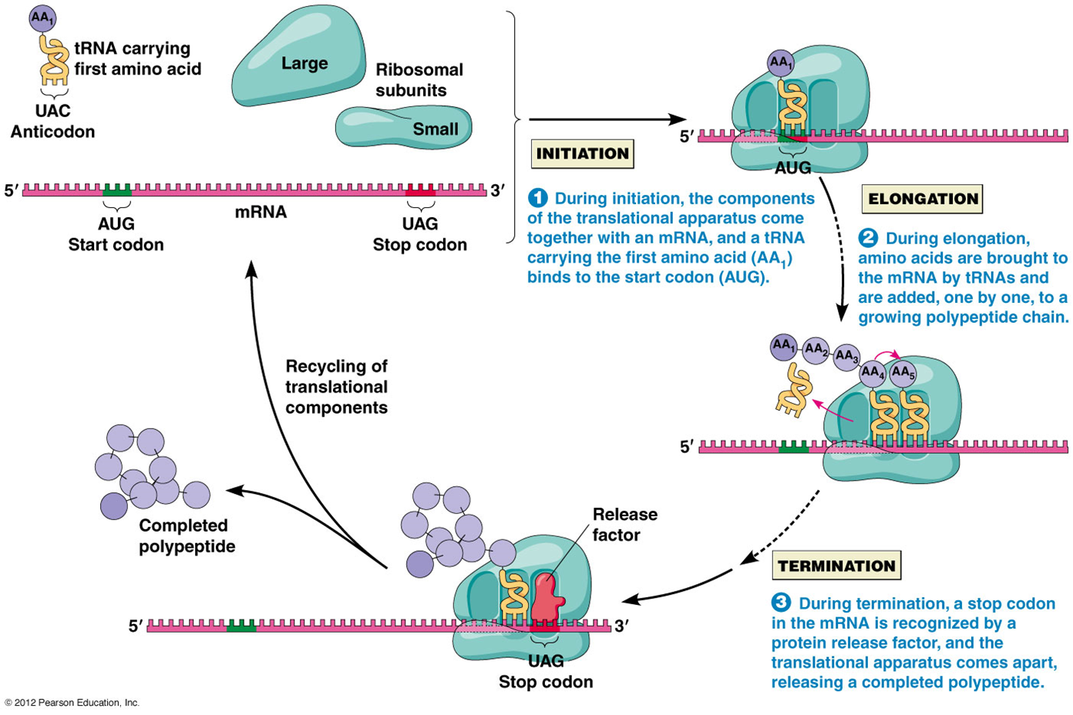

Slide 35

Example:
DNA
5’ TTCAGACCGATCTTA 3’
3’ AAGTCTGGCTAGAAT 5’
TRANSCRIPTION
Transcribe coding strand of DNA into mRNA
Takes place in nucleus
mRNA
5’ UUCAGACCGAUCUUA 3’
Separate mRNA molecule into codons
Codons
5’ UUC AGA CCG AUC UUA 3’
TRANSLATION
Translate codons into amino acids using table
Takes place in cytoplasm
Amino Acids
5’ phe/arg/pro/iso/leu 3’

Slide 36
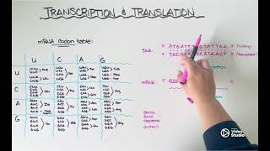
Transcription and Translation Recap

Slide 37
Practice #1
Transcribe the following strand of DNA into mRNA:
DNA: GCT TAG GCC CAT CTA
Translate your mRNA strand above into a sequence of amino acids:
mRNA: CGA AUC CGG GUA GAU
mRNA: CGA AUC CGG AUA GAU
AA sequence: arginine-isoleucine-arginine-valine-aspartate

Slide 38
Practice #2
How many nucleotides are required to code for the following sequence of amino acids?
Leu-Tyr-Arg-Trp-Ser
Is it possible to determine the mRNA sequence that is responsible for producing the sequence of amino acids above? Explain…
No. More than one codon codes for most AAs. For example, leucine can come from an mRNA sequence of UUA, UUG, or anything that begins with CU_
15 nucleotide (each AA requires a codon, which is a nucleotide triplet

Slide 39
Redundancy
The previous practice question illustrates the redundancy of the genetic code. This means that most amino acids are encoded for by different mRNA codons, and therefore different DNA nucleotide triples.
  But no codon will ever specify for two different amino acids
Redundancy is a good thing, when we consider mutations. For example, if the normal DNA sequence is CAA, but during DNA replication DNA polymerase inserts a G instead of the second A and now the DNA sequence is CAG, it still codes for glutamine. The finished protein will be no different.

Slide 40
Practice #3
Identify a single-letter mutation that could occur in the following DNA sequence to produce a stop codon at some point in the amino acid:
AACGAATATCGG
Remember, that AAs are determined based on mRNA codons. The STOP codons are UAA, UAG, and UGA, which would correspond to DNA sequences of ATT, ATC, and ACT.
AAC GAA TAT CGG → ATC GAA TAT CGG

Slide 41
Practice #4
Complete the following table:
Coding strand | ACGGCTTTACAC
Non-coding strand
mRNA
tRNA
AA Sequence
TGCCGAAATGTG
UGCCGAAAUGUG
ACGGCUUUACAC
cys-arg-asp-val

Slide 42
Re-Cap: Types of Nucleic Acids
NUCLEIC ACID | STRUCTURE | FUNCTION
DNA | Double helix | Stores genetic info
mRNA | single strand | Carries genetic info from DNA in nucleus to ribosomes in cytoplasm for protein synthesis. Transcribed from DNA.
tRNA | Single strand | Carries amino acids to the correct codon site during protein synthesis. Complementary to mRNA
rRNA | Single strand | Combines to form a ribosome, the main structure required for protein synthesis

Slide 43
TOPIC 3: MUTATIONS AND GENETIC TECHNOLOGIES
Causes of mutations: Point mutation vs. frameshift mutation
Effects of mutations: Silent vs. missense vs. nonsense mutation
Mitochondrial DNA
Recombinant DNA
Gel electrophoresis
Taq polymerase & PCR
Textbook pgs. 643-662

Slide 44
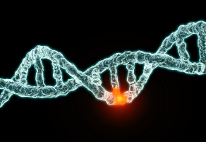
Mutations
Mistakes in the coding of genetic information often take place during DNA replication, transcription and/or translation. Most of the mistakes get corrected right away, by various proofing mechanisms cells have. Mistakes that do not get corrected, however, result in the production of a different sequence than what was intended. These mistakes are referred to as mutations. Certain types of mutations have more severe consequences than others.
Mutations that occur in somatic cells (body cells) are not passed on to offspring (e.g. cancer)
Mutations that occur in the germ line (reproductive cells) are passed on to offspring (e.g. trisomy 21)

Slide 45
Types of Mutations
POINT MUTATION
Chemical change that affects just one nucleotide
This involves the substitution of one nucleotide for another (e.g. a “G” instead of an “A”)
Point mutations can be
    silent: no change in AA
    missense: change to new AA
    nonsense: change to stop codon
CAG UUA CCC
glu/leu/pro
CAG UUG CCC
glu/leu/pro
Mutation changes “A” to “G” in second codon, but does not result in a different amino acid

Slide 46
Point Mutations
Silent
Missense
Nonsense
CAG UUA CCC
glu/leu/pro
CAG UUG CCC
glu/leu/pro
CAG UUA CCC
glu/leu/pro
CAG UCA CCC
glu/ser/pro
CAG UUA CCC
glu/leu/pro
CAG UAA CCC
glu/STOP
Mutation changes “A” to “G” in second codon, but does not result in a different amino acid. Correct protein is made.
Mutation changes “U to “C” in second codon, which results in different AA. This can have varying impacts, depending on how similar the AAs are and where in the protein it is.
Mutation changes “U to “A” in second codon, which results in a STOP codon. This means that no functional protein is made

Slide 47
Causes of Mutations
CAG UUA CCC
glu/leu/pro
CAGG UUA CCC
CAG GUU ACC C
glu/val/thr
2) FRAMESHIFT MUTATION
An insertion or deletion of a nucleotide that causes the entire reading frame of the gene to be altered
Typically has more severe consequences, as it changes the protein entirely (not just a single amino acid)

Slide 48
Practice
Identify the type of mutation in each of the following situations
Original strand: AUG UUU UUG CCU UAU CAU CGU
Mutated strand: AUG UUU UUG CCU UAC CAU CGU
Original strand: AUG UUU UUG CCU UAU CAU CGU
Mutated strand: AUG UUU UUG CCU UAA CAU CGU
Original strand: AUG UUU UUG CCU UAU CAU CGU
Mutated strand: AUG UUU UUG CCU AUC AUC GU
Silent mutation
Nonsense mutation
Deletion frameshift
Remember, you always need to be considering the mRNA sequence. So if a similar question gave you DNA, you would first have to transcribe it into mRNA to identify the type of mutation.

Slide 49
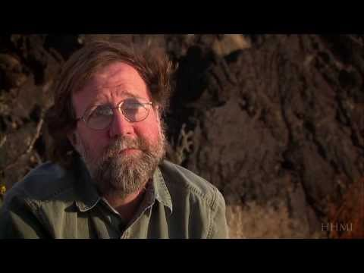
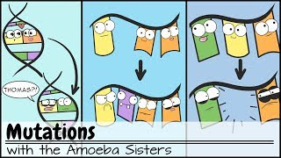
Mutations Summary
Mutations & Natural Selection

Slide 50
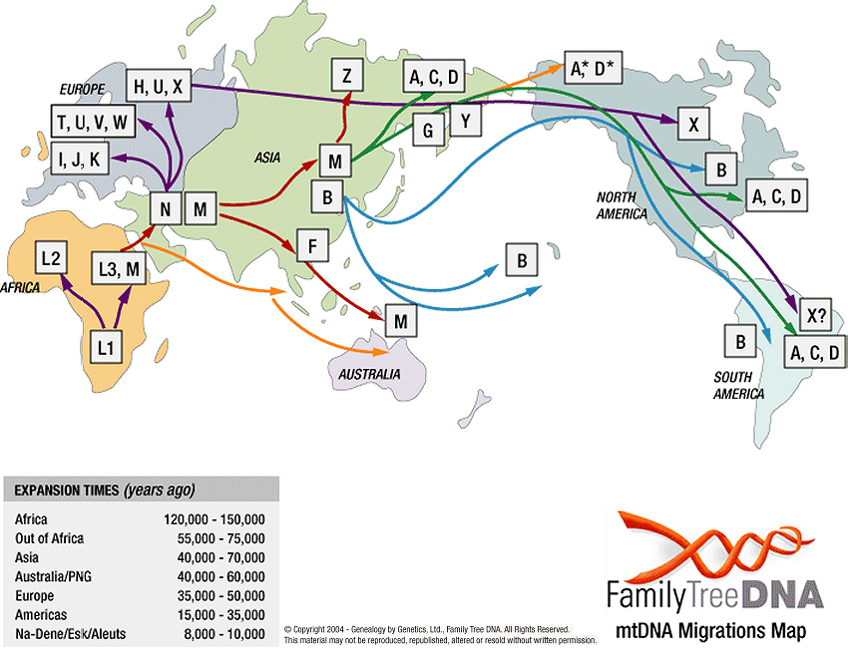
According to our most current understanding, some mitochondria may be donated by the sperm and therefore mtDNA can be paternal, but this is much less frequent and we will ignore for Bio 30.
Mitochondrial DNA
DNA is not just found in the nucleus of the cell; it is also stored in the mitochondria. However, unlike nuclear DNA, mtDNA is only inherited from the mother. This is because all cytoplasm and organelles, such as mitochondria, come from the egg; sperm just contributes DNA.
By analyzing the mtDNA of a species, we can actually trace back lineages through time to identify a common ancestor
  mtDNA mutations usually aren’t lethal, so mutations can accumulate in great numbers over time
  mtDNA is also shorter, which makes sequencing easier
  The more similar mtDNA sequences, the more closely related organisms are

Slide 51
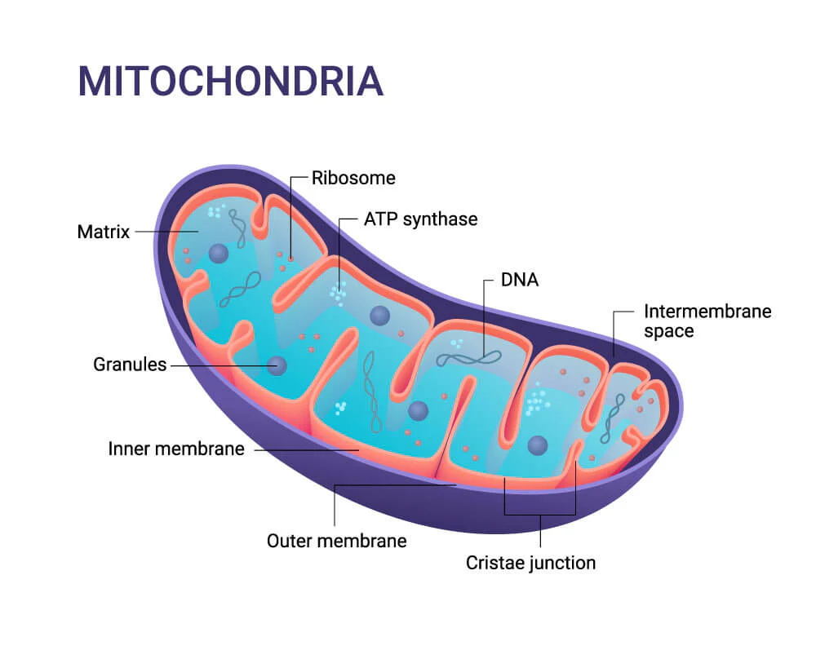
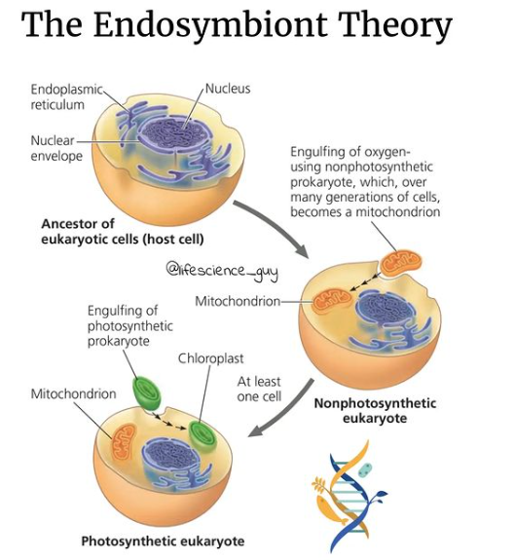
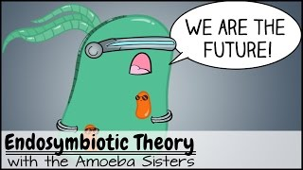
Why do mitochondria contain DNA?
Mitochondria (and chloroplasts) have their own DNA, because they used to be their own free living bacteria. Through the process of endosymbiosis they came to be part of eukaryotic cells.

Slide 52
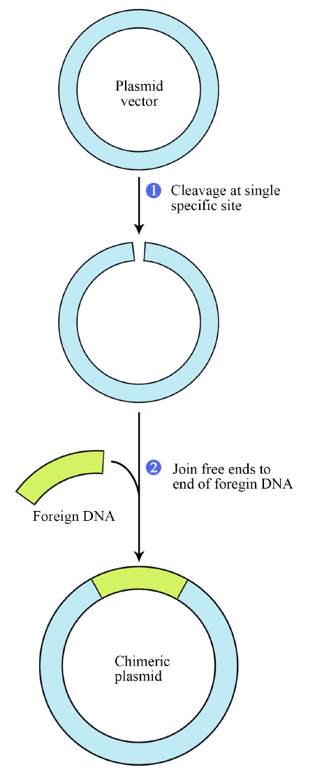
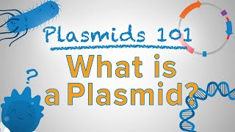

Genetic Engineering
A molecule of DNA that includes genetic material from different sources is called recombinant DNA. It is produced through the process of genetic engineering.
(by restriction endonucleases)
Genetic engineering is used globally to produce organisms with desirable traits that could not be produced via selective breeding (Genetically Modified Organisms - GMOs).
  E.g. herbicide resistant canola or corn
  E.g. mass-production of human insulin by bacteria.
Genetic engineering often involves taking plasmids from bacteria (circular segments of DNA which contain their genetic info) and re-programming them to express certain genes.
Restriction endonucleases (restriction enzymes) “cut” the DNA sequence at a specific recognition site to allow for the insertion of a desired gene, which is “glued” into the genome using DNA ligase.
(restriction fragment)

Slide 53


Genetic Engineering
General steps involved with genetic engineering and creating insulin producing bacteria:
Use restriction enzymes to cut and remove functioning insulin gene from a human pancreatic cell
Use the same restriction enzyme on a plasmid to get same ‘sticky ends’. These are usually palindromic sequences.
For example:

Slide 54

Genetic Engineering
Cont.
Mix the samples and use DNA ligase to fuse/glue the cut-out insulin gene into the plasmid
Allow bacteria to take up plasmid from their environment by transformation
Allow growth of bacterial colonies on petri dish
Isolate insulin producing bacteria and extract insulin

Slide 55


Slide 56



Extra: Genetic Engineering
Genetic engineering is a fast growing field of science. There are so many fascinating and instructional videos on the internet. I encourage you to seek out some videos on this topic to learn more. Here are a few to get started with:

Slide 57


Gel Electrophoresis
Through a process known as gel electrophoresis, we can analyze and compare the DNA of any organism:
Involves applying a current to a gel made of agarose sugar → there is a positive electrode end and a negative electrode end
Restriction enzymes cut DNA at specific points, forming a series of varying sized fragments
DNA is negatively charged, so it will migrate towards the positive electrode
The smaller the fragment, the easier it is to move through the gel, therefore smaller fragments will migrate further
The banding pattern of the gel allows us to compare samples of DNA

Slide 58


E.g. Samples #1 and #4 display the same banding pattern, indicating that the organisms they were taken from are closely related, most likely being the same individual

Slide 59


Slide 60

Applications of Gel Electrophoresis
Who committed the crime?
Who is the father?
Note: Remember that a child has half of its DNA from mom and half from dad. To identify a father, every band that could not from the mother, has to be from the father.
Note: To identify a suspect, it needs to be a perfect match. Every band has to have an exact match.

Slide 61


Practice
Who committed the crime?
Who is the father?

