Slide 1
00 · OVERVIEW
Why code models break naming conventions
A probing study on four code-generation models. Unified re-run, seed 42, 504 function names, 7,212 analysed conditions.
THE CLAIM, IN ONE SENTENCE
SCALE OF THE STUDY
Models do look at the instruction.
What arrives when they look is wrong.
4
MODELS
504
FUNCTION NAMES
So the handle is not attention. It is content — the Value road — at one late layer.
7,212
ANALYSED CONDITIONS
THREE CONTRIBUTIONS
Separating the two roads
Pricing the disturbance
Testing the prescription
Attention share and attended content are intervened on independently, so “does not look” and “reads wrong” become distinguishable claims.
Overwriting anything at all moves the score. We measure that bubble and report treatment minus control, never the raw number.
The remedy implied by the diagnosis is measured on the same instrument as the rival remedy, on the same conditions.
Each is a measurement, not an argument — every number in this deck comes from a stored result file.
Naming-convention probing · 00 · Overview
01

Slide 2
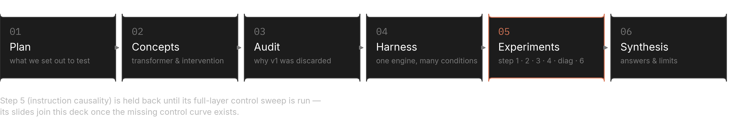
00 · OVERVIEW
How this deck is arranged
Six sections. The experiments are told in the order of the argument, not the order they were run.
SECTION MAP
Step 5 (instruction causality) is held back — its full-layer control sweep has not been run yet.
HOW TO READ A STEP
CONVENTIONS USED THROUGHOUT
Plan
the question, the conditions, what each outcome would mean
Clay
marks the one series being argued about
Code
the pipeline, the lines that matter, the stored fields
Per token
attention is always divided by the span's token count
Results
the figures, the numbers, and what the step does not settle
Net
reported effects are treatment minus control, paired by block
Naming-convention probing · 00 · Overview
02

Slide 3
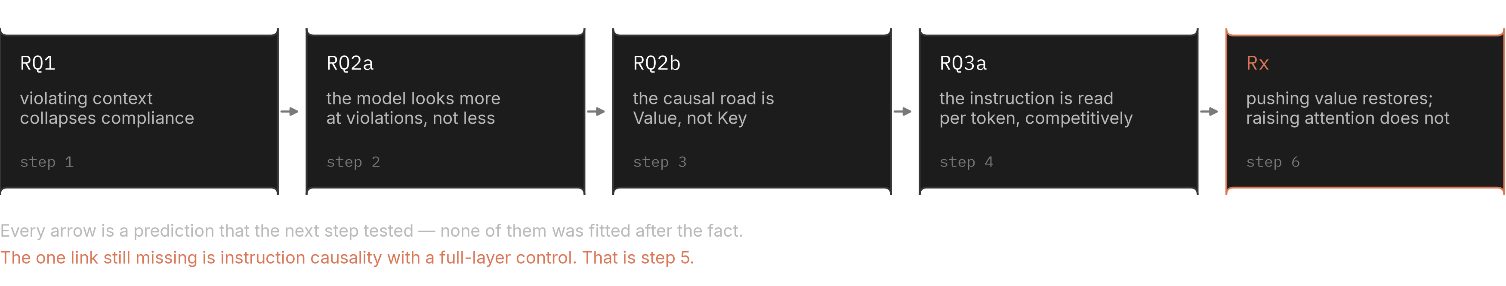
00 · OVERVIEW
The through-line
Five findings, each one a prediction that the next experiment tested.
FROM SYMPTOM TO HANDLE
No arrow was drawn after the fact — each step was specified before the previous one's results were read.
WHAT FAILS
WHERE IT LIVES
WHAT TO DO
Compliance collapses with context
The road is Value, not Key
Push content, not attention
A dozen violating names in the preceding file is enough to drive compliance to the floor, in both notation directions.
Overwriting attended content moves behaviour; overwriting attention share does not, once the disturbance is subtracted.
Adding a contrast direction at one late layer restores preference; raising attention mass on the instruction does not.
Naming-convention probing · 00 · Overview
03

Slide 4
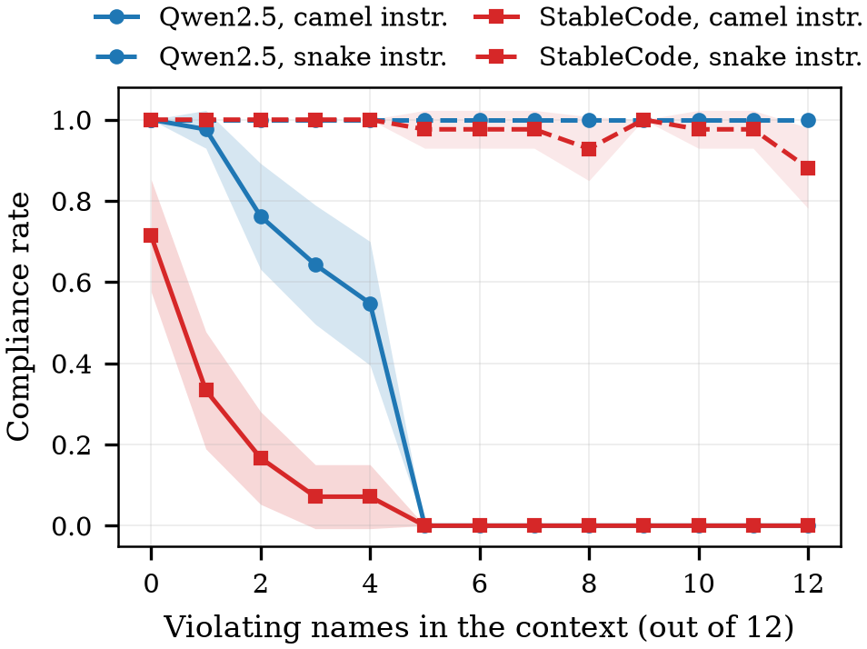
01 · PLAN
The symptom: the file overrides the instruction
The instruction is explicit and unchanged. Only the surrounding file changes.
STEP 1 · COMPLIANCE AGAINST CONTEXT VIOLATIONS
WHAT THE PLOT SAYS
— Axis: how many of the twelve preceding function names violate the instruction
— Value: share of generations that follow the instruction
— Shape: not a gentle slope — compliance falls away over a narrow band
— Both lines: camelCase-required and snake_case-required behave the same way
Both instruction directions are plotted. The collapse is not an artefact of one notation.
WHY THIS IS THE RIGHT STARTING POINT
The instruction text is identical in every condition on this plot. The only thing that moves is how many names in the file already break it. That isolates context as the cause and makes the rest of the study a question about mechanism rather than about prompt wording.
If context did not matter, there would be nothing to localise and no prescription to test.
Naming-convention probing · 01 · Plan
04

Slide 5
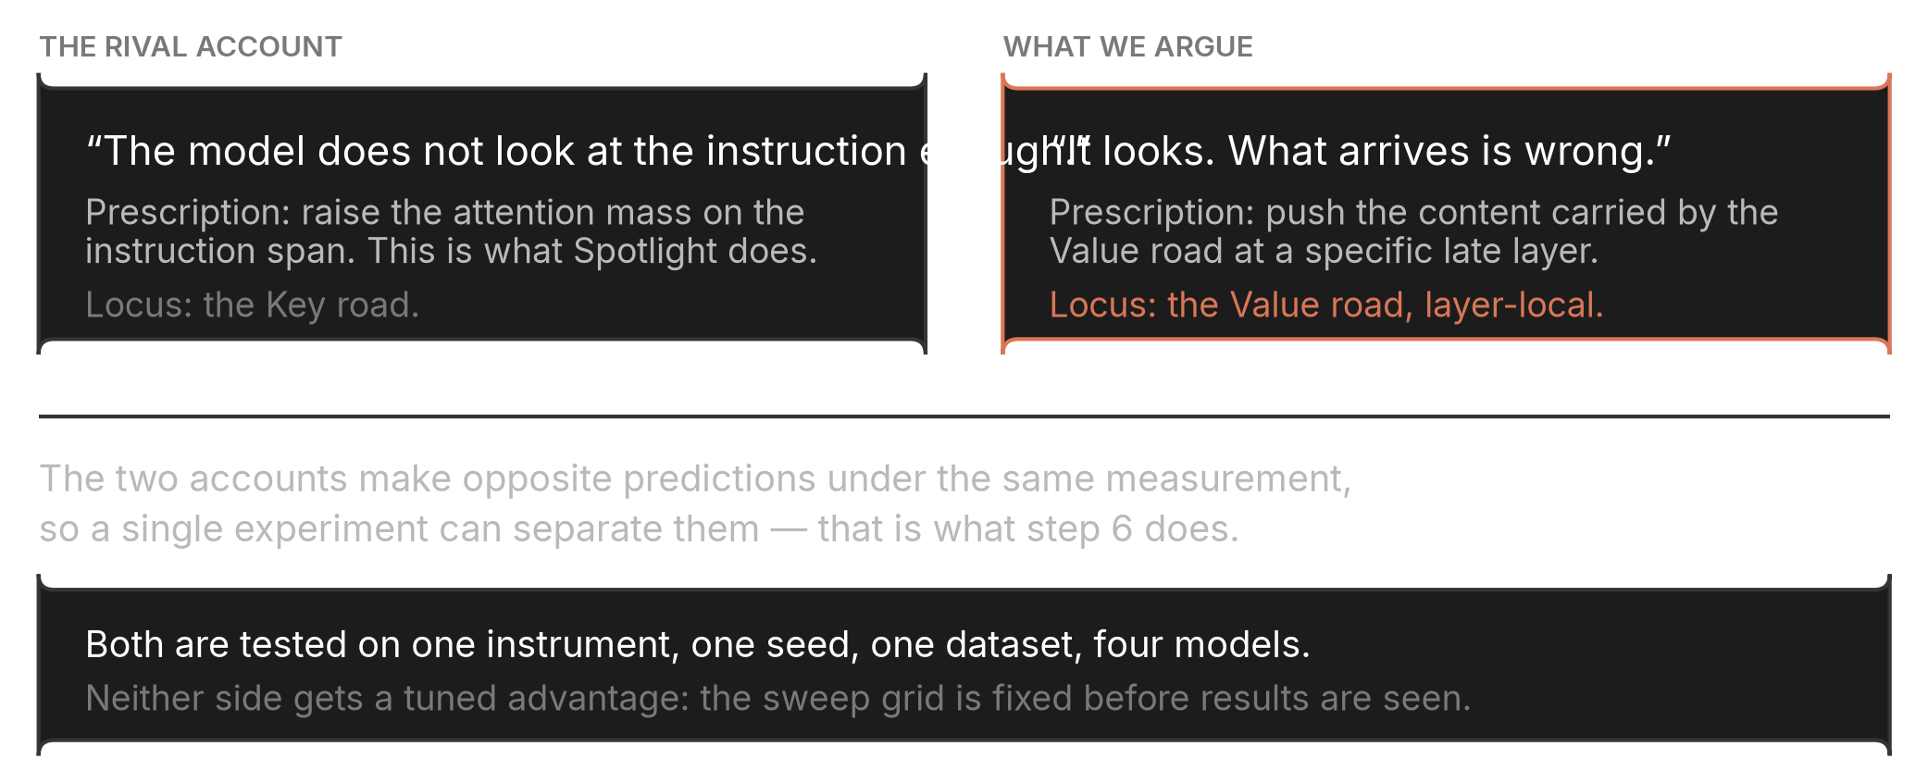
01 · PLAN
Two accounts of the same failure
They disagree about the locus, so they disagree about the remedy — and a single instrument can separate them.
THE DISAGREEMENT
Prior work that raises attention mass on the instruction is committing to the left-hand account.
WHAT WOULD SETTLE IT
HOW WE AVOID STACKING THE DECK
— If attention: raising the instruction's attention share should restore compliance
— If content: it should not — and pushing the attended content should
Both remedies are swept over a fixed grid chosen before any result was read, on the same conditions, the same seed and the same four models. Neither is tuned after seeing the other's outcome.
Naming-convention probing · 01 · Plan
05

Slide 6
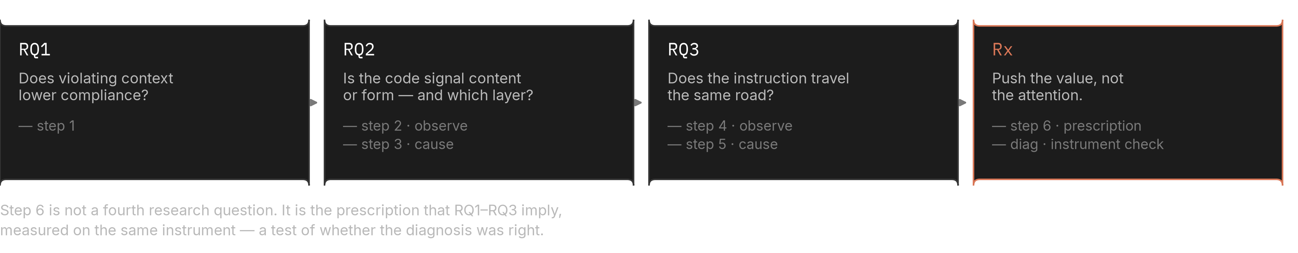
01 · PLAN
Research questions
Three questions and one prescription. Step 6 is not a fourth question — it is the test of whether the first three were read correctly.
STRUCTURE
Observation and causation are kept apart: every “where” claim has a matching intervention.
WHAT EACH ANSWER WOULD LICENSE
QUESTION
IF YES
IF NO
RQ1 context lowers compliance
there is a mechanism to localise
the study has no subject; stop here
RQ2 the code signal is content
the handle is the Value road at a specific layer
attention-based remedies remain live
RQ3 the instruction travels the same road
one prescription covers both signals
code and instruction need separate treatment
Stated before the runs, so that an unexpected result cannot be reinterpreted into a success.
Naming-convention probing · 01 · Plan
06

Slide 7
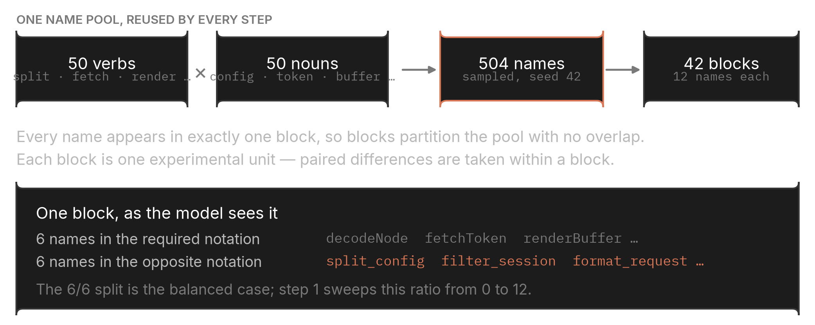
01 · PLAN
Fixed setup
One pool of names, four models, one seed. Every step draws its conditions from the same material.
THE NAME POOL
THE FOUR MODELS
Qwen2.5-Coder-3B
code-specialised, 36 layers
DeepSeek-Coder-6.7B
code-specialised, 32 layers
Llama-3.2-3B
general purpose, 28 layers
StableCode-3B
code-specialised, 32 layers
The general-purpose model is kept in deliberately: it is the one that most often lands in the undecidable band, and that is itself a result.
Blocks are disjoint, so a paired difference within a block is a difference on the same names.
HELD CONSTANT ACROSS EVERY STEP
Seed
42, everywhere
Language
Python only — 0 JavaScript results
Instruction form
positive phrasing, weak strength
Context
12 preceding functions
Substitution
mean-pool, per KV group
Undecidable
gap below 1.0 nat is excluded
Python only. The harness supports JavaScript but no JavaScript condition was ever run, so no claim covers it.
Naming-convention probing · 01 · Plan
07

Slide 8
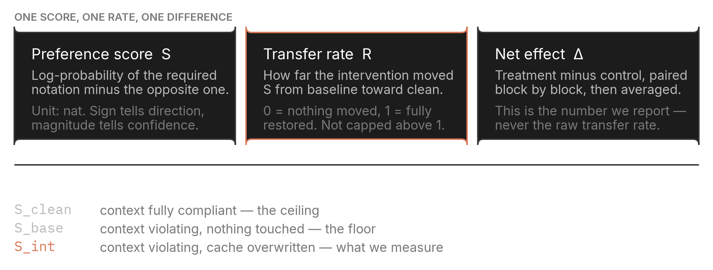
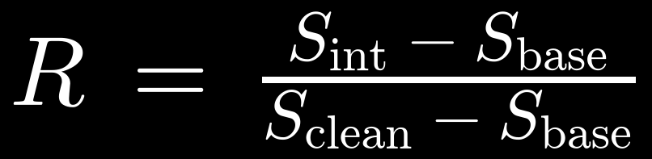
01 · PLAN
What we measure
One score for preference, one rate for how far an intervention moved it, one difference for what survives the control.
THE THREE QUANTITIES
The transfer rate is not capped above 1 — values above 1 mean the intervention overshot the clean condition.
EQ. 2 — PREFERENCE SCORE
EQ. 3 — TRANSFER RATE
P next-token probability under the model
Teacher-forced with the prefix “def ”, no length normalisation.
Clean is the ceiling, base the floor, int the intervened run.
Naming-convention probing · 01 · Plan
08

Slide 9
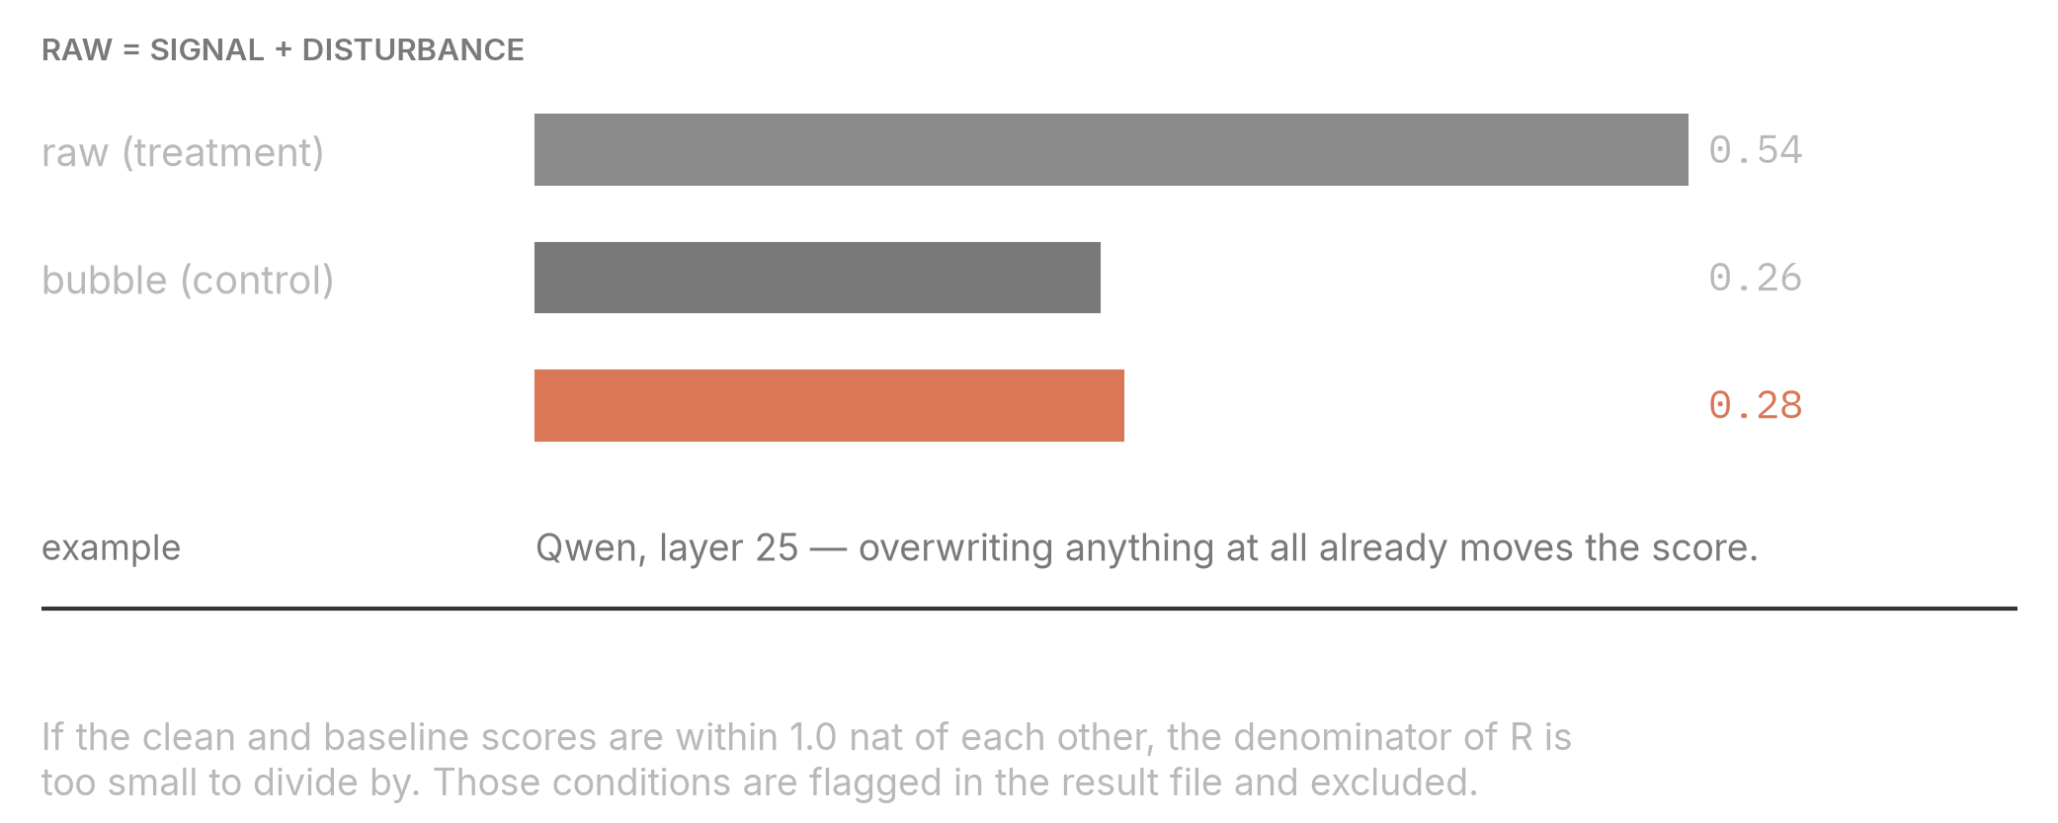
01 · PLAN
Controls are not optional here
Overwriting a cached vector removes the original as well as inserting the new one. The raw number contains both.
THE DECOMPOSITION
BUBBLE SHARE BY MODEL
MODEL
BUBBLE ÷ RAW
Qwen2.5-Coder-3B
49%
DeepSeek-Coder-6.7B
42%
Llama-3.2-3B
40%
StableCode-3B
34%
Bubble measured at the peak layer of each model: 34% (StableCode) to 49% (Qwen) of the raw value.
Raw transfer rates are never reported alone.
EQ. 4 — WHEN A CONDITION CANNOT BE JUDGED
S_clean compliant context S_base violating context 1.0 threshold in nats, stored with every result
Below the threshold the model had no strong preference to restore, so the transfer rate becomes unstable. Those conditions are counted, reported and set aside.
The flag and the gap are both stored, so the threshold's sensitivity can be re-checked without re-running anything.
Naming-convention probing · 01 · Plan
09

Slide 10
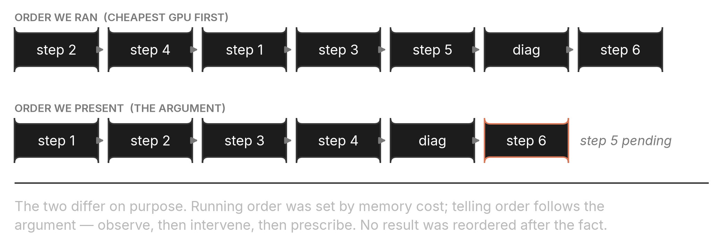
01 · PLAN
The order of work
Running order was chosen by memory cost. Telling order follows the argument. Neither was changed after results appeared.
TWO ORDERS
Step 5 sits in the running order but not yet in this deck — its control sweep is still outstanding.
CONDITION CENSUS — WHAT EXISTS ON DISK
2,184
168
504
336
STEP 1 · CLIFF
STEP 2 · CODE OBSERVE
STEP 3 · CODE CAUSE
STEP 4 · INSTRUCTION OBSERVE
72
2,184
420
336
DIAG · INSTRUMENT
STEP 6 · STEER
STEP 6 · GENERATE
STEP 6 · CROSS-LAYER
7,212 conditions enter the analysis; 1,344 step-5 control runs are excluded and footnoted.
Naming-convention probing · 01 · Plan
10

Slide 11
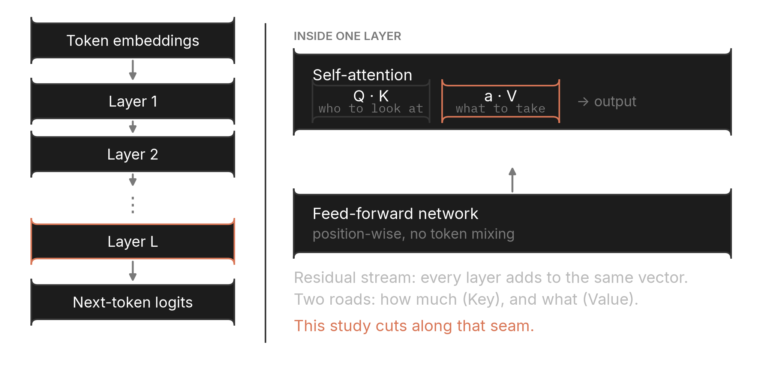
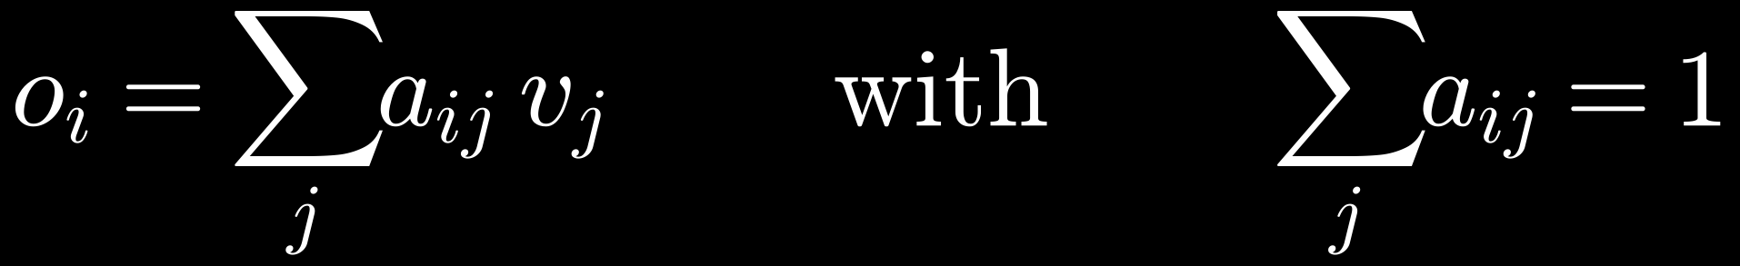
02 · CONCEPTS
Inside one layer: two separable roads
Attention splits into how much to look (Key) and what arrives when it looks (Value). Every intervention in this study cuts along that seam.
TRANSFORMER BLOCK · ONE LAYER
WHAT EACH ROAD CARRIES
— Query: the row of the position about to emit the function name
— Key: decides the share of attention each earlier token receives
— Value: the content actually mixed into the output
— Residual: the running vector each layer adds to, never replaces
We read one query row; it sums to 1, so each span's value is its share.
The Value box is where this study pushes; the Key box is where prior work pushes.
EQ. 5 — THE ATTENTION OUTPUT AT ONE POSITION
WHY THE SEAM IS TESTABLE
The cached K and V are separate tensors, so one can be replaced while the other is left exactly as the model computed it — same prompt, same length.
i query position j earlier token a attention weight v value vector
a is the Key road, v is the Value road. Overwriting v alone leaves a untouched.
This is what separates “looks enough” from “reads wrong”.
Naming-convention probing · 02 · Concepts
11

Slide 12
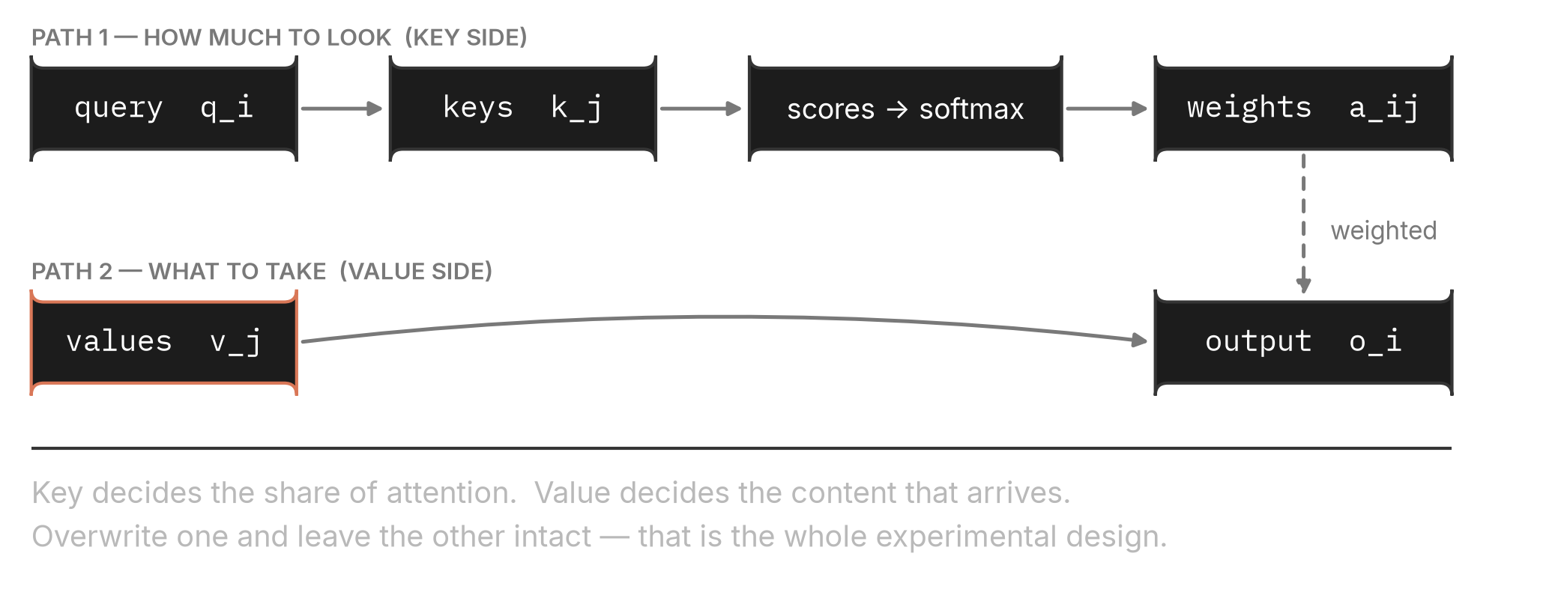
02 · CONCEPTS
Where Q, K and V come from
Three linear maps of the same hidden state. Nothing about them is intrinsically about position or content — the roles come from how they are used.
EQ. 6 — THE THREE PROJECTIONS
x hidden state at a position W learned projection, one per role d_k head dimension
Same input, three learned matrices. The split into “how much” and “what” happens downstream.
THE TWO ROADS, DRAWN OUT
The dashed line is the only place the two roads meet — weights computed on one side scale the other.
Naming-convention probing · 02 · Concepts
12

Slide 13
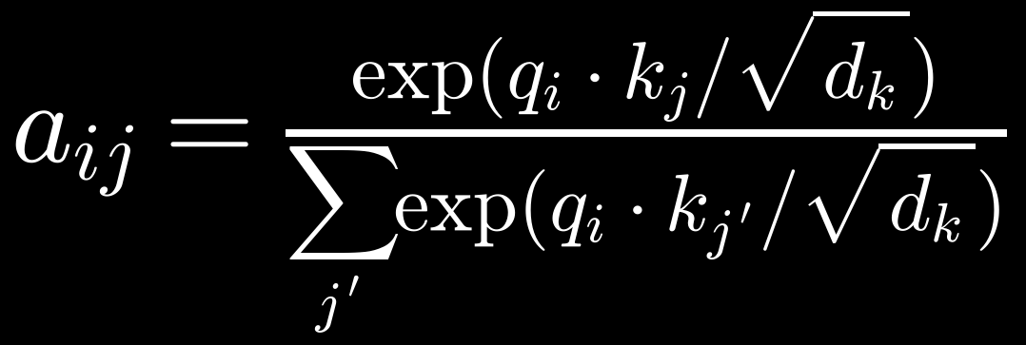
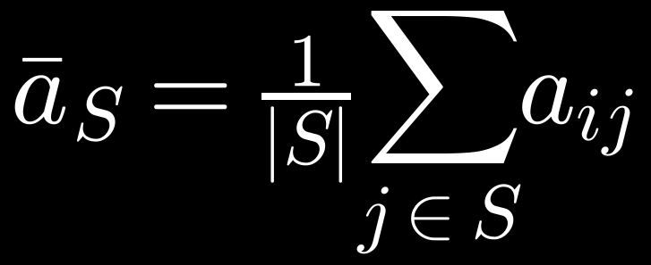
02 · CONCEPTS
Softmax, and why a row sums to one
The normalisation is what turns raw scores into shares — and it is what makes span-level attention interpretable at all.
EQ. 7 — ATTENTION WEIGHTS
CONSEQUENCES WE RELY ON
— Shares: a span's total is the fraction of attention it received
— Competition: one span can only rise if another falls
— Comparability: the same quantity is meaningful across models and layers
— Length: a longer span accumulates more, so we divide by token count
q·k score, before scaling √d temperature
Exponentiate the scores, then divide by their sum.
EQ. 8 — ATTENTION PER TOKEN
Reported everywhere in this deck. The span-sum estimand is reported alongside wherever the two disagree.
Naming-convention probing · 02 · Concepts
13

Slide 14
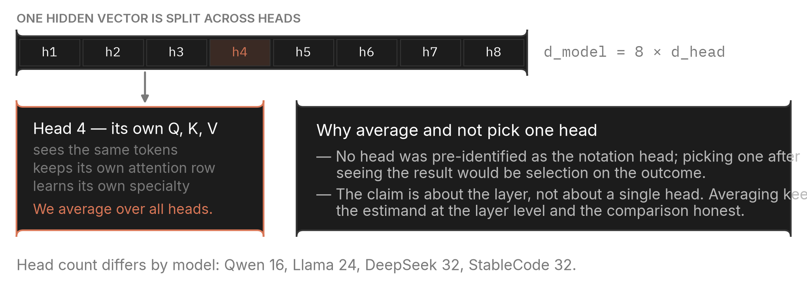
02 · CONCEPTS
What a head is, and why we average over them
Each head runs the whole attention computation on its own slice of the hidden state.
HEADS WITHIN ONE LAYER
Averaging is a choice with a cost: a single specialised head would be invisible in our numbers.
THE HONEST VERSION OF THE CLAIM
Our statements are about layers, not heads. When we say a layer carries the notation signal, we mean the head-averaged quantity at that layer moved — not that every head did, and not that one particular head is responsible.
Head-level structure is left for future work; nothing here depends on its absence.
Naming-convention probing · 02 · Concepts
14

Slide 15
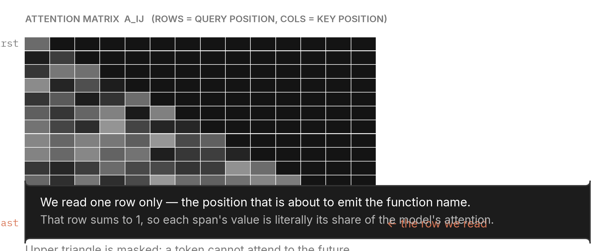
02 · CONCEPTS
The query row: the one row we read
Attention is a matrix. We read a single row of it — the position that is about to write the function name.
THE MATRIX, AND THE ROW
WHY THIS ROW AND NOT AN AVERAGE
— Decision point: this is the position whose output becomes the first name token
— Sums to one: so span values are shares, not arbitrary magnitudes
— Stable: the same row is read in every condition, so conditions are comparable
— Limitation: later name tokens are not read — the study is about the first choice
Masked upper triangle: a token cannot attend to tokens that come after it.
WHAT A SPAN VALUE MEANS
Because the row is a probability distribution, comparing two spans is comparing two shares of one fixed budget. That is what makes the instruction and the code names directly comparable without any further normalisation across models.
A span's value is “how much of this decision's attention went to this stretch of text”, per token of that stretch.
Naming-convention probing · 02 · Concepts
15

Slide 16
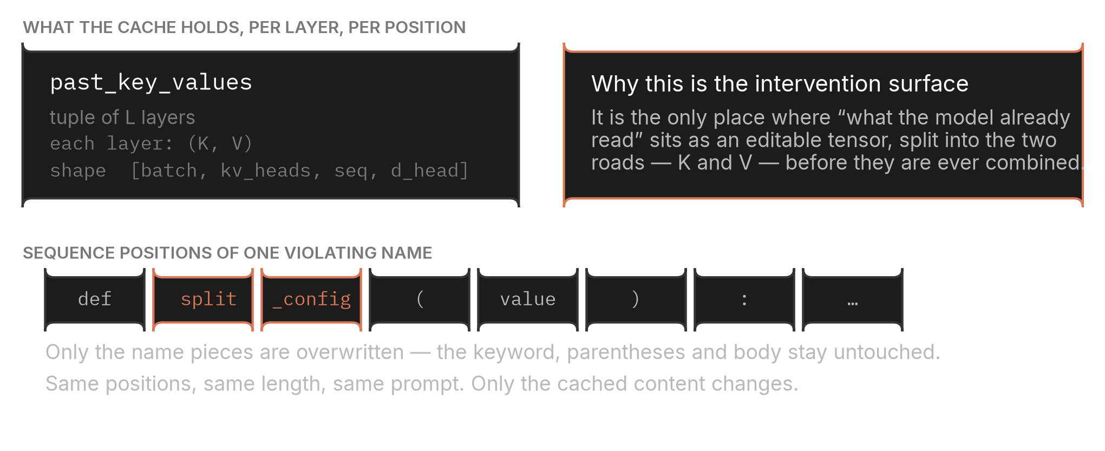
02 · CONCEPTS
The KV cache: the surface we intervene on
Everything the model has already read is stored as two tensors per layer. That storage is where this study operates.
CACHE STRUCTURE AND THE POSITIONS WE TOUCH
Sequence length, prompt text and token identities are unchanged by every intervention in this study.
WHAT AN INTERVENTION IS, EXACTLY
WHAT THAT BUYS
Run the prompt once, take the cache, replace selected slices of K and/or V, then continue the forward pass from that edited cache. Nothing about the text changes.
Any behaviour change is attributable to the replaced content alone — not to a different prompt, a different length, or a different tokenisation.
Naming-convention probing · 02 · Concepts
16

Slide 17
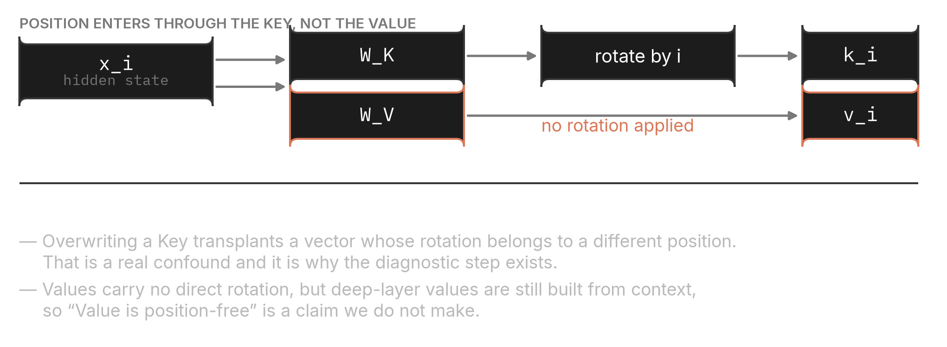
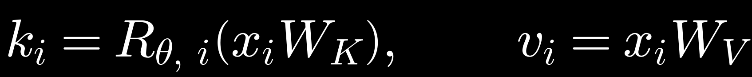
02 · CONCEPTS
Position lives in the Key, not the Value
Rotary embeddings are applied to keys before caching. This is a real asymmetry between the two roads, and we do not hide it.
WHERE THE ROTATION IS APPLIED
A transplanted key carries a rotation that belongs to a different position; a transplanted value does not.
EQ. 9 — THE ASYMMETRY
HOW WE HANDLE IT
We never claim Values are position-free — deep-layer values are built from context and carry positional information indirectly. We claim only that the substitution does not damage Keys more than Values by norm, and we measure that.
R is the position-dependent rotation.
The diagnostic step exists precisely because of this asymmetry.
Naming-convention probing · 02 · Concepts
17

Slide 18
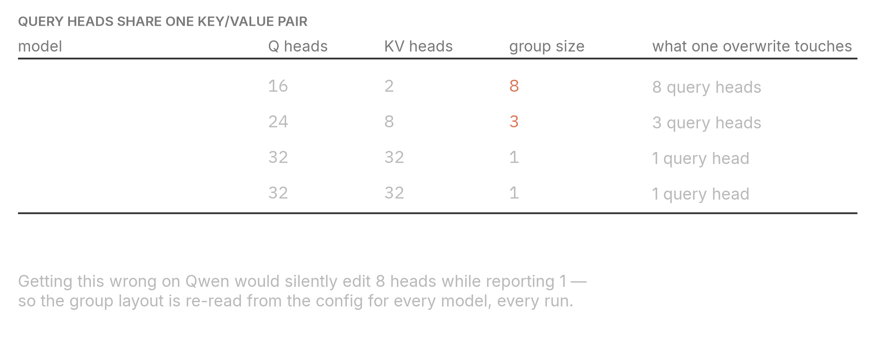
02 · CONCEPTS
Grouped-query attention: what one overwrite touches
Query heads outnumber key/value heads on two of the four models, so a substitution is inherently a group-level edit.
GROUP LAYOUT PER MODEL
Read from each model's configuration at load time, never assumed.
WHY THIS IS A CORRECTNESS ISSUE, NOT A DETAIL
Because the cache stores one K and one V per group, replacing a slice necessarily affects every query head in that group. The intervention is therefore defined at group granularity, and the group size is part of what is stored with each result.
Getting it wrong would edit eight heads on Qwen while the record claimed one.
Naming-convention probing · 02 · Concepts
18

Slide 19
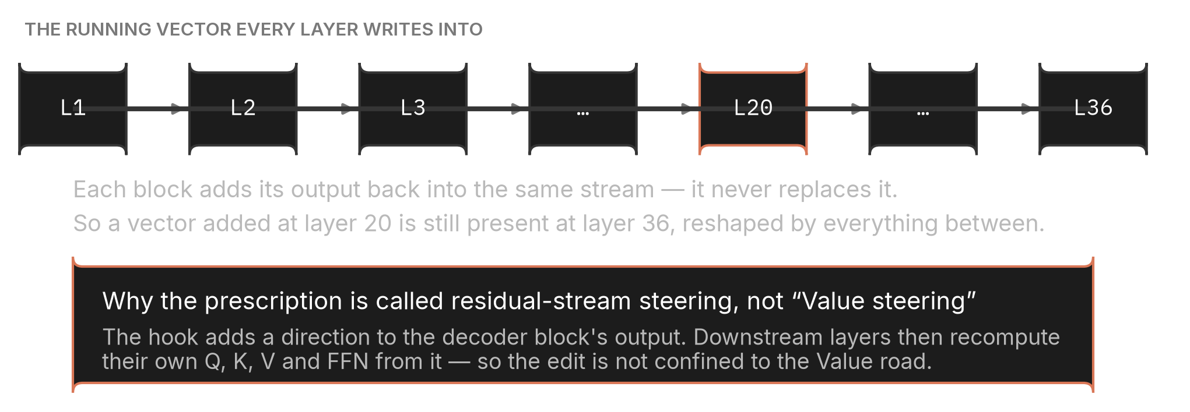
02 · CONCEPTS
The residual stream, and why it is not “Value steering”
Each block adds to a running vector. Anything added at one layer is still present, transformed, at every later layer.
THE RUNNING VECTOR
This is why an edit at layer 20 is not confined to layer 20 — and not confined to one road.
EQ. 10 — A BLOCK'S CONTRIBUTION
THE NAMING DISCIPLINE
Step 6 adds a direction to the block output, so downstream layers recompute their own Q, K, V and FFN from it. Calling that “Value steering” would overstate what is being manipulated.
h the residual stream at layer ℓ
The cache intervention is Value-specific. The steering prescription is not.
Naming-convention probing · 02 · Concepts
19

Slide 20
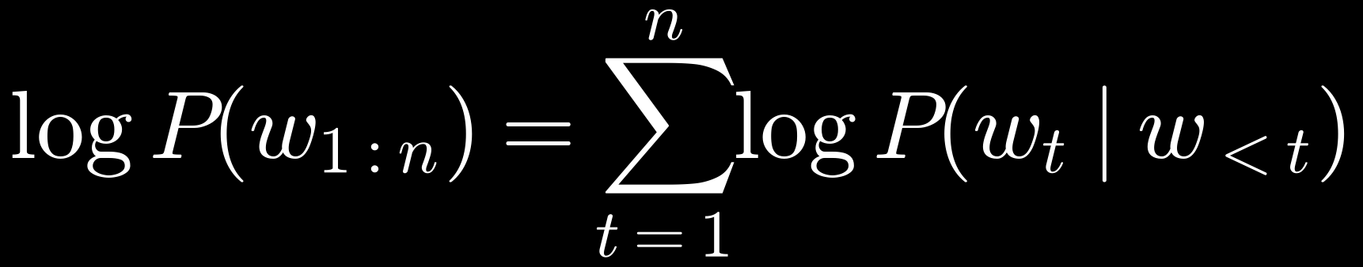
02 · CONCEPTS
Log-probability and the preference score
The score is a difference of two log-probabilities under teacher forcing. Its unit is the nat, and only differences are interpreted.
EQ. 11 — SEQUENCE LOG-PROBABILITY
READING A LOG-PROBABILITY
— Always negative: probabilities are below 1, so their logs are below 0
— Closer to zero: means the model finds the string more likely
— Additive: so a sequence's score is the sum of its tokens' scores
A sum over positions, each conditioned on everything before it.
EQ. 12 — THE PREFERENCE SCORE USED THROUGHOUT
No length normalisation is applied. The two candidate strings are the notation forms of the same name, so their token counts are close but not identical — dividing by length would introduce a different distortion rather than remove one.
Positive means the model prefers camelCase; negative means it prefers snake_case. Zero is genuine indifference.
Naming-convention probing · 02 · Concepts
20

Slide 21
02 · CONCEPTS
Teacher forcing and the forced prefix
The score is read at one position, with the same prefix in every condition, so conditions differ only where we intend them to.
THE PROCEDURE
WHY FORCE A PREFIX AT ALL
# the model is not asked to generate here
— Same position: the score is always read at the same point in the sequence
— Same context: differences come from the manipulation, not from what the model chose to write
— No sampling: no seed-dependent generation noise enters the measurement
prompt = system + preceding_code + request
prefix = "def " # forced, identical everywhere
# one forward pass; read the distribution at the next position
logits = model(prompt + prefix).logits[:, -1]
S = logprob(camel_form) - logprob(snake_form)
# > 0 prefers camelCase < 0 prefers snake_case
Without it, the model could answer in prose and the comparison would never happen.
THE TRADE THIS MAKES
Teacher forcing measures preference, not behaviour. A model can prefer the right notation and still emit the wrong one. That is why the preference-based steps are always paired with a step that actually generates a name and inspects it.
Step 1 and step 6's generation check exist to cover exactly this gap.
Naming-convention probing · 02 · Concepts
21

Slide 22
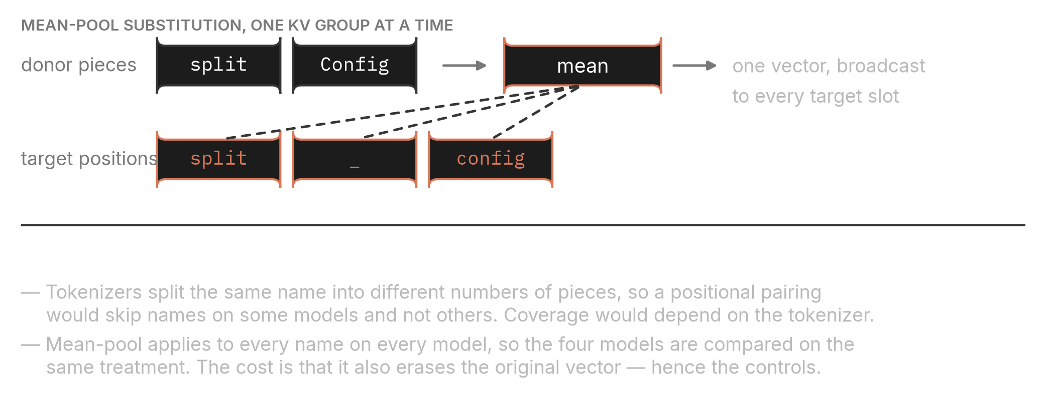
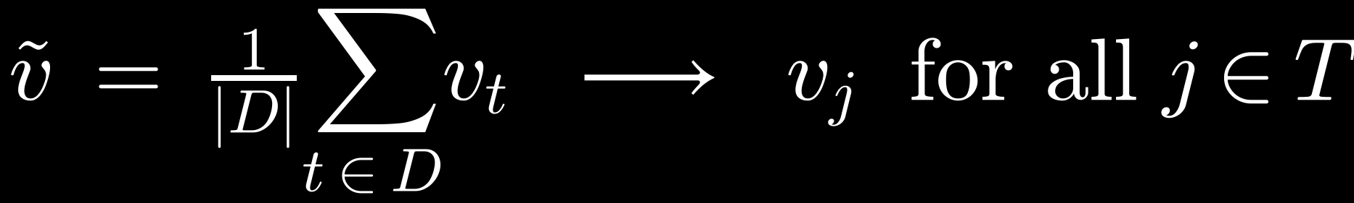
02 · CONCEPTS
Mean-pool substitution: what actually gets written
Donor pieces are averaged into one vector, which is then written into every target slot.
THE OPERATION
Tokenizer-independent by construction: no name is ever skipped for having the wrong number of pieces.
EQ. 13 — THE SUBSTITUTION
THE COST, STATED UP FRONT
Mean-pooling inserts new content and destroys the original in the same stroke. The raw effect therefore contains both. Only the difference against a control isolates the part attributable to notation.
This is the single reason controls are mandatory in this study.
Naming-convention probing · 02 · Concepts
22

Slide 23
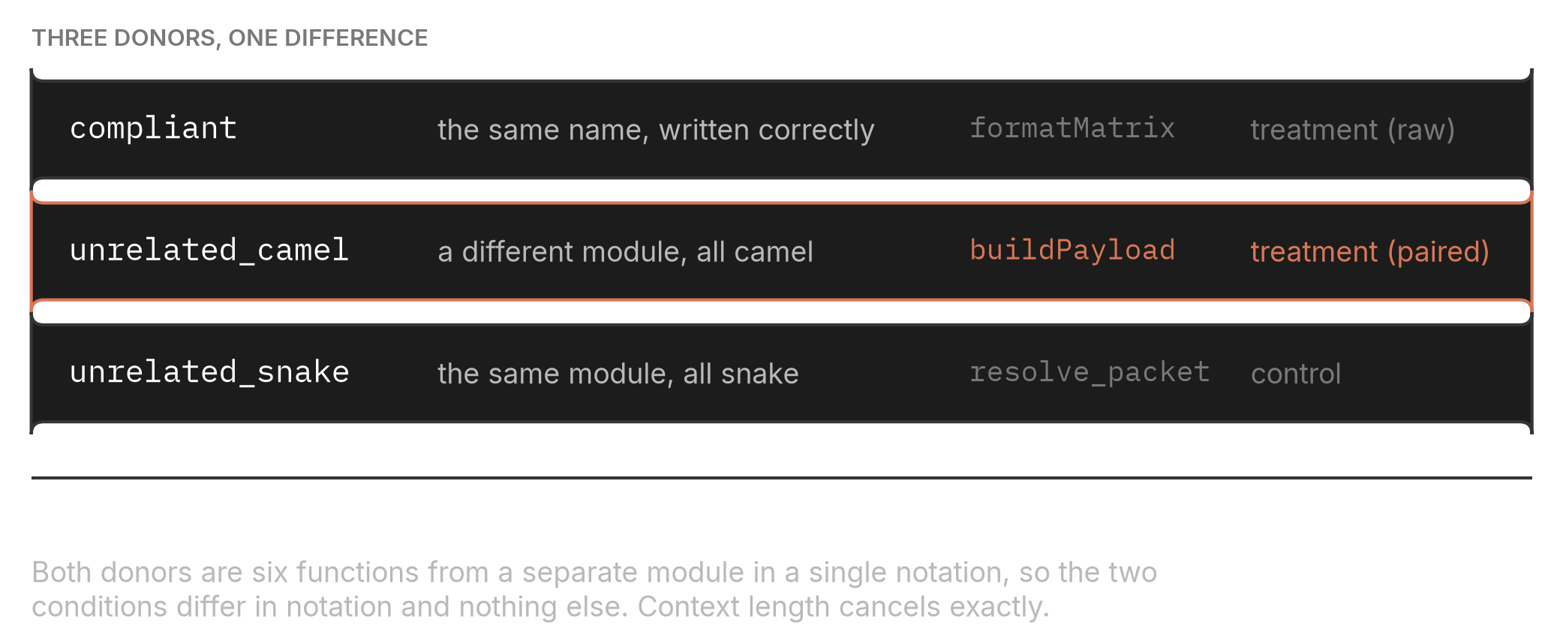
02 · CONCEPTS
Donors: the vocabulary of every intervention
A donor is the source of the values written in. Choosing donors well is what turns an intervention into a controlled comparison.
CODE DONORS
The paired estimand compares two donors that differ in notation and in nothing else.
INSTRUCTION DONORS
DONOR
WHAT IT WRITES
ROLE
opposite
the directive word from the opposite instruction
treatment
self
the same directive word from the same instruction
control — zero new information
unrelated_word
an unrelated word from the same instruction
control — unrelated content
Two controls, not one: an identity-ish donor and a semantically unrelated one bracket the disturbance from both sides.
Naming-convention probing · 02 · Concepts
23

Slide 24
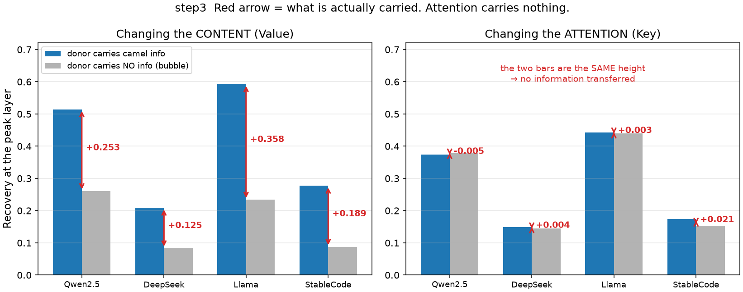
02 · CONCEPTS
The bubble, and the number we actually report
The control's value is not noise. It is the measurable disturbance of the act of overwriting.
RAW, BUBBLE, NET
EQ. 14 — PAIRED NET EFFECT
Pairing matters: blocks differ in difficulty, and taking the difference first removes that variation before the confidence interval is computed.
Reading the raw curve alone would overstate every effect in this study by roughly a factor of two.
Paired within a block, then averaged over blocks.
HOW LARGE THE BUBBLE IS, IN PRACTICE
49%
42%
40%
34%
QWEN2.5-CODER-3B
DEEPSEEK-CODER-6.7B
LLAMA-3.2-3B
STABLECODE-3B
Measured at each model's peak layer in step 3, on the Value road.
Naming-convention probing · 02 · Concepts
24

Slide 25
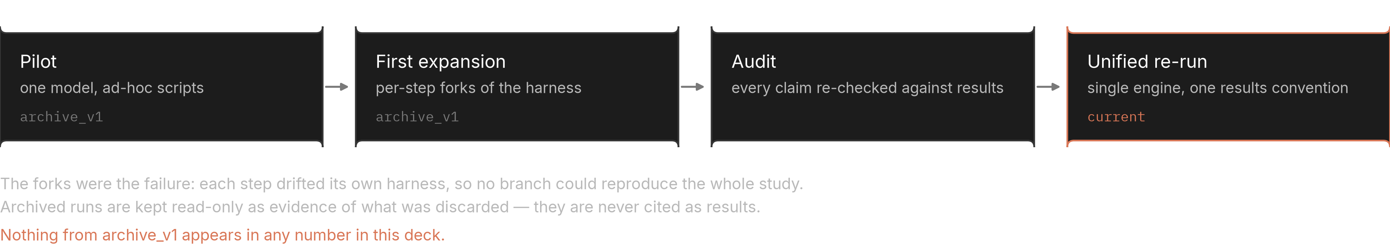
03 · AUDIT
Why the earlier experiments were discarded
Not because the numbers were bad. Because the harness had forked, and no branch could reproduce the whole study.
HOW THE PROJECT GOT HERE
The archive is kept read-only as evidence of what was discarded, and is never cited as a result.
THE FAILURE MODE
THE RULE THAT REPLACED IT
Each step had grown its own copy of the engine. Two steps could disagree about how a span was located or how a substitution was performed, and nothing in the results would show it.
One engine, one entry point, one results convention. A new experiment adds a value to the condition schema — never a new script.
Naming-convention probing · 03 · Audit
25

Slide 26
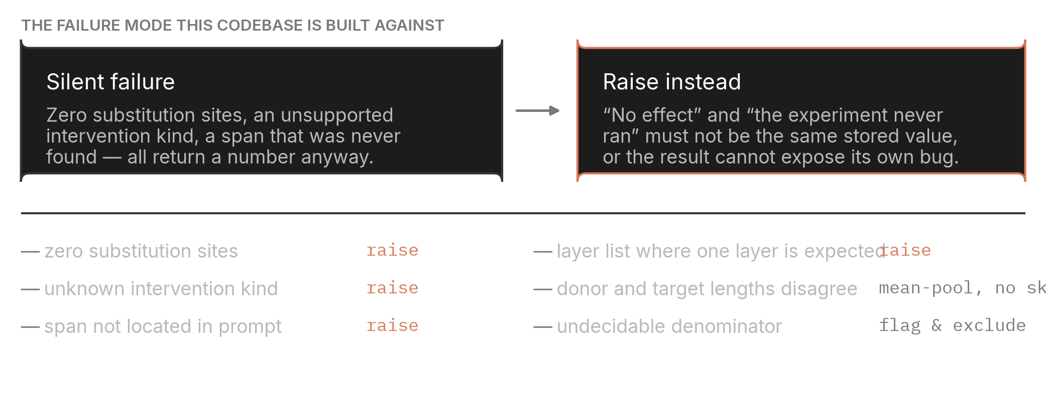
03 · AUDIT
Silent failure is the defect class we build against
If “no effect” and “the experiment never ran” are stored as the same number, no amount of analysis can tell them apart.
GUARDS IN PLACE
Each guard raises rather than returning a plausible value; a crashed run is recoverable, a silent one is not.
THE ONE PLACE WE DELIBERATELY DO NOT RAISE
An undecidable condition is not a bug: the model simply had no strong preference to restore, so the denominator of the transfer rate is near zero. Both the flag and the raw gap are stored, so the threshold can be varied afterwards without re-running anything.
Undecidable conditions are legitimate measurements whose ratio is unstable — they are recorded, flagged and excluded.
Naming-convention probing · 03 · Audit
26

Slide 27
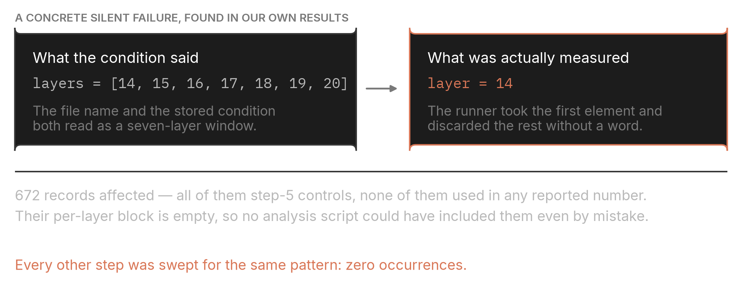
03 · AUDIT
A concrete silent failure, found in our own results
Seven layers were requested. One was measured. Nothing in the file name or the stored condition said so.
REQUESTED VERSUS MEASURED
Found by comparing each record's stored layer list against the layer its metrics were actually keyed on.
WHY NO REPORTED NUMBER IS AFFECTED
SWEPT EVERYWHERE ELSE
Every affected record stores an empty per-layer block, so no analysis script could include it even by accident. All 672 belong to step 5's controls, which are excluded and footnoted.
The same pattern was searched for across every results folder. Occurrences outside step 5's controls: zero.
The bug is a coverage loss, not a contamination.
Naming-convention probing · 03 · Audit
27

Slide 28
03 · AUDIT
What the audit changed, and what it did not
Most findings were corrections to how results were described, not to the results themselves.
VERDICT PER FINDING
FINDING
VERDICT
WHAT WAS DONE
Span attention reported as a sum while the text said per token
re-analysed
recomputed from stored values; peak layers unchanged
“av_norm is the actual contribution”
wording
corrected to an upper bound — it ignores cancellation and precedes the output projection
“The Key net effect is zero”
wording
corrected to negligible — 2–11% of the Value effect, intervals do not contain zero
“RoPE concern rejected”
wording
narrowed to the norm-collapse hypothesis only; phase was never measured
Step 1 figure plotted only one instruction direction
re-plotted
both directions now shown; the collapse holds in both
672 step-5 control records measured one layer, not seven
excluded
flagged, footnoted, and guarded against in the runner
Re-running was reserved for cases where the stored numbers could not answer the question; everything else was re-analysed from the existing files.
Naming-convention probing · 03 · Audit
28

Slide 29
03 · AUDIT
A determinism check that came free
Two steps share 168 conditions. If the harness is deterministic, they must agree exactly — and they do.
THE CHECK
WHAT IT DOES AND DOES NOT LICENSE
Step 2's conditions are a subset of step 4's: the same models, the same blocks, the same instruction direction. Their shared spans were compared value by value, across every layer.
— Licenses: that the measurement pipeline is deterministic under a fixed seed
— Licenses: that step 2 and step 4 can be read as one measurement of one quantity
— Does not: say the quantity is the right one to measure
— Does not: substitute for a control — determinism is not validity
Overlapping conditions
168
Values compared
80,640
Mismatches
0
Maximum absolute difference
0.000e+00
It is a check on the instrument, not on the science.
WHY IT IS WORTH A SLIDE
The two steps were run months apart, on different machines, in different sessions. Exact agreement across 80,640 values is evidence that the seed, the prompt construction and the attention read-out are all pinned down.
Reproducibility claims are cheap to make and rarely checked; this one is checkable from the stored files alone.
Naming-convention probing · 03 · Audit
29

Slide 30
04 · HARNESS
Three design principles
The engine is boring on purpose. Everything interesting lives in the condition, not in the code path.
PRINCIPLE 1
PRINCIPLE 2
PRINCIPLE 3
One entry point
Fail loudly
Results are immutable
Every experiment calls the same run() with a condition and a mode. There is no per-question script, so two steps cannot silently disagree about how a measurement is taken.
Unsupported kinds, empty substitution sets and unlocatable spans raise. A result file never contains a number that was produced by an experiment that did not happen.
A finished file is never rewritten. Resume works by checking whether the path exists, which also makes every run interruptible without loss.
WHAT THIS COSTS
Every knob any experiment ever needed lives in one dataclass, so the schema carries fields most conditions leave unset. We consider that better than the alternative the audit found: several engines that each looked simple and none of which agreed.
The condition schema is wide, and reading a slug takes practice. That is the price of one reproducible engine.
Naming-convention probing · 04 · Harness
30

Slide 31
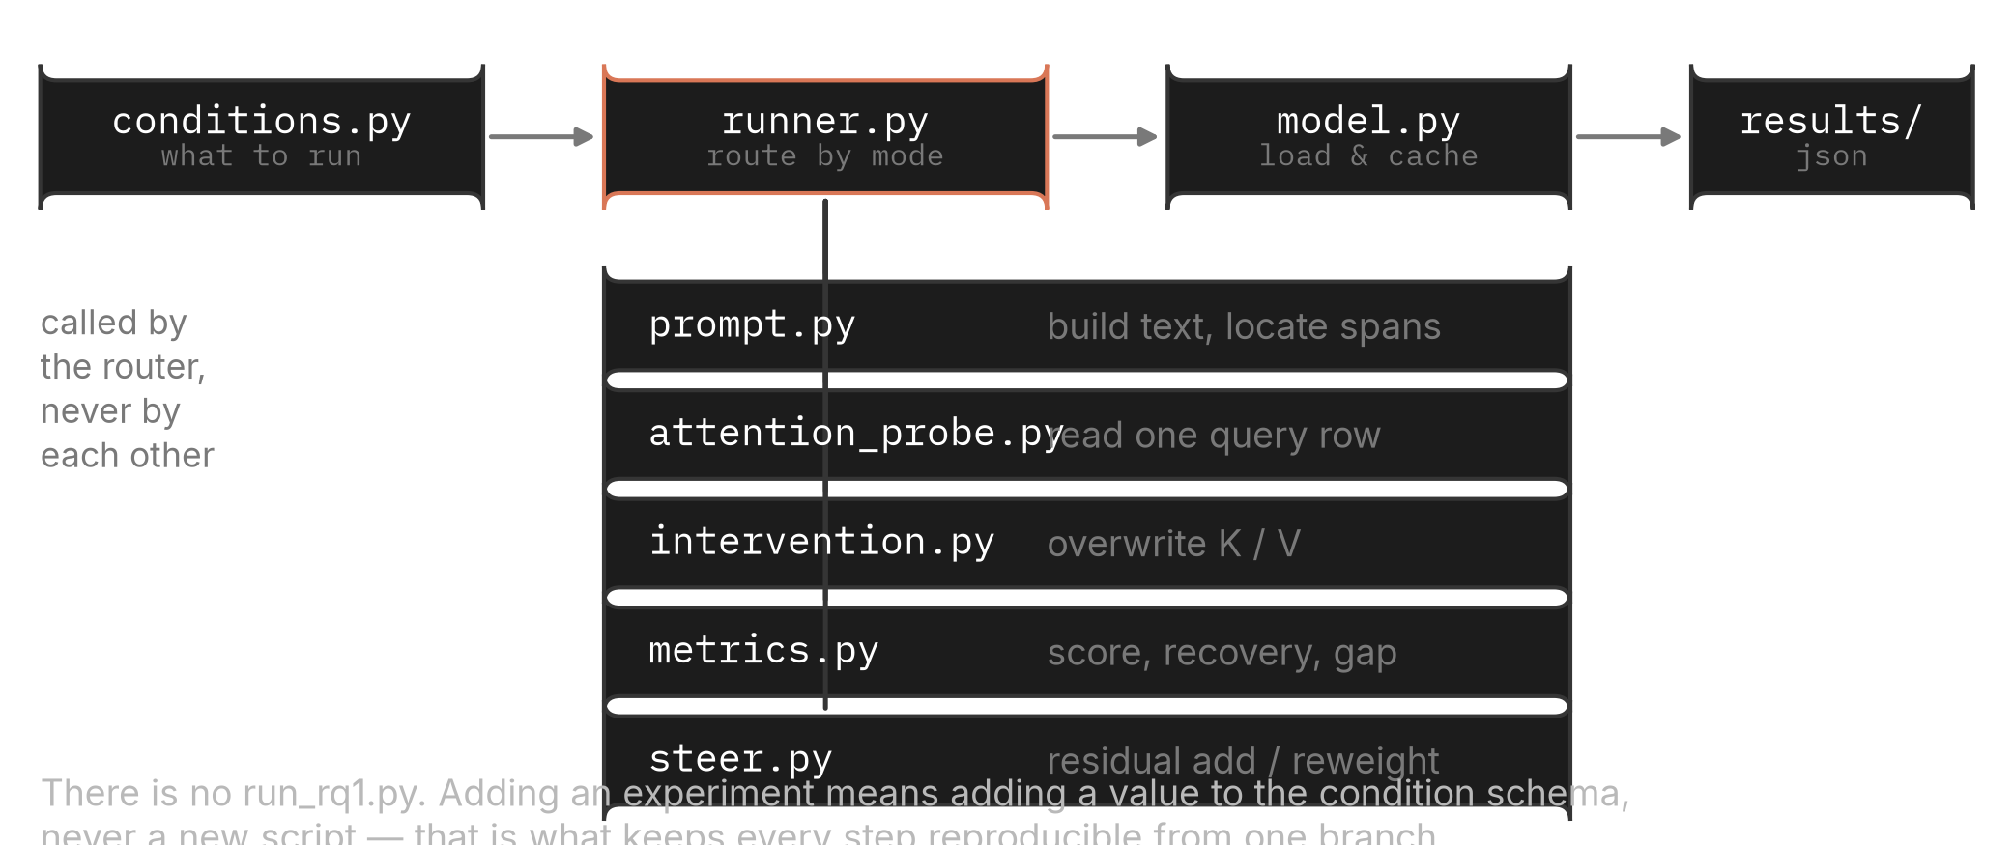
04 · HARNESS
Module map
One router, five workers. Nothing calls anything sideways.
CALL STRUCTURE
Workers are called by the router only — so a change in one cannot quietly alter another's behaviour.
WHAT EACH MODULE OWNS
prompt
text and span offsets
intervention
cache edits
steer
residual add, reweight
attention_probe
one query row
metrics
scores and rates
model
loading and cache
Naming-convention probing · 04 · Harness
31

Slide 32
04 · HARNESS
Run modes
One function, eight behaviours. The mode decides which workers the router calls.
RUN(CONDITION, MODE=…)
MODE
WHAT IT DOES
PER-LAYER OUTPUT
USED BY
generate
generate a function, classify its notation
—
step 1
observe
read one attention row and its value norms
yes
step 2 · step 4
intervene
overwrite the cache at one layer, then score
one layer
step 3 · step 5
intervene_sweep
the same, repeated across every layer
yes
step 3 · step 5
vcosine
compare value directions without scoring
yes
diagnostics
kv_diagnose
measure what the substitution does to K and V
yes
diag
steer
add a direction, or reweight attention, then score
—
step 6
steer_generate
the same, but generate and inspect the name
—
step 6
Modes marked with a dash have no per-layer output by design — they produce a behaviour, not a layer profile.
Naming-convention probing · 04 · Harness
32

Slide 33
04 · HARNESS
The condition schema
A condition is data. Reading one tells you the whole experiment without opening any code.
ONE CONDITION, IN FULL
THE FIELDS THAT CARRY THE DESIGN
Condition(
— preceding: how many of the twelve names violate, and which block
— instruction: which notation is required, and in what phrasing
— intervention: which road, which layer, and from which donor
— token_unit: how donor pieces are combined — mean-pool throughout
model = ModelSpec('Qwen/Qwen2.5-Coder-3B-Instruct', 'qwen'),
preceding = PrecedingCode(n_compliant=6, n_functions=12,
composition=POOL, pool_block=0),
instruction= Instruction(form=POSITIVE, target_notation=CAMEL),
intervention= Intervention(kind=KEY_VALUE, layers='sweep',
donor='unrelated_camel', target='code',
kinds=('key','value','key_value')),
seed=42, token_unit='mean')
ONE FIELD THAT IS NOT A CONDITION AXIS
The instruction form has a negative variant. It belongs to a research question that was cut, and every condition in this study fixes it to positive. Keeping the field but never varying it is safer than deleting it and losing the ability to read archived results.
It survives in the schema because removing it would invalidate the archive; it is never varied in the unified re-run.
Naming-convention probing · 04 · Harness
33

Slide 34
04 · HARNESS
Building the prompt
Three parts, assembled the same way in every step. Nothing about the prompt varies except what a condition says varies.
ASSEMBLY
WHAT EACH PART CONTROLS
# 1 · system — the instruction
— System: the instruction direction — which notation is required
— Body: the violation ratio, swept from 0 to 12 in step 1 and fixed at 6 elsewhere
— Order: names are interleaved, not grouped, so recency cannot explain the effect
— Request: identical in every condition, so the decision point is always the same
You are helping extend an existing Python module.
In this project we generally write function names in camelCase.
Every function name uses one of two styles only:
camelCase or snake_case.
# 2 · user — twelve existing functions from one block
def decodeNode(value): ... # compliant x n
def split_config(value): ... # violating x (12 - n)
# 3 · request
Add one more function.
WHY THE CONTEXT IS SYNTHETIC
Every name is drawn from the same verb-noun pool and every function body has the same shape, so the only thing that differs between a compliant and a violating context is the notation itself. The cost is external validity, which is stated as a limitation rather than argued away.
Real repository files would confound notation with topic, length, and difficulty all at once.
Naming-convention probing · 04 · Harness
34

Slide 35
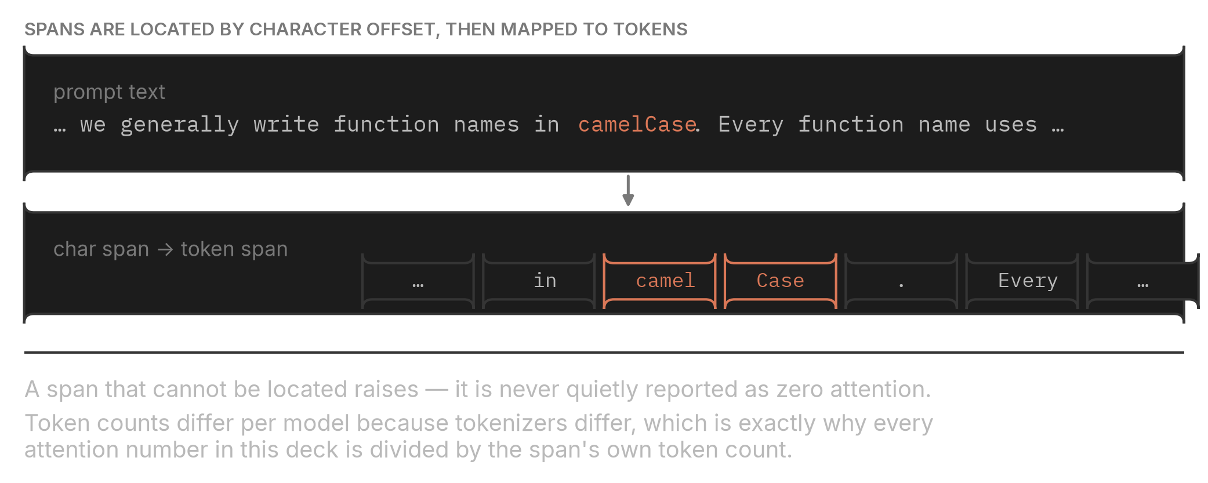
04 · HARNESS
Locating the spans inside the prompt
Spans are located by character offset in the assembled text, then mapped onto tokens.
TEXT TO CHARACTER SPAN TO TOKEN SPAN
A span that cannot be located raises — it is never reported as zero attention.
THE MAPPING, IN CODE
WHY OFFSETS AND NOT STRING SEARCH ON TOKENS
start = text.index(target_word)
The same span therefore covers the same characters on all four models, even though it covers a different number of tokens on each. That difference is exactly what the per-token normalisation removes.
spans['instr_rule_word'] = char_to_token(enc, start, len(target_word))
if not spans['instr_rule_word']:
raise SpanNotFound('instr_rule_word') # never return zero
Token strings differ per model; character offsets do not.
Naming-convention probing · 04 · Harness
35

Slide 36
04 · HARNESS
Performing the substitution
Read the cache, average the donor, write it into the target slots of one KV group at one layer.
THE CORE OF THE INTERVENTION
WHAT IS GUARANTEED HERE
k, v = past_key_values[layer] # [b, kv_heads, seq, d_head]
— Coverage: every target position is written, on every model
— Granularity: the write is per KV group, as the architecture requires
— Locality: exactly one layer is touched unless the mode is a sweep
— Loudness: an empty target set raises instead of returning the baseline
donor_v = v[:, :, donor_positions, :].mean(dim=2, keepdim=True)
v[:, :, target_positions, :] = donor_v # broadcast, no skips
if kind == 'key': write only k
if kind == 'value': write only v
if kind == 'key_value': write both
if len(target_positions) == 0:
raise EmptySubstitution(layer, donor) # never silently no-op
THE THREE KINDS ARE MEASURED ON ONE FORWARD PASS
Separating them across runs would introduce a difference in nothing but bookkeeping, and would make the paired comparison between roads weaker than it needs to be.
So the Key, Value and combined numbers on any slide come from the same prompt, the same cache and the same conditions.
Naming-convention probing · 04 · Harness
36

Slide 37
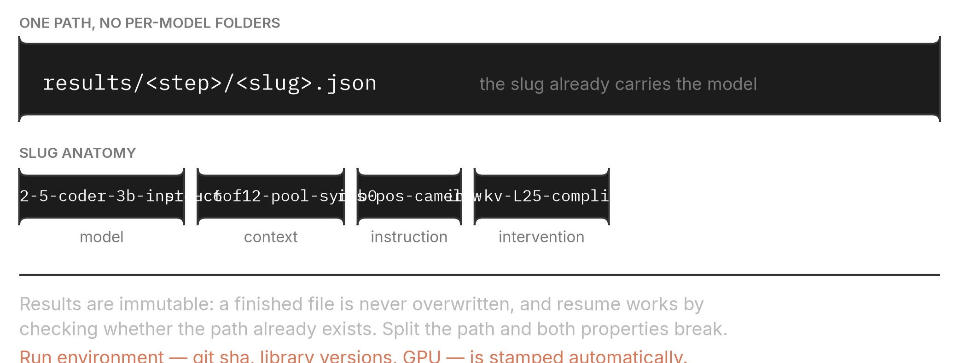
04 · HARNESS
Where results go, and why the path matters
One directory per step, one file per condition, and a slug that encodes the whole condition.
PATH AND SLUG
Split this path by model and both immutability and resume break at once.
WHAT A RESULT FILE CONTAINS
WHY EXTRA CARRIES THE REFERENCE SCORES
condition
the full condition, as stored data
Storing the clean, base and intervened scores rather than only the derived rate means the undecidability threshold can be moved afterwards, and the sensitivity reported, without a single GPU hour.
metrics.per_layer
layer-keyed measurements, when the mode produces them
metrics.extra
mode, donor, the three reference scores, gap, undecidable
meta
git sha, library versions, GPU — filled in automatically
Any later re-analysis can recompute the rate from the stored scores.
Naming-convention probing · 04 · Harness
37

Slide 38
04 · HARNESS
Reproducibility, concretely
What is pinned, what is checked, and what can be verified without a GPU.
PINNED
CHECKED
VERIFIABLE OFFLINE
— Seed: 42 in every condition, stored with the result
— Versions: library versions recorded per run
— Commit: git sha stamped into every file
— Determinism: 80,640 shared values, 0 mismatches
— Guards: unit tests assert that each guard raises
— Census: condition counts recomputed from disk, not remembered
— Prompts: built and printed without loading a model
— Spans: located and inspected on CPU
— Aggregation: every figure regenerated from stored JSON
THE RULE THAT KEEPS FIGURES HONEST
Every aggregate and every figure in this deck is produced by a script that reads the stored result files. No value was transcribed by hand, and no figure was drawn by hand.
A number that appears on a slide but in no script is a number nobody can check.
Naming-convention probing · 04 · Harness
38

Slide 39
05 · EXPERIMENTS
Step 1 · The question
Does a file that already breaks the convention make the model break it too?
WHAT IS MANIPULATED
WHAT EACH OUTCOME WOULD HAVE MEANT
— Held fixed: the instruction text, the request, the twelve function bodies
— Varied: how many of the twelve names violate the instruction
— Measured: whether the generated function name follows the instruction
— Repeated: over 42 disjoint name blocks and both notation directions
IF WE HAD SEEN
THE READING
a sharp fall with more violations
context drives the failure; there is a mechanism to find
a flat line
the failure is about the instruction, not the context; the study stops
a fall in one direction only
the effect is about snake_case, not about violation as such
Stated before the run — the observed outcome is the first row.
WHY THIS STEP USES GENERATION, NOT PREFERENCE
A preference score would be cheaper and less noisy, but it would not show that the model actually writes the wrong name. Step 1 pays the cost of generation so that the rest of the study can use the cheaper measure with a known anchor.
Every later step measures preference; this one has to establish that the behaviour itself moves.
Naming-convention probing · 05 · Experiments
39

Slide 40
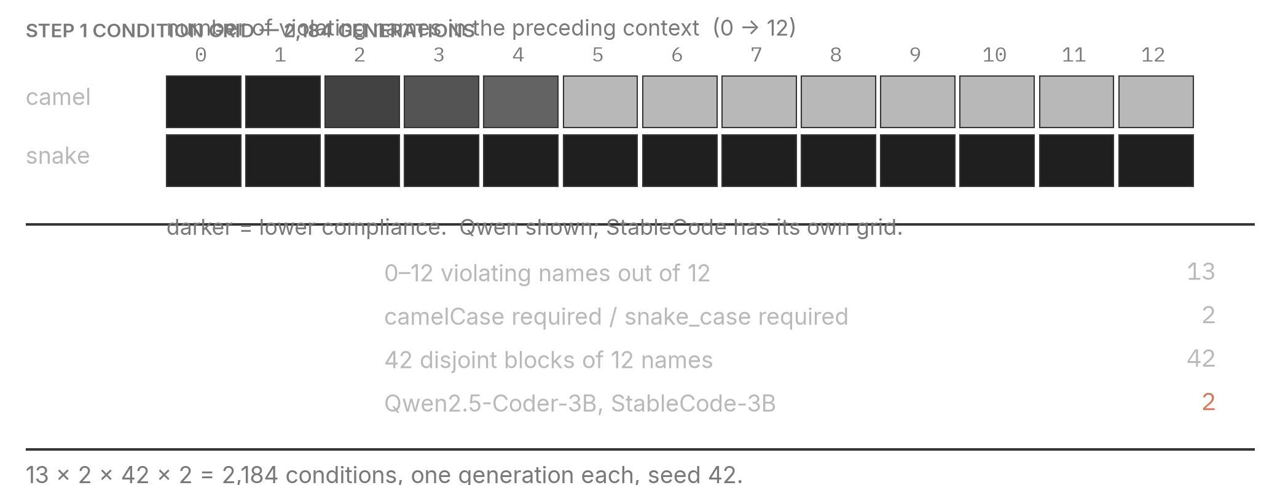
05 · EXPERIMENTS
Step 1 · The condition grid
2,184 generations: thirteen violation levels, two directions, forty-two blocks, two models.
GRID AND ITS AXES
Only two of the four models were run here — the two code-specialised ones. That is a stated limitation, not an oversight.
WHY BOTH DIRECTIONS MATTER
ONE GENERATION PER CONDITION
If only the camelCase-required direction were run, a model that simply likes snake_case would produce the same curve as a model that is influenced by violations. Running both directions separates them.
The 42 blocks provide the replication instead of repeated sampling. That keeps the design paired: the same names appear at every violation level.
Greedy decoding, so the only randomness is in which names a block contains.
Without the second direction, a notation preference would be indistinguishable from a violation effect.
Naming-convention probing · 05 · Experiments
40

Slide 41
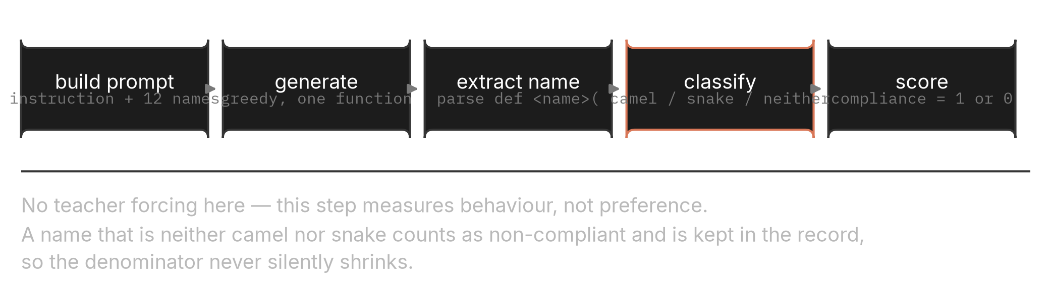
05 · EXPERIMENTS
Step 1 · Pipeline
Build, generate, extract, classify, score. Names that are neither notation are kept, not dropped.
FIVE STAGES
Dropping unclassifiable names would silently shrink the denominator and inflate compliance.
CLASSIFICATION, IN CODE
WHAT IS STORED PER GENERATION
name = re.search(r'def\s+([A-Za-z_][A-Za-z0-9_]*)', text).group(1)
turn_names
the extracted name
turn_notations
camel, snake or neither
if '_' in name: notation = 'snake'
turn_texts
the generated text, verbatim
elif re.search(r'[a-z][A-Z]', name): notation = 'camel'
else: notation = 'neither' # still counted
compliance_rate
1 or 0 for this condition
compliant = (notation == condition.instruction.target_notation)
The full text is kept so any classification question can be re-examined.
Naming-convention probing · 05 · Experiments
41

Slide 42
05 · EXPERIMENTS
Step 1 · Result — compliance collapses with context
The instruction never changes. The surrounding file does, and that is enough.
COMPLIANCE AGAINST VIOLATION COUNT, BOTH DIRECTIONS
READING THE CURVES
— Left edge: a fully compliant file — the model follows the instruction
— Right edge: a fully violating file — the instruction is largely ignored
— Middle: the transition is narrow, not gradual
— Both directions: the same shape appears whichever notation is required
Two models, two instruction directions. The collapse is present in all four curves.
THE NUMBERS BEHIND THE CURVES
MODEL
0 VIOLATING
3
6
9
12 VIOLATING
Qwen2.5-Coder-3B
100%
82%
50%
50%
50%
StableCode-3B
86%
54%
49%
50%
44%
Averaged over both instruction directions and 42 name blocks.
Naming-convention probing · 05 · Experiments
42

Slide 43
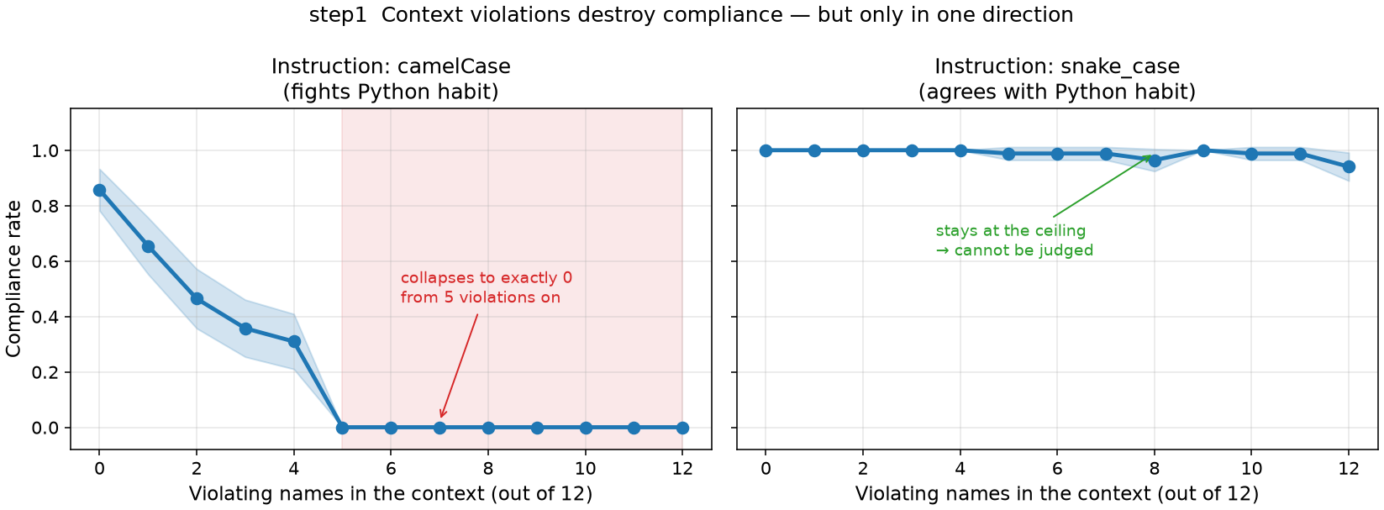
05 · EXPERIMENTS
Step 1 · Result — the same picture, read a second way
A conditional view of the same generations, to check that the collapse is not an artefact of averaging.
EXPLANATORY VIEW
WHY A SECOND VIEW WAS NEEDED
A mean over 42 blocks can hide a bimodal population: most blocks unaffected and a few collapsing completely would produce a similar average curve. Re-aggregating conditionally shows the shift is in the bulk, not in a tail.
Same 2,184 generations, re-aggregated; nothing is re-run.
BOTH VIEWS COME FROM ONE SET OF STORED FILES
This is the practical payoff of storing the generated text rather than only the compliance flag: a new question about the same runs costs an aggregation script, not GPU time.
No condition was added to produce the second figure.
Naming-convention probing · 05 · Experiments
43

Slide 44
05 · EXPERIMENTS
Step 1 · What this step does not settle
It establishes the symptom. It says nothing about mechanism, and its coverage is narrower than the rest of the study.
LIMIT 1
LIMIT 2
LIMIT 3
LIMIT 4
Two models only
Python only
First function only
Synthetic context
Both are code-specialised. The general-purpose model was not run here, so the collapse is not established for it.
The harness supports JavaScript; zero JavaScript conditions were run. No claim covers other languages.
One generation per condition, so whether violations amplify across successive functions cannot be judged.
Names come from one pool and bodies share a shape, which buys control at the cost of external validity.
HOW THE REST OF THE STUDY COMPENSATES
Steps 2 to 6 run all four models, so the mechanism claims are not restricted to two. Language coverage and multi-function amplification are not repaired anywhere and remain open.
None of these limits is repaired by argument; each is either covered by a later step or carried forward as a stated limitation.
Naming-convention probing · 05 · Experiments
44

Slide 45
05 · EXPERIMENTS
Step 1 · Reading the result file
One JSON per condition. The compliance flag alone cannot tell you why a condition failed.
RESULTS/STEP1_CLIFF/<SLUG>.JSON
HOW TO READ IT
"metrics": {
— Start here: turn_names — a zero compliance rate means either a wrong notation or no extractable name, and only this field separates them
— Verify by eye: turn_texts keeps the raw generation, so any classification decision can be re-checked
— Ignore: subsequent_violation_rate is null everywhere; one generation per condition
"compliance_rate": 0.0, # 1.0 if the first name matches
"extra": {
"target": "camel", # notation the instruction required
"turn_names": ["remove_duplicates"], # what the model actually wrote
"turn_notations": ["snake"], # camel | snake | other
"turn_texts": ["def remove_dup…"], # verbatim generation
"first_compliant": false,
"first_violated": true,
"subsequent_violation_rate": null # always null — one turn only
}
}
AGGREGATION
python scripts/step1_reaggregate.py
Groups by model, violation count and direction, then averages over the 42 blocks.
Naming-convention probing · 05 · Experiments
45

Slide 46
05 · EXPERIMENTS
Step 2 · The question
When the file breaks the convention, does the model stop looking at it — or look at it more?
WHAT IS READ
WHAT EACH OUTCOME WOULD HAVE MEANT
— One row: the attention of the position about to write the name
— Five spans: compliant names, violating names, the instruction, and two words in it
— Every layer: 28 to 36 depending on the model
— Averaged: over heads, and over 42 blocks
IF WE HAD SEEN
THE READING
less attention on violations
consistent with an attention deficit; Spotlight-style remedies plausible
more attention on violations
the model is not ignoring them; the failure is about content, not looking
no difference
attention is the wrong place to look at all
The observed outcome is the second row — the opposite of the attention-deficit account.
THIS STEP IS CORRELATIONAL, AND SAYS SO
Attention is observed, not manipulated. A difference between spans shows where the model's attention sits, not whether that attention is what produces the behaviour. Treating an observation as a mechanism is the specific error this study is organised to avoid.
The matching causal step is step 3; nothing here is presented as a mechanism.
Naming-convention probing · 05 · Experiments
46

Slide 47
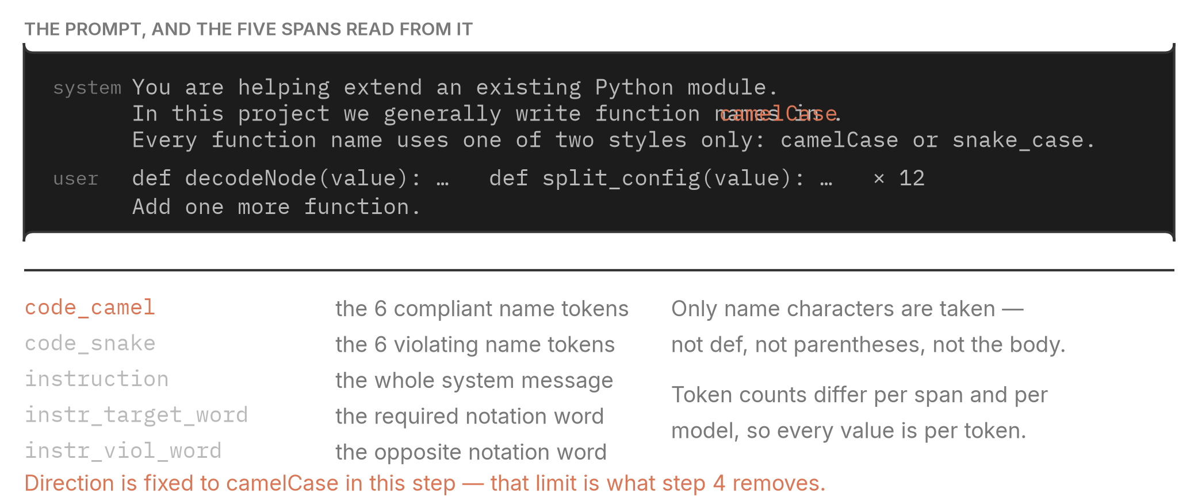
05 · EXPERIMENTS
Step 2 · The prompt, and the spans read from it
Five spans, located by character offset, then measured per token.
PROMPT ANATOMY
Only the name characters are taken — not the def keyword, the parentheses, or the body.
SPAN TOKEN COUNTS DIFFER BY MODEL, WHICH IS WHY WE DIVIDE
Because the number of tokens per span is model-dependent, comparing raw span sums across models would compare tokenizations as much as behaviour. Dividing by the span's own token count removes that.
One name can be two pieces on one tokenizer and four on another; the span is the same characters either way.
Naming-convention probing · 05 · Experiments
47

Slide 48
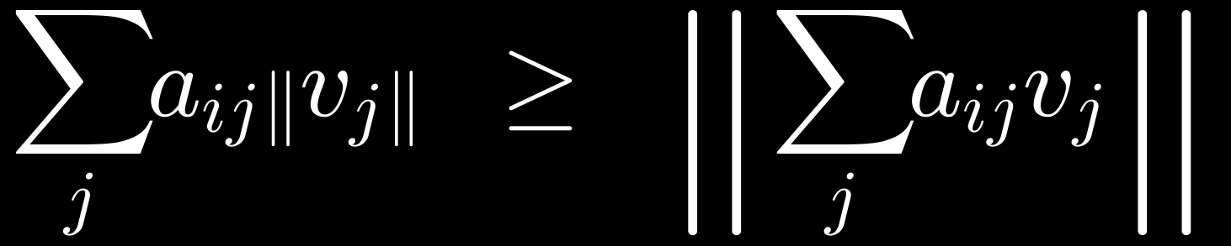
05 · EXPERIMENTS
Step 2 · How the attention is read
One forward pass with attentions returned, one row selected, spans summed and divided.
THE READ-OUT
THREE QUANTITIES PER SPAN
out = model(input_ids, output_attentions=True)
— attention_weight: the share of attention the span received
— v_norm: the average length of the value vectors at those positions
— av_norm: the sum of weight times value length — an upper bound, not a contribution
for layer, att in enumerate(out.attentions): # [b, heads, seq, seq]
row = att[0, :, -1, :].mean(dim=0) # heads averaged, last row
for name, idx in spans.items():
total = row[idx].sum().item()
per_token = total / len(idx) # what we report
# the row sums to 1, so total is a share of this decision's attention
WHY AV_NORM IS CALLED AN UPPER BOUND
It ignores cancellation between vectors and it precedes the output projection.
Naming-convention probing · 05 · Experiments
48

Slide 49
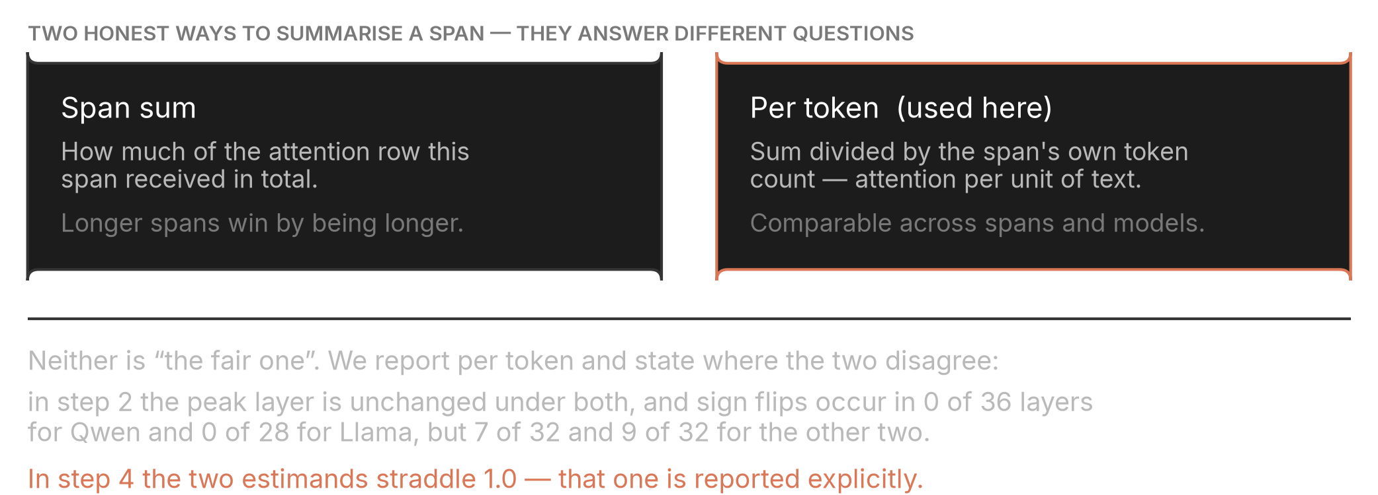
05 · EXPERIMENTS
Step 2 · Two estimands, and where they disagree
Span sum and per token answer different questions. We report per token and state the disagreement rather than hiding it.
THE TWO SUMMARIES
Neither is “the fair one” — they answer different questions about the same measurement.
SENSITIVITY, MEASURED RATHER THAN ASSERTED
MODEL
LAYERS
SIGN FLIPS BETWEEN ESTIMANDS
Qwen2.5-Coder-3B
36
0 of 36
DeepSeek-Coder-6.7B
32
7 of 32
Llama-3.2-3B
28
0 of 28
StableCode-3B
32
9 of 32
Peak layers are unchanged under both estimands in every model.
Naming-convention probing · 05 · Experiments
49

Slide 50
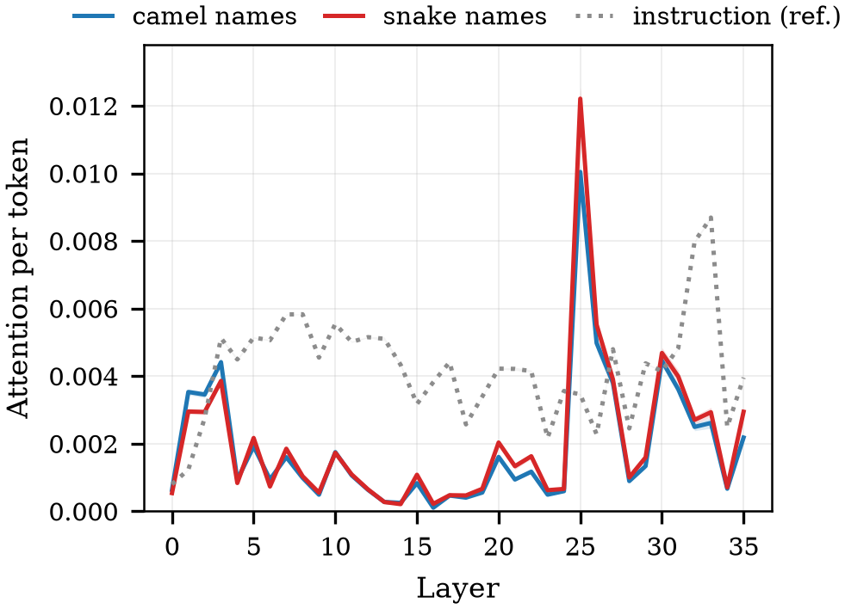
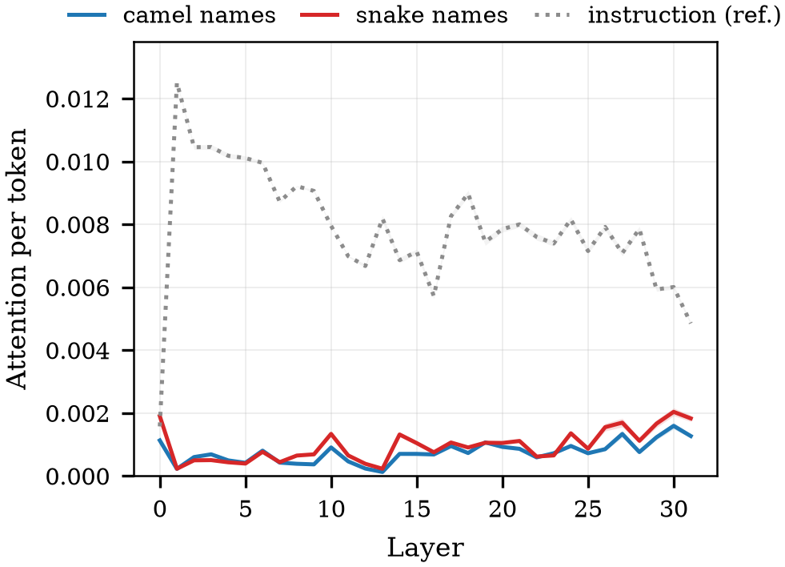
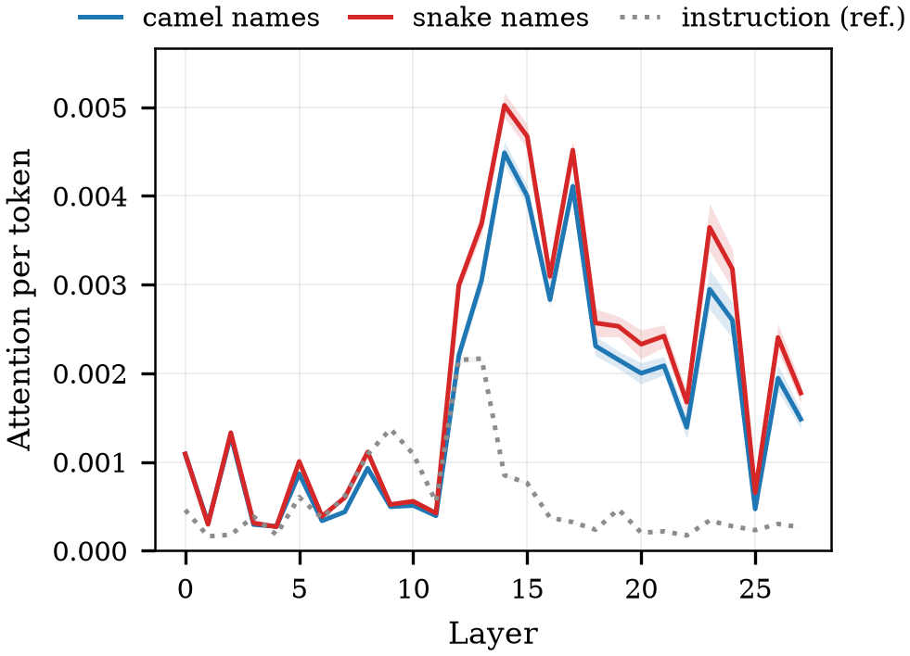
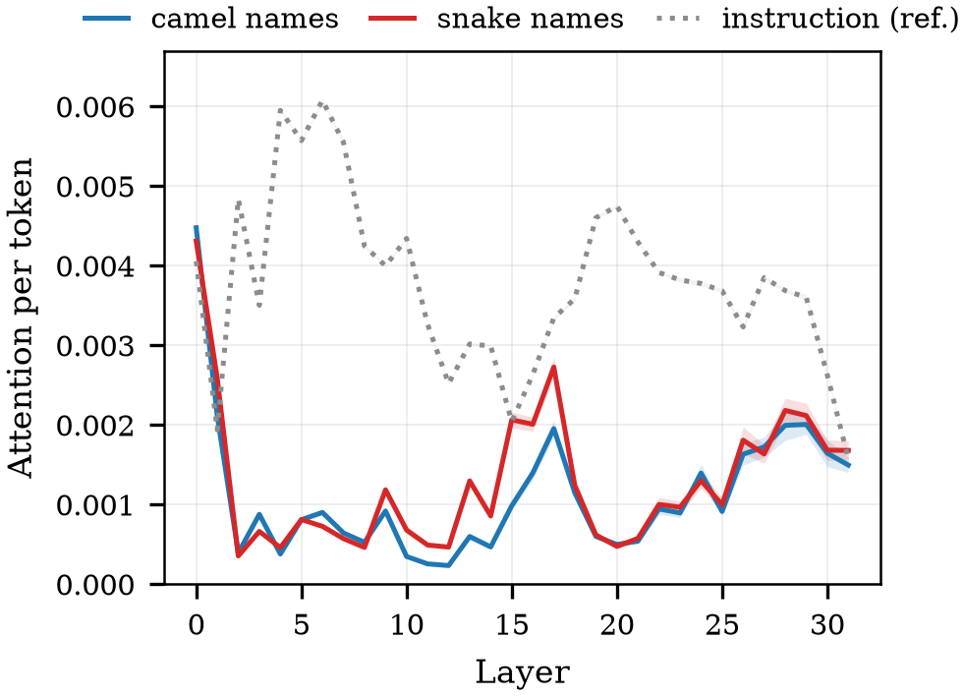
05 · EXPERIMENTS
Step 2 · Result — the model looks more, not less
Attention per token on violating names sits above compliant names in every model.
QWEN2.5-CODER-3B
DEEPSEEK-CODER-6.7B
LLAMA-3.2-3B
STABLECODE-3B
Attention per token, by layer. Violating names above compliant names.
WHAT THIS RULES OUT
If the model were failing because it does not look at the offending material, violating names would receive less attention than compliant ones. They receive more. Whatever is going wrong, it is not that the model is failing to attend.
The attention-deficit account predicted the opposite sign. It does not survive this measurement.
Naming-convention probing · 05 · Experiments
50

Slide 51
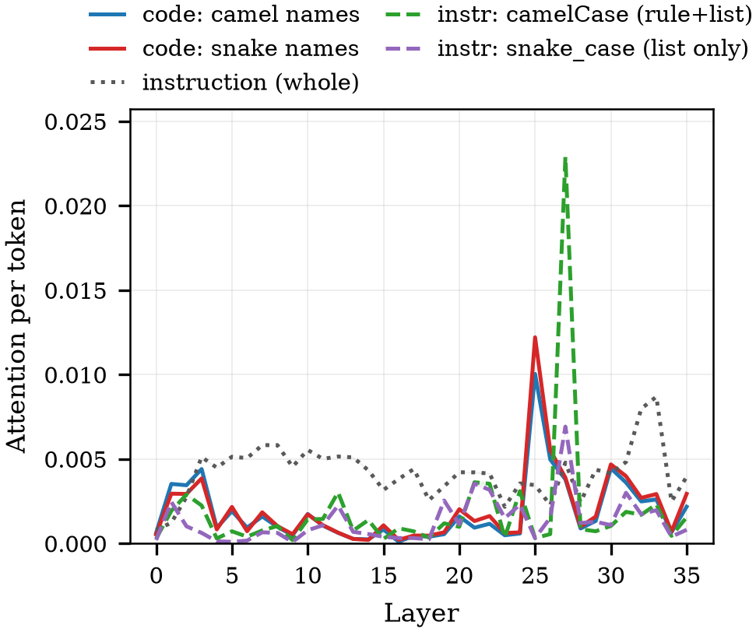
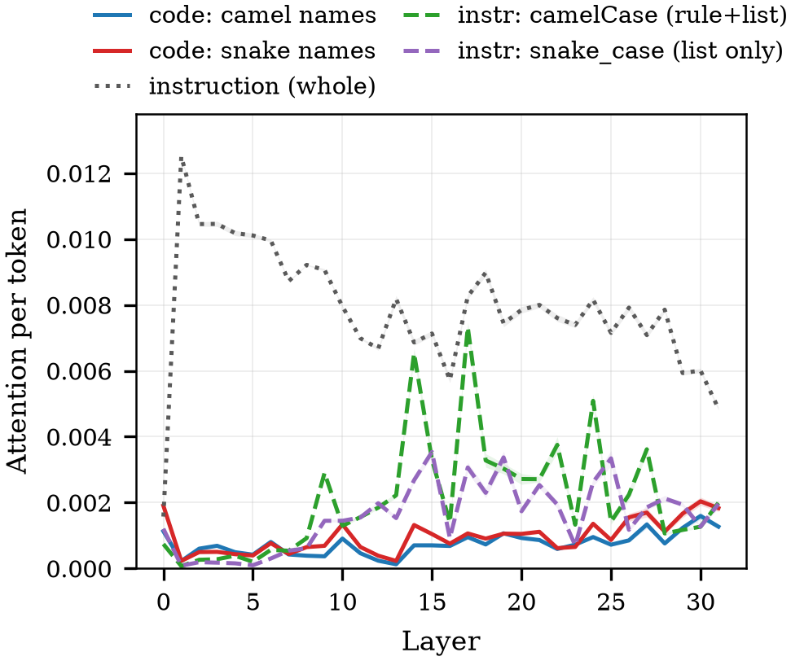
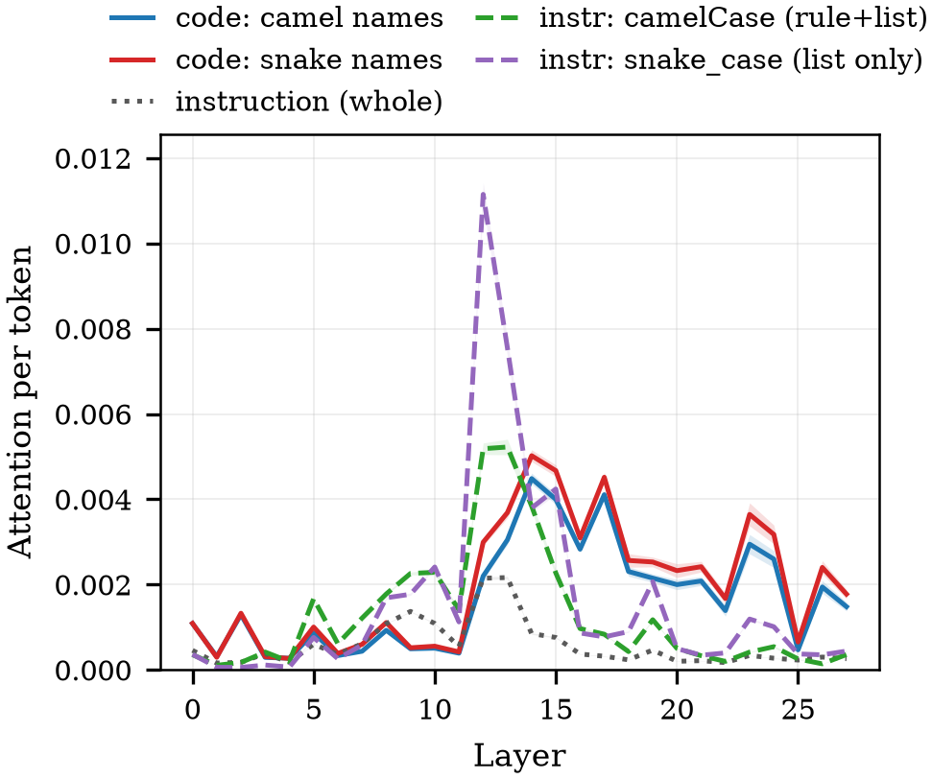
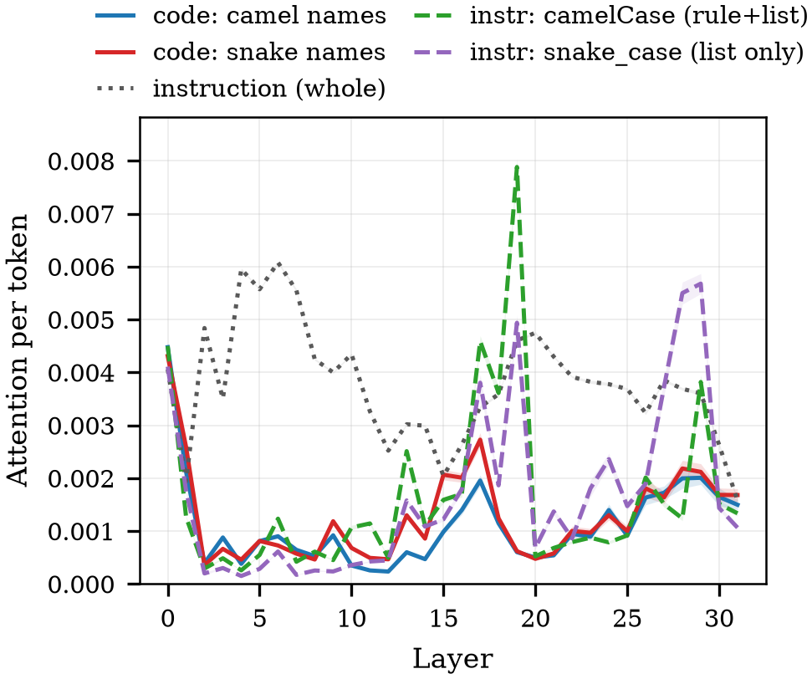
05 · EXPERIMENTS
Step 2 · Result — the same spans, seen together
All five spans on one axis, so the instruction and the code can be compared directly.
QWEN2.5-CODER-3B
DEEPSEEK-CODER-6.7B
LLAMA-3.2-3B
STABLECODE-3B
All five spans, attention per token, by layer.
A CAUTION ABOUT THE INSTRUCTION SPAN HERE
In this step the instruction's notation word is counted wherever it appears, which includes the candidate list as well as the rule sentence. That inflates it by construction, and is exactly the defect step 4 was built to fix.
The role-separated version of this comparison is step 4; this step's instruction keys are the initial ones.
Naming-convention probing · 05 · Experiments
51

Slide 52
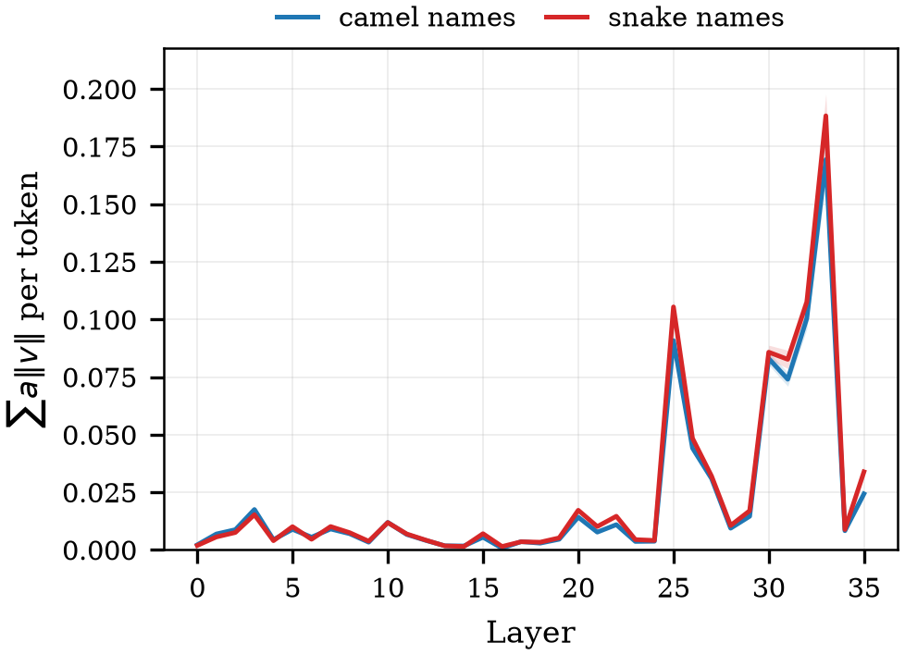
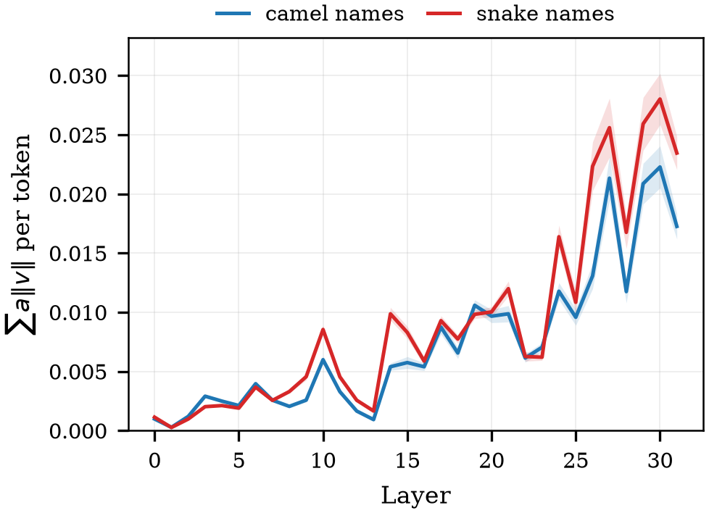
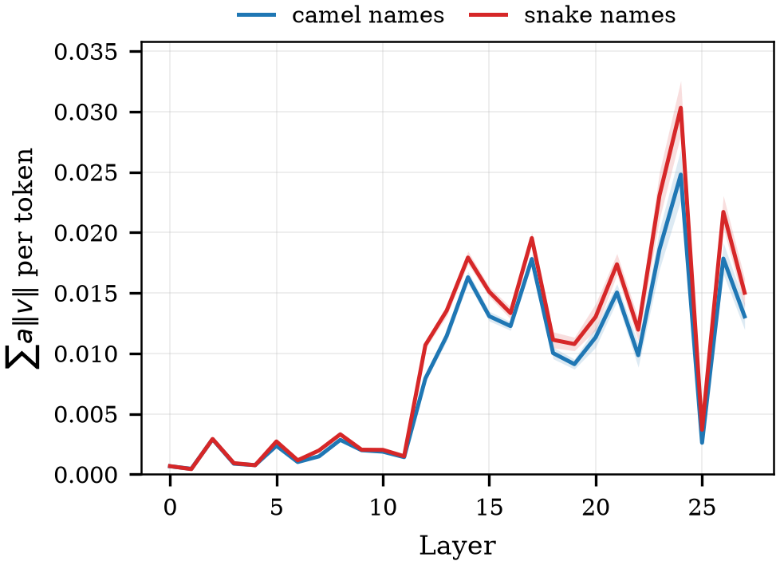

05 · EXPERIMENTS
Step 2 · Result — value norms and the upper bound
Attention share is not the only thing that differs between spans; the vectors themselves differ in length.
QWEN2.5-CODER-3B
DEEPSEEK-CODER-6.7B
LLAMA-3.2-3B
STABLECODE-3B
Attention times value norm, per token — an upper bound on contribution.
WHY THIS IS REPORTED AT ALL
AND WHY IT IS NOT A CONTRIBUTION
If violating names attracted more attention but carried shorter value vectors, the extra attention might deliver no extra content. The upper bound shows that is not what happens.
The true contribution is the norm of the weighted sum, after the output projection. Vectors can cancel; this quantity cannot see that.
It is the first hint that the two roads carry different amounts of signal.
Naming-convention probing · 05 · Experiments
52

Slide 53




05 · EXPERIMENTS
Step 2 · Result — the gap, and where it peaks
The difference between violating and compliant attention, layer by layer.
QWEN2.5-CODER-3B
DEEPSEEK-CODER-6.7B
LLAMA-3.2-3B
STABLECODE-3B
Violating minus compliant, attention per token, by layer.
THE PEAK LAYERS THIS STEP NOMINATES
L25
L0
L12
L15
QWEN2.5-CODER-3B · OF 36 LAYERS
DEEPSEEK-CODER-6.7B · OF 32 LAYERS
LLAMA-3.2-3B · OF 28 LAYERS
STABLECODE-3B · OF 32 LAYERS
These are observation peaks. Whether they are the layers that matter causally is step 3's question, not this one's.
Naming-convention probing · 05 · Experiments
53

Slide 54
05 · EXPERIMENTS
Step 2 · What this step does not settle
It is one direction, one language, one estimand choice, and no causation.
LIMIT 1
LIMIT 2
LIMIT 3
LIMIT 4
Not causal
One direction
Head-averaged
Upper bound
Attention is observed, never manipulated. Step 3 supplies the intervention that this step cannot.
Only camelCase-required conditions were run, so “violating” is always snake_case here. Step 4 runs both.
A single specialised head would be invisible. Claims are made at the layer level only.
The contribution proxy ignores cancellation and precedes the output projection.
THE ONE THAT MATTERS MOST
Because only one instruction direction was run, this step cannot separate “the model attends more to violations” from “the model attends more to snake_case”. Step 4 runs both directions and finds the same ordering, which is what licenses the general reading.
This is why the study does not stop after step 2, and why the headline claim is stated causally only after step 3.
Naming-convention probing · 05 · Experiments
54

Slide 55
05 · EXPERIMENTS
Step 2 · Reading the result file
Layer-keyed attention values, and the one field without which none of them are comparable.
RESULTS/STEP2_CODE-OBSERVE/<SLUG>.JSON
HOW TO READ IT
"metrics": {
— Read first: span_token_counts — attention_weight is a span sum, so comparing two spans without dividing by their counts compares lengths
— Then: per_layer, keyed by layer index as a string
— Check: gqa records the group layout that was actually used for this model
"per_layer": {
"27": {
"code_camel__attention_weight": 0.0184, # span SUM, heads averaged
"code_camel__av_norm": 0.412, # upper bound, not contribution
"code_camel__v_norm": 22.4,
"code_snake__attention_weight": 0.0231, … } },
"extra": {
"span_token_counts": {"code_camel": 12, "code_snake": 15, …},
"gqa": {"num_attention_heads": 16, "num_key_value_heads": 2,
"group_size": 8},
"seq_len": 512, "token_detail": {…} } }
AGGREGATION
python scripts/observe_per_token.py results/step2_code-observe
Prints both estimands side by side so the choice is visible rather than assumed.
Naming-convention probing · 05 · Experiments
55

Slide 56
05 · EXPERIMENTS
Step 3 · The question
Attention sits on the violations. Does the content it carries actually drive the behaviour — and which road carries it?
FROM CORRELATION TO CAUSE
WHAT EACH OUTCOME WOULD HAVE MEANT
— Manipulate: the cached vectors at the violating names' positions
— Separately: Key only, Value only, and both together
— At each layer: one layer at a time, swept across the whole stack
— Against controls: so the disturbance of overwriting is subtracted
IF WE HAD SEEN
THE READING
Value moves, Key does not
the notation signal travels as content, not as attention share
Key moves, Value does not
attention share carries the signal; attention remedies are the right family
both move equally
the two roads are not separable by this instrument
The observed outcome is the first row.
WHY THIS IS THE PIVOTAL STEP
This is the first point in the study where a claim about mechanism becomes possible. If the Key road had moved behaviour, the attention-raising family of remedies would still be live and the prescription in step 6 would be the wrong one to test.
Everything after it — RQ3's framing and step 6's prescription — depends on this answer.
Naming-convention probing · 05 · Experiments
56

Slide 57

05 · EXPERIMENTS
Step 3 · What is touched, and what is not
Six name positions, one layer, one KV group. The prompt and its length are identical to the baseline.
SCOPE OF THE EDIT
Three intervention kinds are measured on one forward pass, so they share every other condition exactly.
THE THREE REFERENCE RUNS
WHY A RATIO AND NOT A DIFFERENCE
S_clean
the same block with all twelve names compliant — the ceiling
Expressing the effect as a fraction of the clean-to-base distance makes the four models comparable. The cost is that the ratio is unstable when that distance is small — which is what the undecidable rule handles.
S_base
six names violating, nothing touched — the floor
S_int
six names violating, cache overwritten — the measurement
All three are stored, so the transfer rate can be recomputed later under a different threshold.
Models differ in how strongly they prefer either notation.
Naming-convention probing · 05 · Experiments
57

Slide 58
05 · EXPERIMENTS
Step 3 · Three donors, one clean comparison
The reported estimand compares two donors whose contexts are identical in everything but notation.
DONOR DEFINITIONS
The compliant donor is kept as a secondary reading: it is the natural treatment but its context differs from the control's.
WHY UNRELATED-CAMEL MINUS UNRELATED-SNAKE
Using the compliant donor against the unrelated-snake control would leave a second difference in play: the treatment's donor comes from a twelve-function context and the control's from a six-function one. The paired estimand removes that; the compliant reading is reported beside it and the two agree within their intervals.
Both donors are six functions from a separate module written in a single notation, so length and structure cancel exactly.
Naming-convention probing · 05 · Experiments
58

Slide 59
05 · EXPERIMENTS
Step 3 · The intervention, in code
Read the cache, mean-pool the donor, write it into the target positions, continue the forward pass.
ONE CONDITION, ONE LAYER
WHAT THE SWEEP PRODUCES
past = model(prompt_ids, use_cache=True).past_key_values
— Per layer: one transfer rate for each of the three intervention kinds
— Per block: one record per name block, so differences can be paired
— Per donor: three donors, each a separate condition and a separate file
k, v = past[layer] # [b, kv_heads, seq, d_head]
donor = v[:, :, donor_pos, :].mean(dim=2, keepdim=True)
v[:, :, target_pos, :] = donor # Value road only
S_int = score(model, past, forced_prefix='def ')
R = (S_int - S_base) / (S_clean - S_base)
record['per_layer'][layer]['value__recovery'] = R
504 FILES, AND WHAT THEY COVER
Every donor is run on every block on every model, so the paired difference is always between two runs that share the same names, the same seed and the same prompt.
42 blocks × 3 donors × 4 models, each sweeping every layer of its model.
Naming-convention probing · 05 · Experiments
59

Slide 60




05 · EXPERIMENTS
Step 3 · Result — the raw curves, by donor
Before any subtraction: all three donors move the score, including the one that carries no notation signal.
QWEN2.5-CODER-3B
DEEPSEEK-CODER-6.7B
LLAMA-3.2-3B
STABLECODE-3B
Transfer rate by layer, Value road, three donors. The control curve is not flat — that is the bubble.
THE FINDING THAT FORCES THE CONTROL
The unrelated-snake donor contains no camelCase information at all, yet overwriting with it moves the preference substantially. That movement is the cost of destroying the original vectors, and it has to be subtracted before anything is claimed.
A study that reported only the treatment curve would be reporting roughly twice the true effect.
Naming-convention probing · 05 · Experiments
60

Slide 61




05 · EXPERIMENTS
Step 3 · Result — raw, bubble and net side by side
The same curves, decomposed. The blue line is the only one that appears in any claim.
QWEN2.5-CODER-3B
DEEPSEEK-CODER-6.7B
LLAMA-3.2-3B
STABLECODE-3B
Raw treatment, control-only bubble, and the paired net effect, by layer.
BUBBLE SHARE AT EACH MODEL'S PEAK LAYER
49%
42%
40%
34%
QWEN2.5-CODER-3B · L25
DEEPSEEK-CODER-6.7B · L20
LLAMA-3.2-3B · L15
STABLECODE-3B · L18
Between a third and a half of the raw effect is attributable to the act of overwriting rather than to notation.
Naming-convention probing · 05 · Experiments
61

Slide 62
05 · EXPERIMENTS
Step 3 · Result — which road carries the effect
Value moves behaviour. Key barely moves it. The two are measured on the same forward pass.
NET EFFECT AT EACH MODEL'S PEAK LAYER
MODEL
PEAK LAYER
VALUE NET
KEY NET
K+V NET
KEY ÷ VALUE
Qwen2.5-Coder-3B
L25
0.253 ± 0.008
-0.005 ± 0.001
0.117 ± 0.006
2%
DeepSeek-Coder-6.7B
L20
0.125 ± 0.008
0.004 ± 0.002
0.055 ± 0.005
4%
Llama-3.2-3B
L15
0.358 ± 0.018
0.003 ± 0.001
0.102 ± 0.008
1%
StableCode-3B
L18
0.189 ± 0.012
0.021 ± 0.003
0.080 ± 0.006
11%
Paired within block, then averaged over 42 blocks; intervals are 95% normal approximations.
THE CAREFUL VERSION OF THE KEY CLAIM
AND THE COMBINED ROAD
The Key intervals do not contain zero in three of the four models. The honest statement is that the Key net effect is 2–11% of the Value net effect — small enough to be practically irrelevant, not small enough to call absent.
K+V lands below Value alone in every model, which is consistent with the transplanted key carrying a rotation that belongs to another position.
“Zero” would be wrong; “negligible” is what the numbers support.
Editing both is worse than editing content alone.
Naming-convention probing · 05 · Experiments
62

Slide 63




05 · EXPERIMENTS
Step 3 · Result — the layer profile, net of control
The effect is not spread evenly across the stack; it concentrates in a band of late-middle layers.
QWEN2.5-CODER-3B
DEEPSEEK-CODER-6.7B
LLAMA-3.2-3B
STABLECODE-3B
Net transfer rate by layer, Value and Key. This is the figure the paper's causality claim rests on.
SPLIT-HALF VALIDATION
MODEL
LAYER CHOSEN ON BLOCKS 1–21
NET ON HELD-OUT 22–42
NET AT THAT LAYER, ALL 42
Qwen2.5-Coder-3B
L25
0.261
0.253
DeepSeek-Coder-6.7B
L20
0.139
0.125
Llama-3.2-3B
L15
0.365
0.358
StableCode-3B
L18
0.193
0.189
Choosing the peak layer on half the blocks and measuring it on the other half — so the peak is not selected on the data it is reported from.
Naming-convention probing · 05 · Experiments
63

Slide 64
05 · EXPERIMENTS
Step 3 · What this step does not settle
One direction, one signal, one instrument — and an instrument whose asymmetry is measured but not fully characterised.
LIMIT 1
LIMIT 2
LIMIT 3
LIMIT 4
One direction
Code, not instruction
Instrument asymmetry
Layer, not head
camelCase-required only. Whether the same layers carry the signal in the other direction is not tested here.
This step localises the code signal. Whether the instruction travels the same road is RQ3's question.
Mean-pool substitution damages Keys and Values differently; the diagnostic step measures norm, not phase.
The peak is a layer. Which heads within it carry the signal is not resolved.
THE STRONGEST THING THIS STEP LICENSES
Under mean-pool substitution with paired controls, the notation signal from preceding code acts through the attended content at a narrow band of late-middle layers, and not through the attention share. The qualifier about the instrument is part of the claim, not a footnote to it.
Stated in the form the evidence supports, with the instrument caveat attached rather than dropped.
Naming-convention probing · 05 · Experiments
64

Slide 65
05 · EXPERIMENTS
Step 3 · Reading the result file
Transfer rates live under per_layer, not under extra — a distinction that once produced an empty table.
RESULTS/STEP3_CODE-CAUSE/<SLUG>.JSON
TWO TRAPS IN THIS STEP'S FILES
"metrics": {
— No gap field: these 504 files predate it; compute it from S_clean and S_base — the value is identical
— No extra.recovery: sweep runs store rates per layer only; extra.recovery exists on single-layer runs
— Always paired: the reported number is a difference between two donors on the same block, never a raw rate
"per_layer": {
"27": {
"value__recovery": 0.42, # the headline number
"key__recovery": 0.02,
"key_value__recovery": 0.45,
"value__S_int": -1.24, … } },
"extra": {
"mode": "intervene_sweep",
"donor": "compliant", # or unrelated_camel | unrelated_snake
"S_clean": 1.83, "S_base": -3.21,
"n_substituted_tokens": 31, # 0 would have raised
"skipped_names": [] } }
AGGREGATION
python scripts/step3_net_effect.py results/step3_code-cause
Computes the paired net effect and its interval — this is the script the paper's numbers come from.
Naming-convention probing · 05 · Experiments
65

Slide 66
05 · EXPERIMENTS
Step 4 · The question
The code signal is content at a late layer. Does the instruction get read the same way — and is it even competitive with the code?
WHAT CHANGES FROM STEP 2
WHAT EACH OUTCOME WOULD HAVE MEANT
— Both directions: camelCase-required and snake_case-required, 42 blocks each
— Eight spans: the instruction's notation words separated by role
— All four models: the same four as steps 2, 3 and 6
— Same read-out: one query row, head-averaged, per token
IF WE HAD SEEN
THE READING
instruction attended far less than code
the instruction is drowned out; an attention remedy is plausible
instruction competitive per token
the instruction is being read; the failure is downstream of looking
result depends on the estimand
the honest answer is that the comparison is estimand-dependent
THE THIRD OUTCOME IS THE ONE WE GOT, AND IT IS REPORTED AS SUCH
This is the clearest case in the study where the answer depends on how a span is summarised. Reporting only the estimand that favours our reading would be the easiest way to overstate the result, so both are plotted on the same axis with the crossover line drawn in.
Per token the instruction leads in most layers; by span sum it rarely does. Both are shown.
Naming-convention probing · 05 · Experiments
66

Slide 67

05 · EXPERIMENTS
Step 4 · The role split, and why it was necessary
The required notation word appears twice, in two different roles. Summing them builds a 2 : 1 advantage into the measurement.
INSTRUCTION ANATOMY AND THE EIGHT SPAN KEYS
The inflated keys are kept in the stored results for transparency, and interpreted nowhere.
THE CANDIDATE LIST IS A SYMMETRIC CONTROL
That symmetry is what makes the rule-sentence word interpretable: it is the only place where the two directions differ in what the text actually demands.
Both notation words appear there in identical roles, so any difference between them is not about which notation is required.
Naming-convention probing · 05 · Experiments
67

Slide 68




05 · EXPERIMENTS
Step 4 · Result — the instruction, by role
Five spans on one axis: the rule word, both candidate words, and both code groups.
QWEN2.5-CODER-3B
DEEPSEEK-CODER-6.7B
LLAMA-3.2-3B
STABLECODE-3B
Attention per token by layer, averaged over both instruction directions.
PEAK LAYER OF THE RULE WORD, PER MODEL
L27
L17
L13
L19
QWEN2.5-CODER-3B · OF 36
DEEPSEEK-CODER-6.7B · OF 32
LLAMA-3.2-3B · OF 28
STABLECODE-3B · OF 32
These land close to the causal peaks from step 3, which is the alignment the next slide examines.
Naming-convention probing · 05 · Experiments
68

Slide 69




05 · EXPERIMENTS
Step 4 · Result — why the initial keys were replaced
The same measurement, with the inflated key drawn beside the role-separated one.
QWEN2.5-CODER-3B
DEEPSEEK-CODER-6.7B
LLAMA-3.2-3B
STABLECODE-3B
Initial required-word key (2 occurrences) against the rule-sentence word alone (1 occurrence).
WHAT THE GAP BETWEEN THE TWO CURVES IS
The distance between the two curves is entirely due to counting the candidate-list occurrence alongside the rule sentence. Any claim built on the higher curve would be measuring the prompt's construction rather than the model's behaviour.
It is not a finding about the model. It is the size of a measurement artefact we removed.
Naming-convention probing · 05 · Experiments
69

Slide 70




05 · EXPERIMENTS
Step 4 · Result — instruction against code, both estimands
The ratio of instruction to code attention, plotted on a log axis with the crossover marked.
QWEN2.5-CODER-3B
DEEPSEEK-CODER-6.7B
LLAMA-3.2-3B
STABLECODE-3B
Rule word divided by compliant code names. Above 1.0 the instruction leads.
HOW MANY LAYERS PUT THE INSTRUCTION AHEAD
MODEL
LAYERS
INSTRUCTION AHEAD · PER TOKEN
INSTRUCTION AHEAD · SPAN SUM
Qwen2.5-Coder-3B
36
19 layers
5 layers
DeepSeek-Coder-6.7B
32
24 layers
6 layers
Llama-3.2-3B
28
11 layers
0 layers
StableCode-3B
32
21 layers
1 layers
The two estimands straddle 1.0 — which is why neither is presented as the answer on its own.
Naming-convention probing · 05 · Experiments
70

Slide 71




05 · EXPERIMENTS
Step 4 · Result — observation peaks against causal peaks
Where the instruction is most attended, set beside where the code signal was shown to act.
QWEN2.5-CODER-3B
DEEPSEEK-CODER-6.7B
LLAMA-3.2-3B
STABLECODE-3B
Observation peak (this step) and causal peak (step 3) on one axis.
WHAT ALIGNMENT WOULD AND WOULD NOT SHOW
If the two peaks coincided, that would be consistent with a single late-layer mechanism handling both signals. It would not establish it: only an intervention on the instruction can do that, and that is precisely the step still waiting on its control sweep.
Alignment is suggestive, not causal. The instruction's own causal test is step 5, which is not in this deck yet.
Naming-convention probing · 05 · Experiments
71

Slide 72
05 · EXPERIMENTS
Step 4 · Determinism, and what is not settled
The overlap with step 2 gives a free reproducibility check; the rest of the limits carry forward.
THE OVERLAP CHECK
LIMITS
Overlapping conditions
168
— Not causal: attention is observed; the instruction's causal test is step 5
— Estimand-dependent: the instruction-versus-code comparison changes with the summary used
— Head-averaged: as in step 2, claims are at the layer level
— One phrasing: positive form, weak strength — other phrasings are untested
Values compared across all layers
80,640
Mismatches
0
Maximum absolute difference
0.000e+00
Step 2's 168 conditions are a subset of step 4's.
WHAT STEP 4 DOES LICENSE
The instruction is not being ignored: per token it is among the most attended material in the prompt across most layers, in both directions. Whether that attention is what drives behaviour is a separate question this step deliberately does not answer.
Enough to rule out the strongest form of the attention-deficit account, and not more.
Naming-convention probing · 05 · Experiments
72

Slide 73
05 · EXPERIMENTS
Step 4 · Reading the result file
Eight span keys, three of which are role-separated and two of which are kept only for continuity.
RESULTS/STEP4_INSTR-OBSERVE/<SLUG>.JSON
READING ORDER
"per_layer": { "27": {
— First: span_token_counts — if two spans differ in token count, do not compare their sums
— Use: instr_rule_word; instr_target_word counts two occurrences and is inflated by construction
— Careful: the candidate-list keys are role-symmetric, but token counts match only on Qwen and Llama, so read them per token
"instr_rule_word__attention_weight": 0.0121, # interpret this one
"instr_cand_camel__attention_weight": 0.0043, # symmetric control
"instr_cand_snake__attention_weight": 0.0041, # symmetric control
"instr_target_word__attention_weight":0.0164, # initial key, inflated
"instr_viol_word__attention_weight": 0.0041, # initial key
"instruction__attention_weight": 0.0312,
"code_camel__attention_weight": 0.0184,
"code_snake__attention_weight": 0.0231 } },
"extra": { "span_token_counts": {…, "instr_rule_word": 2,
"instr_cand_camel": 2, "instr_cand_snake": 2}, … }
AGGREGATION
python scripts/observe_per_token.py results/step4_instr-observe
The same script as step 2, pointed at this step's folder — one estimand comparison, one code path.
Naming-convention probing · 05 · Experiments
73

Slide 74

05 · EXPERIMENTS
Diagnostic · Is the instrument fair to both roads?
If mean-pool substitution damages Keys more than Values, the central result could be an artefact of the method.
THE PREMISE BEING CHECKED
This is a check on the instrument, run on the same conditions as the experiment it checks.
WHY THIS IS NOT OPTIONAL
The whole argument turns on Value moving behaviour while Key does not. If the substitution systematically destroyed Keys, that asymmetry would be manufactured by us rather than found in the model.
A null result on the Key road is only informative if the Key road was given a fair chance.
Naming-convention probing · 05 · Experiments
74

Slide 75

05 · EXPERIMENTS
Diagnostic · What is measured
Three quantities, no scoring. The run is cheap because nothing is generated and nothing is compared to a baseline.
KV_DIAGNOSE MODE
EQ. 15 — THE SHRINK RATIOS
# no score is computed — this mode only inspects the substitution
k_new = k[:, :, donor_pos, :].mean(dim=2)
v_new = v[:, :, donor_pos, :].mean(dim=2)
key_shrink = k_new.norm() / k[:, :, target_pos, :].norm()
If the Key ratio were far below the Value ratio, the Key intervention would be a weaker manipulation and its null result uninformative.
value_shrink = v_new.norm() / v[:, :, target_pos, :].norm()
key_minus_value = key_shrink - value_shrink
position_offsets = [abs(d - t) for d, t in zip(donor_pos, target_pos)]
A ratio near 1 means the averaged vector kept its length.
72 CONDITIONS, SIX BLOCKS, FOUR MODELS
Because no score is computed, the run is a fraction of the cost of a causal sweep, which is why it covers six blocks rather than forty-two.
Deliberately small: this is a property of the substitution, not of the dataset.
Naming-convention probing · 05 · Experiments
75

Slide 76

05 · EXPERIMENTS
Diagnostic · Result — Keys shrink less, not more
The direction of the asymmetry is the opposite of the one that would undermine the central claim.
NORM RETAINED AFTER SUBSTITUTION, BY LAYER
AVERAGED OVER LAYERS, BLOCKS AND MODELS
MODEL
KEY RETAINED
VALUE RETAINED
KEY − VALUE
Qwen2.5-Coder-3B
0.958
0.866
+0.092
DeepSeek-Coder-6.7B
0.948
0.787
+0.162
Llama-3.2-3B
0.954
0.853
+0.102
StableCode-3B
0.950
0.814
+0.136
Key above Value in every model at every layer.
WHAT THIS REJECTS
The norm-collapse account of the Key null is rejected: Keys retain more of their length than Values do, so the Key manipulation is not the weaker one by this measure.
One hypothesis, cleanly. Not the whole family of instrument objections.
Naming-convention probing · 05 · Experiments
76

Slide 77
05 · EXPERIMENTS
Diagnostic · What remains unproven
Norm is not phase. The measurement rules out one mechanism and is silent about another.
THE GAP WE DO NOT CLOSE
THE ONE PIECE OF POSITIONAL EVIDENCE WE DO HAVE
Rotary embeddings encode position as a rotation. A substituted key can retain its full length and still point in a direction that belongs to a different position. This diagnostic measures length, not angle, so a phase-mismatch account of the Key null survives it.
MODEL
MEAN POSITION OFFSET
Qwen2.5-Coder-3B
0.00
DeepSeek-Coder-6.7B
1.38
Llama-3.2-3B
0.00
StableCode-3B
1.33
Where the donor and target positions coincide, a phase mismatch cannot arise.
HOW THIS IS CARRIED INTO THE CLAIMS
On two models the donor and target sit at the same positions on average, so no rotation mismatch is introduced there and the Key null still holds. On the other two an offset exists and the phase account cannot be excluded. We state the Key result with that qualifier rather than without it.
The qualifier travels with the Key result wherever it appears, including in the paper.
Naming-convention probing · 05 · Experiments
77

Slide 78
05 · EXPERIMENTS
Diagnostic · Reading the result file
No scores, no rates — two shrink ratios, two cosines, and the positional evidence.
RESULTS/DIAG_KV-PHASE/<SLUG>.JSON
HOW TO READ IT
"per_layer": { "17": {
— Headline: key_minus_value — positive means the Key kept more of its length, which rejects the norm-collapse account
— Never alone: position_offset_abs_mean must be read beside it; a key can keep its length and still carry the wrong rotation
— No score: this mode computes no transfer rate, which is why the run is cheap
"key_shrink": 0.9512, # 1.0 = no length lost
"value_shrink": 0.8417, # the no-rotation baseline
"key_minus_value": 0.1095, # positive = Key lost LESS
"key_piece_cosine": 0.83, # how aligned the donor pieces were
"value_piece_cosine": 0.61 } },
"extra": {
"mode": "kv_diagnose", "donor": "compliant",
"position_offset_abs_mean": 8.4, # the only phase proxy we have
"donor_piece_counts": [2, 2, 3, …],
"target_piece_counts": [3, 3, 2, …],
"n_substituted_tokens": 31 }
AGGREGATION
python scripts/diag_kv_phase_summary.py results/diag_kv-phase
Averages the shrink ratios over layers and blocks, and reports the offset alongside.
Naming-convention probing · 05 · Experiments
78

Slide 79

05 · EXPERIMENTS
Step 6 · The prescription, tested rather than proposed
RQ1–RQ3 say the handle is content at a late layer. If that reading is right, pushing content should work and raising attention should not.
TWO PRESCRIPTIONS, OPPOSITE PREDICTIONS
Both are measured on the same conditions, the same seed and the same four models.
WHAT WOULD HAVE FALSIFIED THE DIAGNOSIS
If attention reweighting had restored compliance, the conclusion of steps 2 and 3 would be wrong regardless of how clean those measurements were. Step 6 is the place where the diagnosis is exposed to that risk rather than protected from it.
The prediction was recorded before the sweep and is stored in the result files.
Naming-convention probing · 05 · Experiments
79

Slide 80

05 · EXPERIMENTS
Step 6 · The two interventions, in code
One adds a direction to the residual stream; the other rescales attention onto a span.
RESIDUAL-STREAM STEERING
SPOTLIGHT-STYLE ATTENTION REWEIGHTING
# direction built from contrasting contexts, not hand-specified
# raise the span mass toward a target, with the undershoot form
d = mean(h_camel_contexts) - mean(h_snake_contexts) # at steer_layer
psi_after = psi_target / (1 + psi_target - psi_before)
w[:, :, :, span] *= psi_after / psi_before
def hook(module, args, output):
w = w / w.sum(dim=-1, keepdim=True) # renormalise the row
return output[0] + alpha * d, *output[1:] # block output
record["attn_span_before"], record["attn_span_after"] = …
record["attn_calls"] = n # 0 would have raised
model.model.layers[layer].register_forward_hook(hook)
# alpha is swept over a fixed grid: 0.5, 1, 2, 4
EQ. 16 — THE UNDERSHOOT FORM
Stored before-and-after span masses confirm the reweighting actually took effect in every run.
Naming-convention probing · 05 · Experiments
80

Slide 81




05 · EXPERIMENTS
Step 6 · Result — strength sweep
Recovery against steering strength, with the attention-reweighting result on the same axis.
QWEN2.5-CODER-3B
DEEPSEEK-CODER-6.7B
LLAMA-3.2-3B
STABLECODE-3B
Transfer rate against intervention strength. Undecidable conditions excluded.
BEST RESULT EACH METHOD REACHED, PER MODEL
MODEL
STEERING · BEST Α
STEERING · RECOVERY
SPOTLIGHT · BEST Ψ
SPOTLIGHT · RECOVERY
Qwen2.5-Coder-3B
α = 4
1.73
ψ = 0.3
0.03
DeepSeek-Coder-6.7B
α = 4
3.49
ψ = 0.3
-0.11
Llama-3.2-3B
α = 2
1.36
ψ = 0.3
0.49
StableCode-3B
α = 4
3.32
ψ = 0.3
0.16
Value steering exceeds 1.0 on three models, meaning it pushed preference past the fully compliant context.
Naming-convention probing · 05 · Experiments
81

Slide 82

05 · EXPERIMENTS
Step 6 · Result — the headline comparison
The prescription implied by the diagnosis works. The prescription implied by the rival account does not.
CONTENT STEERING AGAINST ATTENTION REWEIGHTING
NOT A NULL OF CONVENIENCE
— It fired: the stored before-and-after span masses show the reweighting took effect every time
— It was swept: two target levels, on the same grid decided in advance
— It is not zero: Llama shows a positive but small recovery; DeepSeek is negative
Same conditions, same models, same measurement.
THE CLAIM THIS LICENSES, STATED AT ITS TRUE STRENGTH
On these four models, on this dataset, and under this measurement, adding a contrast direction at a late layer restores notation preference while raising the instruction's attention mass does not. That is a strong result about the diagnosis and a weak one about deployment.
A prescription that beats the rival on this instrument, not a general method claim.
Naming-convention probing · 05 · Experiments
82

Slide 83

05 · EXPERIMENTS
Step 6 · Result — does the score survive generation?
A preference score that rises while the emitted names fall apart is not a remedy.
SCORE AGAINST ACTUAL GENERATED NAMES
GENERATED NAMES UNDER STEERING
MODEL
WELL-FORMED
COMPLIANT
Qwen2.5-Coder-3B
100%
50%
DeepSeek-Coder-6.7B
79%
64%
Llama-3.2-3B
93%
75%
StableCode-3B
58%
5%
The two measurements come apart, and the gap is the point of the slide.
THE HONEST READING
Steering moves the preference score decisively on all four models, but the generated names follow only partly, and on StableCode barely at all while name quality degrades. The mechanism claim survives; a claim that this is a deployable fix does not.
Reported together, always — the score alone would overstate what steering achieves.
Naming-convention probing · 05 · Experiments
83

Slide 84

05 · EXPERIMENTS
Step 6 · Result — name health under steering
Whether the model still writes a usable identifier, plotted against the strength that moved the score.
WELL-FORMEDNESS AND COMPLIANCE AGAINST STRENGTH
WHAT DEGRADES, AND WHERE
— Baseline: every unsteered generation produces a well-formed name
— Under steering: well-formedness falls to 58% on StableCode and 79% on DeepSeek
— Trade-off: the strengths that maximise the score are not the ones that keep names intact
Dashed lines mark the unsteered baseline for each model.
WHY THIS SLIDE IS IN THE DECK AT ALL
Leaving it out would have been easy and would have made the story cleaner. It is here because the score-only version of this result is the kind of claim this study was reorganised to stop making.
It is the result that most weakens our own prescription, and it comes from the same runs as the headline.
Naming-convention probing · 05 · Experiments
84

Slide 85
05 · EXPERIMENTS
Step 6 · Result — the remedy is not layer-local
The direction is built at the causal peak, then added elsewhere. Location turns out not to matter.
WHAT THE CROSS-LAYER RUNS VARY
WHAT THE RECORDS STORE
Direction
always built at the step-3 causal peak
"extra": {
Injection layer
swept across the stack, including early layers
"method": "value_add", "strength": 1.0,
"steer_from_layer": 20, # where the direction was built
Strength
held at a single value so only location varies
"layer": 5, # where it was injected
"steer_vector": {"n_samples": 8, "n_skipped": 0,
Conditions
336 runs, the same blocks as the main sweep
"vec_norm": 30.48},
"recovery": 1.83, # injecting early works too
"hook_calls": 2 }
Three placements are compared per model, each swept over four strengths; the best strength is reported for each.
steer_from_layer records where the direction came from; layer records where it was applied.
THE READING
Injecting at an early layer works about as well, and on two models slightly better. The prescription is therefore not layer-local — the residual stream carries an added direction forward, so an edit made early survives to the end. This is separate from steps 3 and 5, where the signal itself was localised; that was an observation about where information sits, not about where a remedy must be applied.
Best score recovery per model: peak→peak 1.39–4.30, early→early 1.35–3.62, peak→early 1.35–4.08.
Naming-convention probing · 05 · Experiments
85

Slide 86
05 · EXPERIMENTS
Step 6 · Reading the result files
Two folders, two record shapes. The score record and the generation record must be read together.
THE SCORE RECORD
THE GENERATION RECORD
# results/step6_steer/<slug>.json
# results/step6_steer-generate/<slug>.json
"extra": {
"metrics": {
"mode": "steer",
"compliance_rate": 0.0,
"method": "attn_amplify", # none | value_add | attn_amplify
"extra": {
"kind": "spotlight", "span": "rule_word",
"mode": "steer_generate",
"psi_target": 0.1,
"method": "value_add",
"S_clean": 3.929, "S_base": -1.556, "S_int": -3.327,
"strength": 4, "layer": 25,
"recovery": -0.323, # the headline number
"generated_text": "def RemoveDuplicates(x): …",
"gap": 5.485, "undecidable": false,
"name": "RemoveDuplicates",
"attn_span_before": 0.00080, # proof it fired
"notation": "other", # not camel
"attn_span_after": 0.09053,
"compliant": false,
"attn_calls": 64, "n_span_tokens": 3 }
"name_ok": true, "name_length": 16 } }
THE RULE FOR THIS STEP
Always read recovery and compliant together. The example above is a run where the preference score improved and the emitted name was neither notation.
Reading recovery without compliant is how a score-only success story gets written.
Naming-convention probing · 05 · Experiments
86

Slide 87
06 · SYNTHESIS
The answers, in the order they were asked
Three questions, three answers, and the strength each one is entitled to.
WHAT THE STUDY ESTABLISHES
QUESTION
ANSWER
ON WHAT EVIDENCE
QUALIFIER
RQ1 does violating context lower compliance
yes, sharply
2,184 generations, both directions, 42 blocks
two code-specialised models, Python, first function only
RQ2 is the code signal content or attention
content — the Value road
504 sweeps with paired controls; net effect 0.13–0.36 on Value, 2–11% of that on Key
under mean-pool substitution; phase not measured
RQ2 where in the network
a narrow band of late-middle layers
layer sweeps plus split-half validation on held-out blocks
layer level, head-averaged
RQ3 is the instruction read the same way
it is read, and competitively per token
336 observations, both directions, role-separated spans
observational only — the causal half is step 5, still pending
Each row's qualifier is part of the claim, not a hedge appended to it.
Naming-convention probing · 06 · Synthesis
87

Slide 88
06 · SYNTHESIS
Why raising attention does not fix it
Three independent measurements point the same way, and the prescription test closes the argument.
THE CHAIN
The model already looks
Attention share carries little
Content carries it
And the remedy follows
Violating names receive more attention per token than compliant ones, in every model and at every layer band.
Overwriting the Key road moves behaviour by 2–11% of what the Value road moves, net of control.
Overwriting attended content at one late layer restores preference by 0.13 to 0.36, net of control.
Adding a contrast direction at that layer restores preference; reweighting attention onto the instruction does not.
WHAT THIS DOES NOT SAY ABOUT PRIOR WORK
THE ONE LINK STILL OPEN
Attention reweighting may well help on tasks where the model genuinely under-attends. Our claim is narrower: on this failure, on these models, under this measurement, it does not, because under-attention is not what is wrong.
Everything about the instruction in this deck is observational. The intervention exists but its layer-wise control does not yet, so no causal claim about the instruction is made here.
The disagreement is about the locus of the failure, not about the quality of the earlier method.
The instruction's causal test is specified and half-run.
Naming-convention probing · 06 · Synthesis
88

Slide 89
06 · SYNTHESIS
How claims are worded, and why
The study has a fixed vocabulary for claim strength. Wording drift is the failure mode the audit found most often.
FORBIDDEN PHRASING AND ITS REPLACEMENT
WHAT WE DO NOT WRITE
WHAT WE WRITE INSTEAD
WHY
“the Key path carries no information”
“the Key net effect is 2–11% of the Value net effect”
the intervals do not contain zero in three of four models
“av_norm is the contribution”
“av_norm is an upper bound on the contribution”
it ignores cancellation and precedes the output projection
“RoPE concerns are rejected”
“the norm-collapse hypothesis is rejected”
phase was never measured; only length was
“steering fixes the problem”
“steering restores preference; generated names follow only partly”
well-formedness falls to 58% on one model
“the model ignores the instruction”
“per token the instruction is among the most attended spans”
the opposite of the measurement, under either estimand
Each row on the left is a sentence that appeared in an earlier draft of this project's documentation.
Naming-convention probing · 06 · Synthesis
89

Slide 90
06 · SYNTHESIS
Limitations, collected
Gathered in one place rather than distributed where they are least visible.
COVERAGE
MEASUREMENT
INSTRUMENT
— Language: Python only; zero JavaScript conditions were ever run
— Models: four, three of them code-specialised and all under 7B
— Context: synthetic, one name pool, one function shape
— Prompt: one phrasing — positive form, weak strength
— Preference: teacher-forced score, not behaviour, except in steps 1 and 6
— Heads: averaged; a single specialised head would be invisible
— Estimand: per token throughout; the span-sum reading disagrees in step 4
— Position: first function only; amplification across functions untested
— Substitution: mean-pool destroys the original as it inserts the new
— Phase: measured only through a positional-offset proxy
— Steering: residual-stream, so not confined to the Value road
— Step 5: instruction causality has no layer-wise control yet
NONE OF THESE IS REPAIRED BY ARGUMENT
The list is longer than it would be if limits were only mentioned where they were discovered. That is deliberate: a reader deciding how far to trust the headline needs them in one place.
Where a limit is not covered by a later step, it is carried into the paper as a stated limitation.
Naming-convention probing · 06 · Synthesis
90

Slide 91

06 · SYNTHESIS
What is next — step 5's control sweep
The one experiment this deck is missing, why its absence is a coverage gap rather than an error, and what it costs.
THE STATE OF STEP 5
The treatment swept every layer; the controls ran at one layer only, so no layer-wise net curve can be drawn.
WHAT THE SWEEP WOULD ADD
WHAT IT CANNOT CHANGE
672 runs: four models, 42 blocks, two directions, two control donors, each sweeping every layer instead of one. Roughly two GPU hours.
If the net peak turns out to sit elsewhere, the effect size grows rather than shrinks — the direction and sign of the result are not at stake.
The reported step-5 numbers do not depend on the missing layers.
A step-5 curve directly comparable to step 3's, and a check on the peak-layer assumption.
Naming-convention probing · 06 · Synthesis
91

Slide 92
06 · SYNTHESIS
The through-line, once more
From a symptom anyone can reproduce to a handle that can be tested — and to the one link still open.
FIVE FINDINGS, EACH PREDICTING THE NEXT EXPERIMENT
The dashed link at the right is step 5: specified, half-run, and not claimed.
THE STUDY IN FOUR NUMBERS
7,212
0.13–0.36
2–11%
34–49%
CONDITIONS ANALYSED
VALUE NET EFFECT AT PEAK
KEY EFFECT, AS A SHARE OF VALUE
OF THE RAW EFFECT WAS BUBBLE
Every one recomputed from the stored result files for this deck, not transcribed from notes.
Naming-convention probing · 06 · Synthesis
92

Slide 93
06 · SYNTHESIS
Closing
What to take away, and what to be sceptical about.
TAKE AWAY
BE SCEPTICAL ABOUT
— The diagnosis: the failure is not inattention; the model looks at the violating names more, not less
— The locus: the notation signal acts through attended content at a narrow band of late-middle layers
— The handle: pushing content at that band restores preference where raising attention does not
— The discipline: every effect is reported net of a control, because overwriting alone moves the score by a third to a half
— Generality: four models under 7B, Python, one synthetic context, one prompt phrasing
— Deployability: steering moves the score decisively and the generated names only partly
— The instrument: mean-pool substitution is not neutral; its asymmetry is measured by norm, not by phase
— The instruction: everything about it here is observational; its causal test is not yet complete
WHERE THE MATERIAL LIVES
Plan
docs/연구계획_통일재실험.md
Results
results/<step>/<slug>.json — immutable
Per step
docs/<step>/{방법론, code, results}.md
Scripts
scripts/ — every figure and every aggregate
Figures and aggregates in this deck are produced by scripts that read the stored result files; none was drawn or transcribed by hand.
Naming-convention probing · 06 · Synthesis
93

