Slide 1

Containers and AKS, through the lens of an old weathered server admin
Session 01

Slide 2
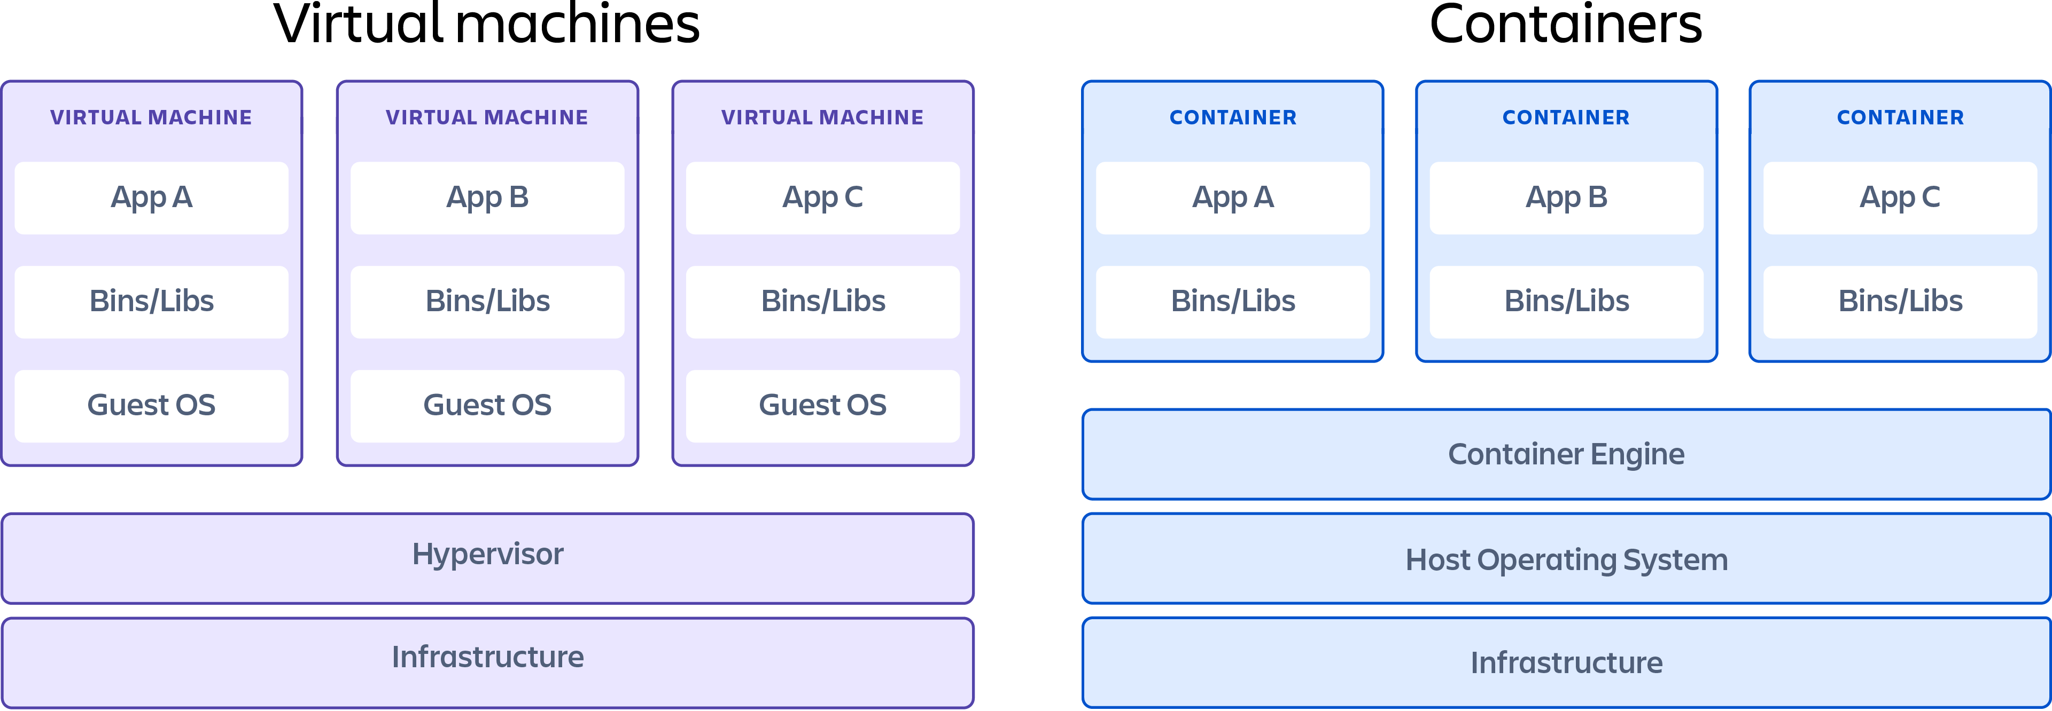
Virtual machines vs containers
Resource Efficiency → Containers use fewer system resources compared to virtual machines.
Faster Startup and Scaling → Containers start up much faster and can scale quickly in response to demand.
Portability and Consistency → Containers are highly portable across different environments and ensure consistent runtime environments.
Easier Deployment and Orchestration → Containers simplify deployment and orchestration tasks, enabling automation and efficient management.
Improved Developer Productivity → Containers streamline development processes and promote DevOps practices.
Isolation with Less Overhead → Containers provide isolation without the overhead of running separate operating system kernels.
https://www.atlassian.com/microservices/cloud-computing/containers-vs-vms

Slide 3
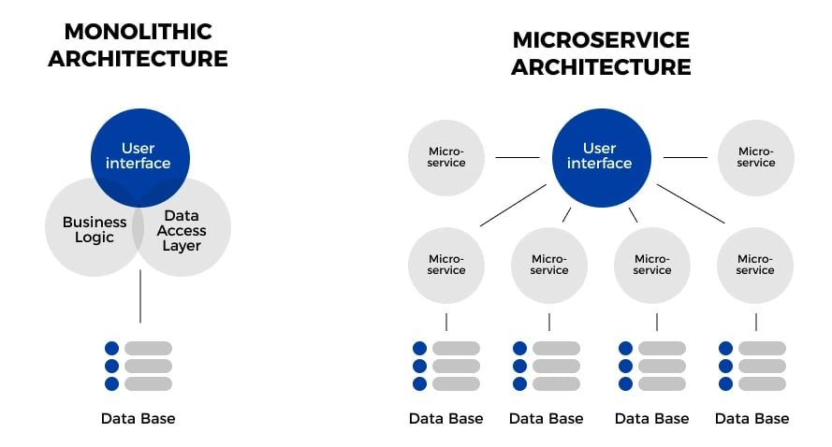
Containers in the enterprise
Decomposed Architecture → Applications are split into small, independent services, each responsible for specific business functions.
Scalability → Allows scaling individual components independently based on demand.
Flexibility → Enables the use of different technologies and programming languages for each service.
Fault Isolation → Failure in one service doesn't necessarily affect others; services can fail gracefully.
Development Agility → Facilitates agile development practices and faster release cycles for individual services.
https://www.openlegacy.com/blog/monolithic-application

Slide 4
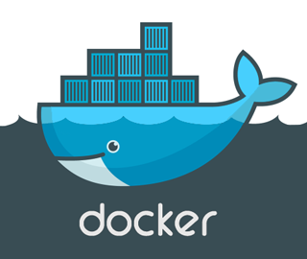
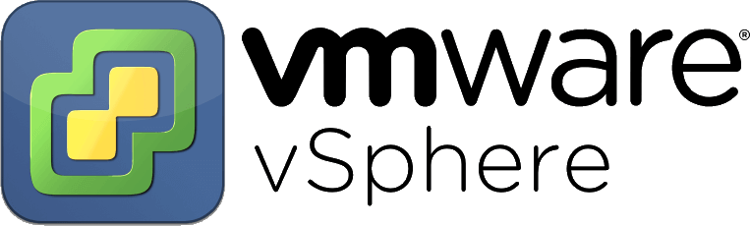
Hypervisor vs container runtime
A container runtime and a hypervisor are both technologies used to create isolated environments for running applications, but they have fundamental differences in their architectures and approaches to virtualization.
HYPERVISOR | CONTAINER RUNTIME
Hardware Level Virtualization | OS Level Virtualization
Creates VMs with dedicated OS | Lightweight, sharing host OS kernel
Strong isolation between VMs | Efficient resource utilization
Supports various guest OSes | Portability across environments
https://www.atlassian.com/microservices/cloud-computing/containers-vs-vms

Slide 5
container runtime
A container runtime is responsible for executing and managing containers, which are lightweight, portable, and isolated environments for running applications.
The container runtime interacts directly with the host operating system's kernel to create and manage these containers providing the runtime environment necessary for running containerized applications.
Containerd is an open-source container runtime designed to be a core component of container platforms.
Containerd was originally developed by Docker, Inc., it was later contributed to the Cloud Native Computing Foundation (CNCF) as a standalone project.
Containerd focuses on providing the essential functionalities required for container execution, image distribution, and lifecycle management, serving as a building block for higher-level container orchestration systems like Kubernetes.
https://www.atlassian.com/microservices/cloud-computing/containers-vs-vms

Slide 6
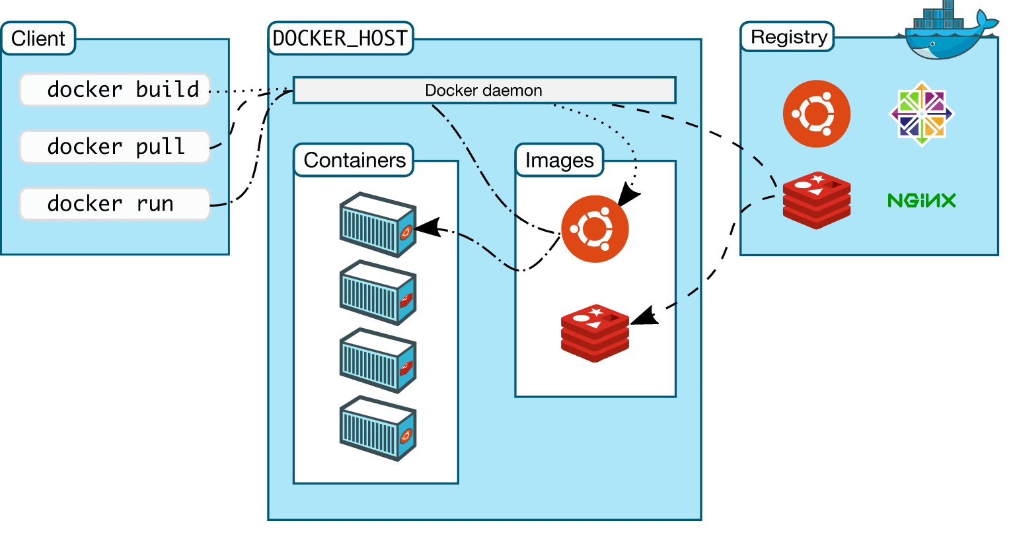
Docker architecture
The Docker architecture employs a client-server design.
A Docker client talks to the Docker daemon via the REST API and the daemon manages the containers according to the commands issued by the user.
Docker Engine is essentially Docker installed on a host. When you install Docker on a system, you are installing the following key components: the Docker daemon, Docker REST API, and Docker CLI which interacts with the Docker daemon through the REST API.
Docker Daemon → This is a background process that manages Docker objects such as images, containers, storage volumes, and networks. It constantly listens to API requests and processes them.
Docker REST API → This is an API interface that applications use to talk with the Docker Daemon and provide instructions.
Docker CLI → This is a command line interface for interacting with the Docker daemon. It helps you to perform tasks such as running, stopping, and terminating containers and images to mention a few. It uses the REST API to interact with the Docker daemon.
A Docker registry is a repository on which various types of container images are hosted.
https://www.cherryservers.com/blog/a-complete-overview-of-docker-architecture

Slide 7
The anatomy of a container
Docker images are the building blocks for containers. A Docker image is an immutable or read-only template that provides instructions for a Docker container.
Docker networking is a subsystem in which Docker containers connect with other containers either on the same host or on different hosts, including internet-facing hosts.
Data stored in a container is ephemeral, and it ceases to exist once the container is terminated. Docker offers the following options to ensure persistent storage:
Data volumes: These are the most preferred storage systems for persisting data generated and used by containers.
Volume Container: Another solution is to have a dedicated container hosting a volume which is then used as a mount space for other containers.
Directory Mounts: For data volumes and volume containers, data is stored in the /var/lib/docker/volumes filesystem which is managed purely by Docker.
Storage Plugins: Plugins extend the functionality of Docker. Storage plugins provide a means of connecting to external storage devices.
CONTAINER
STORAGE
NETWORKING
IMAGE
https://www.cherryservers.com/blog/a-complete-overview-of-docker-architecture

Slide 8
LET’S BUILD IT
https://www.cherryservers.com/blog/a-complete-overview-of-docker-architecture

