Slide 1

Containers and AKS, through the lens of an old weathered server admin
Session 02

Slide 2
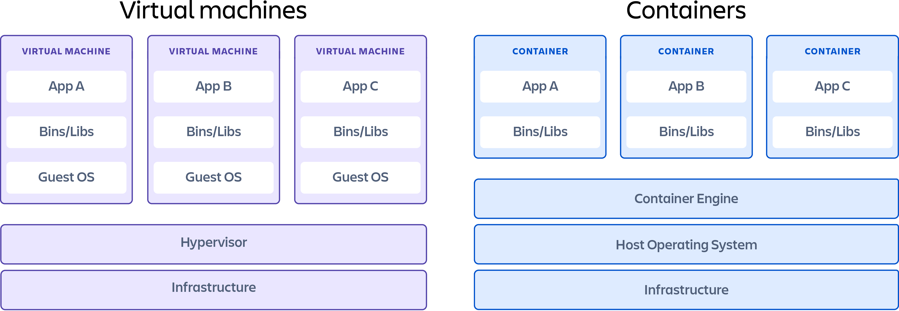
RECAP
Containers are an evolution of traditional hypervisor-based virtualisation
Containers are the building blocks of a Micro-Services Architecture
A container runtime is responsible for executing and managing containers
The container runtime interacts directly with the host operating system's kernel to create and manage containers
Docker is the predominant vendor in the containers space
Container are compiled from simple ‘dockerfile’ manifests
Docker Compose is Dockers offering for container orchestration

Slide 3
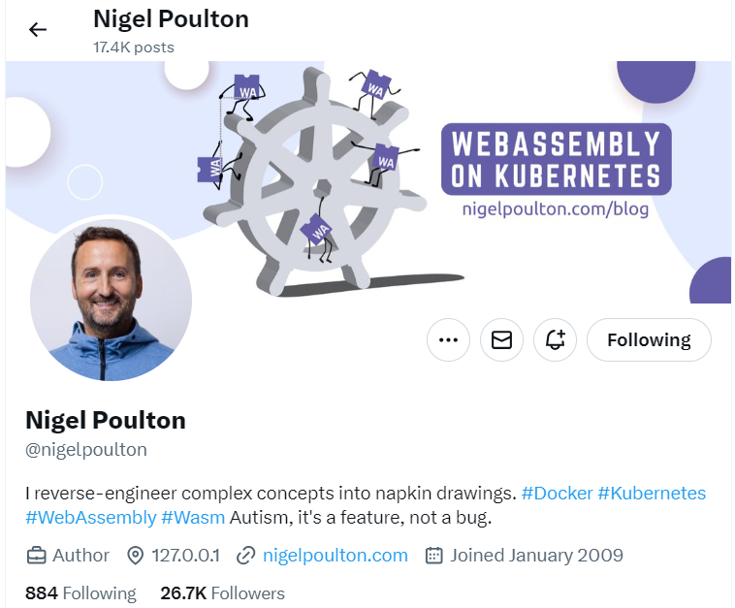
https://app.pluralsight.com/library/courses/kubernetes-getting-started-2023
https://avanade.sharepoint.com/sites/HR/learn/LearningProgramsResources/Pages/pluralsight.aspx -

Slide 4

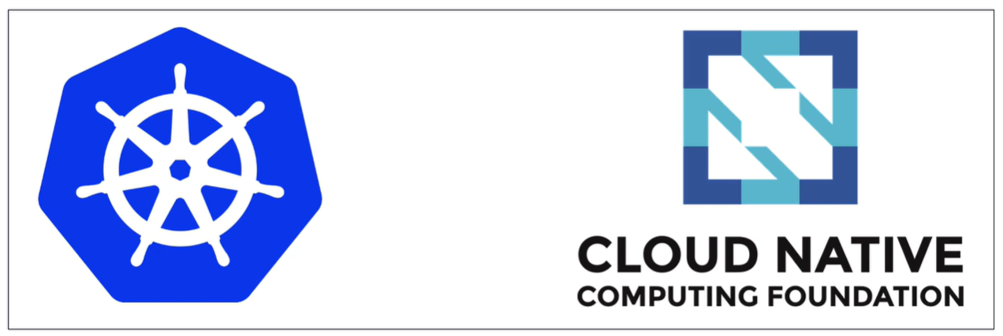
A HISTORY OF KUBERNETES
Kubernetes is an open-source container orchestration system for automating software deployment, scaling, and management.
Originally designed by Google, the project is now maintained by a worldwide community of contributors, and the trademark is held by the Cloud Native Computing Foundation.
Written in Go and hosted on GitHub
The name Kubernetes originates from Ancient Greek, meaning 'helmsman' or 'pilot’.
Kubernetes is often abbreviated as K8s, counting the eight letters between the K and the s
Version 1 released in July 2015
https://en.wikipedia.org/wiki/Kubernetes -

Slide 5
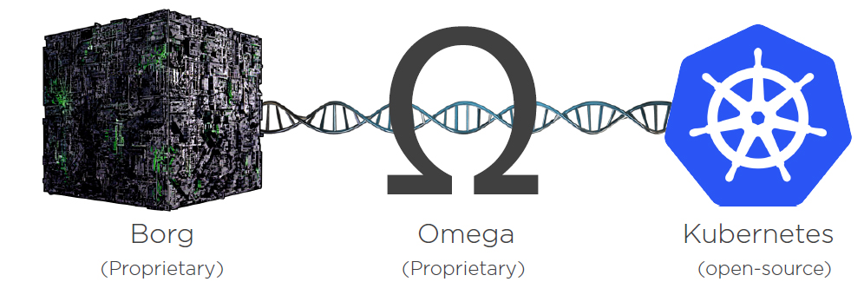
A HISTORY OF KUBERNETES
Google Borg:
Developed by Google in the mid-2000s, Borg is an internal cluster management system used to run Google's vast array of services and applications.
Borg revolutionised Google's approach to managing and scaling its data centre infrastructure.
It allowed Google to achieve high utilisation rates, fault tolerance, and efficient resource allocation across its massive fleet of servers.
Omega:
Omega was conceived as a successor to Borg within Google, addressing some limitations and incorporating new features based on lessons learned from Borg's deployment.
Developed around 2013, Omega aimed to improve efficiency, scalability, and flexibility in managing Google's infrastructure.
Omega introduced a more flexible scheduling model, better support for long-running services, and improved resource isolation.
Kubernetes:
Kubernetes is an open-source container orchestration platform initially developed by Google and later donated to the Cloud Native Computing Foundation (CNCF) in 2015.
Kubernetes draws heavily from Google's experience with Borg and Omega, providing similar functionalities to manage containerised applications across clusters of machines.
Kubernetes simplifies the deployment, scaling, and management of containerised applications by automating tasks such as container scheduling, load balancing, and service discovery.
It has become the de facto standard for container orchestration, enjoying widespread adoption in both on-premises and cloud environments.
Summary
Kubernetes is influenced by the design and principles of Borg and Omega, leveraging many of their concepts and best practices.
Google's experience with Borg and Omega served as the foundation for Kubernetes, with key contributors to Kubernetes having worked on Borg and Omega internally.
While Kubernetes is not a direct descendant of Borg or Omega, it inherits their core ideas and extends them with additional features, making container orchestration accessible to a broader audience beyond Google.
Kubernetes can be seen as the democratisation of Google's internal cluster management technologies, bringing the benefits of container orchestration to the wider community of developers and organisations

Slide 6
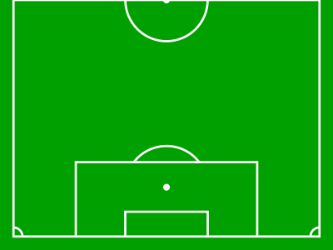
The role of orchestration

Slide 7
The role of orchestration

Slide 8
The role of orchestration

Slide 9
The role of orchestration

Slide 10
The role of orchestration

Slide 11
The role of orchestration
Auth
Node 1
Search
Node 2
Logging
Reporting
Node 3

Slide 12
The role of orchestration
Auth
Node 1
Search
Node 2
Logging
Reporting
Node 3

Slide 13
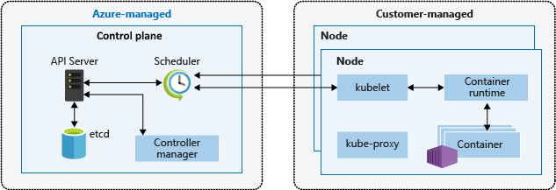
The anatomy of aks
Control Plane:
Acts as the brains of the Kubernetes cluster, managing and coordinating all cluster activities.
Consists of several components:
API Server: Exposes Kubernetes API, allowing users and components to interact with the cluster.
Scheduler: Assigns pods to worker nodes based on resource requirements and availability.
Controller Manager: Monitors the cluster state and ensures that the desired state matches the actual state.
Cluster Store (etcd): Distributed key-value store storing cluster state data, ensuring high availability and consistency.
Handles cluster-wide tasks such as scheduling, scaling, and maintaining desired state.
Worker Nodes:
Form the execution environment for containerised applications within the Kubernetes cluster.
Consists of several components:
Kubelet: Agent running on each node, responsible for managing containers, ensuring they are running and healthy.
Container Runtime: Software responsible for running containers (e.g., Docker, containerd).
kube-proxy: Network proxy maintaining network rules and load balancing across services.
Host one or more pods, which are the smallest deployable units in Kubernetes, containing one or more containers.
Executes application workloads, communicates with the control plane for instructions, and reports back on the node's status.

Slide 14
KEY jargoN
Pods:
The smallest deployable units in Kubernetes, consisting of one or more containers that share networking and storage resources.
Pods are the basic building blocks for running applications on Kubernetes.
Deployments:
A higher-level Kubernetes resource used to manage the lifecycle of pods and replica sets.
Allows declarative updates to application deployments, enabling easy scaling, rolling updates, and rollbacks.
Services:
An abstraction that defines a logical set of pods and a policy by which to access them.
Enables decoupling of applications from individual pod instances, providing stable endpoints for communication.
Replica Sets:
Ensures a specified number of pod replicas are running at any given time.
Helps in achieving high availability and scalability by automatically replacing failed pods and scaling the number of replicas based on demand.
Namespaces:
Virtual clusters within a Kubernetes cluster, used to partition resources and provide isolation between different users, teams, or projects.
Helps in organizing and managing resources in a multi-tenant environment.
Labels:
Key-value pairs attached to Kubernetes objects (such as pods, services, and deployments) for identifying and selecting related resources.
Used for grouping, filtering, and managing objects in Kubernetes.
Persistent Volumes (PVs):
PVs represent storage resources in the cluster that have been provisioned by an administrator.

Slide 15
The anatomy of aks
NAMESPACE
SERVICE – LOAD BALANCER
NODE POOL
NODE
NODE
NODE
NODE
POD
POD
POD
POD
POD
POD
POD
POD
POD
POD
POD
POD
POD
POD
POD
POD
POD
POD
POD
POD

Slide 16
That’s enough talking! LET’S BUILD IT
https://www.cherryservers.com/blog/a-complete-overview-of-docker-architecture

