Slide 1
v0.4
ai-101
# tl;dr
the brief history of ai
└── the significance of the transformer architecture
└── how models are trained
dean.lawrence@avanade.com
github.com/deanl1982/llm101

Slide 2
ai-101
# [cheat-code] everything that follows is not text memorisation, it's pattern recognition!
dean.lawrence@avanade.com
github.com/deanl1982/llm101

Slide 3
ai-101
# the brief history of ai
artificial intelligence
└── machine learning
└── deep learning
└── neural networks
├── recurrent neural networks
└── transformers
└── foundation models
├── large language models
├── vision models
├── speech models
└── multimodal models
└── agentic ai
dean.lawrence@avanade.com
github.com/deanl1982/llm101

Slide 4
“context turns data into knowledge”
ai-101
# the significance of the transformer architecture
google's 2017 deep learning breakthrough that enabled modern ai was the transformer architecture
└── old models read sequentially [word by word] meaning they were slow and forgot context
└── transformers use "attention" to look at all words simultaneously
└── parallel processing unlocked scale
└── could finally train on massive datasets [the entire internet]
└── every modern LLM uses this architecture
dean.lawrence@avanade.com
github.com/deanl1982/llm101

Slide 5
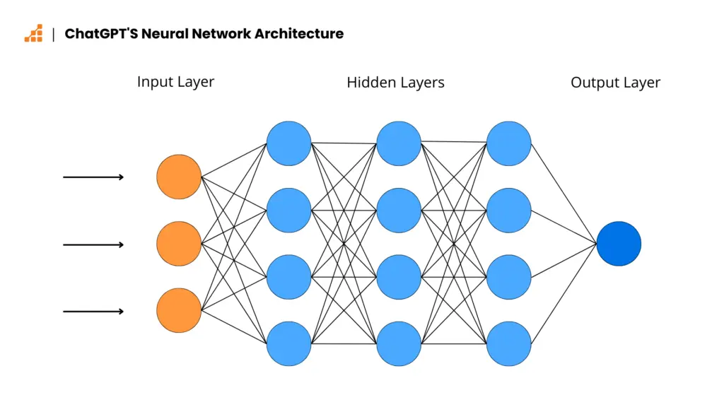
ai-101
# how models are trained
tokenization splits text into smaller pieces ["Hello world!" → "Hello" " world" "!"]
└── embedding maps each token into a list of numbers called weights
└── neural networks process tokens through thousands of layers
└── each layer adjusts the weights as it learns new patterns
└── weights are the "knobs" that predict the next token correctly
└── scale up and repeat this process across trillions of words
Source: https://www.scalablepath.com/machine-learning/chatgpt-architecture-explained
dean.lawrence@avanade.com
github.com/deanl1982/llm101

Slide 6
ai-101
# how models are trained
## [user-prompt] complete this sentence, the cat sat on the…
dean.lawrence@avanade.com
github.com/deanl1982/llm101

Slide 7
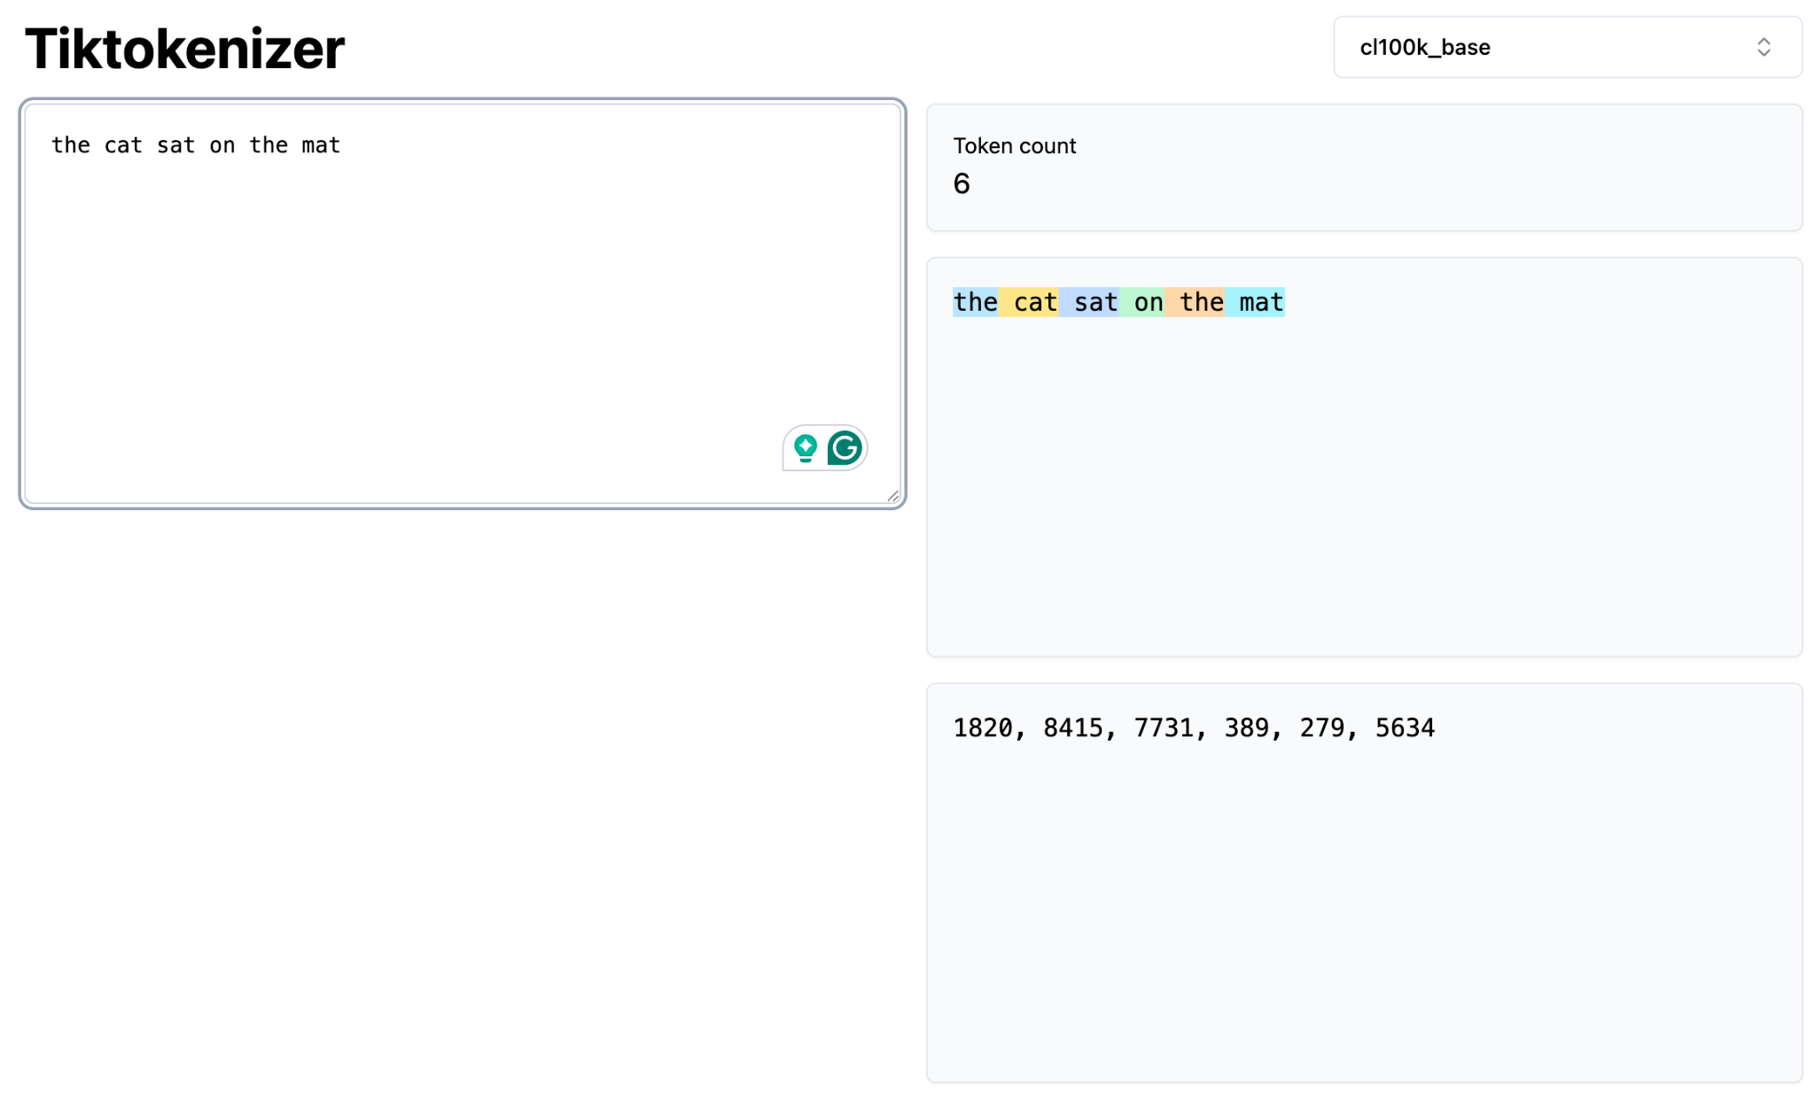
ai-101
# how models are trained
## tokenization
"the cat sat on the mat"
↓
token text: ["the", " cat", " sat", " on", " the", " mat"]
↓
token id: [1820, 8415, 7731, 389, 279, 5634]
https://tiktokenizer.vercel.app
dean.lawrence@avanade.com
github.com/deanl1982/llm101

Slide 8
ai-101
# how models are trained
## embedding
before being processed by the transformer, all tokens are assigned an initial randomised weight:
token weight₁ weight₂ weight₃ weight₄
"the" 0.847 -0.312 1.456 -0.723
"cat" 0.823 0.591 -1.023 0.445
"sat" -0.567 1.234 0.892 -0.156
"on" 0.723 -0.891 0.334 1.567
"the" 1.445 0.223 -0.778 0.901
dean.lawrence@avanade.com
github.com/deanl1982/llm101

Slide 9
ai-101
# how models are trained
## training data is then fed into the transformer
“the cat sat on the mat"
"the dog sat on the couch"
"the bird sat on the branch"
"my cat loves sitting on warm surfaces"
"cats often sit on mats, rugs, and furniture"
"the kitten sat on the cushion"
"animals sit on comfortable places"
"she placed the mat down and the cat sat on it"
dean.lawrence@avanade.com
github.com/deanl1982/llm101

Slide 10
ai-101
# recognising language, layer by layer
layer 1 — tokens > breaks the sentence into pieces > "the", "cat", "sat", "on", "the", "mat". just raw fragments, no meaning yet.
layer 2 — word relationships > which words relate to which? it spots that "cat" connects to "sat" (the cat is doing the sitting). still no understanding — just patterns of association.
layer 3 — context > what role does each word play? it recognises "cat" is the subject, "mat" is the location. it notices this follows patterns it's seen millions of times before.
layer 4 — meaning > "what word likely comes next?“ based on all those patterns, it can now predict: if the sentence continued, words like "and purred" or "then jumped" would fit. words like "elephant" or "quantum" would not.
Source: https://www.scalablepath.com/machine-learning/chatgpt-architecture-explained

Slide 11
ai-101
# how models are trained
## training run
weights change as token make their way through the transformer layers
and new patterns in the data are found, semantically similar words are clustered closer together
"cat" → [0.823 > 0.654 > -0.234 > 0.445 > 0.912]
"mat" → [1.798 > 1.642 > 1.210 > 0.938 > 0.895] ← closer to "cat"
dean.lawrence@avanade.com
github.com/deanl1982/llm101

Slide 12
ai-101
# how models are trained
## semantic similarity
before training:
"cat" "mat"
🐱 ←───── 0.975 ─────→ 🧘
after training:
"cat" "mat"
🐱←─ 0.017 ─→🧘
dean.lawrence@avanade.com
github.com/deanl1982/llm101

Slide 13
ai-101
# sources & useful links
# how modern ai models learn: from raw text to helpful assistants
# loss isn’t failure: it’s how your ai learns
# how llms decide what to say next: demystifying top-k, top-p, and temperature
# understanding the attention mechanism in ai
# https://www.youtube.com/watch?v=7xtgnnlpymi&t=999s
# https://tiktokenizer.vercel.app
# https://bbycroft.net/llm
# https://arxiv.org/abs/1706.03762
dean.lawrence@avanade.com
github.com/deanl1982/llm101

Slide 14
ai-101
# questions & answers…
dean.lawrence@avanade.com
github.com/deanl1982/llm101

