Slide 1
0.1
ai periodic table
tl;dr
a periodic table for ai
└── from primitives to emerging tech
└── how the elements combine into real-world patterns
dean.lawrence@avanade.com
github.com/deanl1982/whey-ai-man

Slide 2
0.2
ai periodic table
the world of ai is drowning in its own vocabulary.
agents. rag. embeddings. guardrails. fine-tuning. vector databases. multimodal
...and you're just supposed to know how it all fits together.
a thousand terms. no shared mental model.
dean.lawrence@avanade.com
github.com/deanl1982/whey-ai-man

Slide 3
0.2
ai periodic table
chemistry had the same problem.
dozens of elements. no structure.
then a famous chemist called mendeleev built a grid [and left gaps].
rows told you complexity. columns told you behaviour.
let's apply that same concept to ai, and build an ai periodic table.
dean.lawrence@avanade.com
github.com/deanl1982/whey-ai-man

Slide 4
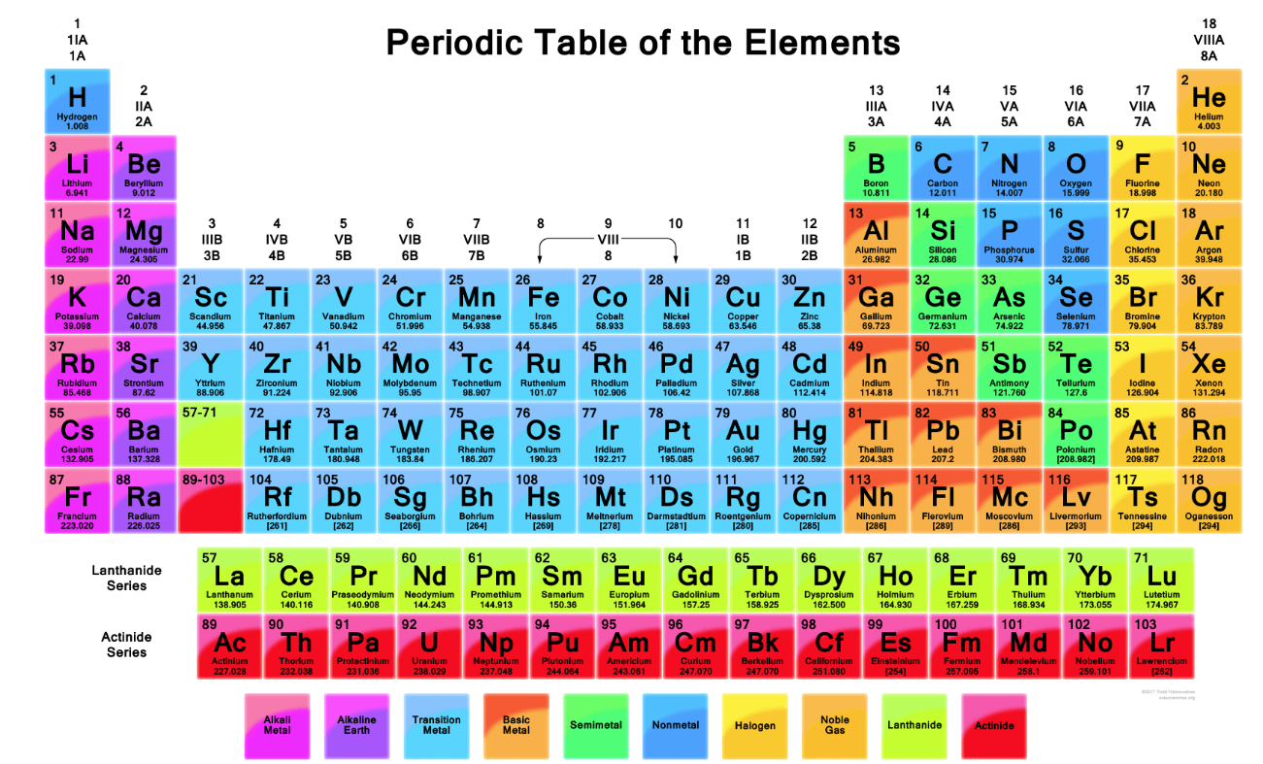

Slide 5
Reactive
Retrieval
Orchestration
Validation
Models
Primitives
Compositions
Deployment
Emerging

Slide 6
Reactive
Retrieval
Orchestration
Validation
Models
Primitives
Pr
Prompts
Em
Embedding
Lg
LLM
Compositions
Fc
Function Call
Vx
Vector
Rg
RAG
Gr
Guardrails
Mm
Multimodal
Deployment
Ag
Agent
Ft
Fine Tuning
Fw
Framework
Rt
Red Team
Sm
Small
Emerging
Ma
Multi Agent
Sy
Synthetic
In
Interpret
Th
Thinking

