Slide 1
Near Room-Temperature Synthesis of Transfer Free Graphene
Kwak et. al.
Notes compiled 4/14/20, Sean Lai

Slide 2
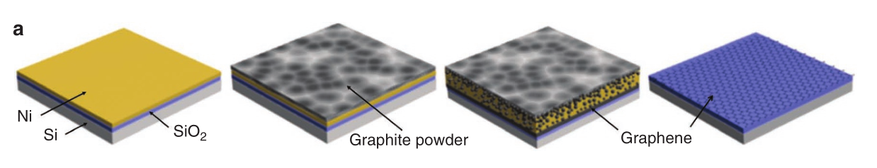
Diffusion Assisted Synthesis
Used three substrates: Thermally oxidized SiO₂, SiO₂ + PMMA, commercial glass.
e- beam evaporation used for Ni deposition
~25 deg C for PMMA/glass → 40-50 nm grain size
~400 deg C for SiO₂ → 1000C anneal → (111) structure ~5-20 um grainsize
PROCESS:
Ni deposition
Preparation of diffusion couple (graphite-Ni)
Anneal in Ar/Air
Clamped under <1MPa pressure
Moved to tube furnace with Ar
Thermocycled 25-260C

Slide 3
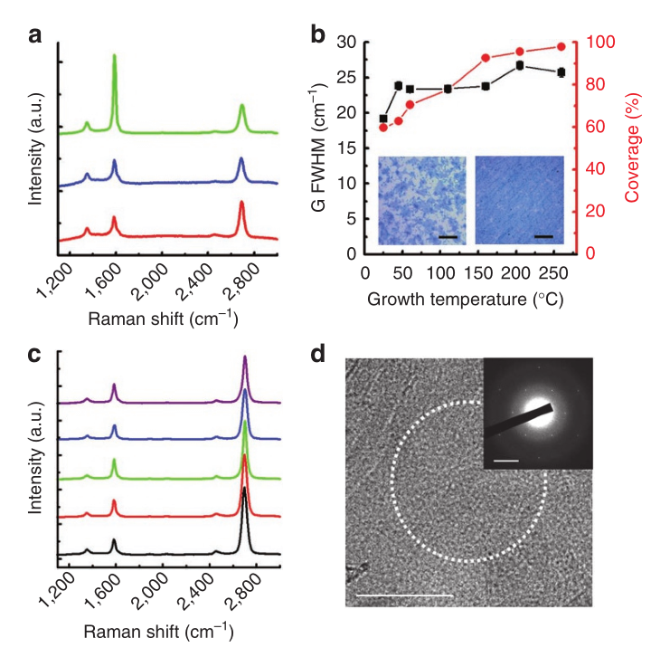
Results on Si-SiO₂
Mostly 1-2 monolayer (ML) graphene
Some multilayer regions
Uniformity over ~320um² regions
Multilayer favored at Ni grain boundaries (filling ridges?)
G-peak FWHM and %coverage increase with temperature
Good G/2D ratios possible at room temperature, but low coverage
Continuous layers only possible at T>160C
Ar, Air achieve similar results
b, c showing temperature dependence of graphene growth on SiO₂. a shows 1, 2, and 3 layer Raman spectra

Slide 4
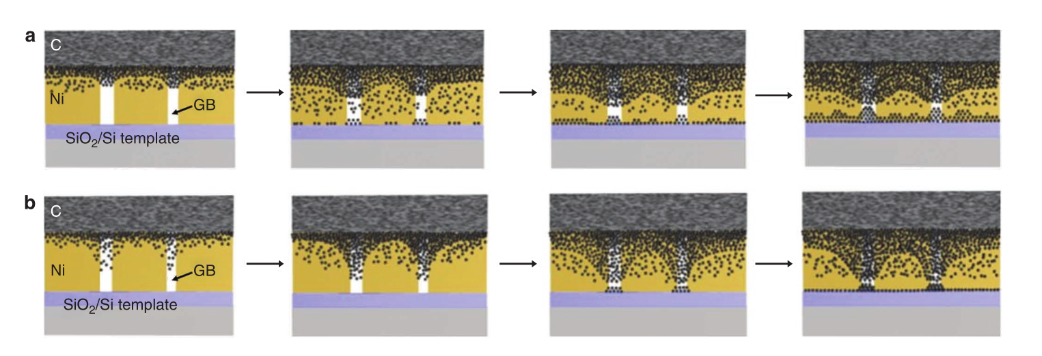
Growth Mechanism
Bulk diffusion at 460C-600C → homogeneous growth
GB diffusion at <260C → heterogeneous growth
Short growths (1-3 minutes) from 25-260C showed only graphene ridges → GB diffusion
Bulk diffusion (a) vs. grain boundary diffusion (b) of C on Ni substrate

Slide 5
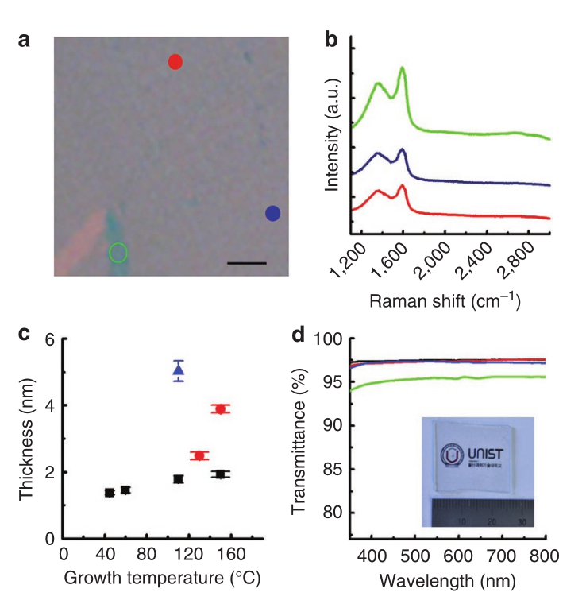
Synthesis on PMMA + glass
Low temperature to minimize degradation of substrate
Continuous growth, but ~nm grain sizes → large FWHM G peak
For glass, layers had 97.4% transmittance → consistent with ML graphene (2.3% white light absorption)
b) Raman spectra for graphene grown on PMMA substrate showing high defect density

Slide 6
Details on experimental parameters
1-2 cm² size substrates
100nm thickness Ni film using e- evaporator
400C substrate temperature for SiO₂ growth, room temperature for PMMA/glass
Deposited Ni grain size ~100nm before anneal on SiO₂, 40-50nm size on PMMA/glass
After 1000C anneal, grain size ~5-20 um + predominantly (111) orientation
H₂ environment yielded larger grain sizes than vacuum
Carbon source of graphite powder ~40um size mixed with ethanol to form paste
Applied to substrate then heated to dry
Clamped at <1MPa
Heated in quartz tube for 1-60min at 25-600C
Cleaned via sonication, Ni etched with FeCl₃

Slide 7
Questions + Conclusions
Room temperature growth possible through C diffusion mechanism using Ni film
Grain size of substrate dependent on annealing temperature
Graphene quality (ML region size) dependent on Ni grain size → GBs form multilayer graphene
Growth possible on various substrate materials
G-D dual peak characteristic of small graphene grain sizes
Can graphene grain structure be influenced after growth (e.g. annealing Ni)?
Advantages of showing growth is possible on glass/PMMA?

