Slide 1
Raman Spectroscopy of Graphene and related materials
Isaac Childres, Luis A. Jauregui, Wonjun Park,
Helin Cao, and Yong P. Chen
Notes compiled 4/16/20, Sean Lai

Slide 2
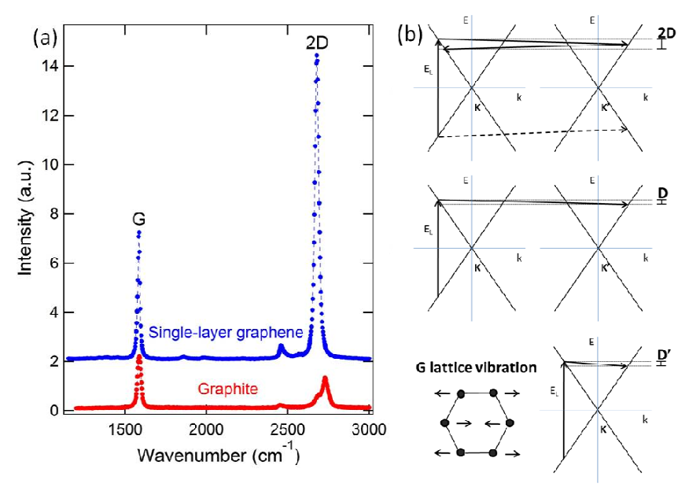
Graphene Raman Characteristics
Primary Peaks:
G peak: primary in-plane vibrational mode
2D peak: 2nd order overtone of different vibration D
2D peak splits with AB graphene stacking → larger FWHM 2D for multilayer graphene + blue shift
I_{2D}/I_{G} ratio used to derive number of graphene layers
(a) Raman spectra of graphene vs. graphite showing large 2D and G peaks. (b) scattering mechanisms for 2D, D, D’

Slide 3
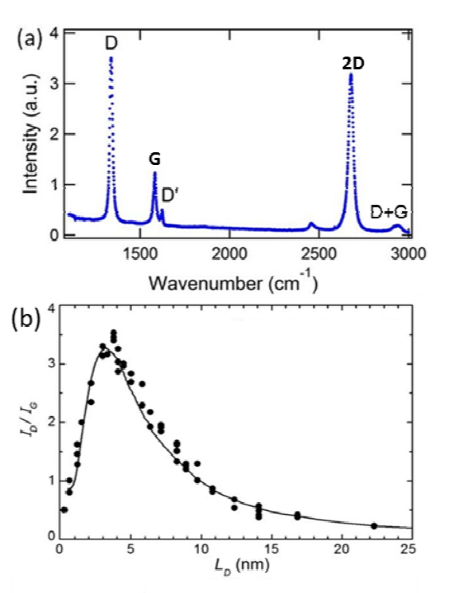
Dependence on defects
With increasing disorder, three new peaks: D, D’, and D+G
Low defect density → small D peak
Moderate defect density → large D peak
High defect density → attenuation of all peaks
Trend ~1/D² for low defects and ~D² for high defects
(a) Characteristic graphene peaks (b) D/G ratio dependence on defect density (L_{D} represents distance between defects)

Slide 4
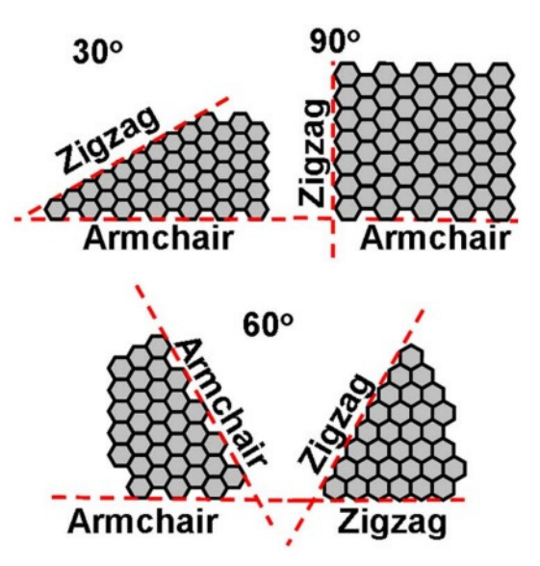
Graphene properties through Raman
Two edge types for hexagonal 2D structure: Zigzag and Armchair
Strong D peak when Raman laser is polarized parallel to armchair edge
G peak enhanced when polarized parallel to armchair and perpendicular to zigzag (90 deg corners)
Grain boundaries contribute to D peak → large D peak implies small grain sizes
Corner angle relationships of graphene edge types

Slide 5
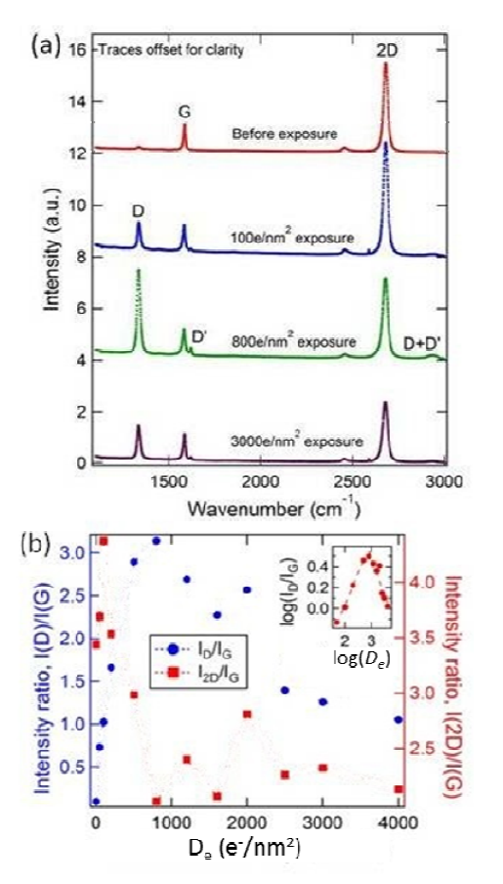
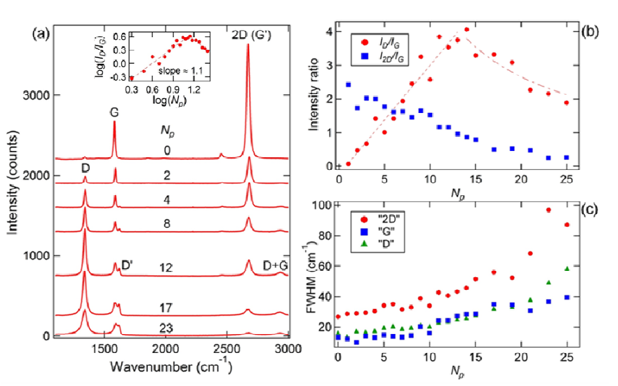
Crating defects for Raman analysis
Sample exposed to plasma pulses and SEM to produce defects
Raman spectra taken after each exposure
1. (a) showing evolution of spectra after plasma exposure
2. (a) shows evolution of Raman spectra with increased exposure (more defects)
Blue data in 2. (b) showing D/G ratio trend
2. (a) 2D peak disappears completely and G-D’ double peak grows with exposure
2. (a) Growth of D peak and widening of 2D peak with increasing defect density using SEM

Slide 6
Questions + Conclusions
Raman spectroscopy captures many graphene parameters
Grain boundaries, layer count, and defects all influence Raman spectra
Laser polarization influences peak characteristics at grain size resolutions
SEM + Plasma can be used to create defects for Raman analysis
Can Plasma from IPCVD cause graphene defects during growth?
How does Raman spectra respond to 3D graphene if used for semiconductor conformity?

