Slide 1
Optimization of CVD parameters for graphene synthesis through design of experiments
Remi Papon, Christel Pierlot, Subash Sharma, Sachin Maruti Shinde, Golap Kalita, and Masaki Tanemura
Notes compiled 4/24/20, Sean Lai

Slide 2
Motivations
CVD Process parameters require time consuming experiments + setups to optimize
Use of DOE can help identify contextual importance of experimental parameters
Without DOE 2^{P} experiments needed for P parameters
5 parameters for these experiments: Growth temperature, anneal time, Carbon source mass, Carbon source heating rate, distance from furnace
In this paper, experiments are reduced to two sets of 2³ experiments by holding certain parameters constant and comparing experimental sets (16 total experiments)

Slide 3
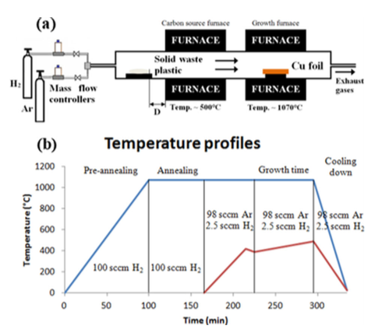
Parameter Details
Fixed one parameter at a time: Cu temperature or annealing time
Tested high/low (+, -) values for the other 4 parameters → 8 experiments per fixed parameter → 16 total experiments
Fixed anneal time at 30 minutes for first set
Fixed temperature at 1070C for second set
Schematic of experimental setup and example heating/cooling temperature profiles

Slide 4
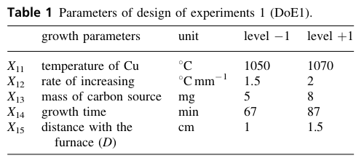
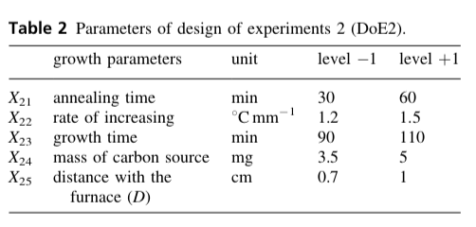
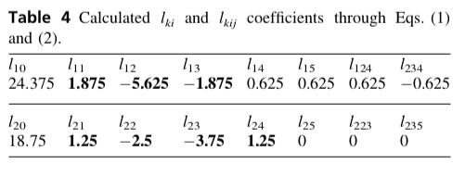
Results
Most relevant parameters in DOE matrices. + and – refer to higher or lower of two tested values:
DOE1 (fixed t = 30 minutes):
+ Temperature, 1070C
- increasing rate, 1.5C/min
- Mass of C, 5mg
DOE2 (fixed T = 1070C):
+ anneal time, 60 minutes
- increasing rate, 1.2C/min
- growth time, 90 min
+ mass of C, 5mg
Response to bending angles of graphene and ITO OPV cells

Slide 5
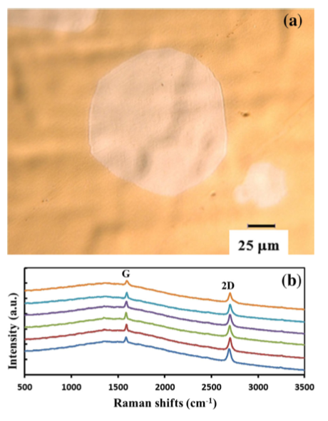
Optimization
Data used to create contour curves to inform further experiments
Optimized parameters by analysis of DOE experiments: 60 minute anneal time, 5mg C source, 1cm distance, 1.4C/min increasing rate, 72 min growth time
Results: 50-130um crystals, and 60mm domain(?)
A 60um single-layer graphene crystal grown using optimized parameters from DOE analysis and associated Raman scpectra

Slide 6
Questions + Conclusions
DOE can help optimize experimental parameters to good precision while reducing the required number of experiments
High anneal temperatures and long growths on Cu produce high quality + large single crystals
How does DOE address non-linear relationships between parameters and outcomes?
How do the number of required experiments scale if optimizing for two different output parameters?

