Slide 1
Overview of CVD Process
From a lecture series from a University of Texas on Micro and Nano chemical processes
Notes compiled 4/30/20, Sean Lai

Slide 2
Intro
Note: RPECVD not covered in these lectures, nor any reference to graphene or metallic deposition
2 types of CVD processes:
Gas-phase:
Reactions occur in gas phase, produce solids, land on substrate
Poor uniformity, particles formed. To be avoided.
Solid Surface Reaction:
Reaction occurs at surface where solid forms as a film.
This is the goal when performing CVD
Simplified mechanism steps:
Transport of reactants to surface (gaseous diffusion)
Adsorption at surface
Surface reaction
Desorption of by-products
Transport of by-products back to gas stream

Slide 3
Two reaction regimes (fluxes)
Diffusion:
J_{D} ~ h_{g}(C_{g}-C_{s})
J_{D} = Diffusion flux
h_{g} = mass transfer coefficient, proportional to diffusivity.
C_{g}, C_{s} concentration of bulk and surface gases.
Surface:
J_{s} = k_{s}C_{s}
J_{s} = flux of reactants as they react
k_{s} = reaction rate constant
At steady state:
J_{D} = J_{S}
Solving for C_{s} we get:
J_{SS} = k_{T}C_{g}
Where
k_{T} = k_{s}h_{g}/(k_{s} + h_{g})
Finally, deposition rate for N particles:
v = J_{SS}/N
Or
v = (k_{T}/N)(1/kT)P_{g}
Where k = Boltzman’s constant, P_{g} = partial pressure of reactants

Slide 4
Importance of reaction regimes
v = J_{SS}/N J_{SS} = k_{T}C_{g} k_{T} = k_{s}h_{g}/(k_{s} + h_{g})
For k_{s} >> h_{g}
k_{T} ~ h_{g}
→ Reaction limited/controlled by diffusion/mass transfer
For k_{s} << h_{g}
k_{T} ~ k_{s}
→ Reaction limited/controlled by reaction rate

Slide 5
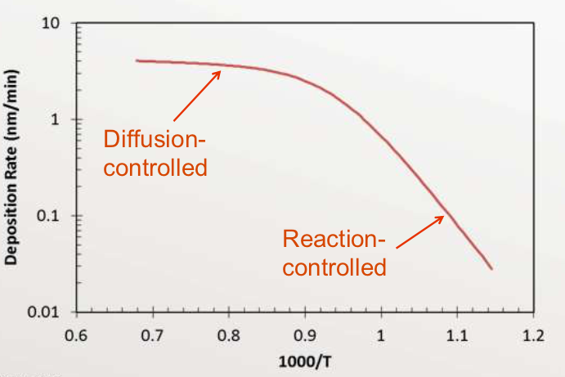
Temperature effects
Reaction dependent on activation energy E_{a}, of the two reaction steps, where:
E_{a(reaction)} >> E_{a(diffusion)}
Diffusion vs. reaction limited regimes are dependent on temperature:
h_{g} ~ T^{3/2}
k_{s} ~ e^{T}
So, at high T, k_{s} >> h_{g} → diffusion limited regime
And at low T, h_{g} >> k_{s} → reaction-rate limited regime

Slide 6
Chamber design based on regimes
In general, high deposition rate is desired (in industry) and precise control of reaction rate for uniformity in deposition.
For reaction-rate controlled regime, k_{T} ~ k_{s}, low T:
Reaction is controlled by temperature (easier)
Chamber needs precise temperature control → heated chamber and walls
Use a hot-wall chamber:
Limited to one material per furnace tube and needs frequent cleaning
For diffusion controlled regime, k_{T} ~ h_{g}, high T:
Reaction is controlled by mass flow rate (more difficult)
Precise MF control needed to adjust reaction
Use a cold-wall chamber:
Poor temperature control → precise MFC
No deposition on walls
Substrate is heated for high T reactions

Slide 7
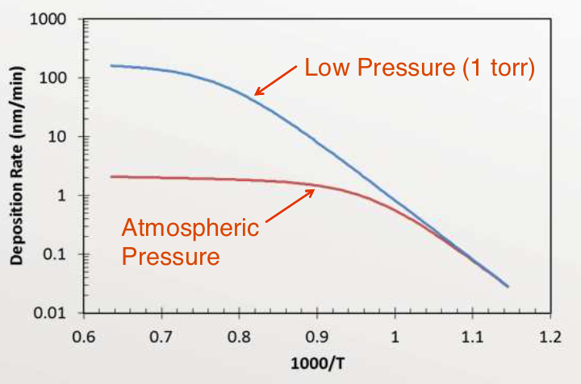
Pressure effects
P_{g}, partial pressure must be kept low to prevent gas-phase reactions
D_{g} ~ 1/P_{T}
Diffusion decreases with increasing total pressure due to more collisions between reactants and inert gases
→ Use low total pressure P_{T} to increase diffusivity while keeping P_{g} low.
Low pressure allows higher temperatures while staying in reaction-rate/temperature controlled regime and keeping high deposition rates.

Slide 8
Chamber types
Atmospheric CVD:
Cold-walled, diffusion controlled
Simple, good deposition rate
Difficult to control MFR → poor uniformity
LPCVD (low pressure):
Temperature easier to control than MFR so there is a preference for reaction-rate limited regime
Low pressure allows higher temperature, and so higher deposition rates
Hot-walled chamber allows precise temperature control
Long mean free path due to low pressure
Can lead to poor step coverage if feature size ~ mfp
Surface diffusion at higher T can improve coverage
PECVD (Plasma Enhanced):
Used for CVD processes that require low temperature
Ex: SiO₂ on Al requires <450C to prevent Si diffusion into Al
Low T → low deposition rates
Solution: Add energy to reactants using RF plasma
Ion bombardment also increases diffusion of adsorbed reactants
Still low deposition rates compared to LPCVD

Slide 9
Questions + Conclusions
2 primary reaction regimes: diffusion limited and reaction-rate limited
Diffusion controlled regime controlled by MFR, occurs at high T
Reaction limited regime controlled by temperature, occurs at low T
Low pressure allows higher temperature growth for reaction limited regime for enhanced deposition rates
Precise temperature control is easier to implement than precise MFR control
Plasma can be used to add energy to reactants without high temperature
Further reading/Questions:
Lectures mentioned some regimes are limited by rate of byproduct removal. Which systems are these? What are the advantages/disadvantages?
How does RPECVD compare to the chambers recorded here?
Do these general concepts hold true for most/all deposited materials? Do some materials behave very differently?
We use MFC extensively in our lab, is this due to needing low T reactions?

