Slide 1
Direct growth of doping density controlled hexagonal graphene on SiO2
Sean Lai, 5/21/20

Slide 2
Motivations for Experiment
CVD growth of graphene is effective at producing high quality layers, but transfer process is difficult for industry use
Direct growth had been previously reported, but with problems around yield, layer growth, large-scale growth, and tunable doping for electronics.
Researchers sought a direct growth method for high quality graphene without transfer process
Overview:
Use RH-PCVD (Rapid-heating plasma CVD) to grow graphene at Ni-SiO2 interface instead of at Ni surface.
Plasma allows T < 600C, where thermal CVD needs 900-1000C
NH3 gas concentration during growth process can be used to dope graphene and shift pos/neg gate bias for FET fabrication

Slide 3
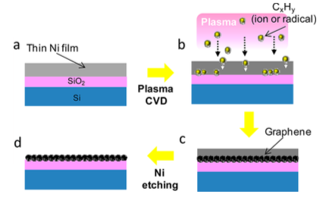
Procedure
Ni deposited by vacuum evaporation (55nm optimal)
Transfer to electric furnace center, where Tsubstrate heated to 950C over ~30s
13.56Mhz, 118W RF Plasma formed
Graphene grown using PE CVD with CH4:H2 ratio of 9:1
Sample cooled
Ni etched with FeCl3

Slide 4
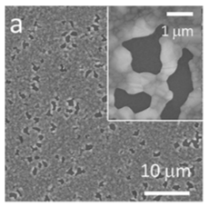
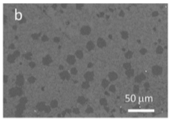
Morphology
Hole-like structures formed during growth process:
Raman analysis showed single-layer graphene in hole areas (a, right)
Postulated that hole growth (due to Ni evaporation) coincident with graphene growth
Researchers note that further study is required for full understanding of these structures
Hexagonal domain formation (b, right):
Size of 10-20um form initially after CVD process
Larger continuous cm scale domains were produced experimentally with unspecified different growth parameters

Slide 5
Temperature and Ni layer thickness dependence
Temperature:
D peak increase at lower temperature indicating an increase in defects
Still a prominent 2D peak at 600C, but shorter and wider than at higher temperature
Ni layer thickness:
For thin Ni, ~25nm, Ni evaporated and formed islands, limited graphene growth via diffusion
For thick Ni, ~85nm, growth initiated after 20 min and occurred on top layer in addition to interface
At moderate Ni thickness, ~55nm, showed preference for interface growth

Slide 6
3 important conditions
For selective growth of graphene at Ni-SiO2 interface:
Film structure must be maintained:
TNi >> ENi * t, TNi = Ni thickness, ENi = Ni evap. rate, t = time
Satisfied by adjusting film thickness, growth time
Carbon density at interface after growth must be higher than threshold density for graphene formation
Carbon density at Ni surface must be lower than threshold density for graphene formation
To satisfy all 3 conditions simultaneously requires ion penetration into Ni layer via plasma
For Ic >> TNi/2, Ic penetration depth of carbon into film, preferential formation of graphene growth at interface observed
Plasma also important to keep ENi low
note: $E_{Ni}∝\frac{1}{hydrocarbonflux}$

Slide 7
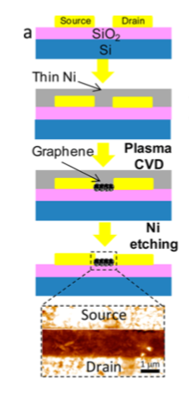
FET Fabrication
Graphene growth in 15 x 50 um channel using RH-PCVD
High gate bias voltage of 60V required due to p-doping of underlying SiO2.
Fix:
Add Nitrogen source to growth process. Researchers used NH3
N in growth allow tuning of carrier doping and shifting of gate bias voltage.

Slide 8
Conclusions & Questions
Direct growth allows graphene growth without transfer process which is not feasible for semiconductor fabrication
Graphene formation in Ni through diffusion and precipitation rather than surface growth like in Cu
Graphene must be energetically diffused using plasma into sufficiently thin Ni layer to preferentially grow at Ni-SiO2 interface
Large domain SLG possible with this method
Nitrogen source can be used to affect the electric properties of graphene for use in creating FET or other electronic devices
Experiment showed that FeCl3 would not etch Ni with a graphene layer on surface. I know Dibyesh had issues etching NiO2 when he used a pressure direct growth method in the furnace. Is it possible he did not sufficiently burn off the carbon layer on top of the Ni to allow etching?
How well would this method work for step coverage which would be essential for Dibyesh’s research into diffusion barriers?
What were the growth parameter differences that produced large domains versus small hexagons for this group?

