Slide 1
CVD and dielectric films lecture review
Notes compiled 4/9/20, Sean Lai

Slide 2
Thin film + Deposition characteristics
THIN FILMS:
Not fully dense, defects different from bulk
Under stress → deformation due to CTE difference between film and SiO₂
Quasi-2D
Characterized by surface + interface effects
DEPOSTION:
Emmision → transport → condensation
Types: CVD, PVD, others (e.g. spin coating)
Characteristics:
Deposition rate
Uniformity
Material types
Quality
Directionality
Cost

Slide 3
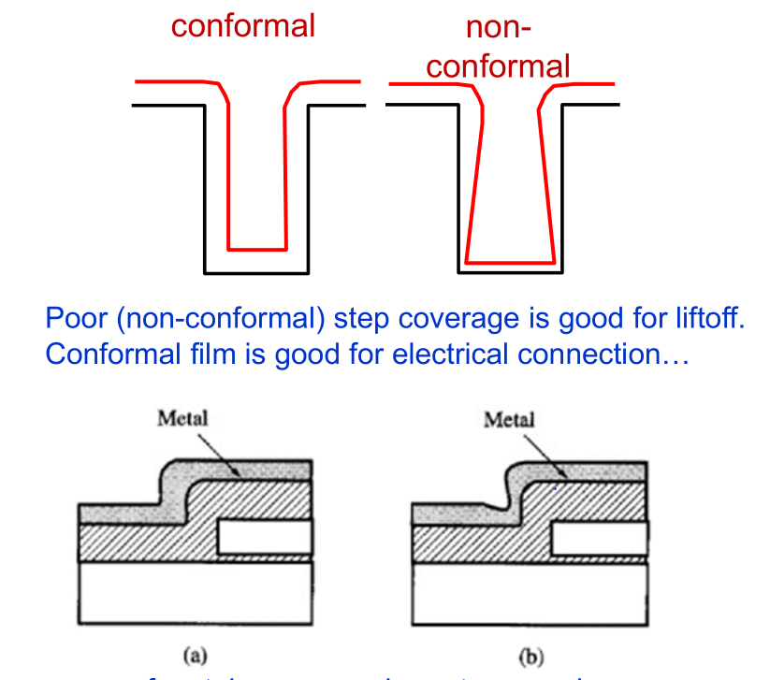
Growth Characteristics
Conformal vs. Nonconformal (step coverage)
Non conformal → difficulty with trences and void creation
Equilibrium Growth:
2D (van der Merwe): epitaxial, high temp, slow
3D (Volmer-Weber): Islands
2D → 3D (Stranski-Krastanov): layers then islands
Latter two are polycrystalline or amorphous
Mode Parameters:
Lattice mismatch
Supersaturation
Gibbs FE → Wetting

Slide 4
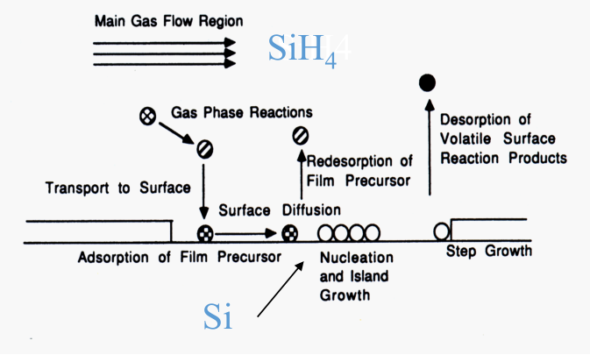
CVD Process
STEPS:
Reactants → Surface
Migration on Surface
Reaction at Surface
Nucleation → Islands → Uniform film
REACTION PROCESS:
Bulk transport
Gas-phase reactions
Transport to surface
Adsorption at surface
Surface reactions → Nucleation
Desorption of byproducts
Transport of byproducts from surface

Slide 5
Reactor Types
APCVD:
760 torr
Ni buffer zones
Controlled by temperature, flowrate, belt speed(~time)
LPCVD:
0.1-1 torr
High temp → > 650°C
Controlled by wafer temperature
PECVD:
1-10 torr
Increased reaction rate due to ionization
High deposition rate at low temperature
HDPCVD:
Low temperature (150°C)
Low pressure (1-10 mTorr)
400°C by bombardment
Simultaneous deposition/sputtering

Slide 6
Dielectric CVD Parameters
CONFORMITY/STEP COVERAGE:
Better at low pressure or high mobility
CHEMISORPTION VS. PHYSISORPTION:
Chem: high bond energy, low mobility
Used for SiH₄, silicon source
Phys: low bond energy, high mobility
TEOS, oxide source
REACTION PARAMETERS:
Surface-reaction limited → slow rate, temperature sensitive
Mass-transport limited → high rate, mass flow controlled
APPLICATIONS:
STI (shallow trench isolation): isolation between transistors
ILD (inter dielectric layer): insulation between interconnects
Passivation: IC protection from moisture or mechanical damage

Slide 7
Questions + Conclusions
CVD integral to semiconductor manufacture
Balance of input parameters to achieve different outcomes
Geometry of etching important to film characteristics
Some parallels with graphene: e.g. lattice matching, gibbs FE.
Low temperatures (<400°C ?) needed to prevent damage to FETs
Is annealing effective for non-metallic thin films?
How does CTE effect graphene growth → wrinkles?

