Slide 1
C‐Plane Sapphire and Catalyst Confinement Enable Wafer-Scale High-Quality Graphene Growth
Lester F. Lampert, Roman Caudillo, Thomas Lindner, and Jun Jiao

Slide 2
Research Motivations
Graphene has desirable qualities to the semiconductor industry
Copper (Cu) thin films are widely used to grow graphene on Si substrates
Important parameters
Cu has poor adhesion with SiO₂
Cu (111) orientation is shown to have best growth characteristics → C-plane sapphire
Catalyst confinement shown to help control Cu surface characteristics

Slide 3
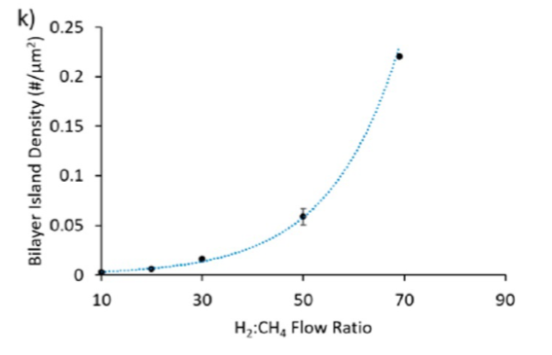
Experimental Results: H₂ effects
H₂:CH₄ ratios used: 10:1, 20:1, 30:1, 50:1 69:1
Higher H₂ resulted in rougher Cu surface, higher bilayer density
Lower H₂ had reduced single-crystal growth and amorphous domains
Bilayer density increased exponentially with H₂ levels.

Slide 4
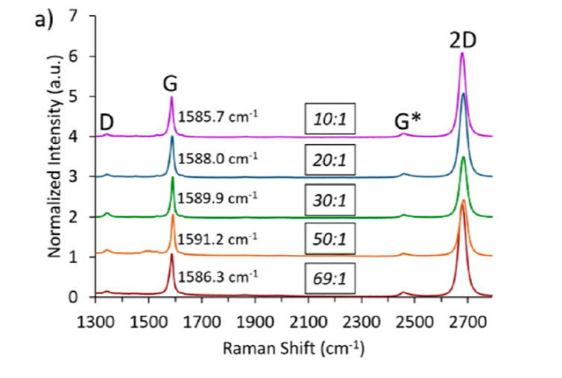
Experimental Results: Raman analysis
10:1 and 69:1 ratios had best graphene quality -> majority monolayer
high 2D/G peak ratios
2D peak shape (low full-width at half maximum)
69:1 showed high bilayer density

Slide 5
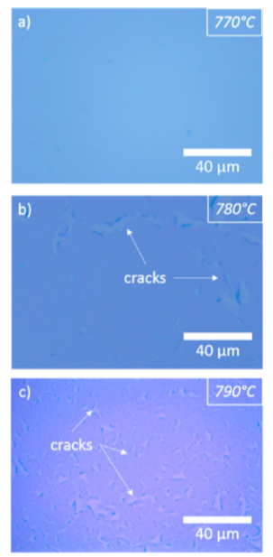
Experimental Results: Using CC for SiO₂ Wafer
Without CC the Cu film is unstable -> voids, delamination
3mm catalyst offset used for experiments
Temperatures used: 770, 780, 790°C
790°C found the have largest Cu grains
Higher temps yielded better quality, but more cracks

Slide 6
Conclusions/Questions
Tradeoff between high-quality graphene and high bilayer density at high H_{2:}:CH₄ ratios could warrant further research/optimization
What scales of single crystal monolayer graphene are needed for viability in semiconductor applications?
We use acetylene often in the lab. What are the differences in graphene seeding between CH₄ and C₂H₂?
Possible label mix up on figure 5 of the paper
What is happening to Cu at temperatures > 790°C?
Why do BEOL applications require low temperatures and what range is considered low?
How does H₂ increase Cu mobility -> large domains of single crystal C(111), shown in figure 3?
Are there other methods to produce highly uniform Cu(111) films?

