Slide 1
Review of CVD of Graphene and related applications
YI ZHANG, LUYAO ZHANG, AND CHONGWU ZHOU
Notes compiled 4/7/20, Sean Lai

Slide 2
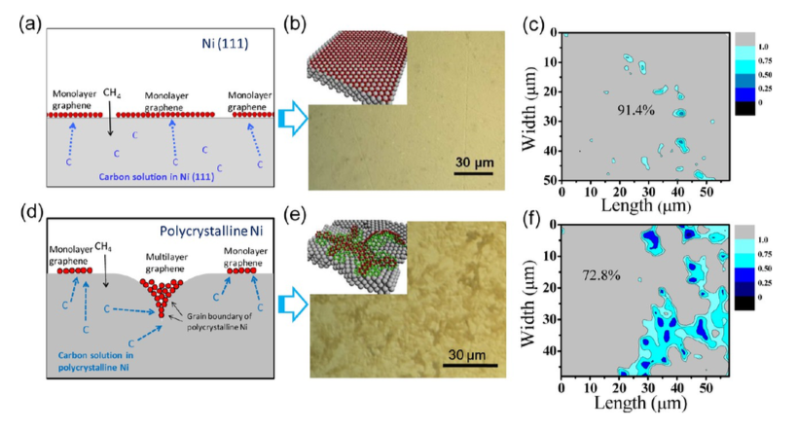
Synthesis on Ni
Ni annealed at 900-1000°C → C₂H₄ gas added
C dissolves into Ni at high temperatures
C diffuses out of Ni-C solution during cooling under Ar
Graphene + Ni(111) have similar lattice constants
Growth dependent on cooling rate, C_{x}H_{x} concentration, catalyst geometry
Ni(111) produced higher % monolayer graphene compared to polycrystalline Ni
a,b,c show Ni(111) vs d,e,f polycrystalline Ni substrate for graphene growth.

Slide 3
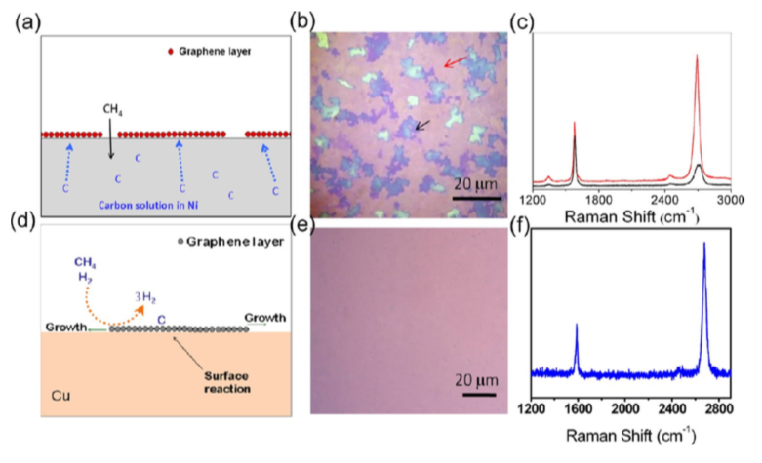
Synthesis on Cu
Ruoff et al. used 25μm Cu film, hot wall, 1000°C anneal
Wrinkles form from different coefficients of thermal expansion
Film thickness + growth rate have little effect on graphene growth → contrast to Ni
Low carbon solubility → self-limiting surface reaction
Ni vs. Cu growth mechanisms and results

Slide 4
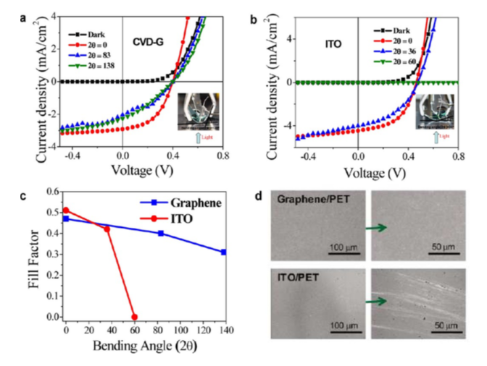
OPV cells using graphene
Graphene less scarce than indium tin oxide (ITO) for use in OPV cells
Graphene is flexible compared to ITO
Compromise between resistance and transmittance with multiple graphene layers
Graphene had 93% power density of ITO in experiments
Graphene performance similar at bend angles of 138°, ITO failed at 60°
Response to bending angles of graphene and ITO OPV cells

Slide 5
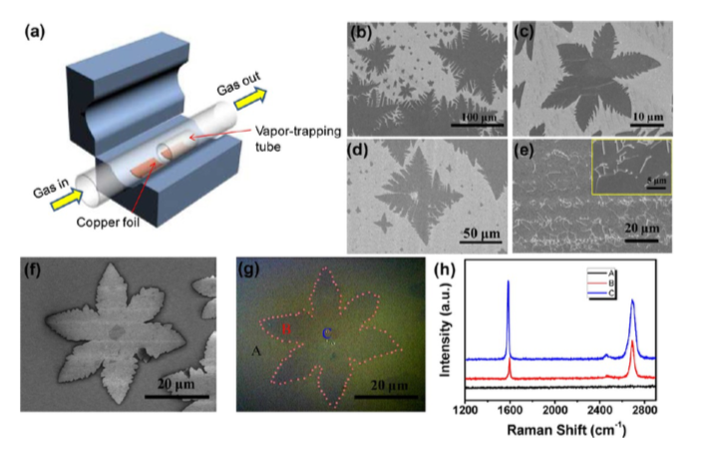
Large grain growth + Transistors
Large grains important for electrical and mechanical properties → charge mobility and strength
Vapor trapping limited gas flow → monolayer flower growth versus continuous etched film
Flowers had bilayer center and monolayer petals by Raman analysis
SiO₂ versus h-BN substrate in FET:
e⁻ mobility of SiO₂ 25%-50% of h-BN
Schematic of growth of monolayer graphene flowers on Cu using vapor trapping

Slide 6
Questions + Conclusions
Cu and Ni are primary catalysts used for CVD growth
Applications exist outside microprocessor fabrication
Cu produces quality graphene due to self limiting reaction
Ni(111) lattice match also produces good quality graphene
Many factors determine growth characteristics
What is the mechanism for flower growth versus hexagonal or amorphous?
Is it possible to “seed” growth from existing graphene, but limit new seeds on catalyst to create more uniform layers?

