Slide 1


How I learned to quit worrying
And love multiple coordinate systems
Deanna M. Church
Senior Director of Genomics and Content
Personalis, Inc
@deannachurch
Short Course in Medical Genetics 2013

Slide 2

Alternate loci/Patch
Transcripts (NM_XXXXXX.X)
Proteins (NP_XXXXXX.X)
RefSeqGene/LRG
* Not drawn to scale

Slide 3
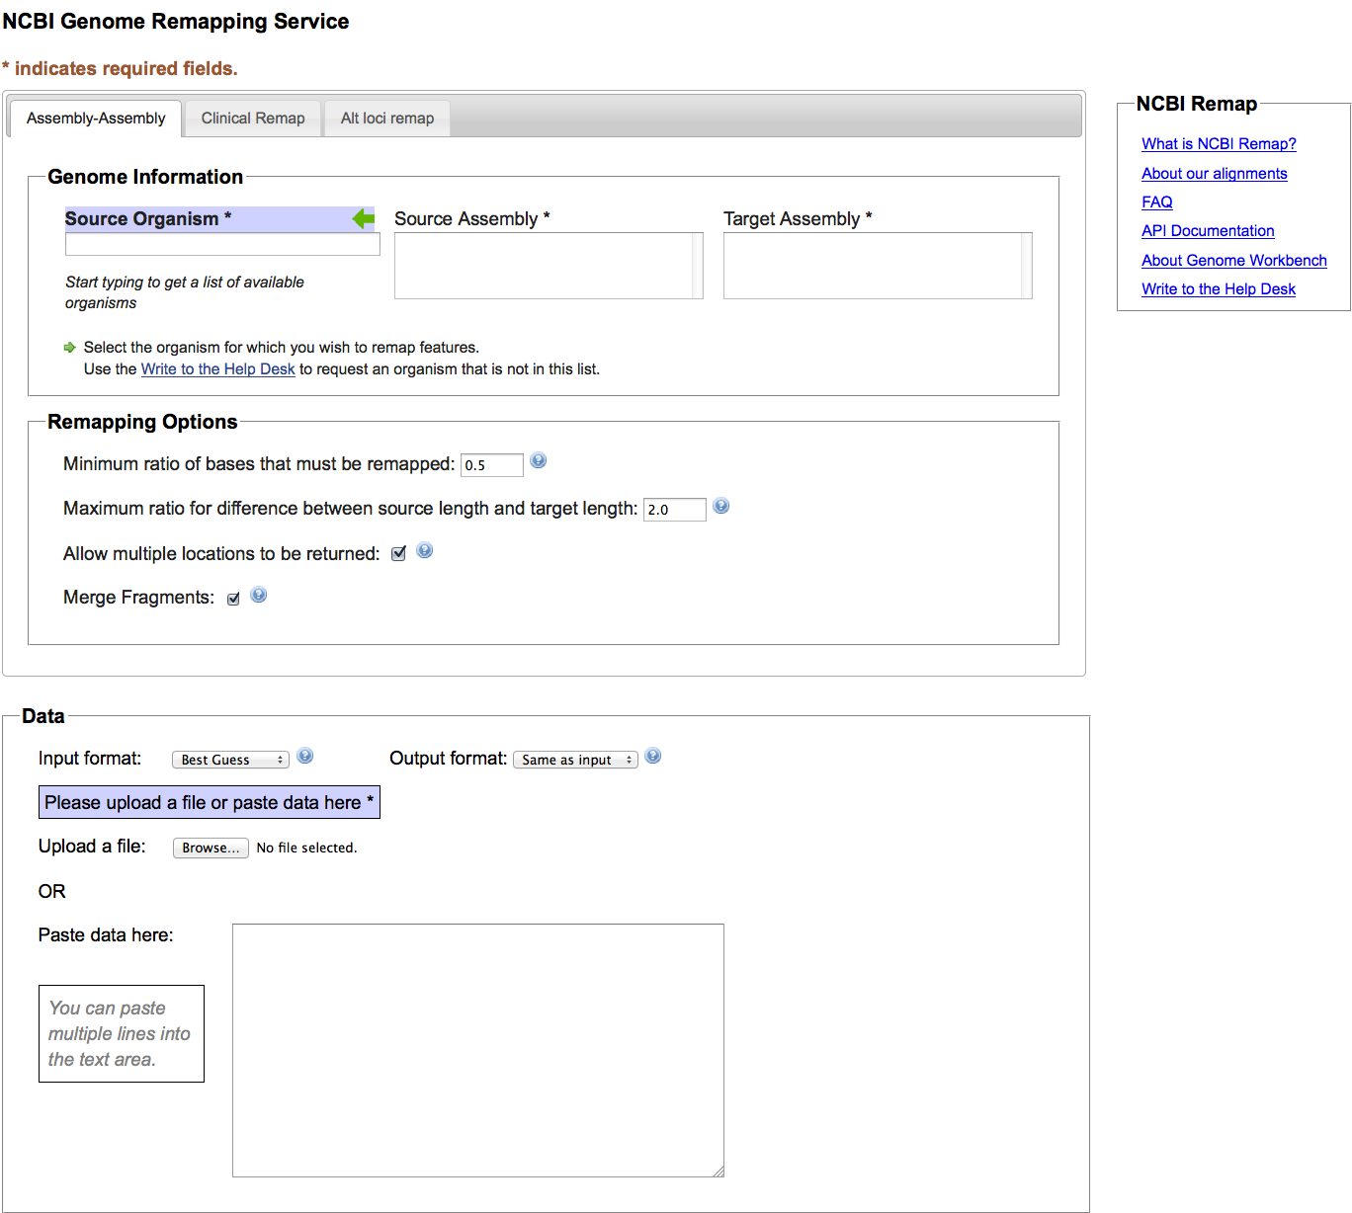

http://www.ncbi.nlm.nih.gov/genome/tools/remap

Slide 4

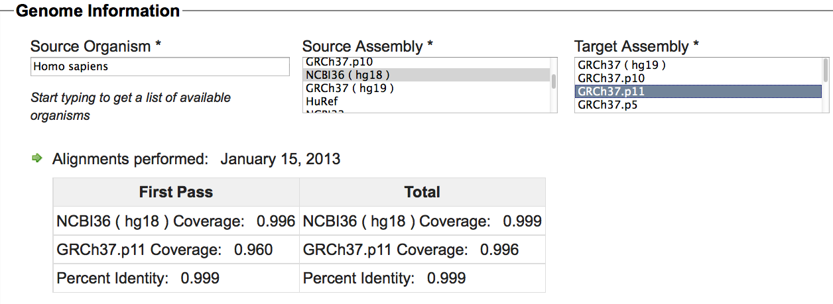
Software v1.4
Different versions of same assembly to each other (e.g. NCBI36<->GRCh37)
Different assemblies from same organism to each other (HuRef<->GRCh37)

Slide 5
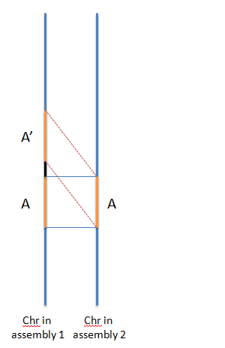
Producing Assembly-Assembly Alignments
B
B
First Pass Alignments
Second Pass
Alignments
First Pass Alignments
First Pass + Second Pass = Collapse
Second Pass Only = Expansion
http://www.ncbi.nlm.nih.gov/genome/tools/remap

Slide 6
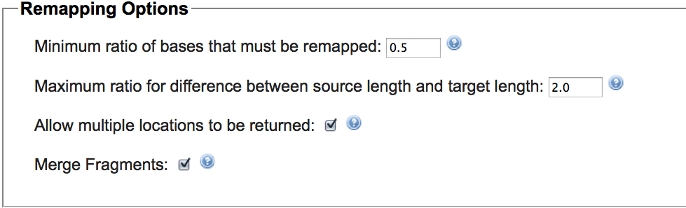
NCBI36
Remap failure: low coverage (<50%)
GRCh37
NCBI36
100 bp
Remap failure: expansion (target length/source length >2)
400 bp
GRCh37

Slide 7

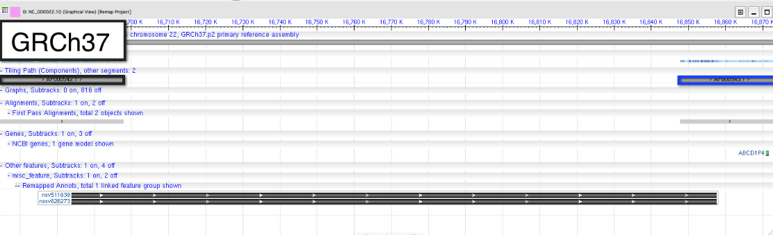
Helps rescue features that cross a gap (common for CNVs/Structural Variants)

Slide 8
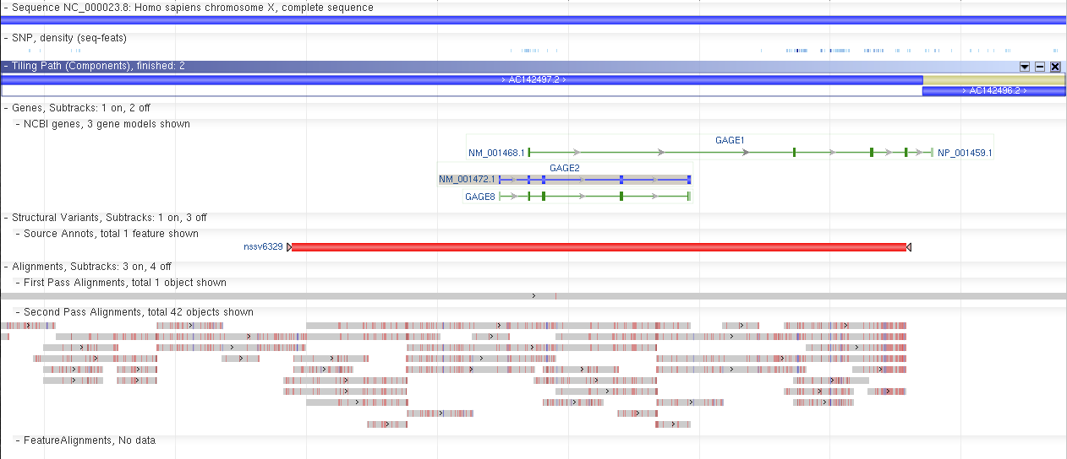
Beware: Second Pass alignments and Merge

Slide 9
Remap Output
Summary data: Quick overview of how well your features mapped
Mapping report: Detailed report containing all of your input features and their source location, target location (or reason for failure) and coverage score.
Annotation File: An annotation file of only the features that successfully remapped. Suitable for loading to most browsers.
Genome Workbench file: A file formatted for loading to Genome Workbench (a client side browser). Includes assembly-assembly alignments for review.
Genome Workbench videos

Slide 10

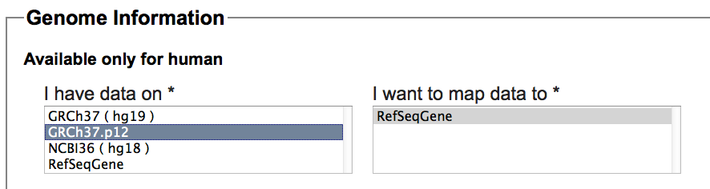
* LRG soon
When mapping to RefSeqGene
Genomic location (NG_XXXXXX.X)
Transcript location(s) (NM_XXXXXX.X)
Protein location(s) (NP_XXXXXX.X)
Optional, but checked by default
No second pass alignments, only one ‘best’ alignment

Slide 11

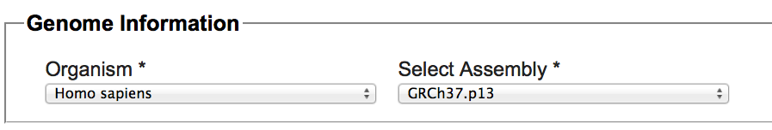
Maps features:
From Primary Assembly -> Alternate Loci/Patches (common)
From Alternate Loci/Patches->Primary Assembly
No second pass alignments, only one ‘best’ alignment

Slide 12

Take home messages
Tools are available for mapping features from one coordinate system to another.
Assembly <-> Assembly
Assembly <-> RefSeqGene
Primary Assembly <-> Alternate Loci/Patches
Feature remapping is NOT a substitute for de novo annotation.

