Slide 1
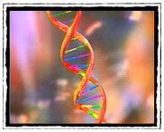

Introduction to Bioinformatics
55th Annual Short Course on Medical & Experimental
Mammalian Genetics
Jackson Laboratory, Bar Harbor, Maine
July 21, 2014
Aravinda Chakravarti, PhD
Johns Hopkins University School of Medicine
aravinda@jhmi.edu

Slide 2
Bioinformatics Sessions in the Short Course
Monday 7/21: Introduction
Wednesday 7/23: Handling Data - Deanna Church & Carol Bult
Thursday 7/24: Secrets of the Human Genome - Deanna Church & Carol Bult
Friday 7/25: Tools for analyzing your data - Deanna Church & Carol Bult
Tuesday 7/29: Statistical methods for complex disease genetics – Aravinda Chakravarti

Slide 3
Today’s agenda
Introduction: Aravinda Chakravarti
Introduction to Bioinformatics Sessions: Carol Bult
Introduction to MGI: Joanne Berghout
Introduction to OMIM: Ada Hamosh

Slide 4

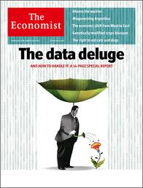

Drinking from a fire hydrant

Slide 5
Diverse computational needs
The entire landscape of the data generated by our experiments has changed from defined focused tests of hypotheses to broad screens emanating from technologies that can produce massive amounts of data.
Bioinformatics: the science of organization, storage, retrieval, and manipulation of biological data to reveal patterns;
Computational Biology: model-based inference of function from structure (mutation detection from sequence, networks from expression, interactions from 3D structure, etc.)
Statistics: The analysis of data to distinguish signal from noise and to design experiments.

