Slide 1


File formats
Wrapping your data in the right package
Deanna M. Church
Senior Director of Genomics and Content
Personalis, Inc
@deannachurch
Short Course in Medical Genetics 2013

Slide 2

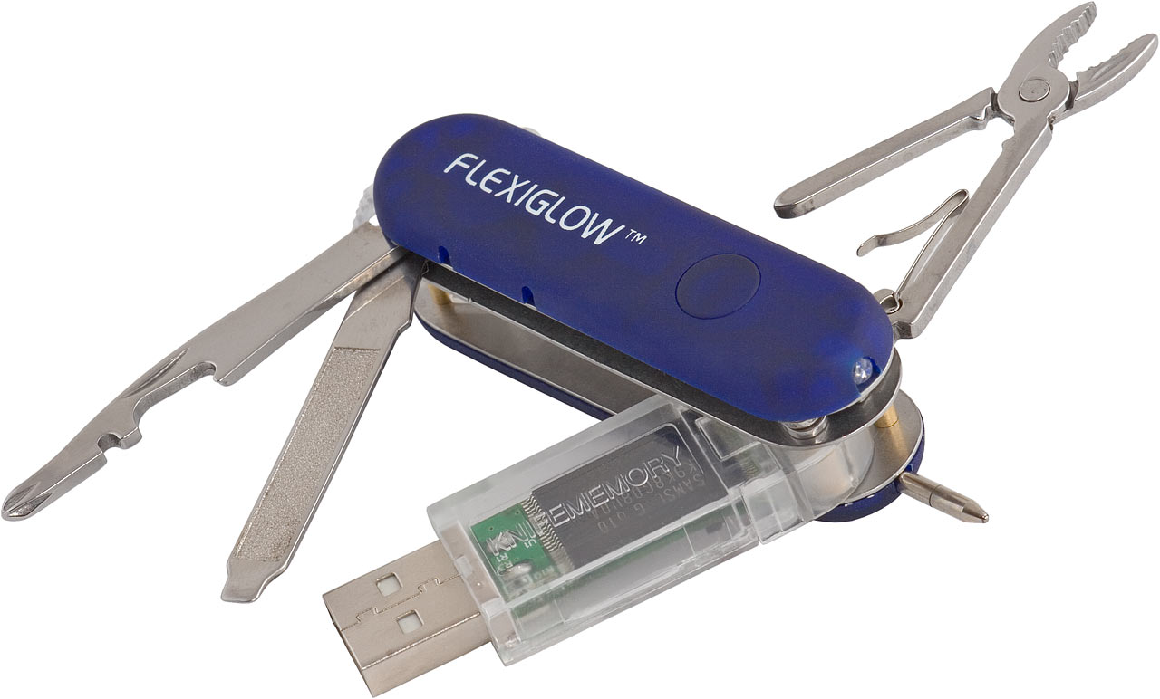

http://www.dansdata.com
http://www.nature.com/encode

Slide 3


Slide 4
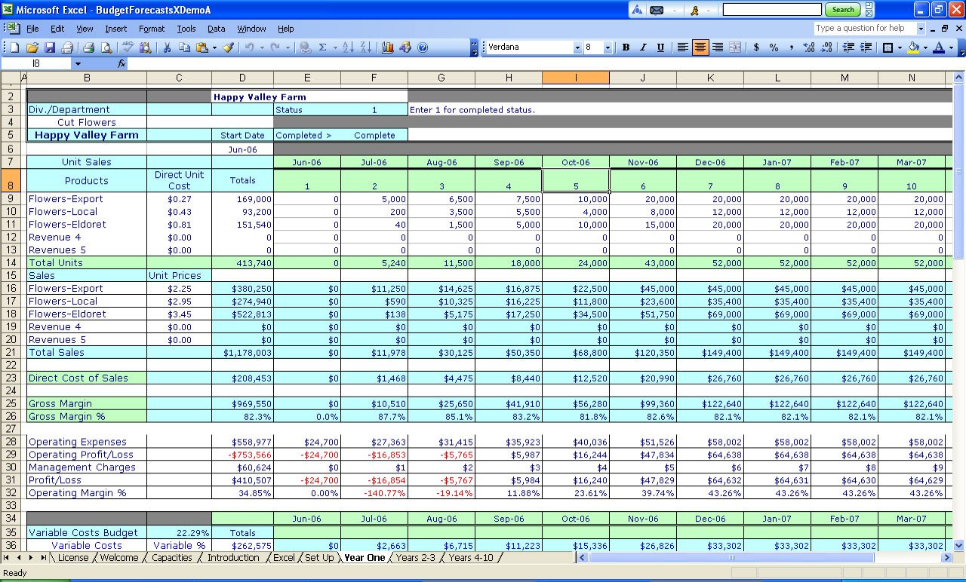
http://www.downloadsoftfree.com/windows/Business/Business-Finance/Budgeting-Spreadsheets-for-Excel-1-2-13-4345-1-0-0.html

Slide 5
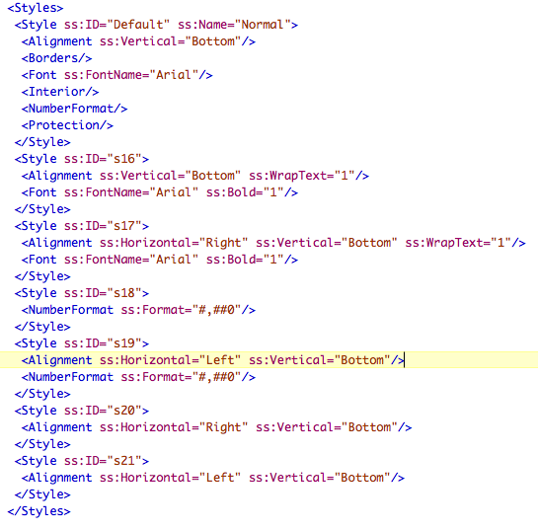

Slide 6
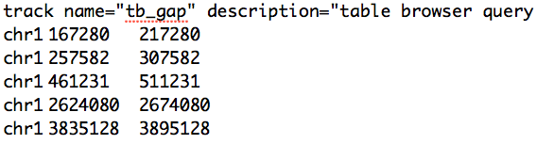

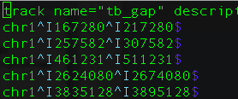
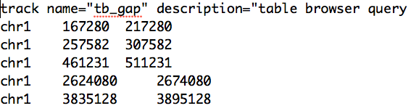

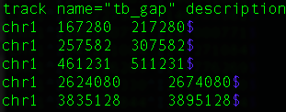

Slide 7
Control Characters: invisible to you but not to software
Carriage return (CR):
\r or ⌃M
Line feed (LF):
\n or ⌃J
Unix/Linux: uses LF character
Macs: uses CR character
Windows: uses CR followed by LF
http://danielmiessler.com/study/crlf/

Slide 8

Most bioinformatics packages expect:
A plain text file
Not a word or excel document
A particular field delimiter
often tab or comma, sometimes pipe
Unix style line terminators
Read file specifications!*
* Even though they may not be complete

Slide 9
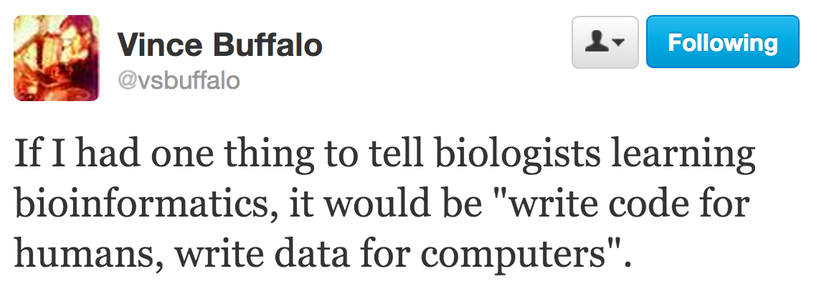

Slide 10
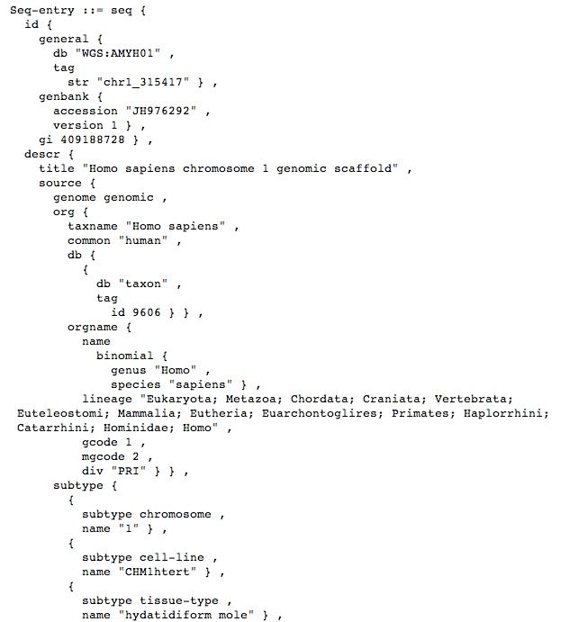
NCBI data representation:
Uses ASN.1
Not easily human readable
Limited flexibility
Robust validation tools
Not easily parsed by Perl/Python

Slide 11
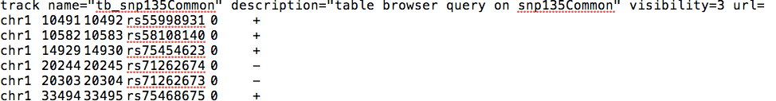
Typical bioinformatics data representation:
Tab delimited file
Flexible
Good: with rapidly changing data/tech (but don’t change/add columns!)
Poor: validation
Human Readable
Convenient for de-bugging
Computer doesn’t care!

Slide 12
Putting the data in the right package
Sequences
FASTA
FASTQ
SAM/BAM
Annotations
Genes
GFF3
GTF
Variation
VCF
GVF
HGVS
General
GFF3
BED
Alignments
SAM/BAM
MAF
http://www.ncbi.nlm.nih.gov/staff/church/GenomeAnalysis/index.shtml#FILES

Slide 13
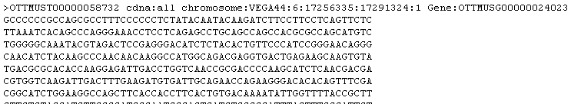

FASTA
FASTQ

Slide 14
FASTQ Details
Sequence data format
Text based
Encodes sequence calls and quality scores with ASCII characters
Stores minimal information about the sequence read
4 lines per sequence
Line 1: begins with @; followed by sequence identifier and optional description
Line 2: the sequence
Line 3: begins with the “+” and is followed by sequence identifiers and description (both are optional)
Line 4: encoding of quality scores for the sequence in line 2
References
http://maq.sourceforge.net/fastq.shtml
Cock et al. (2009) Nuc Acids Res 38: 1767-1771

Slide 15
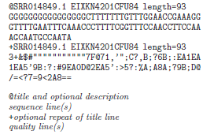
FASTQ Example
For analysis, it may be necessary to convert to the Sanger form of FASTQ.
FASTQ example from Cock et al., 2009

Slide 16
Quality Scores
Phred Quality Score | Probability of incorrect base call | Base call accuracy
10 | 1 in 10 | 90 %
20 | 1 in 100 | 99 %
30 | 1 in 1000 | 99.9 %
40 | 1 in 10000 | 99.99 %
50 | 1 in 100000 | 99.999 %
Q = Phred Quality Scores
P = Base-calling error probabilities

Slide 17
Quality Scores
Not always directly comparable between to programs/pipelines
!"#$%&'()*+,-./0123456789:;<=>?@ABCDEFGHIJKLMNOPQRSTUVWXYZ[\]^_`abcdefghijklmnopqrstuvwxyz{|}~
| | | | | |
33 59 64 73 104 126
S - Sanger Phred+33, raw reads typically (0, 40)
X - Solexa Solexa+64, raw reads typically (-5, 40)
I - Illumina 1.3+ Phred+64, raw reads typically (0, 40)
J - Illumina 1.5+ Phred+64, raw reads typically (3, 40)
with 0=unused, 1=unused, 2=Read Segment Quality Control Indicator
L - Illumina 1.8+ Phred+33, raw reads typically (0, 41)
Format/Platform QualityScoreType ASCII encoding
Sanger Phred: 0-93 33-126
Solexa Solexa:-5-62 64-126
Illumina 1.3 Phred: 0-62 64-126
Illumina 1.5 Phred: 0-62 64-126
Illumina 1.8 Phred: 0-62 33-126 *** Sanger format!
Need to know what your program is expecting
Likely to change again (to improve compressing data)

Slide 18
SAM (Sequence Alignment/Map)
Alignment data format
Standard output of aligners that map reads to a reference genome
Tab delimited w/ header section and alignment section
Header sections begin with @ (are optional)
Alignment section has 11 mandatory fields
BAM is the binary format of SAM
http://samtools.sourceforge.net/

Slide 19
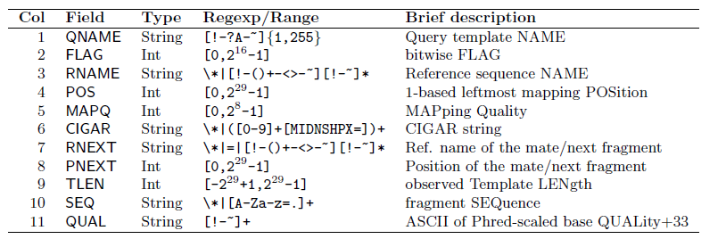
Mandatory Alignment Fields
http://samtools.sourceforge.net/SAM1.pdf

Slide 20
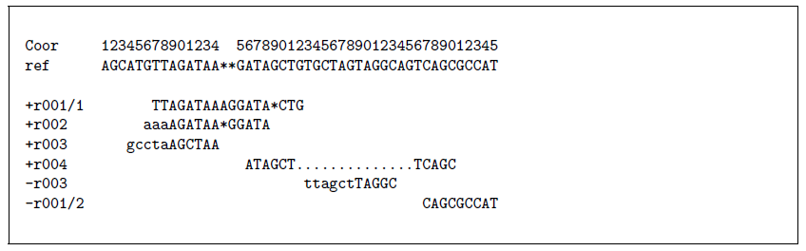
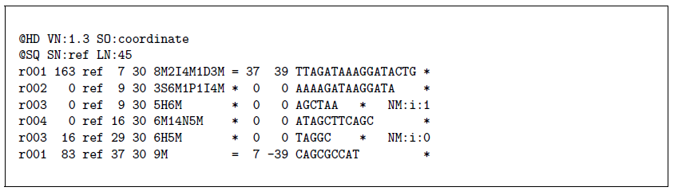
Alignments example
CIGAR string -> 8M2I4M1D3M
Alignments in SAM format
http://samtools.sourceforge.net/SAM1.pdf

Slide 21
Annotation Formats
Mostly tab delimited files that describe the location of genome features (i.e., genes, etc.)
Also used for displaying annotations on standard genome browsers
Important for associating alignments with specific genome features
Descriptions
Knowing format details can be important to translating results!
BED is zero based/exclusive
GTF/GFF are one based/inclusive

Slide 22

BED: zero based, start inclusive, stop exclusive
chr1 10491 10492 rs55998931 0 +
chr1 10582 10583 rs58108140 0 +
First base on the chromosome is 0
Length = stop - start
GTF/GFF: one based, inclusive
chr1 snp135Com exon 10492 10492 0.000
chr1 snp135Com exon 10583 10583 0.000
First base on the chromosome is 1
Length = stop – start+1

Slide 23
BED format
Annotation data format
Required (1-3)
Optional (4-12)
chr1 86114265 86116346 nsv433165
chr2 1841774 1846089 nsv433166
chr16 2950446 2955264 nsv433167
chr17 14350387 14351933 nsv433168
chr17 32831694 32832761 nsv433169
chr17 32831694 32832761 nsv433170
chr18 61880550 61881930 nsv433171
chr1 16759829 16778548 chr1:21667704 270866 -
chr1 16763194 16784844 chr1:146691804 407277 +
chr1 16763194 16784844 chr1:144004664 408925 -
chr1 16763194 16779513 chr1:142857141 291416 -
chr1 16763194 16779513 chr1:143522082 293473 -
chr1 16763194 16778548 chr1:146844175 284555 -
chr1 16763194 16778548 chr1:147006260 284948 -
chr1 16763411 16784844 chr1:144747517 405362 +

Slide 24
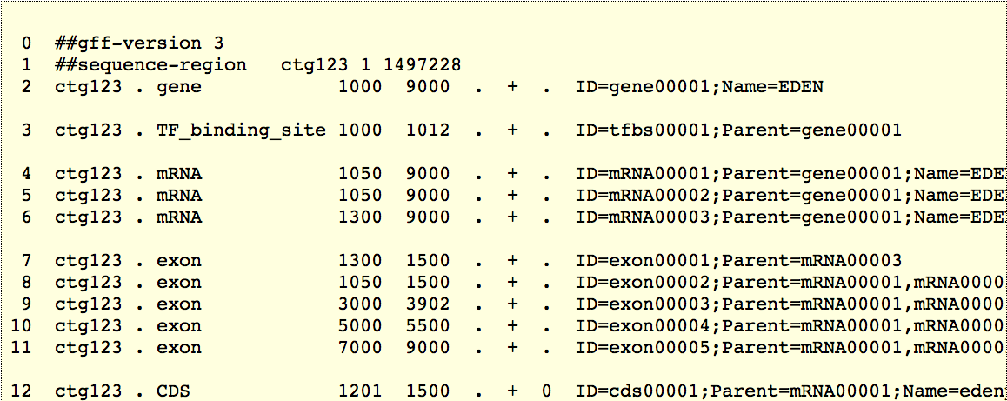
GFF3
Annotation data format
Fixed columns:
Column 1: Sequence Id
Column 2: Source
Column 3: Feature type
Column 4: Start (1-based)
Column 5: End
Column 6: Score
Column 7: Strand
Column 8: Phase (0,1,2)
Flexible column:
Column 9: attributes
Semi-colon delimited tag=value pairs. Some tags are reserved (ID, Name, etc).
http://www.sequenceontology.org/resources/gff3.html

Slide 25
Take home messages
Understand how your tools work
What is the tool expecting?
What type of data am I representing?
What type of data will it produce
Output of programs/pipelines are not always comparable
Score values
Know how to count (starting at 0 or 1)
Just because 2 files are of the same type (BED, GFF3) it does not mean they are identical or ‘standard’.

