Slide 1


Data Management and Accessibility
Deanna M. Church
Senior Director of Genomics and Content
Personalis, Inc
@deannachurch
Short Course in Medical Genetics 2014

Slide 2
Disclosures
Deanna Church works for Personalis, Inc. A company that provides whole genome and whole exome sequencing and analysis services.

Slide 3
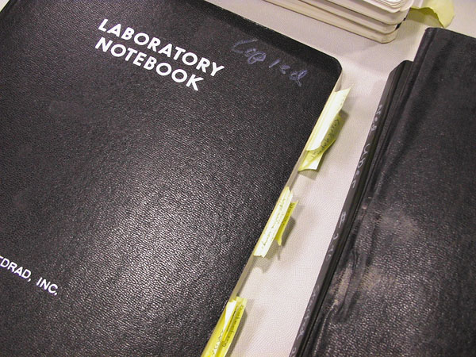


The nature of data management has changed
Was…
Now…
Notes
Pictures of gels
Autoradiograms
Notes
Data images
Sequence files
http://www.sxc.hu/photo/1072645
http://www.hcii.cmu.edu/M-HCL/2006/MEDRADProject/images/notebook.jpg

Slide 4
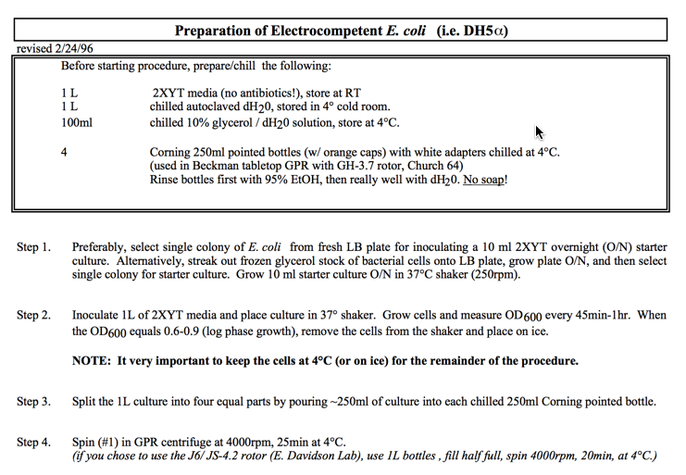
Protocols
http://www.its.caltech.edu/~bjorker/protocols.html

Slide 5
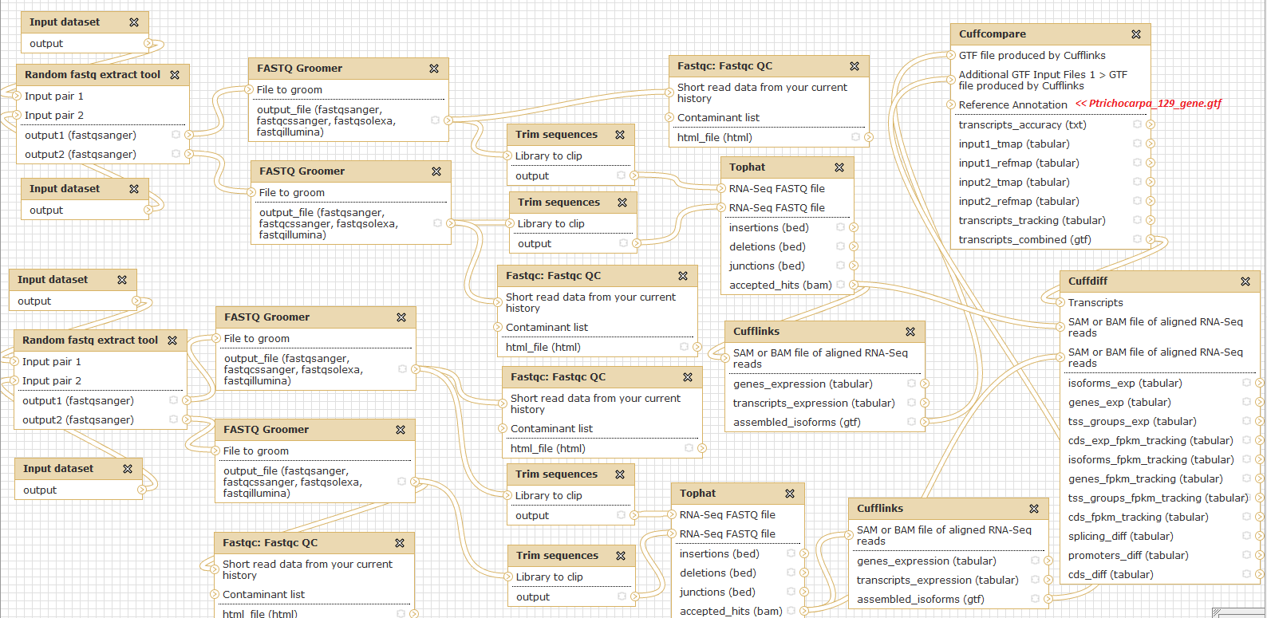
Protocols: electronic workflows
http://galaxy.popgenie.org

Slide 6
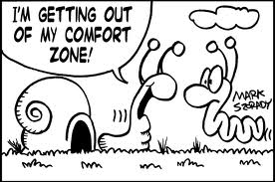
Electronic protocols: workflows
Often require a Unix environment
Often run on the command line
Not always easy to make work

Slide 7
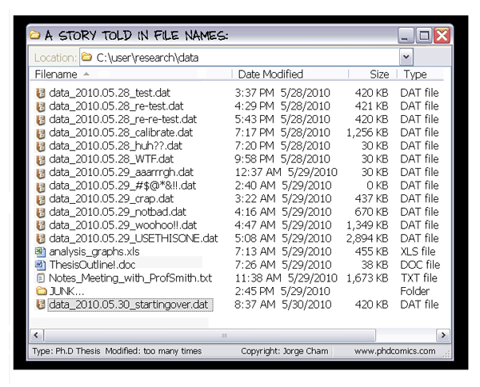
Getting a handle on data
http://www.phdcomics.com/archive.php?1323

Slide 8
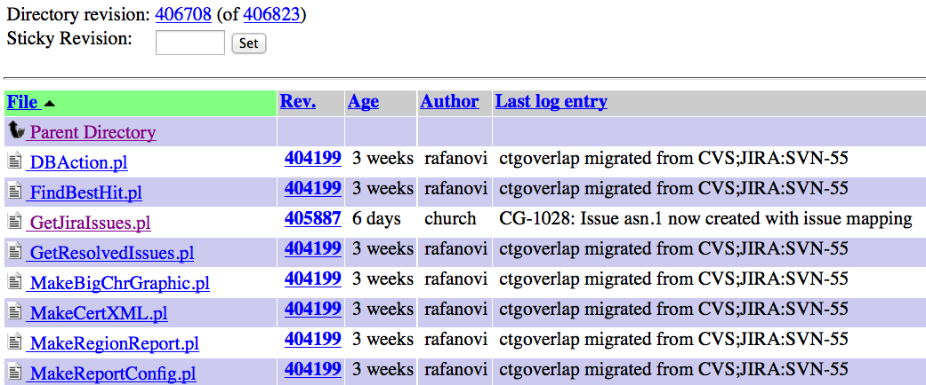
Getting a handle on data: version control
SVN example

Slide 9
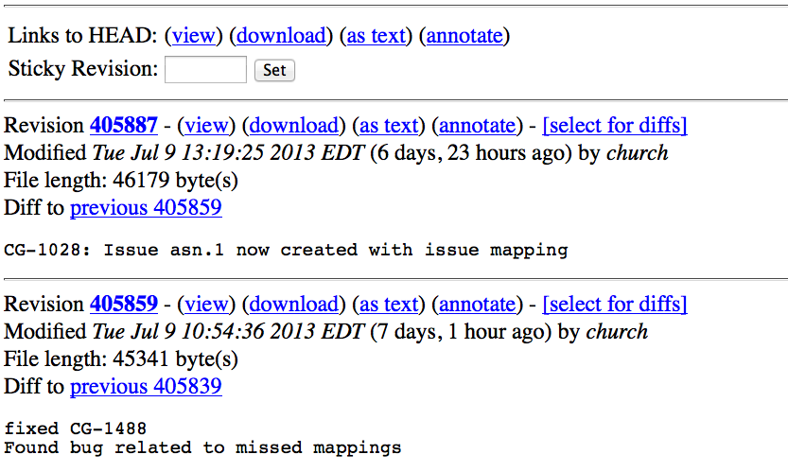
Getting a handle on data: version control
SVN example

Slide 10
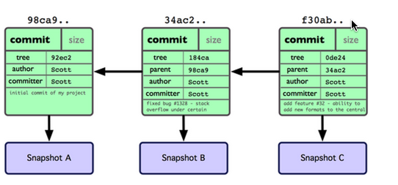
Getting a handle on data: version control
Git
http://nyuccl.org/pages/GitTutorial/

Slide 11
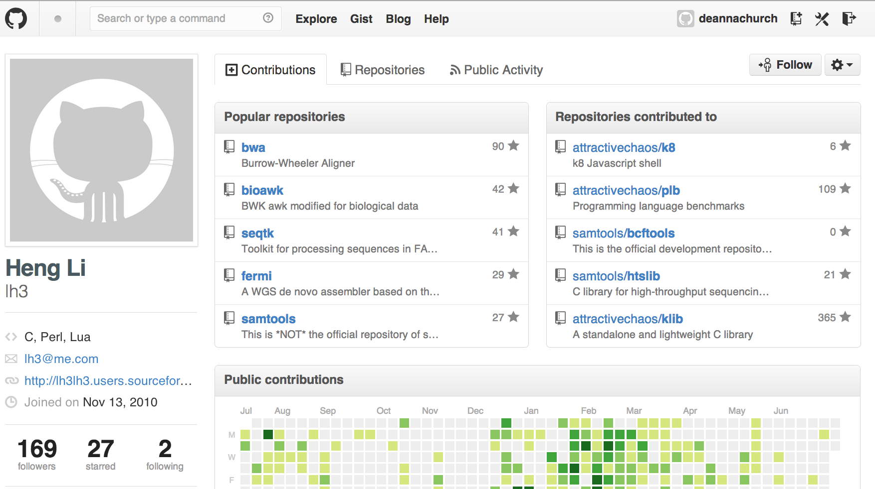
Getting a handle on data: socially
GitHub example
https://github.com/lh3
Bitbucket, Google Code

Slide 12
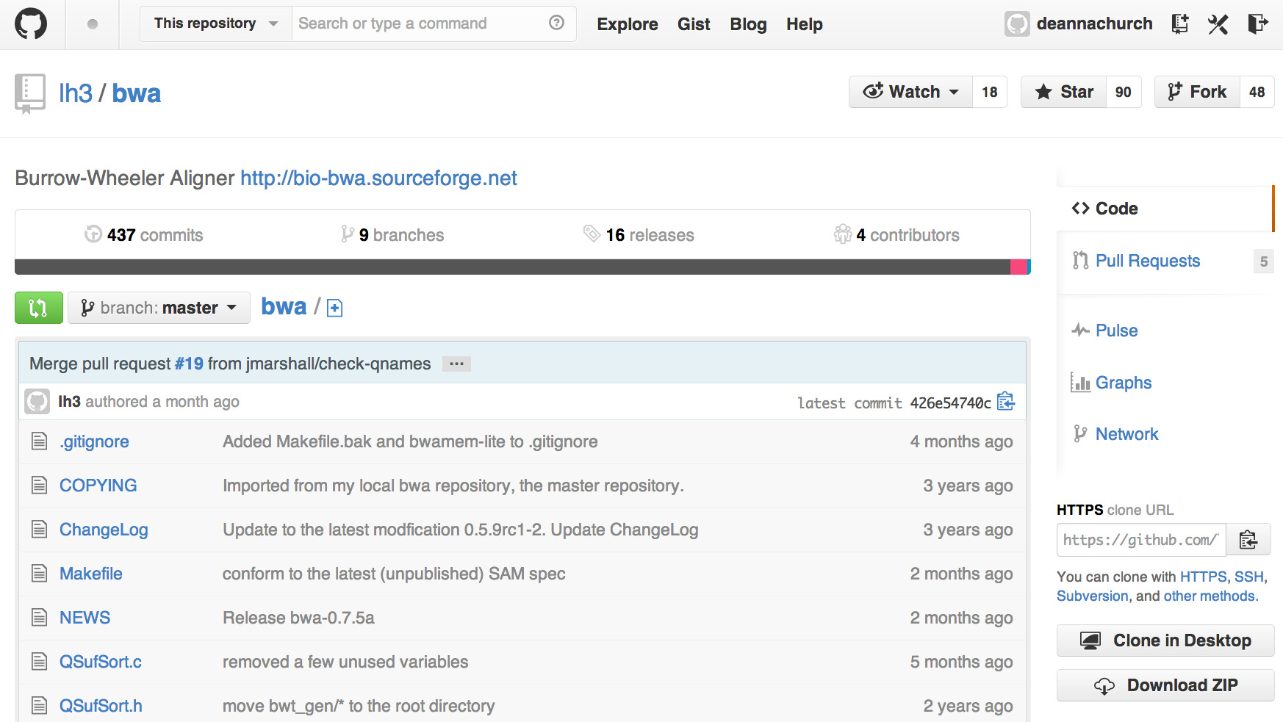
Getting a handle on data: version control
GitHub example
https://github.com/lh3/bwa

Slide 13
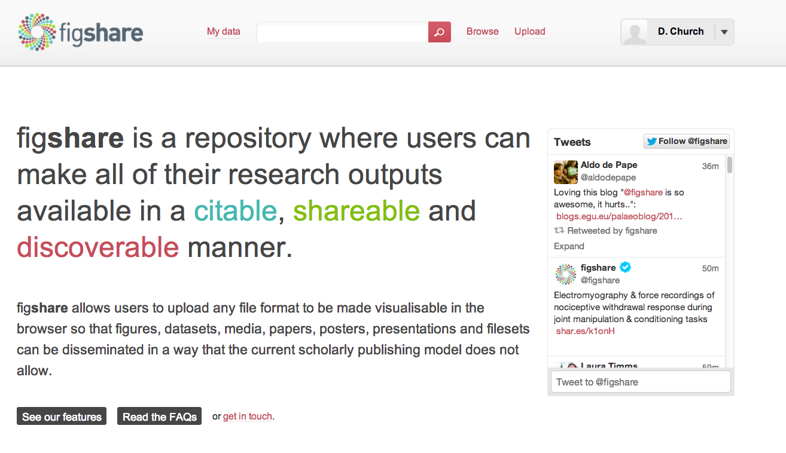
Data citing and sharing
Figshare example
https://figshare.com/about

Slide 14
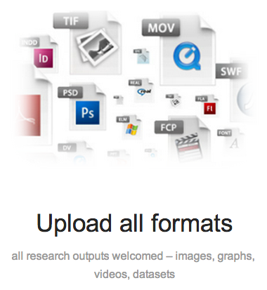
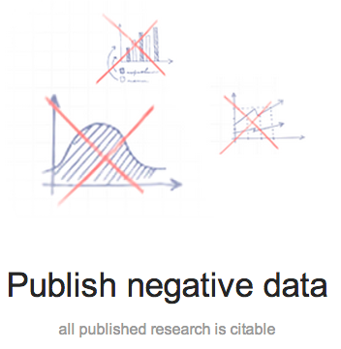
Data citing and sharing
Figshare example

Slide 15
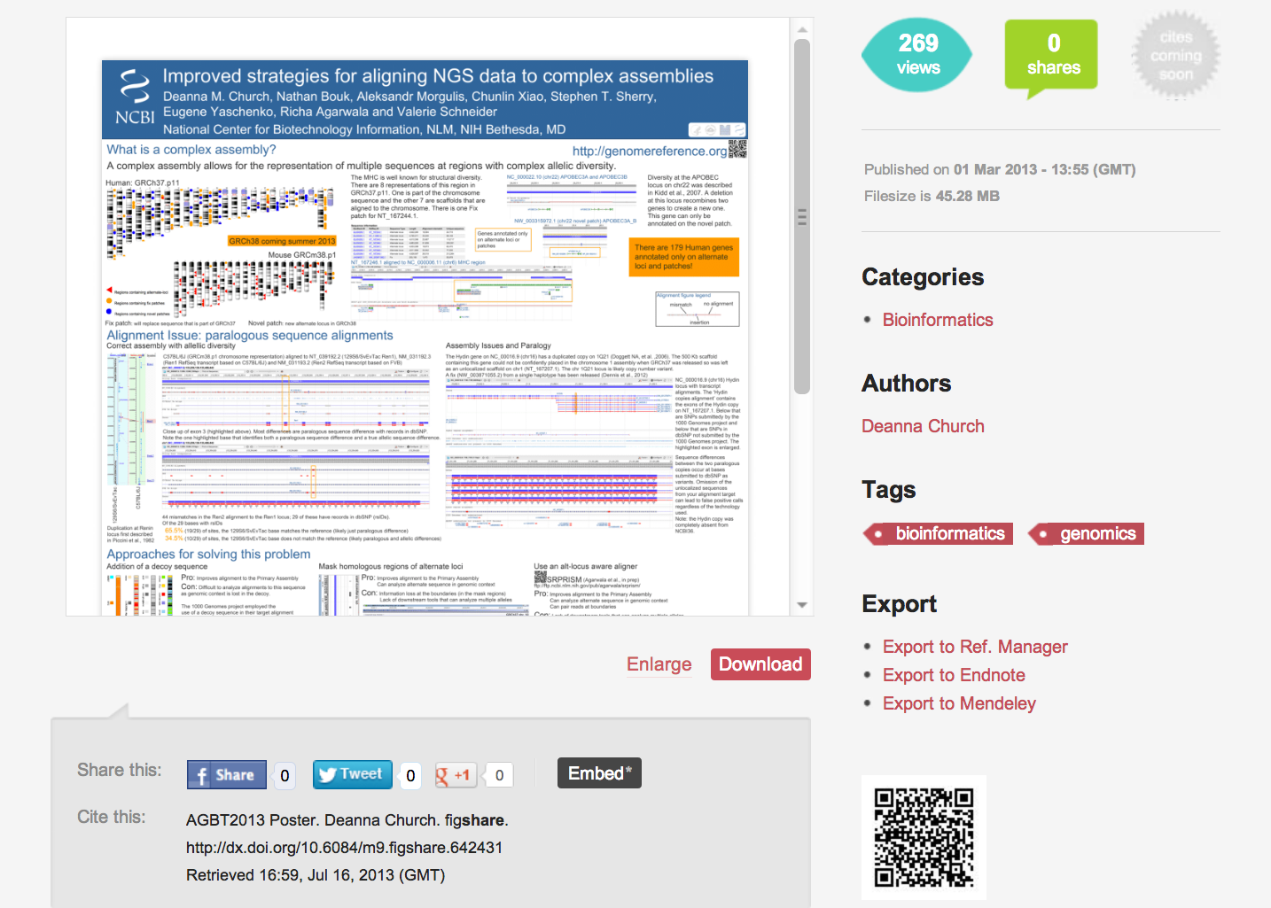

Data citing and sharing
Figshare example

Slide 16


Data citing and sharing
INSDC submission
GenBank
Data in a common format
Data in a single location (and mirrored)
Most quality checked prior to deposition
Robust data tracking mechanism (accession.version)
Data owned by submitter

Slide 17
What is next?
Talk to colleagues about their best practices
Solutions may exist in your institution
Learn to program
Software carpentry (http://software-carpentry.org)
Codecademy (http://www.codecademy.com)
Watch this video http://www.youtube.com/watch?v=N2zK3sAtr-4

