Slide 1


Excel is your Frenemy
Deanna M. Church
Senior Director of Genomics and Content
Personalis, Inc
@deannachurch
Short Course in Medical Genetics 2014

Slide 2

Typical response from your local bioinformatician
“I just emailed my data as an Excel workbook…”

Slide 3

Typical response from your local bioinformatician
http://dontuseexcel.wordpress.com/

Slide 4
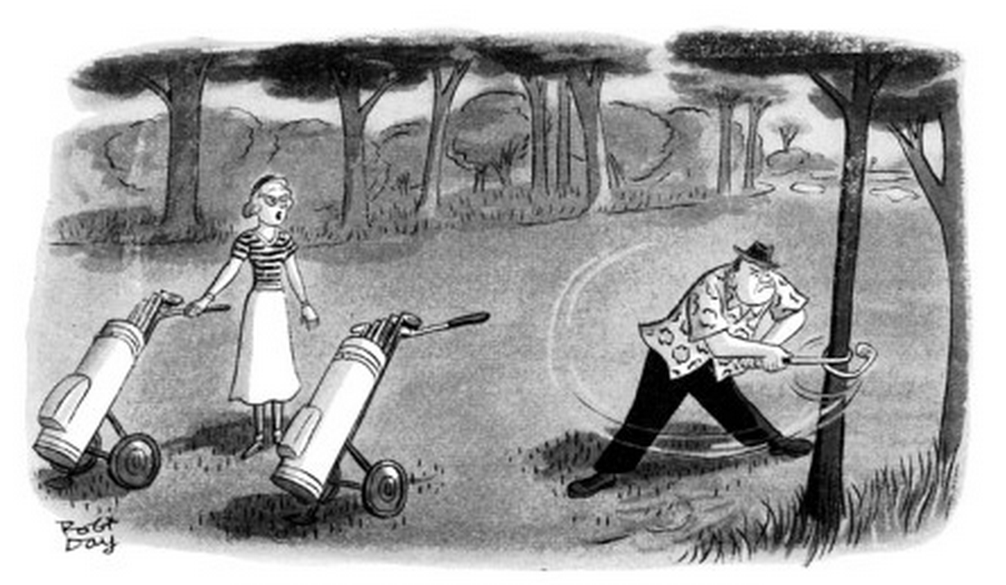
It is a poor workman, Malcolm, that blames his tools
New Yorker Cartoon (May 14, 1955), Robert J. Day

Slide 5
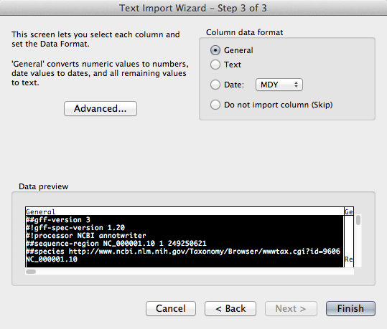
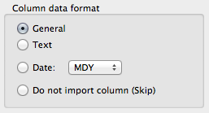
Application’s default settings
Excel will try to guess what type of data
you have and format it accordingly

Slide 6
Application’s default settings
Oct4
4-Oct
Note: The official HGNC name for this gene is POU5F1, but Oct4 is a commonly used alias

Slide 7
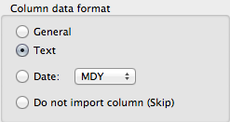
Change default settings as needed

Slide 8
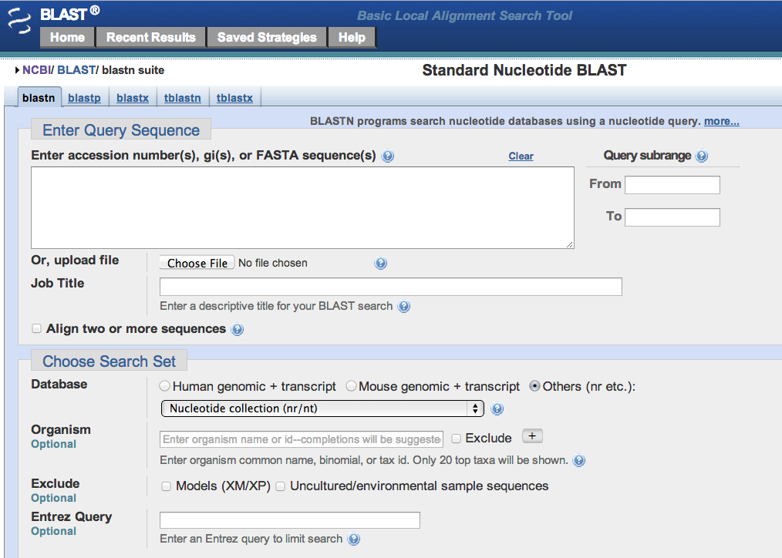
Change default settings as needed
http://www.ncbi.nlm.nih.gov/blast

Slide 9
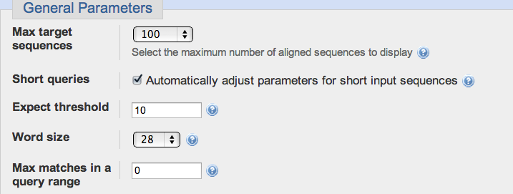
Change default settings as needed
Only some of the available BLAST parameters
Default BLAST page parameters tuned for highly related sequences

Slide 10

Take home messages
Understand how your tools work
Understand default parameters
Adjust your parameters to address your question
Do the exercises to see this in action!

