Slide 1


Sequence Tracking
Understanding your sequence context
Deanna M. Church
Senior Director of Genomics and Content
Personalis, Inc
@deannachurch
Short Course in Medical Genetics 2014

Slide 2
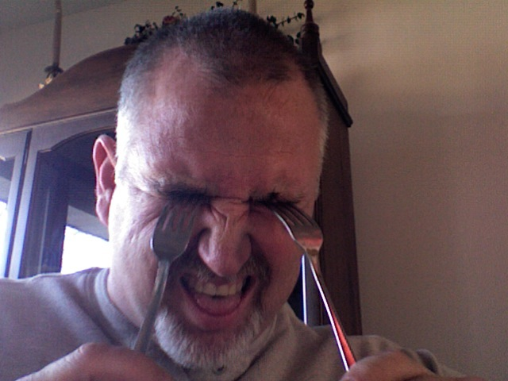



What’s in a name?
Bob
Bob
Bob
Bob
Notes:
Names are not a sufficient identifier. The term ‘Bob’ correctly identifies all four of these people, but clearly they are not the same.

Slide 3

What’s in a name?
Bob
123-45-6789
*
*http://howmanyofme.com
Notes:
Even increasing the specificity does not help- as we can see, there are over 600 Robert Fultons in the US! We really need unique identifiers, such as SSN to robustly track people.

Slide 4
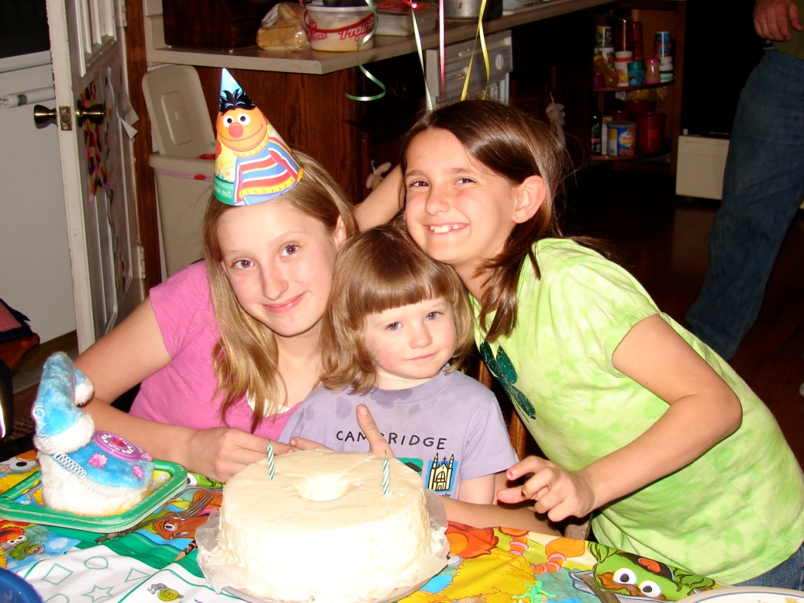
What’s in a name?
Bob
Samantha
Miranda
Lydia
Need more than unique identifier track updates/improvements
Notes:
Additionally, when there is an upgrade, and names change, but you need to be able to track the changes and the relationships.

Slide 5

chr1
Chr1
1
Chrom1

Slide 6
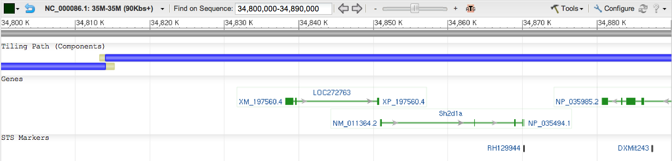
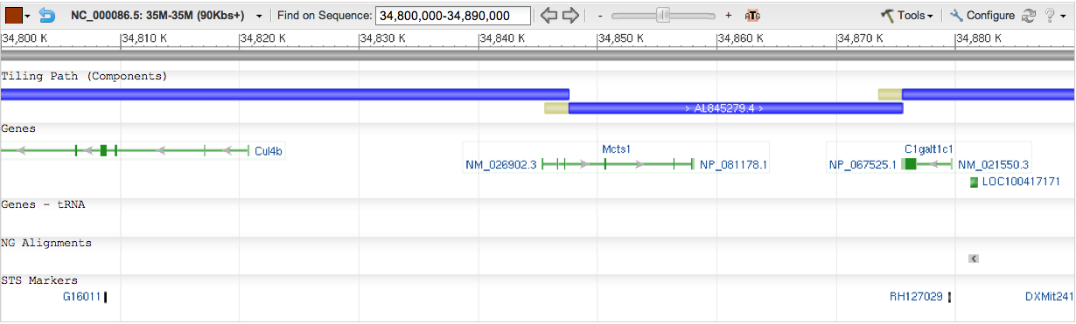
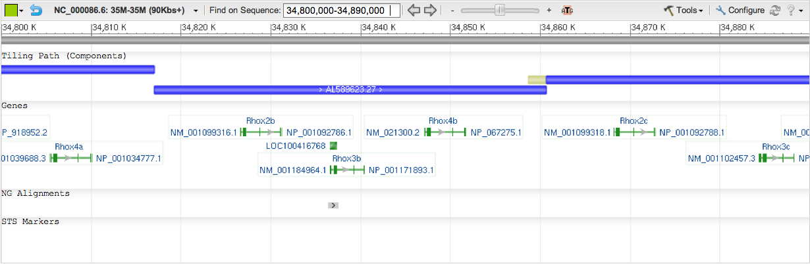
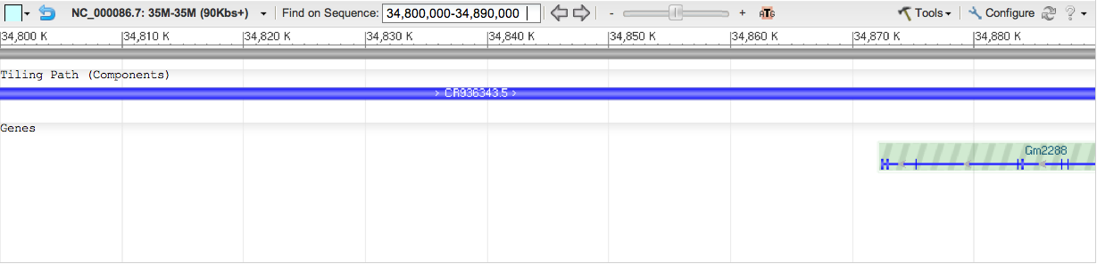
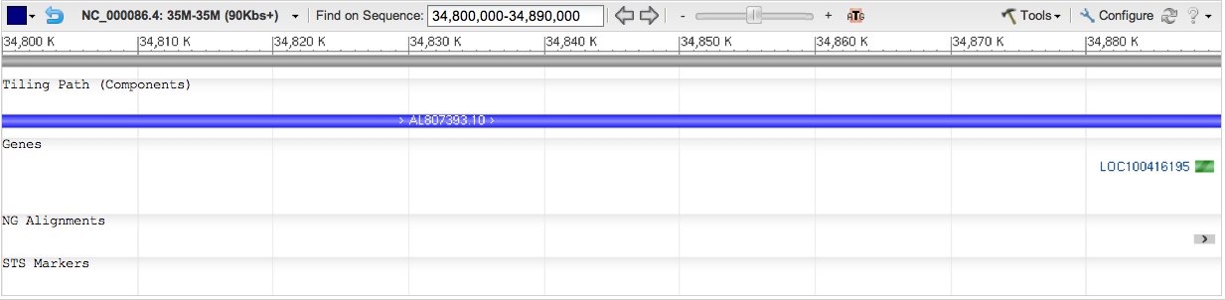
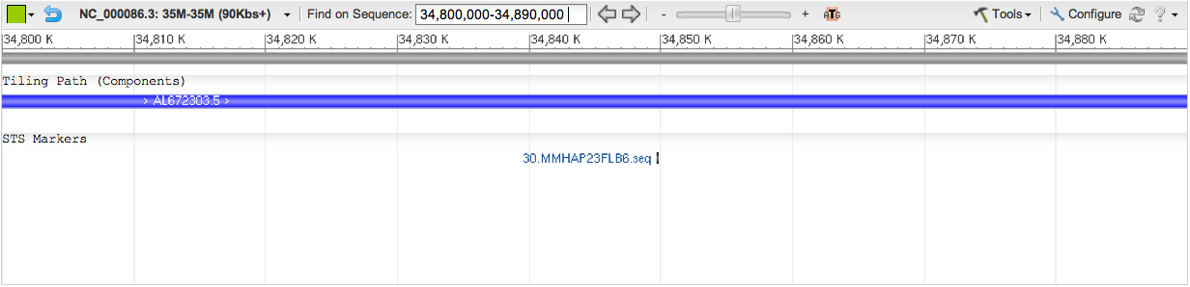
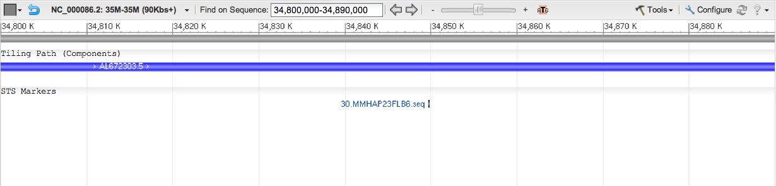
Mouse chrX: 34,800,000-34,890,000
NC_000086.
1
2
CM001013.
1
3
2
4
5
6
7

Slide 7
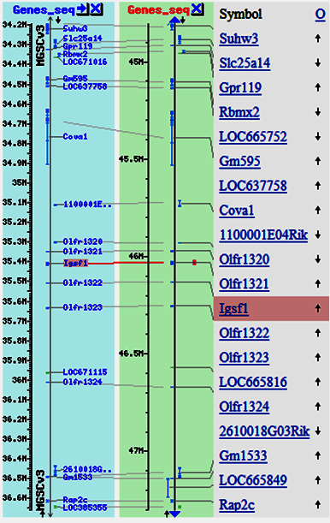
Mouse chrX: 35,000,000-36,000000
MGSCv3
MGSCv36
X
Notes:
Show alignment of a feature from first slide to show how far down the chromosome it has moved…

Slide 8



Data Archives
GenBank
Data in a common format
Data in a single location (and mirrored)
Most quality checked prior to deposition
Robust data tracking mechanism (accession.version)
Data owned by submitter

Slide 9
Data tracking
ABC14-1065514J1
Date
Phase
Gaps
Length
FP565796.1
21-Oct-2009
1
1
FP565796.2
14-Oct-2010
1
0
FP565796.3
07-Nov-2010
3
0

Slide 10
Data Archives
Initial versions of human and mouse
reference assemblies not in INSDC!!*
First human version in INSDC: GRCh37
First mouse version in INSDC: NCBI36
* But were tracked by RefSeq

Slide 11
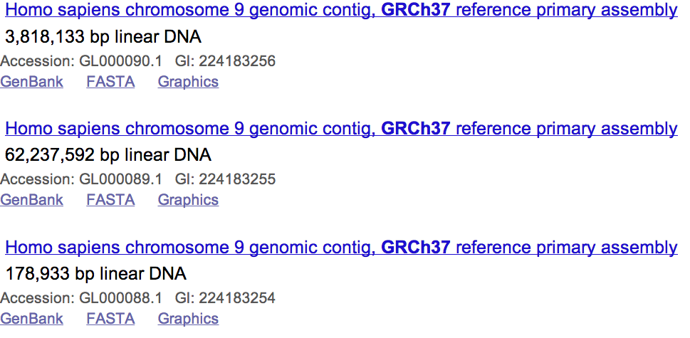
Data Archives
INSDC archives track INDIVIDUAL sequences
An assembly is a COLLECTION of sequences

Slide 12
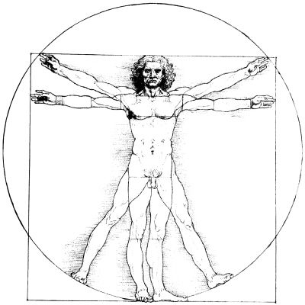
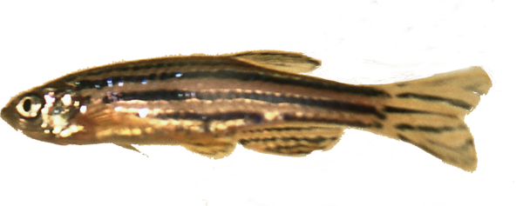

More naming issues
GRCh38
hg18
Zv9
danRer7
GRCm38
mm10
Notes:
Keeping track of people is way easier than keeping track of assemblies.

Slide 13
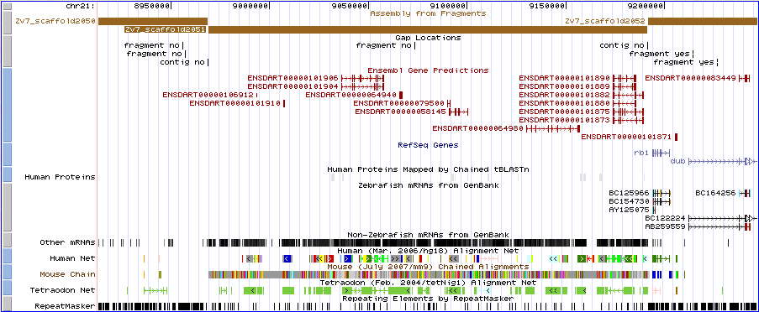
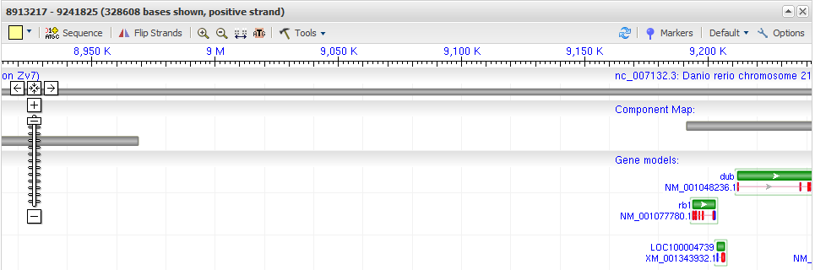
Zv7
chr21:8,913,216-9,246,964

Slide 14
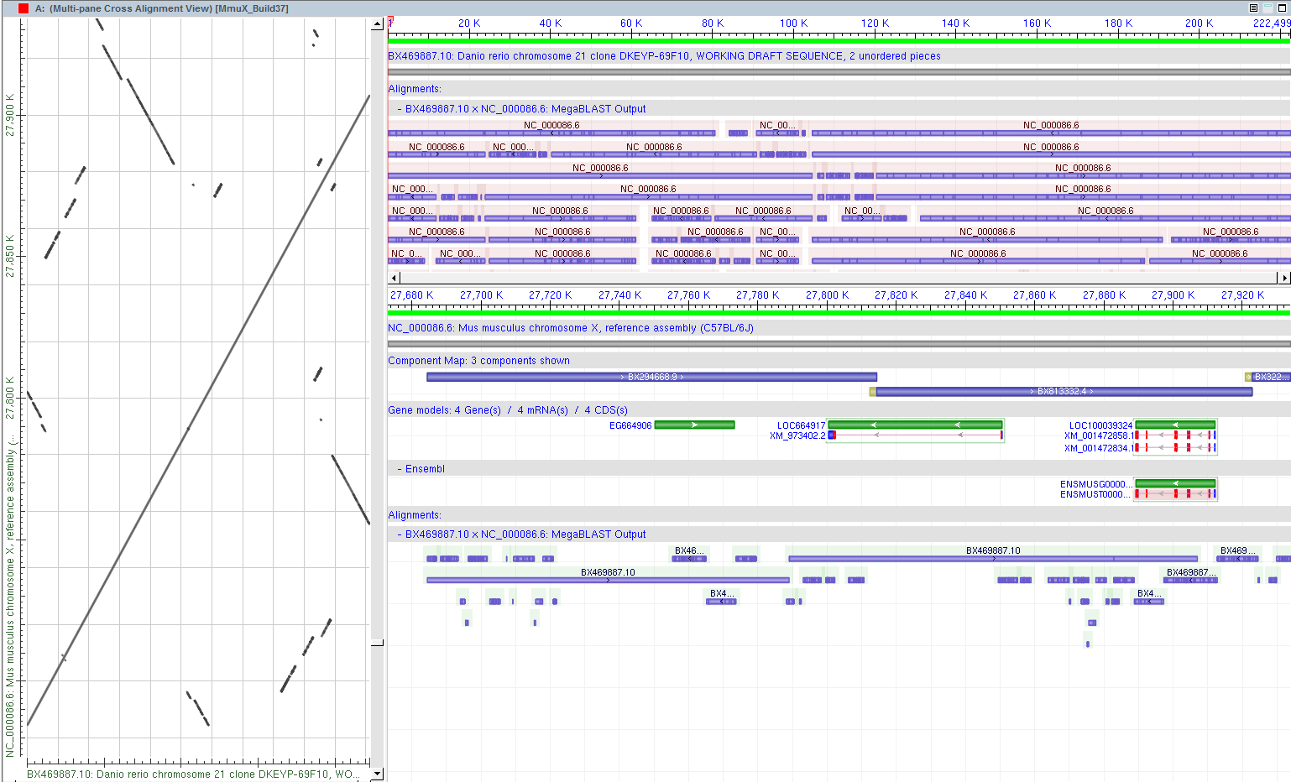
Zv7 chr21:8,913,216-9,246,964 vs MGSCv36 chrX

Slide 15
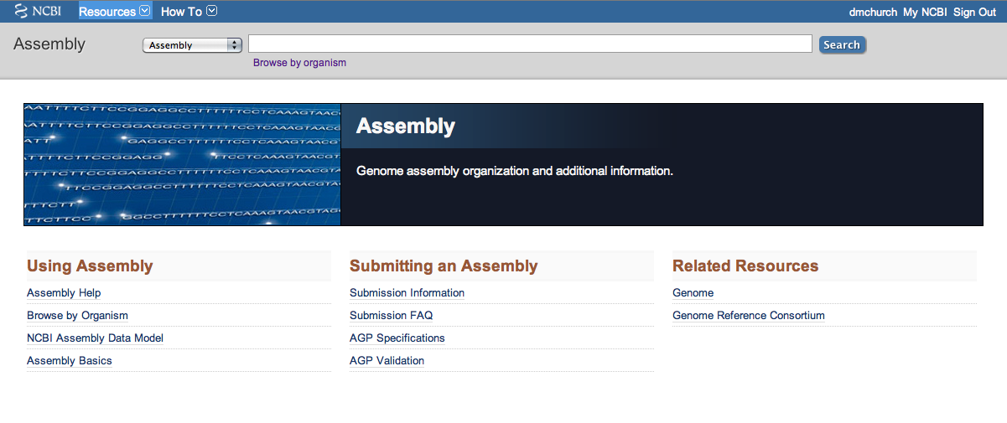
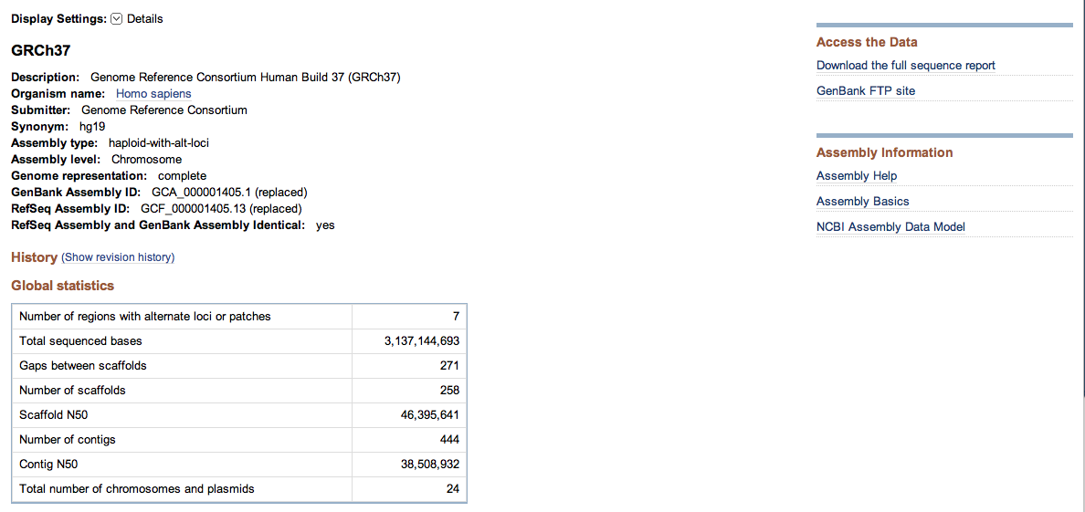
GRCh37
hg19
http://www.ncbi.nlm.nih.gov/genome/assembly

Slide 16
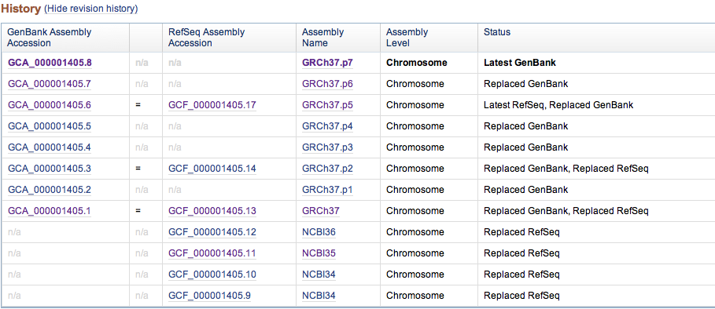

Slide 17



Genome Browser Agreement
Submitter deposits assembly to GenBank/EMBL/DDBJ
Assembly QA
Submitter updates assembly based on QA results
Browsers pick up assembly from GenBank/EMBL/DDBJ
Assemblies must be in
GenBank/EMBL/DDBJ

Slide 18
GenBank
RefSeq
vs
Submitter Owned
RefSeq Owned
Redundancy
Non-Redundant
Updated rarely
Curated
INSDC
Not INSDC
BRCA1
83 genomic records
3 genomic records
31 mRNA records
5 mRNA records
27 protein records
1 RNA record
5 protein records

Slide 19
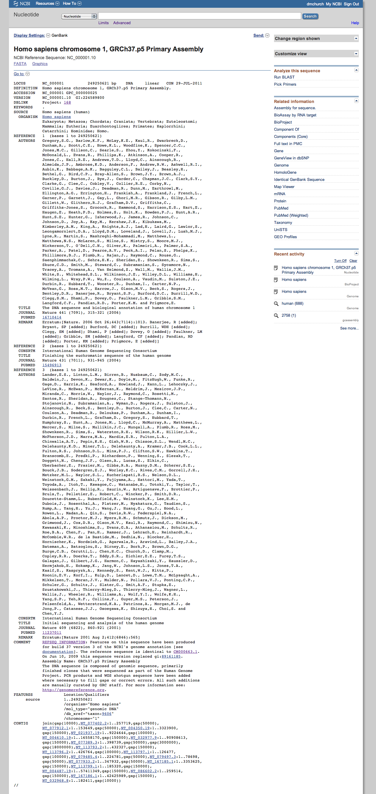
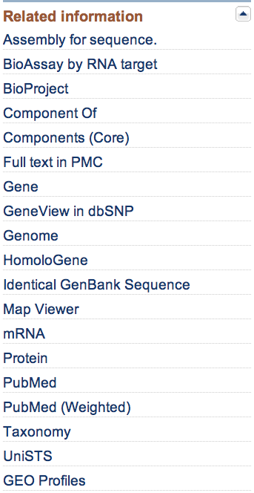
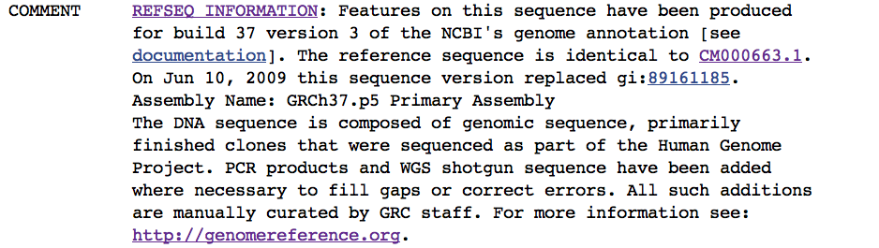

Slide 20
RefSeq for Assemblies
Typical assembly edits
Addition of non-nuclear (e.g. MT) assembly units
Removal of contamination
Drop unlocalized/unplaced scaffolds
Mask contamination that is placed on chromosome (while preserving coordinate space)

Slide 21
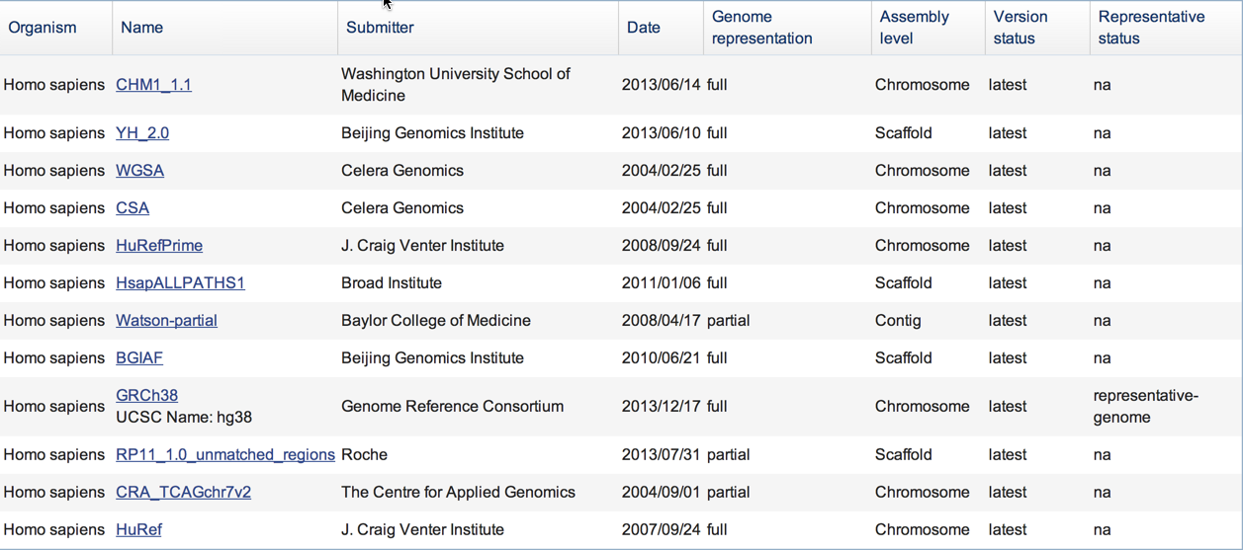
Human assemblies in assembly database
http://www.ncbi.nlm.nih.gov/assembly/organism/9606/

Slide 22
Annotation should have versions too!
NCBI
NCBI Homo sapiens annotation 105
NCBI Homo sapiens annotation 106
Ensembl
Ensembl 74
Ensembl 75

Slide 23
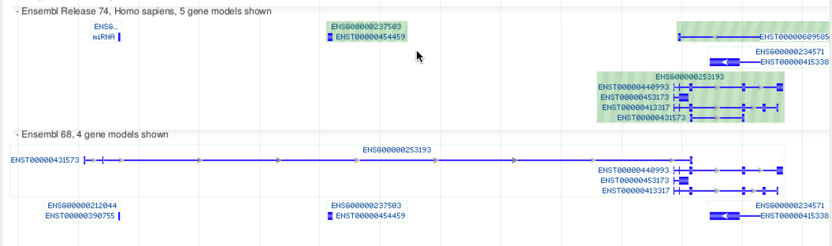
Annotation should have versions too!
Ensembl 74
Ensembl 68

Slide 24
Take home messages
Assemblies can (and do) update!
Know what assembly your are working on
Track by accession.version, not just name
Data in INSDC databases are mirrored
RefSeq is NCBI specific
Track annotation too!

