Slide 1
Syriatel communications
Deanna Gould

Slide 2
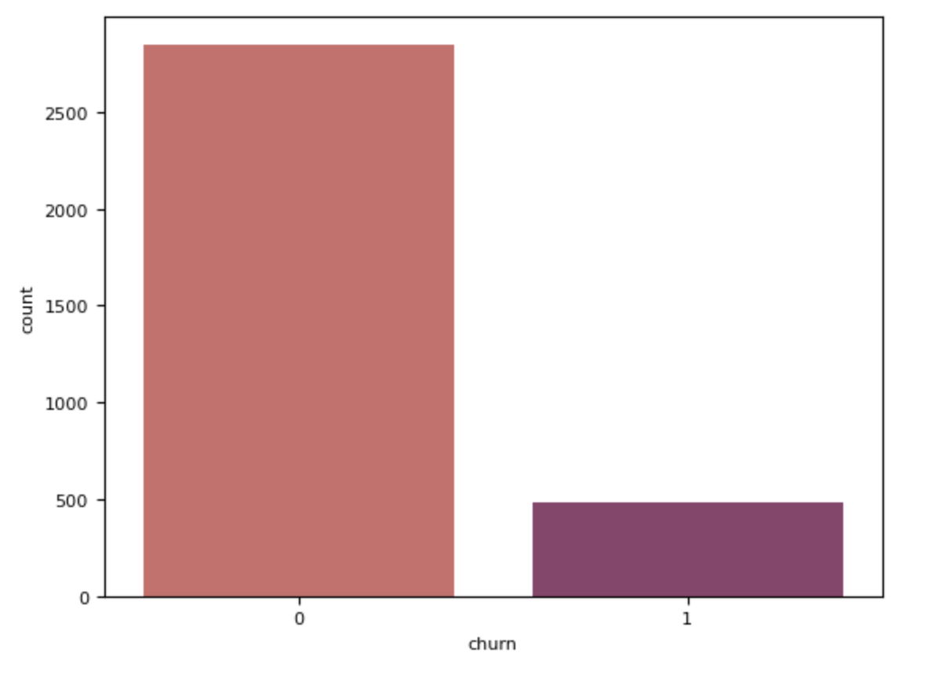
Overview
14.5% overall churn rate
3,333 total rows
485 customers churned

Slide 3
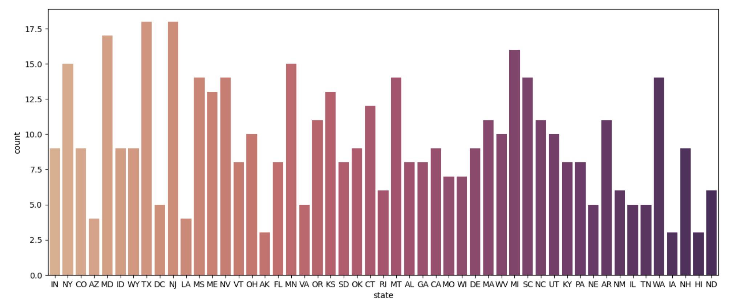
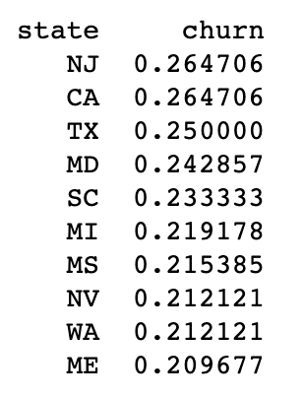
Churn by state

Slide 4
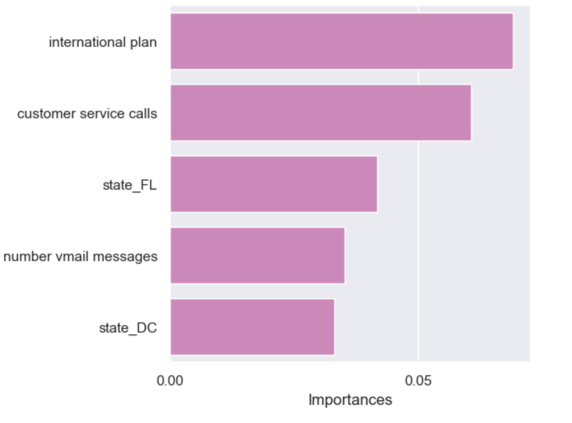
5 Most important features

Slide 5
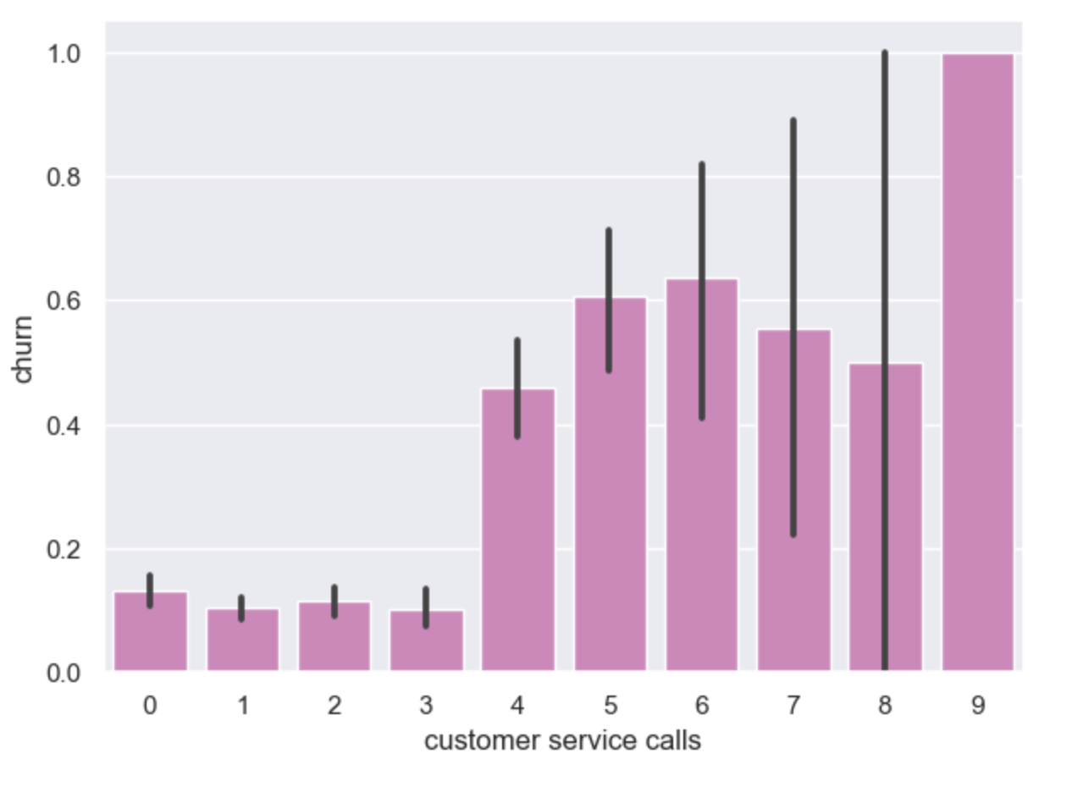
Churn & customer service
More customer service calls, higher churn

Slide 6
recommendations
Promotions for international plans
Higher initial cost for voicemail plans and lower fee per voicemail
Investing in popular countries to our clients, lower cost initially
Improve customer service call center
Consider NLP for recorded lines

Slide 7
Thank you
Questions, comments, concerns
For more information, I can be reached at deannagould4@gmail.com and to view the notebook, please visit https://github.com/deannagould/phase3_customerchurn

