Slide 1
Pneumonia detection
Deanna Gould
Data Science Flex

Slide 2
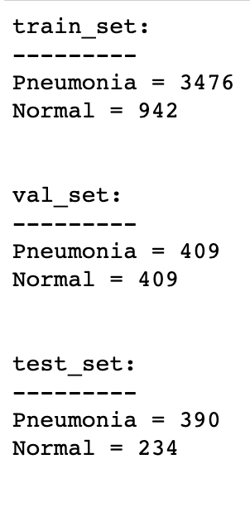
The purpose
- Predicting pneumonia with X-Ray images for HealthWorx, a telehealth company
- Responsible for 15% of all deaths in kids under 5 in 2017
(World Health Organization)
- Decrease emergency room wait times and get faster care
- 5,860 total X-Ray images in dataset

Slide 3
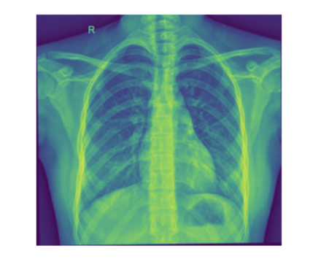
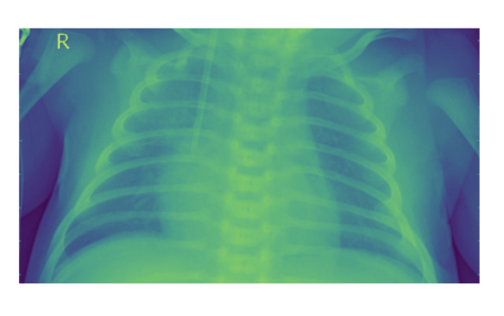
Pneumonia or not?

Slide 4
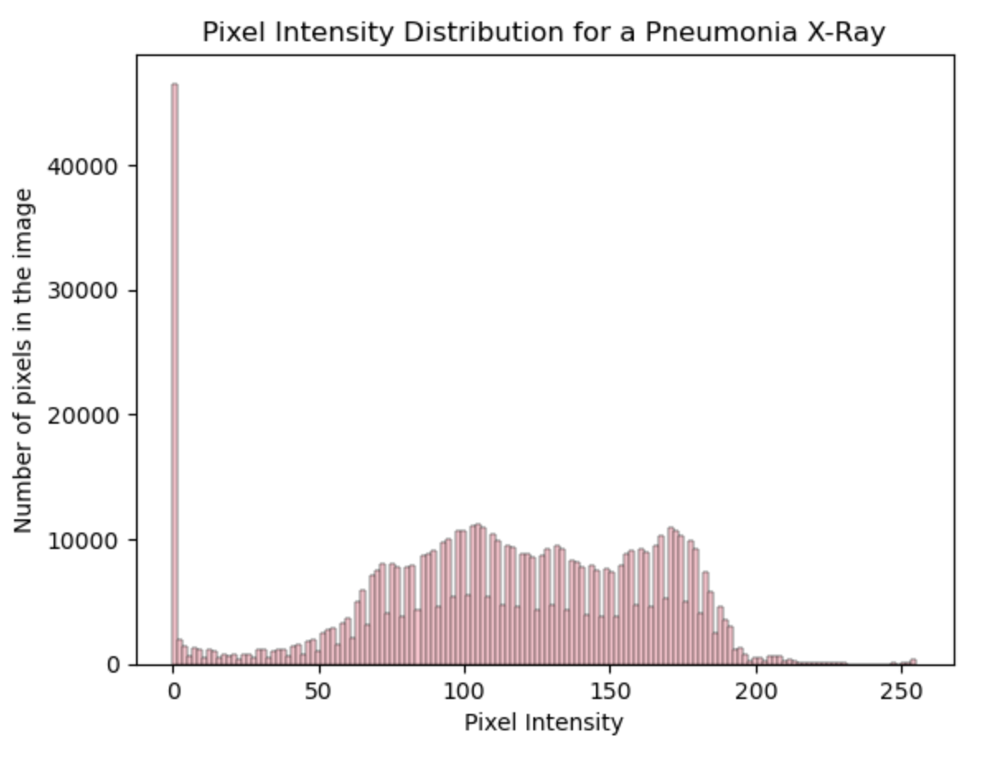
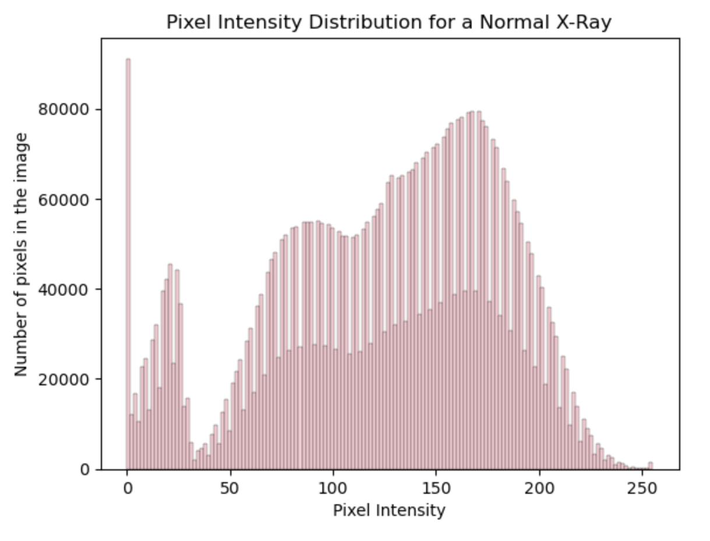
Pixel intensity comparison

Slide 5
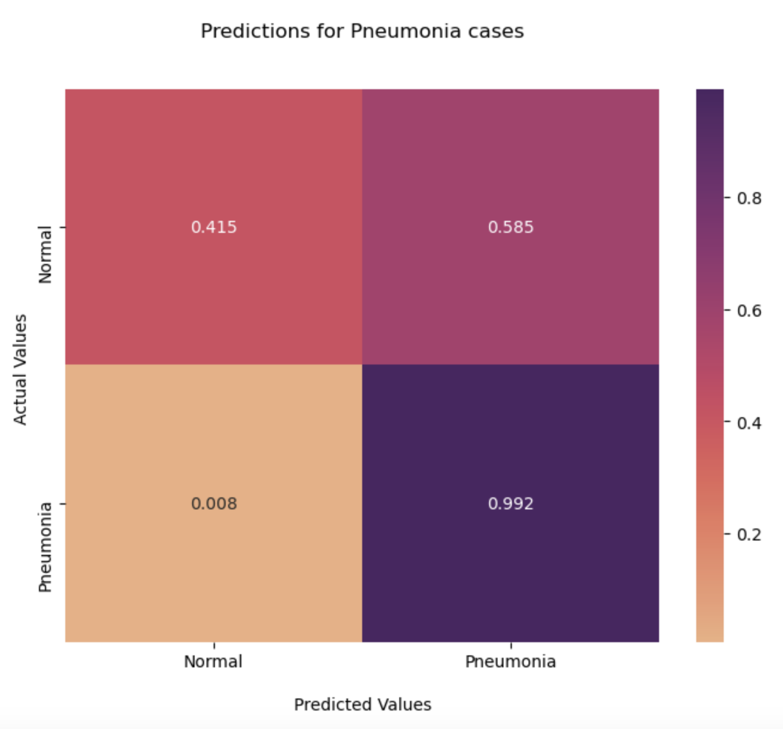
Final confusion matrix
- 99.2% true positive rate
- .08% false negative rate
- 59.5% false positive rate

Slide 6
Recommendations
- Use Inception V3 for modeling purposes
- Generate patient data to ensure we’re training the model on diverse demographics
- Age, sex, race, smoking history
- With more time, try other models, and with more resources, use more X-Ray images

Slide 7
questions
If there are questions after the conclusion of the presentation, I can be reached at deannagould4@gmail.com.

