Slide 1
Fixed Income Valuation model on 10Y government bonds
Langyu Gu, Analytics Team
13/04/17

Slide 2
10Years Treasury notes across 4 developed countries
Global bond valuation model is built on four developed countries’ 10 years government bonds: US, EU, UK and Japan. Eurobond is only available since 2001, data prior to the date is continued with Germany 10 years bunds.
Signals are generated on zero-coupon yield indices. The reason of using zero-coupon bond yield is that it excludes the impact of variation of coupon on yields.
Underlying trading instruments are 10 years bond 1st generic futures, as typically only the first-to-expire contract is liquid. (shown in below table)
Country | Yield Index | Futures
US | F08210Y | TY1 Comdty
EU | F91010Y | RX1 Comdty
UK | F11010Y | G 1 Comdty
Japan | F10510Y | JB1 Comdty
2

Slide 3
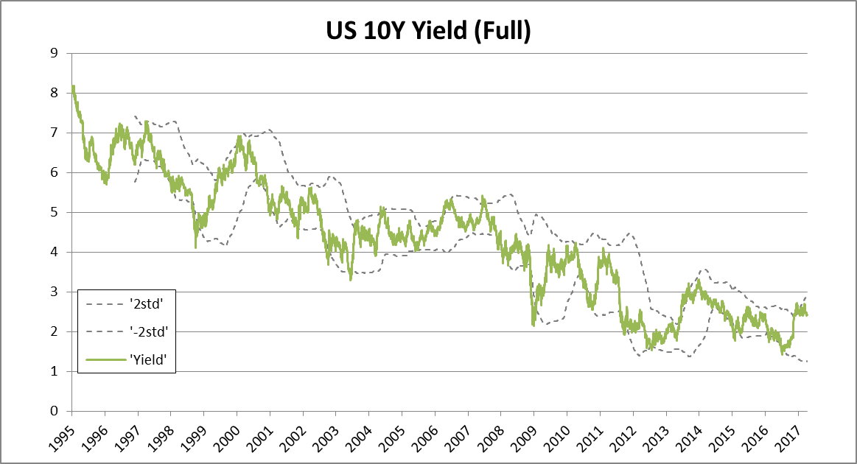
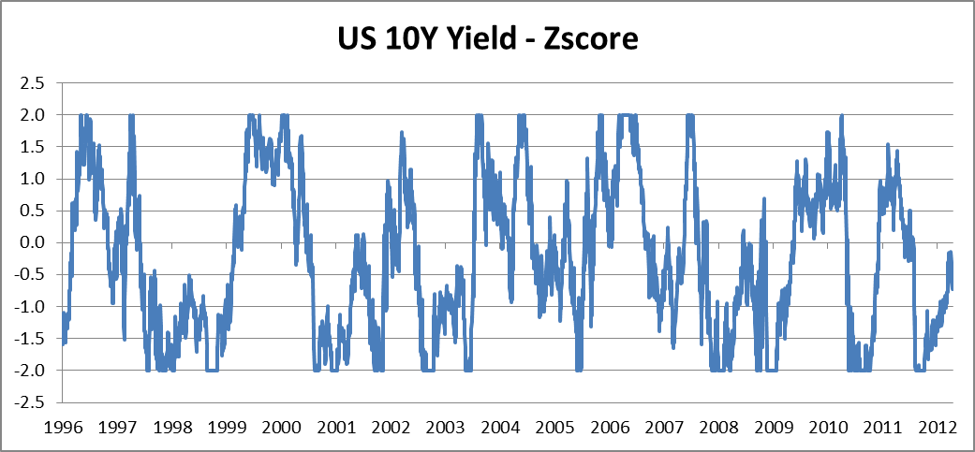
Mean-reversion signal
Yields have been trending down in general for decades in developed countries. The signal is generated when yield has risen (dropped) above (below) its 2 standard deviations. It expects the yield mean reverses back to its short-term mean. Signal is standardised to z-score for cross-sectional comparison use. Signals are capped at +/- 2.
Please see charts on other regions in Appendix.
3

Slide 4
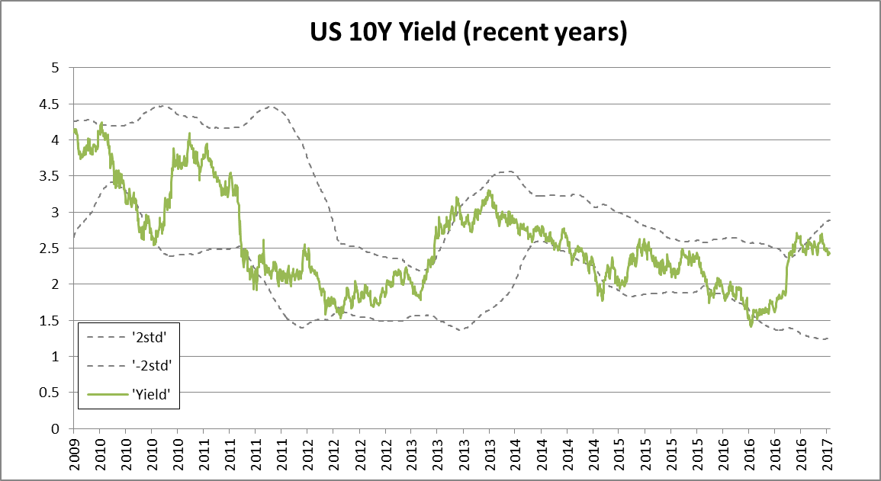
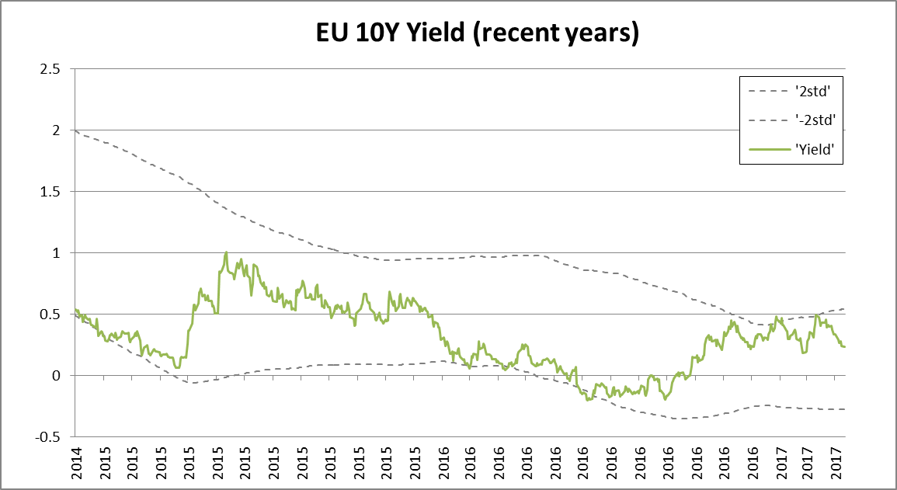
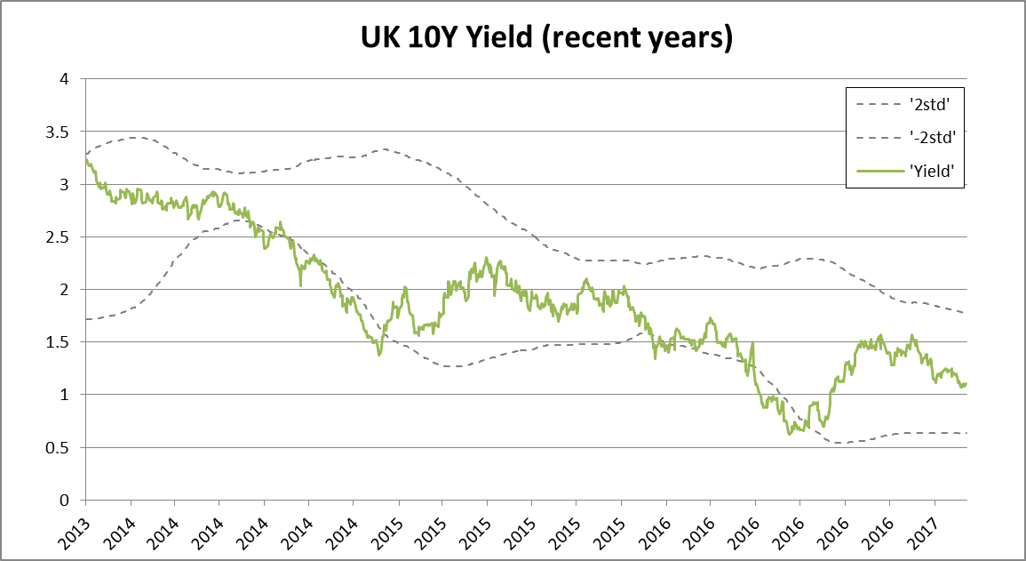
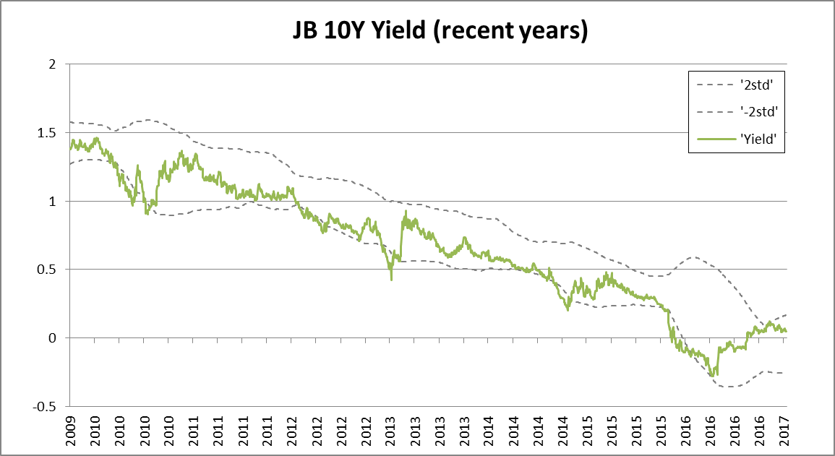
Mean-reversion signal (2)
Closer look at the recent chart of mean-reversion signals
4

Slide 5
Mean-reversion signal (3)
Below table shows the signal as of 10 Apr 2017, buy/sell recommendation and the performance since the first time that the buy/sell recommendation appeared. (Buy/sell signals on bond futures.) As you can see in the last slide, most of bond yields have risen sharply over the past 4 quarters, mean-reversion signals suggest to long bond futures in US/EU and Japan regions. The performance since the first appearance of the suggestion are all positive.
5

Slide 6
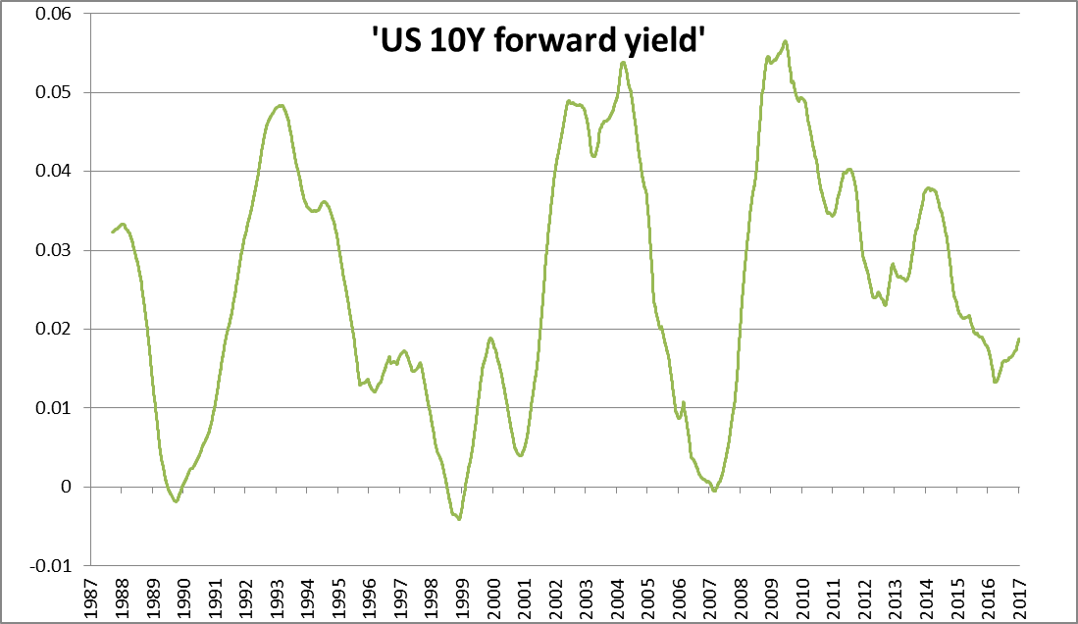
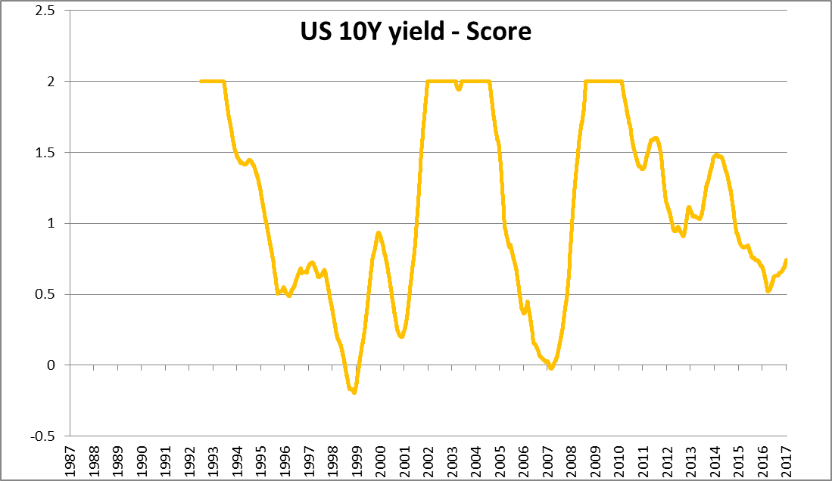
Carry signal
Carry return of bond is defined as the yield you earn if the yield curve stays the same over the next time period. It is the forward yield that market has priced in for the period. Signal are capped at +/- 2.
6

Slide 7
Signal blending
Signalling correlation check: as shown in the below table, the correlation between two strategies (signals) have significant low correlation across all four regions. It means that we could find good diversification in blended signals.
Here I take a simple 50/50 approach, the final signal is equal weighted of the two.
7

Slide 8
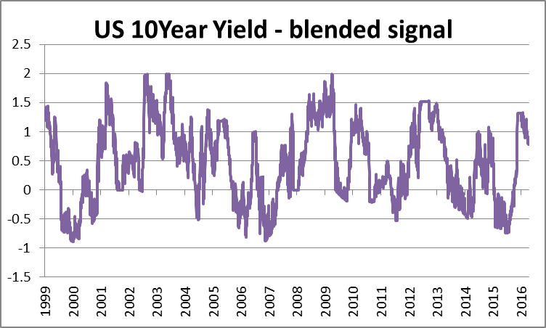

Signal blending
Here I take a simple 50/50 approach, the final signal is equal weighted of the two.
50%
50%
8

Slide 9
Model Performance

Slide 10
Assessment on Common bias
Survivorship bias: None. They are the most common bond futures.
Data snooping bias: Low. As the model uses only two sub-models and the blending process is simple and easy. In future, when the number of alpha models increases, the cross-validation technique can be applied to avoid over-fitting/data snooping bias.
Forward looking bias: None. Model is constructed with a careful consideration to avoid forward looking bias. All volatility, returns, correlation and beta are calculated on rolling basis with only historical data available at each point in time.
Scalability and liquidity: Large. The signals are traded on bond futures. The minimum contract $ size in this analysis is $100,000. Therefore it is liquid and scalable.
10

Slide 11
Portfolio construction
Portfolio construction settings and constraints:
  Long only strategy, if no long signal, all capital allocated into cash.
  Since bond futures are traded in different currency, in order to avoid FX impact on the return, all non-£ positions are hedged into £. FX hedging cost is considered in transaction costs.
  Transaction costs include FX hedging cost and trading cost at 0.05%.
  Portfolio weights are calculated by blended signal rankings. Higher the rank of an instrument, more weights are allocated.
11

Slide 12
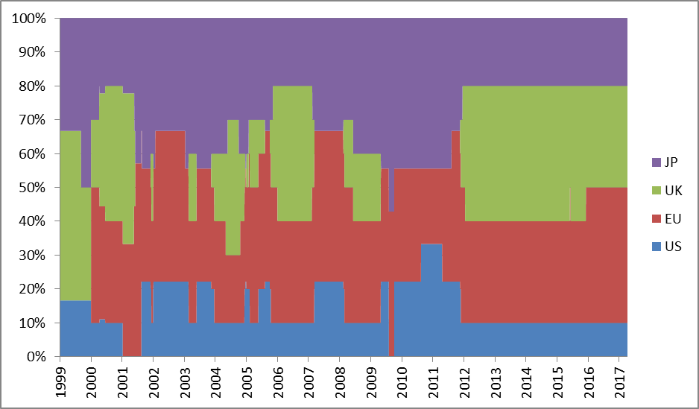
Dynamic weights since 1999
12

Slide 13
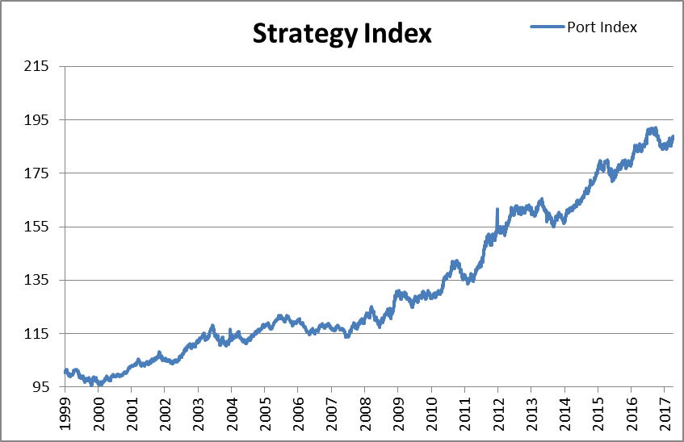
Performance
13

Slide 14
Appendix

Slide 15
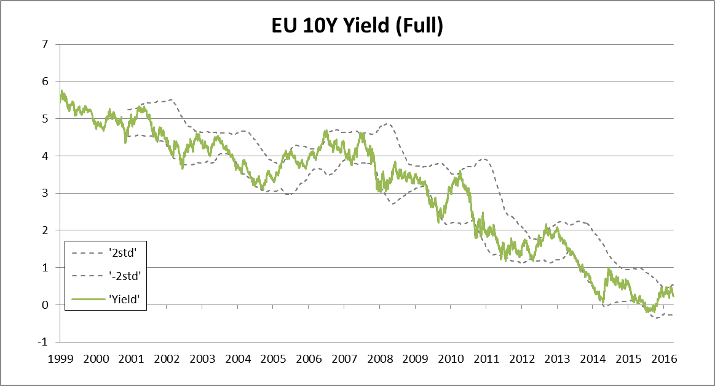
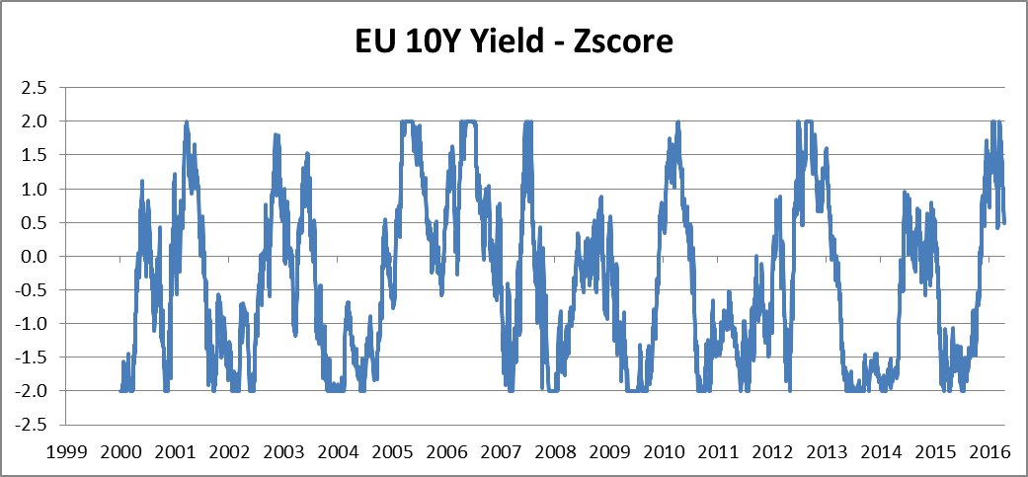
Mean-reversion signal – Eurobond
15

Slide 16
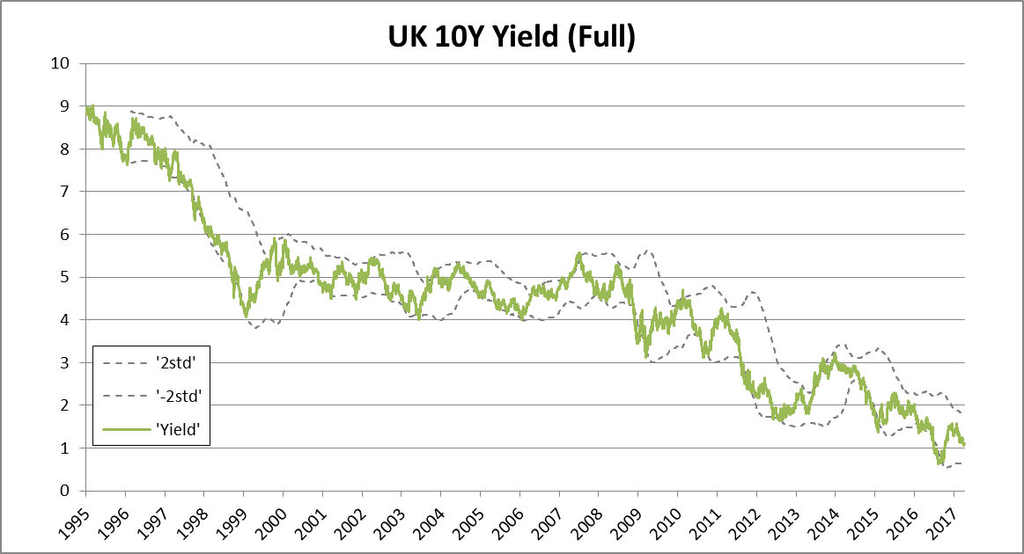
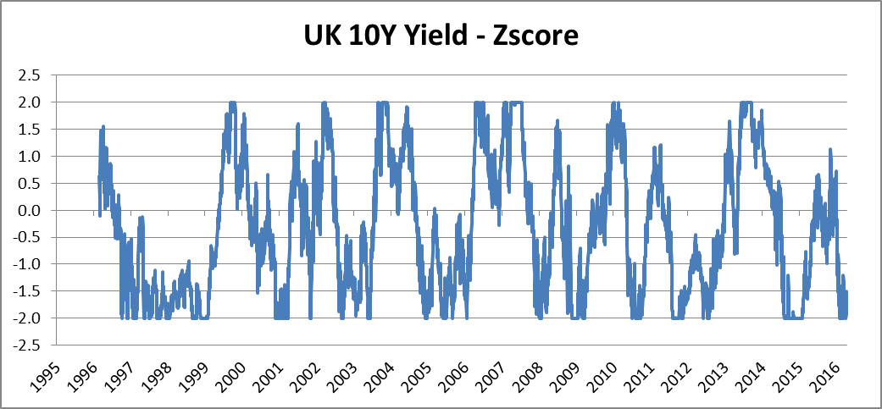
Mean-reversion signal – UK Gilts
16

Slide 17
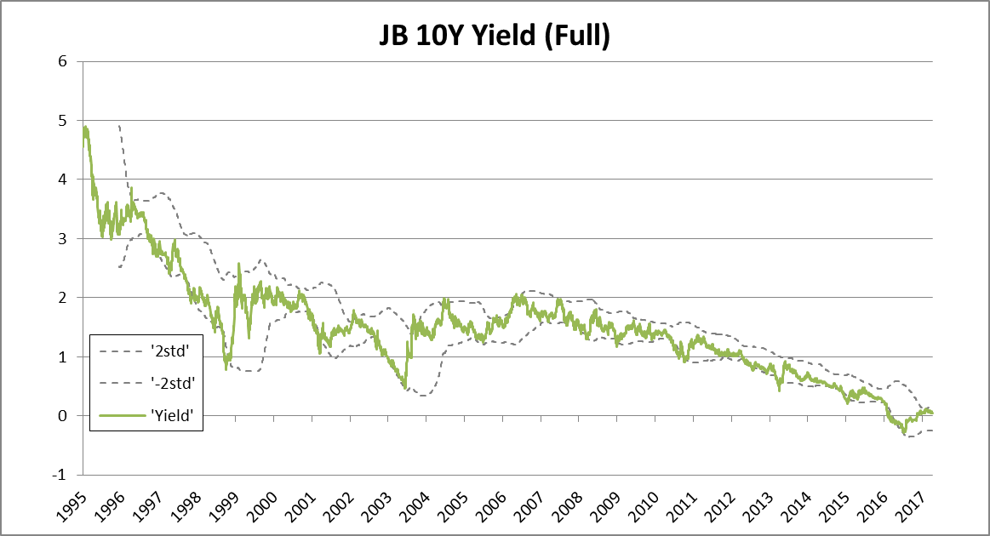
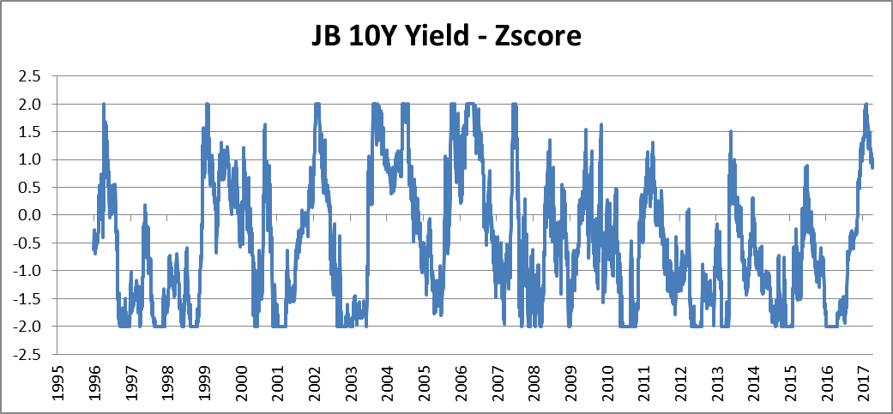
Mean-reversion signal – Japan Bond
17

