Slide 1
Sigmaa003 Strategy proposition Dividend enhanced model
Langyu Gu
13/04/23

Slide 2
Bitcoin Strategy
Current challenges in Bitcoin Strategy:
Unable to open account in Binance
Due to limited capital in Lmax, we are only able to trade one-sided strategy. Not many long signals was flagged in the current down market, therefore, the true performance of the strategy can not be reflected.
Market risk in Cypto world is still elevated given the recent vulnerability in banking system. The risk of extreme volatility in an intra-day trading environment in Bitcoin remains high.
The regulatory risk is also another factor that keeps us away from transferring money into Binance.
2

Slide 3
Dividend elements
As we discussed last time regarding the dividend element, the bitcoin strategy is not a good strategy to provide a stable dividend under the current market environment. It also exposes to higher market risk at the moment.
However, enhanced Simgaa003 is a better option to suit client needs. Sigmaa003 has several advantages:
Neutral to bear market. It delivers a stable return under standard bear markets.
It has a limit drawdown under stress markets, ie GFC2008 and Covid2020.
Liquid and scalable as its underlying is S&P500 Index.
A proven strategy. We have been running Sigmaa003 since 2018.
3

Slide 4
Dividend elements
As we discussed last time regarding the dividend element, the bitcoin strategy is not a good strategy to provide a stable dividend under the current market environment. It also exposes to higher market risk at the moment.
However, enhanced Simgaa003 is a better option to suit client needs. Sigmaa003 has several advantages:
Neutral to bear market. It delivers a stable return under standard bear markets.
It has a limit drawdown under stress markets, ie GFC2008 and Covid2020.
Liquid and scalable as its underlying is S&P500 Index.
A proven strategy. We have been running Sigmaa003 since 2018.
Year (Live) | FY2019 | FY2020 | FY 2021 | FY 2022 | Since inception
Sigmaa003 | 3.3% | 25.8% | 11.8% | -8.8% | 32.3%
Sigmaa003 has launched in 2019. It has been delivering consistent low volatility returns for 3 out of 4 years since 2019. It has made 32% accumulative return.
It had delivered 25.8% return in 2020, marked its best performing year. However, it has made 8.8% loss in 2022, but it is within the expectation given the sharp decline in TESLA as its undelying.
4

Slide 5
Introducing new Sigmaa003
A new enhanced sigmaa003:
Full automation vs manual execution in current model
Dynamic weightings vs Fixed weightings in current model
More agile in terms of risk controlling
Risk category | Annualised return | Total Return (since 2005) | Volatility | Max. Drawdown
Defensive | 3.5% | 86.3% | 5.4% | 11.4%
Balanced | 5.0% | 143.3% | 7.3% | 15.3%
Growth | 7.7% | 284.3% | 11.6% | 24.4%
Adventure | 9.1% | 384.5% | 18% | 36.2%
5

Slide 6
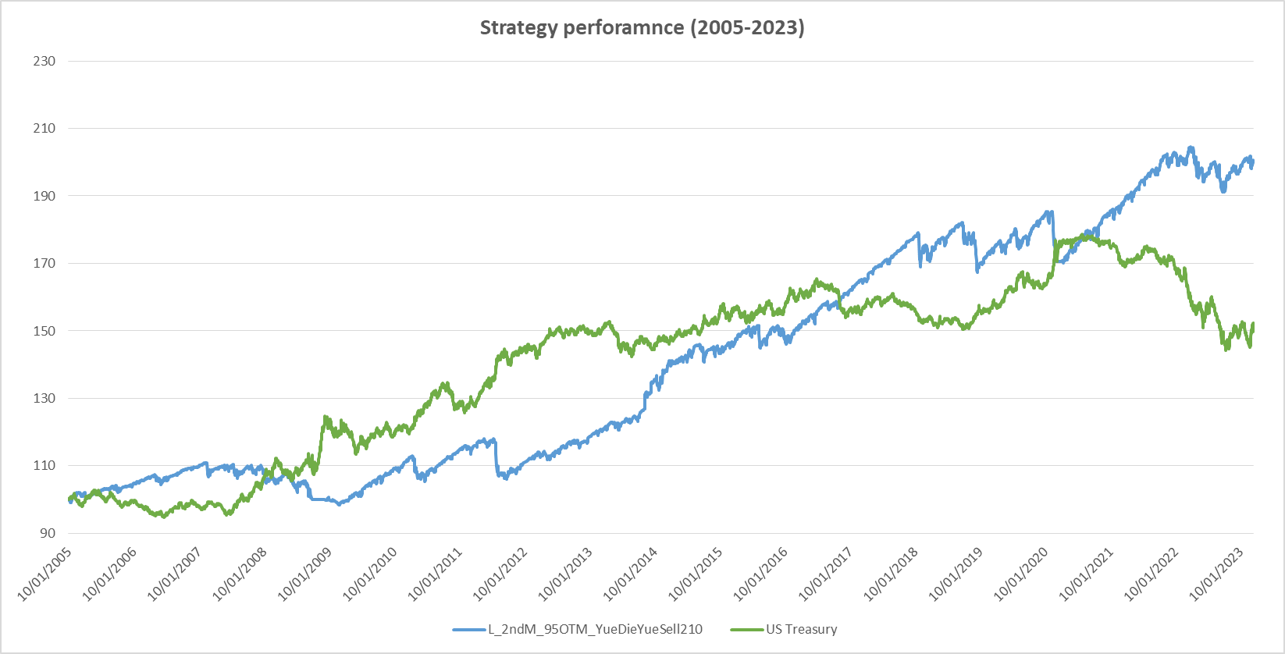
Defensive Proposition
Strategy definition:
6

Slide 7
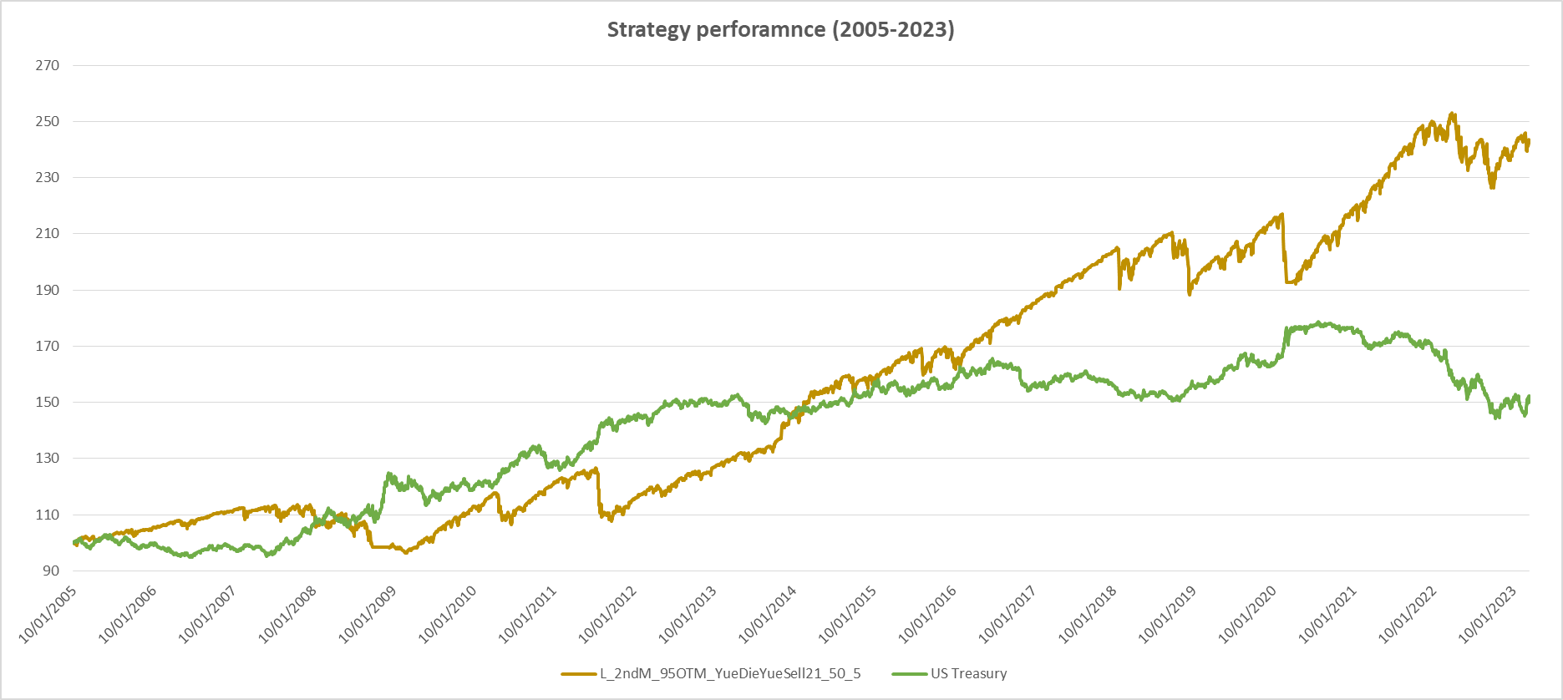
Balanced Proposition
7

Slide 8
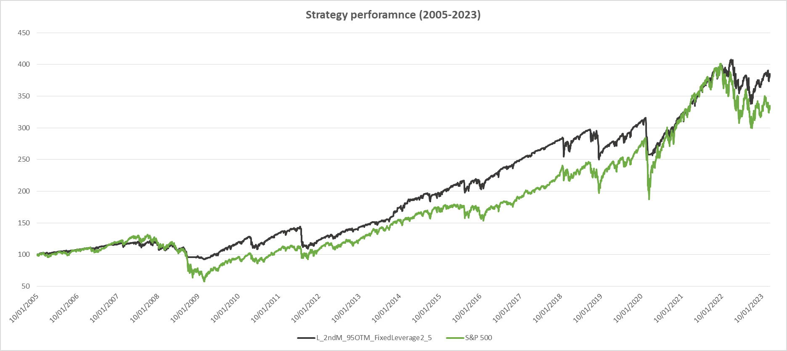
Growth Proposition
8

Slide 9
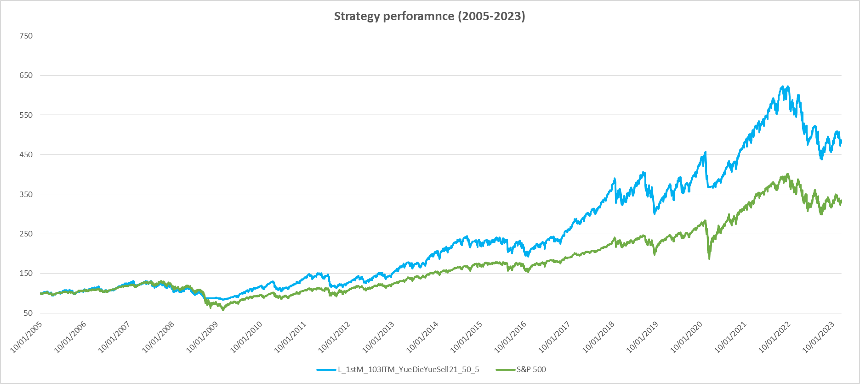
Adventure Proposition
9

Slide 10
Audit Trail
Option pricing model – checked against live option prices over 2016-2023. Most of pricing are close and backtest results are very similar to live trading simulation.
Simulation backtest model – checked as mentioned above.
10

