Slide 1
Not to being smart, but being diversified
Explanation on why to be diversified
Invested in regions (regional diversification)
Asset type diversification
Style diversification

Slide 2
How to be smart on diversification
8 Assets correlation table
* Performance of the long/short basket using representative securities, captures the TAA trade performance (not securities selection)
** Indicative trade date for the pair trade. Note: not all the pair trades were in place for the full YTD period.
*** Distribution of 3-month rolling returns for the pair since Jan-1998

Slide 3
Factor constructions
Not a single strategy would make money forever. Momentum strategy works in trending market but mean-reversion strategy works when factor has gone too extreme. The combination of momentum and mean-reversion strategies, empirically, produces better performance over individual one of them.
All type of strategy signals can be split into 6 categories:
Short-term Momentum | Medium-term Momentum | Long-term Momentum
Short-term Mean-reversion | Medium-term Mean-reversion | Long-term Mean-reversion
Momentum strategy:
stop-loss system
Positive skew
Mean-reversion strategy:
Catch falling knives
Negative skew
Short Term Mean-reversion
Medium Term Momentum
Long Term Mean-Reversion

Slide 4
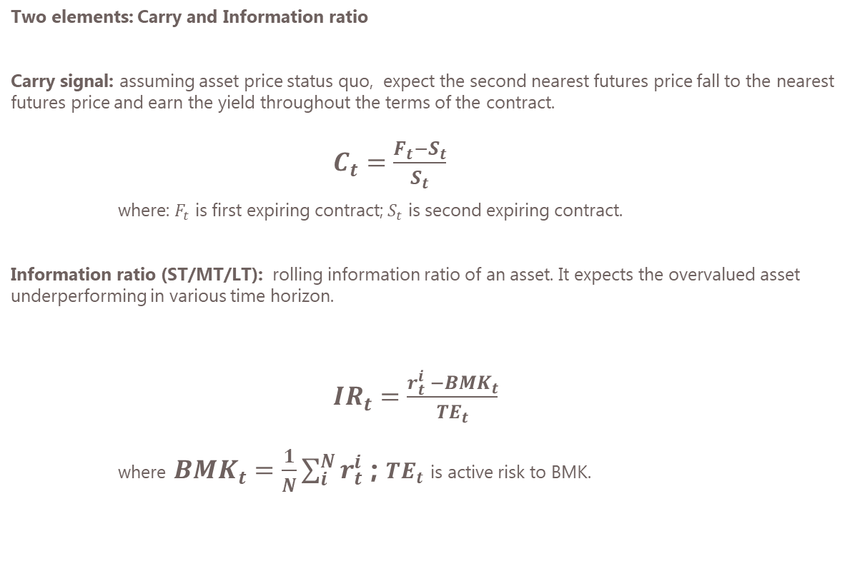
Factor constructions – Mean reversion
Two elements: Carry and Information ratio
Carry signal: assuming asset price status quo, expect the second nearest futures price fall to the nearest futures price and earn the yield throughout the terms of the contract.
$C_{t}=\frac{F_{t}−S_{t}}{S_{t}}$
where: $F_{t}$ is first expiring contract; $S_{t}$ is second expiring contract.
Information ratio (ST/MT/LT): rolling information ratio of an asset. It expects the overvalued asset underperforming in various time horizon.
${IR}_{t}=\frac{r_{t}^{i} −{BMK}_{t}}{{TE}_{t}}$
where ${BMK}_{t}=\frac{1}{N}\sum_{i}^{N}{r_{t}^{i}}$ ; ${TE}_{t}$ is active risk to BMK.
Chart of Carry signal
Chart of IR signal (ST/MT/LT)

Slide 5
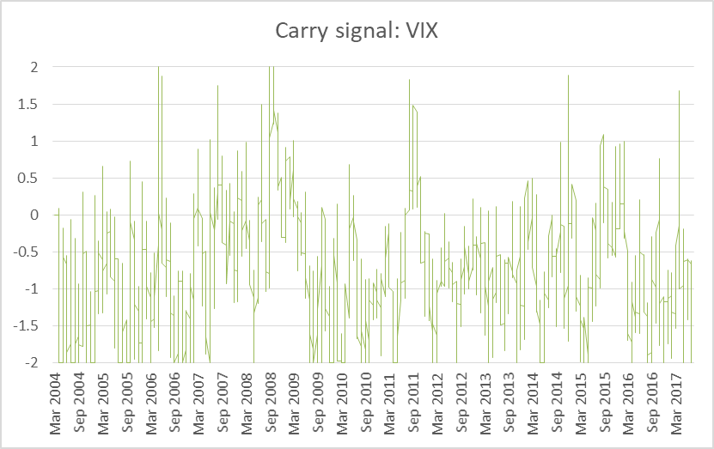
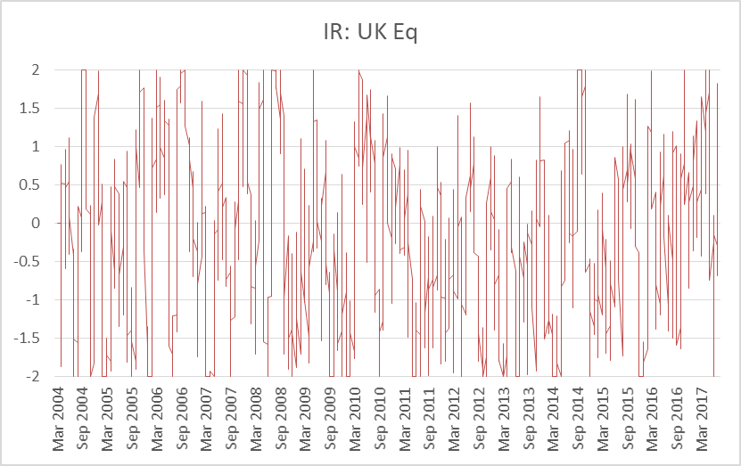
Factor constructions – Mean reversion
Carry signal of VIX
IR signal of UKX

Slide 6
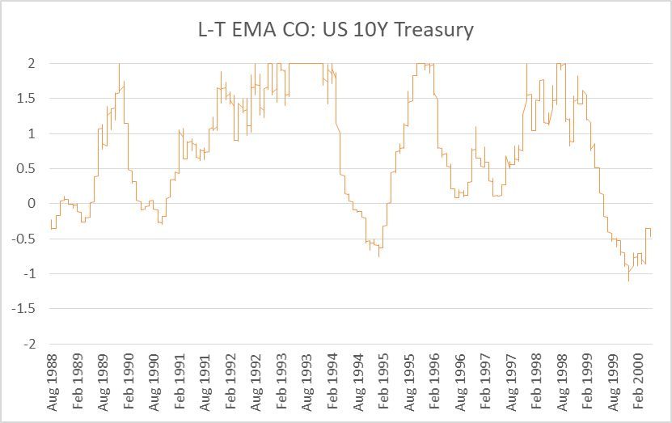
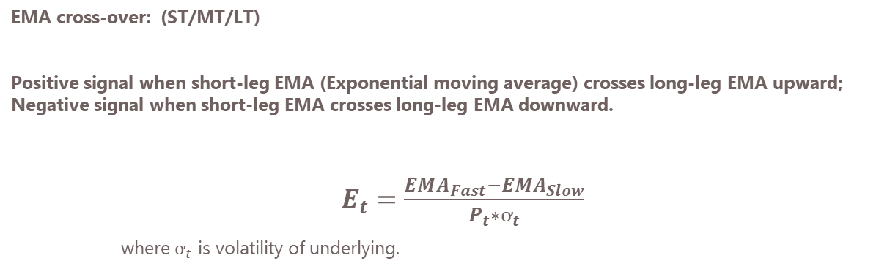
Factor constructions – Momentum
EMA cross-over: (ST/MT/LT)
Positive signal when short-leg EMA (Exponential moving average) crosses long-leg EMA upward; Negative signal when short-leg EMA crosses long-leg EMA downward.
$E_{t}=\frac{{EMA}_{Fast}−{EMA}_{Slow}}{P_{t}∗ơ_{t}}$
where $ơ_{t}$ is volatility of underlying.

Slide 7
Dynamic tuning engine
A good set of variations(parameters) should work well on various instruments. It is especially true for price based strategies. It is also the best way to avoid overfitting by stopping individually tailoring rule for every instrument.
Hence, the “core” set of parameters is defined by the best sharp ratio across all instruments. Fixed income instruments and Equity instruments behave fundamentally different, the core parameters are analysed in separate groups.
In the system, to find the second and third sets of parameters does not rely on the performance or sharpe ratio. Instead, the correlation is the key selection criteria. It is because of that:
(1) It is very difficult to significantly prove that one set of rules outperforms the others.
(2) expected low correlated rules provides diversification benefit.
The table shows the number of years required to be certain that one rule is better than another
Correlation between rules
Sharpe Ratio advantage
0.1
0.25
0.5
-1.0 | 0.0 | 0.5 | 0.8 | 0.95
47 | 47 | 46 | 44 | 37
46 | 45 | 40 | 32 | 10
41 | 37 | 25 | 10 | 3
Source: Systematic Trading

Slide 8
To avoid overfitting
The big problem with strategy constructions is the model is easily get overfitting, after all sorts of optimisation, parameter tuning etc. Model is considered overfitted when it only works for the past in a particular market environment but it works poorly in more general market.
We use bootstrap.
Correlation table example

Slide 9
Combining signals
Maximum sharp ratio portfolio to construct final signal for an instrument:
Chart of Carry signal
Chart of Sharp ratio signal
Chart of Combined signal
Chart of EMA-CO signal

Slide 10
Diversifier multiplier
Given the diversification benefit of signals, we need the DM to bring the combined signal to the defined standard

Slide 11
Trading cost as a vital factor
Actual return = market return – (trading cost + commission).
We try hard to estimate the market return and often fail to do so. Costs is generally certain and easier to predictable. In certain instruments or strategy, costs could be the “deal breaker” although strategies look amazing before costs, especially for short-term strategies.
The model has considered costs seriously and costs are involved in every part of analysis and simulations.
Annualised turnover and cost in Sharpe Ratio term in the simulated back-test based on a $100m portfolio.

Slide 12
Optimization – which one is the best?
List out all possible Optimisation techniques
MVO
Equal risk
Equal risk contribute
Min vol
Max risk-adjusted return

Slide 13
Result - 8 assets model
Final PNL:
AND statistics

