Slide 1
Mup-A-Doodle
Mapping by Muppets

Slide 2

Meet the Team
From Left: Johnny Morris, Dean O’Gorman, Tony O’Keeffe and Louise Harte

Slide 3
Introduction
Interactive Mapping application
MVC4 based design
Written in C# using ASP .Net
Fully Scalable
Integrated API
Utilisation of Bing Maps

Slide 4
Objects\Models
Designed following Object Oriented guidelines
Modelled real-world objects
Created classes
Implemented Inheritance
Models are tables in Database
Incorporated IDataParser interface

Slide 5
Data Sources
Open Source
Open source information
Open source data
Standards and formats
Quality of data
Ingestion and Parsing

Slide 6
Five Tier Model
Domain Model
Service
layer
Presentation Layer
Business
Logic
Layer
Data
Access Layer
Database
Controllers
Views
UI
Business Calculations
Mapping
CSV Parsing
JSON Creation
DAL Objects
CRUD etc.

Slide 7
DAL & UI Implementation
Sits between business logic/controllers and dB
Shields accessing entities from dB details and changes
Consists of a series of venue-like classes for dB access
Consider creating an IVenue and using this as the main object parameter type
UI using Javascript and Bing maps to render aesthetically pleasing front end
Data is serialised and de-serialised requiring different DbContext setting to disable Proxy Creation
Visually displays cities and their venues with venue details

Slide 8
API
ASP.Net Web API Framework
HTTP Web Services
Configured to JSON
Simple searches implemented
Scalable
API Key
Notes:
ASP.Net Web API Framework
Included in MVC 4
HTTP Web Services
Broad range of clients; browsers and mobile devices
Configured to JSON
Text-based
Better for slow connections
Simple searches implemented
Search by city
Search by name
Get all
Scalable
Easily extendable
Include Admin service
Client view
API Key
Security
Diagnostics

Slide 9
NLog
Open source advanced logging platform for .Net
Auditing of API Calls
Keep track of
Requests
Responses
Users

Slide 10
Testing
Unit Testing
Test each tier
Code meets design and intended behaviour
Reinforces loose coupling
Independent, readable tests
Iterative Testing
Print to screen
Test files
Debugging

Slide 11
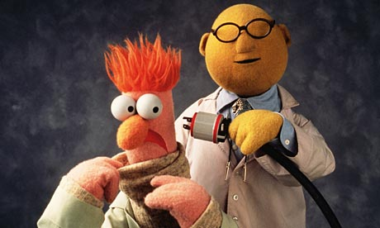
Questions
Q&A

