Slide 1


NBA Player Salaries
A Machine Learning Model
To Predict NBA Salaries

Slide 2
Table of Contents
Page 3 - Introduction
Page 4 - Source of Data
Page 6 – Hypothesis
Page 7 - Brief Summary of CPI (Consumer Price Index)
Page 8 – List of Tools Used
Page 9 - Data Exploration/Analysis
Page 10 – Machine Learning Models
Page 11 – Results and Visualizations

Slide 3
Introduction
Basketball is a rapidly growing sport internationally. The National Basketball Association(NBA) is the league where the top paid and most valuable players play. It was founded in New York City on June 6, 1946, and is currently the third wealthiest professional sports league in North America. Since 2020, the NBA has the highest average annual salary of all professional associations in the world.
As a group we have a mix of interest in sports and finance. In order to accommodate and combine the interests, we decided to investigate the finance side (i.e. salaries) of sports.
We used machine learning models to analyze the statistical production of each player and determine what their salary range will be.
“Everything is worth what its purchaser will pay for it” — Publilius Syrus

Slide 4
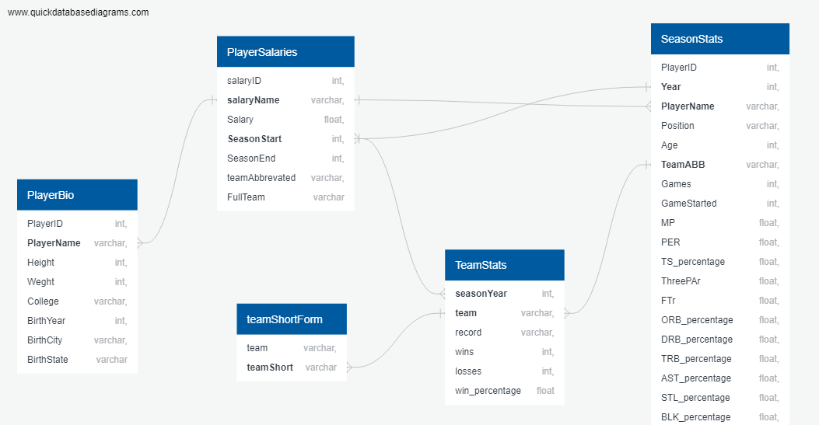
Source of Data
Our datasets currently contain data on NBA players and their season stats. It also contains biographical information and the records of their teams.
https://www.kaggle.com/whitefero/nba-player-salary-19902017
https://www.kaggle.com/drgilermo/nba-players-stats
https://data.world/gmoney/nba-team-records-by-year

Slide 5
Source of Data
Our datasets currently contain data on NBA players and their season stats. It also contains biographical information and the records of their teams.
-https://www.kaggle.com/whitefero/nba-player-salary-19902017
-https://www.kaggle.com/drgilermo/nba-players-stats
-https://data.world/gmoney/nba-team-records-by-year

Slide 6
Source of Data
We are looking to answer how much a player should be paid with the amount of on court statistical production they provide in the major categories. Points, rebounds, assists, steals, blocks, three pointers made, field goal percentage, three point percentage, team record and turnovers are all considered.
The datasets that we found provide salary from the 1990-2017 seasons, which is when the league’s players experienced a massive increase to their salary from the new Collective Bargaining Agreement in 2017.

Slide 7
Hypothesis
The statistics mentioned before will be consider the ‘features’ of our Machine Learning Model. The salary will be the ‘output’. The question we will be hoping to answer is: “Can we predict a player’s salary based on their NBA statistics?”

Slide 8
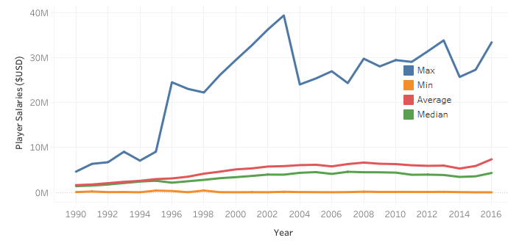
Brief Summary of CPI (Consumer Price Index)
Definition:
A statistical estimate of price fluctuations based on a weighted average of prices for a list of consumer goods and services
Relies on historical price data collected periodically
Can be used to estimate inflationary price increases
Purpose for our project:
Source data included player salaries over several years
For salary summaries (sum, average, etc.) for players to be comparable, we required the salaries to be adjusted so that each year represented the same $ value
CPI module was checked for accuracy and then applied to our source data

Slide 9
Tools Used
Excel was used for ease to explore/filter through whole dataset
SQL was used to join raw csv/datasets into one table
Python/Pandas was used to load in and clean data
Python/Pandas was also used for Machine Learning

Slide 10
Data Exploration/Analysis
Dropping Values:
Advanced stats weren’t tracked throughout all the years in the dataset, so those columns were dropped
Salary data was not available until 1990 so prior years were dropped
Non-statistical/non-predictive values were dropped for the Machine Learning model
Joining Tables:
Joined tables based on player names and year to join their player stats, salaries, and team stats (add image of ERD later)
Realized that some of the players played for multiple teams in a year so to accurately track the data within a year, some of the columns need to be summed while others need to be averaged
Adjusting Data
Salaries were adjusted using a CPI inflation module so that the $ is reported in the same value
Salaries were placed into ranges to work with Machine Learning model better

Slide 11
Machine Learning Models
Linear Regression: Used to determine if we could predict salary based on aggregate stats by curve-fitting
Random Forest: Used to determine if stats can predict salaries divided by clusters (based on various ranges) and rank the feature importance of stats

Slide 12
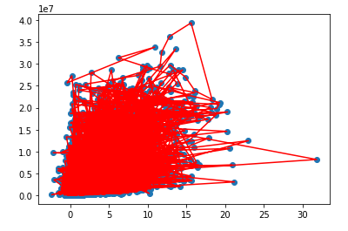
Results and Visualizations
Linear Regression Model
LR could not predict salary based on aggregate stats
Let’s try another ML model

Slide 13
Results and Visualizations
Random Forest Model
Bins Sizes: $1 million, from 0 to $40 million ($0 - $999,999, $1,000,000 - $1,999,999, etc.)

Slide 14
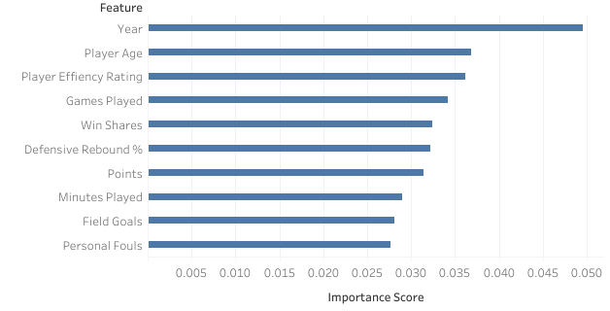
Results and Visualizations
Random Forest Model
Top 10 Features by Importance:

Slide 15
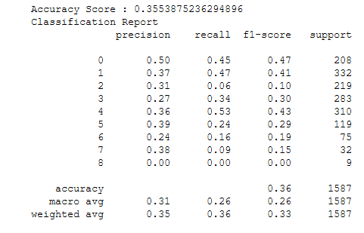
Results and Visualizations
Classification Report

Slide 16
Future Considerations
The machine learning models were not that successful in predicting our target feature. This suggests that there might be other factors at play when teams decide on a player’s salary. Some factors might be:
The Collective Bargaining Agreement having a salary cap, maximum/minimum contracts and rookie contracts
Players have perceived value for very specific skills that don’t end up showing up in the statistics
A player got injured then their production would drop while still being paid
Players take pay cuts to salary in order to play for teams they think will win a championship
Certain teams are less desirable to play for and might end up overpaying for production

