Slide 1
NBA Player Salaries
A Machine Learning Model
To Determine NBA Salaries

Slide 2
Table of Contents
Page 3 to 4 – Introduction
Page 5 to 6 – Source of Data
Page 5 – Description of the Data Exploration Phase
Page 6 – Description of the Analysis Phase
Page 7 – Tools used

Slide 3

Introduction – Selected Topic
Basketball is a rapidly growing sport internationally. The National Basketball Association(NBA) is the league where the top paid and most sought after players play in. It was founded in New York City on June 6, 1946 and is currently the third wealthiest professional sports league in North America. Since 2020, the NBA has the highest average annual salary of all professional athletes in the world.
We will use a machine learning model to analyze the statistical production of each player and determine what their salary range will be.
“Everything is worth what its purchaser will pay for it” — Publilius Syrus

Slide 4


Introduction – Topic & Questions to Answer
As a group we have a mix of interest in sports and finance. In order to accommodate and combine the interests, we decided to take a look at the finance side (i.e. salaries) of sports
We will use the player’s statistics as the ‘features’ of our Machine Learning Model and the player's salary will be the ‘output’. The questions we are hoping to answer are:
“Can we predict a player’s salary based on their NBA statistics?”
“Do player statistics have an impact on salaries”
“If so, which statistics have a greater impact on salaries or are more impactful”

Slide 5
Source of Data
We are looking to answer how much a player should be paid with the amount of on court statistical production they provide in the major categories.
Points, rebounds, assists, steals, blocks, three pointers made, field goal percentage, three point percentage, team record and turnovers are all considered.
The datasets that we found provide salary from the 1990-2017 seasons, which is when the league’s players experienced a massive increase to their salary from the new Collective Bargaining Agreement in 2017.

Slide 6
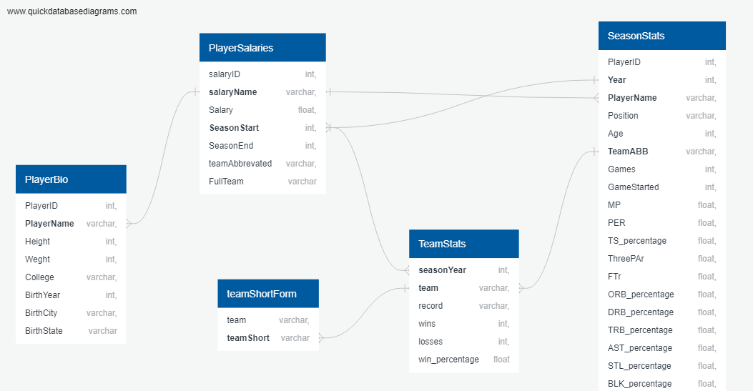
Source of Data
Our datasets currently contain data on NBA players and their season stats. It also contains biographical information and the records of their teams.
https://www.kaggle.com/whitefero/nba-player-salary-19902017
https://www.kaggle.com/drgilermo/nba-players-stats
https://data.world/gmoney/nba-team-records-by-year

Slide 7
Description of the data exploration phase of the project
Dropping Values:
Advanced stats weren’t tracked throughout all the years in the dataset, so those columns were dropped
Salary data was not available until 1990 so prior years were dropped
Non-statistical/non-predictive values were dropped for the Machine Learning model
Joining Tables:
Joined tables based on player names and year to join their player stats, salaries, and team stats
Realized that some of the players played for multiple teams in a year so to accurately track the data within a year, some of the columns need to be summed while others need to be averaged
Adjusting Data
Salaries were adjusted using a CPI inflation module so that the $ is reported in the same value
Salaries were placed into ranges to work with Machine Learning model better

Slide 8



Tools Used
Excel was used for ease to explore/filter through whole dataset
SQL was used to join raw csv/datasets into one table
Python/Pandas was used to load in and clean data
Python/Pandas was also used for Machine Learning

Slide 9
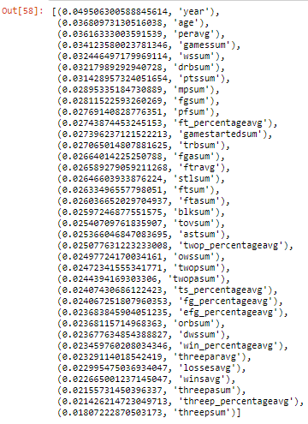
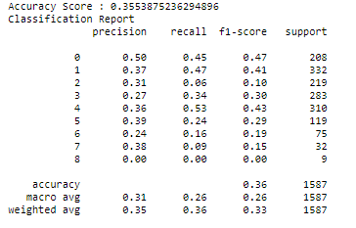
Findings (to be done for deliverable 4)
0. 'Predicted 0 To 999999',
'Predicted 1000000 To 1999999',
'Predicted 2000000 To 2999999',
'Predicted 3000000 To 4999999',
'Predicted 5000000 To 9999999',
'Predicted 10000000 To 14999999',
'Predicted 15000000 To 19999999',
'Predicted 20000000 To 24999999',
'Predicted 25000000 To 39999999']
Notes:
To be done for deliverable 4:
interpret/explain what the scores mean (can either go into detail for each or not, but essentially the model was not very good at predicting)
Explain the ranking of features (maybe add Dean’s visualizations here) we can see that each feature individually doesn’t have much of an impact, therefore other factors might come into play, though the top ranking features are what we’d expect, the longer you play the higher your salary is as indicated by year, age and games. PER = player efficiency rating and WS = win share are also near the top which are usually stats which track player performance as a whole and wins added so those are good metrics to measure/indicate that better/winning players tend to be paid more
Explain that we went from a linear model (not insightful since it was a blob) to Random Forest (to try and improve predictions and determine importance of features; which we see isn’t accurate either) to Deep learning model

