Slide 1


NBA Player Salaries
A Machine Learning Model
To Predict NBA Salaries
Dashboard: https://public.tableau.com/app/profile/dean.arnold/viz/NBASalariesDashboard/NBASalariesDashboard?publish=yes

Slide 2
Table of Contents
Page 3 - Introduction
Page 4 - Hypothesis
Page 5 – Source of Data
Page 9 - Brief Summary of CPI (Consumer Price Index)
Page 10 - Data Exploration/Analysis
Page 14 – Machine Learning Models
Page 15 – Results
Page 19 Future Considerations

Slide 3
Introduction
Basketball is a rapidly growing sport internationally. The National Basketball Association(NBA) is the league where the top paid and most valuable players play. It was founded in New York City on June 6, 1946, and is currently the third wealthiest professional sports league in North America. Since 2020, the NBA has the highest average annual salary of all professional associations in the world.
As a group we have a mix of interest in sports and finance. In order to accommodate and combine the interests, we decided to investigate the finance side (i.e. salaries) of sports.
We used machine learning models to analyze the statistical production of each player and determine what their salary range will be.
“Everything is worth what its purchaser will pay for it” — Publilius Syrus

Slide 4
Hypothesis
The statistics mentioned before will be consider the ‘features’ of our Machine Learning Model. The salary will be the ‘output’. The question we will be hoping to answer is: “Can we predict a player’s salary based on their NBA statistics?”

Slide 5
Source of Data
Our datasets currently contain data on NBA players and their season stats. It also contains biographical information and the records of their teams.
-https://www.kaggle.com/whitefero/nba-player-salary-19902017
-https://www.kaggle.com/drgilermo/nba-players-stats
-https://data.world/gmoney/nba-team-records-by-year

Slide 6
Source of Data
We are looking to answer how much a player should be paid with the amount of on court statistical production they provide in the major categories. Points, rebounds, assists, steals, blocks, three pointers made, field goal percentage, three point percentage, team record and turnovers are all considered.
The datasets that we found provide salary from the 1990-2017 seasons, which is when the league’s players experienced a massive increase to their salary from the new Collective Bargaining Agreement in 2017.

Slide 7
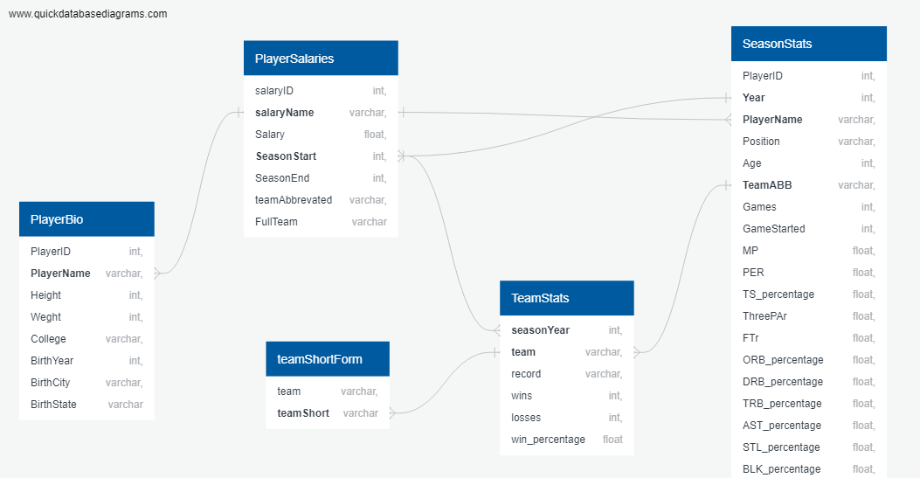
Source of Data
Our datasets currently contain data on NBA players and their season stats. It also contains biographical information and the records of their teams.
https://www.kaggle.com/whitefero/nba-player-salary-19902017
https://www.kaggle.com/drgilermo/nba-players-stats
https://data.world/gmoney/nba-team-records-by-year

Slide 8
Source of Data
Key Variables to be used in joining tables (identifying primary/foreign keys) :
Player Names
Year (season start year)
Team Names

Slide 9
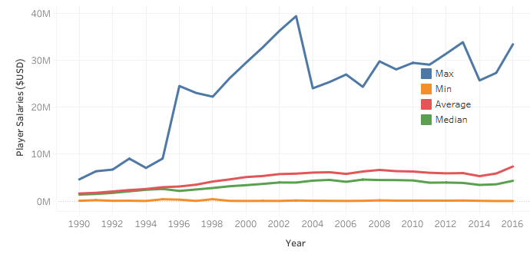
Brief Summary of CPI (Consumer Price Index)
Definition:
A statistical estimate of price fluctuations based on a weighted average of prices for a list of consumer goods and services
Relies on historical price data collected periodically
Can be used to estimate inflationary price increases
Purpose for our project:
Source data included player salaries over several years
For salary summaries (sum, average, etc.) for players to be comparable, we required the salaries to be adjusted so that each year represented the same $ value
CPI module was checked for accuracy and then applied to our source data

Slide 10
Data Exploration/Analysis Tools Used
Excel was used for ease to explore/filter through whole dataset
SQL was used to join raw csv/datasets into one table
Python/Pandas was used to load in and clean data
Python/Pandas was also used for Machine Learning

Slide 11
Data Exploration/Analysis Database
The following describes the SQL tables that were created:
Player Salaries (from raw data)
Player Bio (from raw data)
Season Stats (from raw data)
Team Stats (new table)
Team name short form (new table)
Raw data included the team names variable in both abbreviated and full name form – a new table was created matching each full name to it’s abbreviation in order to join raw data tables

Slide 12
Data Exploration/Analysis Final Joined Table
Team stats was joined with the Team name short form table to create an updated team stats table (joined on team name)
Season stats was joined with player salaries to create a combined season/salary table (joined on player name and year as each player is paid annually)
The above two tables were joined on team name and year – this orders the table based on player team record for each year
The final table was exported as a csv and loaded into a pandas dataframe for cleaning and analysis

Slide 13
Data Exploration/Analysis Data Cleaning
The table was filtered to remove all non-predictive variables
Salary data was unavailable before 1990, so values for all prior years were dropped
Players can play for more than one team per year. For analysis, we required certain values be summed (player stats, as these will vary for each team per year) and others averaged (salaries, as these are annually reported and the same across teams
We ran into issues when trying to sum or average individual columns (all columns ended being summed or average), to overcome this we created separate tables containing sums and averages and merged them on a common id (player name and year)
Unnecessary variables were dropped, and the CPI module was applied to create the cleaned dataframe

Slide 14
Machine Learning Models
Linear Regression: Used to determine if we could predict salary based on aggregate stats by curve-fitting
Random Forest: Used to determine if stats can predict salaries divided by clusters (based on various ranges) and rank the feature importance of stats

Slide 15
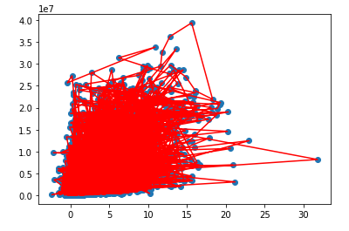
Results
Linear Regression Model
Plot shows adjusted salary vs aggregate stats
Linear Regression model unable to generate predictive line of best fit
Let’s try another ML model

Slide 16
Results
Random Forest Model – Binning by salary range
Bins Sizes: $1 million, from 0 to $40 million ($0 - $999,999, $1,000,000 - $1,999,999, etc.)
9 bins in total
Model was used to determine predictiveness of stats by categorical salary range, and overall accuracy

Slide 17
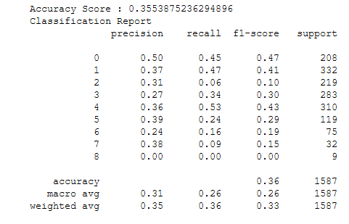
Results
Random Forest Model - Classification Report
Rows are each of the bins
Precision ranges from 0 to 0.50
Recall Ranges from 0 to 0.53
The model is susceptible to both false positives and false negatives (low precision and recall scores for all ranges)
Low accuracy score of 36%
The model could not predict true positives for the highest salary range (annual salaries above $25M)

Slide 18
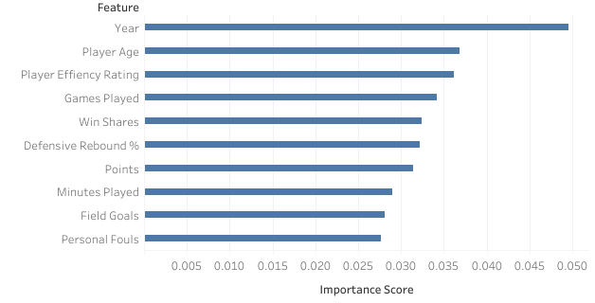
Results
Random Forest Model – Feature Importance
Top 10 Features by Importance:
The most important feature was the year, sharply above player stats
As expected, player age is highly predictive of salary, as performance can drop as players age
Player stats are relatively close in importance score

Slide 19
Future Considerations
The machine learning models demonstrated limited success in predicting our target feature.
This indicates that there are key factors besides player stats, not included in the raw dataset, that strongly influence salary. Some factors might be:
Features of the Collective Bargaining Agreement such as salary cap, maximum/minimum contracts and rookie contracts
Perceived player value based on specific skills not reflected in stats
Injuries resulting in dropped production, whilst the player is still being paid
Voluntary salary cuts that players might take when signing with a team that is perceived to have a high chance of winning championship
Less desirable teams overpaying to retain players

