Slide 1
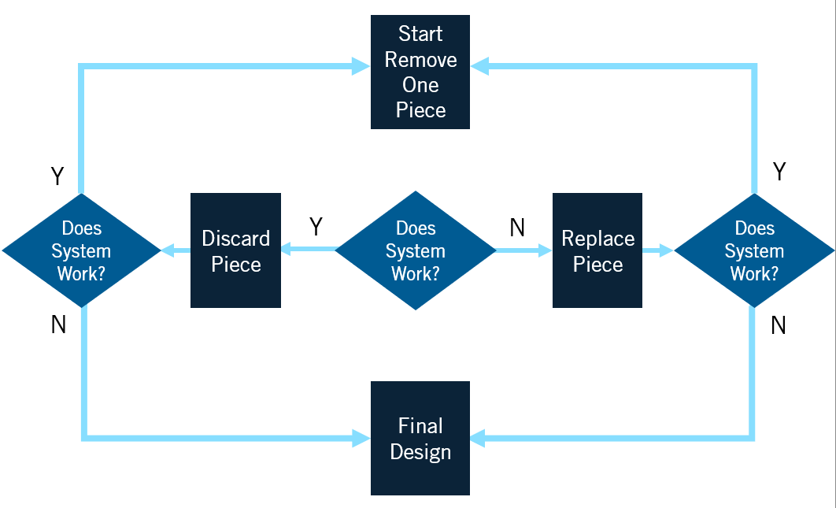
TRIMMING TOOL:
Improve your design by reducing complexity
Hypothesis
When will we stop?
How do we pick which pieces to remove?
Meet threshold / goal
At a certain time
After checking every piece
Other
If we trim __________________________
out of _____________________________
we can _____________________________
Obviously extraneous
Threshold busters
Speedy trim
Acceleration trim
Random
Obviously necessary
Other
I am using the Trimming canvas in order to ___________________
I can tell it is time to stop trimming when _____________________
What are the pieces? List and categorize
Start
remove one piece
How do we remove pieces?
Delete – remove entire piece
Trim – remove portion of piece
Integrate – combine multiple pieces
Shrink – replace with smaller piece
Un-copy – remove redundant piece
Trust – remove a check function
Polish – remove friction between pieces
Relocate – move piece elsewhere
Other
Try again
Discard piece
Does system work?
Replace piece
Try again
Final design
Does the system work? How will you confirm the core function? Describe an experiment & data collection pin
Discard/replace mechanism(s)
How might we ______________________________________________
In the absence of ___________________________________________
Without causing harm to_____________________________________
Discard / replace entire piece
Discard / replace part of piece
Introduce alternative piece
(Perform key function)
(Piece being removed)
(Stakeholders/environment/goals)
itk.mitre.org | itk@mitre.org
Trimming V1
© 2021 The MITRE Corporation. All rights reserved. Approved for public release. Distribution unlimited PR_20-01469-11.

