Slide 1
mindsense
Everything you had in mind for Sisense
Black&yellow Team

Slide 2
What are we solving?
70%

Slide 3
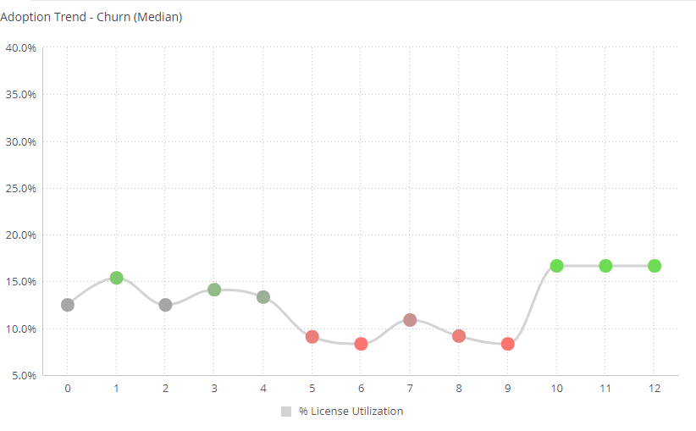
Churn
License utilization in 12 months
Special thank you to Hila Kantor for providing us the numbers

Slide 4
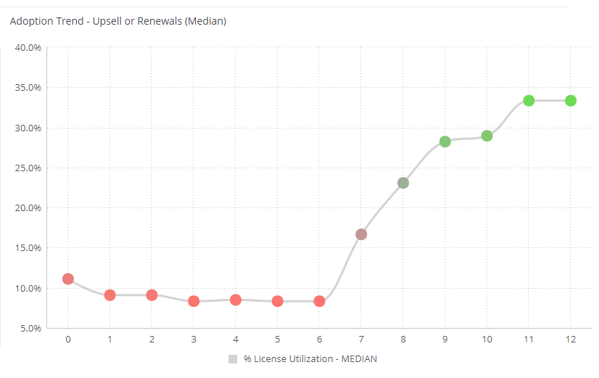
Active
License utilization in 12 months
Special thank you to Hila Kantor for providing us the numbers

Slide 5

Active
License utilization in 12 months
Special thank you to Hila Kantor for providing us the numbers

Slide 6
the solution
MindSense

Slide 7

WHY MINDSENSE

Slide 8
Better Adoption

Slide 9
more Engagement
Better Adoption

Slide 10
more Engagement
Better Adoption
Ultimate Solution

Slide 11
mindsense
Black&yellow Team

