Slide 1

Employee Turnover Prediction Model
Benjy Manning, Cecilia Zhang, Sahar Jamal

Slide 2
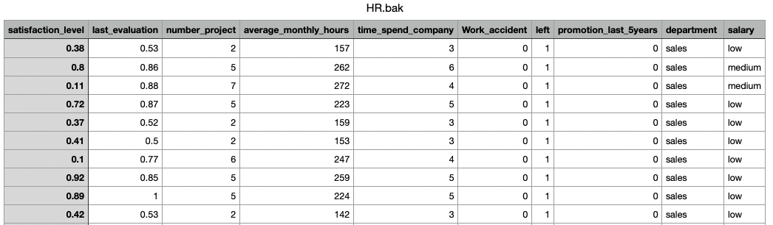
HR Analytics Dataset – Kaggle
~15000 records x10 features
“The dataset contains employee profiles of a large company, where each record is an employee details.”
https://www.kaggle.com/viveknimsarkar/hr-analytics-dataset?select=HR.bak.csv

Slide 3
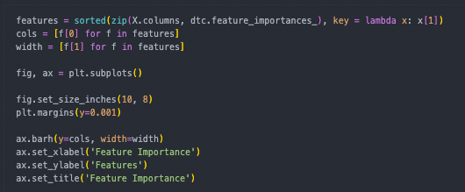
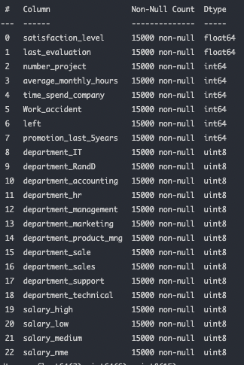
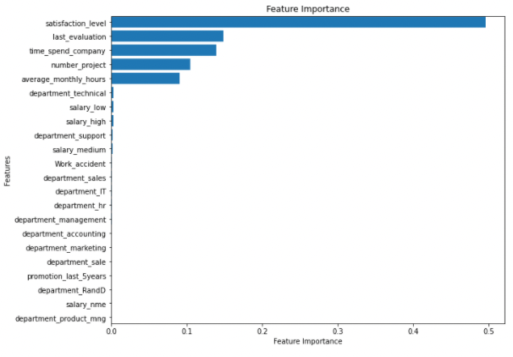
Selecting Data Features
Notes:
The initial data set had 22 columns of data and 15000 records. This data set was found on kaggle. We used some code to determine what features were most important to include in our model. Majority of these columns were not logical to collect this data. They were not broad enough to apply to everyone who might want to utilize or visit this app. This then left us with 5 important features we would collect about the subject in order to predict their outcome. These data points are satisfaction level, last evaluation, time spent with company, number of projects, and average monthly hours.

Slide 4



Programming Tools and Components

Slide 5

HTML & Flask

Slide 6
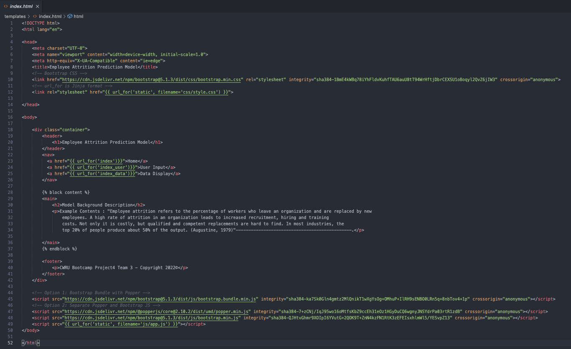

Slide 7
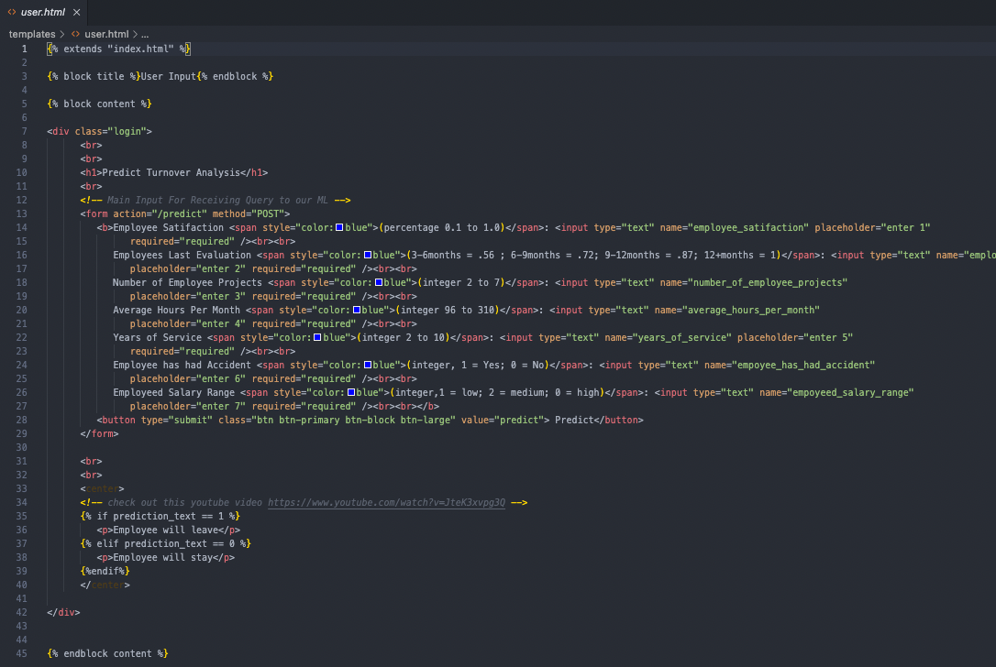

Slide 8
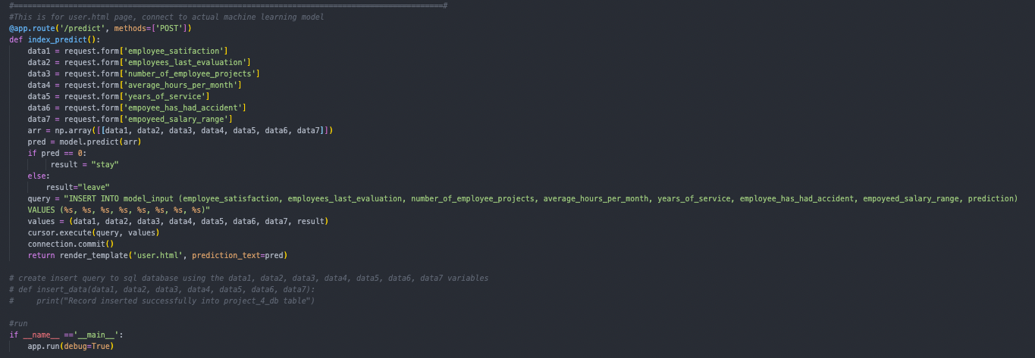
Connecting Modeled Data to Flask

Slide 9
Data Dictionary
df_name | Intuitive Name | Definition | Range | Measure | Model/DB Inputs | DB Dtypes
satisfaction_level | Employee Satifaction | Measurement of employee satisfaction by percentage (0 = Unsatisfied, 100 = Totally Satisfied) | 0-100 | Percent | 0-100 | float
last_evaluation | Employees Last Evaluation | Measurement of how long ago the last review was ( 3-6 months, 6-9 months, 9-12 months, or 12+ months) | 3-6, 6-9, 9-12, 12+ | Months | 3-6 = .56 6-9 = .72 9-12 = .87 12+ = 1 | float
number_projects | Number of Employee Projects | The number of projects the employee is working on simultaneously | 2-7 | Individual Projects | 2-7 | int
average_monthly_hours | Average Hours Per Month | The average number of months the employee works. | 96-310 | Hours | 96-310 | int
time_spend_company | Years of Service | Number of Years the Employee has been with the company | 2-10 | Years | 2-10 | int
Work_accident | Employee has Had Accident | If the emplolyee has had an accident at work | Yes(1) , No (0) | Binary | Yes or No | int (Yes = 1, No = 0)
salary | Employees Salary Range | Band in which the employee pay falls ( Low= Underpaid compared to peers, Medium = Pay appropriate compared to peer employees, High = Overpaid compared to peers) | Low, Medium, High | Selection | Low, Med, High | object to int using get dummies
Notes:
Since there

Slide 10


Hosting and Database Architecture

Slide 11
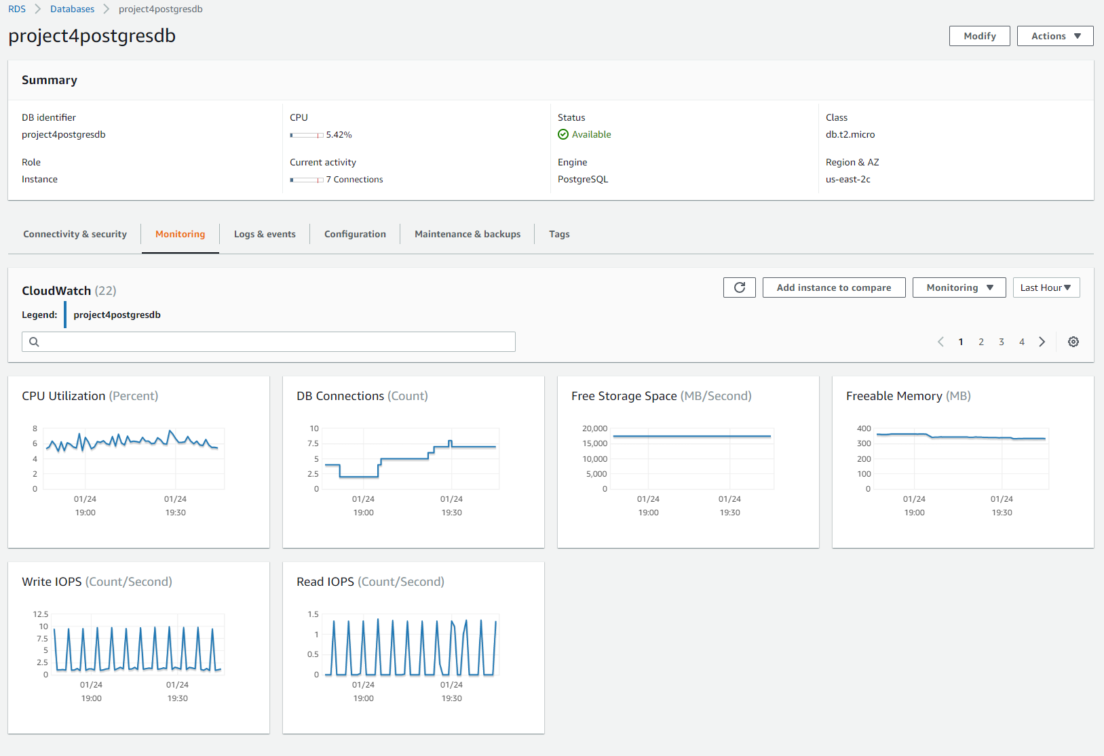
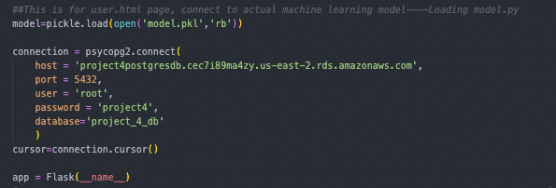
Hosting the Database & connecting via HTML

Slide 12
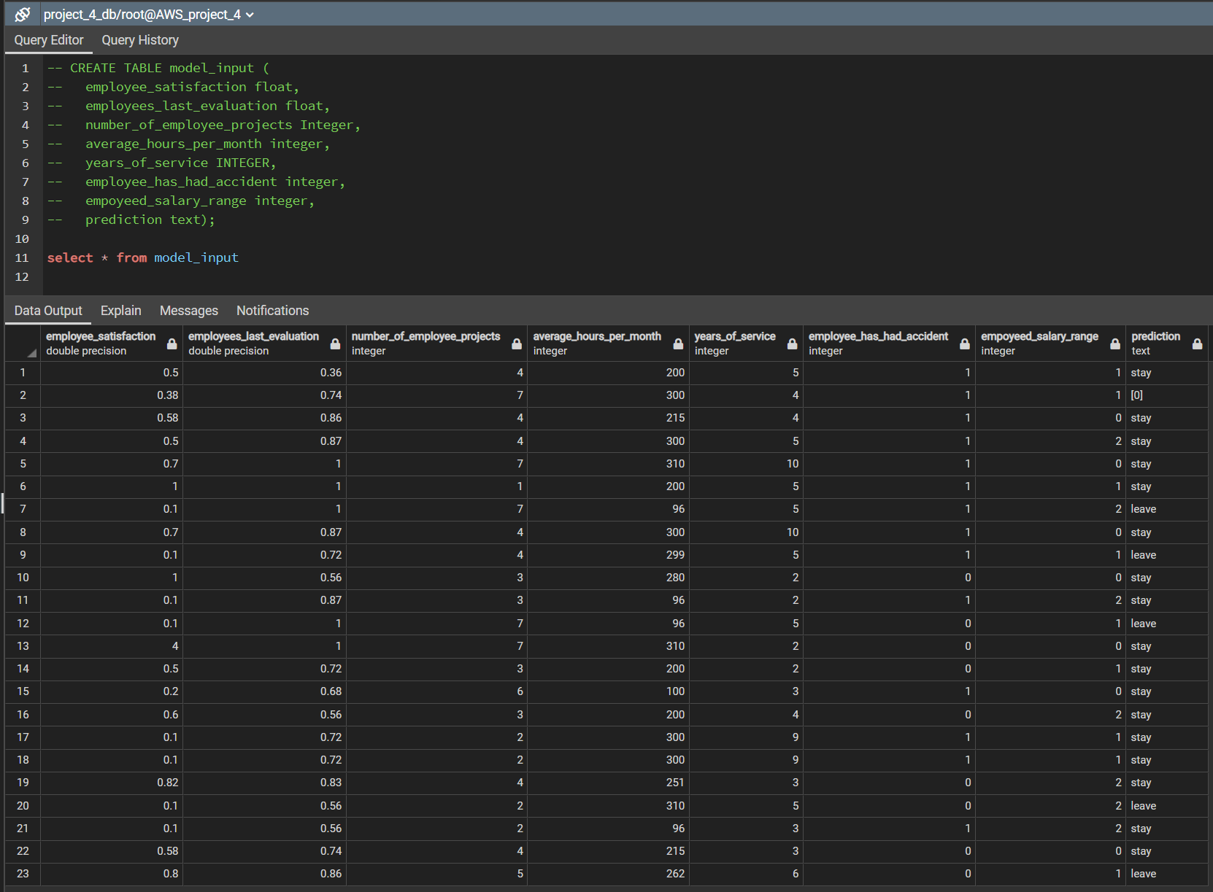
Building the Database & Storing the Data

Slide 13
Deploy to Heroku
Create
Create the App on Heroku.
Create
Create a Procfile for Heroku.
Create
Create a requirement text
Connect
Connect Github to Heroku
Push
Push Your GitHub Repo to Heroku to Deploy.

Slide 14

https://turnoverratepreditapp.herokuapp.com/

