Slide 1
Scholar Name Space/Directed Energy Academic Level Mentor
The following slides are guidance for preparing the technical briefing and to maintain consistency among the briefings.
The briefing must be a maximum of five (5) PowerPoint slides.
No animations or links to other slides/sites/documents are allowed.
Use an Arial font and select the appropriate font sizes for headers, sub-headers and text.
Directorate: Please use “Space Vehicles” or “Directed Energy”

Slide 2
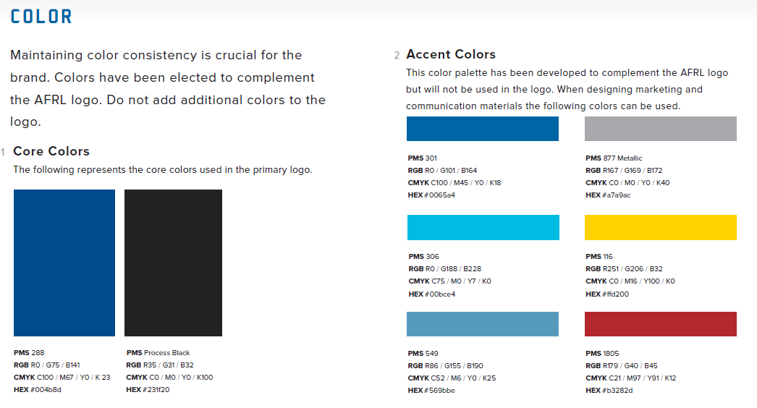
Colors

Slide 3
Distribution Statement
A distribution statement has been included on the slide Master and must not be removed.

Slide 4
Overview
BLUF (Bottom Line Up Front)
Main Points
Support
Conclusion
Explain the overall purpose of the research, e.g. what is the problem.
Explain your experimental approach, including reference of graphics if applicable, e.g. how you tackled the challenges and what options are possible to solve the problem.
Explain the potential future research, e.g., where the research should go next.
“DISTRIBUTION C – Distribution authorized to U.S. Government Agencies and their contractors; Technical content [date of poster session].”

Slide 5
Slide Layout
Goal: Professional, stand-alone briefings
Only use high-value data
Use enough detail to describe meaning without oversimplifying message
Use animation / build effects if they enhance or strengthen your message
Provide clear classification markings if classified
Try to keep main bullets = one line
Sub bullets provide more detail
Avoid just one sub-bullet (if possible)
Fourth level
Fifth level

Slide 6
Bell Curve Charts
Charts & graphs help tell the story
Keep them simple, relevant, and readable
# of Storms
Instructions for making a chart
Click the “Insert” tab
Click on the “Chart” button
Select “X Y (Scatter)” as chart to be inserted (it is the default selection)
Enter values in Excel spreadsheet that pops up when the chart is inserted on the PPT slide
Save PPT Slide and you are done!
Number of Storms in 1999
Quarter
Use the “ASPECT” color palette for Bell Curve Charts. It should be the default selection. Click the ‘Design “ tab, click on the ‘Colors” button on the right side, click on ‘Aspect”

