Slide 1
Opportunity Indicator Onboarding
March 2025

Slide 2
Agenda
Introduction
Process to build an OI
Set up and collaboration
Additional guidelines

Slide 3
The Opportunity Indicator is a 48-hr service performed by the Cost Diagnostic COE to help identify cost opportunities & provide commercial support to account teams
overall_0_131807440991652814 columns_1_131636078172712215 21_0_131738903433273104 22_0_131738903433273104 26_0_131738903433273104 29_0_131807438808058586 31_0_131807438898049071 5_1_131807439211173307 13_1_131807453746378019
% of requests:
80%
20%
Opportunity Indicator
Ad-hoc Commercial Support
What is it?
Outside-in service to identify cost opportunities in a company based on how it performs against comparable peers on key financial metrics
Tailored research & commercial support for account teams, as well as internal ‘growth initiatives’ to advance the team’s ability to advance its support toolkit
When is it performed?
Tailored support: When a Bain Account team needs additional commercial support for an upcoming sales play (beyond the scope of a traditional OI)
Growth initiatives: When the team has extra capacity within the ongoing OI cadence
When a Bain Account team needs a quick answer first but has limited time and client data
What questions does it answer?
In which part(s) of the P&L are we likely to find a cost opportunity? How sizeable is it?
What are the likely “cost plays” to consider?
What additional insights can we provide the account team to help equip them for a potential sales play?
How can we advance our ability to deliver insights & uncover opportunities more efficiently?
Who performs it?
Cost Diagnostic COE, with light support from client team
Cost Diagnostic COE

Slide 4
The Opportunity Indicator output takes several forms; most requests are for a Standard OI, while some requests require more bespoke materials
Types of OI | Commentary | Sample OI
Standard OI | The standard Opportunity Indicator (OI) benchmarks a target company against comparable peers on several metrics (i.e., shareholder returns, top-line growth, cost, and net working capital). The goal of the OI is to understand the potential opportunity or gap that exists between the target company and its peers. Note: For certain industries (e.g., Airlines, Oil & Gas, Retail, Technology), the Standard OI loop includes pages on industry-specific benchmarks. For more information, see Appendix. | Autodesk Pegasus Cracker Barrel
Sector Scan | A sector scan OI benchmarks companies within a sector or subsector against comparable peers using the same metrics as a standard OI as well as any industry-specific metrics. The goal is to assess each company's position relative to peers and identify critical trends across the peer set. | MedTech Sector Scan
Net Working Capital Analysis | A Net Working Capital (NWC) analysis is an OI focused exclusively on the NWC portion of a Standard OI. The goal is to identify opportunities for improvement in cash flow management by benchmarking a company’s DIO, DSO, and DPO relative to peers. | Ford NWC
Cash Flow and Solvency Analysis | A cash flow and solvency analysis is an OI focused on a company’s ability to generate cash and pay off debts; this analysis typically delves into metrics such as FCF and Net Debt / EBITDA, and may involve peer benchmarking if relevant. | Sabre
Industry-Specific OIs (e.g., Banking, Insurance) | Focused on benchmarking core KPIs within certain industries where P&L does not conform to the standard structure (e.g., Banking, Insurance). | Banking [Banamex] Insurance [OneAmerica]

Slide 5
Agenda
Introduction to OI
Process to build an OI
Set up and collaboration
Additional guidelines

Slide 6
Process to build an OI: High-level cadence for engagement with account teams
overall_1_131853661087170100 columns_1_131853661087170100 42_1_132076782673932012
Initiate OI
Intake call
Completed OI shared
NPS Survey
~1-2 days
Typically, 48 hours*
Based on client discussion timeline
Account team
Reach out to Diagnostic CoE
Provide client name and expected timeline for client discussion
Input on peer set for benchmarking and valuation
Join 15-minute intake call (if requested or necessary)
Share client context
Align on scope of analysis and outputs
Share known nuances to sector or company financial reporting
Finalize peer set and valuation approach
Send NPS survey
Ask key account team member to fill out NPS link
Ask to see any known and relevant client discussion materials
Prompt with any follow up tools, resources that might be helpful
CoE team
Confirm team capacity
Suggest (or ask) for peer set
Schedule intake call (if requested or necessary)
Run Opportunity Indicator
Standard analysis takes ~48 hours*
Customization can take up to 1 week
Send completed OI and any relevant follow up materials based on opportunity and client situation
E.g., sector specific analyses, relevant materials & contacts to support sales play
Note: *Subject to team capacity and pipeline

Slide 7
Process to build an OI: Overview of the step-by-step process
overall_0_132077626006419448 columns_1_132076921966464267 4_1_132076953839434906
 |  | Action | Description | Est. time allocation
Day 1 |  | Stage 1: Peer Selection | Gather essential case and company context, including peers; if peers have not been provided by the account team, identify, audit, and share the proposed peer list | 2 hours
 |  | Stage 2: Data Collection & Output Creation | Pull in financials for all companies of interest and make adjustments as necessary to ensure apples-to-apples comparison across the group Run the automated slide generation tool to create the initial OI deck; update the tags, formatting, and footnotes to ensure the deck is ready for review | 14-16 hours*
Day 2 |  | Stage 3: Savings Identification | Research key trends across the deck; understand critical similarities / differences between the target and its peers Assess savings opportunities based on peer analysis derived from Excel Dashboard Create a value-at-stake recommendation for each metric using benchmarks and Bain experience | 3-4 hours
 |  | Stage 4: Output completion | Discuss emerging insights with the LT team; understand what net-new slides or additional research is required Finalize story (tags, footnotes, savings recommendation, etc.); finish execution of the deck and ZD all slides Share the deck with LT for final review; action feedback Share findings with the account team | 2-3 hours
 |  | Continuous improvement | Receive feedback to improve the OI process and product
Typically 48 hours
1
2
3
4
5
Note: *Timing expectations are case dependent; includes time to set up the Excel Dashboard, run the slide gen, and take a first pass at the slide loop

Slide 8
Stage 1 – Peer Selection: Introduction
overall_0_132502973815464807 columns_3_132068249530534771 4_1_132068243855844808 7_1_132502972248158988 12_1_132502972248328154 15_1_132502972248488500 26_1_132502973655446130
1
Stage 1
Overview
Each OI contains companies that we compare and benchmark our target with, to provide a comprehensive analysis
Selecting the right peer group for our analysis is critical for accurate benchmarking
Aligning companies with similar business models, cost structures, and market conditions helps avoid misleading conclusions that could arise from comparing fundamentally different businesses; hence, effective peer selection is the foundation of a meaningful analysis
Inputs / Requirements
Peer selection inputs: Peers are selected either by the account team (the partners/principals/managers requesting the OI) or by the OI team (when a peer set is not provided); analysis should NOT begin until the account team has agreed to the peer set to avoid yield loss
Peer selection requirements:
Comparability: A peer group must be well-defined to ensure apples-to-apples comparisons. To identify a relevant peer set, we must first understand the target’s reporting structure and key financial and operational metrics, including revenue streams, cost allocations, profitability, and segment performance. Non-financial factors like headcount and geographic presence may also be considered for a comprehensive view. These factors are then compared against prospective peers to ensure accurate and meaningful comparisons
Size of peer set: An analysis should be conducted with ~5-8 comparable peers that report publicly available data (unless the account team is able to provide private financials). Selecting fewer than 5 peers might lead to skewed insights, while selecting too many could dilute the relevance of the comparison. Note that 20 peers is the maximum allowed in our dashboard.
Commercial focus: It is important to validate whether the account team has a particular commercial focus in mind (e.g., specific financial metrics, segment-level analysis). If the team is interested in a segment-level analysis or a financial metric that is not widely reported, expectations should be managed early. Segment-level analyses, for example, are often limited to EBIT / EBITDA (as opposed to the full cost bar) due to data availability constraints intends to focus on any specific financial metrics

Slide 9
Stage 1 – Peer Selection: Process Overview
overall_0_132077626006419448 columns_1_132076921966464267 4_1_132076953839434906
1
Stage 1
Note: This stage is only performed when the account team does not have a peer list in mind, and is generally completed by the OI team managers
 |  | Action | Description | Est. time allocation | Value addition
Peer Selection Process |  | Identify peer list | Use ChatGPT to generate an initial list of comparable companies based on industry, business model, and financial characteristics; refine selection using CapIQ’s Quick Competitor Screen, which leverages company-specific filters to identify relevant publicly listed peers | 1 hour
 |  | Audit peer list | Validate peer comparability through financial reporting structures and business unit alignment using earnings reports and CapIQ’s ‘Segments’ screen | 1 hour
 |  | Share peer list with account team | Share the peer list with the account team, aligning on selection criteria and incorporating feedback to ensure relevance before proceeding; sometimes, an Excel spreadsheet is shared to highlight details on peer alignment and comparability with the target | 10 minutes
Stage 1: Peer Selection
1a
1b
1c

Slide 10
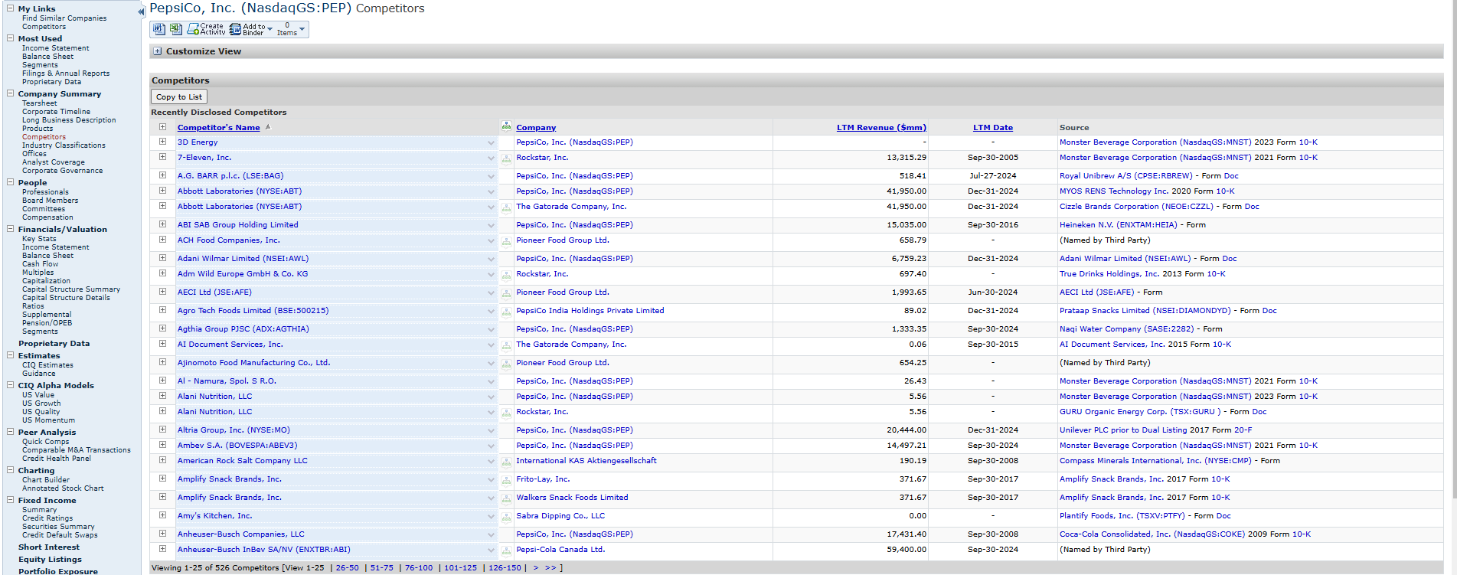
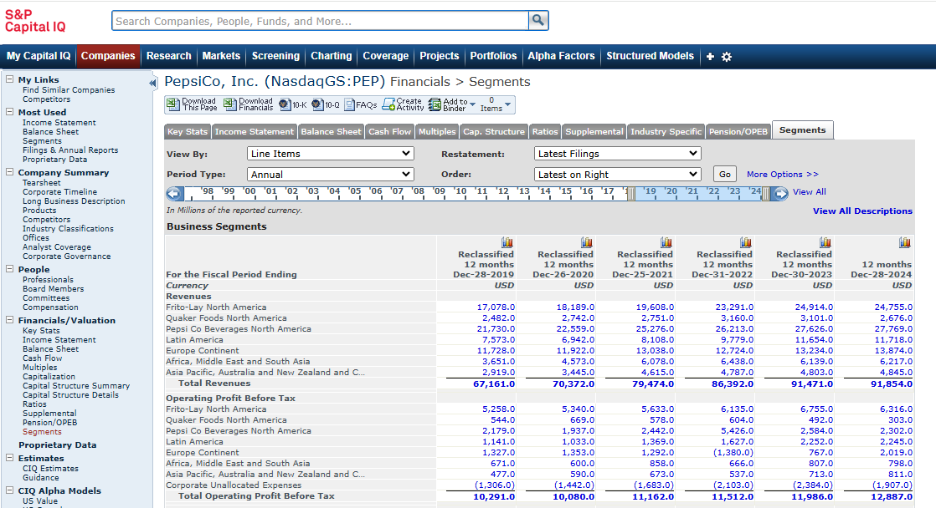
Stage 1 – Peer Selection: Process Breakdown (1/2)
overall_0_132502973815464807 columns_3_132068249530534771 4_1_132068243855844808 7_1_132502972248158988 12_1_132502972248328154 15_1_132502972248488500 26_1_132502973655446130
1
Stage 1
Process & Output
 | Action | Description | CIQ’s Competitor Screen for PepsiCo shows a large list of peers
STEP 1 | Identify list of peers | ChatGPT can be used to generate an initial list of comparable companies based on industry, business model, and financial characteristics, providing a starting point for peer selection CapIQ’s Quick Competitor Screen allows for data-driven peer selection, leveraging financial metrics, industry classifications, and filters to identify relevant peers with publicly available data Look at 10-K, DB Hoovers, Analyst Reports (Thomson Reuters), Seeking Alpha, and/or Google; reading the upfront portion of an Annual report / 10-K (public company’s annual filing with the SEC) is helpful to understand each peer’s product and business model
1a
 |  |  | CIQ’s Segment section for PepsiCo shows its operating BUs
STEP 2 | Audit Peer List | Verify that peers have comparable financial reporting structures to the target; this can be done by visiting each peer’s latest earnings report to validate which line items are listed in the income statement and by analyzing the contribution of each cost bucket to total expenses For large and diversified companies, assess whether their business units (BU) are comparable by evaluating the operational aspects of each company - ensuring alignment in functions and market positioning. This can be done using CIQ’s ‘Segments’ screen In certain scenarios, it is necessary to analyze specific BUs instead of the entire company; in these situations, it is important to confirm that companies release BU data with sufficient granularity (i.e., with data on lower-level cost benchmarks) and that peer BUs are truly comparable
1b

Slide 11
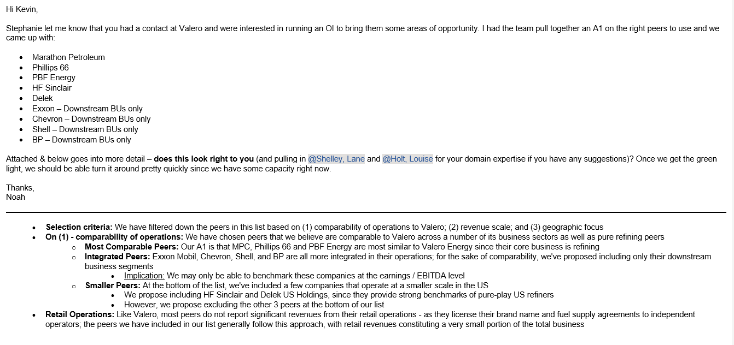
Stage 1 – Peer Selection: Process Breakdown (2/2)
overall_0_132502973815464807 columns_3_132068249530534771 4_1_132068243855844808 7_1_132502972248158988 12_1_132502972248328154 15_1_132502972248488500 26_1_132502973655446130
1
Stage 1
Process & Output
 | Action | Description | A sample email sent to the account team finalizing the peer set for Valero’s OI
STEP 3 | Share peer list with Account Team | Share the peer list with the account team, explaining the selection criteria and noting any limitations in comparability Sometimes, it is helpful to share an Excel spreadsheet that details insights on how peers align to the selection criteria (including any notes on comparability limitations) The account team’s feedback will help ensure the peer set is accurate and relevant before proceeding with the analysis
1c

Slide 12
Stage 1 – Peer Selection: Tips & Best Practices (1/2)
overall_0_132502973815464807 columns_3_132068249530534771 4_1_132068243855844808 7_1_132502972248158988 12_1_132502972248328154 15_1_132502972248488500 26_1_132502973655446130
1
Stage 1
Tips for auditing the peer set:
Functional comparability: Once a potential peer has been identified, ensure they are comparable to the client in the following: size (revenue), geography, cost profile, and product portfolio
CapitalIQ can be used to check the high-level cost structure for a peer to ensure it is loosely aligned with the client/other peers (i.e., if their GM is >15% higher/lower than most peers, this implies there may be something inherently different in their business model)
Reporting period comparability: When auditing the peer set, we also need to make sure that peers report data in the same periods that are of interest for the target
If in between periods (i.e., after Q1), validate when the target’s most recent quarterly financials will be available and ensure most peers are reporting over the same period
If the target’s most recent financials (or a majority of peer financials) aren’t available, identify when they’re expected to be released (via the company’s earnings / IR calendar) and confirm with the account team if they have time to wait for the updated financials or if they don’t mind using the previous year’s
Tips for dealing with private peers:
Do not automatically dismiss privately held peers; some private companies (particularly those in EMEA) may have data available on CapIQ or on their websites
You may also submit a request to the IS Helpdesk to see if data may be available from another source
Some private companies only disclose high-level financials (i.e., at the revenue and EBIT/DA level); in these instances, it is important to validate with the account team that this level of analysis is of interest to them

Slide 13
Stage 1 – Peer Selection: Tips & Best Practices (2/2)
overall_0_132502973815464807 columns_3_132068249530534771 4_1_132068243855844808 7_1_132502972248158988 12_1_132502972248328154 15_1_132502972248488500 26_1_132502973655446130
1
Stage 1
Tips for analyzing peers at the segment level:
If CapIQ does not provide segment or business unit (BU) data, check the investor relations page, press releases, 10-Q filings, and financial disclosures to determine the level of segment-wise reporting
Ensure peers report similar metrics such as Gross Margin, Revenue, or EBIT/DA to maintain consistency in BU-level analysis; verify that cost structures and reporting categories are truly comparable across BU level peers
General best practices:
If a peer has undergone recent mergers, acquisitions, or restructuring, evaluate whether its financials remain comparable and whether the reclassified/re-stated numbers are available
Companies may classify inventories, receivables, or payables differently - making direct comparisons inaccurate; if re-bucketing is not feasible due to significant variations, reconsider including those peers in the analysis
Cross-check key financial data using CapIQ, investor presentations, regulatory filings, earnings calls, and analyst reports to ensure accuracy and completeness
Consider regional variations/alterations due to COVID-19 pandemic and consider which year / what type of financials can be included

Slide 14
Specific Industry Guidelines
Industry Watch-Outs
Industry | Watch-outs
Retail / CP | Ensure shipping, distribution, and freight costs are consistently defined across peers Assess whether advertising spend can be isolated for benchmarking purposes Clarify whether the retailer is pure-play or also manufactures its own products, as this affects factory optimization levers Capture retail-specific KPIs such as same-store sales growth and total system revenue Consider including operational KPIs like selling square footage Adjust for one-time items such as store closing costs and pre-opening expenses
AMS / Defense | Confirm that R&D expenses are strictly company-funded and exclude any customer-funded R&D
Technology | Determine whether stock-based compensation should be excluded based on the valuation or benchmarking objective Include technology-specific metrics such as S&M Magic Number, Rule of 40, and S&M productivity While capturing EBITDA, check for amortization of acquired intangibles Record adjusted D&A separately to support Rule of 40 analysis Assess whether Product vs. Services Gross Margin can be analyzed separately
ENR | Verify whether levies and excise taxes are recorded within revenue or other operating expenses Ensure pass-through costs are treated consistently across peers Include operational KPIs such as total installed capacity and throughput
ENR-Oil and gas | Check for the presence of derivatives and hedging activities Incorporate relevant CIQ supplemental KPIs such as cost per BOE, production volume mix, and historical MBOE growth Confirm whether exploration costs are included in operating expenses unless otherwise specified
Healthcare | Confirm treatment of in-process R&D (IPR&D) and whether it is included Ensure royalty and collaboration revenues are classified consistently across peers Note that amortization of intangibles is typically acquisition-related and should be analyzed at the EBITDA level Use total costs as the denominator for net working capital (NWC) analysis Exclude acquired R&D where appropriate

Slide 15
Adjustments to look out for while building out the Adjustment Summary
Adjustments non-recurring keywords
Write-offs / asset impairment / facility closure / obsolete inventory | Adjust out
Restructuring costs / severance | Adjust out
Litigation / settlements / legal accruals | Adjust out
Credit losses | Adjust out, unless related to operations (e.g., companies that extend credit cards / financing)
Stock-based compensation | Usually included, unless technology sector (or client excludes)
Acquisition-related costs / transaction fees / business combination | Adjust out
Net gain on asset disposal | Adjust out
Provision for bad debt / (losses) | Adjust out
Reduction in contingent liability | Adjust out
Casualty reserve | Adjust out
Amortization of acquired intangibles | Adjust out ONLY IF ASSOCIATED WITH ACQUISITIONS
Change in fair value of deferred earnout | Adjust out
COVID-19 costs | Adjust out
Derivatives / hedging (usually under Other OpEx) | Adjust out (watch out for utilities, oil/gas where it might be more common)
Russia / Ukraine costs | Adjust out
Foreign currency losses | KEEP
Gain on sale of PPE | Adjust out
D&A on cash flow sheet and income statement does not match | Difference in D&A should be adjusted out/in of relevant cost bucket if needed (usually COGS)
Purchase price allocation / pro forma adjustments | Adjust out
Pro forma financials | Usually we like to use

Slide 16
Adjustment summary- Data collection
Data Collection- General Guidelines
Stage-1 | Once peers are selected, create the Adjustment Summary Always double check the revenue, COGS, SG&A, EBIT, etc. of the “target” company against its Annual Report / 10-K, as these are the numbers the account team (partners) and the client (CEO, SVPs, etc.) are most likely to be familiar with. If there are major discrepancies, identify why and determine appropriate path forward (generally try to align with ARs / 10-Ks) Always use CapIQ data, without significant changes, in order to expedite the process and ensure apples to apples comparison, except: When the deviation between adjusted EBIT/EBITDA and CIQ EBIT/EBITDA are significant; Wherever available, use Non-GAAP financials (For US companies) and Adjusted/Underlined financials (for EU companies) If there are any major outliers in the peer set (SG&A, COGS, etc. looks way off from rest of peers), utilize the 10-Ks to try to figure out why this might be the case and ensure that we have apples-to-apples comparison
Stage-2 | Ensure bucketing of COGS and SG&A is consistent across comps to ensure an apples-to-apples comparison. Key components that usually create discrepancies across comps (use 10-Ks to determine additional detail): Depreciation & Amortization could either be its own line item and/or could be included in COGS or SG&A. Ensure this is consistent across all peers (usually by adding to COGS when it is a separate line item) Rent might be included in COGS or SG&A (usually in retail companies or industries with considerable real estate) R&D is sometimes included within SG&A or as a separate line item. Ensure this is consistent across all peers. In general, for industries where there’s high R&D, it is helpful to ensure it is separate from SG&A (e.g. pharmaceuticals, technology, etc.). In cases where R&D can be excluded from its respective cost bucket for all/most peers, we prefer benchmarking it separately
Stage-3 | Pull CapIQ information on each of the companies into the CIQ Dashboard (see “Key excels used” section for greater detail) and begin to reconcile any key differences between the companies Data should be taken for the past four periods (e.g. FY17-FY20 & LTM FY21) Sometimes certain critical companies don’t have data available. Still include them, but that means sometimes the benchmarks need to be taken off of an earlier year (e.g. 2019 instead of 2020), even if 2020 is still kept on the chart (savings would be calculated based on the target company’s 2018 values) Make sure you are aware of each of the latest years of data for each of the companies (e.g. know that Unilever’s last available data was 2017, not 2018)

Slide 17
Adjustment Summary- Cost Adjustments
Cost Specific- Guidelines
R&D | Complication: Companies not reporting R&D as a separate line item and bucketing it under COGS or SG&A Way Forward/Solution: Typically R&D amount and bucketing is available in footnotes. In case just the amount is available then take a judgement call on bucketing basis where peers bucket this expense
Personnel/Staff costs (Primarily for Non-US companies) | Complication: Some EU companies, especially, report staff/personnel costs instead of typical SG&A and R&D expense items making benchmarking with US peers (usually reporting COGS and SG&A) difficult Way Forward/Solution: Typically allocate staff costs to COGS, SG&A and R&D using relevant employee split provided in annual/investor report. In cases where all/most peers report staff costs as a separate line item, bucketing under other cost heads is not required and staff costs are shown separately [Need to align on both the options with the account team as this is highly directional and might heavily skew performance of that peer]
Distribution and Rent (Mainly for CPG/Retail companies) | Complication: Shipping & Handling/Distribution/Rent might not be consistently reported by all peers under the same head (COGS, SG&A or separate line item) making apples-to-apples benchmarking difficult Way Forward/Solution: Use footnotes to reallocate relevant expenses to ensure comparability For those peers where reallocation is not possible we can take client’s expense as % revenue as proxy to reallocate expenses [Need to align this assumption with account team]
Share-based compensation (Mainly for Tech comps) | Complication: Tech companies (Pinterest, FB, Twitter etc.) usually have significant costs in SBC that might distort the benchmarking exercise Way Forward/Solution: Capture SBC accruing to each major cost bucket (COGS, SG&A and R&D) separately and align with account team on how they want to view the cost buckets (with or w/o SBC)

Slide 18
Stage 2 – Data Collection & Output Creation: Introduction (1/5)
2
Stage 2
Overview
Once the peer list for an OI has been confirmed, the first step to kicking off an OI is building the Excel Dashboard output
The Excel Dashboard is the central tool for the OI analysis, consolidating all financial data, adjustments, and outputs. The dashboard contains a few main tabs:
Input Form – This tab is used to input the names and CapIQ tickers for each peer as well as parameters that are used to scope the CapIQ analysis; this tab must be filled out to enable proper unlinking and seamless data pull from the CapIQ platform
Reporting Structure – Used to document the reporting structures of the target and peers, highlighting key differences for accurate benchmarking
Income Statement Revised – Used to pull in peer financials across multiple years and apply necessary adjustments for standardization
Financials & KPIs – Consolidates key financial data from the Income Statement Revised tab as well as additional metrics sourced from CapIQ
Mekko Graph Outputs – Captures the outputs for each slide in the OI deck
TSR Analysis – Consolidates indexed stock price data and TSR performance for all peers
EV/EBIT(DA) Calculation – Used to model the TSR and EV uplift provided by the value-at-stake recommended in the OI
Slide Automation Excel Input – Contains the same data as the Mekko Graph Outputs tab, but data is pre-sorted and structured for efficient use in generating automated slide outputs
Overview of the main tabs in the Excel Dashboard:
Input Form | Reporting Structure | Income Statement Revised | Financials & KPIs | Mekko Graph Outputs | TSR Analysis | EV/EBIT(DA) Calculation | Slide Automation Excel Input

Slide 19
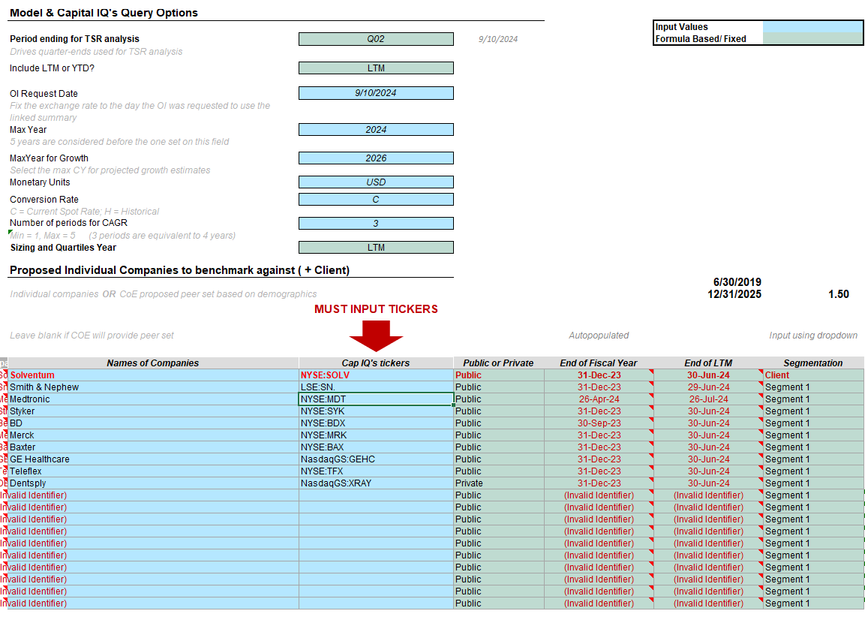
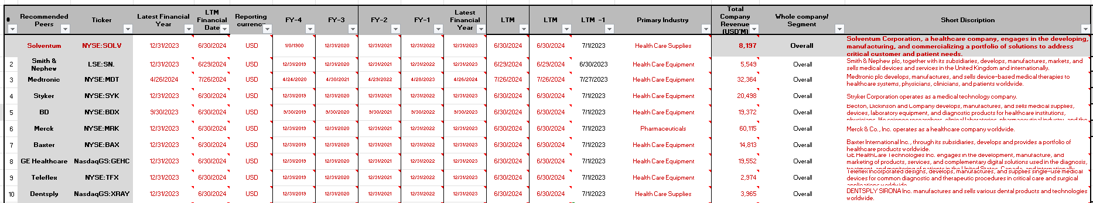
Stage 2 – Data Collection & Output Creation: Introduction (2/5)
2
Stage 2
Input Form Tab
Reporting Structure Tab
The Input Form tab is used to input critical information regarding the target, its peer set, and the parameters of the intended analysis
The full name of each company must be inputted under the ‘Names of Companies’ column, with the associated CapIQ ticker added from the company’s CapIQ page
It is important to adjust the time period of the analysis as well as the monetary units that should be used
The Reporting Structure tab includes information on the reporting period for each peer as well as its industry, latest revenue, and a description of its operations
No input is needed for this tab; however, the tab should be reviewed to account for differences in peers’ reporting structure – which must be noted in the footnotes of the OI analysis

Slide 20
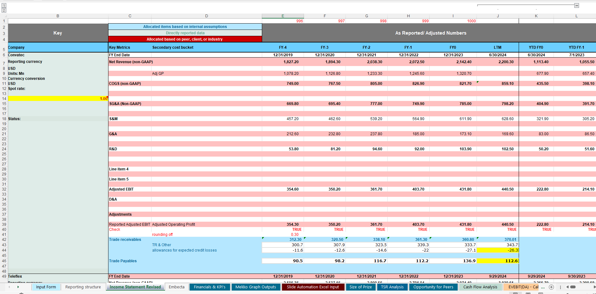
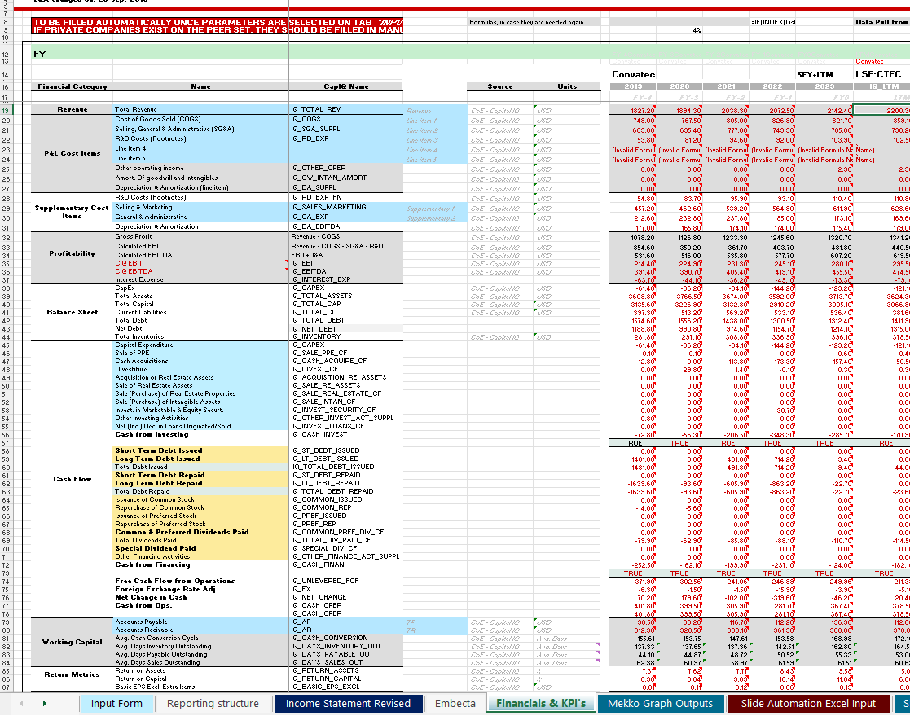
Stage 2 – Data Collection & Output Creation: Introduction (3/5)
2
Stage 2
Income Statement Revised Tab
Financials & KPIs Tab
The Income Statement Revised tab is where all adjustments are made, with reported figures for each peer categorized under the appropriate headers
At the bottom, a reconciliation section ensures accuracy by comparing the reported and calculated numbers
Further, Balance Sheet figures for Trade Receivables and Trade Payables are also included
The Financials & KPIs tab consolidates key financial data from the Income Statement Revised tab, including Revenue, Cost Buckets, Profitability, and Balance Sheet figures. Additionally, it incorporates other financial metrics sourced directly from Capital IQ to ensure comprehensive benchmarking
Proper integration of financial data in the Financials & KPIs tab establishes a strong foundation for all subsequent analysis

Slide 21
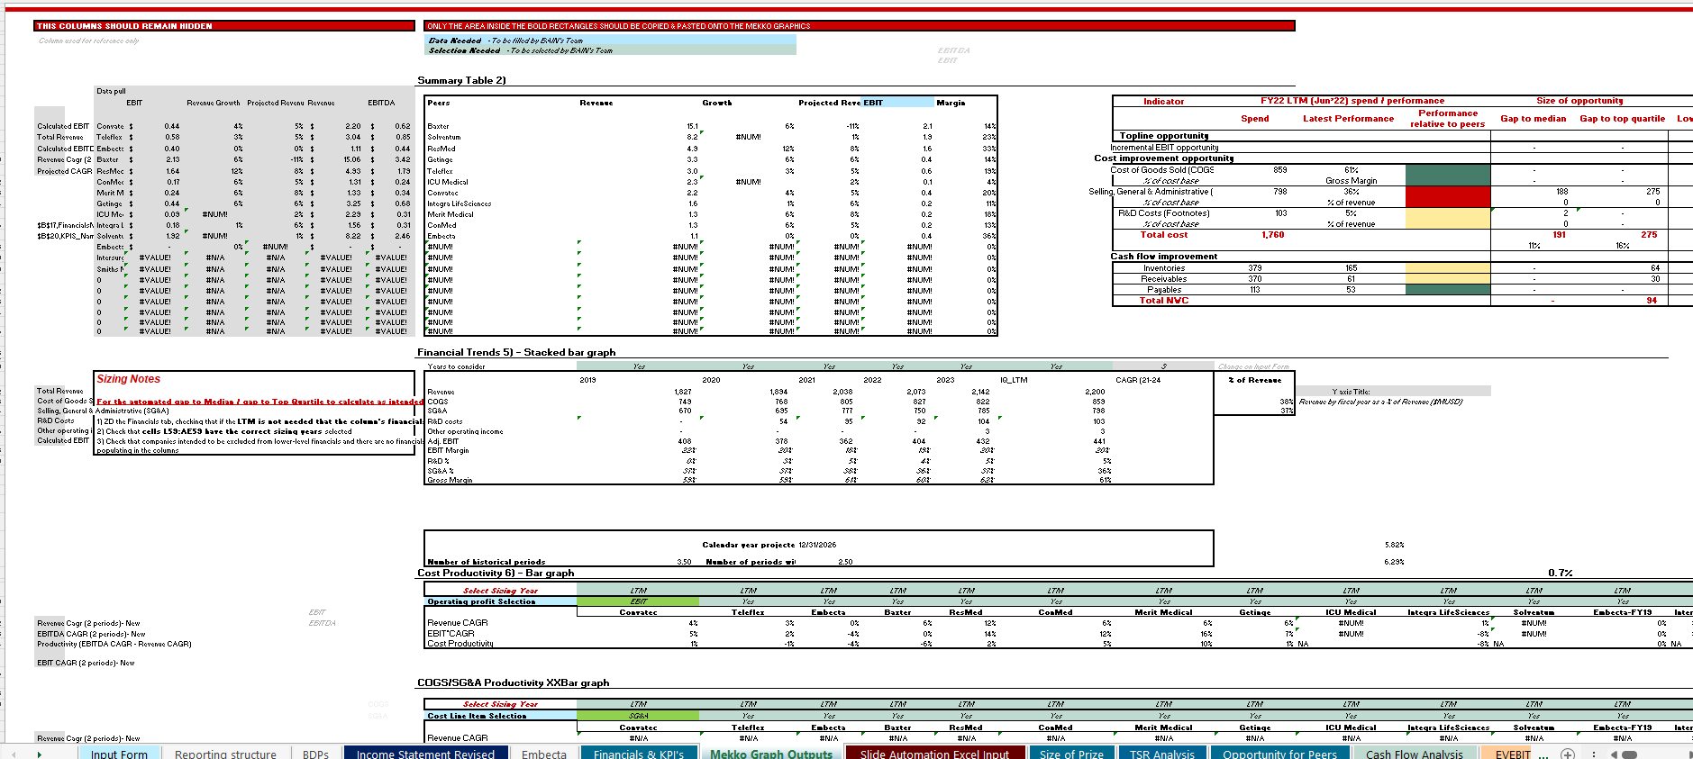
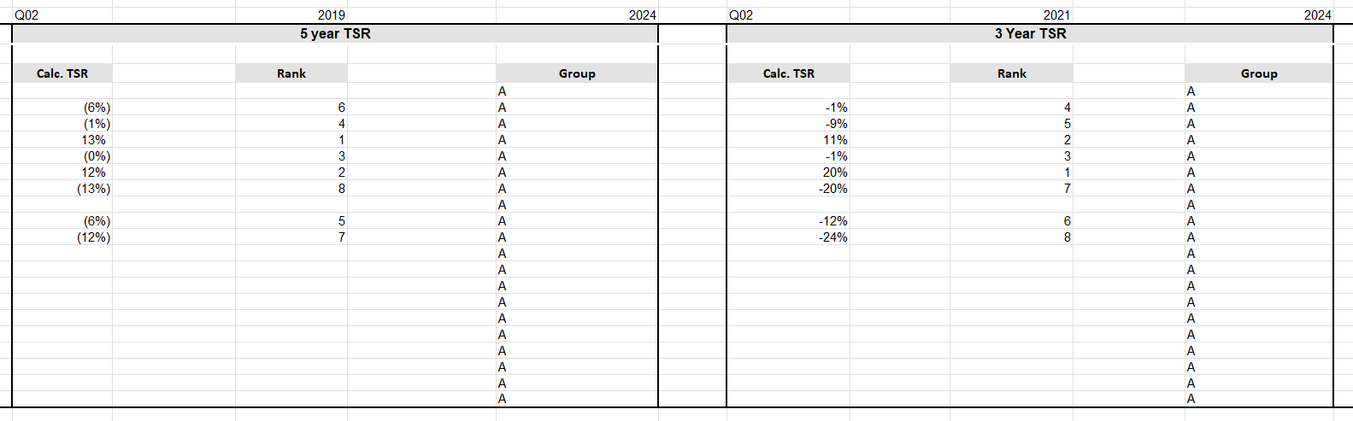
Stage 2 – Data Collection & Output Creation: Introduction (4/5)
2
Stage 2
Mekko Graph Outputs Tab
TSR Analysis Tab
The Mekko Graph Outputs tab consolidates data from the Financials & KPIs tab, ensuring that key financial metrics are accurately mapped to relevant tables such as EBITDA Margin, Net Working Capital (NWC) metrics, and other performance indicators
This tab facilitates automated calculations, reducing manual effort and potential errors
The TSR Analysis tab includes granular data on indexed dividend-adjusted share price for all peers in the last 5 years; this information is used to calculation 5-year, 3-year, and 1-year TSR for each peer
Data from this tab is used to generate the TSR Analysis and Share Price Analysis slides of the standard OI loop

Slide 22
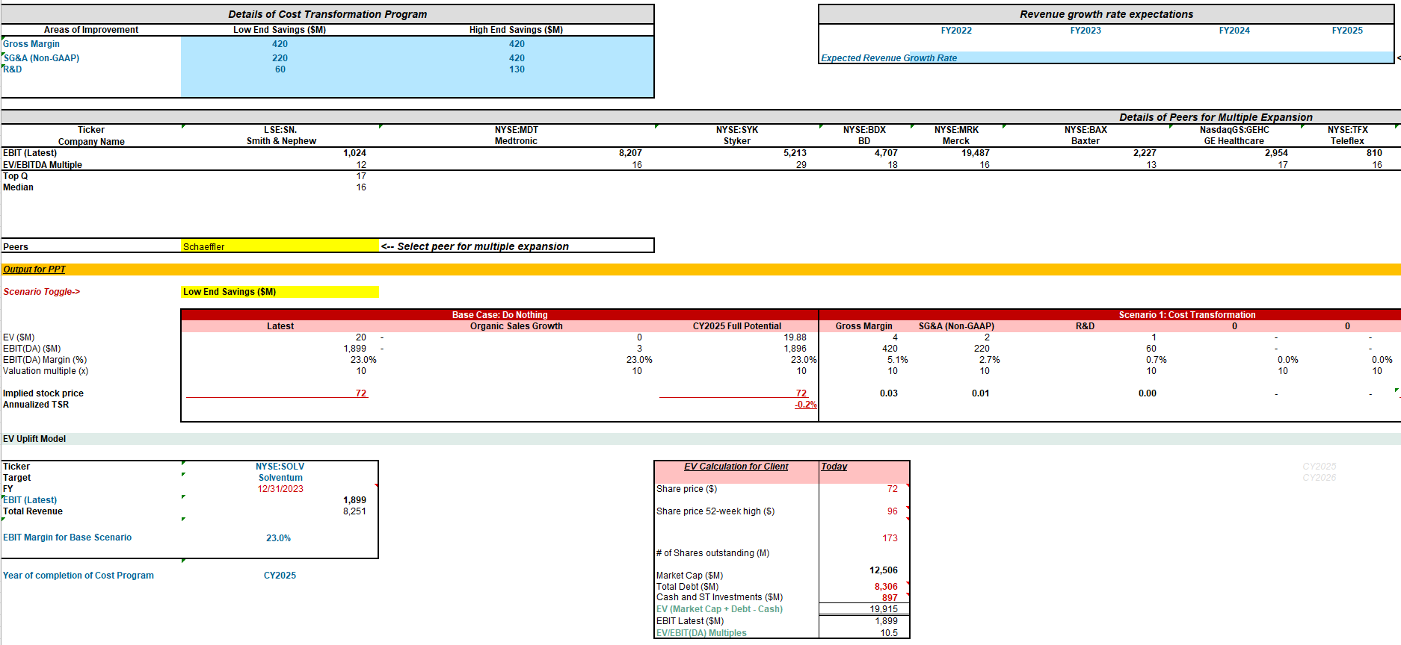
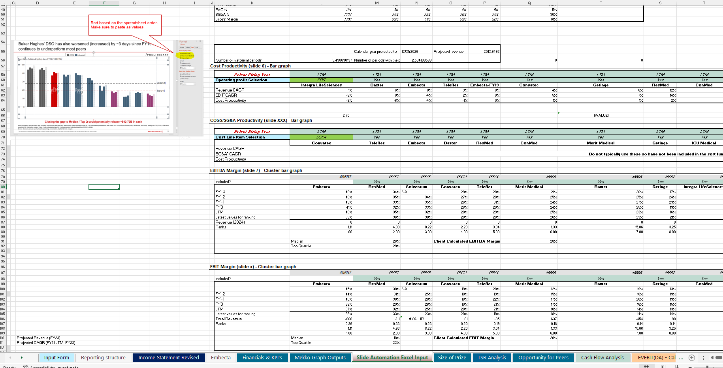
Stage 2 – Data Collection & Output Creation: Introduction (5/5)
2
Stage 2
EV/EBIT(DA) Calculation Tab
Slide Automation Excel Input Tab
The EV/EBIT(DA) Calculation tab is used to model the TSR and EV uplift provided to the target by the value-at-stake opportunity recommended in the OI analysis
The ‘low end’ and ‘high end’ savings numbers and ‘scenario toggle’ fields need to be inputted to generate the output for the associated EV uplift waterfall slide in the standard OI
If the target’s EV is significantly lower than peer median or top quartile, the OI team may consider recommending multiple expansion based on a close peer
The Slide Automation Excel Input tab is similar to the Mekko Graph Outputs tab, as both contain the same financial and performance data. However, this tab ensures data is pre-sorted and structured for direct use in generating automated slide outputs
Data from this tab is copied and pasted into the Slide Automation Excel to facilitate slide generation and automate the slide deck using Think-Cell

Slide 23
Stage 2 – Data Collection & Output Creation: Process overview
overall_0_132077626006419448 columns_1_132076921966464267 4_1_132076953839434906
2
Stage 2
 |  | Action | Description | Est. time allocation | Value addition
Data Collection & Output Creation Process |  | Create an empty Excel Dashboard | Use the Excel Dashboard template to set up a new file for the OI analysis | 10 minutes
 |  | Pull in peer financial data | Pull in the Reported Financials from CapIQ or peer annual reports for each year | 14-16 hours
 |  | Make adjustments to peer financials | Create Non-GAAP / adjusted income statement for the peers to standardize reporting structure to that of the target company
 |  | Review adjustments and validate the dashboard | Review the adjustments and understand the “why” behind the numbers, making additional adjustments as needed
Dashboard |  | Create the initial slide output | Run the linked version of the slide deck template to populate slides with data; take a first pass at updating the deck formatting and tags (e.g., set quartiles on charts, add labels and color coding to bars, revise auto-generated slide tags)
Stage 2: Data collection and output creation
2a
2b
2c
2d
2e

Slide 24
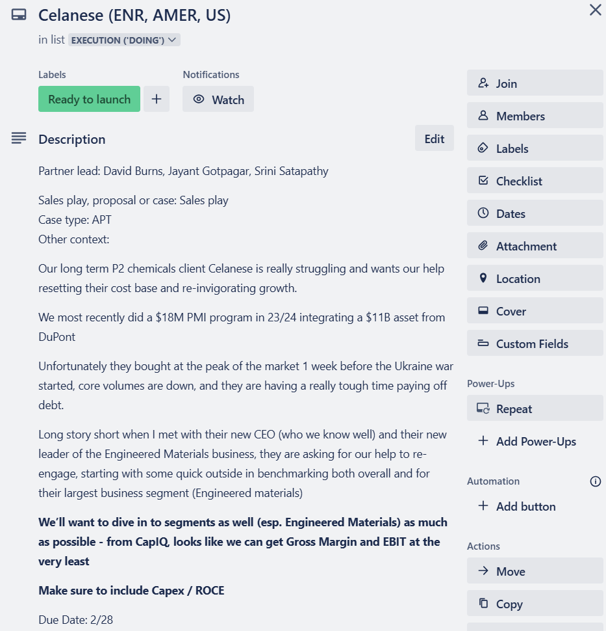
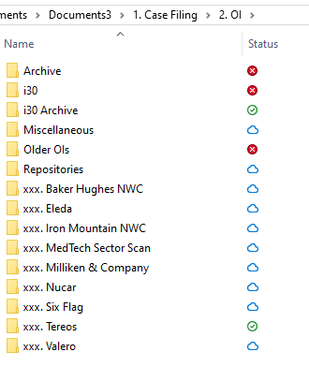
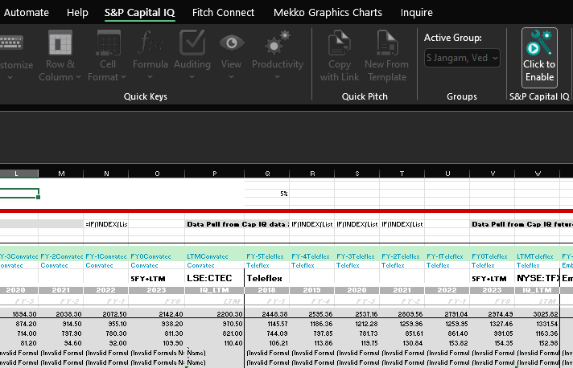
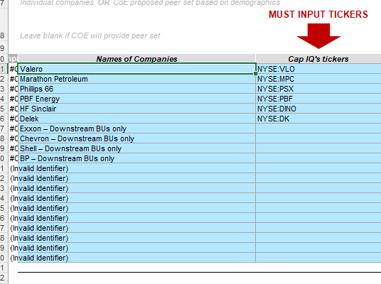
Stage 2 – Data Collection & Output Creation: Process Breakdown (1/8)
overall_0_132502973815464807 columns_3_132068249530534771 4_1_132068243855844808 7_1_132502972248158988 12_1_132502972248328154 15_1_132502972248488500 26_1_132502973655446130
2
Stage 2
Process & Output
 | Action | Description | Process to create an empty Excel Dashboard
STEP 1 | Create an empty Excel Dashboard | Once the peer list is confirmed, every OI begins by checking Trello for details on context provided by the account team (incl. peer list, additional slides that are of interest, etc.) The next step is to create an empty Excel Dashboard: Create a folder for the target company in Case M9DC > OI folder in xxx.Target Name format Get an excel dashboard template from OI Templates>Standard OI>Template Internal. Copy it to the folder and rename it in yymmdd_Adjustment Summary+Dashboard_Target_v1 format Once Capital IQ Excel plugin is installed from its website, then enable the Plugin using Click to Enable Update the peer list in the Input Form tab, starting with the target. Add Tickers for each peer
2a

Slide 25
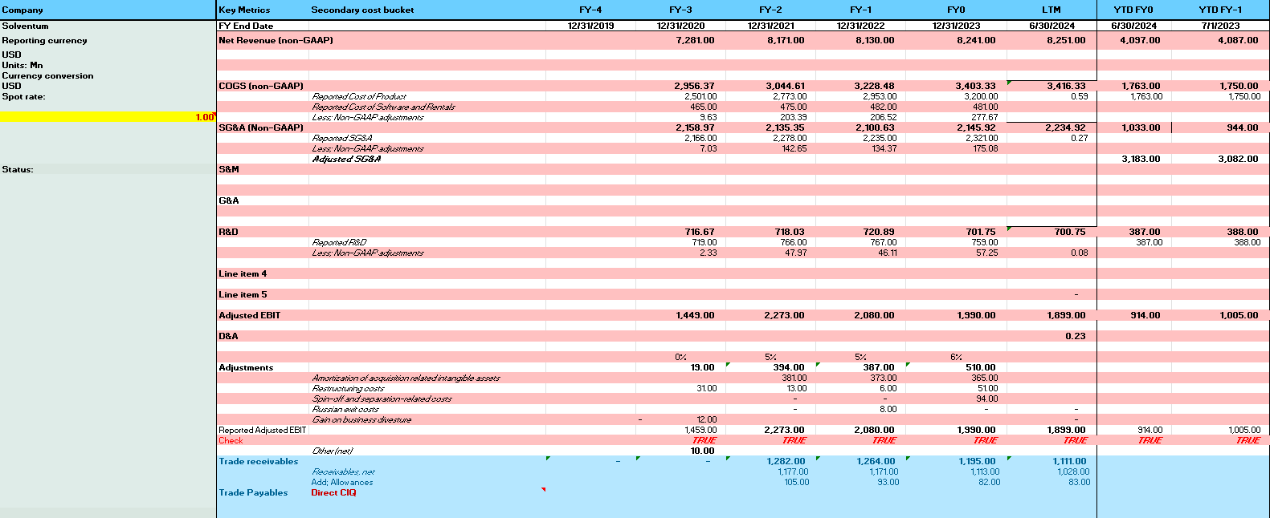
Stage 2 – Data Collection & Output Creation: Process Breakdown (2/8)
overall_0_132502973815464807 columns_3_132068249530534771 4_1_132068243855844808 7_1_132502972248158988 12_1_132502972248328154 15_1_132502972248488500 26_1_132502973655446130
2
Stage 2
Process & Output
 | Action | Description | Process to pull in financial data
STEP 2 | Pull in peer financial data | Once the Excel Dashboard is set up, the next step is to create the Income Statement Revised for all peers Begin by pulling in reported financial information for the target, including any Non-GAAP adjustments (see screenshot) After reviewing the reporting structure of each peer, each peer’s section of the Income Statement Revised tab with reported figures for each line item (using data from the 10-K Report, Annual Report, or Press Release) Before moving on to the next step, Non-GAAP adjustments and non-recurring / exceptional line items must be carved out of reported financials (see ‘Tips & Best Practices’ section for a list of these one-time adjustments)
2b
Reported financials for target company used as basis for adjustments made to peers in the next step

Slide 26
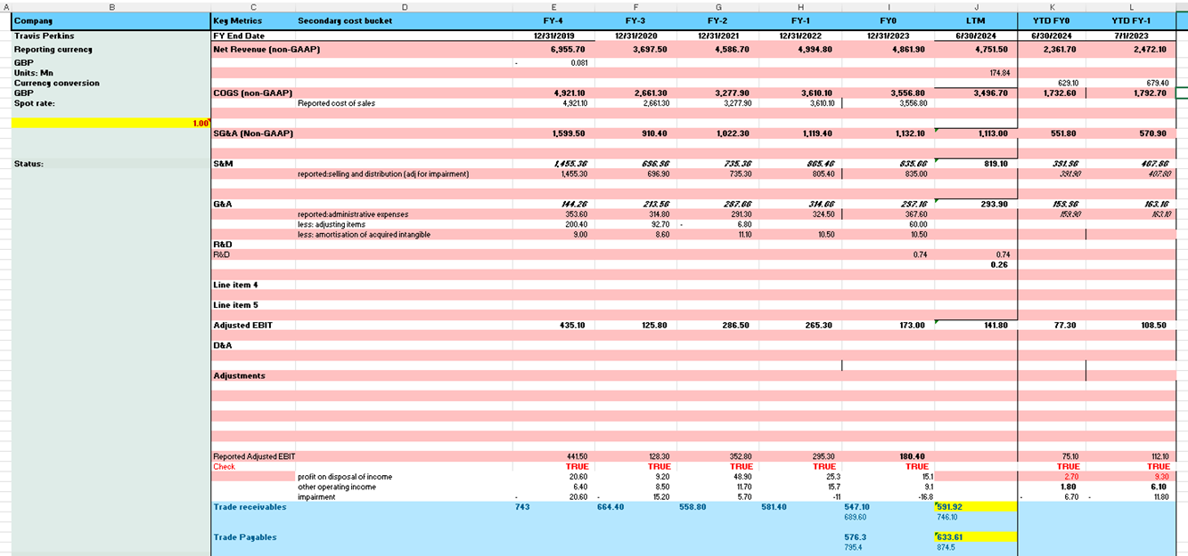
Stage 2 – Data Collection & Output Creation: Process Breakdown (3/8)
overall_0_132502973815464807 columns_3_132068249530534771 4_1_132068243855844808 7_1_132502972248158988 12_1_132502972248328154 15_1_132502972248488500 26_1_132502973655446130
2
Stage 2
Process & Output
 | Action | Description | Process to pull in financial data (Travis Perkins example)
STEP 2 | Pull in peer financial data | The following presents an example of Step 2b for Travis Perkins: Non-GAAP (Adjusted) numbers have been recorded for Travis Perkins; the cost buckets are COGS, and SG&A - with the split between S&M and G&A recorded separately Following BDP, we have removed non-recurring and exceptional items (e.g., amortization of acquired intangibles) from the relevant cost buckets Since Depreciation and Amortization are bucketed under each cost head (e.g., COGS, SG&A, R&D), we have done the analysis at the EBIT level The items added below the “Check” row have been used as reconciling items to reconcile our calculated Adjusted EBIT (row 34) with the Reported Adjusted EBIT (row 47) Gross Trade Receivables have been manually pulled from annual reports across all years. If a company reports Net Trade Receivables, we must add back provisions to calculate Gross Receivables Trade Payables and Inventory have not been recorded, as they are generally pulled directly from CapIQ Note that if a company does not separately report TR and TP, it is okay to use total AR and AP as proxies
2b

Slide 27
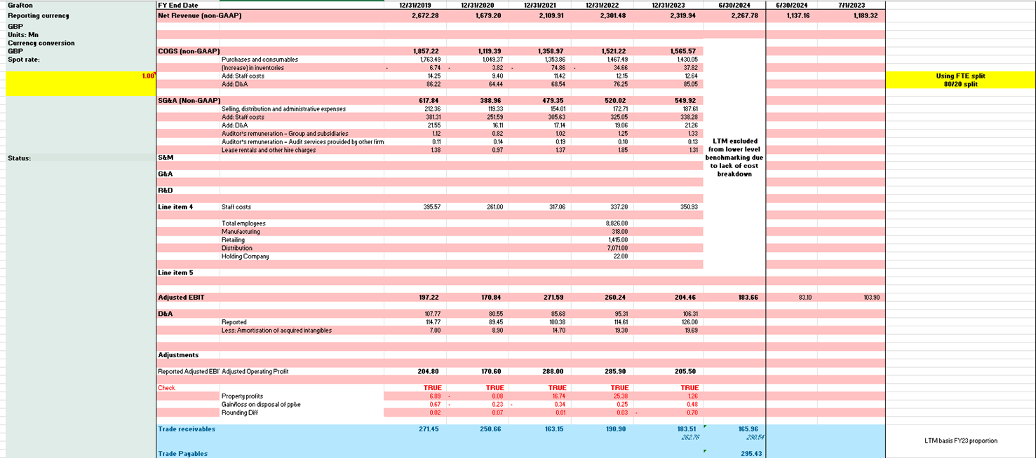
Stage 2 – Data Collection & Output Creation: Process Breakdown (4/8)
overall_0_132502973815464807 columns_3_132068249530534771 4_1_132068243855844808 7_1_132502972248158988 12_1_132502972248328154 15_1_132502972248488500 26_1_132502973655446130
2
Stage 2
Process & Output
 | Action | Description | Process to make adjustments to peer financials
STEP 3 | Make adjustments to peer financials | Once financials for the target and its peers are recorded (less any Non-GAAP adjustments and non-recurring items), we are ready to begin adjusting peers’ income statements to align cost bucketing with that of the target The first step to do this is to visit the target’s latest earnings report to review the definitions of each cost bucket (e.g., COGS) to determine what items have been included or excluded Based on whether peers also include / exclude these items from the relevant cost buckets, we must re-allocate expenses for peers based on how the target has allocated them
2c

Slide 28
Stage 2 – Data Collection & Output Creation: Process Breakdown (5/8)
overall_0_132502973815464807 columns_3_132068249530534771 4_1_132068243855844808 7_1_132502972248158988 12_1_132502972248328154 15_1_132502972248488500 26_1_132502973655446130
2
Stage 2
Process & Output
 | Action | Description | Process to make adjustments to peer financials (Travis Perkins example)
STEP 3 | Make adjustments to peer financials | The following presents an example of Step 2c for Travis Perkins & its peers: For one of the peers, Grafton, we can see various adjustments have been made to ensure all one-off costs have been removed Likewise, we see Staff Costs have been re-bucketed from SG&A to COGS to align with how Travis Perkins has allocated this item Travis Perkins included D&A in each cost bucket; however, Grafton reported its D&A as a separate line item in its Income Statement. As such, we have proportionally split D&A across the two cost buckets Grafton’s LTM has been excluded from the analysis due to lack of public data available for 2024. In cases such as these, we only include the peer from FY19 to the latest year available
2c

Slide 29
Stage 2 – Data Collection & Output Creation: Process Breakdown (6/8)
overall_0_132502973815464807 columns_3_132068249530534771 4_1_132068243855844808 7_1_132502972248158988 12_1_132502972248328154 15_1_132502972248488500 26_1_132502973655446130
2
Stage 2
Process & Output
 | Action | Description | Process to review adjustments & validate the dashboard
STEP 4 | Review adjustments & validate the dashboard | Review once more to ensure any one-off or non-relevant expenses have been removed from the reported figures. For instance, if amortization of intangible assets is included in a cost bucket, it should be adjusted accordingly. See ‘Tips & Best Practices’ page for a list of expenses that should be adjusted out Reverse calculate Reported Adjusted EBIT/DA by subtracting Reconciled items (as reported in the company’s financials) from the calculated Adjusted EBIT/DA; use the CHECK formula to validate that these numbers match Lastly, add a backup tab in our Excel Dashboard for each peer (with screenshots and links of reports used to record numbers) for future reference
2d
The CHECK formula validates that ‘Reported Adjusted EBIT’ plus the 3 items Grafton lists as Reconciled items equals our calculated ‘Adjusted EBIT’

Slide 30
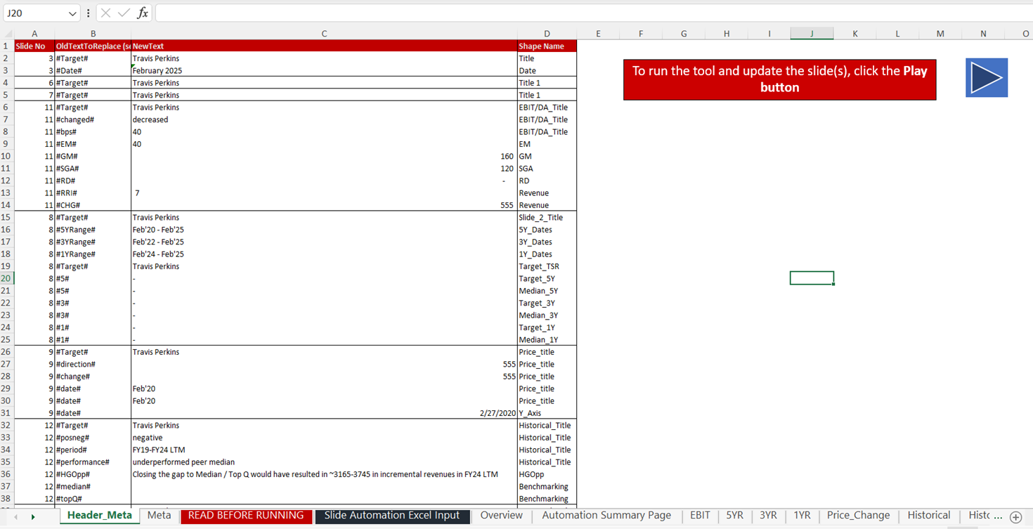
Stage 2 – Data Collection & Output Creation: Process Breakdown (7/8)
overall_0_132502973815464807 columns_3_132068249530534771 4_1_132068243855844808 7_1_132502972248158988 12_1_132502972248328154 15_1_132502972248488500 26_1_132502973655446130
2
Stage 2
Process & Output
 | Action | Description | Process to create the initial slide output
STEP 5 | Create the initial slide output | Create a copy of the Excel Dashboard; in this new file, open the CapIQ dashboard in the Excel ribbon and click ‘Unlink’ Visit the “Input_v3.pptx” file using the following pathway: "8. Templates" -> "OI Templates" -> "1. Standard OI" -> "Automated OI" -> "Think-cell“ Copy a version of this file into the same OI folder where the Excel Dashboard sits Follow the same process for the Slide Automation Excel (Thinkcell) file that sits in the “Think-cell” folder Copy the values from the Slide Automation Excel Input tab of the unlinked file and paste them into the same tab of the Slide Automation Excel In the “Header_Meta” tab of the Slide Automation Excel, update the text in Column C to personalize the content; address errors Close all tabs except for the Slide Automation Excel and the Input PPT and click “Play”
2e

Slide 31
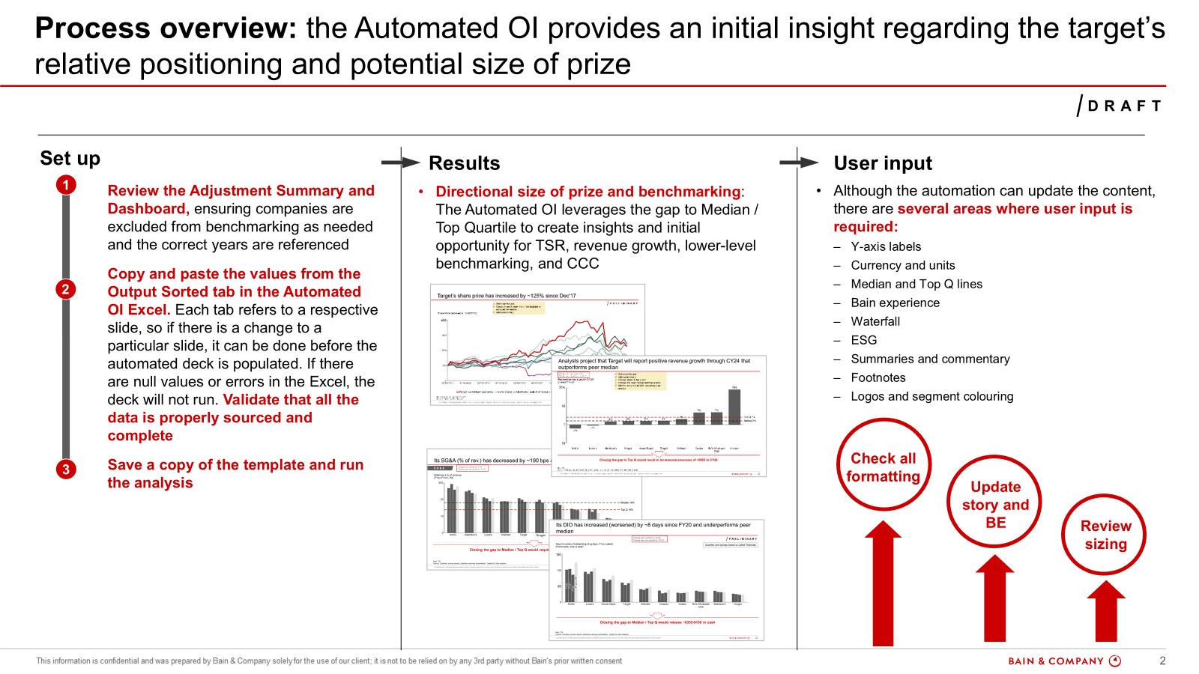
Stage 2 – Data Collection & Output Creation: Process Breakdown (8/8)
overall_0_132502973815464807 columns_3_132068249530534771 4_1_132068243855844808 7_1_132502972248158988 12_1_132502972248328154 15_1_132502972248488500 26_1_132502973655446130
2
Stage 2
Process & Output
 | Action | Description | Process to create the initial slide output
STEP 5 | Create the initial slide output | Once the automated slide gen has been run, the next step is to update the deck It is necessary to flip through each page to make the following updates: Add logos Color-code bars as necessary (to visualize different peer groupings, segments, etc.) Add y-axis labels to all charts Update Median and Top Q lines using data from the Mekko Graph Outputs tab of the unlinked Excel Add footnotes Add ESG slide (see Appendix for more information) Note that the Performance Summary, Cost Savings Summary, Bain Experience, and EBIT/DA / EV waterfall slides will not be updated until Stages 3 and 4
2e

Slide 32
Stage 2 – Data Collection & Output Creation: Tips & Best Practices (1/2)
2
Stage 2
Making the adjustments:
Always double check the reported numbers of the “target” against its Annual Report / 10-K, as these are the numbers the account team and the client are most likely to be familiar with. If there are major discrepancies, identify why and determine appropriate path forward (generally try to align with ARs / 10-Ks)
Wherever available, use Non-GAAP financials (for US companies) and Adjusted/Underlined financials (for EU companies). If there are any major outliers in the peer set (SG&A, COGS, etc. looks way off from rest of peers), utilize the 10-K reports to try to figure out why this might be the case and ensure that we have apples-to-apples comparison
Ensure bucketing of COGS and SG&A is consistent across peers to ensure apples-to-apples comparison. One of the key components that usually create discrepancies across peers are Depreciation & Amortization, which could either be its own line item and/or could be included in COGS or SG&A. Ensure this is consistent across all peers (usually by adding to COGS when it is a separate line item)
Write-offs / asset impairment / facility closure / obsolete inventory should be adjusted out from the reported numbers
Before unlinking the dashboard:
Verify that all values in the Financials & KPIs tab are TRUE. If any FALSE values appear, identify the issue and resolve it accordingly
Review the CAGR values and identify any spikes or drops in Net Working Capital (NWC) numbers
To run the slide Gen:
Copy and paste the values from the Slide Automation Excel Input tab of the unlinked file
Check for any # or error values in the Header Meta tab of the Slide Automation Excel. If errors are found, locate the relevant cells and resolve the issue before running the slide generation process
Rename the output generation deck to Input.ppt before running Slide Gen (if it has a different name)

Slide 33
Stage 2 – Data Collection & Output Creation: Tips & Best Practices (2/2)
2
Stage 2
Guidance for adjusting non-recurring line items
Item | Action
Write-offs / asset impairment / facility closure / obsolete inventory | Adjust out
Restructuring costs / severance | Adjust out
Litigation / settlements / legal accruals | Adjust out
Credit losses | Adjust out, unless related to operations (e.g., companies that extend credit cards / financing)
Stock-based compensation | Usually included, unless technology sector (or client excludes)
Acquisition-related costs / transaction fees / business combination | Adjust out
Net gain on asset disposal | Adjust out
Provision for bad debt / (losses) | Adjust out
Reduction in contingent liability | Adjust out
Casualty reserve | Adjust out
Amortization of acquired intangibles | Adjust out ONLY IF ASSOCIATED WITH ACQUISITIONS
Change in fair value of deferred earnout | Adjust out
COVID-19 costs | Adjust out
Derivatives / hedging (usually under Other OpEx) | Adjust out (watch out for utilities or oil/gas where it might be more common)
Russia / Ukraine costs | Adjust out
Foreign currency losses | Keep in
Gain on sale of PPE | Adjust out
D&A on cash flow sheet and income statement does not match | Difference in D&A should be adjusted out/in of relevant cost bucket if needed (usually COGS)
Purchase price allocation / pro forma adjustments | Adjust out
Pro forma financials | Okay to use pro forma financials for merger cases

Slide 34
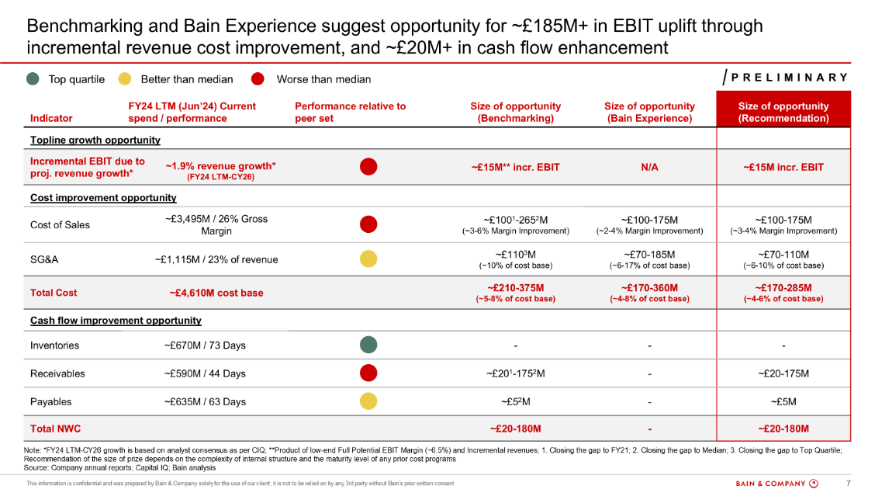
Stage 3 – Savings Identification: Introduction
overall_0_132502973815464807 columns_3_132068249530534771 4_1_132068243855844808 7_1_132502972248158988 12_1_132502972248328154 15_1_132502972248488500 26_1_132502973655446130
3
Stage 3
Overview
Savings identification is a critical step in uncovering optimization opportunities across the cost bar and net working capital
To size the value-at-stake opportunity for the target company, we compare its performance on each metric against benchmarks for comparable peers (typically, but not always, median and top quartile)
Based on these benchmarks, as well as Bain’s internal experience in a given sector, we triangulate a size of prize across 4 core areas: shareholder returns, topline growth, cost, and net working capital
This analysis serves as a key input for the partner/account team to drive efficiency and cost transformation initiatives for prospective clients
Example Cost Savings Summary (for Travis Perkins), which showcases the target’s current performance across core cost & net working capital metrics and recommends a size of prize based on peer benchmarks and Bain experience

Slide 35
Stage 3 – Savings Identification: Process Overview
overall_0_132080267593530230 columns_1_132076921966464267 4_1_132076953839434906
3
Stage 3
 |  | Action | Description | Est. time allocation | Value addition
Savings Identification Process |  | Research peer performance and trends | Flip through each page to identify and research key trends in the data; add call-outs to note the rationale behind industry-wide trends, outliers, and the target’s performance over time | 1 hour
 |  | Assess value-at-stake across core metrics | Calculate value-at-stake opportunity based on peer benchmarks across top-line growth, cost, and net working capital metrics; conduct research to inform value-at-stake recommendation (‘down arrow’) on each slide | 1-2 hours
 |  | Calculate Bain Experience savings potential | Calculate savings potential based on Bain Experience (cross check and validate with practice area, previous OIs, and industry benchmarks on IRIS) | 30 minutes
 |  | Deliver comprehensive value-at-stake recommendation | Construct Cost Savings Summary & overall value-at-stake recommendation based on peer benchmarking and Bain experience | 30 minutes
Stage 3: Savings identification Process
3a
3b
3c
3d

Slide 36
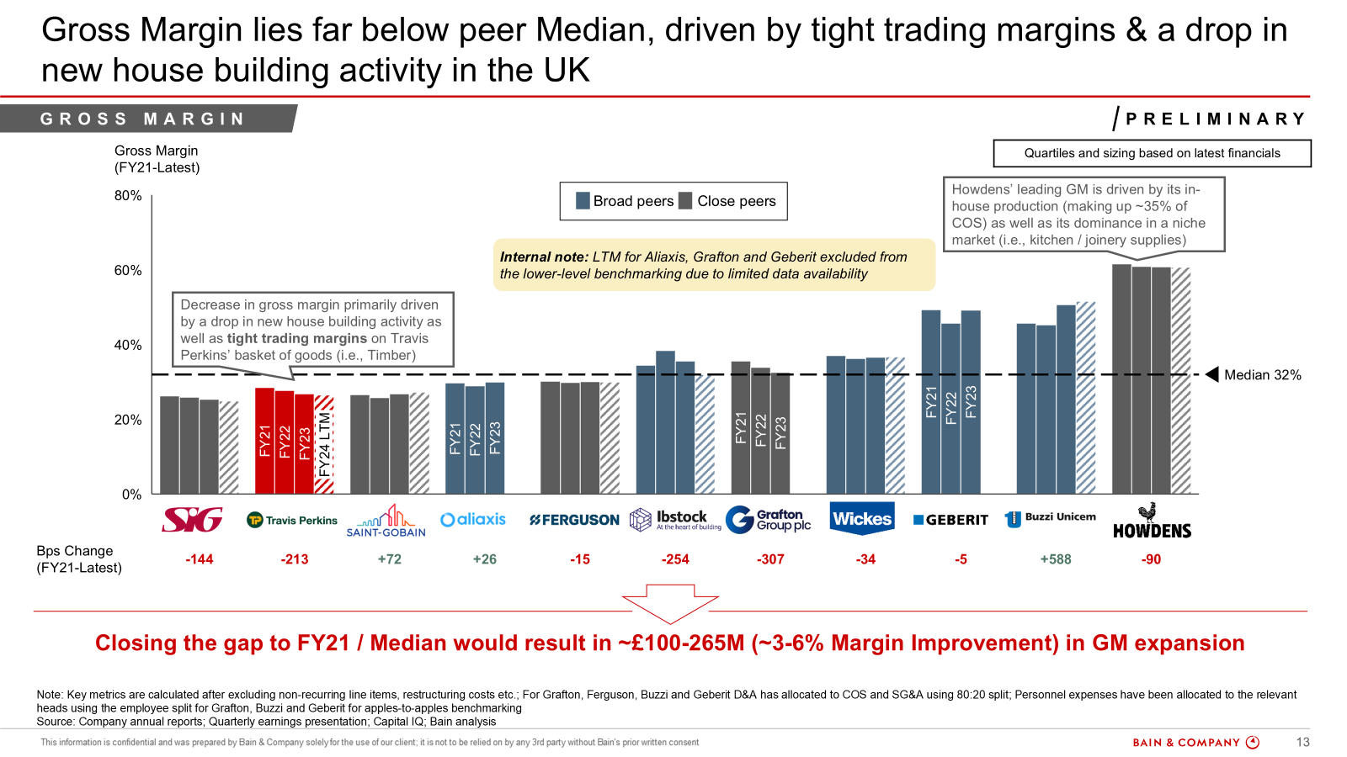
Stage 3 – Savings Identification: Process Breakdown (1/5)
overall_0_132502973815464807 columns_3_132068249530534771 4_1_132068243855844808 7_1_132502972248158988 12_1_132502972248328154 15_1_132502972248488500 26_1_132502973655446130
3
Stage 3
Process & Output
 | Action | Description | Process to research peer performance and trends (Travis Perkins example)
STEP 1 | Research peer performance & trends | Before sizing the value-at-stake opportunity across core OI metrics, it is important to research the industry, key events / shifts, and trends that are visible in the slides Leverage AI tools (see ‘Set up and collaboration’ section for more information), earnings reports / press releases, and online research to understand trends and add call outs to slides It is not necessary to research every trend in every slide; focus on the trends that will be most answer-changing
In the Travis Perkins example, call-outs are added to explain why GM has decreased over time for the target as well as why certain peers are performing exceptionally well; researching these trends helps us understand whether the company’s worsening performance is truly addressable and highlights best practices from comparable peers
3a

Slide 37
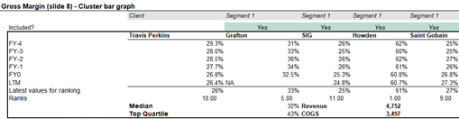
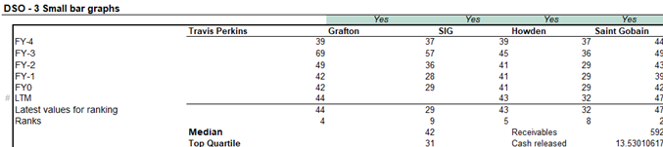
Stage 3 – Savings Identification: Process Breakdown (2/5)
overall_0_132502973815464807 columns_3_132068249530534771 4_1_132068243855844808 7_1_132502972248158988 12_1_132502972248328154 15_1_132502972248488500 26_1_132502973655446130
3
Stage 3
Process & Output
 | Action | Description | Process to assess value-at-stake across core metrics (Travis Perkins example)
STEP 2 | Assess value-at-stake across core metrics | Once you understand the trends and similarities / differences across the peer set, the next step is to assess the value-at-stake across core OI metrics For Cost metrics (e.g., Gross Margin), the value-at-stake is typically calculated as follows: Calculate the difference between the target’s latest performance and peer median / Top Q If relevant (i.e., client is above Top Q or other savings are unreasonable), calculate the gap to historical performance / close comparable peer Multiply the gap by the target’s overall revenue; the result is the value-at-stake opportunity For COGS, divide the calculated gap with Revenue to find margin improvement %; for other cost buckets, divide the calculated gap with the cost for that bucket (e.g., SG&A expense) to find % of cost base Add value-at-stake opportunity and % margin improvement / % of cost base to the down arrow A similar process is followed for NWC metrics; the difference is: Instead of multiplying by Revenue to get the value-at-stake opportunity, we must multiply the gap by cash released per day of improvement, which is total [Inventories, Receivables, or Payables] divided by [latest DIO, DSO, or DPO value]
For Travis Perkins:
Gap to Median is 32% - 26.4% = 5.6%
Value-at-stake is 5.6% * 4,752M = 266M
Represents a (266 / 4752) = 5.6 p.p. uplift
3b
For Travis Perkins:
Gap to Median is 44 – 42 = 2 days
Cash released is 592M / 44 days = $13M / day
Value-at-stake is 2 * $13M = $26M

Slide 38
Stage 3 – Savings Identification: Process Breakdown (3/5)
overall_0_132502973815464807 columns_3_132068249530534771 4_1_132068243855844808 7_1_132502972248158988 12_1_132502972248328154 15_1_132502972248488500 26_1_132502973655446130
3
Stage 3
Process & Output
 | Action | Description | Process to assess value-at-stake across core metrics (Travis Perkins example)
STEP 2 | Assess value-at-stake across core metrics | Once the value-at-stake opportunity has been calculated, it is important to validate whether the opportunity size is feasible Identify which peers are driving Median / Top Q and research whether there are any core business model differences that would make the gap less addressable Based on this research, deliver a recommendation and add it as a ‘down arrow’ to the slide You may choose not to deliver a savings recommendation if the opportunity is not addressable or if the target outperforms all peers You may also assess whether there is a more appropriate / feasible benchmark to aim for given industry / company context (e.g., previous year, closest peer)
In the Travis Perkins example, peer Top Q is driven by less comparable peers (e.g., Geberit and Buzzi Unicern, which are more diversified; and Howdens, which drives higher margins due to its niche focus). As such, the recommended opportunity was based on a previous year (FY21) and peer median. The team believed it was feasible to achieve these targets because FY21 was not an outlier year and because several close peers performed near the median.
3b

Slide 39
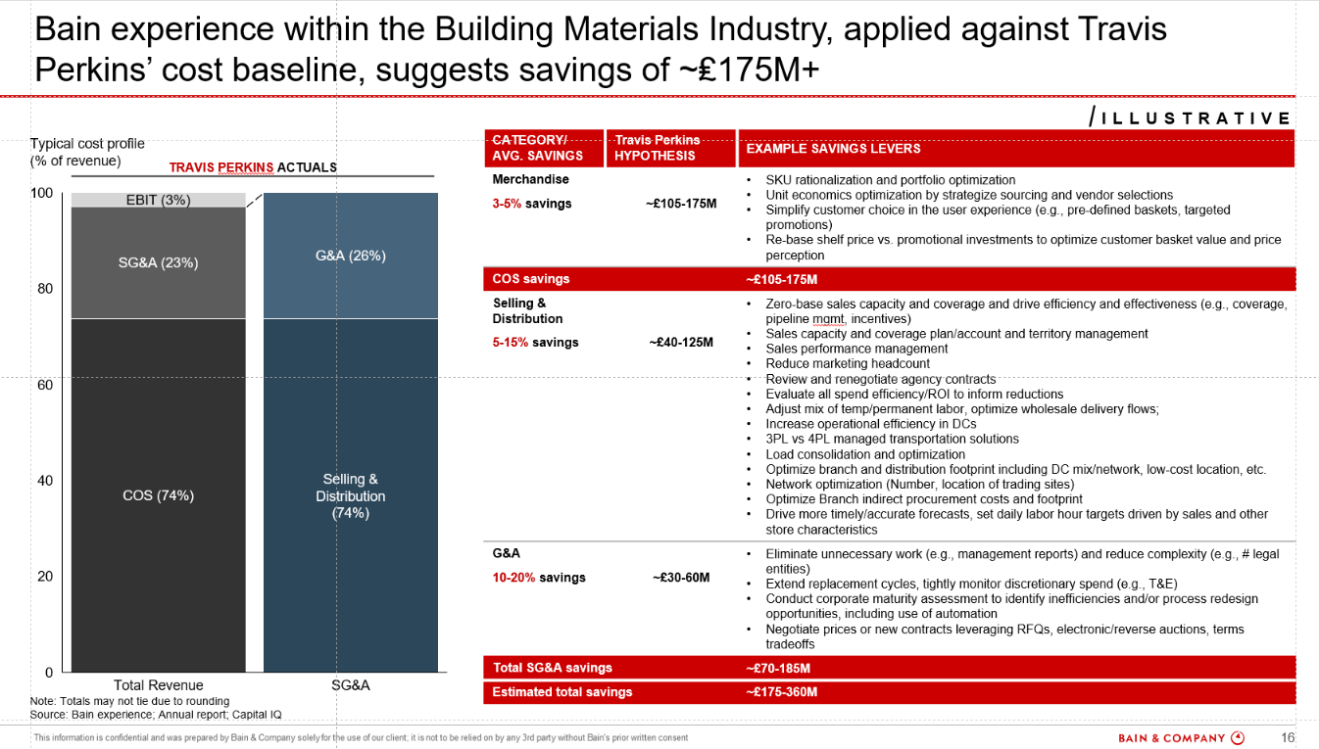
Stage 3 – Savings Identification: Process Breakdown (4/5)
overall_0_132502973815464807 columns_3_132068249530534771 4_1_132068243855844808 7_1_132502972248158988 12_1_132502972248328154 15_1_132502972248488500 26_1_132502973655446130
3
Stage 3
Process & Output
 | Action | Description | Process to build out the Bain Experience slide (Travis Perkins example)
STEP 3 | Calculate Bain Experience savings potential | Build the ‘cost profile’ section of the Bain Experience slide by breaking out the target’s cost bar into its various line items Include sub-cost bucket breakdowns (e.g., G&A and S&D) where sufficient granularity exists; where this granularity does not exist, it may be reasonable to use the split from a comparable peer – though we must note that we have done so Ensure cost bucket names match the target’s income statement (e.g., verify how ‘COGS’ is labeled and update across the deck) Identify the ‘Category Avg. Savings’ by leveraging the savings percentages from a comparable OI in the industry; if such an OI does not exist, find benchmarks from IRIS or online research If a comparable OI is used, take the example savings levers from the relevant Bain Experience page; confirm that savings levers accurately reflect the target’s actual operations, especially if the cost profile is not derived from the company’s financials Compare savings percentages and total dollar amounts with other OI studies in the same industry to ensure consistency and feasibility Calculate the value-at-stake opportunity by multiplying the target’s expenditure under the relevant bucket with the associated savings percentages
3c

Slide 40
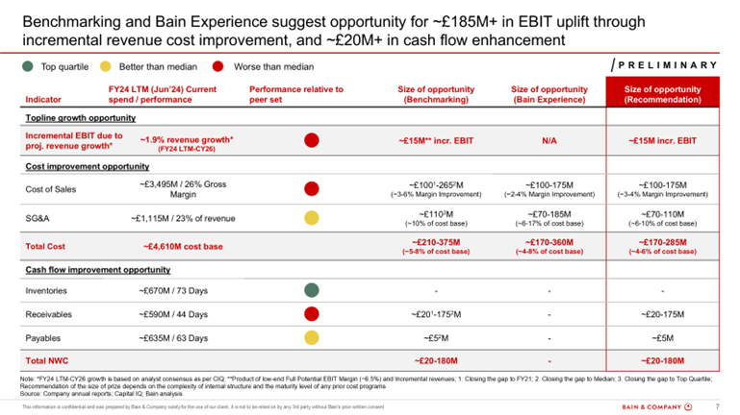
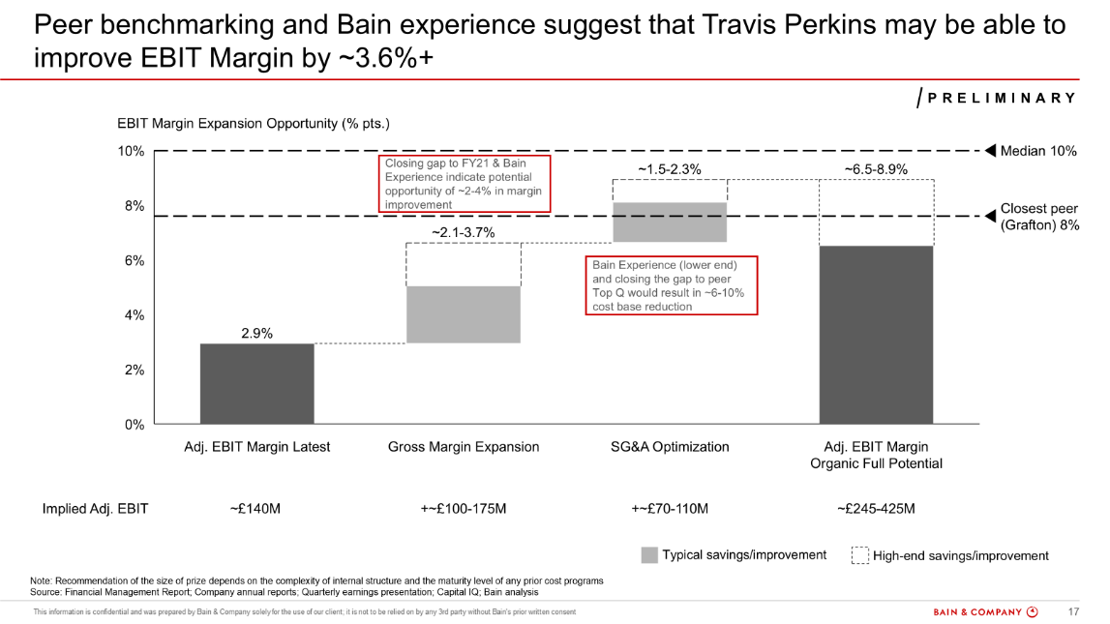
Stage 3 – Savings Identification: Process Breakdown (4/5)
overall_0_132502973815464807 columns_3_132068249530534771 4_1_132068243855844808 7_1_132502972248158988 12_1_132502972248328154 15_1_132502972248488500 26_1_132502973655446130
3
Stage 3
Process & Output
 | Action | Description | Process to deliver a value-at-stake recommendation (Travis Perkins example)
STEP 4 | Deliver comprehensive value-at-stake recommendation | The overall value-at-stake recommendation is typically delivered using the Cost Savings Summary slide The ‘Current spend / performance’ column of this slide can be filled out using data from the Excel Dashboard The Harvey balls are inputted based on whether the target performs worse than median, better than median, or in the Top Q for a given metric The ‘Size of opportunity (Benchmarking)’ column is filled in using the ‘down arrow’ value-at-stake opportunity from each slide The ‘Size of opportunity (Bain Experience)’ column comes from the Bain Experience slide The size of opportunity recommendation is created based on the synthesis of peer benchmarking & Bain Experience The team should decide which values to use based on what feels most feasible / addressable for the target If an opportunity within a given metric does not feel addressable, it is reasonable to avoid making a savings recommendation If possible, we should never recommend an opportunity using both the low-end and high-end from Bain Experience; it is important to leverage our peer benchmarking for at least one end of the range Once the Cost Savings Summary page is created, it is important to update the EBIT/DA Margin waterfall (see Appendix for more information)
3d

Slide 41
Stage 3 – Savings Identification: Tips & Best Practices (1/2)
3
Stage 3
When going through an OI, it is important to conduct 3 sense checks before finalizing our savings recommendation:
#1 - Do the benchmarks make sense?
Run through the core cost slides & check whether the recommended savings ranges are reasonable given the context of the industry / trends we observe in the analysis; if the ranges are unreasonable, look for another benchmark we can use (i.e., prior year, etc.)
Check the Bain experience savings slide
Check to make sure the naming of each cost bucket aligns with the target's income statement (e.g., COGS v. CoS); update throughout the deck
If the cost profile does not come from the target's actuals, confirm that the savings levers accurately represent the target's operations / activities
Find a previous OI in the industry and compare the savings %s and overall savings $$ against it; make sure the %s align and that we're in the same ballpark; the quickest way to do this is to check if we have already done an OI for one of the target’s peers and to sense check this OI for the savings %s
#2 - Does the story make sense?
Go through each slide to observe the main trends. Does the target’s performance make sense given what we know about the industry and about each metric?
[For answer-changing trends] Add call-outs to explain why the target is overperforming / underperforming relative to peers
Generally, we want to call out whenever the target looks like an outlier in the data or whenever a key metric has declined up to this year (e.g., revenue has declined recently, SG&A cost has gone up, etc.)
Update tags to tell the story; check good examples (i.e., Travis Perkins, Autodesk) to make sure the sentence structure for a given slide matches
#3 - What is our overall savings recommendation?
Update the savings #s based on any updates we make to benchmarks throughout the review process
When the Cost Savings Summary is updated, make sure to revise any slides that depend on it for inputs (i.e., Performance Summary, waterfall slides)

Slide 42
Stage 3 – Savings Identification: Tips & Best Practices (2/2)
3
Stage 3
Median and Top Q ranges:
Sometimes, companies in the peer set are less comparable to the target in their operations and cost profile; in cases where peers are so structurally different that they skew the quartile ranges, we may exclude them from our quartiles and value-at-stake sizing. In these cases, we must note that we have done so using a footnote or call-out
How to interpret R&D:
When R&D is benchmarked in an OI, we pay special attention to our verbiage and recommendations; E.g.,
We do not always assume that an R&D spend reduction is a positive outcome for the target; if R&D spend is strongly correlated with revenue & gross margin improvement (see ‘R&D Correlation’ slide in the Appendix), higher R&D investment may be beneficial for the target
If R&D spend is not correlated with revenue & gross margin improvement, and the target’s R&D (% of revenue) is still higher than peer median, we may recommend a cost reduction opportunity
For these reasons, we generally do not write that the target should ‘close the gap to peer median’; instead, we might write that ‘bringing R&D spend to peer median would require a ~$50M spend reduction (~0.2x current spend)’
In our cost metric bubble chart slide (see Appendix), we color the R&D chart gray to highlight that performing above peer median is neither good nor bad
Additional guidance on building the Bain Experience slide:
Search the OI folder and tracker for past OIs of the target company's peers to identify the most comparable Bain Experience savings benchmarks
Ensure cost levers align with client-reported categories (e.g., COGS, OpEx, SG&A, R&D). If cost structures differ across peers, reference multiple OIs or similar industry benchmarks to validate comparability
Adjust for cost breakdown differences if peers lack detailed splits (e.g., merchandising costs in COGS). Use multiple past OIs, industry benchmarks, or adjacent sector insights to make these adjustments - with proper validation and sense checks
Enter the finalized savings levers into the "Size of Prize" tab in the dashboard under the Bain Experience table, ensuring accurate data input for calculations
Derive the Bain Experience savings $$s by multiplying the savings %s with the target’s financials and rounding to the nearest 5

Slide 43
Stage 4 – Output Completion: Process Overview
overall_0_132080267593530230 columns_1_132076921966464267 4_1_132076953839434906
4
Stage 4
 |  | Action | Description | Est. time allocation | Value addition
Output Completion Process |  | Present initial findings to the LT team | Discuss the emerging answer, story, and critical questions with the LT team; identify any net-new slides or additional research that must be completed | 0.5-1 hour
 |  | Update remaining slides | Update the EBIT/DA waterfall slide (if the value-at-stake recommendations shifted), the EV waterfall slide, and the Performance Summary slide | 30 minutes
 |  | Review the full deck & refine the storyline | Flip through each page to perform a full ZD, ensuring that numbers and labels tie throughout the deck; adjust taglines as needed to ensure that the story flows and that is answer-oriented Note: Once this step is performed, send the deck to LT for final review; action feedback before proceeding to the final step | 1 hour
 |  | Share findings with the account team | After incorporating LT feedback and performing a final ZD, draft an email to the account team and share the OI | 30 minutes
Stage 4: Output Completion Process
4a
4b
4c
4d
Once the OI is shared with the account team, be cognizant of potential follow-ups or questions that might come up

Slide 44
Stage 4 – Output Completion: Process Breakdown (1/2)
overall_0_132502973815464807 columns_3_132068249530534771 4_1_132068243855844808 7_1_132502972248158988 12_1_132502972248328154 15_1_132502972248488500 26_1_132502973655446130
4
Stage 4
Process & Output
 | Action | Description
STEP 1 | Present initial findings to the LT team | Review the emerging answer with the LT team during our daily content sync, making sure to draw attention to the most important areas for input (i.e., savings recommendations, open questions)
Step 2 | Update remaining slides in the deck | Revise the benchmarking pages and the Cost Savings Summary based on LT feedback Update the EBIT/DA Margin waterfall once the Cost Savings Summary has been finalized (see details in Appendix) Once the full-potential EBIT/DA Margin is calculated, multiply this value (either low- or high-end) by the incremental revenue figure in the down arrow of the projected revenue slide to arrive at the incremental EBIT/DA opportunity from revenue growth; this value will be included in the Cost Savings & Performance summaries Leverage the ‘EV/EBIT(DA) Calculation’ tab of the Excel Dashboard to model the EV uplift provided by the recommended cost savings; update the EV uplift waterfall slide (see details in Appendix); the TSR uplift calculated here will be added to the Performance Summary Construct the Performance Summary slide based on key insights across the deck (see details in Appendix)
Step 3 | Review the full deck & refine the storyline | Flip through each page to perform a full ZD, ensuring that numbers and labels tie throughout the deck; E.g., The ‘Size of Opportunity’ column of the Performance Summary slide should tie to the recommendations in the Cost Savings Summary & waterfall slides Ensure all numbers reflect the same currency and unit (e.g., $M) Confirm that footnotes and sources are updated for each slide Validate that Bps changes and color coding are accurate Update taglines to ensure that the story flows from slide-to-slide and that each tagline is additive to the answer; reference best-practice examples like Travis Perkins and Autodesk. Please visit this document for more information on how to frame the answer. Share the full deck for LT feedback and action any changes as needed
4a
4b
4c

Slide 45
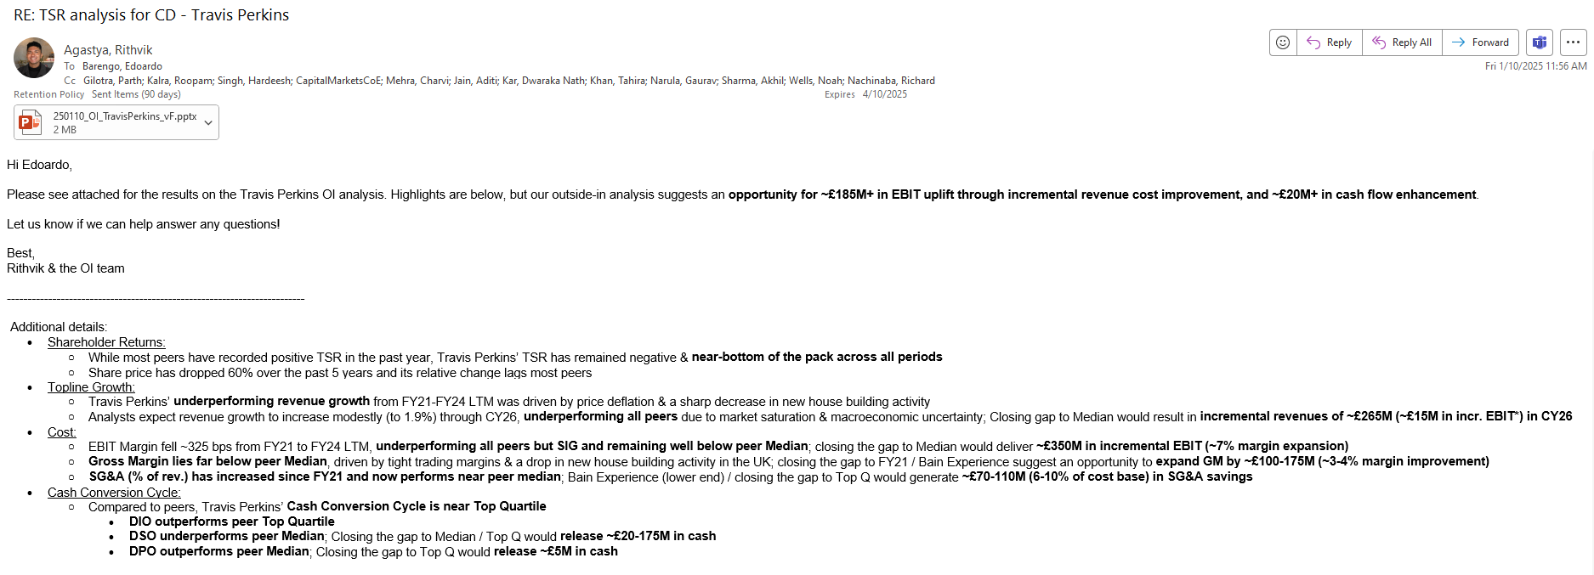
Stage 4 – Output Completion: Process Breakdown (2/2)
overall_0_132502973815464807 columns_3_132068249530534771 4_1_132068243855844808 7_1_132502972248158988 12_1_132502972248328154 15_1_132502972248488500 26_1_132502973655446130
4
Stage 4
Process & Output
 | Action | Description | Process to share findings with the account team (Travis Perkins example)
STEP 4 | Share findings with the account team | Draft an email to the account team with the standard format (see screenshot) Bullet points for the ‘Additional details’ section can be pulled from the Performance Summary Do a final ZD check by opening the attached file to confirm that all the latest changes are reflected and that there are no stickies present in the deck When sending the email, make sure to respond in the correct thread; CC the BCN working team (check Trello to see who worked on the OI) and the OI LT (incl. BCN LT)
4d

Slide 46
Agenda
Introduction to OI
Process to build an OI
Set up and collaboration
Additional guidelines

Slide 47
Set up: Overview of tools available to the OI team
 | Tool | Description | Links
Required tools | Capital IQ | Data & analytics platform (incl. Excel plug-in) providing detailed company information and financials | Capital IQ
 | Trello | Project management tool to organize the OI workflow process for the US and BCN teams | Trello
Supplemental tools | OI tracker | Detailed tracker with key information and statistics on prior OIs | OI tracker
 | A1OI | Interactive Tableau dashboard providing a rapid “A1” on benchmarking and savings opportunities | A1OI
 | OI GenAI tools repository | Collection of AI tools that can help when generating OIs | OI GenAI tools repository
 | PEG Get Smart | Research platform generating instant reports on a company / industry | PEG Get Smart

Slide 48
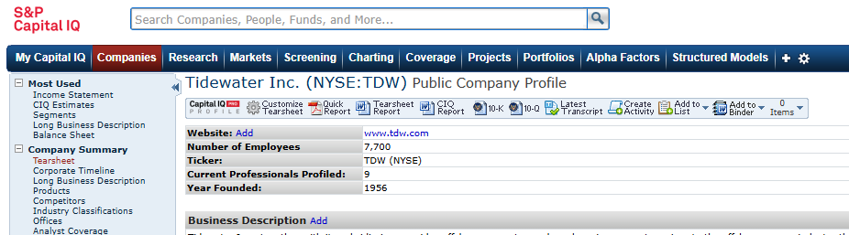
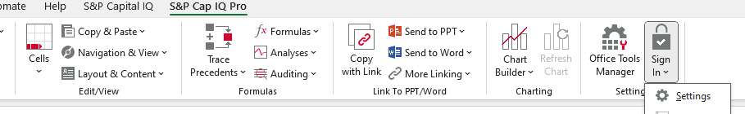
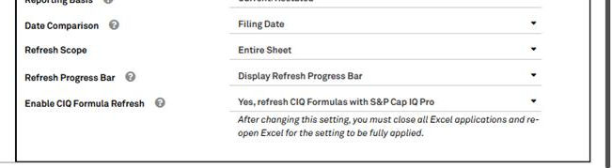
Set up: Capital IQ
 | Action | Description | Illustrative steps
STEP 1 | Obtain access to “CapIQ Classic” | Default platform for Bain is CapIQ Pro, which is accessible on Compass Our team prefers CapIQ Classic given its more intuitive user interface – for access, please ask team manager to reach out to RDS contact
STEP 2 | Configure the CapIQ Excel plug-in | The BCN team uses the Classic plug-in, but you may use either that or Pro If you use Pro, click on “Settings” in the toolbar and enable CIQ Formula Refresh, allowing you to refresh adjustment summaries completed by BCN For rapid setup, please visit your local TSG team

Slide 49
Set up: Using ChatGPT well
ChatGPT is a useful tool throughout the OI process – from initial “get smart” to deeper investigations into recent trends
When starting an OI, it is often helpful to prompt ChatGPT for a “primer” on the company and its sector, asking for input on:
Company history
Stock price performance
Profitability trends
Key competitors
Recent acquisitions
ChatGPT can also provide relevant context to explain key trends (e.g., why did SG&A rise suddenly in FY22) as you investigate performance, though it is best practice to validate its output against company reporting via annual (10-K) or quarterly (10-Q) filings, earnings reports, and call transcripts
ChatGPT can also help provide quick analysis on annual reports / financial statements with questions like “What page shows segment level EBIT margins” or “Does the annual report mention why COGS has increased in the past year?”
Importantly, always be cautious with output generated by ChatGPT given possible “hallucinations” or incorrect responses and instead view it as a supporting tool for your analysis. Always verify through additional research in company website / financials before adding callouts to the deck

Slide 50
Collaboration: Working on the OI team involves ongoing collaboration between the US and India teams
We complete OIs with the help of a dedicated BCN India team, who has deep expertise and is a critical partner as we strive to deliver outputs efficiently
The BCN team is ~6–8 people and has capacity for supporting up to three workstreams each night
Before ~7:00 PM PST, send an EOD note to the BCN team outlining progress made that day and next steps on any outstanding tasks. Be sure to include all open OIs—even if no action is needed from BCN—so they have full visibility
Supplement the EOD note with more detailed instructions on the Trello board. While the overview in the EOD note is helpful, Trello should include clear, step-by-step guidance to ensure accurate execution
Given large gaps in time zones, clear communication is very important. We have limited hours (either late at night or early in the morning) where we overlap and meeting to ask clarifying questions can be very difficult
When planning work with the BCN team, it’s helpful to leverage their strengths:
The team is highly skilled at creating adjustment summaries and often completes them more quickly than the US team. We typically recommend having them lead the charge in creating these, while the US team leads the charge on the OI presentations
It is often helpful to have the BCN team focus on formatting changes (e.g., logos, bar colors, footnotes), as the US team typically leads on sizing and recommendations after discussions with LT

Slide 51
Agenda
Introduction to OI
Process to build an OI
Set up and collaboration
Additional guidelines

Slide 52
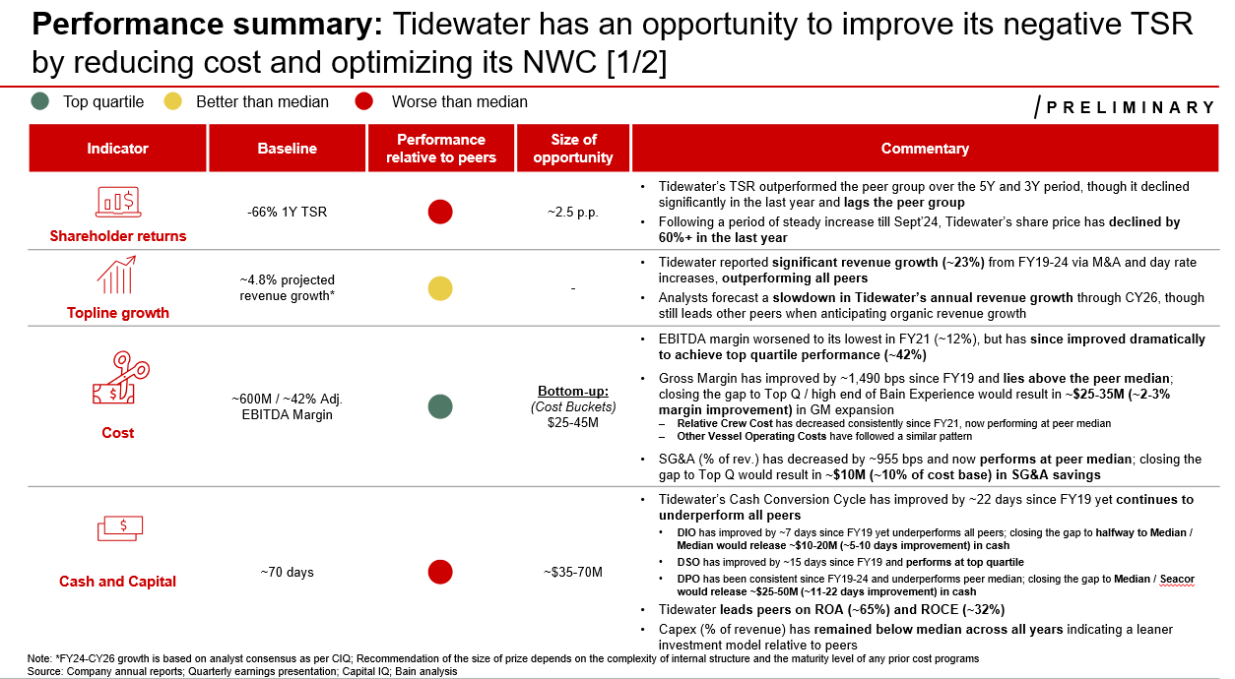
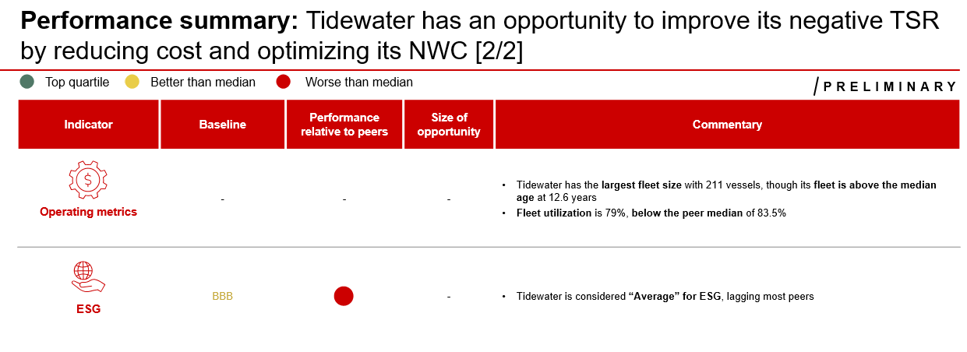
Additional guidelines: Typical OI Output – Performance Summary
overall_1_132068218561777362 columns_2_132068240461622282 8_1_132068218988632400 17_0_132068240611373894 32_1_132068242579311268 37_0_132068245183525871 45_1_132068245913371389 48_1_132068246261560536
additional guidelines
typical output
Illustrative
Input
Output
Performance Summary output is commonly shown as one page, though certain OIs also highlight additional “Operating Metrics”
There is no Excel input for this slide; it needs to be constructed by synthesizing the main insights from the OI
Shareholder returns: Usually comes from the two pages on TSR and share price performance over time
Size of opportunity is taken from the EV uplift slide (see P62)
Topline growth: Based on insights on historical revenue growth and projected revenue growth
Incremental revenue opportunity is taken from the projected revenue growth page
Incremental EBIT/DA opportunity is usually the product of the incremental revenue opportunity and full-potential EBIT/DA margin (see P61)
Cost: Based on the core cost slides in the OI (e.g., EBIT/DA Margin, Gross Margin, SG&A, R&D)
Top-down EBIT/DA opportunity comes from the EBIT/DA margin page (see P56)
Bottom-up opportunity is the recommended cost opportunity in the cost savings summary (see P51)
Cash Conversion Cycle: Based on the CCC slides; size of opportunity comes from the recommended value-at-stake in the cost savings summary (see P51)
ESG: Comes from the ESG benchmarking page (see P65)

Slide 53
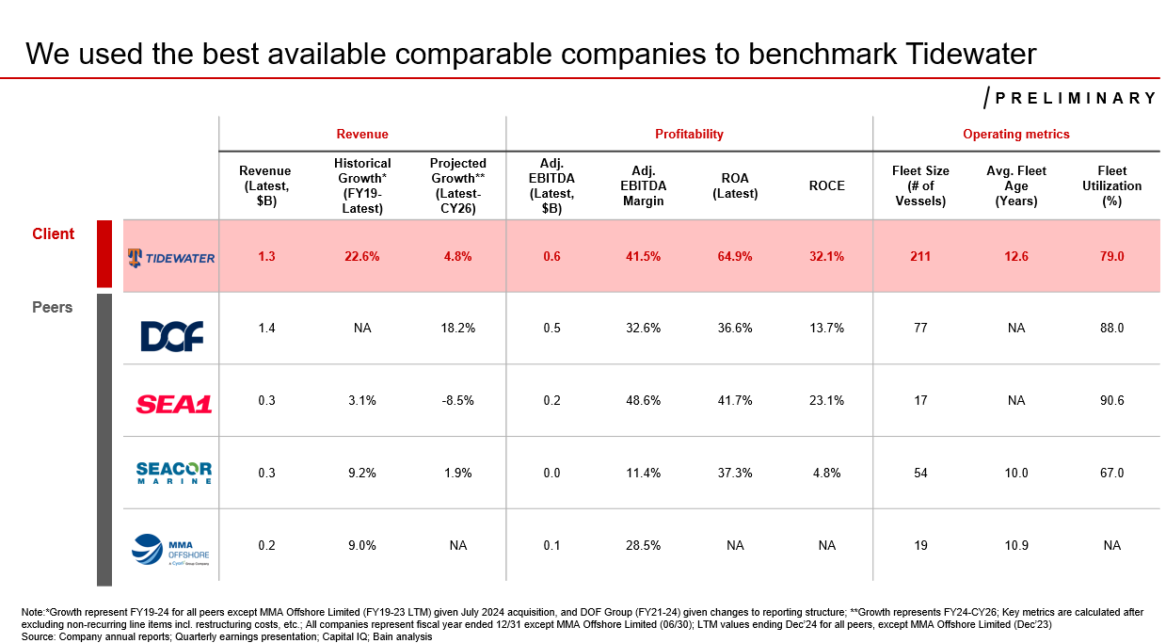
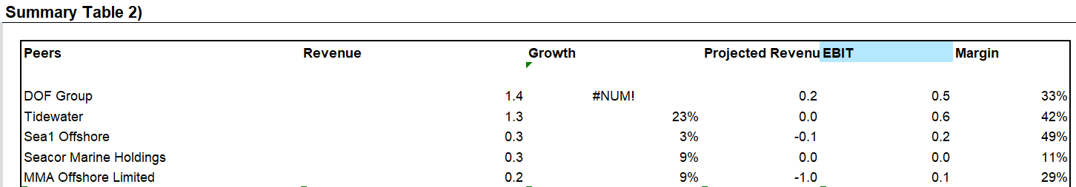
Additional guidelines: Typical OI Output – Peer Set Overview
overall_1_132068218561777362 columns_2_132068240461622282 8_1_132068218988632400 17_0_132068240611373894 32_1_132068242579311268 37_0_132068245183525871 45_1_132068245913371389 48_1_132068246261560536
additional guidelines
typical output
Illustrative
Input
Output
Summary data on the peer set is in the below Summary Table found on the Mekko Graph Outputs tab
Pull in revenue, historical growth, projected growth, EBIT (or EBITDA), EBIT (or EBITDA) Margin, and any other OI-specific metrics (e.g., ROCE, fleet size)
Note: Figures should be rounded to the nearest 0.1 (e.g., $1.3B, 22.6%)
Footnote must include the timeframe for historical and projected growth, highlight adjustments for non-recurring line items, explain fiscal year timing across peers, and identify any significant adjustments to the financials
Note: We often leverage BCN to help draft the footnote given their detailed knowledge of the adjustments made

Slide 54
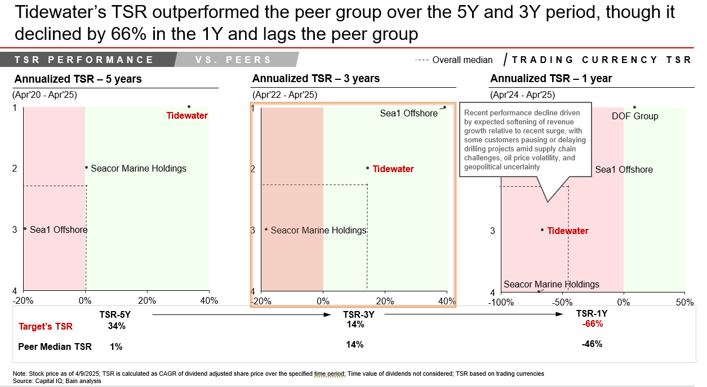
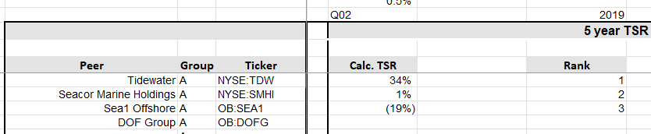
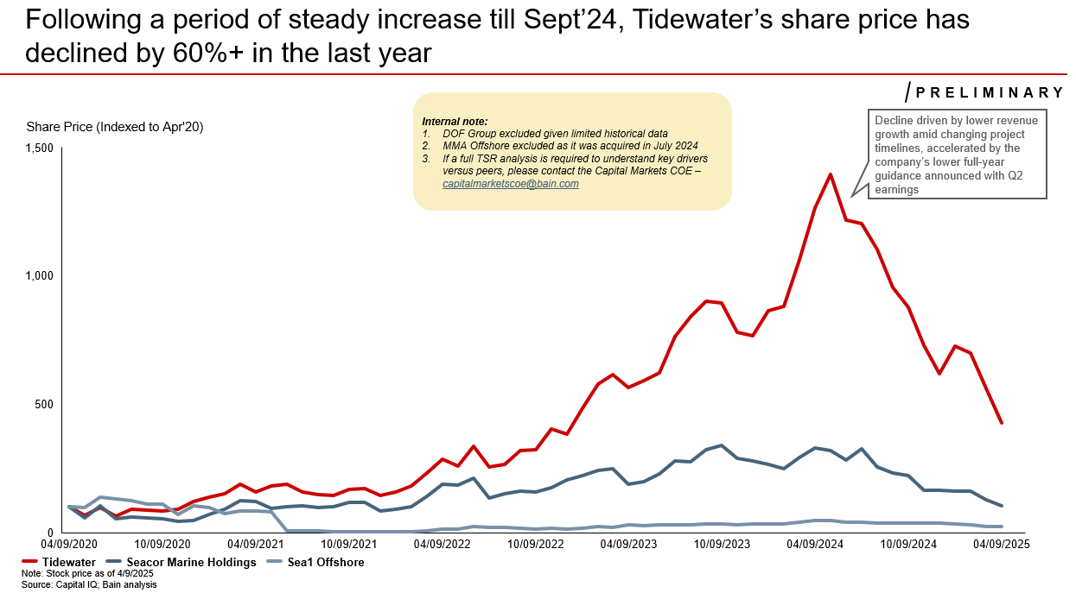
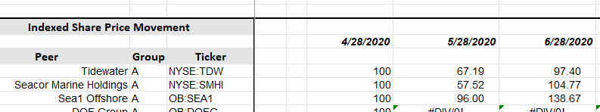
Additional guidelines: Typical OI Output – TSR Analysis
overall_1_132068218561777362 columns_2_132068240461622282 8_1_132068218988632400 17_0_132068240611373894 32_1_132068242579311268 37_0_132068245183525871 45_1_132068245913371389 48_1_132068246261560536
additional guidelines
typical output
Illustrative
Input
Output
TSR data is found on the TSR Analysis tab, which contains calculated TSR and rank for each peer over the 5Y, 3Y, and 1Y periods
To build out the TSR performance slide, pull the calculated TSR for each peer into the think-cell chart and manually update the data row below with the target company’s TSR and the peer median TSR
On the chart itself, update the dotted lines to reflect the median
For the indexed share price slide, pull in the relevant data from the Indexed Share Price Movement section and add any relevant callouts

Slide 55
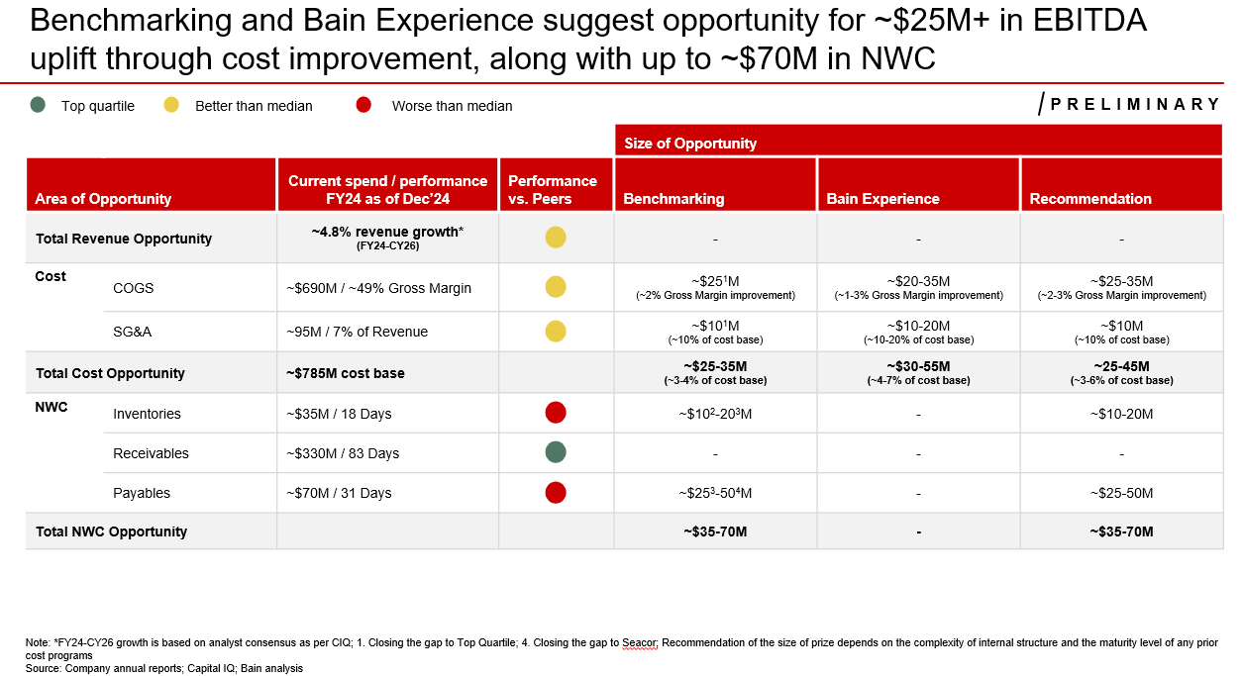
Additional guidelines: Typical OI Output – Cost Savings Summary
overall_1_132068218561777362 columns_2_132068240461622282 8_1_132068218988632400 17_0_132068240611373894 32_1_132068242579311268 37_0_132068245183525871 45_1_132068245913371389 48_1_132068246261560536
additional guidelines
typical output
Illustrative
Input
Output
This slide summarizes the company’s current performance and resulting size of opportunity
First step is to align on the rows you’ll include, which are commonly the simple cost items shown in the Tidewater example, though we sometimes show others depending on the context (e.g., advertising, top-down EBIT)
Next, pull in the current spend / performance column:
Values can be found on either the Income Statement Revised (e.g., COGS, SG&A) and Financials & KPIs (e.g., Inventory $ amount)
For performance vs. peers, visit the benchmarking slide for each line item (e.g., Gross Margin for COGS) and note whether the target is Top Q, better than Median, or worse than Median
For Benchmarking & Bain Experience, pull in the savings amounts from the down arrows and recommendations on each slide
Lastly, use your judgment to issue a recommendation based on these benchmarks and carefully update the footnotes to specify how each benchmarking analysis was done (e.g., Closing the gap to Median)

Slide 56
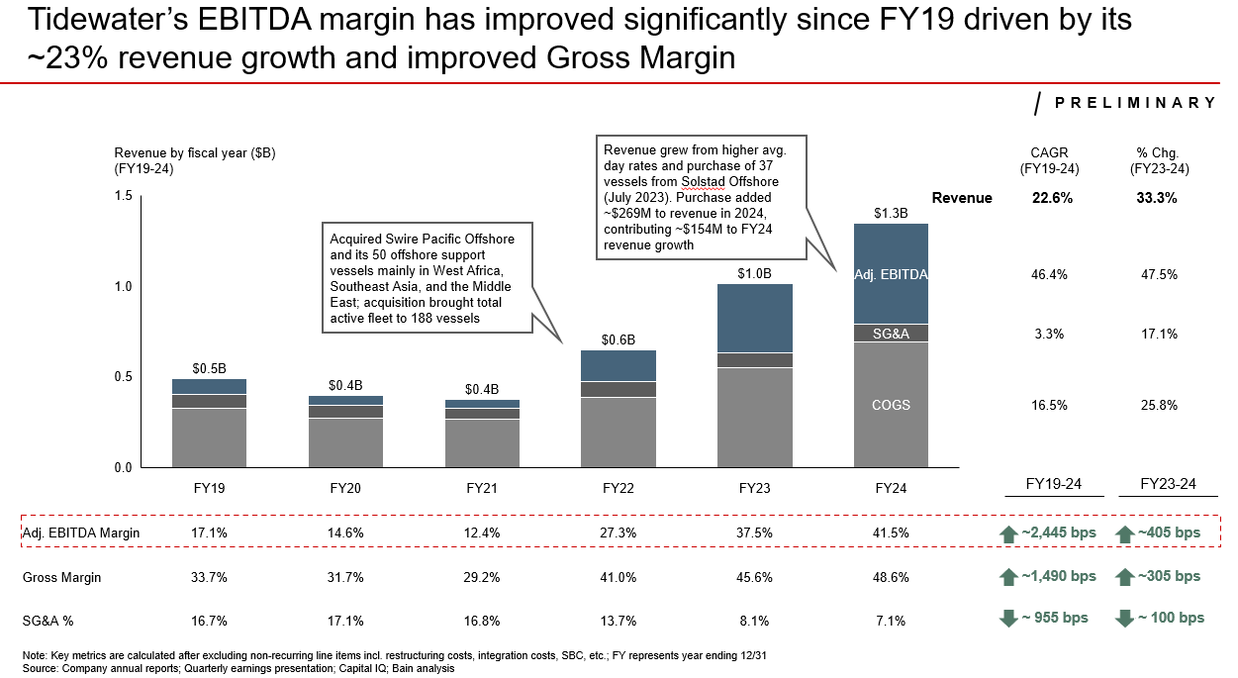
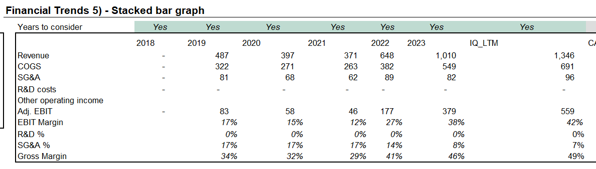
Additional guidelines: Typical OI Output – Revenue Build
overall_1_132068218561777362 columns_2_132068240461622282 8_1_132068218988632400 17_0_132068240611373894 32_1_132068242579311268 37_0_132068245183525871 45_1_132068245913371389 48_1_132068246261560536
additional guidelines
typical output
Illustrative
Input
Output
Data for this slide can be found in the Financial Trends section on the Mekko Graph Output tab
Once the think-cell cart is updated, manually calculate the FY19-24 and FY23-24 bps change in Excel and add it to the relevant text boxes
Review the slide in detail, looking for key trends or outliers (e.g., revenue jumps, profitability declines) and add brief callouts explaining the change
Potential sources include company annual (10-K) and quarterly (10-Q) filings, earnings reports, call transcripts, ChatGPT*
Be aware of acquisitions as a potential source of YoY revenue swings
Note: *See slide on Using ChatGPT well and follow those best practices, particularly on vetting its output against company reporting

Slide 57
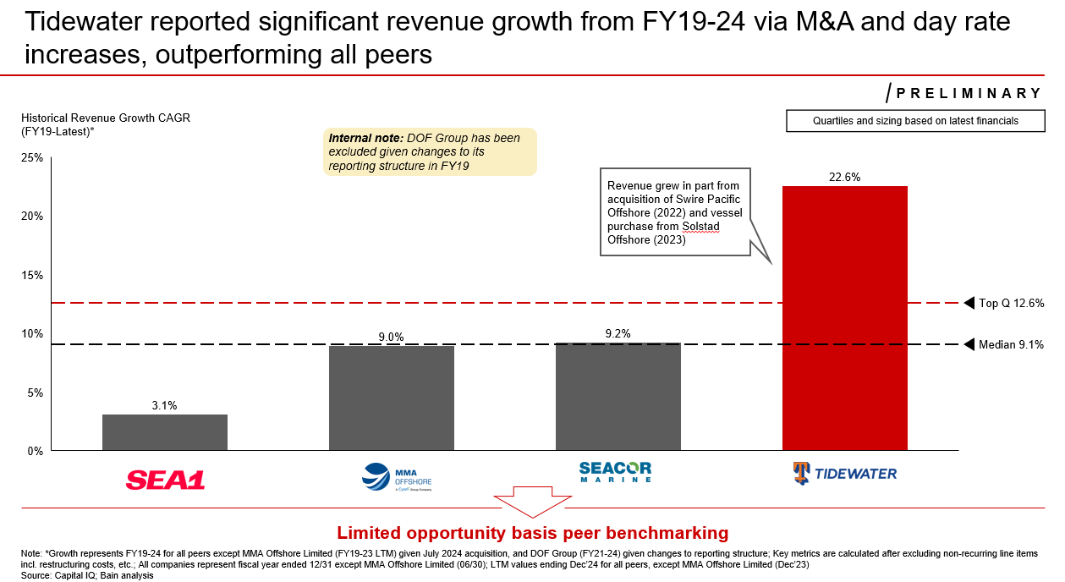
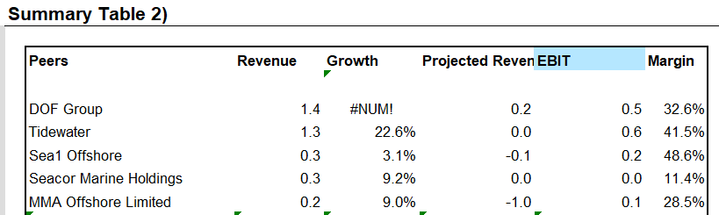
Additional guidelines: Typical OI Output – Historical Revenue Growth
overall_1_132068218561777362 columns_2_132068240461622282 8_1_132068218988632400 17_0_132068240611373894 32_1_132068242579311268 37_0_132068245183525871 45_1_132068245913371389 48_1_132068246261560536
additional guidelines
typical output
Illustrative
Input
Output
Historical revenue growth is found in the Growth column of the Summary Table on the Mekko Graph Outputs tab
Update the think-cell chart with the historical growth for each company, as well as the Median and Top Q which you should calculate in Excel
Determine whether benchmarking is feasible
If benchmarking is feasible, follow the below steps:
Start with the beginning period revenue (FY19 in this example) and grow it by the actual historical growth rate (22.4%), which should tie exactly to FY24 revenue
Then determine the benchmarked growth rate (e.g., median, top Q) and grow beginning period revenue by that growth rate to calculate implied FY24 revenue
Difference between implied FY24 revenue from the benchmarked growth rate and actual FY24 revenue provides the savings opportunity to be included in the down arrow

Slide 58
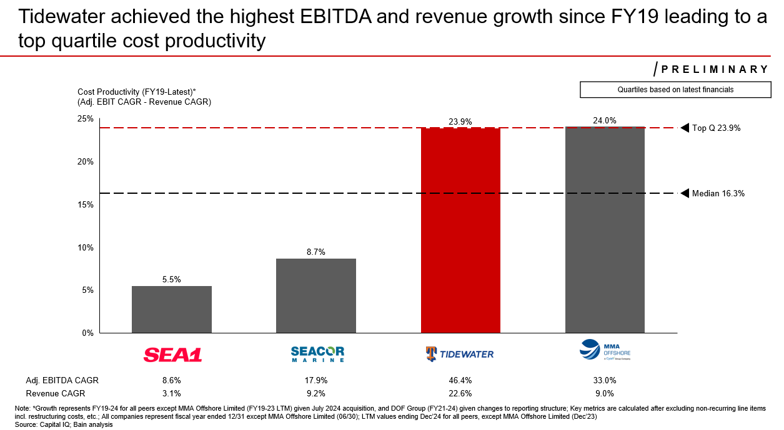
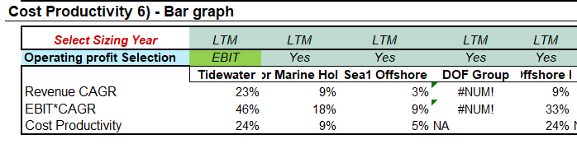
Additional guidelines: Typical OI Output – Cost Productivity
overall_1_132068218561777362 columns_2_132068240461622282 8_1_132068218988632400 17_0_132068240611373894 32_1_132068242579311268 37_0_132068245183525871 45_1_132068245913371389 48_1_132068246261560536
additional guidelines
typical output
Illustrative
Input
Output
See the Cost Productivity section on the Mekko Graph Outputs tab
For the tagline, be sure to lead with the insight rather than describing the definition of cost productivity
Cost productivity is calculated as Adj. EBIT/DA CAGR – Revenue CAGR, which contextualizes a change in EBIT margin by indicating how effectively the company optimized its profitability
Note: In certain cases where the EBIT/DA $ value starts or ends negatively, they must be excluded from this chart

Slide 59
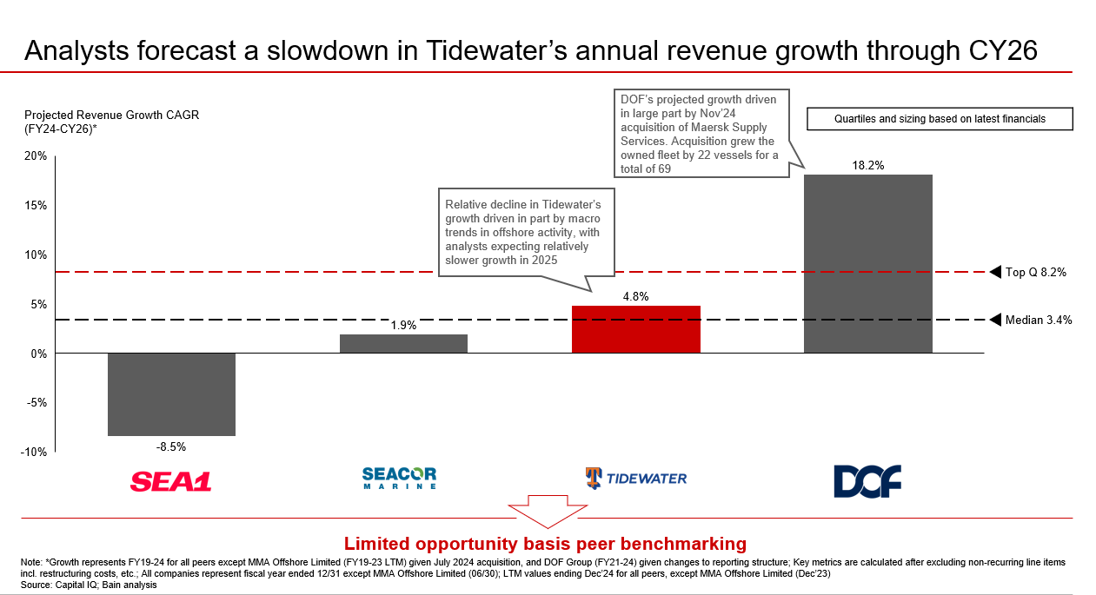
Additional guidelines: Typical OI Output – Projected Revenue Growth
overall_1_132068218561777362 columns_2_132068240461622282 8_1_132068218988632400 17_0_132068240611373894 32_1_132068242579311268 37_0_132068245183525871 45_1_132068245913371389 48_1_132068246261560536
additional guidelines
typical output
Illustrative
Input
Output
Historical revenue growth is found in the Projected Revenue column of the Summary Table on the Mekko Graph Outputs tab
Update the think-cell chart with the projected growth for each company, as well as the Median and Top Q which you should calculate in Excel
Determine whether benchmarking is feasible – not feasible here as DOF’s growth was due to an acquisition
Incremental revenue calculation proceeds as follows:
Take current period (FY24 in this case) revenue
Grow that revenue by the projected CAGR (4.9%) through CY26*
Calculate the implied CY26 value using the benchmarked growth rate
Difference between implied and projected CY26 values gives incremental revenue
For incremental EBIT, multiply the incremental revenue by the full-potential EBIT calculated on the full potential waterfall (slide 61)
Note: *Be sure to calculate the exact time period gap from FY24 to CY26 – in certain cases of a Dec FY end, you could use a gap of two periods; however, some other fiscal years might end at different points

Slide 60
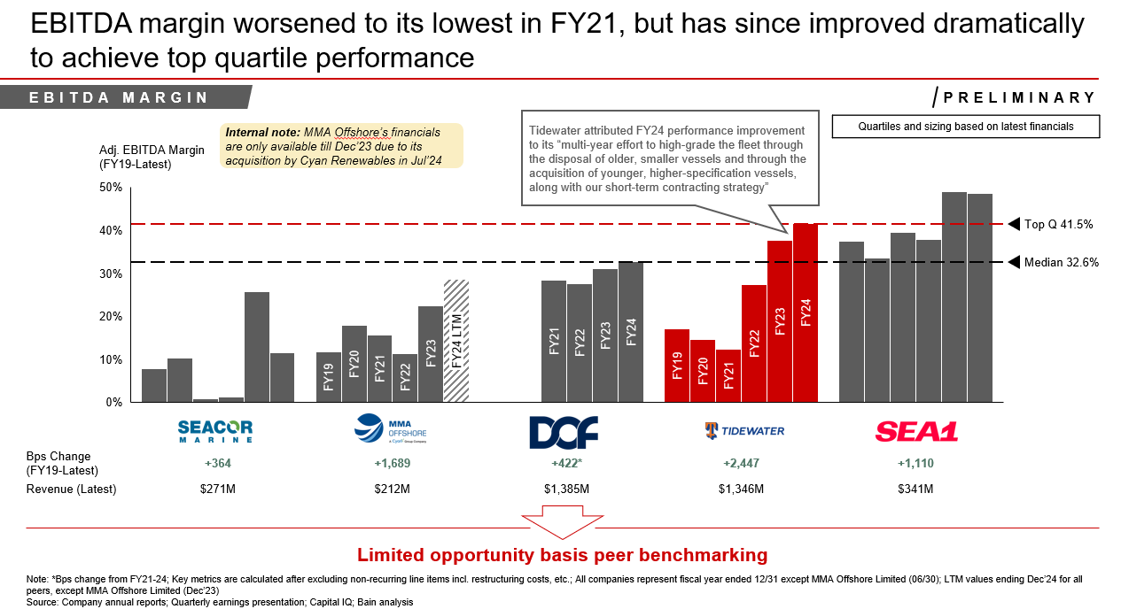
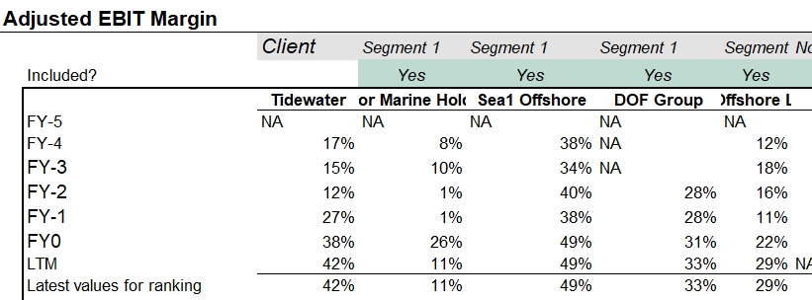
Additional guidelines: Typical OI Output – EBIT/DA Margin
overall_1_132068218561777362 columns_2_132068240461622282 8_1_132068218988632400 17_0_132068240611373894 32_1_132068242579311268 37_0_132068245183525871 45_1_132068245913371389 48_1_132068246261560536
additional guidelines
typical output
Illustrative
Input
Output
See the EBIT Margin section on the Mekko Graph Outputs tab
Note that even when the analysis is done at the EBITDA level, the EBIT Margin section is where the output is shown – always be sure to verify this against BCN’s work on the Income Statement Revised tab
Update the think-cell chart (incl. Median and Top Q), considering the below:
Timing: See the Input Form which shows the end of FY for each company and label LTM accordingly (e.g., MMA Offshore)
Order: To show values from “worse to better” sort from low to high based on the latest (FY24 or LTM) values
For the savings calculation, consider the feasibility of your recommendation, which could range from Median, Top Q, past performance, etc.
Additionally, be sure to sense check any significant trends or outliers and add callouts as needed

Slide 61
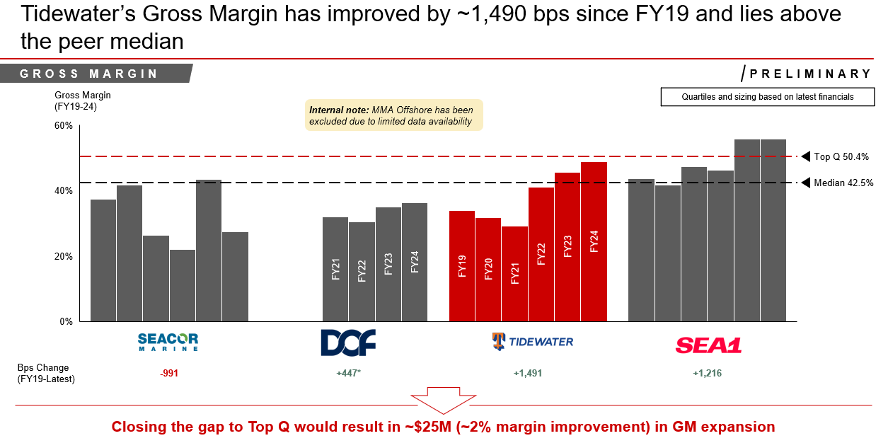


Additional guidelines: Typical OI Output – Gross Margin
overall_1_132068218561777362 columns_2_132068240461622282 8_1_132068218988632400 17_0_132068240611373894 32_1_132068242579311268 37_0_132068245183525871 45_1_132068245913371389 48_1_132068246261560536
additional guidelines
typical output
Illustrative
Input
Output
See the Gross Margin section on the Mekko Graph Outputs tab
Update the think-cell chart (incl. Median and Top Q), considering timing and order
For the savings calculation, consider the feasibility of your recommendation, which could range from Median, Top Q, past performance, etc.
We chose Top Q given comparability with Sea1 and prior upward trajectory, which implied savings of ~2% margin improvement
We often dig one level deeper (e.g., here COGS is split into crew costs and other vessel operating costs) and calculate savings for each – these costs can be found on the Income Statement Revised tab as part of the COGS breakdown pulled in by the BCN team

Slide 62


Additional guidelines: Typical OI Output – SG&A (% of revenue)
overall_1_132068218561777362 columns_2_132068240461622282 8_1_132068218988632400 17_0_132068240611373894 32_1_132068242579311268 37_0_132068245183525871 45_1_132068245913371389 48_1_132068246261560536
additional guidelines
typical output
Illustrative
Input
Output
See the SG&A, Selling & Marketing, and G&A sections on the Mekko Graph Outputs Tab
We often start with top-down SG&A and might add a detailed split (e.g., advertising vs. other SG&A) where relevant
In this case, the more detailed cost split was at the COGS level, so we instead did a top-down benchmarking to Top Q, which would imply ~10% of cost base savings

Slide 63



Additional guidelines: Typical OI Output – SG&A Breakdown
overall_1_132068218561777362 columns_2_132068240461622282 8_1_132068218988632400 17_0_132068240611373894 32_1_132068242579311268 37_0_132068245183525871 45_1_132068245913371389 48_1_132068246261560536
additional guidelines
typical output
Illustrative
Input
Output
See the Selling & Marketing and G&A sections on the Mekko Graph Outputs Tab
We’ll often show a detailed breakdown of SG&A oriented around these two primary cost buckets, as shown in this example for Electronic Arts:
Selling & marketing (S&M)
General & administrative (G&A)
As a ZD check, it’s helpful to ensure that the broken-down SG&A spend you show sums to the overall SG&A value
Note: This SG&A breakdown varies by company and sector – see the adjustment summary for a detailed breakdown of the key line items.

Slide 64


Additional guidelines: Typical OI Output – R&D
overall_1_132068218561777362 columns_2_132068240461622282 8_1_132068218988632400 17_0_132068240611373894 32_1_132068242579311268 37_0_132068245183525871 45_1_132068245913371389 48_1_132068246261560536
additional guidelines
typical output
Illustrative
Input
Output
See the R&D section on the Mekko Graph Outputs tab
Savings is more nuanced for R&D than many other cost items as lower cost is not necessarily an indicator of better performance, therefore the BPS change data row is color gray regardless of whether it is positive or negative
If you decide to include R&D benchmarking, it is best practice to include the R&D correlation with Gross Margin slide to demonstrate how effectively the R&D spend translates into profitability (see S69)
For the right-hand side SLB example, we did not recommend savings and instead included the theoretical savings to median as a callout given low correlation with gross margin
As with other cost items, be sure to sense check and add any relevant callouts

Slide 65


Additional guidelines: Typical OI Output – Bubble Chart
overall_1_132068218561777362 columns_2_132068240461622282 8_1_132068218988632400 17_0_132068240611373894 32_1_132068242579311268 37_0_132068245183525871 45_1_132068245913371389 48_1_132068246261560536
additional guidelines
typical output
Illustrative
Input
Output
See the EBIT/DA, Gross Margin and SG&A with respect to size- 3 bubble charts section of the Mekko Graph Outputs tab
Update each of the think-cell charts and headers, ensuring that:
Target company’s circle is colored Bain Red
All key metrics called out on prior slides are shown (e.g., had we called out R&D for Tidewater, we would have shown it as a segment here)

Slide 66

Additional guidelines: Typical OI Output – Full Potential EBIT/DA Margin Waterfall
overall_1_132068218561777362 columns_2_132068240461622282 8_1_132068218988632400 17_0_132068240611373894 32_1_132068242579311268 37_0_132068245183525871 45_1_132068245913371389 48_1_132068246261560536
additional guidelines
typical output
Illustrative
Input
Output
This slide demonstrates how your recommended cost savings would be reflected in a “full-potential” EBITDA
Refer to the upfront cost savings slide (S51) and ensure that you are pulling in all of the buckets of cost savings, which are Gross Margin Expansion and SG&A Optimization in this example
Tactically, you should open the think-cell chart and pull in the below information:
Adj. EBITDA Margin – sourced from EBITDA margin slide
Gross Margin Expansion – sourced from upfront cost savings slide (S51) based on your chosen range there
SG&A Optimization – sourced from upfront cost savings slide (S51) based on your chosen range there
Additionally, based on what you’ve inputted, add relevant callouts for each area of savings identifying what you are benchmarking to and the size of the opportunity
It’s best practice to run several ZD checks on this slide as it brings together several key components in the analysis

Slide 67


Additional guidelines: Typical OI Output – EV Uplift Waterfall
overall_1_132068218561777362 columns_2_132068240461622282 8_1_132068218988632400 17_0_132068240611373894 32_1_132068242579311268 37_0_132068245183525871 45_1_132068245913371389 48_1_132068246261560536
additional guidelines
typical output
Illustrative
Input
Output
This slide demonstrates the EV uplift resulting from your recommended revenue and cost improvements
First step is to navigate to the EVEBIT(DA) Calculation tab and input the low-end and high-end savings for each of your recommended buckets – refer to the upfront cost savings slide (S51)
Next, see the Output for PPT section and select either low-end or high-end savings in the scenario toggle
Note: we often use low end savings as the default, though use your judgement and get alignment with LT during content session
Assuming you did use high-end, we often add in incremental sales and assume that margin expands to high-end full potential from the waterfall slide (S61)
Lastly, be sure to add the below:
A text box with median / Top Q multiples (see rows 25-26 in Excel)
Consider adding “Scenario 2” if there is significant opportunity for multiple expansion
Callouts explaining the assumptions for base case and scenarios
Update footnote to explain recommendations and assumptions

Slide 68


Additional guidelines: Typical OI Output – Cash Conversion Cycle
overall_1_132068218561777362 columns_2_132068240461622282 8_1_132068218988632400 17_0_132068240611373894 32_1_132068242579311268 37_0_132068245183525871 45_1_132068245913371389 48_1_132068246261560536
additional guidelines
typical output
Illustrative
Input
Output
See the Cash Conversion Cycle section of the Mekko Graph Outputs tab

Slide 69




Additional guidelines: Typical OI Output – NWC Pages
overall_1_132068218561777362 columns_2_132068240461622282 8_1_132068218988632400 17_0_132068240611373894 32_1_132068242579311268 37_0_132068245183525871 45_1_132068245913371389 48_1_132068246261560536
additional guidelines
typical output
Illustrative
Input
Output
See the relevant sections on the Mekko Graph Outputs tab
For each of DIO, DSO, and DPO, you will determine the relevant benchmark (median, top Q, past performance, etc.)
DPO example:
Here we recommended closing the gap to Median / Seacor, and taking the median as an example:
Days: Tidewater FY24: 31 days; Median: 42 days; Difference: 11 days
Cash released: $71M payables / 31 DPO = $2.32M
Savings: Days difference x cash released = ~$25M
As with other metrics, ensure that you sense check and add callouts on any notable trends or outliers (e.g., here we added further detail on what Tidewater considered inventory)
Note: we sometimes calculate DPO differently (O&G; when we have Other Opex – we use COGS + Other OpEx) – be sure to align with BCN on whether they have made any relevant adjustments that would result in this

Slide 70

Additional guidelines: Typical OI Output – ESG
overall_1_132068218561777362 columns_2_132068240461622282 8_1_132068218988632400 17_0_132068240611373894 32_1_132068242579311268 37_0_132068245183525871 45_1_132068245913371389 48_1_132068246261560536
additional guidelines
typical output
Illustrative
Input
Output
Pull the ESG scores and trajectories from the latest ESG Global Output Excel file, which is updated around every quarter
If certain peers or metrics are unavailable, please mark as “N/A” and note accordingly, as shown for this example
Lastly, it is best practice to paste the table as a screenshot such that it cannot be edited in PowerPoint

Slide 71

Additional guidelines: Extra Output – Segment Breakdown
overall_1_132068218561777362 columns_2_132068240461622282 8_1_132068218988632400 17_0_132068240611373894 32_1_132068242579311268 37_0_132068245183525871 45_1_132068245913371389 48_1_132068246261560536
additional guidelines
extra output
Illustrative
Input
Output
This slide demonstrates a breakdown of a company’s key segments and is often shown when:
The company operates multiple, distinct segments
Profitability levels and/or trends vary widely across segments
Account team is curious about opportunities in a particular segment of the business
As a BDP, we often have the BCN team pull in the relevant segment-level metrics once we decide to do this analysis; however, if time-sensitive, these metrics can often be found in the company’s latest annual (10-K) or quarterly (10-Q) filings

Slide 72

Additional guidelines: Extra Output – Personnel Analysis
overall_1_132068218561777362 columns_2_132068240461622282 8_1_132068218988632400 17_0_132068240611373894 32_1_132068242579311268 37_0_132068245183525871 45_1_132068245913371389 48_1_132068246261560536
additional guidelines
extra output
Illustrative
Input
Output
Personnel expenses are often a key cost item and a source of potential savings in an OI analysis
Where relevant, you might want to consider the below analysis to diagnose potential personnel expense savings
Personnel Expenses as a % of revenue
When reported, BCN will often pull Personnel Expenses as a line item either on the Income Statement Revised or Financials & KPIs tab
FTEs per $B in revenue
This calculation requires that you or BCN pull in FTE count for the target and peers over time
# of FTEs is often included in the Financials & KPIs tab via CapIQ; however, when unavailable there, it can be found in the company’s financial filings and reporting
Personnel Expenses per FTE
As with other cost items, ensure that you ZD these metrics thoroughly and leave callouts where relevant (e.g., if a particular company needs to be excluded for not isolating personnel expenses)

Slide 73


Additional guidelines: Extra Output – R&D Correlation
overall_1_132068218561777362 columns_2_132068240461622282 8_1_132068218988632400 17_0_132068240611373894 32_1_132068242579311268 37_0_132068245183525871 45_1_132068245913371389 48_1_132068246261560536
additional guidelines
extra output
Illustrative
Input
Output
As a reminder from S69, if you decide to include R&D benchmarking, it is best practice to include the R&D correlation with Gross Margin slide to demonstrate how effectively the R&D spend translates into profitability
Following that SLB example, we built this slide, but observed that the correlations were under our usual significance threshold (0.30), such that we could not recommend R&D savings
To calculate the significance value, you can use the CORREL function in Excel

Slide 74


Additional guidelines: Extra Output – SG&A vs. Relative Revenue Size
overall_1_132068218561777362 columns_2_132068240461622282 8_1_132068218988632400 17_0_132068240611373894 32_1_132068242579311268 37_0_132068245183525871 45_1_132068245913371389 48_1_132068246261560536
additional guidelines
extra output
Illustrative
Input
Output
This slide highlights SG&A spend relative to a company’s scale
First step is to plot the relative revenue size and SG&A % of revenue
Next, use the CORREL function in Excel to calculate R-squared (note that you’ll need to use the function twice to get R-squared); add that R-squared value on the upper right of the slide
We need to manually calculate the line of best fit, as well as the implied savings; for both of which, we tend to leverage BCN’s support
We’ll often calculate an implied savings by closing the gap to the line of best fit, but this is not always included in our recommendations

Slide 75

Additional guidelines: Extra Output – SG&A Required Change
overall_1_132068218561777362 columns_2_132068240461622282 8_1_132068218988632400 17_0_132068240611373894 32_1_132068242579311268 37_0_132068245183525871 45_1_132068245913371389 48_1_132068246261560536
additional guidelines
extra output
Illustrative
Input
Output
This slide explains how SG&A would need to change for its % of revenue to remain consistent over time
We’ll often leverage this slide in cases where a company’s revenue is expected to fall significantly
For this slide, you’ll need to manually calculate the SG&A spend reduction needed to maintain a particular % of revenue
The output should clearly illustrate historical SG&A % of revenue, as well as the default and reduced scenarios

Slide 76
Additional guidelines: More Guidance and OI Best Practices
overall_1_132068218561777362 columns_2_132068240461622282 8_1_132068218988632400 17_0_132068240611373894 32_1_132068242579311268 37_0_132068245183525871 45_1_132068245913371389 48_1_132068246261560536
additional guidelines
More guidance & Oi best practices
Illustrative
In an attempt to continually improve our process to build an OI, we created a ‘Best Practice Sharing’ document – which should be updated regularly with guidance on proposed changes to the Slide Gen template, feedback on answer framing, and additional output that may be created for specific industries
Please visit and update this document here

