Slide 1
PlantBuddy
By: Team ʕ•ᴥ•ʔ g̡̡̧̞̥͖̣̫̔̓͑̂̑̂ͪ͋̐ͣ̀̚̚͘i̷̧͕̜͎̮̬̖̼̗̺̭͙̠̗̲͚̘̬̊ͥ̎͂̅̆ͩ̇̾̊̿ͤ̀͢ḋ̴̵̂̐ͮ͛̓͛͂ͪͪ͢҉̘̤̞̩̝̩͍̣̹͖̥̖̗̟͍̜͇͈g̡͐̊́ͭ̍̒̔̓͊͞҉̴̲̠̫̙͔̺̺̙̤͔ũ̸̸͉͔͈̘̬̭͐ͭ͆̑͌̅͆ͪ̂̇̌̓ͣ̃ͪ͊̕͜͜d̷͚̳̯̝͙̫̥̯͚͙ͪ̄̐ͤ͂͋ ̴̡̧̩͓̺̥͚̬̪̹̭̥̜̪͈̳̜͖̊̆̂ͨͦ͑ͨ̊̄̌̏̄ͭ͞

Slide 2
The Team
Andersen Chan
Roman Huts
Dean Wedgbury
Daniel Wang
Eugene Au Yeung
Dominik Loncar

Slide 3
Personas
Notes:
Wang

Slide 4
Introduction
Arduino-based automatic plant maintenance system:
Automatic watering based on moisture
Measuring data such as: temperature, moisture, and humidity over time
Keep track of the data for users to see
Access the website for on the go control
Notes:
Eugene

Slide 5

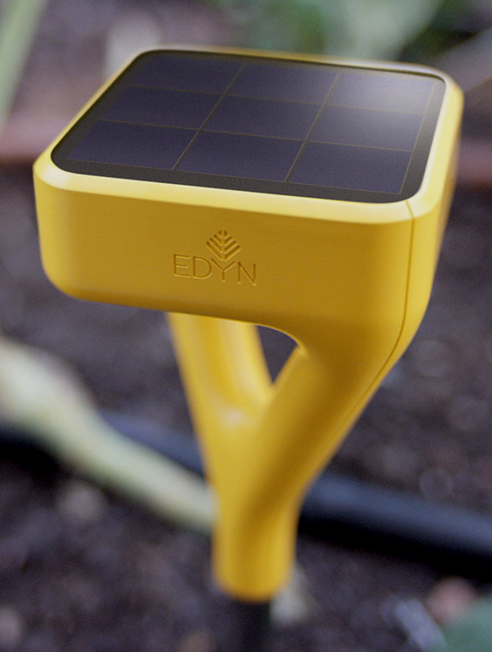
Competitors
Their product:
Automatically measures and waters outdoor gardens based on a database of over 5000 plants
Our advantage:
Our product can operate offline, we don’t have to be connected to the internet at all times
We will not sell your data to third party companies
Notes:
Dom

Slide 6
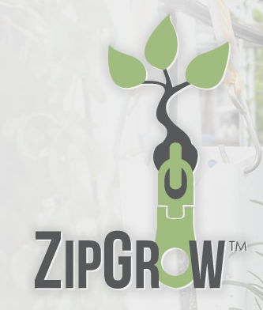
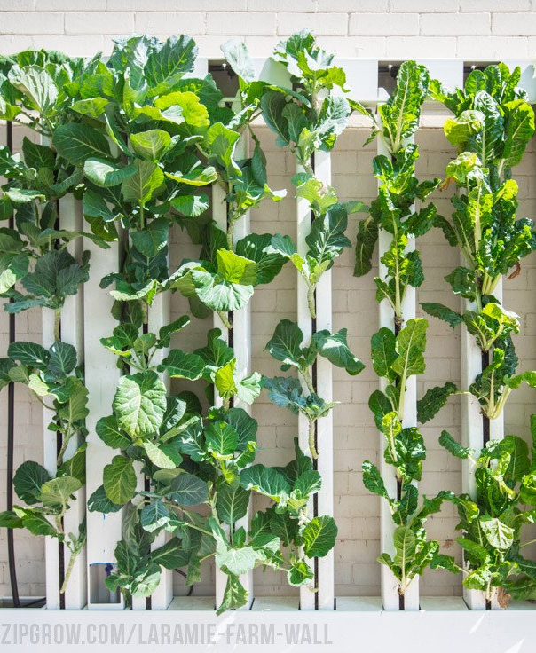
Competitors
Their product:
Tall vertical towers which automate watering and light source
Minimal interaction required once it's set up
Our advantage:
Our product can be monitored, tracked and interacted with online
Our product can be used on any plant, not a specific set of plants
Notes:
Dom

Slide 7
Features: Automatic Watering
Demo
Notes:
Dom

Slide 8
Features: Web and History
Demo
Notes:
Wang

Slide 9
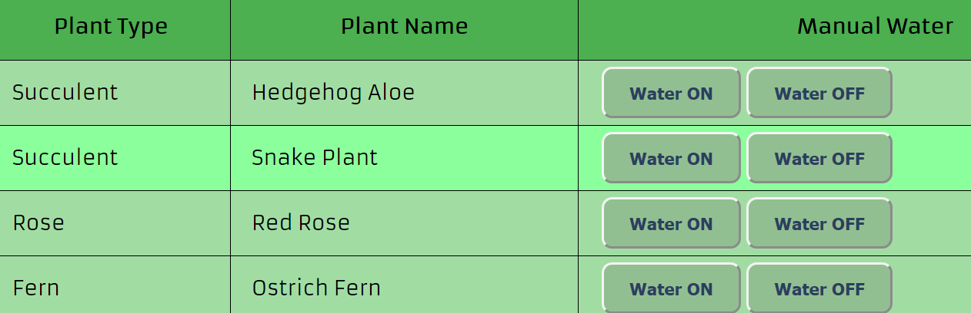
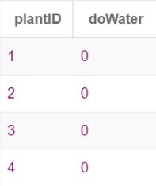
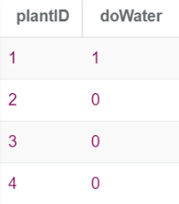
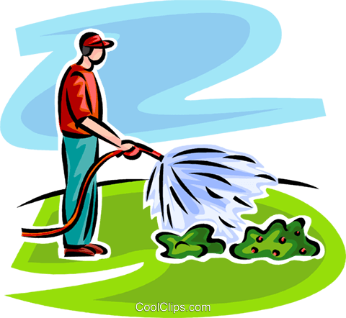
Features: Manual Watering (Web)
User’s plants retrieved and displayed
ON/OFF buttons set state for each plant in DB
Raspberry pi reads DB
Raspberry pi forwards state to Arduino
Arduino controls pump
Notes:
Roman

Slide 10
Technologies
C (for arduino)
Python (on RaspberryPi)
SQL
Javascript (node.js, AJAX, RESTful API)
HTML/CSS
Notes:
Andy

Slide 11
Database Schema
User(username, password, name)
Owner(plantID, username)
Plant(plantId, plantType, plantName)
History(plantId, recordDate, moisture, humidity, temp)
Optimal(plantType, potMoisture, optHumidity, optTemp)
ManualWater(plantId, doWater)
Notes:
Andy

Slide 12
Hardware Code
Notes:
Andy

Slide 13
Website Code
Notes:
Andy

Slide 14



Software Process
Communication:
Messenger
Github
Meetings:
Whiteboard
For decision Making /Assigning Tasks
Assigning tasks: (based on skills and interest)
Dom: hardware (Arduino)
Andy: hardware (RaspberryPi)
Roman: Web (Database and node.js)
Dean: Web (UI/Aesthetics)
Eugene: Web (Controls/Navigation)
Daniel: Web (Graphing)
Notes:
All

Slide 15
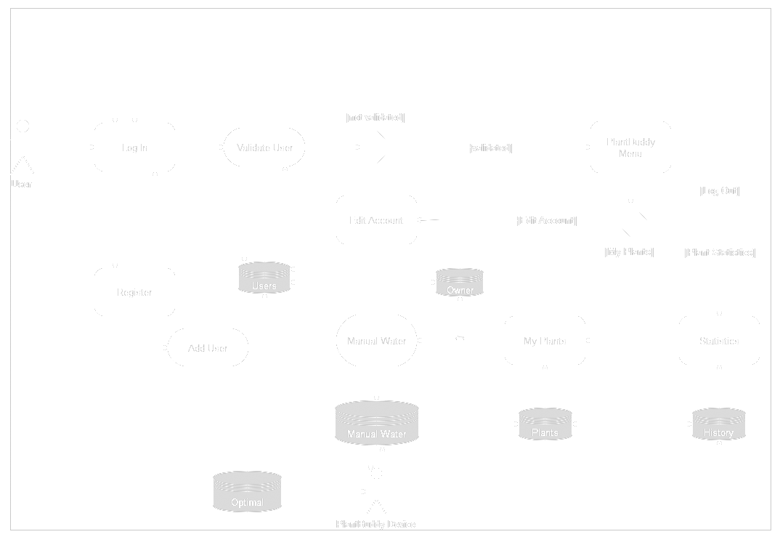
Software Architecture
Notes:
Dean

Slide 16
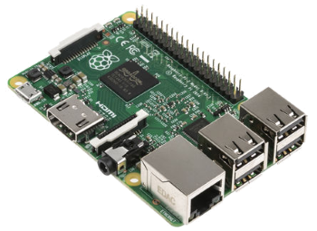


Challenges
Technological:
Communication between Pi, and Web, and Database
Pivotal Trackers
Physical:
Obtaining Materials
Power Delivery
Notes:
All

Slide 17
The End
Questions?

